Slide 1
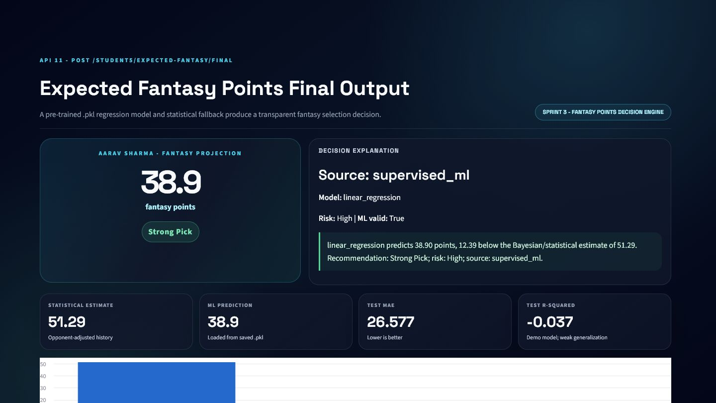
KHEL AI
Cricket Intelligence API Platform
11 APIs | 3 Sprints | Explainable cricket analytics
Mentor Review Edition
Student 5 - Om Batavia

Slide 2
Contents
INDEX
A 68-slide technical walkthrough aligned with the mentor samples
Sprint 1
Live Match Intelligence
Slides 6-32
Sprint 2
Player Performance Analytics
Slides 33-54
Sprint 3
Fantasy Decision Engine
Slides 55-67
Conclusion
One Explainable Pipeline
Slide 68

Slide 3
Problem Context in Cricket Analytics
WHY
Why a specialised API layer is needed
Fragmented Data
Raw is Not Readable
Ball events, scorecards, match context, and player history live at different grains.
Frontends and agents need structured cricket meaning, not unprocessed rows.
No Shared Logic
Predictions Need Trust
Independent clients can calculate legal balls, rates, and labels inconsistently.
Model output requires provenance, metrics, validation, and fallback behavior.

Slide 4
System Design Philosophy
DESIGN
Why eleven specialised APIs instead of one monolithic endpoint
SPRINT 1 - MATCH STATE
SPRINT 2 - PLAYER CONTEXT
SPRINT 3 - DECISION
Score and innings aggregation
Chase resources and required rate
Explainable match outlook
Regression-based recent form
Opponent-specific Bayesian update
Confidence and evidence warnings
Event-level expected value
Saved .pkl model prediction
Selection labels and fallback
Separation of intelligence layers improves reuse, testing, scaling, and explainability.

Slide 5
Evidence, Dataset, and Deployment
EVIDENCE
Authoritative sources used throughout this presentation
DATASET
VERIFIED OUTPUT
DEPLOYMENT
HimanshuKhale/datasets_cricket
4 teams and 12 synthetic T20 matches
24 innings and 2,846 ball events
Player-match and ball-level training tables
Synthetic/faux - never presented as real data
Real schemas.py and services.py functions
Eleven 1440x810 dashboards
Actual service response values
Editable schema and JSON examples
No random presentation values
API 11 publicly hosted on Render
Swagger and model-info verified
APIs 1-10 shown as local verified services
GitHub repository and presentation assets
Render free tier may cold-start

Slide 6
SPRINT 1
Live Match Intelligence
Five APIs transform delivery events into score, chase, pressure, and outlook intelligence.

Slide 7
API 1 - Live Match Scoreboard API
WHAT / WHY
GET /student5/live-scoreboard/{match_id}
API Name
Endpoint
Sprint
Status
Live Match Scoreboard API
GET /student5/live-scoreboard/{match_id}
Sprint 1
Local service + verified dashboard
OBJECTIVE
CRICKET PROBLEM
Aggregate a live match snapshot into one frontend-ready scoreboard response.
Raw match, innings, player, and delivery rows are fragmented; a frontend should not rebuild cricket state independently.
WHY THIS MATTERS TO KHEL AI
Live match dashboard
Broadcast overlay
AI commentary context

Slide 8
Live Match Scoreboard API - Processing Logic
HOW
From validated input to structured cricket intelligence
1. Receive match_id
2. Load saved match and innings
3. Aggregate legal balls, runs, wickets
4. Rank top performers
5. Return recent-ball context
CORE FORMULAS / RULES
ENGINEERING APPROACH
Separate schema validation from service logic
Use cricket-specific legal-ball handling
Return explanation alongside numeric output
Keep response directly consumable by dashboards
total_runs = sum(runs_off_bat + extras)
overs = legal_balls // 6 + remainder notation
run_rate = total_runs / legal_balls x 6

Slide 9
Live Match Scoreboard API - API Schema
SCHEMA
Editable request and response contracts from Pydantic models
REQUEST SCHEMA
RESPONSE SCHEMA
Field | Type | Required | Description
match_id | path parameter | Yes | Unique match identifier
Field | Type | Required | Description
match | str | Yes | match
venue | str | Yes | venue
innings_number | int | Yes | innings number
batting_team | str | Yes | batting team
bowling_team | str | Yes | bowling team
score | str | Yes | score
overs | str | Yes | overs
run_rate | float | Yes | run rate
Field
Type
Required
Description
Field
Type
Required
Description
Nested objects and arrays are summarized here; the complete schema remains available in FastAPI/OpenAPI.

Slide 10
Live Match Scoreboard API - Validation and Example
VALIDATION
Representative payloads generated from the real local service workflow
VALIDATION / ERROR HANDLING
SAMPLE REQUEST
SAMPLE RESPONSE
match_id is required
Unknown match returns HTTP 404
Missing database returns HTTP 500
Wickets are capped at 10
{
"match_id": "1"
}
{
"match": "Match 1: INDI vs BHOP",
"venue": "Holkar Cricket Stadium",
"innings_number": 2,
"batting_team": "Bhopal Blazers",
"bowling_team": "Indore Invincibles",
"score": "95/3",
"overs": "10.0"
}

Slide 11
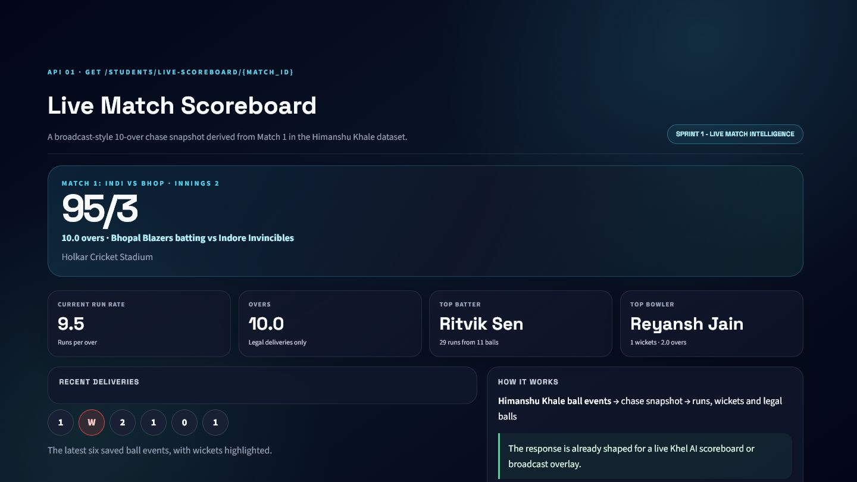
Live Match Scoreboard API - Evidence and Integration
EVIDENCE
Verified dashboard output generated by the corresponding service logic
KHEL AI INTEGRATION
Live match dashboard
Broadcast overlay
AI commentary context
KNOWN LIMITATIONS
Snapshot uses stored data rather than a streaming feed
Top-performer ranking is descriptive, not predictive
SCORE
OVERS
RUN RATE
TOP BATTER
95/3
10.0
9.5
Ritvik Sen

Slide 12
API 2 - Innings Summary API
WHAT / WHY
GET /student5/innings-summary/{innings_id}
API Name
Endpoint
Sprint
Status
Innings Summary API
GET /student5/innings-summary/{innings_id}
Sprint 1
Local service + verified dashboard
OBJECTIVE
CRICKET PROBLEM
Transform one completed innings into scorecard, efficiency, and top-performer summaries.
Ball events are too granular for post-innings analysis and must be reconciled into batter and bowler records.
WHY THIS MATTERS TO KHEL AI
Scorecard tab
Post-innings report
Player performance cards

Slide 13
Innings Summary API - Processing Logic
HOW
From validated input to structured cricket intelligence
1. Receive innings_id
2. Load saved deliveries
3. Aggregate team total
4. Build batter and bowler tables
5. Select top performers
CORE FORMULAS / RULES
ENGINEERING APPROACH
Separate schema validation from service logic
Use cricket-specific legal-ball handling
Return explanation alongside numeric output
Keep response directly consumable by dashboards
strike_rate = runs / balls_faced x 100
economy = runs_conceded / legal_balls x 6
innings_run_rate = total_runs / legal_balls x 6

Slide 14
Innings Summary API - API Schema
SCHEMA
Editable request and response contracts from Pydantic models
REQUEST SCHEMA
RESPONSE SCHEMA
Field | Type | Required | Description
innings_id | path parameter | Yes | Unique innings identifier
Field | Type | Required | Description
innings_id | int | Yes | Unique innings identifier
total_runs | int | Yes | total runs
wickets | int | Yes | wickets
legal_balls | int | Yes | legal balls
overs | str | Yes | overs
run_rate | float | Yes | run rate
batters | list | Yes | batters
bowlers | list | Yes | bowlers
Field
Type
Required
Description
Field
Type
Required
Description
Nested objects and arrays are summarized here; the complete schema remains available in FastAPI/OpenAPI.

Slide 15
Innings Summary API - Validation and Example
VALIDATION
Representative payloads generated from the real local service workflow
VALIDATION / ERROR HANDLING
SAMPLE REQUEST
SAMPLE RESPONSE
innings_id must be positive
Unknown innings returns HTTP 404
Safe division handles zero balls
Only legal balls count toward overs
{
"innings_id": "1"
}
{
"innings_id": 1,
"total_runs": 206,
"wickets": 3,
"legal_balls": 120,
"overs": "20.0",
"run_rate": 10.3,
"batters": [
{
"name": "{...}",
"runs": "{...}",
"balls": "{...}",
"fours": "{...}",
"sixes": "{...}"
},
"..."
]
}

Slide 16
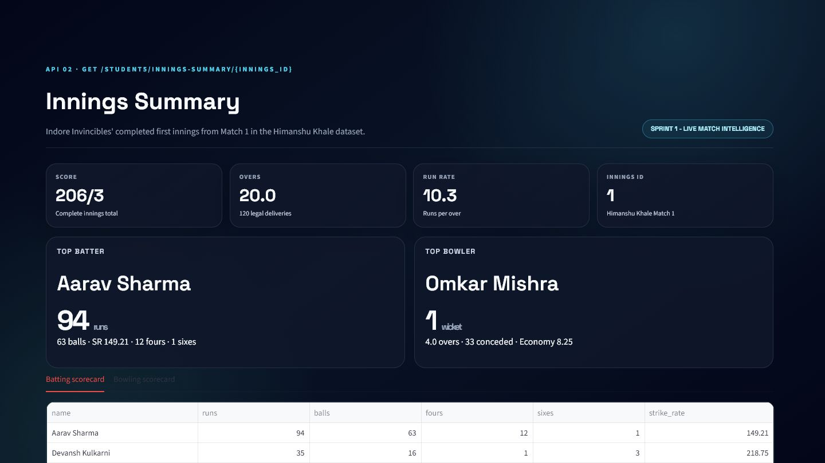
Innings Summary API - Evidence and Integration
EVIDENCE
Verified dashboard output generated by the corresponding service logic
KHEL AI INTEGRATION
Scorecard tab
Post-innings report
Player performance cards
KNOWN LIMITATIONS
Depends on complete saved ball-event history
Fielding analysis is outside this endpoint
SCORE
OVERS
RUN RATE
TOP BATTER
206/3
20.0
10.3
Aarav Sharma

Slide 17
API 3 - Current Match State API
WHAT / WHY
POST /student5/match-state
API Name
Endpoint
Sprint
Status
Current Match State API
POST /student5/match-state
Sprint 1
Local service + verified dashboard
OBJECTIVE
CRICKET PROBLEM
Explain the current chase using target, score, time, wickets, and scoring pressure.
A score alone does not explain whether the chase is ahead, behind, or under resource pressure.
WHY THIS MATTERS TO KHEL AI
Chase progress card
Live commentary
Match-state agent tool

Slide 18
Current Match State API - Processing Logic
HOW
From validated input to structured cricket intelligence
1. Validate match and innings context
2. Aggregate current score
3. Count legal balls and wickets
4. Calculate chase resources
5. Create cricket-language status
CORE FORMULAS / RULES
ENGINEERING APPROACH
Separate schema validation from service logic
Use cricket-specific legal-ball handling
Return explanation alongside numeric output
Keep response directly consumable by dashboards
runs_needed = max(target - score, 0)
balls_remaining = total_balls - legal_balls
wickets_remaining = 10 - wickets
CRR and RRR use six-ball rates

Slide 19
Current Match State API - API Schema
SCHEMA
Editable request and response contracts from Pydantic models
REQUEST SCHEMA
RESPONSE SCHEMA
Field | Type | Required | Description
match | khel_showcase_match_state_schemas. | No | match
innings | khel_showcase_match_state_schemas. | No | innings
balls | list[khel_showcase_match_state_sch | No | Ordered delivery-event list
Field | Type | Required | Description
match | str | Yes | match
innings_number | int | None | No | innings number
score | str | Yes | score
overs | str | Yes | overs
wickets | int | Yes | wickets
batting_team | str | None | No | batting team
bowling_team | str | None | No | bowling team
target | int | None | No | target
Field
Type
Required
Description
Field
Type
Required
Description
Nested objects and arrays are summarized here; the complete schema remains available in FastAPI/OpenAPI.

Slide 20
Current Match State API - Validation and Example
VALIDATION
Representative payloads generated from the real local service workflow
VALIDATION / ERROR HANDLING
SAMPLE REQUEST
SAMPLE RESPONSE
Non-negative runs and extras
Positive target and overs limit
Ball number >= 1
Empty ball list returns a valid initial state
{
"match": {
"match_id": "1",
"title": "Match 1: INDI vs BHOP",
"total_overs": 20,
"target": 207
},
"innings": {
"innings_number": 2,
"batting_team": "Bhopal Blazers",
"bowling_team": "Indore Invincibles",
"total_overs_limit": 20,
"target": 207
},
"balls": [
{
"over_number": "{...}",
"ball_number": "{...}",
"runs_off_bat": "{...}",
"extras": "{...}",
"is_legal_delivery": "{...}"
},
"..."
]
}
{
"match": "Match 1: INDI vs BHOP",
"innings_number": 2,
"score": "95/3",
"overs": "10.0",
"wickets": 3,
"batting_team": "Bhopal Blazers",
"bowling_team": "Indore Invincibles"
}

Slide 21
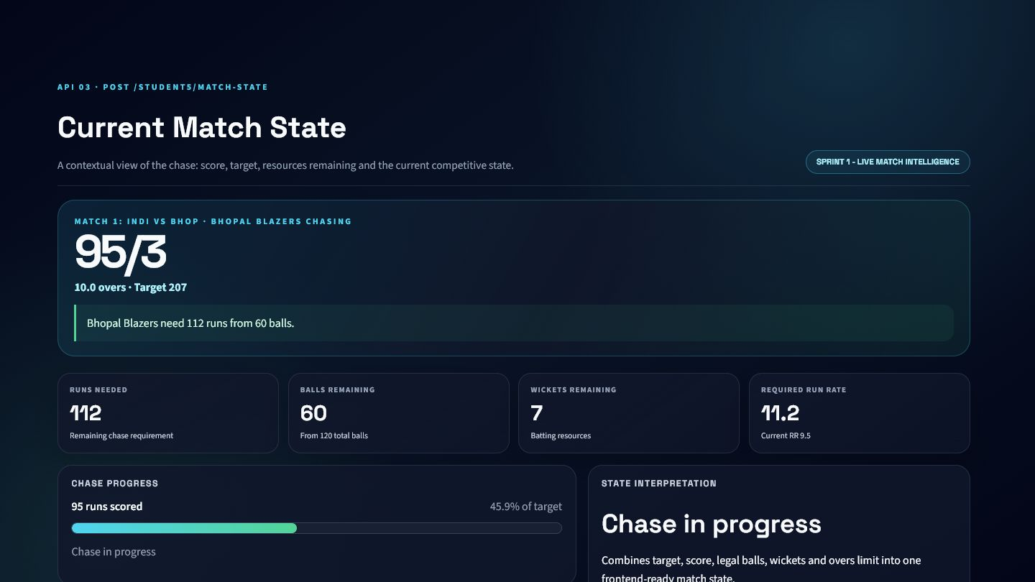
Current Match State API - Evidence and Integration
EVIDENCE
Verified dashboard output generated by the corresponding service logic
KHEL AI INTEGRATION
Chase progress card
Live commentary
Match-state agent tool
KNOWN LIMITATIONS
No weather or DLS adjustment
Assumes standard ten-wicket innings
SCORE
RUNS NEEDED
BALLS LEFT
RRR
95/3
112
60
11.2

Slide 22
API 4 - Required Run Rate API
WHAT / WHY
POST /student5/required-run-rate
API Name
Endpoint
Sprint
Status
Required Run Rate API
POST /student5/required-run-rate
Sprint 1
Local service + verified dashboard
OBJECTIVE
CRICKET PROBLEM
Return the exact scoring pace required to complete a chase.
Clients often calculate RRR inconsistently, especially when wides and no-balls are present.
WHY THIS MATTERS TO KHEL AI
Live pressure panel
Commentary sentence
Mobile scorecard

Slide 23
Required Run Rate API - Processing Logic
HOW
From validated input to structured cricket intelligence
1. Read target and delivery history
2. Aggregate score
3. Count legal balls only
4. Calculate remaining requirement
5. Return substituted equation
CORE FORMULAS / RULES
ENGINEERING APPROACH
Separate schema validation from service logic
Use cricket-specific legal-ball handling
Return explanation alongside numeric output
Keep response directly consumable by dashboards
RRR = runs_needed / balls_remaining x 6
runs_needed = max(target - current_score, 0)

Slide 24
Required Run Rate API - API Schema
SCHEMA
Editable request and response contracts from Pydantic models
REQUEST SCHEMA
RESPONSE SCHEMA
Field | Type | Required | Description
match | khel_showcase_required_rate_schema | No | match
innings | khel_showcase_required_rate_schema | No | innings
balls | list[khel_showcase_required_rate_s | No | Ordered delivery-event list
Field | Type | Required | Description
target | int | None | No | target
current_score | str | Yes | current score
runs_needed | int | Yes | runs needed
balls_remaining | int | Yes | balls remaining
required_run_rate | float | Yes | required run rate
equation | str | Yes | equation
message | str | Yes | message
Field
Type
Required
Description
Field
Type
Required
Description
Nested objects and arrays are summarized here; the complete schema remains available in FastAPI/OpenAPI.

Slide 25
Required Run Rate API - Validation and Example
VALIDATION
Representative payloads generated from the real local service workflow
VALIDATION / ERROR HANDLING
SAMPLE REQUEST
SAMPLE RESPONSE
Target must be positive when present
Overs limit must be positive
Illegal deliveries do not consume a ball
No target returns an explicit non-chase response
{
"match": {
"match_id": "1",
"title": "Match 1: INDI vs BHOP",
"total_overs": 20,
"target": 207
},
"innings": {
"innings_number": 2,
"batting_team": "Bhopal Blazers",
"bowling_team": "Indore Invincibles",
"total_overs_limit": 20,
"target": 207
},
"balls": [
{
"over_number": "{...}",
"ball_number": "{...}",
"runs_off_bat": "{...}",
"extras": "{...}",
"is_legal_delivery": "{...}"
},
"..."
]
}
{
"target": 207,
"current_score": "95/3",
"runs_needed": 112,
"balls_remaining": 60,
"required_run_rate": 11.2,
"equation": "Required run rate = (112 runs needed / 60 balls remaining) x 6 = 11.2",
"message": "Chasing side needs 112 runs from 60 balls at 11.2 runs per over."
}

Slide 26
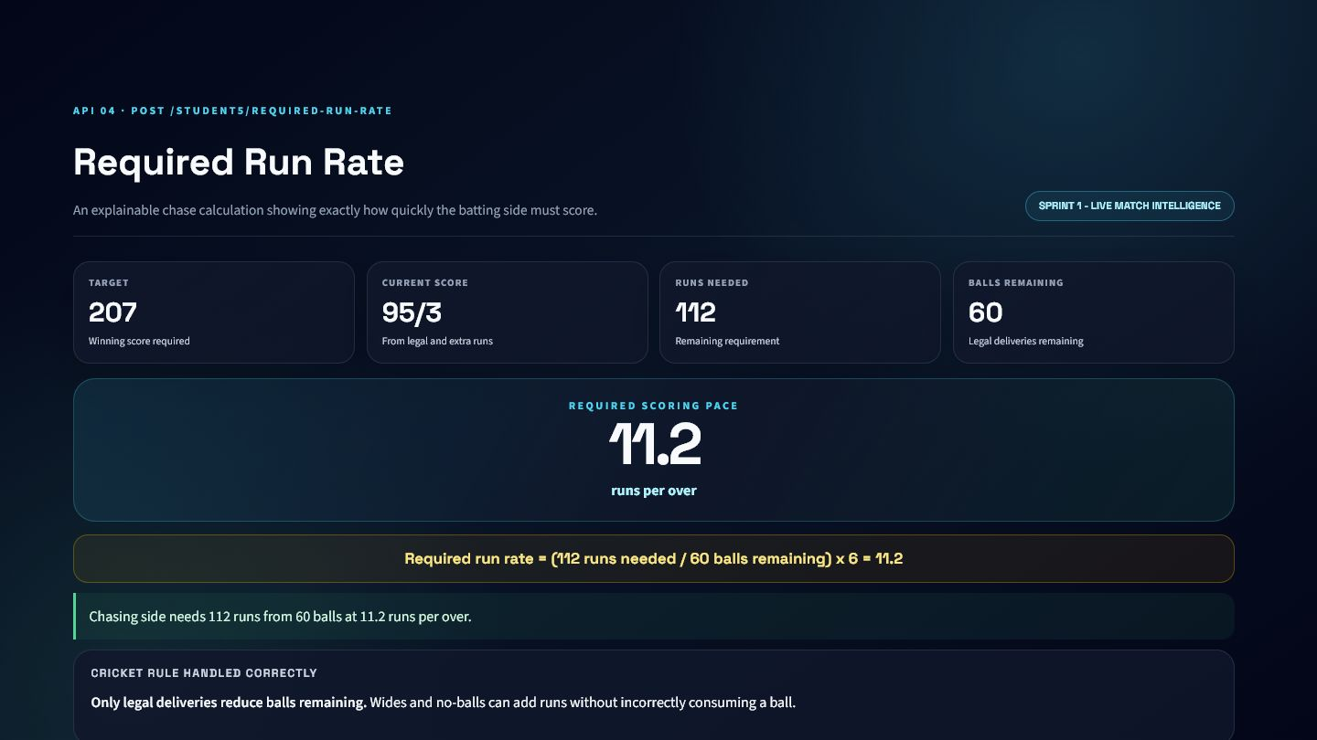
Required Run Rate API - Evidence and Integration
EVIDENCE
Verified dashboard output generated by the corresponding service logic
KHEL AI INTEGRATION
Live pressure panel
Commentary sentence
Mobile scorecard
KNOWN LIMITATIONS
No DLS/par-score support
Does not itself classify win chance
TARGET
SCORE
RUNS NEEDED
RRR
207
95/3
112
11.2

Slide 27
API 5 - Win Probability Label API
WHAT / WHY
POST /student5/match-outlook
API Name
Endpoint
Sprint
Status
Win Probability Label API
POST /student5/match-outlook
Sprint 1
Local service + verified dashboard
OBJECTIVE
CRICKET PROBLEM
Classify the chase as High, Medium, or Low Chance using transparent cricket rules.
Users need an interpretable match outlook, but an uncalibrated numeric probability would be misleading.
WHY THIS MATTERS TO KHEL AI
Live outlook badge
Explainable AI commentary
Match dashboard alert

Slide 28
Win Probability Label API - Processing Logic
HOW
From validated input to structured cricket intelligence
1. Calculate match state
2. Compare RRR with CRR
3. Inspect wickets and balls
4. Apply declared thresholds
5. Return label and reason
CORE FORMULAS / RULES
ENGINEERING APPROACH
Separate schema validation from service logic
Use cricket-specific legal-ball handling
Return explanation alongside numeric output
Keep response directly consumable by dashboards
High: RRR <= CRR + 1.5 and wickets >= 4
Low: RRR > CRR + 4 or critical wickets/resources
Otherwise: Medium

Slide 29
Win Probability Label API - API Schema
SCHEMA
Editable request and response contracts from Pydantic models
REQUEST SCHEMA
RESPONSE SCHEMA
Field | Type | Required | Description
match | khel_showcase_outlook_schemas.Matc | No | match
innings | khel_showcase_outlook_schemas.Inni | No | innings
balls | list[khel_showcase_outlook_schemas | No | Ordered delivery-event list
Field | Type | Required | Description
runs_needed | int | Yes | runs needed
balls_remaining | int | Yes | balls remaining
required_run_rate | float | Yes | required run rate
prediction | str | Yes | prediction
wickets_in_hand | int | Yes | wickets in hand
overs_left | str | Yes | overs left
current_run_rate | float | Yes | current run rate
heuristic | str | Yes | heuristic
Field
Type
Required
Description
Field
Type
Required
Description
Nested objects and arrays are summarized here; the complete schema remains available in FastAPI/OpenAPI.

Slide 30
Win Probability Label API - Validation and Example
VALIDATION
Representative payloads generated from the real local service workflow
VALIDATION / ERROR HANDLING
SAMPLE REQUEST
SAMPLE RESPONSE
Uses validated match-state payload
Target reached returns High Chance
No target returns context-safe output
Reason and heuristic accompany every label
{
"match": {
"match_id": "1",
"title": "Match 1: INDI vs BHOP",
"total_overs": 20,
"target": 207
},
"innings": {
"innings_number": 2,
"batting_team": "Bhopal Blazers",
"bowling_team": "Indore Invincibles",
"total_overs_limit": 20,
"target": 207
},
"balls": [
{
"over_number": "{...}",
"ball_number": "{...}",
"runs_off_bat": "{...}",
"extras": "{...}",
"is_legal_delivery": "{...}"
},
"..."
]
}
{
"runs_needed": 112,
"balls_remaining": 60,
"required_run_rate": 11.2,
"prediction": "Medium Chance",
"wickets_in_hand": 7,
"overs_left": "10.0",
"current_run_rate": 9.5
}

Slide 31
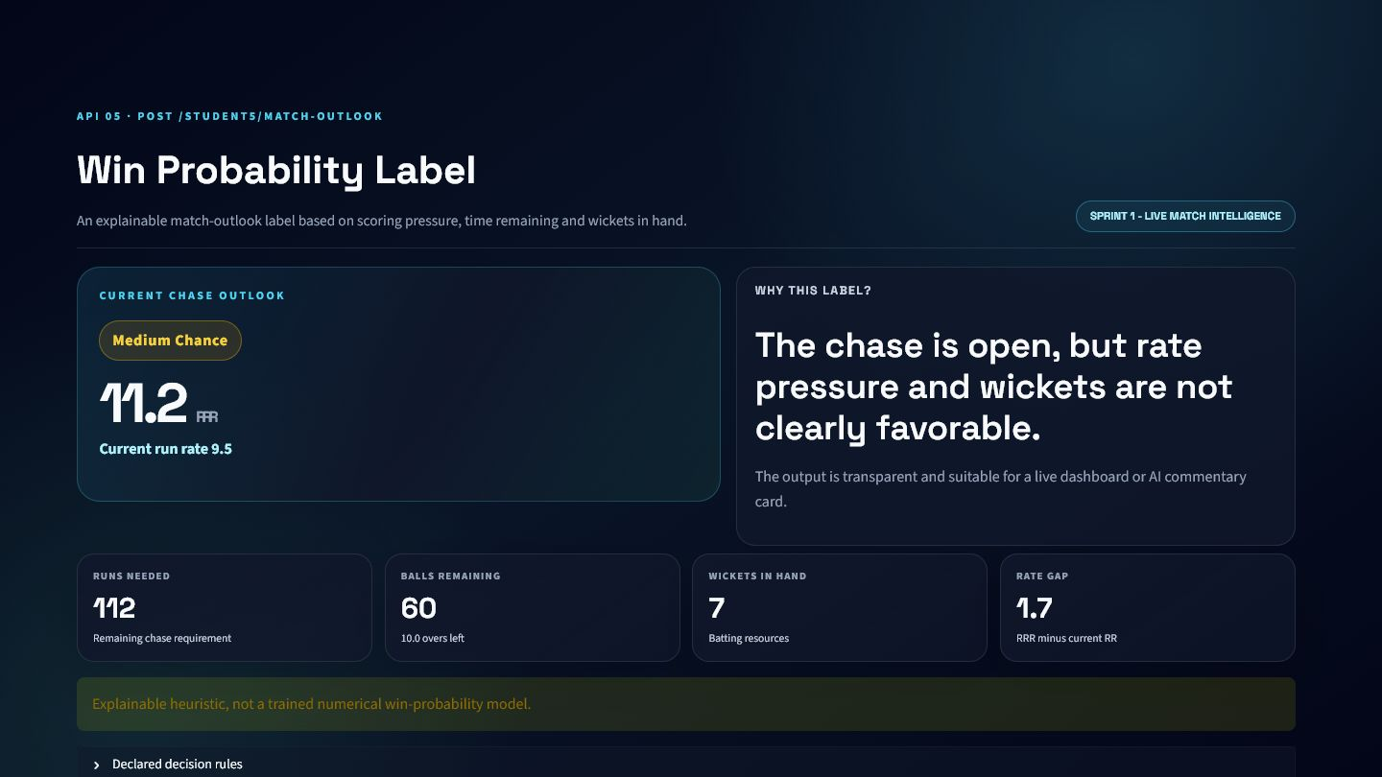
Win Probability Label API - Evidence and Integration
EVIDENCE
Verified dashboard output generated by the corresponding service logic
KHEL AI INTEGRATION
Live outlook badge
Explainable AI commentary
Match dashboard alert
KNOWN LIMITATIONS
Heuristic, not trained probability
Thresholds need calibration on real match data
OUTLOOK
RRR
CRR
WICKETS
Medium Chance
11.2
9.5
7

Slide 32
Sprint 1 - Integration and Lessons
SUMMARY
From raw deliveries to live match understanding
API MODULES
WHAT THE SPRINT ADDS TO KHEL AI
01
Live Match Scoreboard API
One legal-ball calculation standard across endpoints
Frontend-ready score, innings, chase, and outlook responses
Transparent formulas and rule-based explanations
Reusable context for dashboards and AI agents
02
Innings Summary API
03
Current Match State API
04
Required Run Rate API
05
Win Probability Label API

Slide 33
SPRINT 2
Player Performance Analytics
Four APIs explain form direction and opponent-specific matchup effects.

Slide 34
API 6 - Form Trend Derived Variables API
WHAT / WHY
POST /student5/form-trend
API Name
Endpoint
Sprint
Status
Form Trend Derived Variables API
POST /student5/form-trend
Sprint 2
Local service + verified dashboard
OBJECTIVE
CRICKET PROBLEM
Measure player form direction, volatility, linear fit, and confidence from recent performances.
A recent average cannot reveal whether performance is improving, declining, or unstable.
WHY THIS MATTERS TO KHEL AI
Player form chart
Trend filter
Upstream fantasy feature

Slide 35
Form Trend Derived Variables API - Processing Logic
HOW
From validated input to structured cricket intelligence
1. Sort performances chronologically
2. Derive or accept performance score
3. Fit OLS regression
4. Measure volatility and R-squared
5. Classify normalized slope
CORE FORMULAS / RULES
ENGINEERING APPROACH
Separate schema validation from service logic
Use cricket-specific legal-ball handling
Return explanation alongside numeric output
Keep response directly consumable by dashboards
performance = runs + 0.10 x strike_rate - dismissal_penalty
slope = covariance(x,y) / variance(x)
normalized_trend = slope / average
confidence = R2 x noise adjustment

Slide 36
Form Trend Derived Variables API - API Schema
SCHEMA
Editable request and response contracts from Pydantic models
REQUEST SCHEMA
RESPONSE SCHEMA
Field | Type | Required | Description
player | khel_showcase_form_variables_schem | No | Player identity and role
recent_performances | list[khel_showcase_form_variables_ | Yes | Chronological recent performance records
stable_slope_threshold | float | No | Rising/Stable/Declining threshold
Field | Type | Required | Description
metric | str | Yes | metric
label | str | Yes | label
explanation | str | Yes | explanation
recent_match_sequence | list[float] | Yes | recent match sequence
regression_slope | float | Yes | regression slope
recent_average | float | Yes | recent average
volatility | float | Yes | volatility
trend_confidence | float | Yes | trend confidence
Field
Type
Required
Description
Field
Type
Required
Description
Nested objects and arrays are summarized here; the complete schema remains available in FastAPI/OpenAPI.

Slide 37
Form Trend Derived Variables API - Validation and Example
VALIDATION
Representative payloads generated from the real local service workflow
VALIDATION / ERROR HANDLING
SAMPLE REQUEST
SAMPLE RESPONSE
At least three performances
Unique positive sequence numbers
Non-negative runs and scores
Positive stable-slope threshold
{
"player": {
"player_id": "1",
"player_name": "Aarav Sharma",
"role": "batter"
},
"recent_performances": [
{
"match_id": "{...}",
"sequence_number": "{...}",
"runs_scored": "{...}",
"balls_faced": "{...}",
"was_out": "{...}"
},
"..."
],
"stable_slope_threshold": 0.15
}
{
"metric": "form_trend",
"label": "Declining",
"explanation": "Recent form is dropping because the regression slope is negative (-16.629) and meaningfully below the stable threshold.",
"recent_match_sequence": [
108,
"..."
],
"regression_slope": -16.629,
"recent_average": 50.67,
"volatility": 36.22
}

Slide 38
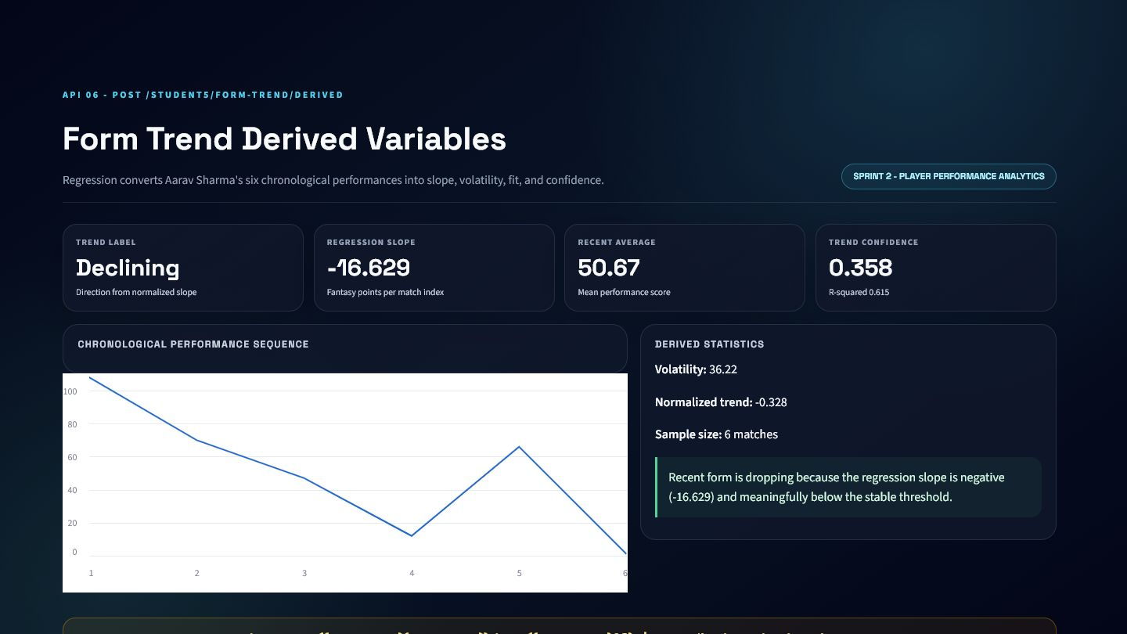
Form Trend Derived Variables API - Evidence and Integration
EVIDENCE
Verified dashboard output generated by the corresponding service logic
KHEL AI INTEGRATION
Player form chart
Trend filter
Upstream fantasy feature
KNOWN LIMITATIONS
Linear trend misses nonlinear form
Six-match sample is small
LABEL
SLOPE
AVERAGE
CONFIDENCE
Declining
-16.629
50.67
0.358

Slide 39
API 7 - Form Trend Final Output API
WHAT / WHY
POST /student5/form-trend-final
API Name
Endpoint
Sprint
Status
Form Trend Final Output API
POST /student5/form-trend-final
Sprint 2
Local service + verified dashboard
OBJECTIVE
CRICKET PROBLEM
Convert form statistics into a 0-100 score, label, confidence, and explanation.
Frontends should not independently interpret raw regression values or duplicate threshold logic.
WHY THIS MATTERS TO KHEL AI
Player dashboard badge
Selection ranking
AI-agent explanation

Slide 40
Form Trend Final Output API - Processing Logic
HOW
From validated input to structured cricket intelligence
1. Accept recent or player-match rows
2. Exclude target leakage
3. Calculate derived variables
4. Map normalized slope to score
5. Return label and explanation
CORE FORMULAS / RULES
ENGINEERING APPROACH
Separate schema validation from service logic
Use cricket-specific legal-ball handling
Return explanation alongside numeric output
Keep response directly consumable by dashboards
form_score = clamp(50 + normalized_trend x 100, 0, 100)
Rising > +threshold; Declining < -threshold; else Stable

Slide 41
Form Trend Final Output API - API Schema
SCHEMA
Editable request and response contracts from Pydantic models
REQUEST SCHEMA
RESPONSE SCHEMA
Field | Type | Required | Description
player | khel_showcase_form_final_schemas.P | No | Player identity and role
recent_performances | list[khel_showcase_form_final_sche | No | Chronological recent performance records
player_match_rows | list[khel_showcase_form_final_sche | No | Historical player-match rows
pressure_confidence_rows | list[khel_showcase_form_final_sche | No | pressure confidence rows
recent_match_limit | int | No | recent match limit
stable_slope_threshold | float | No | Rising/Stable/Declining threshold
Field | Type | Required | Description
metric | str | Yes | metric
label | str | Yes | label
form_trend_score | float | Yes | Upstream form score from API 7
trend_label | str | Yes | trend label
trend_confidence | float | Yes | trend confidence
derived_variables_used | khel_showcase_form_final_schemas.D | Yes | derived variables used
explanation | str | Yes | explanation
supporting_values | dict[str, Any] | Yes | supporting values
Field
Type
Required
Description
Field
Type
Required
Description
Nested objects and arrays are summarized here; the complete schema remains available in FastAPI/OpenAPI.

Slide 42
Form Trend Final Output API - Validation and Example
VALIDATION
Representative payloads generated from the real local service workflow
VALIDATION / ERROR HANDLING
SAMPLE REQUEST
SAMPLE RESPONSE
Recent performances or player rows required
Minimum three records
Player rows must match requested player
Target row must not enter history
{
"player": {
"player_id": "1",
"player_name": "Aarav Sharma",
"role": "batter"
},
"player_match_rows": [
{
"match_id": "{...}",
"player_id": "{...}",
"player_name": "{...}",
"team_id": "{...}",
"team_name": "{...}"
},
"..."
],
"recent_match_limit": 6,
"stable_slope_threshold": 0.15
}
{
"metric": "form_trend_final_output",
"label": "Declining",
"form_trend_score": 17.18,
"trend_label": "Declining",
"trend_confidence": 0.358,
"derived_variables_used": {
"recent_match_sequence": [
"{...}",
"..."
],
"regression_slope": -16.629,
"recent_average": 50.67,
"volatility": 36.22,
"normalized_trend_score": -0.328
},
"explanation": "Form is classified as Declining with a score of 17.18. The ordered recent sequence produced regression_slope=-16.629 and normalized_trend_score=-0.328. The label uses threshold +/-0.15, so positive values above the threshold are Rising, negative values below the threshold are Declining, and values inside the band are Stable. Trend confidence is 0.358 after adjusting trend fit for volatility."
}

Slide 43
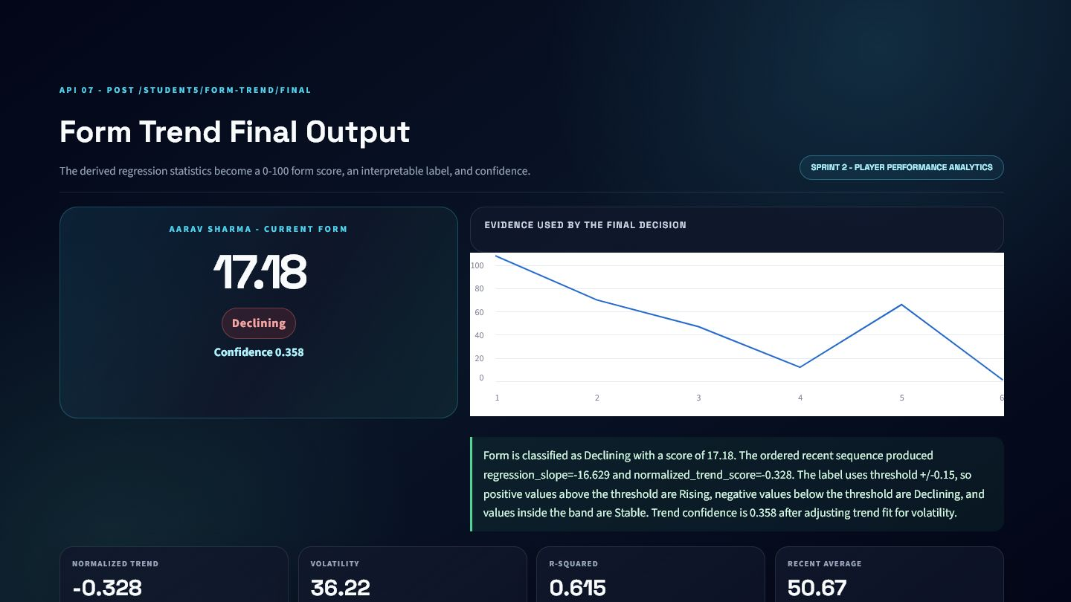
Form Trend Final Output API - Evidence and Integration
EVIDENCE
Verified dashboard output generated by the corresponding service logic
KHEL AI INTEGRATION
Player dashboard badge
Selection ranking
AI-agent explanation
KNOWN LIMITATIONS
Score mapping is rule-based
Confidence can remain low despite a strong direction
SCORE
LABEL
CONFIDENCE
AVERAGE
17.18
Declining
0.358
50.67

Slide 44
API 8 - Opponent Bayesian Derived Variables API
WHAT / WHY
POST /student5/opponent-bayesian-derived
API Name
Endpoint
Sprint
Status
Opponent Bayesian Derived Variables API
POST /student5/opponent-bayesian-derived
Sprint 2
Local service + verified dashboard
OBJECTIVE
CRICKET PROBLEM
Update a player's overall performance expectation using opponent-specific evidence.
Overall form can hide favorable or difficult matchup history, while one opponent result is too noisy to trust alone.
WHY THIS MATTERS TO KHEL AI
Opponent matchup card
Pre-match report
Fantasy context feature

Slide 45
Opponent Bayesian Derived Variables API - Processing Logic
HOW
From validated input to structured cricket intelligence
1. Calculate overall prior
2. Calculate opponent mean
3. Measure opponent volatility
4. Compute evidence strength
5. Produce weighted posterior
CORE FORMULAS / RULES
ENGINEERING APPROACH
Separate schema validation from service logic
Use cricket-specific legal-ball handling
Return explanation alongside numeric output
Keep response directly consumable by dashboards
consistency = 1 - volatility / (average + volatility)
evidence_strength = capped_n x consistency
posterior = weighted prior + opponent evidence

Slide 46
Opponent Bayesian Derived Variables API - API Schema
SCHEMA
Editable request and response contracts from Pydantic models
REQUEST SCHEMA
RESPONSE SCHEMA
Field | Type | Required | Description
player | khel_showcase_bayesian_variables_s | No | Player identity and role
opponent_team_id | str | None | No | opponent team id
opponent_team_name | str | None | No | opponent team name
prior_performances | list[khel_showcase_bayesian_variab | Yes | Overall historical samples
opponent_performances | list[khel_showcase_bayesian_variab | Yes | Samples against selected opponent
prior_weight | float | No | Weight assigned to overall prior
max_evidence_weight | float | No | Cap on opponent evidence
Field | Type | Required | Description
metric | str | Yes | metric
label | str | Yes | label
explanation | str | Yes | explanation
prior_performance_estimate | float | Yes | prior performance estimate
opponent_specific_evidence | float | Yes | opponent specific evidence
evidence_strength | float | Yes | evidence strength
posterior_estimate | float | Yes | posterior estimate
confidence | float | Yes | confidence
Field
Type
Required
Description
Field
Type
Required
Description
Nested objects and arrays are summarized here; the complete schema remains available in FastAPI/OpenAPI.

Slide 47
Opponent Bayesian Derived Variables API - Validation and Example
VALIDATION
Representative payloads generated from the real local service workflow
VALIDATION / ERROR HANDLING
SAMPLE REQUEST
SAMPLE RESPONSE
At least three prior samples
At least one opponent sample
Positive prior and evidence weights
Non-negative performance values
{
"player": {
"player_id": "1",
"player_name": "Aarav Sharma",
"role": "batter"
},
"opponent_team_id": "4",
"opponent_team_name": "Gwalior Guardians",
"prior_performances": [
{
"match_id": "{...}",
"runs_scored": "{...}",
"balls_faced": "{...}",
"was_out": "{...}",
"performance_value": "{...}"
},
"..."
],
"opponent_performances": [
{
"match_id": "{...}",
"runs_scored": "{...}",
"balls_faced": "{...}",
"was_out": "{...}",
"performance_value": "{...}"
},
"..."
],
"prior_weight": 6,
"max_evidence_weight": 10
}
{
"metric": "opponent_bayesian_performance_derived_variables",
"label": "Neutral Opponent Adjustment",
"explanation": "The prior performance estimate is 50.67. Opponent-specific evidence is 24.0 with evidence strength 1.021. The Bayesian weighted update gives posterior_estimate=46.79 and confidence=0.356. The final label is Neutral Opponent Adjustment, so the result updates prior belief using opponent evidence instead of guessing from a single match.",
"prior_performance_estimate": 50.67,
"opponent_specific_evidence": 24,
"evidence_strength": 1.021,
"posterior_estimate": 46.79
}

Slide 48
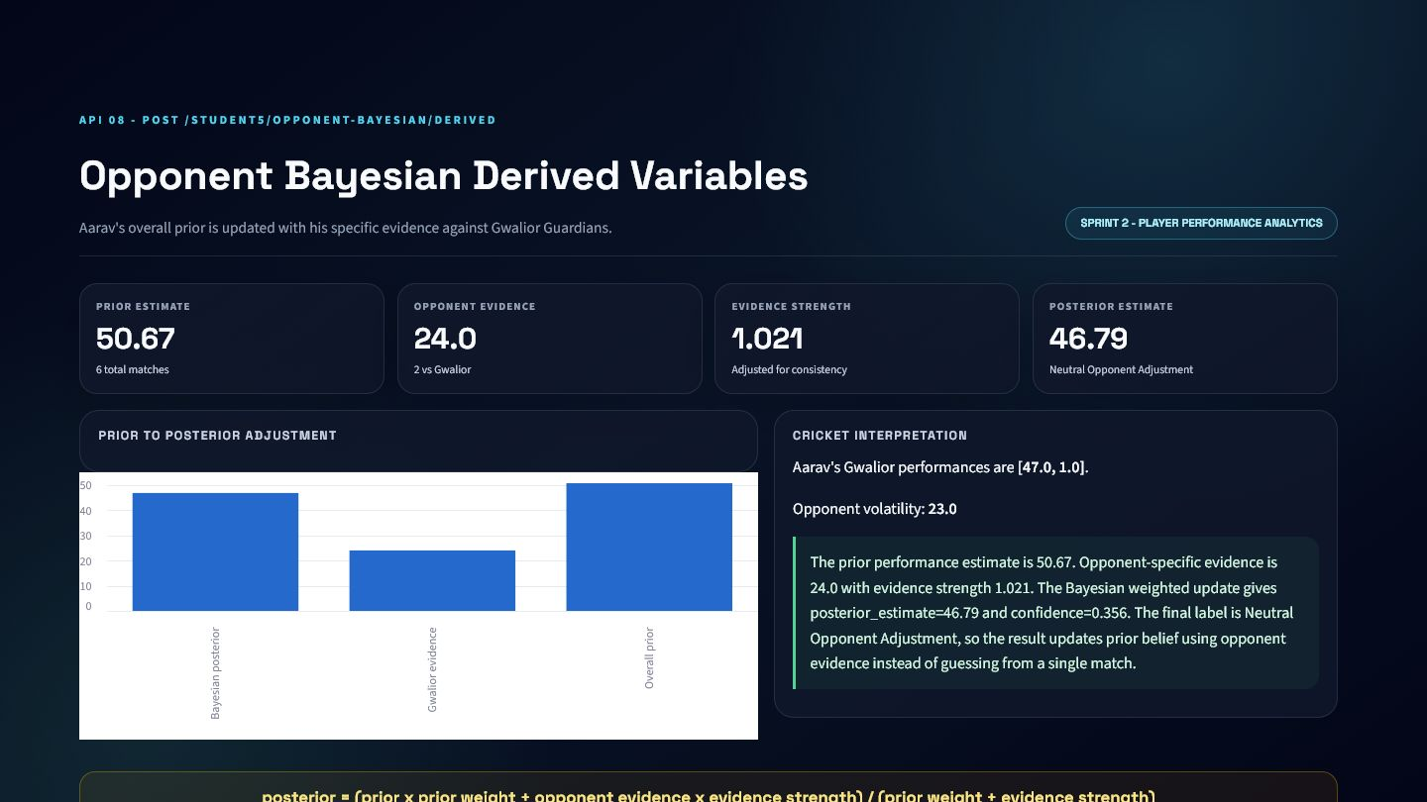
Opponent Bayesian Derived Variables API - Evidence and Integration
EVIDENCE
Verified dashboard output generated by the corresponding service logic
KHEL AI INTEGRATION
Opponent matchup card
Pre-match report
Fantasy context feature
KNOWN LIMITATIONS
Two opponent samples are fragile
Posterior depends on chosen weights
PRIOR
EVIDENCE
STRENGTH
POSTERIOR
50.67
24
1.021
46.79

Slide 49
API 9 - Opponent Bayesian Final Output API
WHAT / WHY
POST /student5/opponent-bayesian-final
API Name
Endpoint
Sprint
Status
Opponent Bayesian Final Output API
POST /student5/opponent-bayesian-final
Sprint 2
Local service + verified dashboard
OBJECTIVE
CRICKET PROBLEM
Return an opponent-adjusted performance score, matchup label, and confidence.
A posterior number needs a decision label, change explanation, and evidence warning before product use.
WHY THIS MATTERS TO KHEL AI
Pre-match player panel
Opponent-adjusted fantasy input
AI matchup explanation

Slide 50
Opponent Bayesian Final Output API - Processing Logic
HOW
From validated input to structured cricket intelligence
1. Filter player history before target date
2. Separate opponent rows
3. Calculate smoothed posterior
4. Measure prior change
5. Classify matchup and confidence
CORE FORMULAS / RULES
ENGINEERING APPROACH
Separate schema validation from service logic
Use cricket-specific legal-ball handling
Return explanation alongside numeric output
Keep response directly consumable by dashboards
weight = opponent_n / (opponent_n + smoothing_k)
posterior = (1-weight) x prior + weight x evidence
change_percent = (posterior-prior) / prior x 100

Slide 51
Opponent Bayesian Final Output API - API Schema
SCHEMA
Editable request and response contracts from Pydantic models
REQUEST SCHEMA
RESPONSE SCHEMA
Field | Type | Required | Description
player | khel_showcase_bayesian_final_schem | No | Player identity and role
opponent_team_id | str | None | No | opponent team id
opponent_team_name | str | None | No | opponent team name
venue | str | None | No | venue
target_match_date | datetime.date | None | No | Anti-leakage cutoff date
prior_performances | list[khel_showcase_bayesian_final_ | No | Overall historical samples
opponent_performances | list[khel_showcase_bayesian_final_ | No | Samples against selected opponent
player_match_rows | list[khel_showcase_bayesian_final_ | No | Historical player-match rows
Field | Type | Required | Description
metric | str | Yes | metric
label | str | Yes | label
opponent_adjusted_performance_score | float | Yes | opponent adjusted performance score
posterior_expectation | float | Yes | posterior expectation
confidence_label | str | Yes | confidence label
derived_variables_used | khel_showcase_bayesian_final_schem | Yes | derived variables used
explanation | str | Yes | explanation
supporting_values | dict[str, Any] | Yes | supporting values
Field
Type
Required
Description
Field
Type
Required
Description
Nested objects and arrays are summarized here; the complete schema remains available in FastAPI/OpenAPI.

Slide 52
Opponent Bayesian Final Output API - Validation and Example
VALIDATION
Representative payloads generated from the real local service workflow
VALIDATION / ERROR HANDLING
SAMPLE REQUEST
SAMPLE RESPONSE
History or explicit samples required
Target-date anti-leakage filter
Positive smoothing and weights
No matching history returns HTTP 422
{
"player": {
"player_id": "1",
"player_name": "Aarav Sharma",
"role": "batter"
},
"opponent_team_id": "4",
"opponent_team_name": "Gwalior Guardians",
"target_match_date": "2026-07-15",
"player_match_rows": [
{
"match_id": "{...}",
"player_id": "{...}",
"player_name": "{...}",
"team_id": "{...}",
"team_name": "{...}"
},
"..."
],
"smoothing_k": 5,
"prior_weight": 6
}
{
"metric": "opponent_bayesian_performance_final_output",
"label": "Neutral Matchup",
"opponent_adjusted_performance_score": 46.79,
"posterior_expectation": 46.79,
"confidence_label": "Low Confidence",
"derived_variables_used": {
"prior_performance_estimate": 50.67,
"opponent_specific_evidence": 24,
"evidence_strength": 1.021,
"posterior_estimate": 46.79,
"prior_to_posterior_change": -3.88
},
"explanation": "The prior belief was 50.67. Opponent-specific evidence was 24.0 and received evidence_strength=1.021. After the Bayesian weighted update, the posterior expectation became 46.79, so the prior belief decreased by 3.88 (7.66%). The final label is Neutral Matchup with Low Confidence."
}

Slide 53
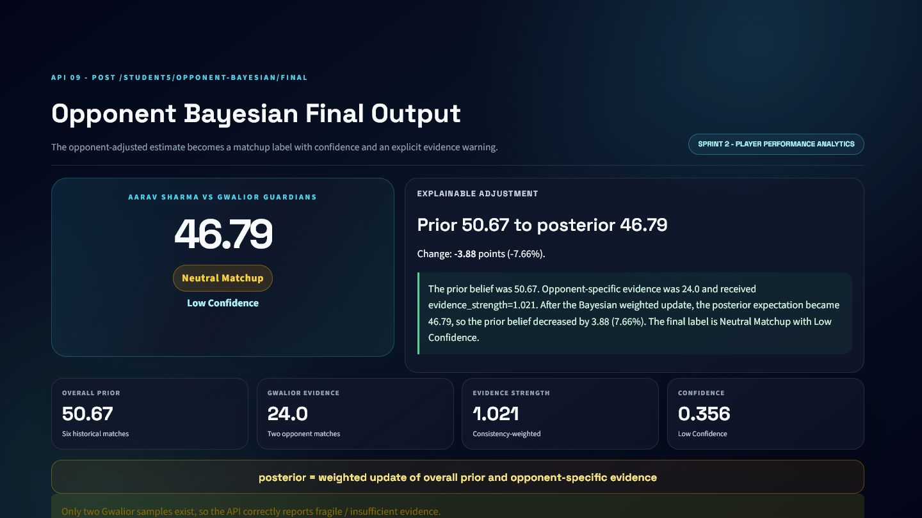
Opponent Bayesian Final Output API - Evidence and Integration
EVIDENCE
Verified dashboard output generated by the corresponding service logic
KHEL AI INTEGRATION
Pre-match player panel
Opponent-adjusted fantasy input
AI matchup explanation
KNOWN LIMITATIONS
Sparse opponent history produces low confidence
Neutral label can mask a meaningful but uncertain shift
ADJUSTED SCORE
LABEL
CONFIDENCE
MODE
46.79
Neutral Matchup
Low Confidence
demo_only

Slide 54
Sprint 2 - Integration and Lessons
SUMMARY
From player history to explainable context
API MODULES
WHAT THE SPRINT ADDS TO KHEL AI
06
Form Trend Derived Variables API
Aarav Sharma provides one continuous six-match story
Regression exposes direction, fit, and volatility
Bayesian updates balance prior belief with opponent evidence
Confidence warnings prevent overclaiming small samples
07
Form Trend Final Output API
08
Opponent Bayesian Derived Variables API
09
Opponent Bayesian Final Output API

Slide 55
SPRINT 3
Fantasy Decision Engine
Two APIs connect event probabilities, player context, and a saved prediction model.

Slide 56
API 10 - Expected Fantasy Points Derived Variables API
WHAT / WHY
POST /student5/expected-fantasy-derived
API Name
Endpoint
Sprint
Status
Expected Fantasy Points Derived Variables API
POST /student5/expected-fantasy-derived
Sprint 3
Local service + verified dashboard
OBJECTIVE
CRICKET PROBLEM
Calculate expected fantasy value from event probabilities and scoring rules.
Fantasy outcomes combine uncertain batting, bowling, and fielding events; raw averages hide those components.
WHY THIS MATTERS TO KHEL AI
Fantasy contribution chart
Player comparison
Explainable recommendation input

Slide 57
Expected Fantasy Points Derived Variables API - Processing Logic
HOW
From validated input to structured cricket intelligence
1. Receive event probabilities
2. Load point values
3. Multiply each probability by value
4. Sum component totals
5. Classify expected value
CORE FORMULAS / RULES
ENGINEERING APPROACH
Separate schema validation from service logic
Use cricket-specific legal-ball handling
Return explanation alongside numeric output
Keep response directly consumable by dashboards
event_EV = probability x point_value
total_EV = batting_EV + bowling_EV + fielding_EV

Slide 58
Expected Fantasy Points Derived Variables API - API Schema
SCHEMA
Editable request and response contracts from Pydantic models
REQUEST SCHEMA
RESPONSE SCHEMA
Field | Type | Required | Description
player | khel_showcase_fantasy_variables_sc | No | Player identity and role
batting_event_probabilities | khel_showcase_fantasy_variables_sc | Yes | Batting event probabilities, each 0-1
bowling_event_probabilities | khel_showcase_fantasy_variables_sc | Yes | Bowling event probabilities, each 0-1
fielding_event_probabilities | khel_showcase_fantasy_variables_sc | Yes | Fielding event probabilities, each 0-1
event_point_values | khel_showcase_fantasy_variables_sc | No | Fantasy scoring values
Field | Type | Required | Description
metric | str | Yes | metric
label | str | Yes | label
explanation | str | Yes | explanation
batting_event_probabilities | dict[str, float] | Yes | Batting event probabilities, each 0-1
bowling_event_probabilities | dict[str, float] | Yes | Bowling event probabilities, each 0-1
fielding_event_probabilities | dict[str, float] | Yes | Fielding event probabilities, each 0-1
event_point_values | dict[str, float] | Yes | Fantasy scoring values
expected_value_components | khel_showcase_fantasy_variables_sc | Yes | expected value components
Field
Type
Required
Description
Field
Type
Required
Description
Nested objects and arrays are summarized here; the complete schema remains available in FastAPI/OpenAPI.

Slide 59
Expected Fantasy Points Derived Variables API - Validation and Example
VALIDATION
Representative payloads generated from the real local service workflow
VALIDATION / ERROR HANDLING
SAMPLE REQUEST
SAMPLE RESPONSE
All probabilities constrained to 0-1
Required event groups enforced
Point values have documented defaults
Non-negative player event inputs
{
"player": {
"player_id": "1",
"player_name": "Aarav Sharma",
"role": "batter"
},
"batting_event_probabilities": {
"run_0": 0.3835,
"run_1": 0.3058,
"run_2": 0.1359,
"run_3": 0.0049,
"four": 0.1602
},
"bowling_event_probabilities": {
"dot_ball": 0,
"wicket": 0,
"maiden_over": 0,
"economy_bonus": 0
},
"fielding_event_probabilities": {
"catch": 0.5,
"run_out": 0,
"stumping": 0.1667
}
}
{
"metric": "expected_fantasy_points_derived_variables",
"label": "Low Expected Fantasy Value",
"explanation": "Expected fantasy points are calculated as sum(probability * point_value) across batting, bowling, and fielding events. The total expected value is 7.42.",
"batting_event_probabilities": {
"run_0": 0.3835,
"run_1": 0.3058,
"run_2": 0.1359,
"run_3": 0.0049,
"four": 0.1602
},
"bowling_event_probabilities": {
"dot_ball": 0,
"wicket": 0,
"maiden_over": 0,
"economy_bonus": 0
},
"fielding_event_probabilities": {
"catch": 0.5,
"run_out": 0,
"stumping": 0.1667
},
"event_point_values": {
"run_0": 0,
"run_1": 1,
"run_2": 2,
"run_3": 3,
"four": 5
}
}

Slide 60
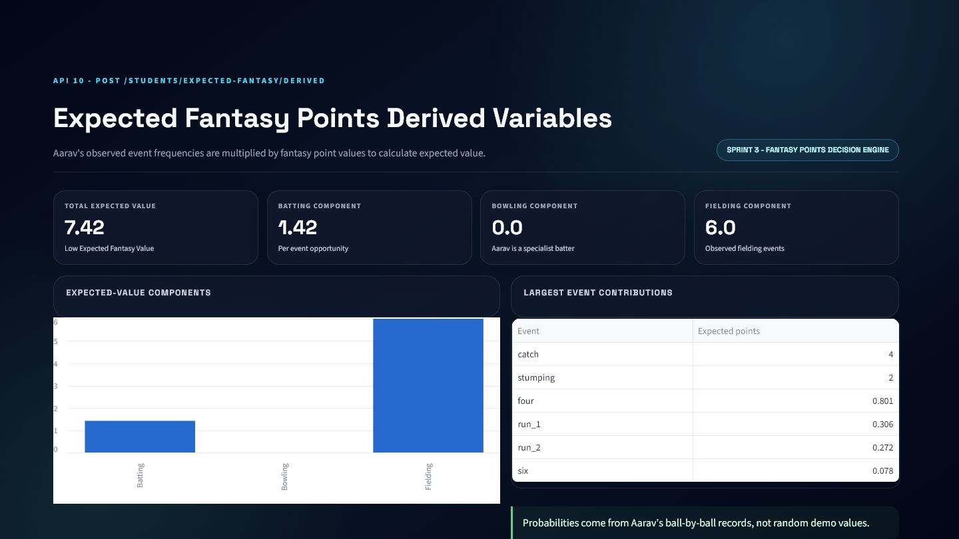
Expected Fantasy Points Derived Variables API - Evidence and Integration
EVIDENCE
Verified dashboard output generated by the corresponding service logic
KHEL AI INTEGRATION
Fantasy contribution chart
Player comparison
Explainable recommendation input
KNOWN LIMITATIONS
Per-opportunity EV is not a complete match projection
Probabilities need larger role-specific samples
TOTAL EV
BATTING
BOWLING
FIELDING
7.42
1.42
0
6

Slide 61
API 11 - Expected Fantasy Points Final Output API
WHAT / WHY
POST /student5/expected-fantasy-final
API Name
Endpoint
Sprint
Status
Expected Fantasy Points Final Output API
POST /student5/expected-fantasy-final
Sprint 3
Public Render deployment
OBJECTIVE
CRICKET PROBLEM
Produce the final fantasy projection, model provenance, risk, and selection label.
Khel AI needs an actionable prediction while retaining feature-contract safety, fallback behavior, and honest model limits.
WHY THIS MATTERS TO KHEL AI
Fantasy selection panel
Batch player ranking
AI model-vs-statistical explanation

Slide 62
Expected Fantasy Points Final Output API - Processing Logic
HOW
From validated input to structured cricket intelligence
1. Build pre-match historical features
2. Load cached .pkl bundle
3. Enforce feature_columns.json
4. Validate prediction range/distribution
5. Return ML or statistical fallback
CORE FORMULAS / RULES
ENGINEERING APPROACH
Separate schema validation from service logic
Use cricket-specific legal-ball handling
Return explanation alongside numeric output
Keep response directly consumable by dashboards
final_prediction = valid ML output else statistical fallback
selection: Must Pick / Strong Pick / Risk Pick / Avoid

Slide 63
Expected Fantasy Points Final Output API - API Schema
SCHEMA
Editable request and response contracts from Pydantic models
REQUEST SCHEMA
RESPONSE SCHEMA
Field | Type | Required | Description
player | khel_showcase_fantasy_final_schema | No | Player identity and role
opponent_team_id | str | None | No | opponent team id
opponent_team_name | str | None | No | opponent team name
venue | str | None | No | venue
target_match_date | datetime.date | None | No | Anti-leakage cutoff date
adjusted_posterior | float | None | No | adjusted posterior
player_match_rows | list[khel_showcase_fantasy_final_s | No | Historical player-match rows
pressure_confidence_rows | list[khel_showcase_fantasy_final_s | No | pressure confidence rows
Field | Type | Required | Description
metric | str | Yes | metric
label | str | Yes | label
expected_fantasy_points | float | Yes | expected fantasy points
final_prediction | float | Yes | final prediction
supervised_ml_prediction | float | None | No | supervised ml prediction
ml_prediction_valid | bool | Yes | ml prediction valid
fallback_used | bool | Yes | fallback used
fallback_reason | str | None | No | fallback reason
Field
Type
Required
Description
Field
Type
Required
Description
Nested objects and arrays are summarized here; the complete schema remains available in FastAPI/OpenAPI.

Slide 64
Expected Fantasy Points Final Output API - Validation and Example
VALIDATION
Representative payloads generated from the real local service workflow
VALIDATION / ERROR HANDLING
SAMPLE REQUEST
SAMPLE RESPONSE
Exact saved feature order
At least one prior match
No target-date leakage
Reject NaN, infinite, or 0-200 outliers
Batch size 1-100
{
"player": {
"player_id": "1",
"player_name": "Aarav Sharma",
"role": "batter"
},
"opponent_team_id": "4",
"opponent_team_name": "Gwalior Guardians",
"venue": "Holkar Cricket Stadium",
"target_match_date": "2026-07-15",
"adjusted_posterior": 46.79,
"opponent_posterior": 46.79
}
{
"metric": "expected_fantasy_points_final_output",
"label": "Strong Pick",
"expected_fantasy_points": 51.29,
"final_prediction": 38.9,
"supervised_ml_prediction": 38.9,
"ml_prediction_valid": true,
"fallback_used": false
}

Slide 65
Expected Fantasy Points Final Output API - Evidence and Integration
EVIDENCE
Verified dashboard output generated by the corresponding service logic
KHEL AI INTEGRATION
Fantasy selection panel
Batch player ranking
AI model-vs-statistical explanation
KNOWN LIMITATIONS
Demo-only synthetic model
Negative test R2 indicates weak generalization
Free-tier Render can cold-start
FINAL PREDICTION
STATISTICAL
SELECTION
MODEL
38.9
51.29
Strong Pick
linear_regression

Slide 66
API 11 - Model Card and Deployment
MODEL CARD
Saved artifact, feature contract, metrics, baseline, and public endpoints
MODEL IDENTITY
DATA AND SPLIT
REQUEST SAFETY
Model: StandardScaler + LinearRegression
Version: 2.0.0
Target: fantasy_points
Mode: demo_only
Source: HimanshuKhale/datasets_cricket
264 canonical rows
220 training workflow rows
Chronological 70/15/15 split
Train 154 | Validation 33 | Test 33
All features calculated before target match
model.pkl loaded once
Exact feature_columns.json order
No request-time training
Batch endpoint: 1-100 rows
422/503 errors are explicit
TEST MAE
TEST RMSE
TEST R2
BASELINE MAE
26.577
33.530
-0.037
29.065
PUBLIC DEPLOYMENT
Hosted API: https://student5-expected-fantasy-final-api.onrender.com
Swagger: /docs | Model metadata: /model-info | Prediction: /predict | Batch: /predict-batch
Limitation: small synthetic dataset; metrics demonstrate the API and modelling workflow, not production accuracy.

Slide 67
Sprint 3 - Integration and Lessons
SUMMARY
From uncertain events to a selection recommendation
API MODULES
WHAT THE SPRINT ADDS TO KHEL AI
10
Expected Fantasy Points Derived Variables API
Expected value keeps batting, bowling, and fielding auditable
Saved-model prediction never retrains during requests
Feature contract and anti-leakage checks protect validity
Risk, model source, and fallback reason remain visible
11
Expected Fantasy Points Final Output API

Slide 68
Conclusion - One Explainable Cricket Pipeline
CONCLUSION
Eleven specialised APIs compose into a unified Khel AI intelligence layer
SPRINT 1
SPRINT 2
SPRINT 3
What is happening?
How is the player trending?
What decision should Khel AI make?
Live score, innings, chase resources, required rate, and outlook.
Regression form, opponent evidence, posterior expectation, and confidence.
Expected fantasy value, saved-model prediction, risk, and selection label.
FINAL RESULT
Real service logic + validated schemas + dashboard evidence + honest metrics + clear Khel AI integration

