Slide 1
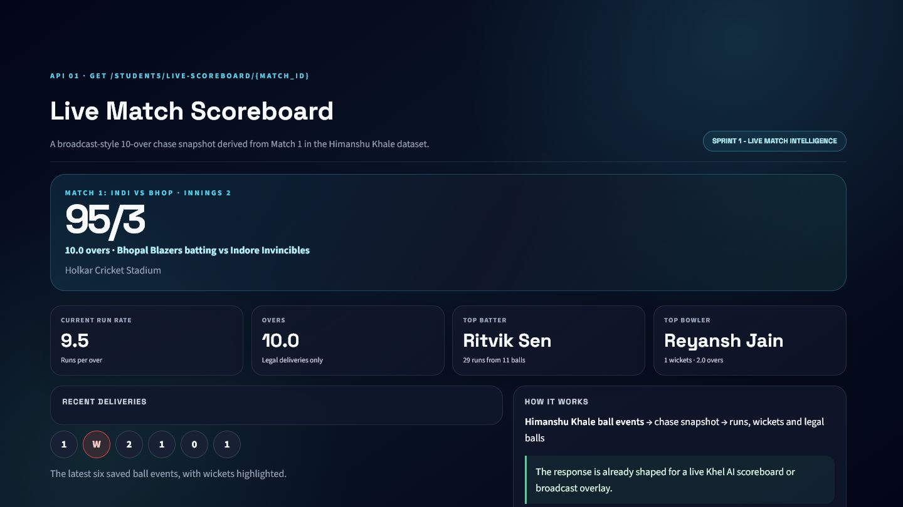
KHEL AI
Cricket Intelligence APIs
11 APIs across three sprints
Student 5: Om Batavia
Live match intelligence | Player analytics | Fantasy decision engine
VERIFIED DASHBOARD OUTPUT

Slide 2
01
Sprint 1: Live Match Intelligence
Five APIs convert ball-by-ball events into frontend-ready match context.

Slide 3
ARCHITECTURE
Sprint 1 Data and API Pipeline
One coherent Match 1 snapshot powers all five dashboards.
CSV source tables: matches, innings, ball events, scorecards, teams, and players.
Legal-delivery handling is shared across score, overs, chase, and rate calculations.
FastAPI service functions produce validated response objects.
Streamlit renders the real service output for presentation evidence.

Slide 4
PURPOSE AND APPROACH
API 1: Live Match Scoreboard
A single response shaped for live match interfaces.
Aggregates score, overs, teams, run rate, top batter, top bowler, and recent balls.
Uses Bhopal Blazers' chase after 60 legal deliveries.
Removes frontend duplication by returning one coherent state.
Khel AI placement: match dashboard or broadcast overlay.
VERIFIED DASHBOARD OUTPUT

Slide 5
FORMULA AND EVIDENCE
API 1: Core Calculations
Every number is derived from saved ball events.
Total runs include runs off the bat and extras.
Wickets are counted from wicket events and capped at ten.
Only legal balls count toward overs.
Current example: 95/3 after 10.0 overs at 9.5 runs per over.
SCORE
OVERS
RUN RATE
TOP BATTER
run rate = total runs / legal balls x 6
95/3
10.0
9.5
Ritvik Sen

Slide 6
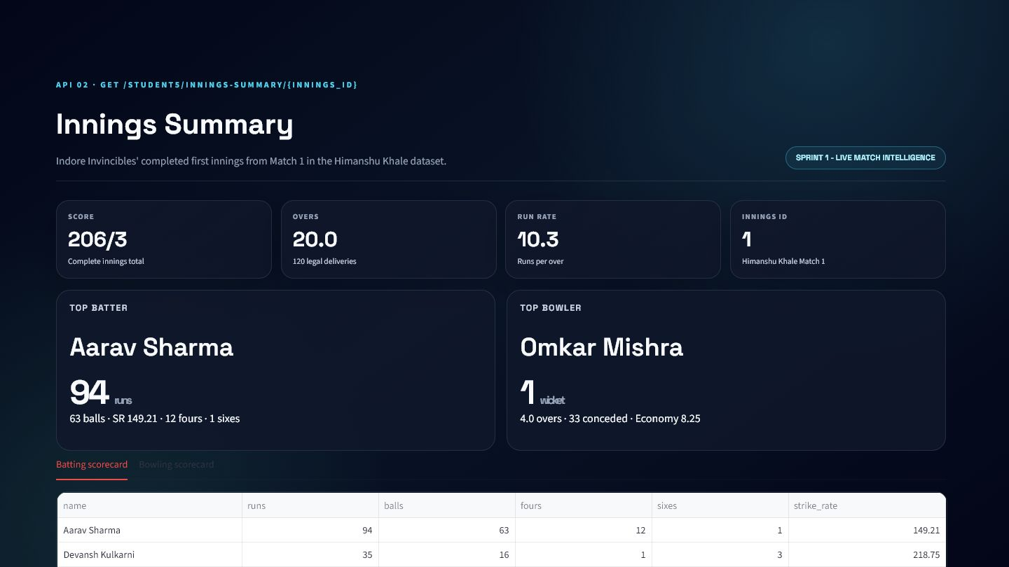
PURPOSE AND APPROACH
API 2: Innings Summary
A completed innings becomes a compact scorecard response.
Returns total score, overs, run rate, batting table, bowling table, and top performers.
Uses Indore Invincibles' completed first innings.
Scorecard records are reconciled with ball-event totals.
Khel AI placement: innings tab and match analysis report.
VERIFIED DASHBOARD OUTPUT

Slide 7
FORMULA AND EVIDENCE
API 2: Performance Formulas
Batting and bowling efficiency use cricket-standard rates.
Batter strike rate measures runs per 100 balls.
Bowler economy measures conceded runs per six legal balls.
Innings run rate measures team scoring pace.
Example innings: Indore Invincibles 206/3 from 20 overs.
strike rate = runs / balls x 100 | economy = conceded runs / legal balls x 6

Slide 8
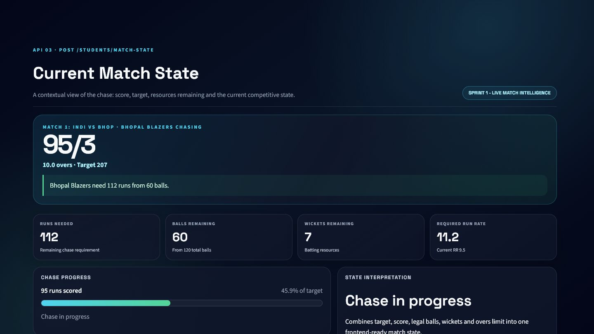
PURPOSE AND APPROACH
API 3: Current Match State
Score, target, time, and wickets become a plain-language chase state.
Combines current score, target, remaining balls, wickets, CRR, and RRR.
Uses legal deliveries to calculate the time resource.
Returns a frontend-ready chase status and message.
Khel AI placement: live match card and AI commentary.
VERIFIED DASHBOARD OUTPUT

Slide 9
FORMULA AND EVIDENCE
API 3: Chase Resource Formulas
The API measures both the requirement and remaining resources.
Runs needed = target minus current score.
Balls remaining = total balls minus legal balls used.
Wickets remaining = ten minus wickets lost.
Match 1 state: 112 needed from 60 balls with seven wickets remaining.
RRR = runs needed / balls remaining x 6 | CRR = score / legal balls x 6

Slide 10
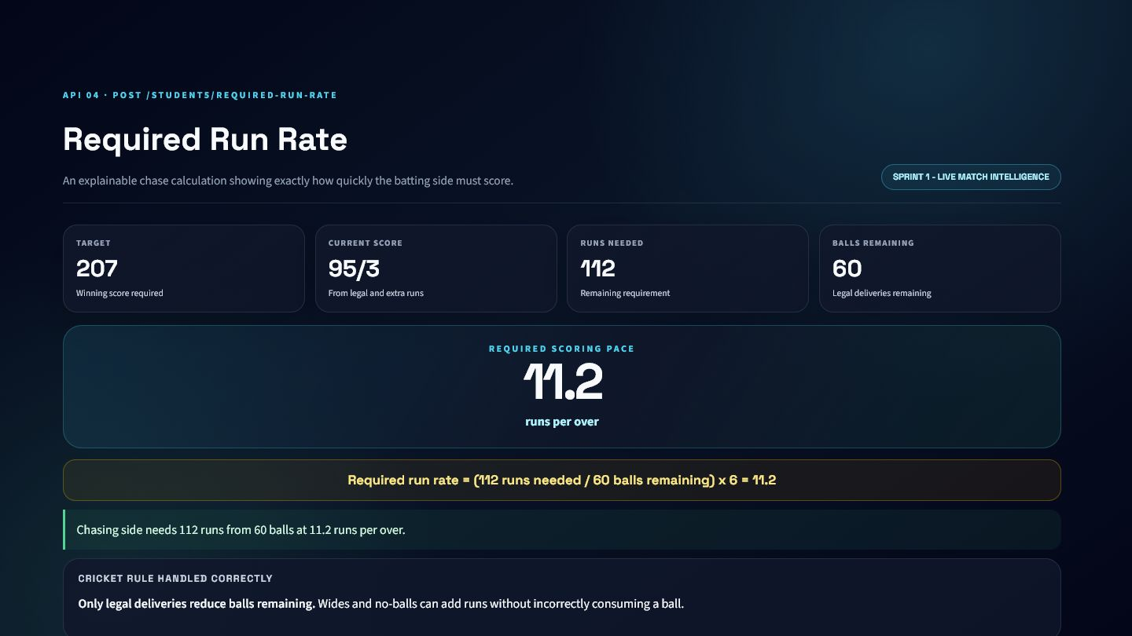
PURPOSE AND APPROACH
API 4: Required Run Rate
A dedicated and auditable chase-pressure calculation.
Returns target, current score, runs needed, balls remaining, and RRR.
Includes the substituted equation in the API response.
Wides and no-balls add runs without consuming a legal delivery.
Khel AI placement: live pressure panel and commentary card.
VERIFIED DASHBOARD OUTPUT

Slide 11
FORMULA AND EVIDENCE
API 4: Main Equation
The current chase requires 11.2 runs per over.
Target is 207 and the score is 95/3.
The batting side needs 112 more runs.
Sixty legal balls remain.
The equation is transparent enough for user-facing explanations.
required run rate = 112 / 60 x 6 = 11.2 runs per over

Slide 12
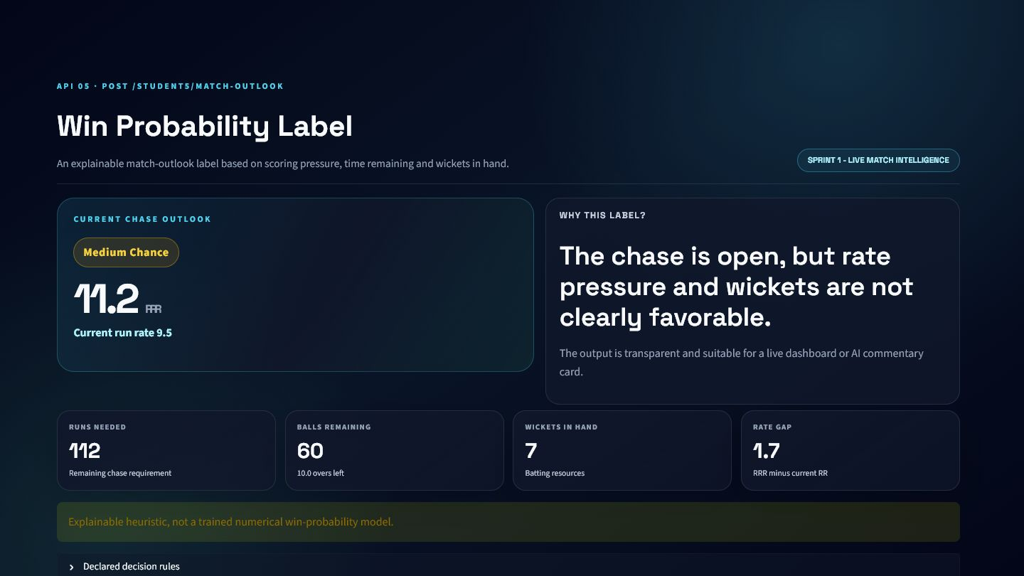
PURPOSE AND APPROACH
API 5: Explainable Match Outlook
A rule-based label avoids pretending to be calibrated ML probability.
Uses RRR, CRR, wickets in hand, runs needed, and balls remaining.
Returns High Chance, Medium Chance, or Low Chance.
The response includes the exact reason and declared heuristic.
Khel AI placement: live outlook card and AI-agent tool.
VERIFIED DASHBOARD OUTPUT

Slide 13
FORMULA AND EVIDENCE
API 5: Decision Rules
The Match 1 state produces Medium Chance.
High: RRR is within CRR + 1.5 and at least four wickets remain.
Low: RRR exceeds CRR + 4, or resources are critically low.
Medium: the competitive middle state.
The label is explainable, reproducible, and not marketed as ML.
High if RRR <= CRR + 1.5 and wickets >= 4 | Low if RRR > CRR + 4 or critical resources

Slide 14
PRODUCT INTEGRATION
Sprint 1 Integration Inside Khel AI
Each endpoint maps directly to an existing cricket interface.
Match dashboard: live scoreboard and innings summary.
Live-style dashboard: chase state, RRR, and outlook.
AI agent tool: plain-language explanations from structured values.
Match analysis report: completed innings and key performers.
Shared JSON contracts keep frontend components consistent.

Slide 15
HONEST EVALUATION
Sprint 1 Limitations and Lessons
Explainability was prioritized over unnecessary complexity.
The presentation uses one coherent synthetic match snapshot.
The outlook is a heuristic rather than a calibrated probability model.
Calculations depend on accurate legal-delivery flags.
Production deployment requires live ingestion, caching, and reconnection handling.
The current APIs are strong integration building blocks, not a full live scoring platform.

Slide 16
02
Sprint 2: Player Performance Analytics
Four APIs explain recent form and opponent-specific matchup effects.

Slide 17
CONSISTENT EXAMPLE PLAYER
Aarav Sharma Dataset Story
One player connects form, matchup, and fantasy decisions.
Six chronological matches from July 1 to July 9, 2026.
Fantasy sequence: 108, 70, 47, 12, 66, 1.
Two matches against Bhopal, Ujjain, and Gwalior.
All rows come from the HimanshuKhale synthetic dataset.
Predictive APIs exclude target rows from the historical inputs.
MATCHES
AVERAGE FP
BEST
LATEST
6
50.67
108
1

Slide 18
PURPOSE AND APPROACH
API 6: Form Trend Problem
An average alone cannot show direction, fit, or volatility.
Ordinary least squares measures the direction of recent performance.
Records are sorted oldest to newest before regression.
Fantasy points provide the consistent performance score.
The response exposes the full derived sequence and assumptions.

Slide 19
SCIENTIFIC METHOD
API 6: Regression Formulas
Trend strength is normalized relative to the player's average.
Slope measures points gained or lost per match index.
Volatility is population standard deviation.
R-squared measures how consistently the sequence follows the line.
Confidence penalizes a good fit when performance noise is high.
slope = sum((x-x mean)(y-y mean)) / sum((x-x mean)^2) | normalized trend = slope / average

Slide 20
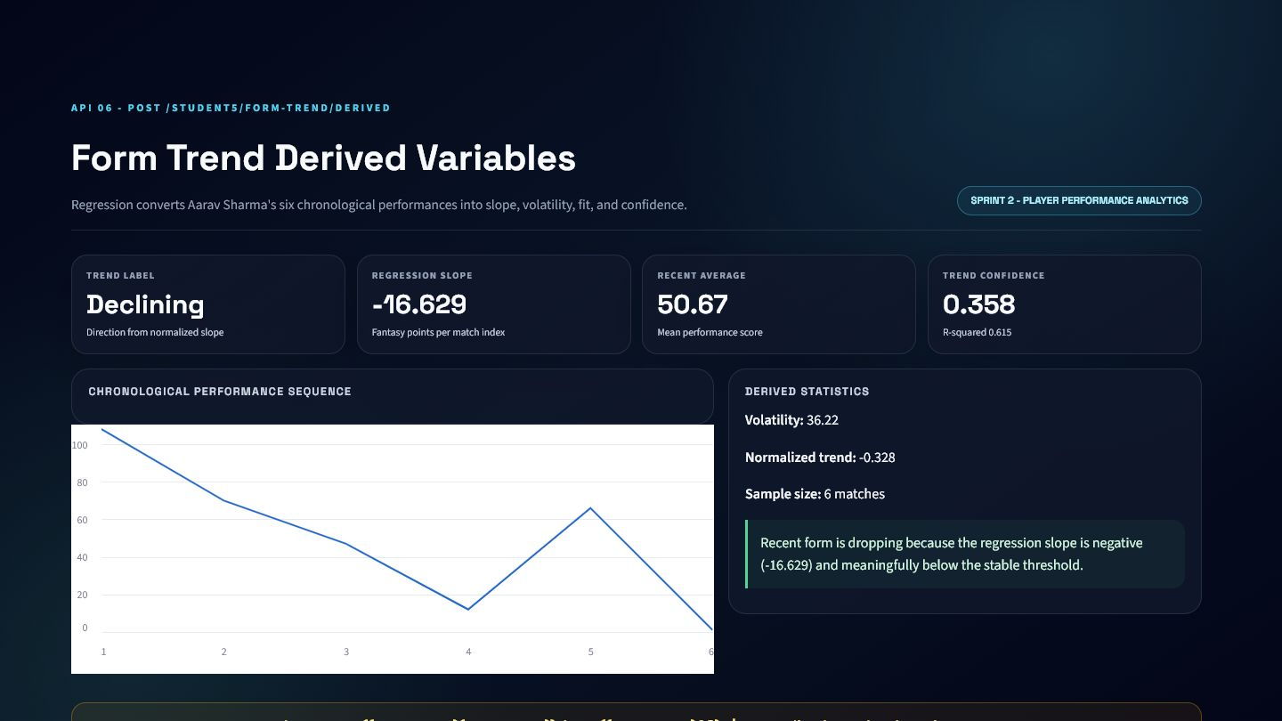
VERIFIED RESULT
API 6: Derived Variables Dashboard
Aarav's six-match sequence is classified as declining.
Regression slope: -16.629.
Recent average: 50.67.
Normalized trend: -0.328.
R-squared: 0.615; trend confidence: 0.358.
VERIFIED DASHBOARD OUTPUT

Slide 21
DECISION LAYER
API 7: Form Trend Final Approach
Raw statistics become a frontend-ready score and label.
Maps normalized trend onto a bounded 0-100 scale.
Keeps direction and confidence alongside the final score.
Returns a cricket-language explanation.
Avoids duplicating classification logic in the frontend.

Slide 22
FORMULA
API 7: Score and Label Formula
Thresholds keep Rising, Stable, and Declining reproducible.
Rising when normalized trend is above +0.15.
Declining when normalized trend is below -0.15.
Stable inside the threshold band.
Confidence combines regression fit with volatility penalty.
form trend score = clamp(50 + normalized trend x 100, 0, 100)

Slide 23
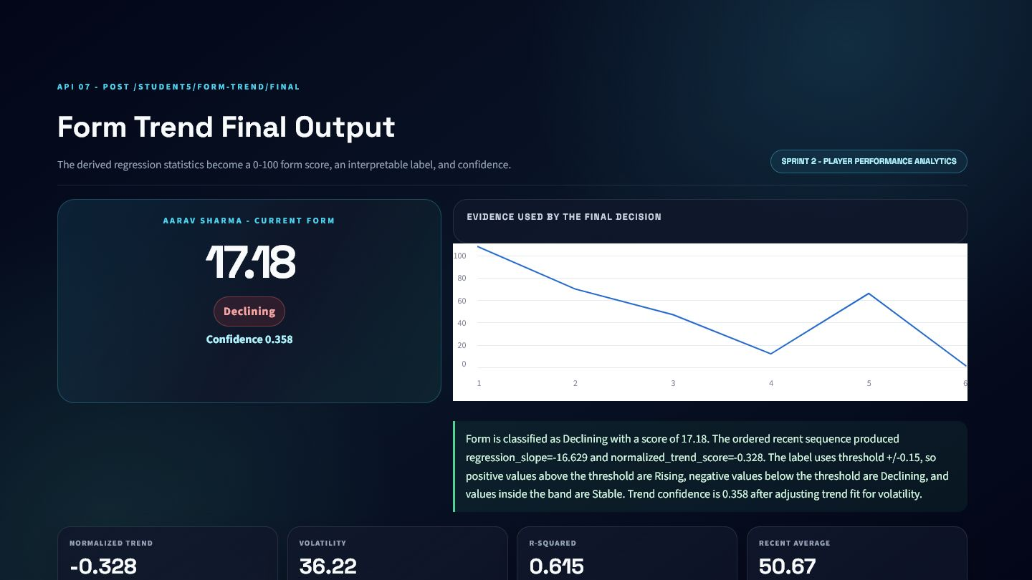
VERIFIED RESULT
API 7: Final Form Dashboard
The final badge retains the chart and statistics behind it.
Aarav form score: 17.18 out of 100.
Label: Declining.
Confidence: 0.358.
Khel AI placement: player form badge and selection filters.
VERIFIED DASHBOARD OUTPUT

Slide 24
PURPOSE AND APPROACH
API 8: Bayesian Matchup Variables
Opponent history updates the overall prior without replacing it.
The overall mean is the prior belief.
Gwalior-specific performances provide the new evidence.
Evidence strength decreases when opponent results are volatile.
The approach avoids guessing from one isolated match.

Slide 25
STATISTICAL METHOD
API 8: Bayesian Formulas
Sample size and consistency determine how much the prior moves.
Prior = mean of all historical performance scores.
Opponent evidence = mean against the selected opponent.
Consistency factor penalizes opponent volatility.
The posterior is a weighted combination of prior and evidence.
posterior = (prior x prior weight + evidence x evidence strength) / (prior weight + evidence strength)

Slide 26
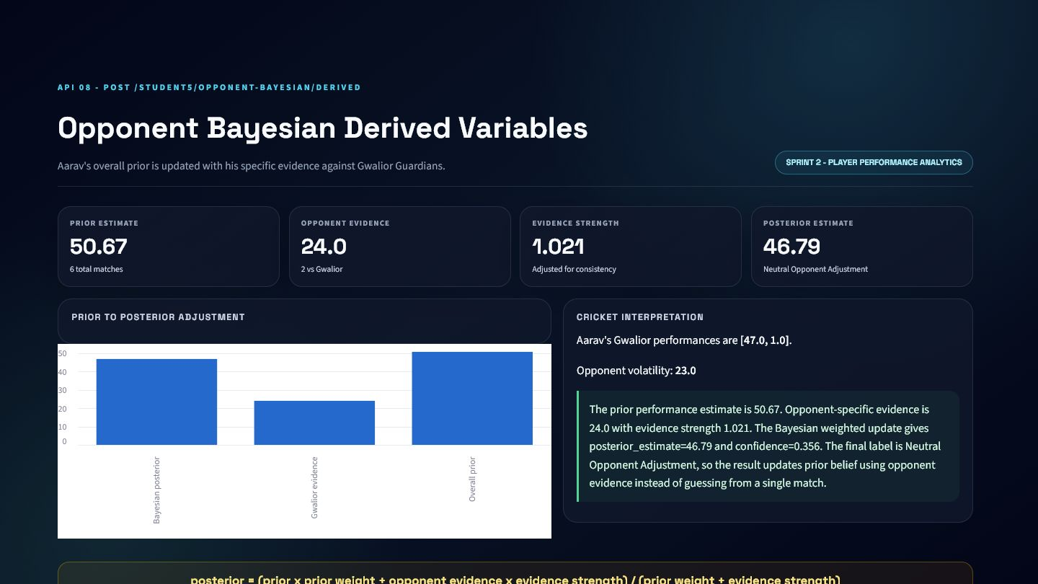
VERIFIED RESULT
API 8: Prior-to-Posterior Dashboard
Gwalior evidence lowers Aarav's expectation but remains weak.
Overall prior: 50.67.
Gwalior evidence: 24.0 from performances of 47 and 1.
Opponent volatility: 23.0.
Evidence strength: 1.021; posterior: 46.79.
VERIFIED DASHBOARD OUTPUT

Slide 27
DECISION LAYER AND FORMULA
API 9: Final Matchup Decision
Smoothing limits the influence of two opponent samples.
Reports opponent-adjusted performance score and prior-to-posterior change.
Filters rows on or after the target match date.
Change percent determines Strong, Difficult, or Neutral Matchup.
Confidence remains low when evidence is sparse.
weight = n / (n + k) | posterior = (1 - weight) x prior + weight x opponent evidence

Slide 28
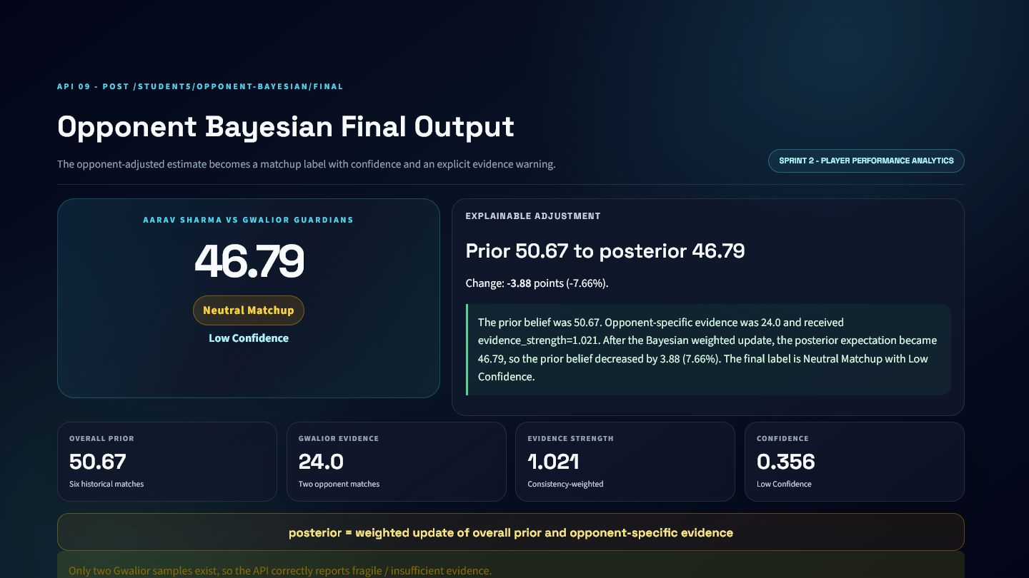
VERIFIED RESULT
API 9: Matchup Dashboard
The API reports a neutral matchup with low confidence.
Opponent-adjusted score: 46.79.
Prior-to-posterior change: -3.88 points.
Label: Neutral Matchup.
Confidence: Low Confidence with only two samples.
VERIFIED DASHBOARD OUTPUT

Slide 29
PRODUCT INTEGRATION
Sprint 2 Integration Inside Khel AI
Form and matchup become reusable signals across the product.
Player dashboard: trend chart, form score, and matchup card.
Prediction panel: opponent-adjusted expectation.
AI agent: explain why a player's outlook changed.
Fantasy panel: form and matchup feed later projections.
Player ranking filters can preserve uncertainty alongside scores.

Slide 30
HONEST EVALUATION
Sprint 2 Limitations and Lessons
Small samples require explicit confidence and evidence warnings.
Six matches are insufficient for stable long-term conclusions.
Only two samples exist per opponent.
Linear regression cannot model every nonlinear form pattern.
Bayesian estimates depend on prior and smoothing choices.
The response design makes these limitations visible to users.

Slide 31
03
Sprint 3: Fantasy Decision Engine
Two APIs combine expected value, matchup context, and a saved prediction model.

Slide 32
ARCHITECTURE
Sprint 3 End-to-End Pipeline
Uncertain cricket events become an auditable selection recommendation.
Ball events create empirical batting, bowling, and fielding probabilities.
Player history creates form, role, opportunity, and matchup features.
API 10 exposes event-level expected value.
API 11 loads a saved .pkl and compares ML with a statistical estimate.

Slide 33
PURPOSE AND APPROACH
API 10: Expected Value Purpose
Fantasy outcomes are uncertain combinations of cricket events.
Each possible event has an empirical probability.
Each event also has a fantasy point value.
Expected value makes the uncertainty explicit.
Components separate batting, bowling, and fielding contribution.

Slide 34
DATASET METHOD
API 10: Probability Derivation
The inputs are derived from Aarav's records rather than random demo values.
Batting probabilities use Aarav's legal-ball outcomes.
Dismissal probability uses recorded wicket events.
Bowling probabilities are zero because he is a specialist batter.
Fielding probabilities use recorded catches, run-outs, and stumpings per match.

Slide 35
FORMULA
API 10: Expected-Value Formula
Every component remains independently auditable.
Compute probability multiplied by point value for each event.
Sum batting events into batting expected points.
Repeat for bowling and fielding.
Add the three components for total expected value.
expected fantasy points = sum(event probability x event point value)

Slide 36
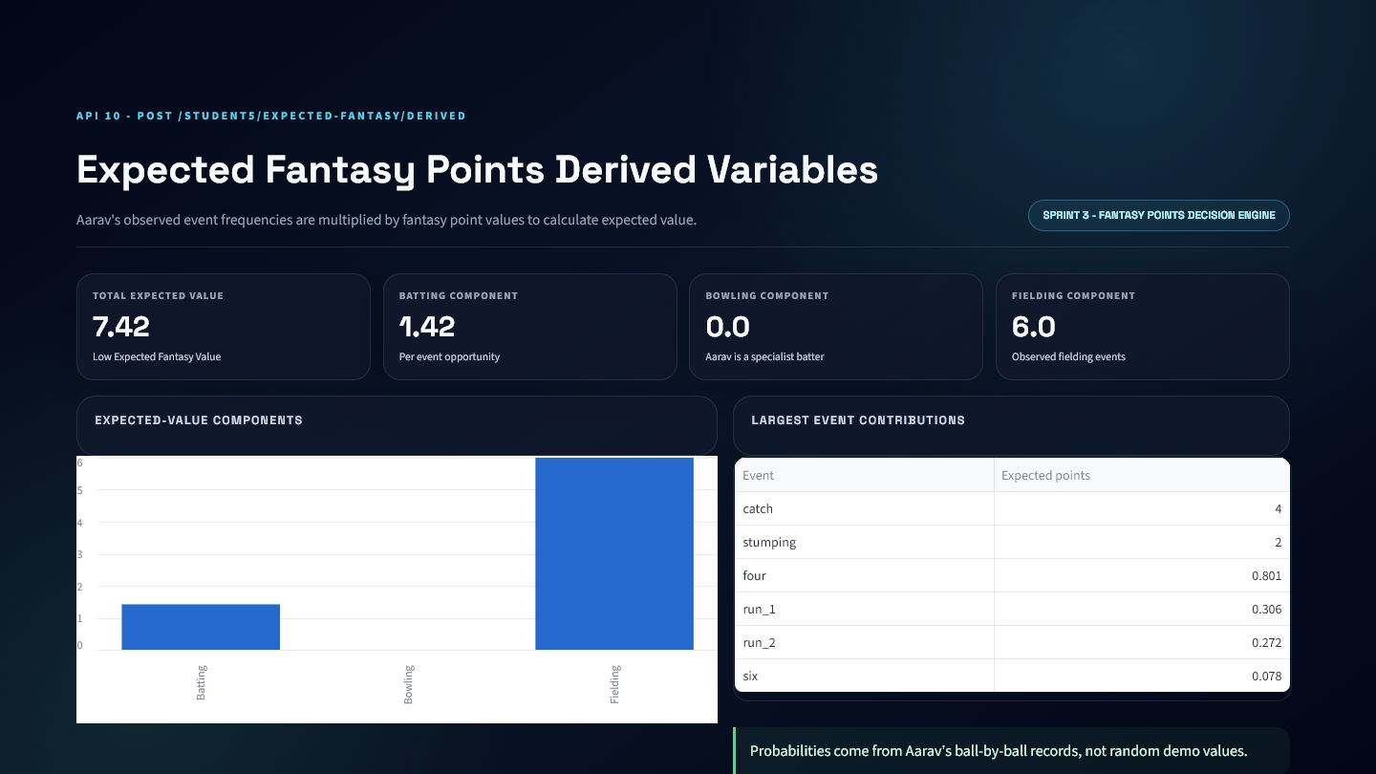
VERIFIED RESULT
API 10: Derived Fantasy Dashboard
The contribution table shows exactly where 7.42 expected points come from.
Total expected value: 7.42 per opportunity.
Batting component: 1.42.
Bowling component: 0.0.
Fielding component: 6.0.
VERIFIED DASHBOARD OUTPUT

Slide 37
PURPOSE AND APPROACH
API 11: Final Fantasy Prediction
Historical features become one selection-oriented prediction.
Uses a saved model.pkl and never retrains during a request.
Checks model mode, feature contract, output range, and distribution.
Returns model source, risk, and selection label.
Keeps a documented statistical fallback for invalid ML outputs.

Slide 38
FEATURE ENGINEERING
API 11: Pre-Match Features
All features are calculated strictly before the target match.
Career and recent two, three, and five-match averages.
Prior match count and days since last match.
Historical batting and bowling opportunity.
Role indicators for batter, bowler, all-rounder, and wicketkeeper.
Bayesian posterior and pressure-context features.

Slide 39
MODEL LIFECYCLE
API 11: Saved Model Architecture
The request path performs prediction only.
model.pkl contains the trained linear regression artifact.
feature_columns.json enforces exact input order.
metrics.json provides model name, version, mode, and evaluation.
Cached loading prevents repeated disk work.
The model is never fitted or retrained inside the API request.

Slide 40
MODEL CARD
API 11: Metrics and Baseline
The model improves MAE over baseline but remains demonstration quality.
Test MAE: 26.577.
Test RMSE: 33.530.
Test R-squared: -0.037.
Career-average baseline test MAE: 29.065.
Weak generalization is disclosed rather than hidden.
TEST MAE
TEST RMSE
TEST R2
BASELINE MAE
26.577
33.530
-0.037
29.065

Slide 41
RELIABILITY CONTROLS
API 11: Prediction and Fallback Logic
A prediction must pass several checks before becoming the final output.
Validate payload model mode against artifact model mode.
Build the exact saved feature vector.
Reject missing, non-finite, unrealistic, or out-of-distribution outputs.
Use supervised prediction only when valid.
Otherwise return the statistical estimate and fallback reason.

Slide 42
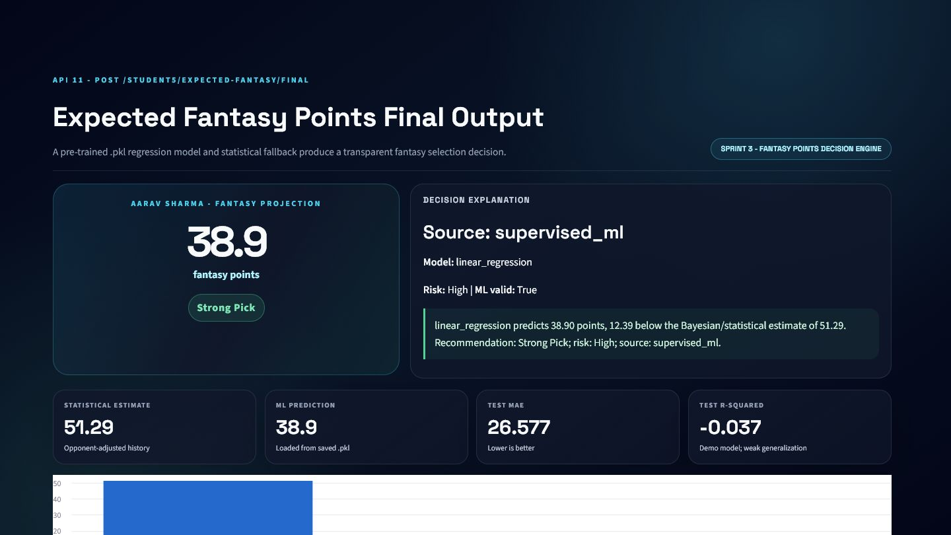
VERIFIED RESULT
API 11: Final Fantasy Dashboard
The saved model predicts 38.9 points and returns Strong Pick.
Supervised ML prediction: 38.9.
Statistical estimate: 51.29.
Model source: supervised_ml.
Risk: High; ML validation: True.
VERIFIED DASHBOARD OUTPUT

Slide 43
PRODUCT INTEGRATION
Sprint 3 Integration Inside Khel AI
The API supports both user interfaces and AI-agent workflows.
Fantasy panel: projection, selection label, and risk.
Player comparison: rank by ML prediction and expected value.
AI agent: explain model-versus-statistical disagreement.
Match preview: opponent and venue-aware recommendations.
Batch endpoint can score multiple candidate players.

Slide 44
HONEST EVALUATION
Sprint 3 Limitations and Future Work
The current model demonstrates the workflow, not production accuracy.
Only 264 canonical synthetic player-match rows are available.
Negative test R-squared indicates weak out-of-sample fit.
Event probabilities need larger role-specific samples.
Future work: real data, calibration, uncertainty intervals, and monitoring.
The current model remains clearly marked demo-only.

Slide 45
ONE EXPLAINABLE CRICKET PIPELINE
From match events to fantasy decisions
SPRINT 1
SPRINT 2
SPRINT 3
What is happening?
How is the player trending?
What decision should Khel AI make?
Live score, innings, chase pressure, and match outlook.
Regression form and opponent-specific Bayesian context.
Expected value and saved-model fantasy projection.
11 APIs | Real local service logic | Validated schemas | Cricket-language explanations | Khel AI integration ready

