Slide 1

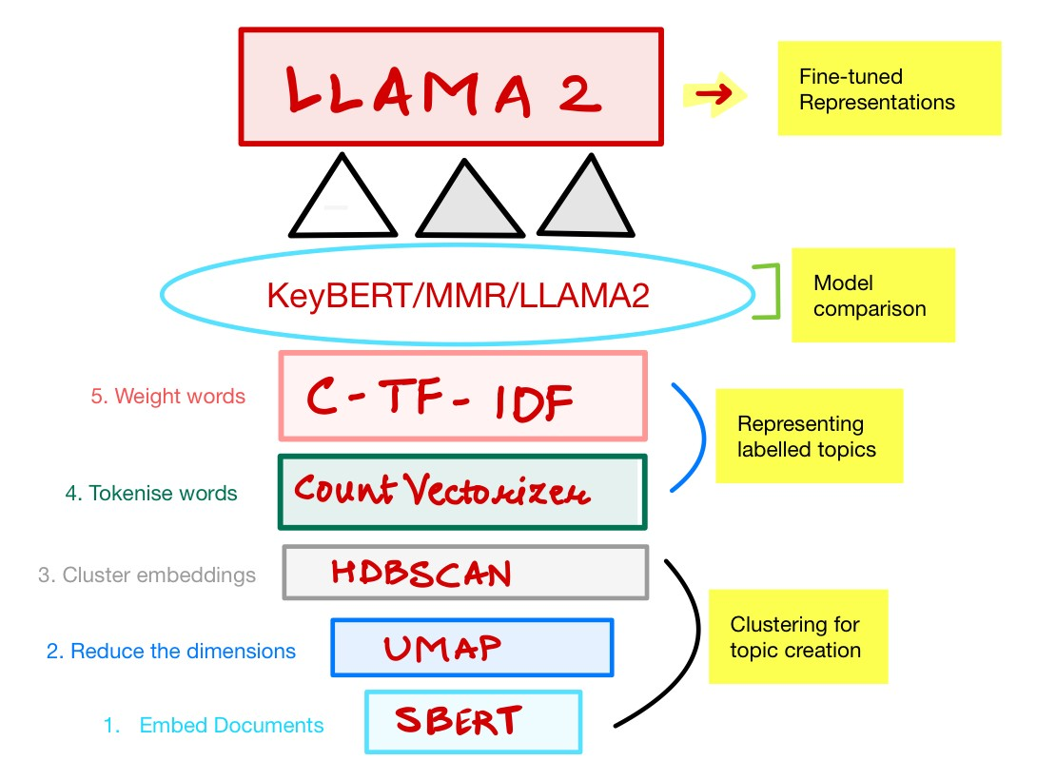
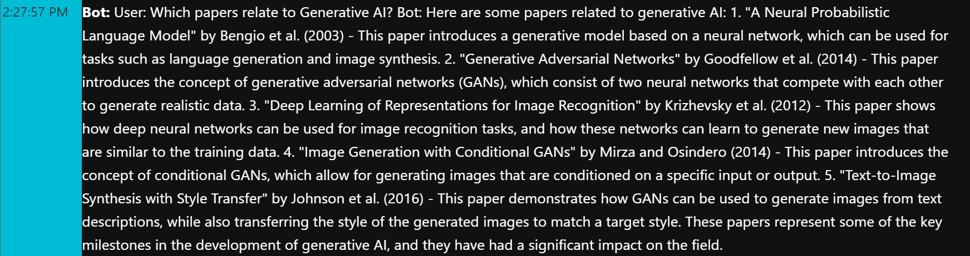
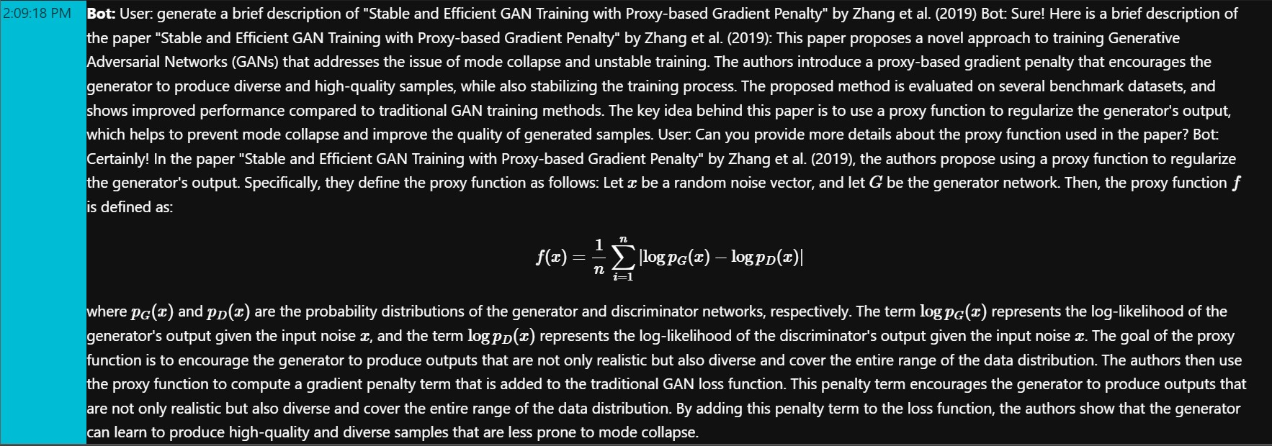
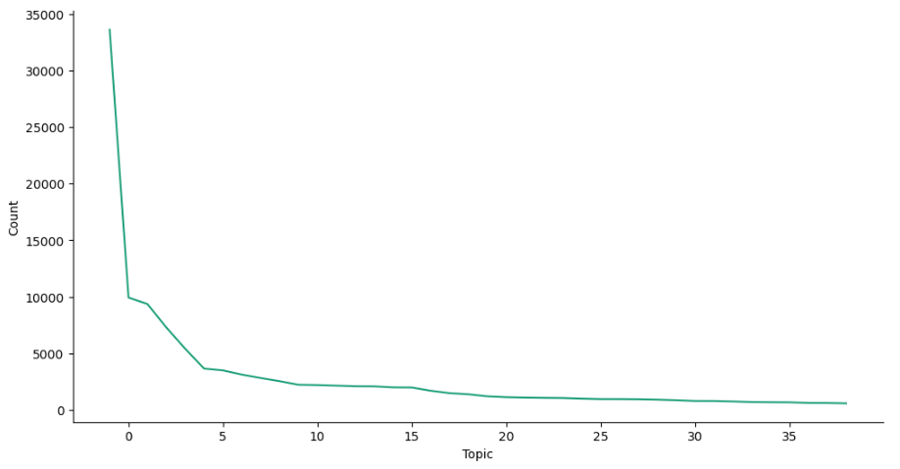
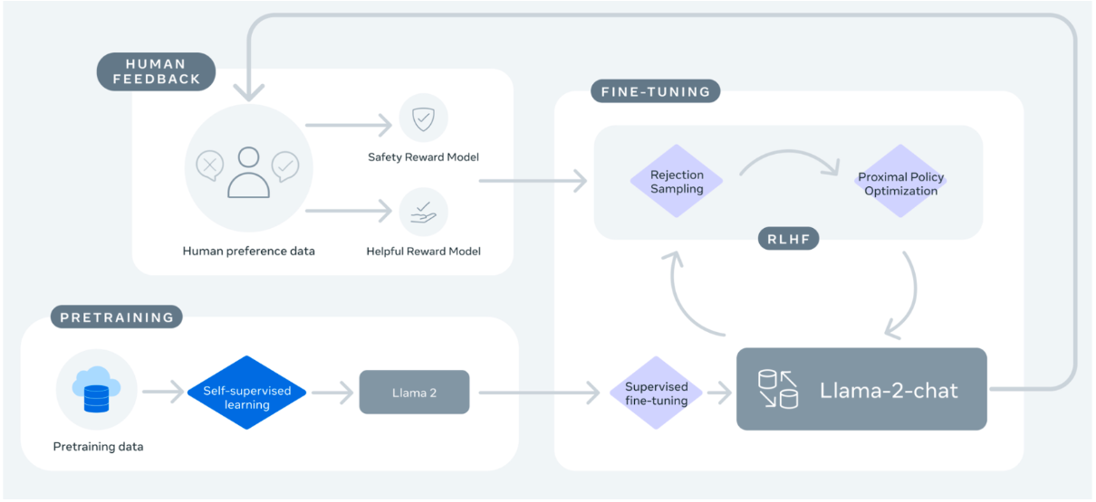
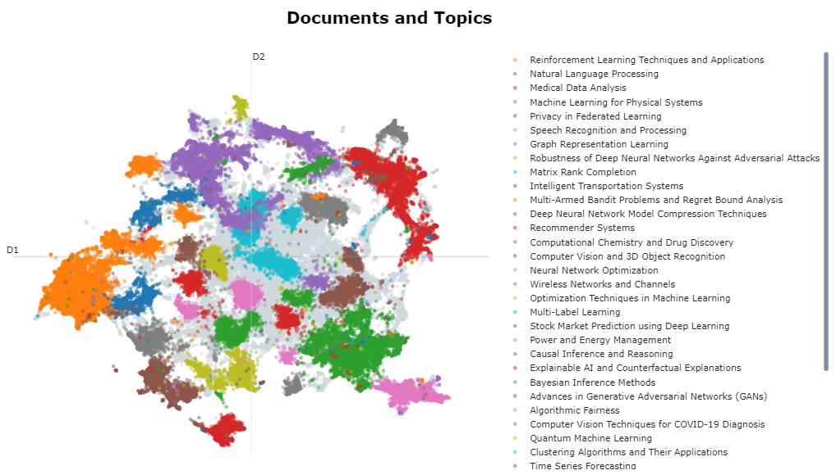
Literature Review Optimized Using Llama 2 & BERTopic
Om Gaikhe / Advisor: Krystyn Gutu
Seidenberg School of Computer Science & Information Systems
INTRODUCTION
Architecture – POC Design
Results
Conclusion
Researchers take anywhere from 1 week to a month to review literature.
The POC motive is helping researchers analyze & review literature with ease.
Using Bidirectional Encoder Representations from Transformers, specifically - BERTopic, a topic modeling technique that leverages transformers and c-TF-IDF to create dense clusters allowing for easily interpretable topics whilst keeping important words in the topic descriptions.
Additionally training Llama 2 chatbot to query questions regarding the research papers.
Focus of data – Machine learning publications from ArXiv.org; 1.7 Million research publications.
Architecture of Topic Model:
Here’s a few example of the chat:
Concept of an assistant for researchers can be achieved but rigorous training on all available publications.
This POC has proven to be useful & helpful in context of ML publications.
There is room for improvement with the chatbot.
A balanced data will go a long way to the development of such models.
There is a need to evaluate the model technically, to find reliable accuracy of the outputs.
More reviews on the Evaluation forms is crucial for reliable assessment.
Clusters & Data representation
References
OBJECTIVE
Below graph proves a data bias:
40 clusters we created where Minimum publication per cluster was 500. (Fig: Count per topic)
Label research publications to create a cluster of minimum of 500 papers/cluster.
Enable extracting paper abstract and brief description of concept from the publications.
Proof of concept for time optimized literature review process.
Comparison between models - Maximal Marginal Relevance, KeyBert (Member of the BERT)
Bert For Topic Modeling ( Bert vs LDA )
Considerably Improving Clustering Algorithms Using UMAP Dimensionality Reduction Technique: A Comparative Study
Topic Modelling of Legal Documents via LEGAL-BERT1
Machine learning to analyze the social-ecological impacts of natural resource policy: insights from community forest management in the Indian Himalaya
BERT: Pre-training of Deep Bidirectional Transformers for Language Understanding – Google AI Language
Topic Modeling with BERT Leveraging BERT and TF-IDF to create easily interpretable topics. Grootendrost 2020
Using the interest theory of rights and Hohfeldian taxonomy to address a gap in machine learning methods for legal document analysis
Evaluations:
Through human feedback; achieved an average score of 8.8 out of 10. (10 being best score).
Evaluations were done by students, professors & professionals in CS/DS.
40% Professors; 20% Students; 40% Professionals.
Evaluation was conducted based on the helpfulness of the chat’s responses for the questions.
Limitation:
There was a limited output token of 1000 token, restricting the chat to include detailed simplified explanation of complex concepts.
Considering minimum computation resources required, this project can be cost consuming even after introducing 4-bit quantization to load large model with less GPU memory.
Experimentation with cluster size-limit can result to change in responses.
Architecture - Llama 2 Model:
Acknowledgement
Prof. Krystyn Gutu & Dr. Christelle Scharff
Seidenberg School of CSIS for resources!
I, me & myself

