Slide 1
ARTHA
Turning the kirana counter into a financial identity for the next 500 million.
An AI commerce-and-finance OS for India's 13 million corner shops — the phone is the only tool.
Local-first — runs on the iQOO's on-device edge; the cloud is touched only to OCR a photo.
PS 3 · REIMAGINE MONEY FOR BHARAT iQOO Hackathon

Slide 2
THE PROBLEM
13 million kirana stores run India. They run on paper.
Invisible
The day's sales, the udhaar owed, the stock running low live in a notebook under the counter.
No insight
She can't see her own profit or cash flow — no P&L, no idea what's bleeding her margin.
No credit
A 20-year track record earns her ZERO formal credit. The bank can't see paper.
Under siege
Quick-commerce has shut 200,000 kiranas since 2023.

Slide 3
THE SOLUTION · ONE LOOP, ALL ON THE PHONE
capture → understand → advise → sell → credit
1 · CAPTURE
Photograph a ledger, a customer bill, or a wholesaler challan — or just speak it. Claude Opus 4.8 vision reads Hindi handwriting; whisper.cpp handles voice on-device. Zero typing.
2 · UNDERSTAND
Entries auto-build a live P&L, inventory (cost→sell margins, low-stock), and udhaar tracker. Every line snapshots price+cost — credit-grade data, not estimates.
3 · ADVISE
Four AI agents brief her daily; an agentic assistant answers anything in her language — with inline charts — and drafts sales/payments she confirms.
4 · SELL
One tap publishes her live stock as a neighbourhood storefront — her counter-punch to quick commerce, from data she already has.
5 · CREDIT
Every rupee feeds an Artha Score (0–100) + working-capital band — an alternative-data credit profile from real commerce flow. The first credit she was ever offered.

Slide 4
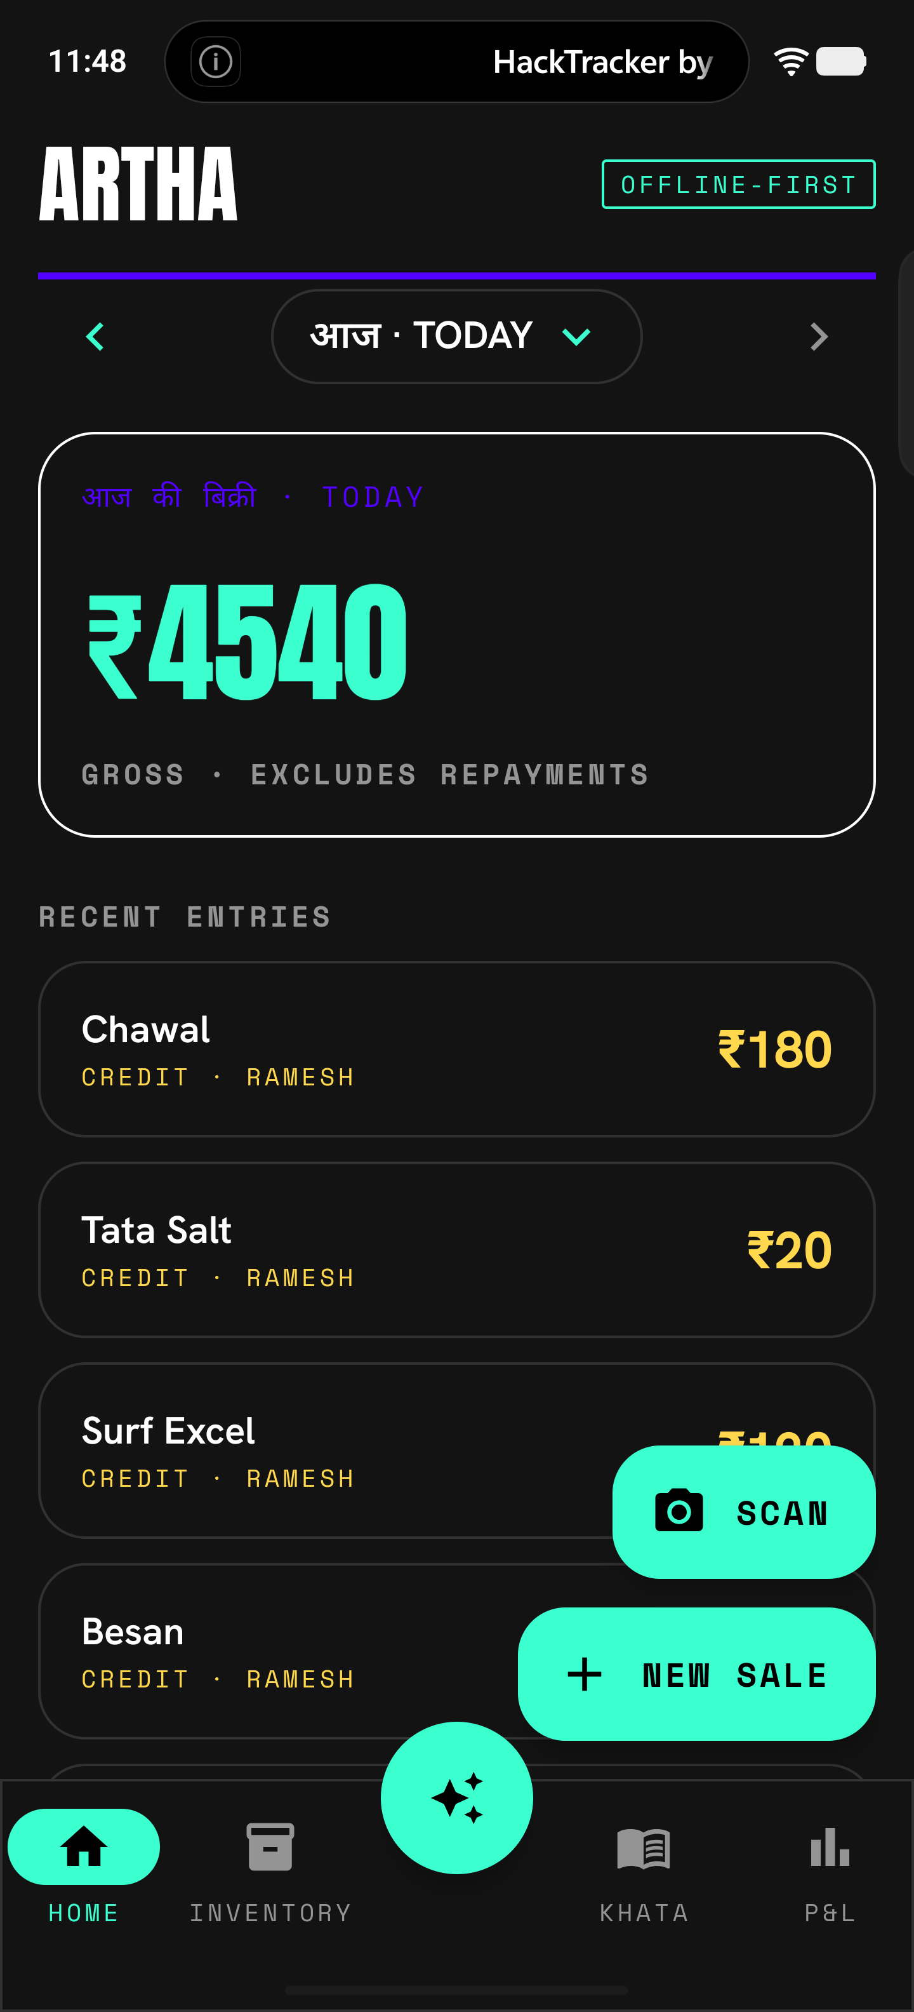
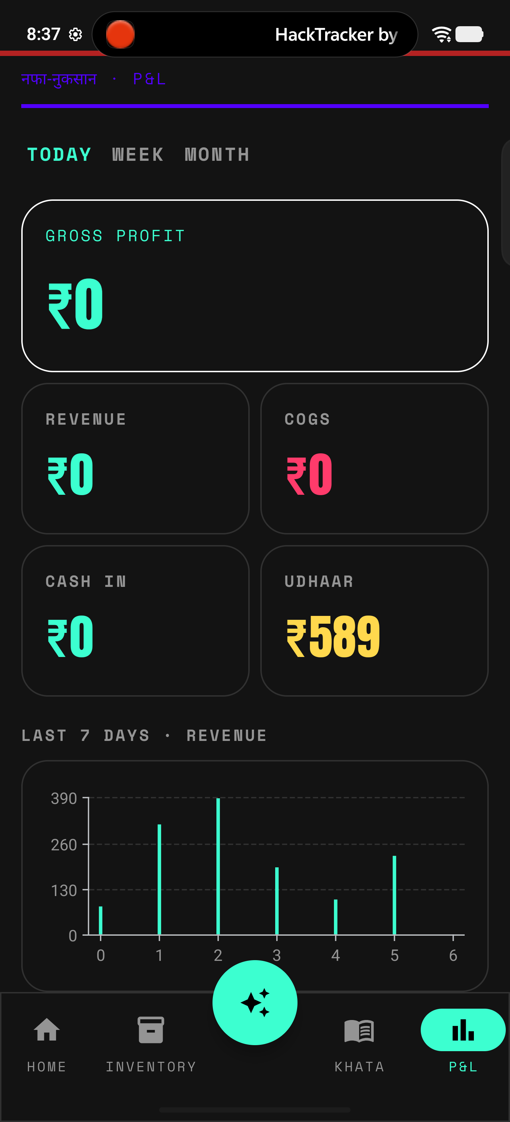
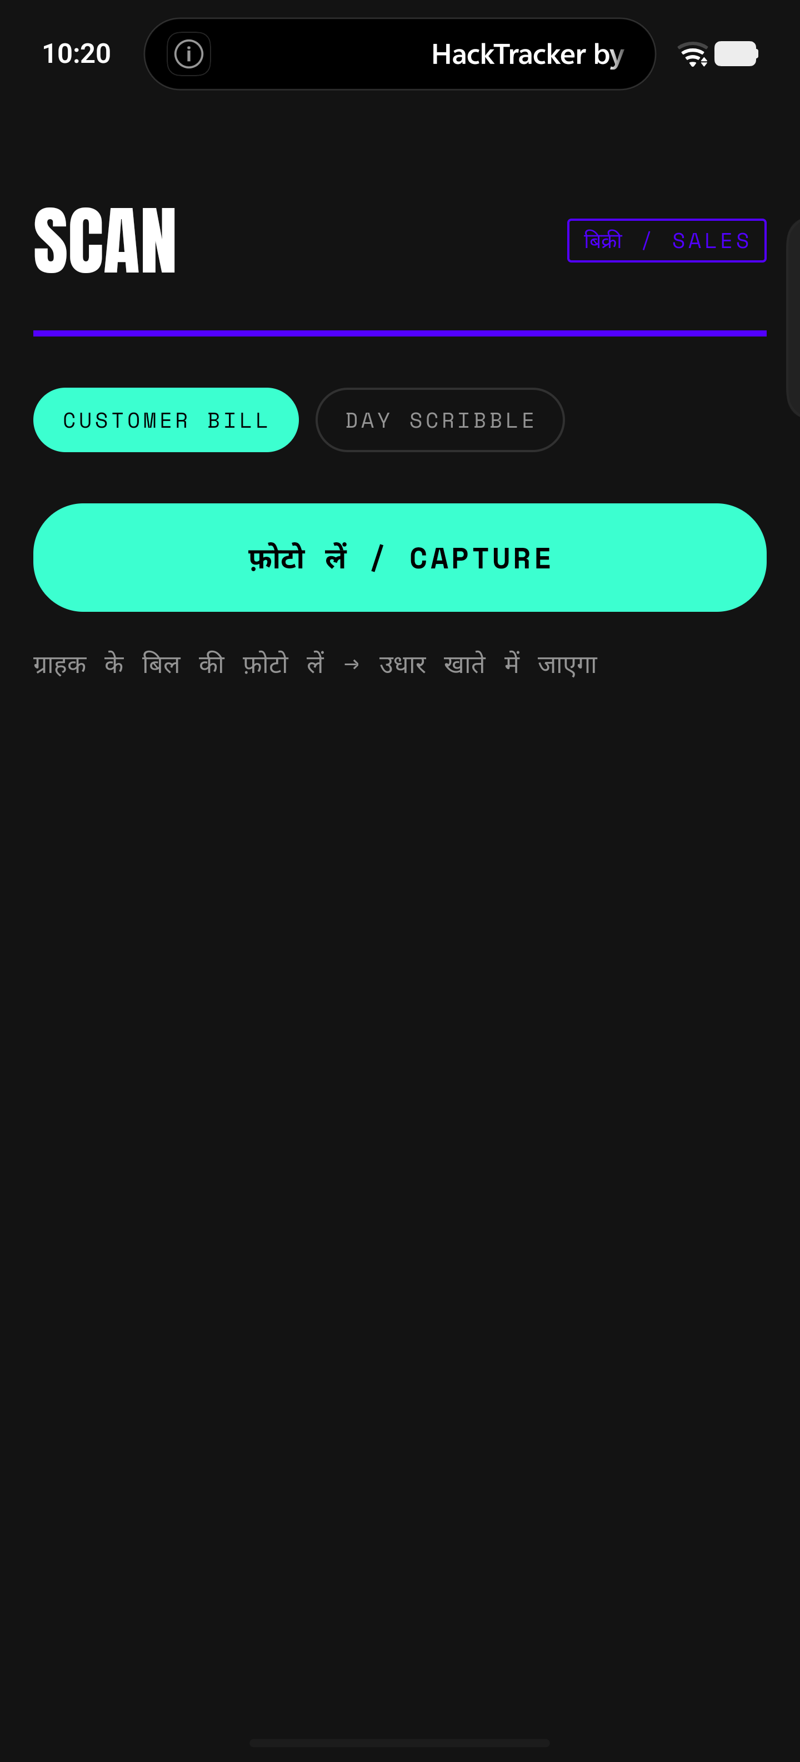
THE PRODUCT (1/2)
HOME + DATE NAV
Any day's P&L · ◄ date ►
P&L DASHBOARD
Revenue · profit · udhaar · chart
SCAN A SALE
Customer bill / day scribble

Slide 5
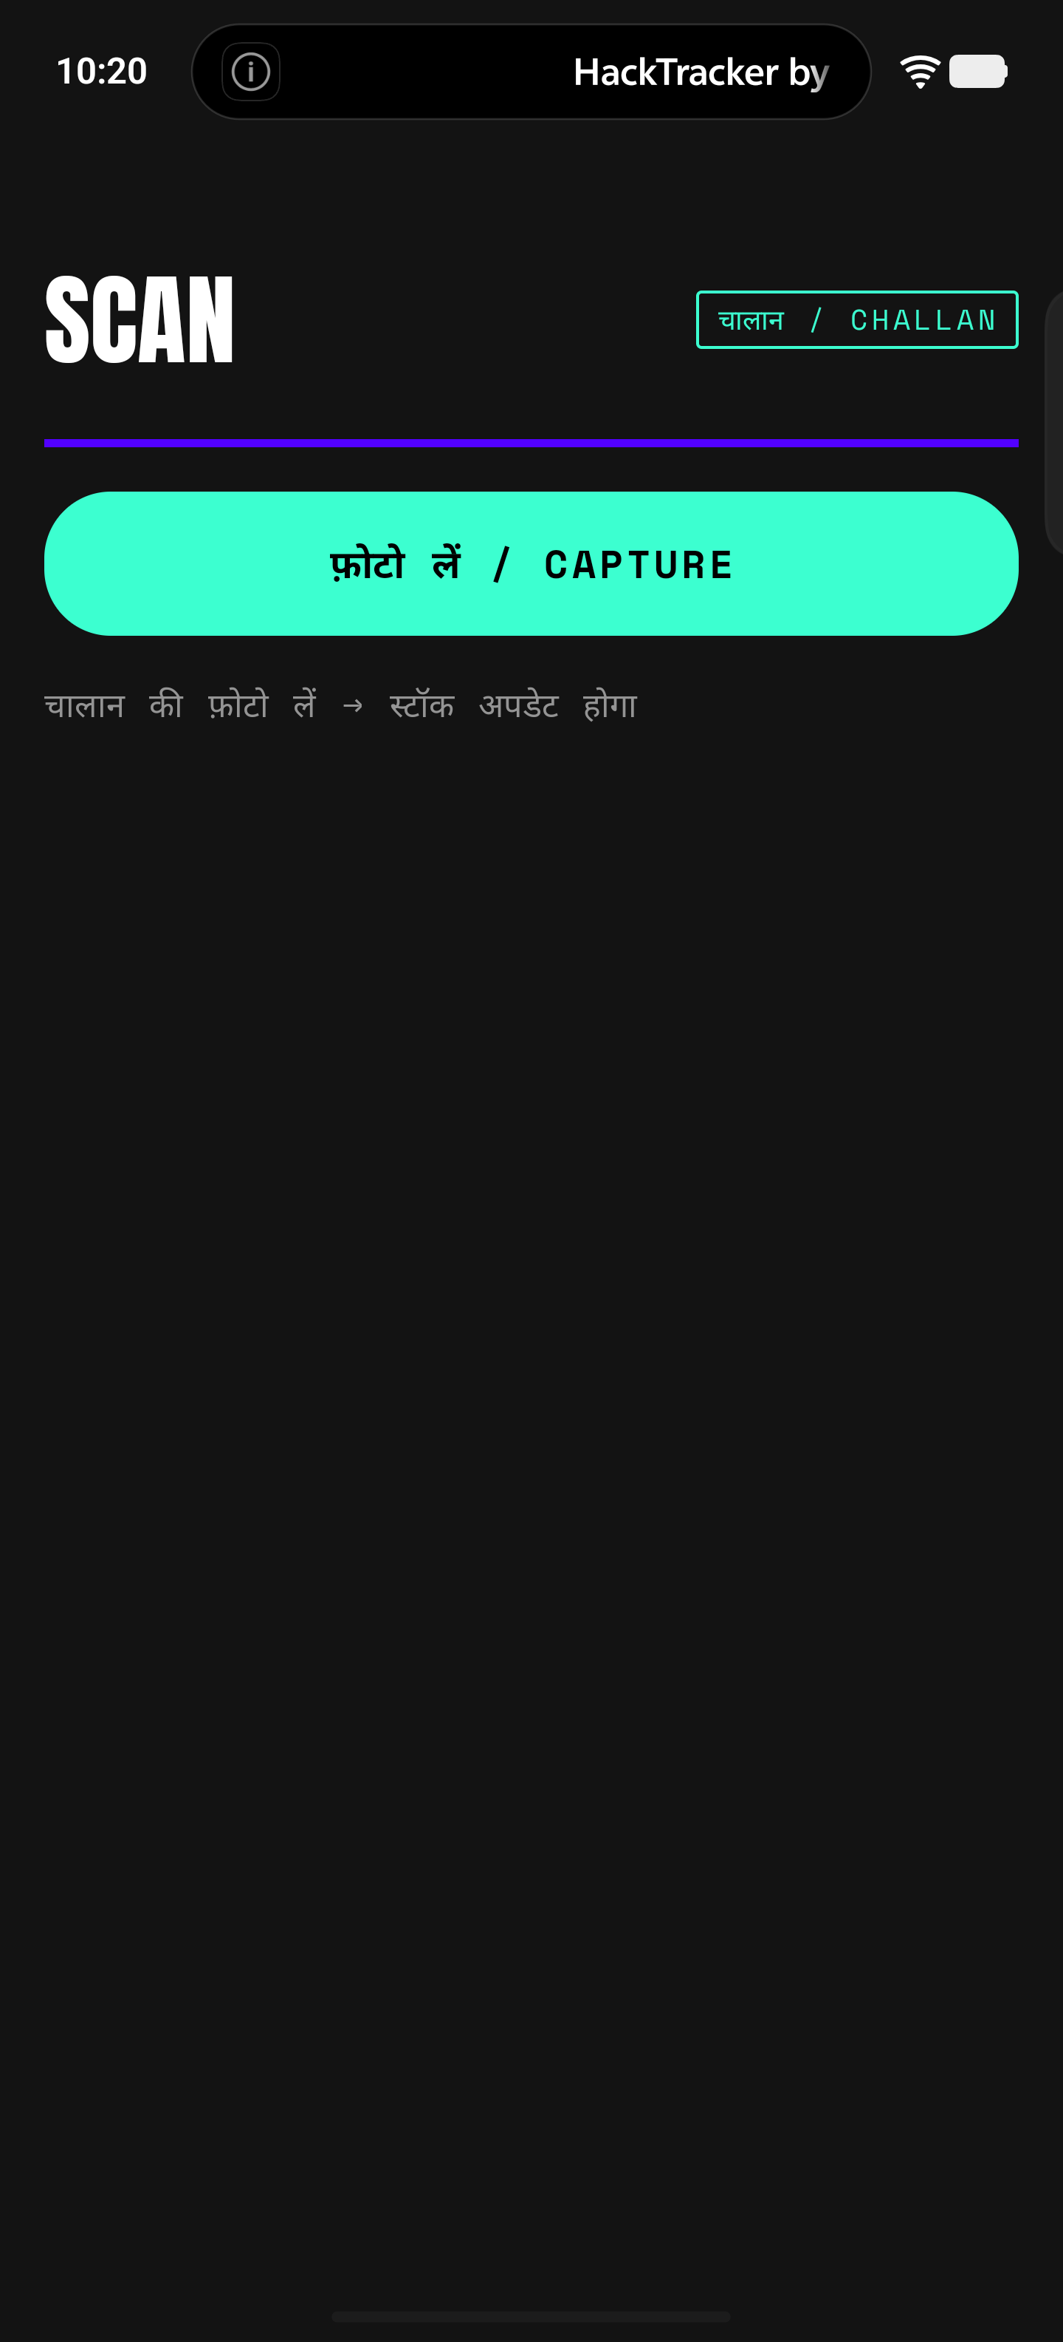
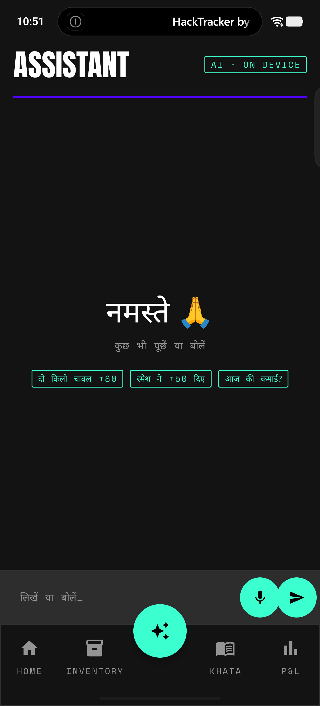
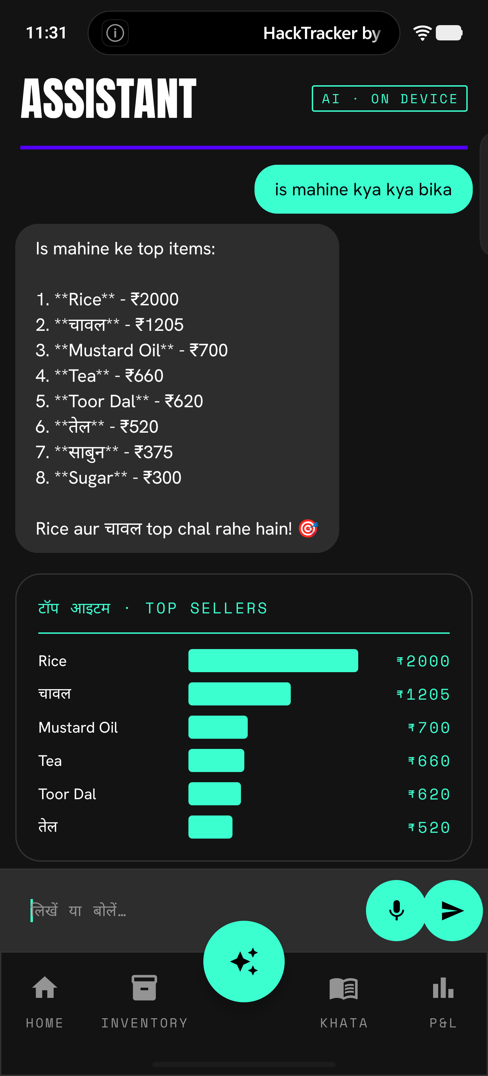
THE PRODUCT (2/2)
SCAN A CHALLAN
Supplier bill → priced stock
ASK IN HINDI
Voice or text, your language
AGENT + CHARTS
Reads live data, answers visually

Slide 6
ARCHITECTURE · LOCAL-FIRST, ON-DEVICE EDGE
Runs on the iQOO's edge — nothing leaves the phone but an image for OCR.
ON-DEVICE LLM
Qwen 2.5 3B via llama.cpp parses entries, routes intents, and runs the insight loop on the iQOO — offline.
CLOUD = OCR ONLY
Claude Opus 4.8 vision reads Hindi handwriting — the one task that genuinely needs a frontier model. The sole cloud touchpoint.
VOICE
On-device Hindi STT — fine-tuned whisper-hindi-small (whisper.cpp, JNI, arm64).
DATA
Local Room/SQLite v3 — customers, price snapshots, reactive flows. The credit-grade record stays on the phone.
AGENT
Tool-calling over 8 read-only shop-data tools + draft-action tools → confirm cards; answers with inline charts.
APP
Kotlin · Jetpack Compose · Clean Arch · Hilt · 'The Verge' design system. OfficeKit bridges the build.

Slide 7
WHY IT HOLDS WHERE OTHERS BROKE
The ledger is free — acquisition + data, never the revenue.
The storefront builds daily habit and a digital order trail.
The credit layer is the monetisation the category never had.
Three PS angles — phone-as-POS, credit for the unbanked, a vernacular assistant — fused into one loop.
ARTHA
github.com/Om-Midya/artha-kirana

