Slide 1

Simplifying calibration of Powders by use of Numerical Methods
Work by: Om Mihani
Guided by: Pankaj Doshi

Slide 2
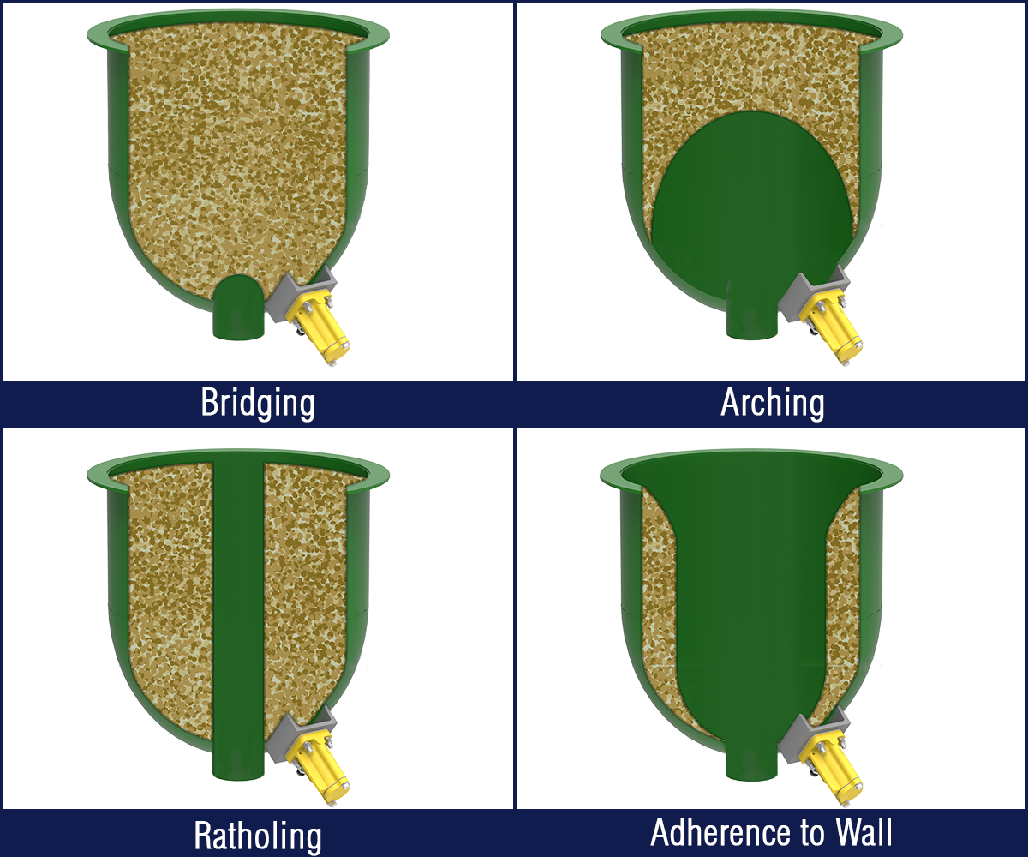
INTRODUCTION
Use of Powders in daily life
Problems like Segregation, Rat holing, etc
No Rigid Body Mechanics, No Fluid Dynamics: Need for simulations
What do simulations do?
Fig 1: Various problems in Hoppers
Image Source: google

Slide 3
OBJECTIVE
The simulation has two parts:
1) Calibration
2) Solving for the system
Calibration is a hit-and-trial method: Simulation + Experiment
The Simulation part of calibration is long (~5 hrs of work 10 – 12 times per substance)
Plan: To reduce this simulation time

Slide 4
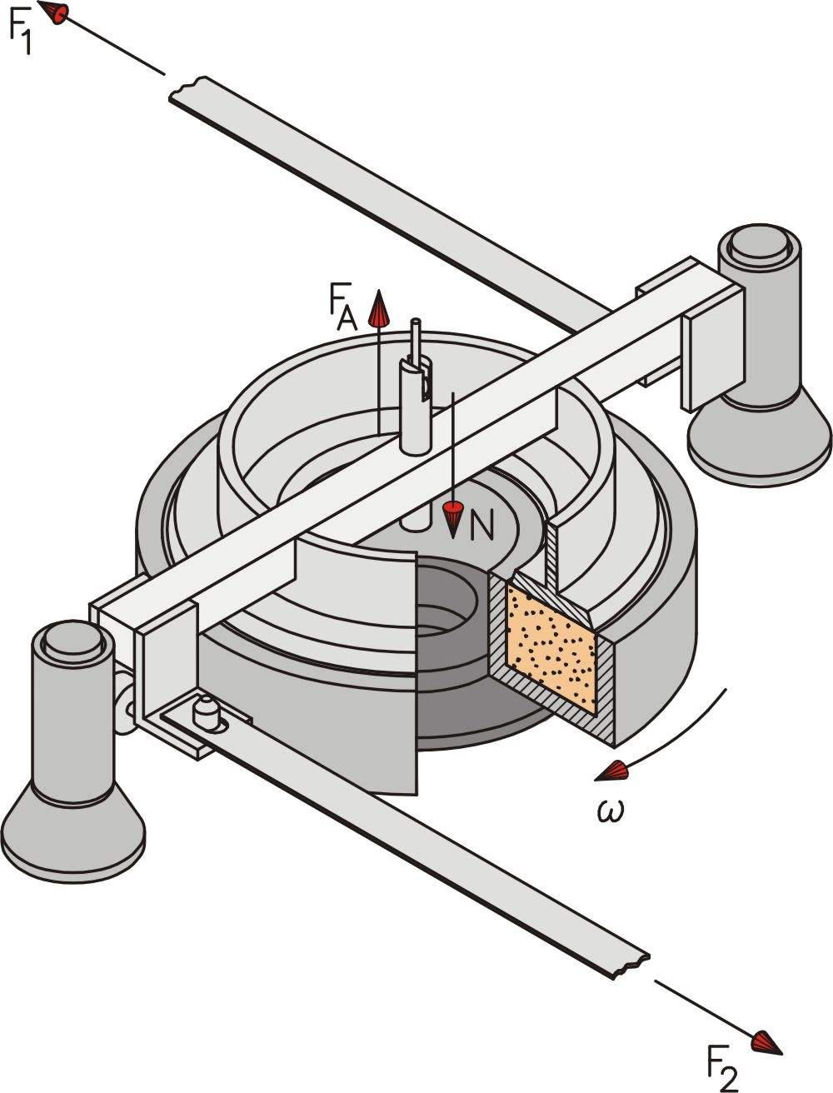
METHODOLOGY
Understanding parameters:
Input parameters
Young's Modulus
Coefficients of Restitution
Friction coefficients
Output parameters
Force needed
Angles of restitution

Slide 5
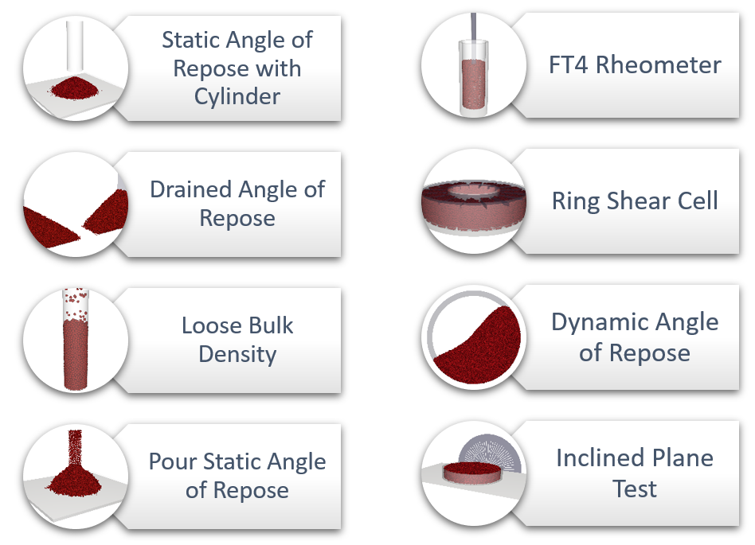
METHODOLOGY
Understanding Tests
Drained Angle of Repose
Dynamic Angle of Repose
Ring Shear Cell Test
Inclined Plane Test

Slide 6
METHODOLOGY
Simulate
Conduct a set of simulations with varying parameters
Hunt
Find the most sensitive parameters
Select
Select parameters such that number of parameters = number of outputs
Interpolate
Make an inverse polynomial using Lagrange Interpolation
Validate
Validate using Validation dataset

Slide 7
RESULTS
Limited Results for display due to non-disclosure agreement
The process is known to work for a smaller set of parameters
The time reduces from days to milliseconds

Slide 8
CONCLUSIONS
A method has been proposed for Calibration of Powders
It is a one-time process and then can be used for any number of substances
Known to work for a smaller set of parameters
Further scope: Other researchers and companies are invited to use this work for their benefits. The process is a one-time process that will later reduce calibration time from days to a fraction of second

Slide 9
THANK YOU

