Slide 1
Web Development
Notes:
Introduce the workshop schedule and then the following topics.

Slide 2

HTML and CSS

Slide 3

GIT
Notes:
HTML5 and CSS introduction and what they do

Slide 4

Python
Notes:
HTML5 and CSS introduction and what they do

Slide 5

Flask
Notes:
HTML5 and CSS introduction and what they do

Slide 6

MongoDB
Notes:
HTML5 and CSS introduction and what they do

Slide 7

JavaScript
Notes:
HTML5 and CSS introduction and what they do

Slide 8
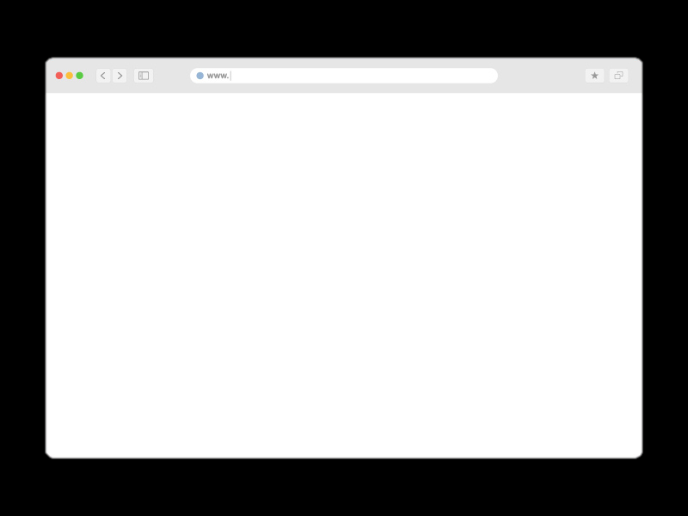
User Interfaces
Notes:
HTML5 and CSS introduction and what they do

Slide 9

Testing and CI/CD
Notes:
HTML5 and CSS introduction and what they do

Slide 10

Scalability and Security
Notes:
HTML5 and CSS introduction and what they do

Slide 11
HTML and CSS

Slide 12
HTML

