Slide 1
Web Development

Slide 2

HTML
HTML and CSS

Slide 3

Git

Slide 4

Python

Slide 5

Flask

Slide 6

MongoDB

Slide 7

JavaScript

Slide 8
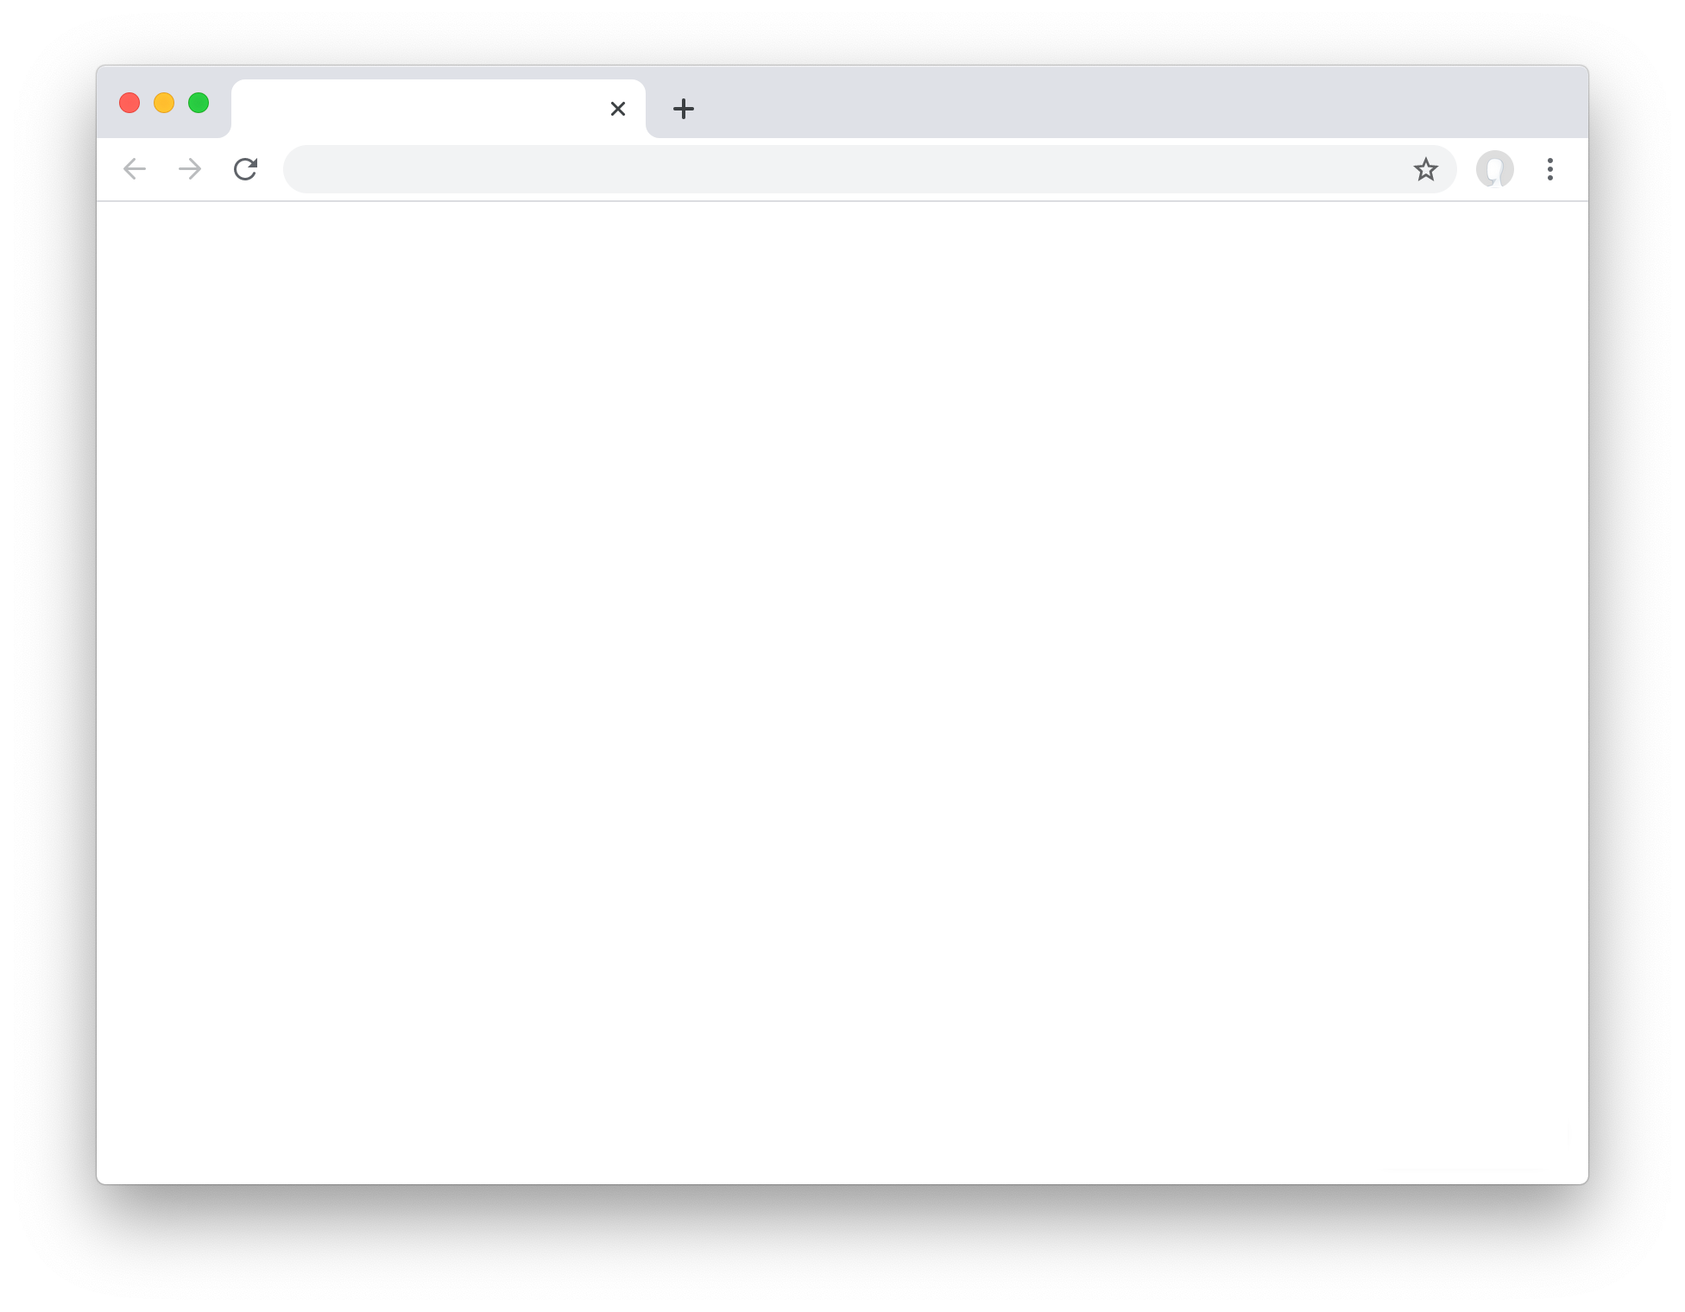
User Interfaces

Slide 9
Testing and CI/CD

Slide 10
Load Balancer
Scalability and Security
Server
Server
Server

Slide 11
HTML and CSS

Slide 12
HTML

Slide 13
<!DOCTYPE html>
<html lang="en">
<head>
<title>Hello!</title>
</head>
<body>
Hello, world!
</body>
</html>

Slide 14
<!DOCTYPE html>
<html lang="en">
<head>
<title>Hello!</title>
</head>
<body>
Hello, world!
</body>
</html>

Slide 15
<!DOCTYPE html>
<html lang="en">
<head>
<title>Hello!</title>
</head>
<body>
Hello, world!
</body>
</html>

Slide 16
<!DOCTYPE html>
<html lang="en">
<head>
<title>Hello!</title>
</head>
<body>
Hello, world!
</body>
</html>

Slide 17
<!DOCTYPE html>
<html lang="en">
<head>
<title>Hello!</title>
</head>
<body>
Hello, world!
</body>
</html>

Slide 18
<!DOCTYPE html>
<html lang="en">
<head>
<title>Hello!</title>
</head>
<body>
Hello, world!
</body>
</html>

Slide 19
<!DOCTYPE html>
<html lang="en">
<head>
<title>Hello!</title>
</head>
<body>
Hello, world!
</body>
</html>

Slide 20
<!DOCTYPE html>
<html lang="en">
<head>
<title>Hello!</title>
</head>
<body>
Hello, world!
</body>
</html>

Slide 21
Document Object Model
html
<!DOCTYPE html>
<html lang="en">
<head>
<title>Hello!</title>
</head>
<body>
Hello, world!
</body>
</html>
head
body
title
Hello, world!
Hello!

Slide 22
Common HTML Tags
<h1>, <h2>, ..., <h6>
<ol>, <ul>
<img>
<a>
<table>
<form>
...

Slide 23
CSS

Slide 24
Common CSS Properties
color
text-align
width, height
margin, padding
font-family, font-size, font-weight
border
...

Slide 25
Identifying Elements
div
span
id
class

Slide 26
Specificity
inline
id
class
type

Slide 27
Specificity
<div id="foo"> Hello!
</div>
Hello!
div {
color: blue;
}

Slide 28
Specificity
<div id="foo"> Hello!
</div>
Hello!
div {
color: blue;
}
#foo {
color: red;
}

Slide 29
Specificity
<div id="foo"> Hello!
</div>
Hello!
#foo {
color: red;
}
div {
color: blue;
}

Slide 30
CSS Selectors
a, b | Multiple Element Selector
a b | Descendant Selector
a > b | Child Selector
a + b | Adjacent Sibling Selector
[a=b] | Attribute Selector
a:b | Pseudoclass Selector
a::b | Pseudoelement Selector

Slide 31
Responsive Design

Slide 32
Responsive Design
viewport
Media Queries
Flexbox
Grids

Slide 33
<meta name="viewport" content="width=device-width, initial-scale=1.0">

Slide 34
Viewport

Slide 35
Viewport

Slide 36
Media Queries
Media Types: print, screen, ...
Media Features: height, width, orientation, ...

Slide 37
Flexbox
1 2 3 4 5 6
1
2
3
4
5
6

Slide 38
Flexbox
1 2 3 4 5 6
1 2 3 4 5 6

Slide 39
Flexbox
1 2 3 4 5 6
1
2
3
4
5
6

Slide 40
Flexbox
1 2 3 4 5 6
1
2
3
4 5 6

Slide 41
Flexbox
1 2 3 4 5 6
1
2
3
4
5
6

Slide 42
Flexbox
1 2 3 4 5 6
1
2
3
4
5
6

Slide 43
Bootstrap

Slide 44
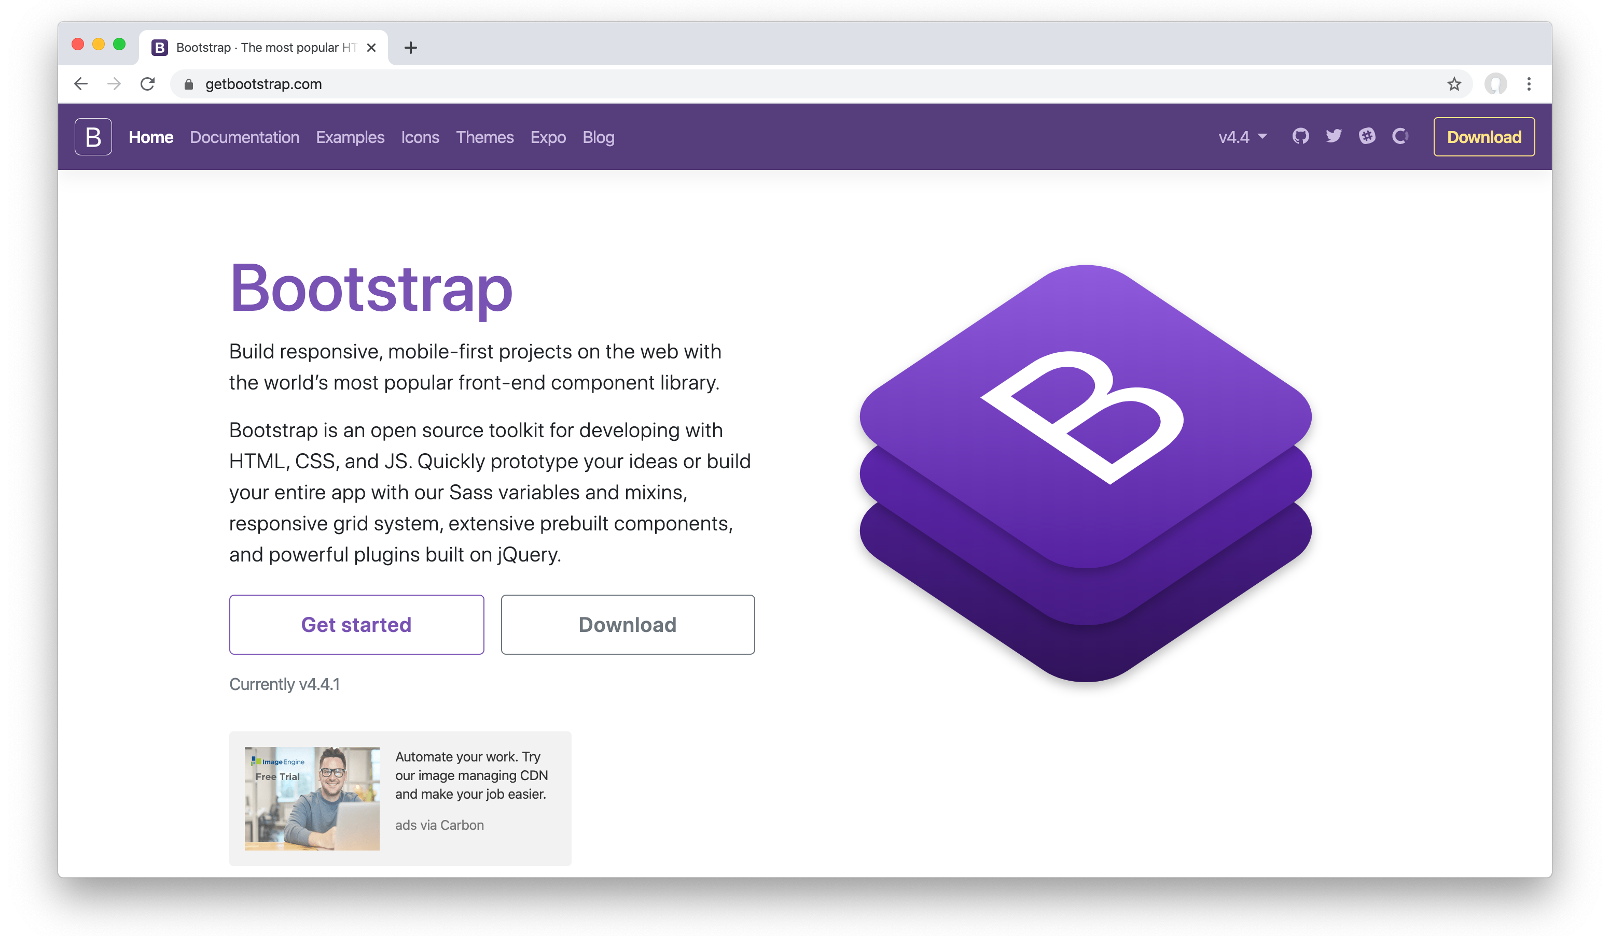



Slide 45
Sass

