Slide 1

Nagar Yuwak Shikshan Sanstha’s
DATTA MEGHE COLLEGE OF ENGINEERING
Airoli, Navi Mumbai
DEPARTMENT OF ARTIFICIAL INTELLIGENCE AND DATA SCIENCE
Sem VI Academic Year 2025 -26 Cloud Computing Project Presentation
Project Title:
CloudNest
Students Name | Roll No.
Viraj Shirsekar | 31
Sumit Mane | 44
Vaibhavi Pawar | 48
Vaishnavi Mohe | 51
Mohammad Ibrahim | 52
Prof. Aruna Divekar
Supervisor

Slide 2
CONTENTS
Introduction
Problem Statement
Software Requirements
Methodology
Result
Conclusion

Slide 3
INTRODUCTION
CloudNest is a cloud-based project that demonstrates modern web hosting using serverless architecture.
It eliminates the need for physical servers by using AWS services like S3 and CloudFront.
The system ensures high scalability, low latency, and global accessibility.
It provides a fast, secure, and cost-efficient solution for hosting static websites.
Eliminates the need for manual server management and maintenance

Slide 4
PROBLEM STATEMENT
Traditional web hosting relies on physical servers, which require high maintenance and cost.
These systems face issues like downtime, limited scalability, and high latency for distant users.
There is a need for a reliable and automated solution. CloudNest solves this by using cloud technologies to provide scalable, secure, and globally accessible hosting.
Lack of centralized monitoring and performance tracking in traditional systems
Difficulty in ensuring data security and secure communication (HTTPS)

Slide 5
SOFTWARE REQUIREMENTS
Frontend:
HTML5, CSS3, JavaScript for responsive and interactive UI.
Backend:
Amazon S3 for static website hosting.
Content Delivery:
Amazon CloudFront for fast global content delivery.
DNS & Security:
Amazon Route 53 for DNS management and AWS Certificate Manager for HTTPS security.
Monitoring:
Amazon CloudWatch for performance tracking.
Infrastructure:
Serverless cloud environment with low cost and auto scaling.

Slide 6
METHODOLOGY
Requirement Analysis Defined project objectives for a scalable, secure, and cost-effective static website using serverless architecture.
System Design Designed architecture integrating storage, CDN, DNS, and security layers to ensure high availability and low latency.
Frontend Development Developed responsive UI using HTML5, CSS3, and JavaScript with optimized assets for performance.
Cloud Setup Configured Amazon Web Services, created Amazon S3 bucket, and hosted static website files.
Content Delivery Implemented Amazon CloudFront to enable fast global content distribution with caching.
Domain & Security Configured domain using Amazon Route 53 and enabled HTTPS via AWS Certificate Manager.
Monitoring Integrated Amazon CloudWatch for performance tracking and logging.
Testing & Deployment Conducted functional and performance testing, then deployed globally using S3 and CloudFront.
Maintenance Continuously monitored, optimized performance, and updated content with minimal cost and no downtime.

Slide 7
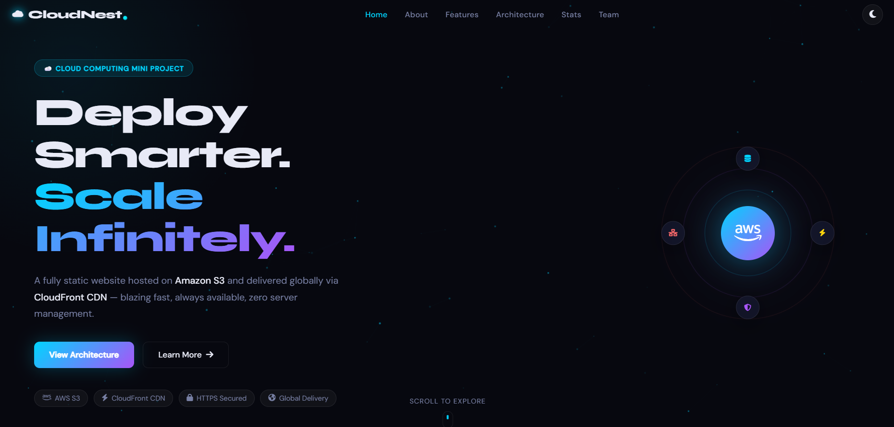
RESULT

Slide 8
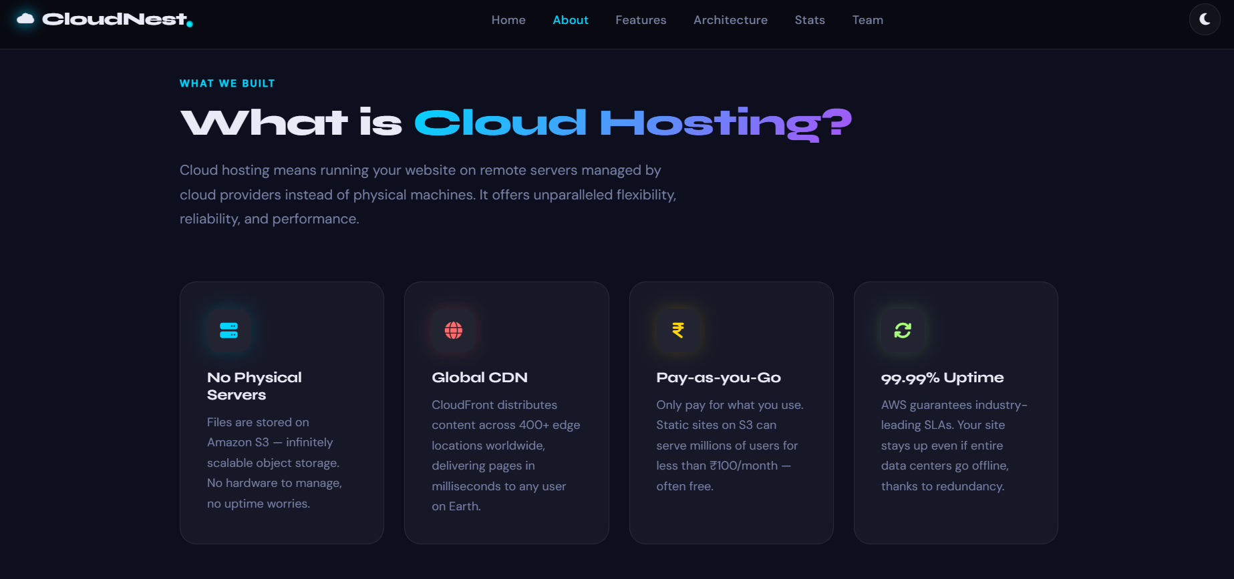

Slide 10
CONCLUSION
The CloudNest project successfully demonstrates the power and efficiency of a serverless, cloud-native approach to web hosting. By integrating core AWS services such as Amazon S3 for storage and Amazon CloudFront for global content delivery, the system provides a highperformance platform that ensures sub-50ms latency and 99.99% uptime. The transition from traditional server-based hosting to a cloud-based infrastructure significantly reduces manual maintenance, lowers operational costs, and eliminates hardware-related bottlenecks.
The project also emphasizes security, reliability, and ease of use. Firebase Authentication ensures secure user access, while role-based control and a user-friendly interface enhance the overall experience. By providing a digital platform for complaint management, the system reduces manual effort and improves accountability. With further enhancements, the system can evolve into a more advanced and scalable solution for real-world applications.

Slide 11
Thank You!!

