Slide 1
LabReportAPI
Secure Lab Report Collection & Transfer System
By:
Om B Suryawanshi
S Vishal Reddy
Sanskruti Rout

Slide 2
Problem Statement – The Old Method
Traditional Lab Report Workflow:
Lab assistants collect patient samples and use diagnostic machines.
Machines display results on screen.
Lab assistant notes data manually into a logbook.
Later, data is manually entered into the HMS.
Problems:
Prone to human error
Time-consuming and inefficient
No digital backup or audit trail

Slide 3
Proposed Solution – LabReportAPI
Machines send report data via TCP/IP to a Middleware PC.
Data is parsed, validated, and cached in memory.
Valid reports are saved to a USB drive in JSON format.
System logs each interaction: USB detection, data reception, validation etc.
Why USB?
HAL servers are isolated from external networks.
USB acts as a secure bridge from untrusted to trusted zones.

Slide 4
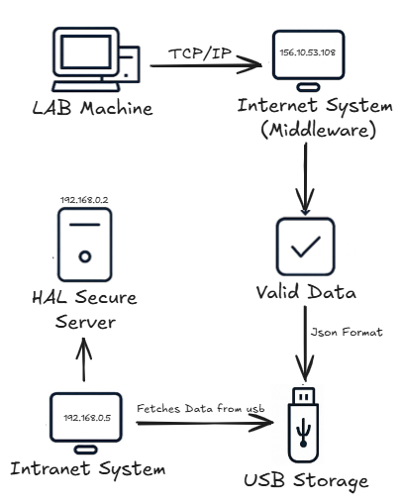
System Architecture

Slide 5
Benefits
No manual data entry
Real-time report ingestion
Secure USB-based transfer
Validation and error logging
Simple frontend monitoring

Slide 6
Future Enhancements
USB encryption and checksum validation
Frontend analytics dashboard

Slide 7
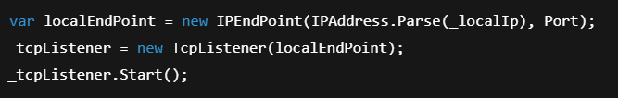
Implementation
TCP Listener(Services/TcpListenerService.cs) - ExecuteAsync
This class inherits BackgroundService and it listens for incoming TCP connections on a specified IP and port.
It runs in the background and listens for TCP clients.
Creates a TCP Listener on given IP and Port.
This is the core of the TCP server- it waits for incoming TCP Clients.
The ExecuteAsync method also calls SaveMessagesToJsonPeriodically, it starts a background task that saves received messages to a Json file if now new messages is received within 30 seconds.

Slide 8
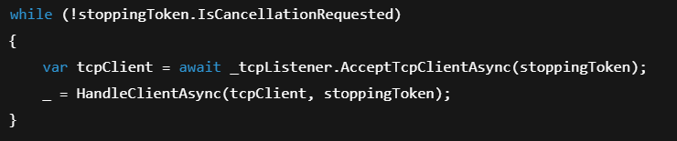

Implementation
The main loop accepts clients until the service is told to stop
It waits for a new client, and then calls HandleClientAsync to process the client asynchronously (without blocking the loop).
This Stops the TCP Listener safely when a shutdown is requested.
Helps avoid corrupted data or hanging connections.

Slide 9
Data Validation
This is also done in TcpListenerService.cs in ProcessMessageBuffer function.
This method is responsible for reading, validating and processing the lab data messages recived from the TCP Client. It takes StringBuilder buffer containing the raw bytes of message data.
It Scans the message buffer to find messages that start with STX(\x02) and end with ETX(\x03) these are special characters which indicate the start and end of a valid message.
If a message is found it extracts the content between STX and ETX.
It performs various checks like Malformed check, valid data check, malicious data check.
And Sends a response to the client like ACK(\0x06) for valid message and NAK(\x15) for invalid or rejected messages.

Slide 10
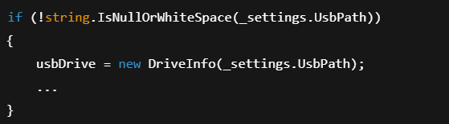

Data Storage(Automatic)
The automatic data storage is done by SaveMessagesToJsonPeriodically which runs in background. It check if the system is idle for 30 seconds, it writes the collected messages to a json file on a USB drive.
It keeps running in background until the service is stopped
It first checks if there is a configured path in appsettings.json.
If not valid then, it scans all drives.
It Finds the first available and ready removable drive (USB).

Slide 11

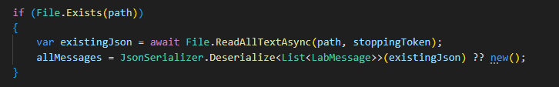

Data Storage(Automatic)
If no USB is found it logs a warning and waits 10 seconds before trying again.
Then it prepares Json file path.
If File exists it reads the old data so it doesn’t overwrite it.
Then it merges new messages with existing ones and writes them all as formatted json
Empties the in-memory message buffer after saving.

Slide 12
API Endpoints
GET /api/labdata/status
Returns the current state of the TCP Listener.
POST /api/labdata/save
Allows a manual trigger to save lab data to the USB.
It calls a method in TCP Listener to save data to the USB immediately
Logs Controller
GET /api/logs
It returns all the logged data from stored in the application.

Slide 13
Thank You
Project: LabReportAPI
GitHub: github.com/Om-Suryawanshi/LabReportAPI
Feel free to ask questions!

