Slide 1

QUIZ GAME
Submitted by:
Om Anand ( T0187CS231149)
SAGAR INSTITUTE OF SCIENCE & TECHNOLOGY, GANDHI NAGAR, BHOPAL

Slide 2
Index
Introduction
Software & Hardware Requirement
Problem Description
Implementation
Result
Conclusion
References

Slide 3
Introduction
Welcome to the Quiz Game project, a simple and interactive console-based application developed in C. This project aims to provide an engaging platform for users to test their knowledge on various topics through a series of multiple-choice questions.

Slide 4
Software & Hardware Requirement
Software Requirements: C Compiler: For compiling the code. Git: To clone repo and version control. Terminal/Command Prompt: To run commands.
Hardware Requirements: Computer: A desktop or laptop . Memory (RAM):A minimum of 2GB RAM. Storage: Ensure sufficient free storage space.

Slide 5
Problem Description
Many beginners encounter difficulties in transitioning from theoretical understanding to practical application in the realm of programming. The lack of interactive tools that reinforce learning through immediate feedback and user engagement contributes to this challenge. Aspiring programmers need a platform that not only tests their knowledge but also provides a real-time assessment of their understanding, fostering a more effective learning process.

Slide 6
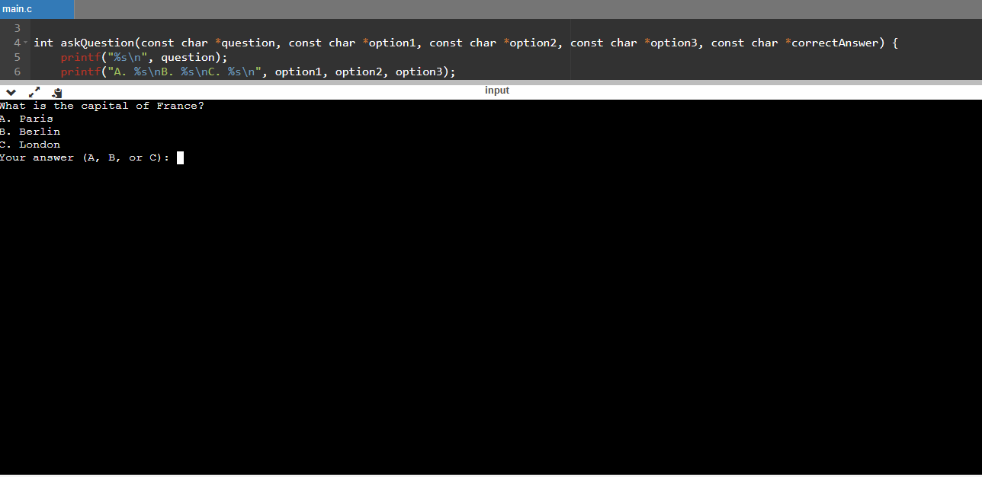
Result

Slide 7
Conclusion
In conclusion, the Quiz Game project represents a valuable step towards enhancing the learning experience for aspiring programmers. By combining interactive elements, immediate feedback, and a scoring system, this project addresses the challenges often faced by beginners in transitioning from theory to practical application.

Slide 8
References
Google.com
Github.com

Slide 9
THANK YOU

