Slide 1

JobHunt
A Comprehensive Job Searching and Hiring Platform
Submitted by:
Jyotirmaya Panda (RegNo:2241016085)
Saranya Rout (Reg No: 2241018168)
Abhisek Sahoo (RegNo:2241019023)
Om Suryakanta Panda (RegNo: 2241016091)
In partial fulfillment for the award of the degree of
BACHELOR OF TECHNOLOGY IN COMPUTER SCIENCE & INFORMATION TECHNOLOGY

Slide 2

Project Overview: JobHunt
Jobhunt is a comprehensive web-based job searching and hiring platform designed to bridge the gap between job seekers and recruiters by providing a secure, efficient, and user-friendly recruitment environment. Built using the MERN stack (MongoDB, Express.js, React.js, and Node.js), the platform enables seamless job posting, application management, and profile handling through a modern single-page application. Role-based access ensures structured interaction for job seekers, recruiters, and administrators, while JWT-based authentication and encrypted credentials maintain data security and user privacy
The platform focuses on improving recruitment efficiency by offering advanced job search and filtering, real-time application tracking, and responsive UI design using Tailwind CSS. Recruiters can manage job listings and review applications through dedicated dashboards, while candidates can monitor application status transparently. InLinked reduces recruitment friction, enhances user experience, and provides a scalable foundation for future enhancements such as AI-based job matching, video interviews, and mobile application support

Slide 3
Addressing Recruitment Challenges
In the modern recruitment landscape, several critical challenges impact the efficiency and reliability of hiring platforms. Inefficient application tracking often leaves job seekers without timely feedback and burdens recruiters with unorganized applicant data. Data security is another major concern, as sensitive personal and professional information is frequently vulnerable to misuse or unauthorized access. Additionally, poor user experience caused by cluttered interfaces makes navigation difficult for users, while the lack of real-time updates results in outdated job listings and delayed application status information. Together, these issues create frustration for both job seekers and recruiters, highlighting the need for a secure, intuitive, and real-time recruitment solution.
Inefficient Tracking
Data Security
Candidates rarely receive feedback on application status.
Personal data is often mishandled on generic platforms.
Poor User Experience
Lack of Real-time Updates
Cluttered interfaces hinder navigation for non-tech-savvy users.
Jobs remain listed even after being filled, wasting time.

Slide 4
Project Objectives
The primary objective of this project is to develop a modern and efficient job searching and hiring platform that simplifies the recruitment process for both job seekers and recruiters. The system aims to provide a user-friendly interface that ensures easy navigation and accessibility, even for non-technical users. It incorporates secure authentication mechanisms to protect user data and maintain privacy through reliable authorization techniques. The project also focuses on building a responsive and scalable backend capable of handling multiple concurrent requests efficiently, along with real-time data management to ensure instant updates of job postings and application statuses, thereby improving transparency and overall recruitment efficiency.
1
User-Friendly Interface
2
Secure Authentication
Design with ReactJS and TailwindCSS for simplified navigation for both recruiters and applicants.
Implement JWT (JSON Web Tokens) to protect user data and sessions.
3
Responsive Backend
4
Real-time Data Management
Create with NodeJS and Express to handle concurrent requests efficiently.
Utilize MongoDB for instant updates on job postings and application statuses.

Slide 5
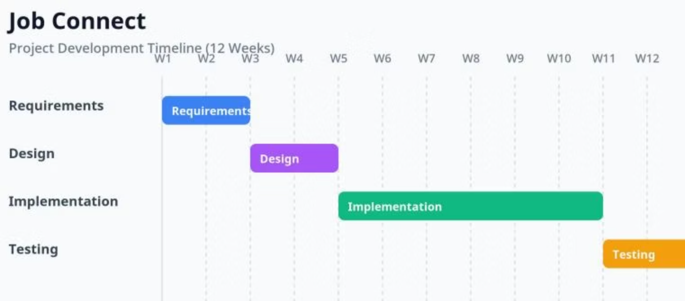
Project Development Timeline
The project development followed a well-defined timeline starting with requirement analysis and planning, followed by system and UI design. This was succeeded by frontend and backend
implementation using the MERN stack, along with database integration. The project then underwent testing and debugging to ensure functionality, security, and performance, and concluded
with final deployment, documentation, and evaluation of future enhancements.
Requirements
W1
W3
Design
W3
W5
Implementation
W5
W11
Testing
W11
W12

Slide 6
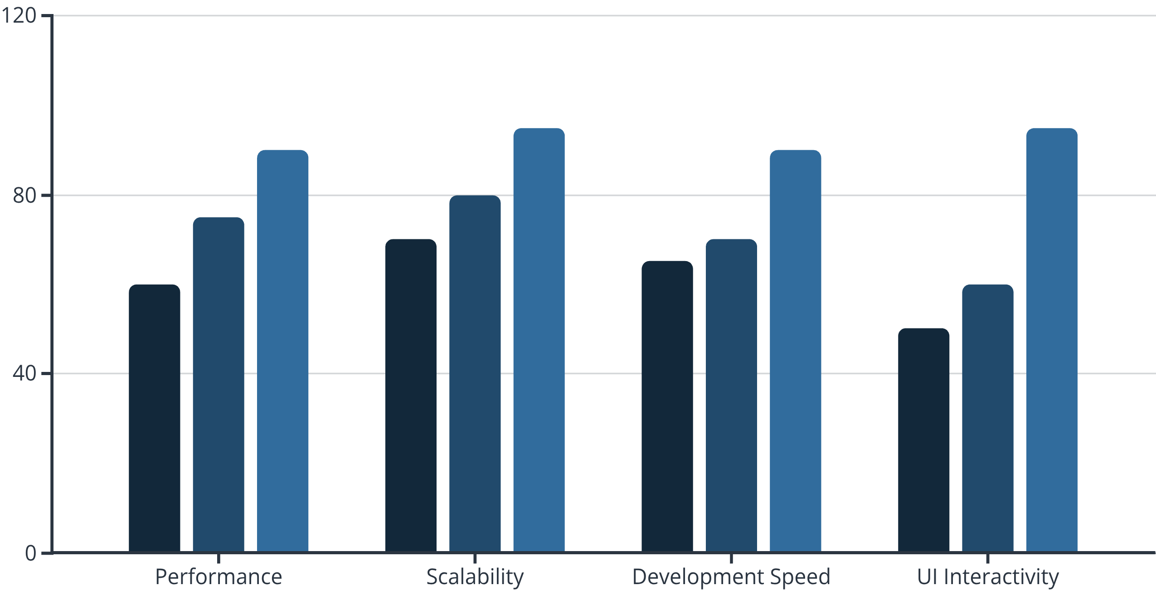
Technology Stack Selection
After evaluating several architectural approaches, the MERN stack was selected for its unified JavaScript environment, high performance, and seamless data flow.
LAMP Stack
Django/SQL
MERN Stack
The MERN stack (MongoDB, Express, React, Node) offers excellent real-time capabilities and client-side UI interactivity, making it ideal for a dynamic job portal.

Slide 7

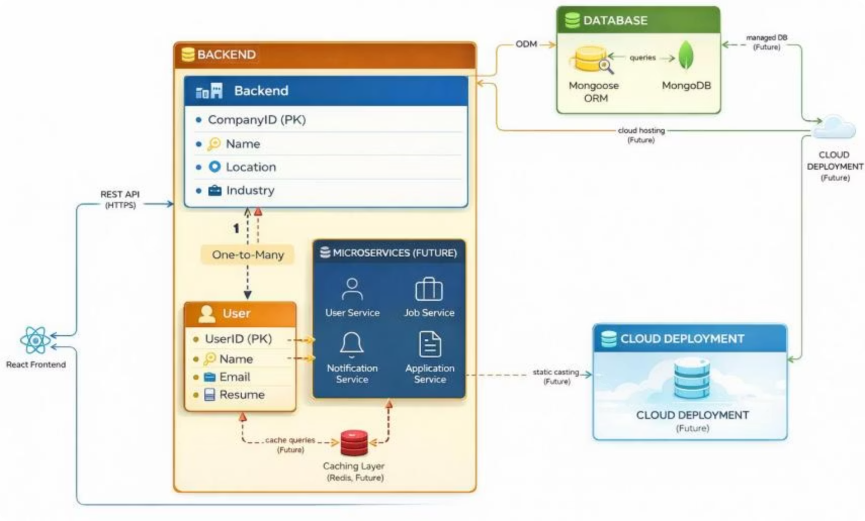
System Architecture
The system follows a three-tier architecture consisting of the presentation layer, application layer, and data layer. The presentation layer is built using React.js and Tailwind CSS to provide a responsive and user-friendly interface. The application layer uses Node.js and Express.js to handle business logic, authentication, and RESTful API communication. The data layer is managed by MongoDB, which stores user profiles, job listings, and application data, enabling real-time updates and ensuring secure, efficient data flow across the platform.
Presentation Layer
Application Layer
Built with ReactJS and TailwindCSS for a responsive user interface.
Built with NodeJS and Express, handling business logic and API requests.
Data Layer
Utilizes MongoDB for flexible, schema-less data storage.

Slide 8
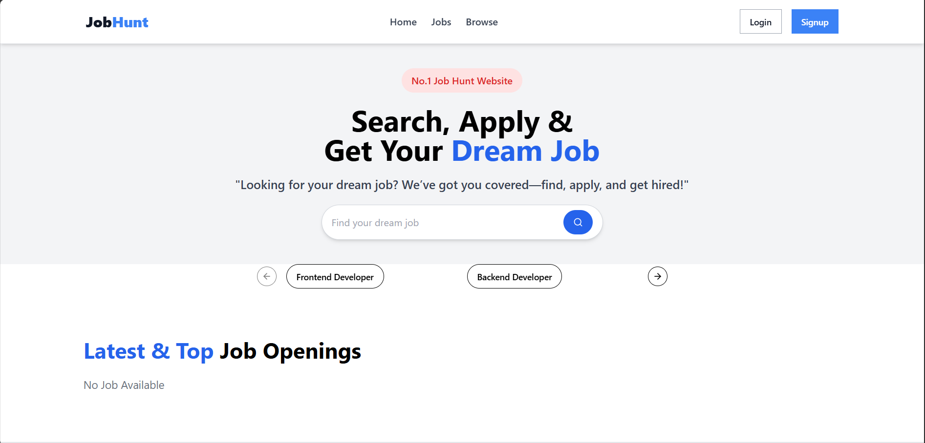
Database Design & UI/UX
The system uses MongoDB with key collections such as Users for applicant and recruiter profiles, Jobs for job details, and Applications to link users
with jobs and track application status. The Entity–Relationship Diagram represents the relationships between these entities. Tailwind CSS is used for
UI development, following a mobile-first approach to ensure a responsive and user-friendly experience across all devices.
Key Collections
Users: Stores applicant and recruiter profiles.
Jobs: Contains job details like title, description, and requirements.
Applications: Links users to jobs with application status.
The Entity-Relationship Diagram illustrates the relationships between these core entities.
UI/UX Design
TailwindCSS enables rapid UI development with a focus on "Mobile First" responsiveness, ensuring optimal experience across all devices.

Slide 9




Software Features & Working
The platform provides secure authentication for users, advanced job search and filtering for candidates, and job posting features for recruiters.
An integrated application dashboard allows job seekers to track application status in real time while enabling recruiters to efficiently manage and
review applications.
Authentication
Job Search & Filter
Provides secure user registration and login using encrypted passwords
and token-based authentication, ensuring data privacy and role-based
access for job seekers and recruiters.
Allows candidates to search jobs using keywords, location, and job type filters, helping them quickly find roles that match their skills and preferences.
Job Posting
Application Dashboard
Enables authorized recruiters to create, update, and delete job listings, ensuring only verified employers can post opportunities.
Offers a centralized dashboard where candidates can track application
status, and recruiters can review and manage received applications efficiently.
The process involves user registration/login, token generation, job browsing, and application submission, with the backend verifying tokens and updating MongoDB records.

Slide 10

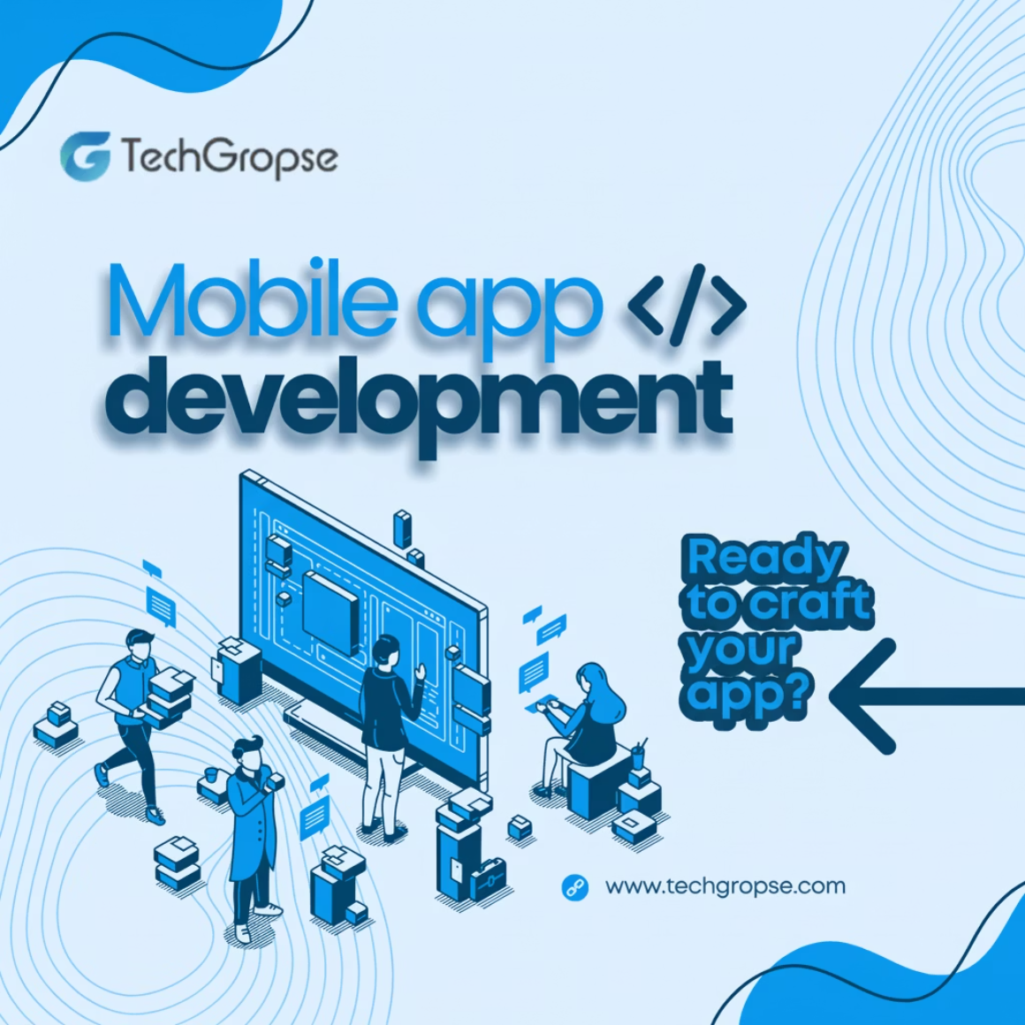
Conclusions & Future Scope
The project successfully delivered a secure, scalable, and user-friendly job searching and hiring platform that streamlines recruitment by improving application tracking, transparency, and overall user experience.
By effectively utilizing the MERN stack, the system demonstrates efficient performance, real-time data handling, and secure authentication. In the future, the platform can be enhanced by integrating AI-based job
recommendations, resume parsing, in-platform video interviews, mobile application support, and social profile integration to further modernize and expand its recruitment capabilities.
Key Achievements
Future Enhancements
Deep insights into MERN stack architecture.
AI-Based Matching: Implement ML algorithms for resume parsing and job recommendations.
Simplified application tracking, addressing a major pain point.
Video Interviews: Integrate WebRTC for in-platform video interviews.
Efficient performance with low latency due to NodeJS.
Mobile App: Develop a React Native application for on-the-go access.
Social Integration: Allow profile imports from LinkedIn or GitHub.

