Slide 1



SMART INDIA HACKATHON 2026
TITLE PAGE
Problem Statement ID – SIH26107
Problem Statement Title- Al-powered Intelligent Assistant for Indian Standards and BIS Services for Industries and Consumers
Theme- Smart Automation
PS Category- Software
Team ID-
Team Name - Jagruk Swadesh

Slide 2
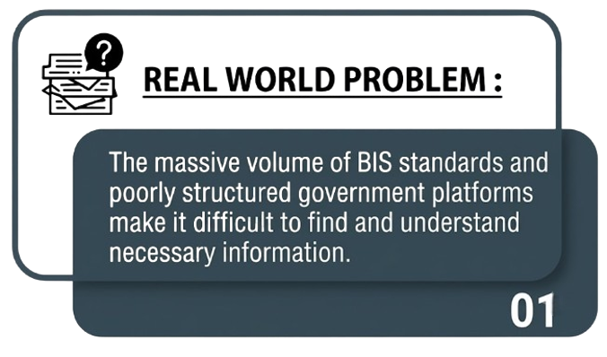

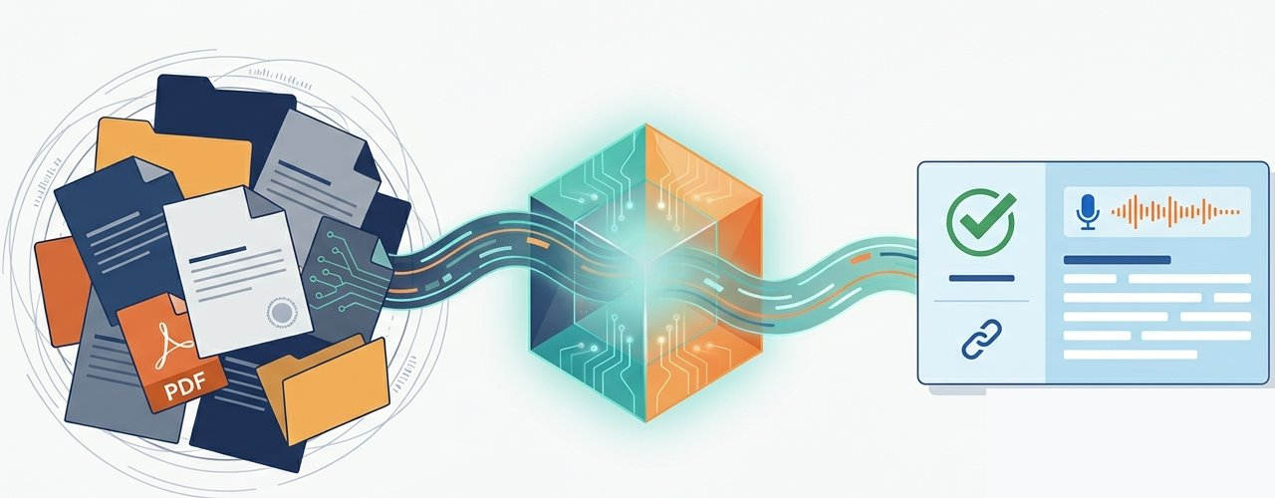
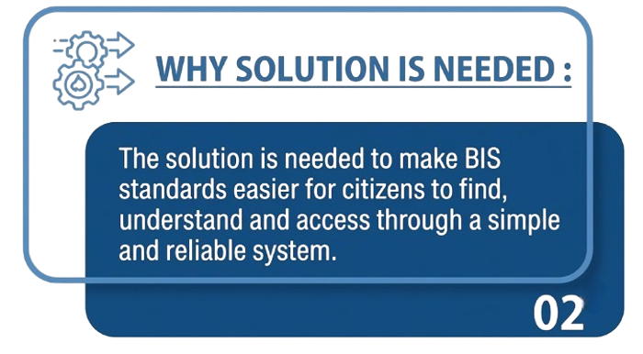
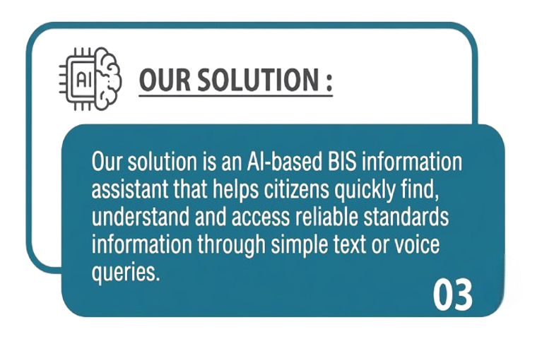

AI-Automated Chatbot For
Bureau of Indian Standards
Unstructured Data
Agentic AI pipeline
Structured Response
“Pressure Cooker” → product context → BIS testing and certifications
Project report
REPORT
Prototype
VIDEO

Slide 3
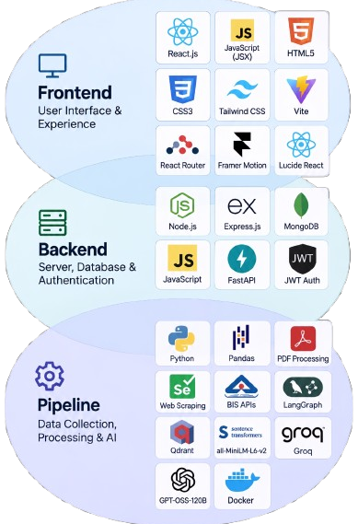
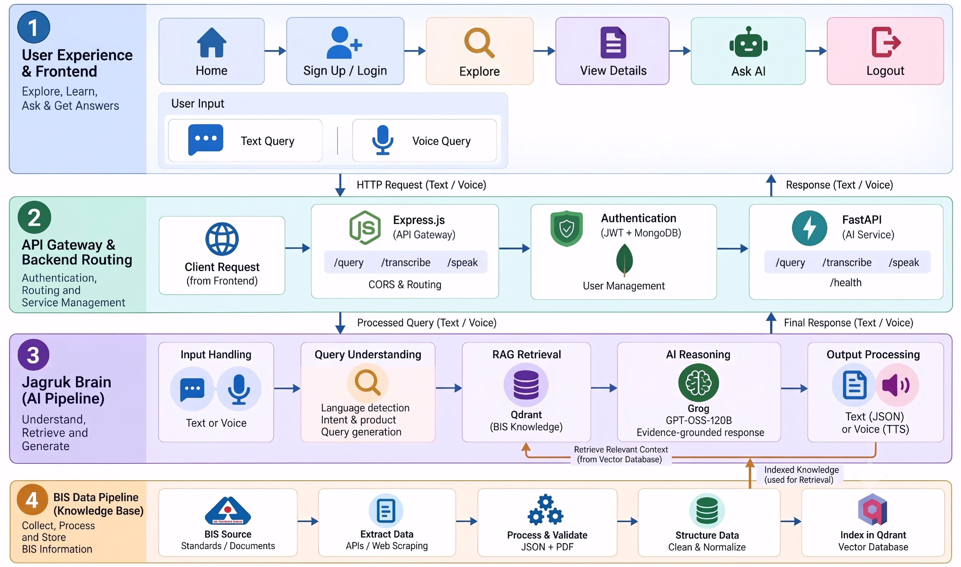
TECHNICAL APPROACH
TECH STACK
WORK FLOW DIAGRAM

Slide 4
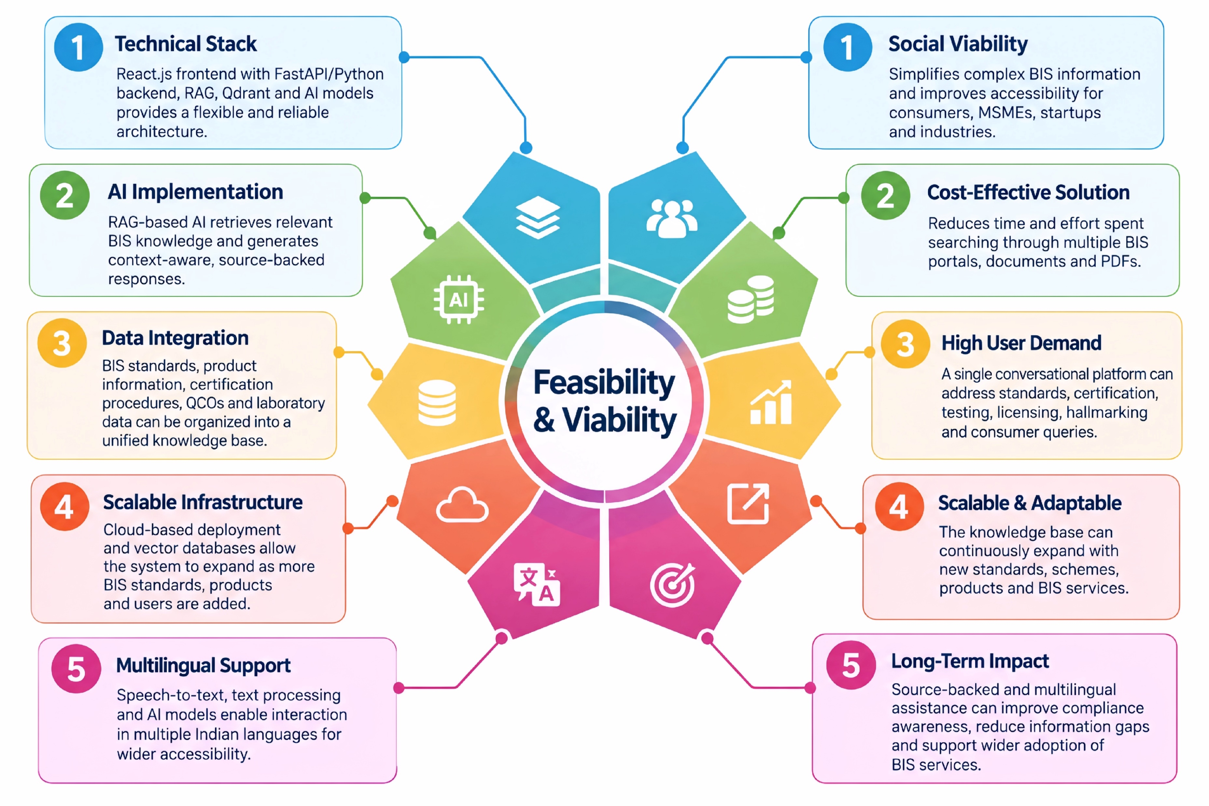
FEASIBILITY AND VIABILITY

Slide 5
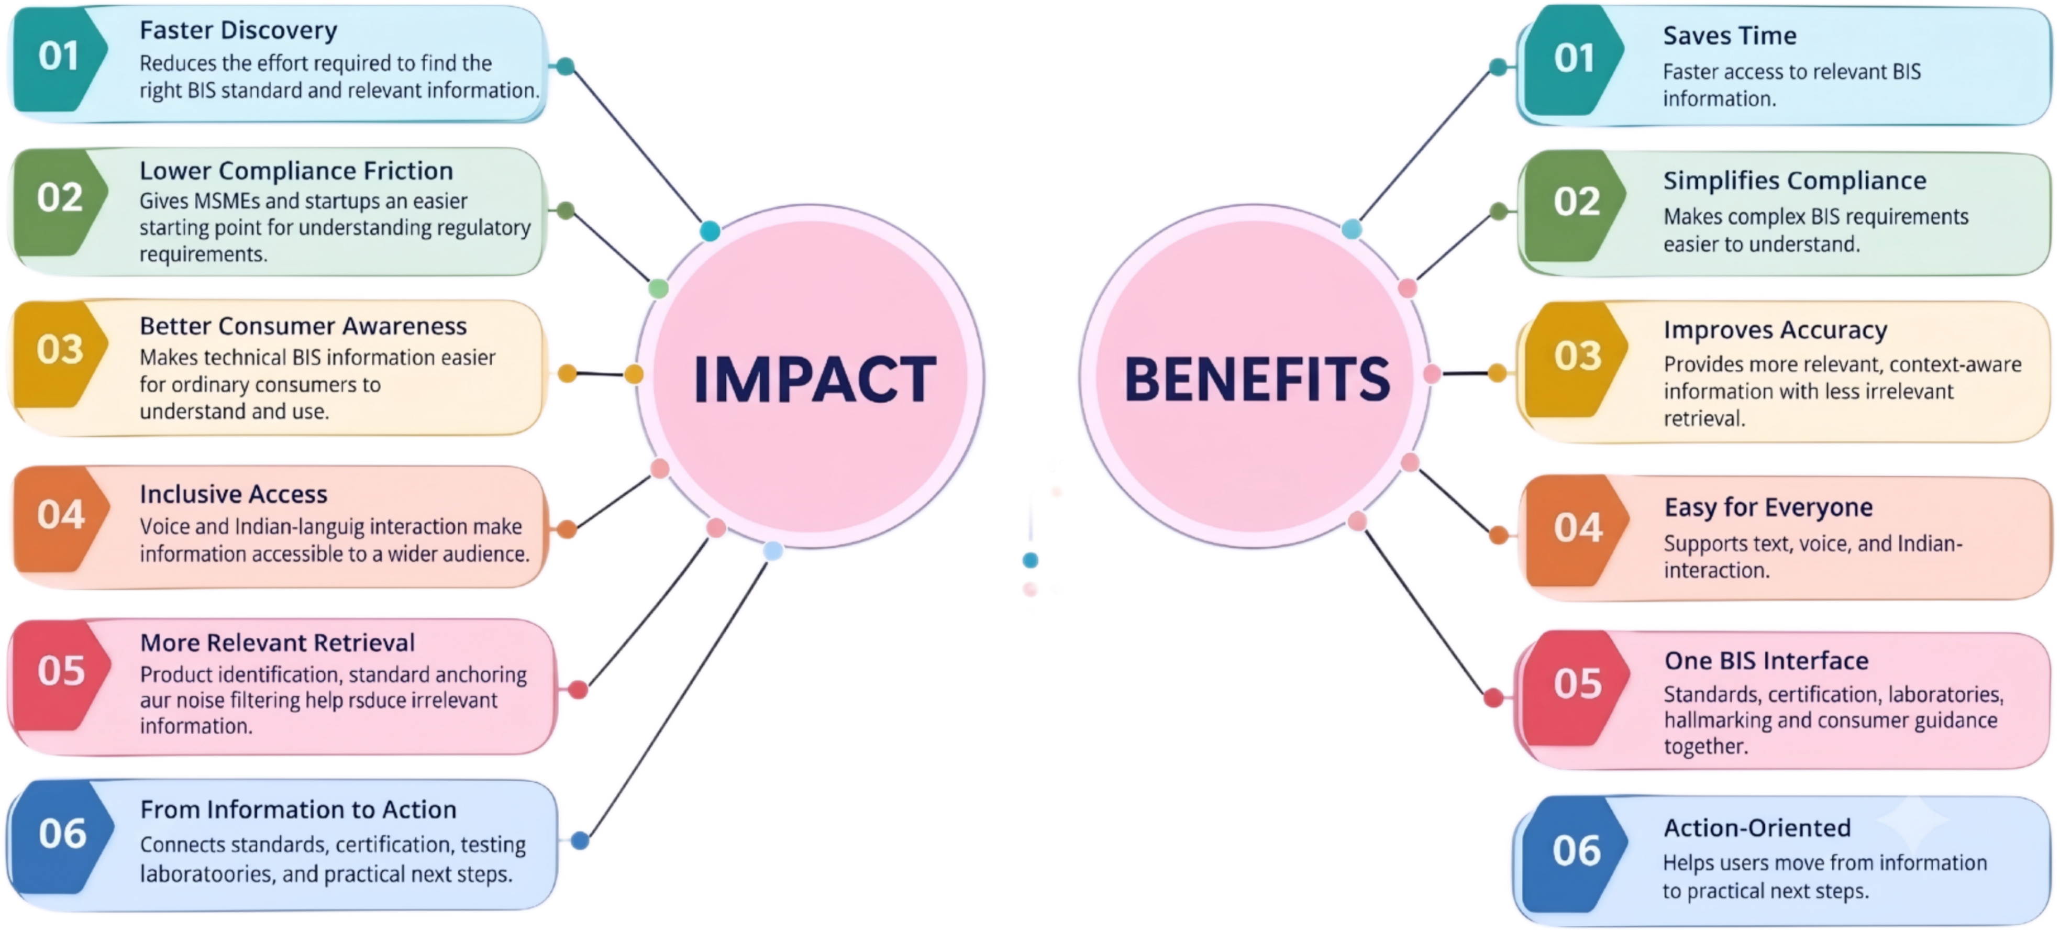


IMPACT AND BENEFITS

Slide 6
RESEARCH AND REFERENCES
BIS Official Website
Standards, certification,
hallmarking and other services.
🔗 bis.gov.in
Article 1
the-bureau-of-indian-standards-has-a-design-problem-so-does-india
🔗 Article Link
Research
Graph
Data insights and
analysis of BIS services
and user trends.
🔗 Graph Link
Beyond BIS
Information on BIS services,
initiatives and resources.
🔗 Beyond BIS
Article 4
the-case-for-ai-in-citizen-services.
🔗 Article Link
BIS Care App
Grievance redressal and
consumer support services.
🔗 BIS Care
Article 2
ux-in-indian-government-websites-where-function-meets-friction.
🔗 Article Link
Research Document
Explainer video on BIS
services, standards and
certification.
🔗 Document Link
Know Your Standard
Search Indian Standards
by product, keyword or IS number.
🔗 Know Your Standard
Article 5
building-trust-and-sustaining-government-through-generative-ai
🔗 Article Link
e-BIS
Access to e-services,
licenses and certification.
🔗 ebis.gov.in
Article 3
ux4g-design-system-building-a-design-system-for-the-government
🔗 Article Link

