Slide 1
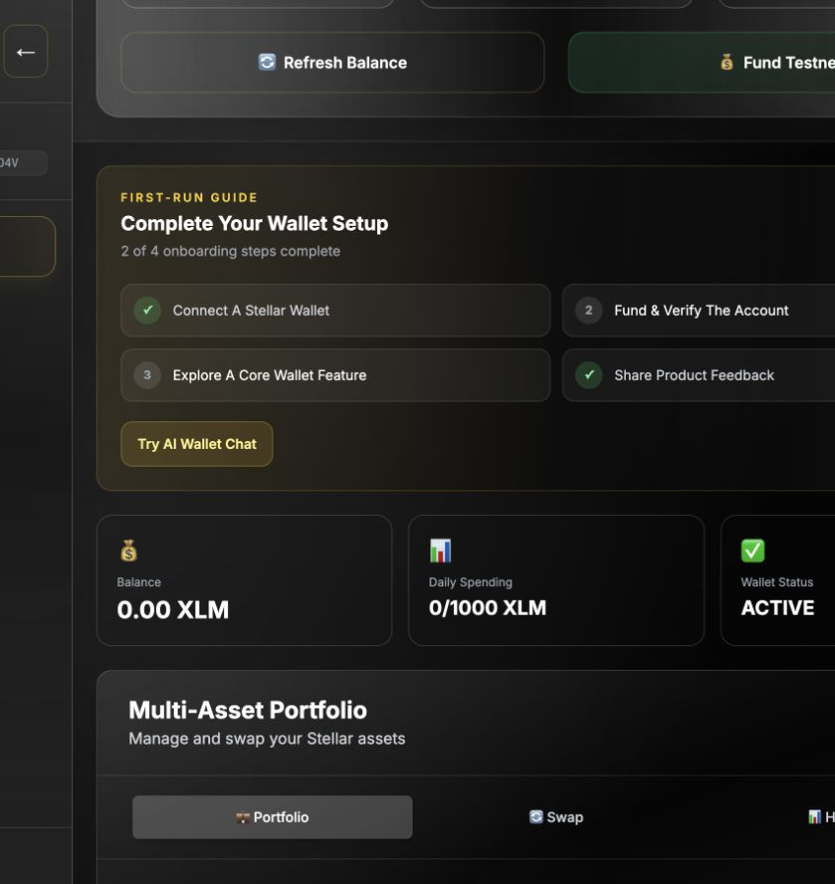
STELLAR · LEVEL 5
AI Wallet
Manager
Natural-language wallet actions with on-chain spending guardrails.
Pitch · Product iteration · Growth validation
Notes:
Open with the product promise: make Stellar actions understandable without removing user control.
[Sources]
- /Users/neelsubhashpote/om ingle/docs/screenshots/04-desktop-dashboard.png

Slide 2
PROBLEM AND SOLUTION
Wallet power is high; everyday clarity is low
THE FRICTION
THE RESPONSE
Addresses and fees intimidate new users
Plain-English commands with explicit confirmations
Security rules are scattered across interfaces
Soroban spending limits and wallet freeze controls
Transaction proof is hard to package for reviews
Ledger-linked activity evidence and CSV export
02
Notes:
[Sources]
- /Users/neelsubhashpote/om ingle/README.md
- /Users/neelsubhashpote/om ingle/components/ChatInterface.tsx
- /Users/neelsubhashpote/om ingle/components/pages/ActivityProof.tsx

Slide 3
PRODUCT EXPERIENCE
A guided flow moves users from connection to proof
01
02
03
Connect safely
Act with confidence
Verify on-chain
Freighter or generated testnet account
Chat, send, swap, contacts and limits
Explorer links, analytics and evidence CSV
03
Notes:
[Sources]
- /Users/neelsubhashpote/om ingle/components/WalletLoginForm.tsx
- /Users/neelsubhashpote/om ingle/components/OnboardingChecklist.tsx
- /Users/neelsubhashpote/om ingle/components/pages/ActivityProof.tsx

Slide 4
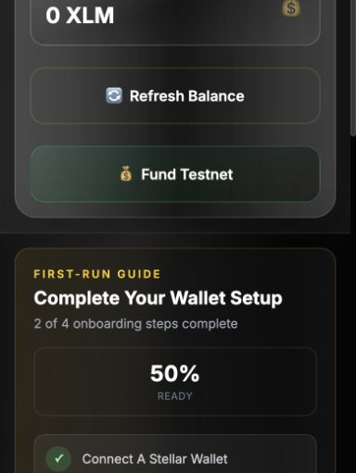
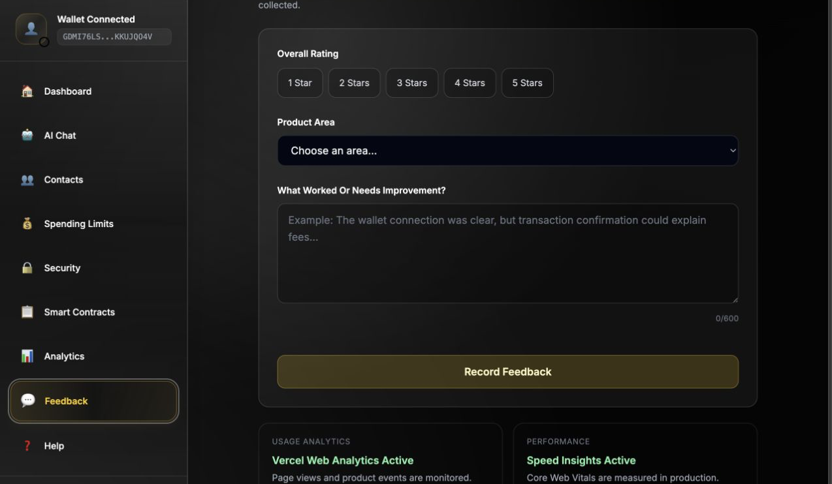
PRODUCT WALKTHROUGH
One responsive workspace carries the user journey
04
Notes:
[Sources]
- /Users/neelsubhashpote/om ingle/docs/screenshots/03-mobile-dashboard.png
- /Users/neelsubhashpote/om ingle/docs/screenshots/05-feedback-monitoring.png

Slide 5
TECHNICAL ARCHITECTURE
The architecture separates experience, policy and settlement
Next.js interface
Typed API layer
Soroban policy
Stellar testnet
→
→
→
Responsive UI · onboarding · analytics
AI parsing · Horizon · transaction orchestration
Limits · freeze state · contact controls
Horizon + Soroban RPC · immutable settlement
05
Notes:
[Sources]
- /Users/neelsubhashpote/om ingle/README.md
- /Users/neelsubhashpote/om ingle/app/api/stellar
- /Users/neelsubhashpote/om ingle/contracts

Slide 6
CURRENT PROOF
The deployed MVP is independently auditable
9
2
54
confirmed contract deployment and configuration transactions
deployed Soroban contracts on Stellar testnet
automated JavaScript tests after the Level 5 activity-proof release
Wallet Guard · CBLWI…G7DQ
Multi Asset Manager · CAVY…4CXD
06
Notes:
[Sources]
- /Users/neelsubhashpote/om ingle/deployments/testnet.json
- /Users/neelsubhashpote/om ingle/__tests__

Slide 7
MARKET OPPORTUNITY
The opportunity is the usability layer above on-chain finance
Start narrow
Expand through use cases
Create an ecosystem layer
Stellar testnet builders and first-time wallet users who need a safe guided experience.
Freelancer payments, small-team treasury controls and reusable wallet policy tooling.
A composable interface where AI explains intent and Soroban enforces policy.
Market sizing will be quantified only after the 50-wallet study establishes acquisition and retention baselines.
07
Notes:
No unsupported market-size figures are used; the slide frames the beachhead and expansion logic.
[Sources]
- /Users/neelsubhashpote/om ingle/docs/USER_FEEDBACK_SUMMARY.md

Slide 8
GROWTH STRATEGY
Growth becomes a measurable product-learning loop
01
Acquire
Developer communities, campus groups and Stellar ecosystem demos
02
Activate
Five-step onboarding with a funded wallet and first verified action
03
Learn
Rating, friction theme, requested feature and transaction evidence
04
Retain
Saved contacts, spending policies, activity history and follow-up releases
08
Notes:
[Sources]
- /Users/neelsubhashpote/om ingle/components/OnboardingChecklist.tsx
- /Users/neelsubhashpote/om ingle/components/pages/Feedback.tsx
- /Users/neelsubhashpote/om ingle/components/pages/ActivityProof.tsx

Slide 9
ROADMAP AND ASK
The next release is driven by observed behavior—not guesses
Now
Next
Then
50-wallet validation
Friction-led iteration
Ecosystem exposure
Real interactions, 2–3 minute cadence, feedback baseline
Ship the highest-frequency onboarding and transaction fixes
Demo video, partner presentations and repeat-usage cohort
Live product: omyaingle.vercel.app
GitHub: Om12345-ingle/ai-wallet-manager
09
Notes:
Close with the immediate ask: recruit genuine test users and record the observed results.
[Sources]
- /Users/neelsubhashpote/om ingle/README.md
- /Users/neelsubhashpote/om ingle/docs/DEMO_SCRIPT.md

