Slide 1

Project Title - Healthcare Analytics for Doctor Visits
Om Chandrakant Bagal
COEP Technological University, Pune
TIRTC Programme

Slide 2

PROBLEM STATEMENT
Most people never see a doctor in this dataset, and a few go many times. Of 5,190 people, 79.8% had no visit and the heaviest user had 9. The raw records do not say which health, income, age or coverage factors go with more visits.
I analyse the patient records to find patterns in doctor visits. I also check which factors still matter once the others are held fixed, and which only looked important because they overlap with something else.
why do some people visit a doctor more often than others?

Slide 3
Project Description
Which factors go with more doctor visits among 5,190 people?
Data: 5,190 people and 13 columns: doctor visits, gender, age, income, illnesses, lost activity days, health score, private and free cover, and two chronic-condition flags. Nothing was missing or duplicated, so I changed no records.
Outcome: 79.8% had no visit and 20.2% had at least one. Most values are zero, so the main outcome is the share who visited at least once.
Method: chi-square and Mann-Whitney tests for group differences, Spearman correlation, and a logistic regression that holds all variables fixed together.
Results: illness count, lost activity days and health score matter most and stay significant after adjustment. Women visit more. Free-repatriation cover goes with more visits. The chronic-condition gap shrinks once illness is held fixed.
Deliverables: the Jupyter notebook with code and charts on GitHub, plus this deck.

Slide 4

WHO ARE THE END USERS?
Health insurers: see which groups use doctors more and plan coverage around them.
Hospital and clinic managers: plan staff and appointment slots for groups that visit often.
Public health planners: focus outreach on groups with several illnesses or many lost activity days.
Students and researchers: a worked example of analysing zero-heavy count data and checking overlapping factors.

Slide 5

Technology Used
Python 3: loading, checks and analysis
Pandas and NumPy: data handling, grouping and summaries
Matplotlib and Seaborn: charts and the correlation heatmap
SciPy: chi-square, Mann-Whitney and Spearman tests
Statsmodels: logistic regression for the adjusted analysis
Jupyter Notebook and GitHub: code others can rerun
Microsoft PowerPoint: presentation

Slide 6
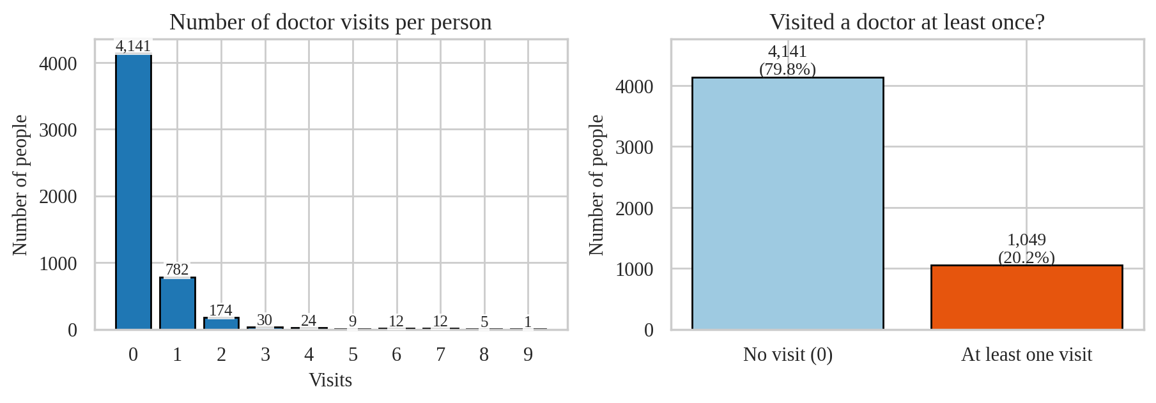
RESULTS 1: Data and Visit Pattern
79.8% of people had no doctor visit. A few heavy users account for a large share of all visits.
5,190 people, 13 columns, 0 missing values, 0 duplicate rows. I did no cleaning.
Mean 0.30 visits, maximum 9. 1,049 people (20.2%) visited at least once and averaged 1.49 visits.
93 people (1.8%) made 3 or more visits. They account for 436 of the 1,566 visits (27.8%).

Slide 7
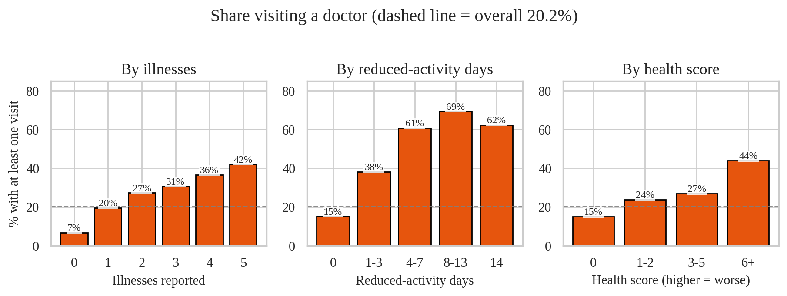
RESULTS 2: Health Indicators
More illnesses, more lost activity days and a worse health score all go with more visits.
Share visiting: 6.8% with 0 illnesses, 41.9% with 5. 15.2% with no lost activity days, 69.4% with 8-13 days.
Spearman correlation with visits: lost days 0.34, illnesses 0.26, health score 0.18 (all p < 0.001).
Age and income links are weaker: 14.7% visited at 25 or under vs 30.2% at 66+; 25.6% in the lowest income quartile vs 15.7% in the highest.

Slide 8
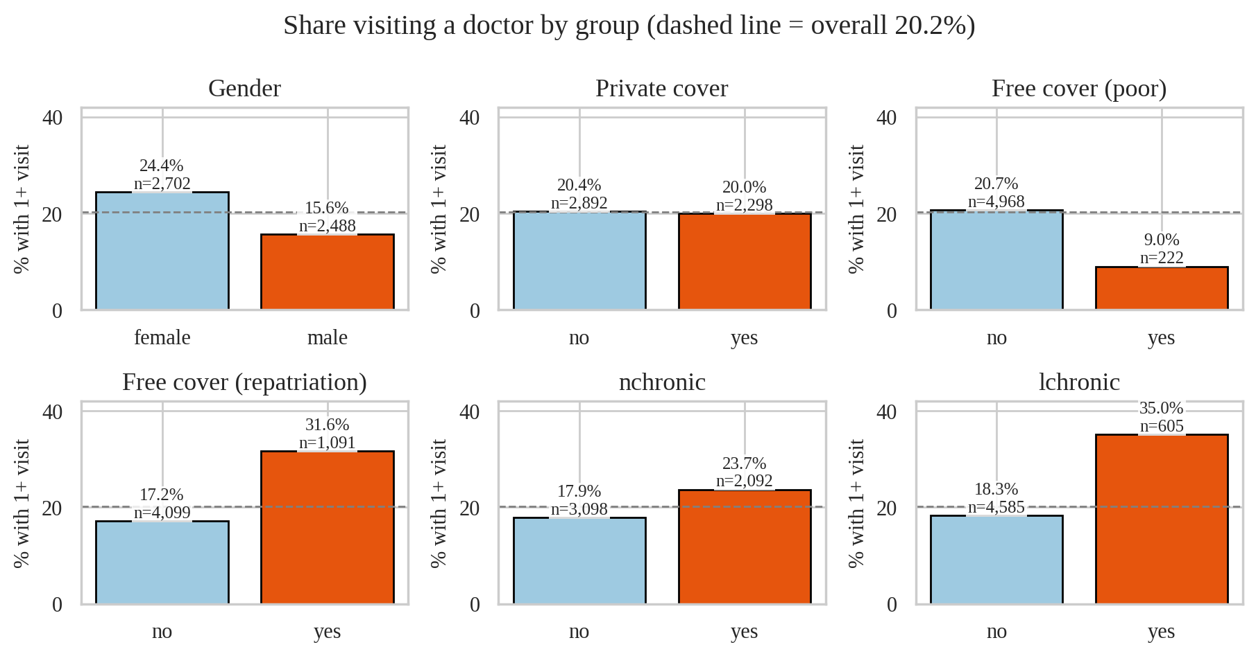
RESULTS 3: Gender, Coverage, Chronic Groups
Women, people with free-repatriation cover and people with a limiting chronic condition visit more. Private cover shows no difference.

Slide 9
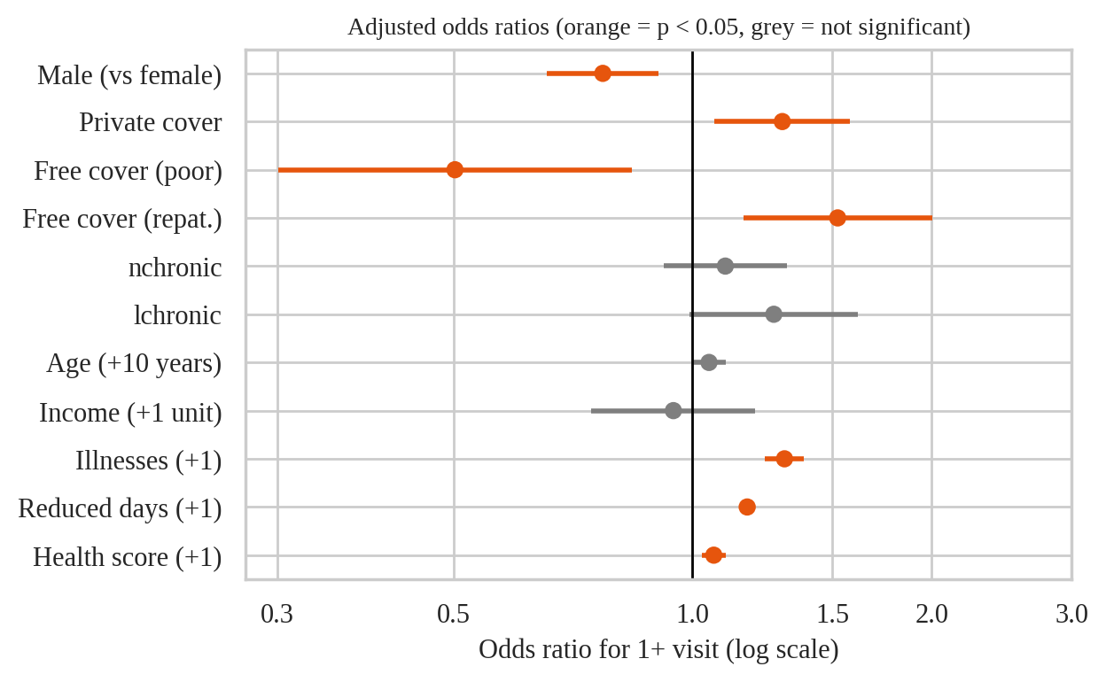
RESULTS 4: Adjusted Analysis
With all variables held fixed together, health measures, gender and coverage type still go with visits.
Still significant: illness (odds ratio 1.31 per illness), lost days (1.17 per day), health score (1.06), male (0.77), free-repatriation cover (1.52), free-poor cover (0.50, only 222 people).
Weaker: the chronic-limitation gap falls from 35.0% vs 18.3% to an odds ratio of 1.27 (p = 0.059). Age and income lose significance.
Private cover: no raw gap, but an odds ratio of 1.30 after adjustment. Treat with caution.
Health measures give the clearest signal: illness, lost activity days and health score.
The model explains little (pseudo R-squared 0.13). Most of what decides who visits is not in this data.
Odds ratios compare people who differ by one illness, one lost day, one score point or 10 years of age.

Slide 10
Limitations, Future Scope
Limitations
One snapshot of data, so the results show associations and no cause can be proven.
The guide does not state the period behind 'visits' or the units of age and income. I assumed age = years / 100.
Free-poor cover covers only 222 people, so its estimate is uncertain. Most visit counts are zero.
Future scope
Fit a count model built for many zeros (zero-inflated Poisson or negative binomial).
Add cost, diagnosis and access-to-care data, and confirm the variable definitions with the data owner.
Build a dashboard where planners filter by age, health and coverage group.
Github link :- https://github.com/Om777-Stack/Healthcare-Analytics-Doctor-Visits

