Slide 1

Project Title - Seasonal Agriculture Performance Analysis
[Student Name – Om Chandrakant Bagal
College Name- COEP Technological University]
AICTE STU ID : STU698271eec6e021770156526

Slide 2

PROBLEM STATEMENT
(Agricultural activities are influenced by seasonal variations in environmental conditions, farming practices, resource availability and market conditions. As a result, agricultural performance may differ from one season to another.
However, raw agricultural data does not clearly explain how agricultural performance changes across seasons or what patterns can be observed in different seasonal conditions.
The problem is to analyze the given agricultural dataset and investigate seasonal differences in agricultural performance by identifying meaningful patterns, trends, relationships and variations within the available data. )

Slide 3
Project Description
This project analyzes 4,000 farm records collected across eight Indian states, covering three agricultural seasons: Kharif, Rabi, and Zaid. Each record includes farming conditions such as rainfall, temperature, soil pH, and irrigation type, along with performance outcomes: yield, production, cost, revenue, and profit.
The objective was to determine how much of a farm's performance is actually explained by season, as opposed to crop type or irrigation method. Rainfall and temperature differ between Kharif and Rabi, but the extent to which this affects yield and profit required verification through the data rather than assumption.
Before any comparison could be made, the dataset required cleaning. Rainfall, soil moisture, and yield contained missing values, and the yield column contained an outlier reaching 101 tonnes per hectare against an average of approximately 5, which required correction before further analysis.
The analysis then proceeded season by season: yield, cost, and profit were compared across Kharif, Rabi, and Zaid; irrigation method was examined for its effect on water efficiency within each season; and disease and pest risk were evaluated to determine whether they correlate more strongly with season or with crop type.
The resulting analysis provides a season-wise breakdown of farm profitability, identifying the specific patterns and outliers that season-level averages alone would not reveal.

Slide 4

WHO ARE THE END USERS?
The primary users of the information in the report are farmers and agricultural cooperatives. The information on seasonal comparisons in the report helps the farmers to choose what to plant and what irrigation system to adopt based on actual results in similar conditions instead of using the default options.
State Agricultural Departments can use the information on yield and profit trends to determine the allocation of subsidies or issue guidelines to growers on what to plant in particular areas depending on the season.
Agri-input dealers can use the information on the usage of resources in the report to plan what to stock depending on the season and the area.
Extension agents and agricultural scientists can use the findings in the report on the relationships between environmental conditions and agricultural yields as a lead for further field experiments.

Slide 5

Technology Used
  Python 3 - core language for data loading, cleaning and analysis
Pandas and NumPy - data manipulation, grouping, aggregation and statistics
Matplotlib and Seaborn - univariate, bivariate and multivariate visualizations (histograms, boxplots, heatmaps, pair plots)
Jupyter Notebook - documented, reproducible end-to-end analysis workflow
Microsoft PowerPoint - project submission and results presentation

Slide 6
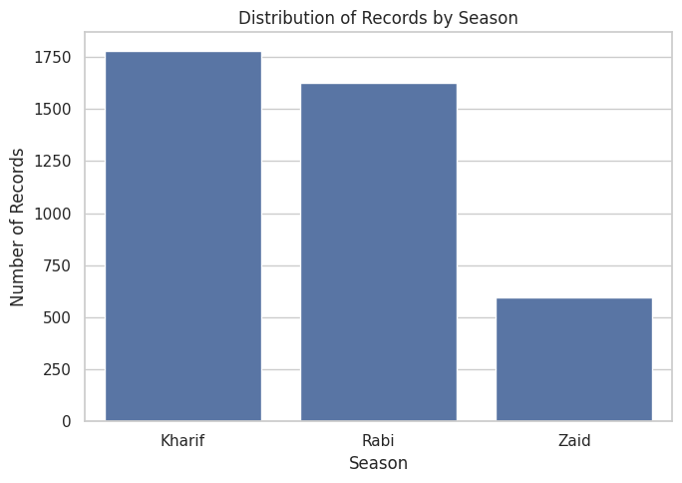
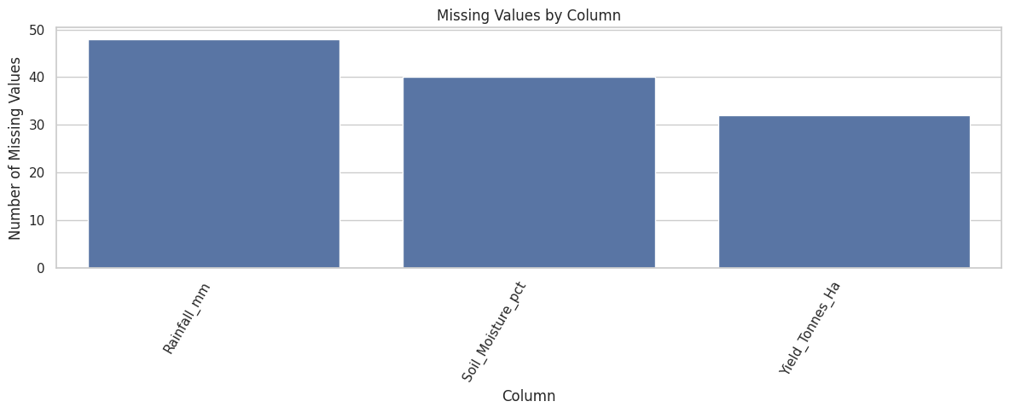
RESULTS
Data Quality
3 columns had missing values (max 1.2%) and 0 duplicate rows were found across 4,000 records.

Slide 7
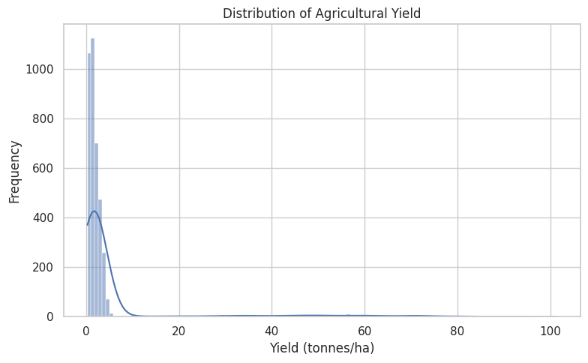
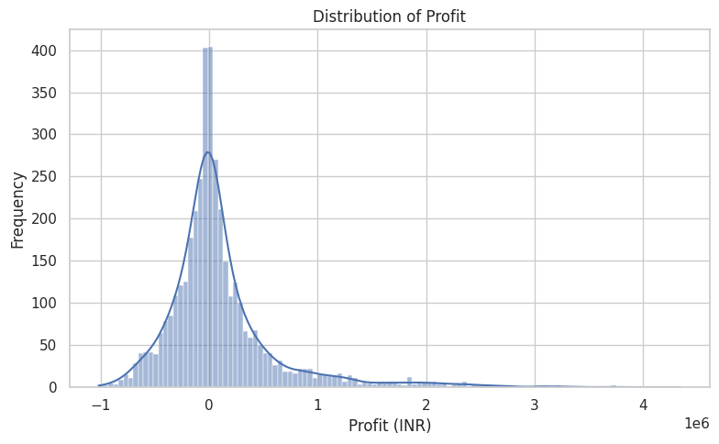
RESULTS
Distributions
Yield and Profit are both right-skewed; nearly half of all farm records (49.15%) show a loss.
Distribution of agricultural yield
Distribution of profit (INR)

Slide 8
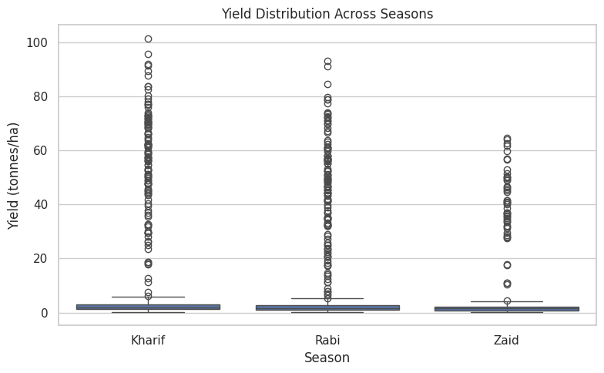
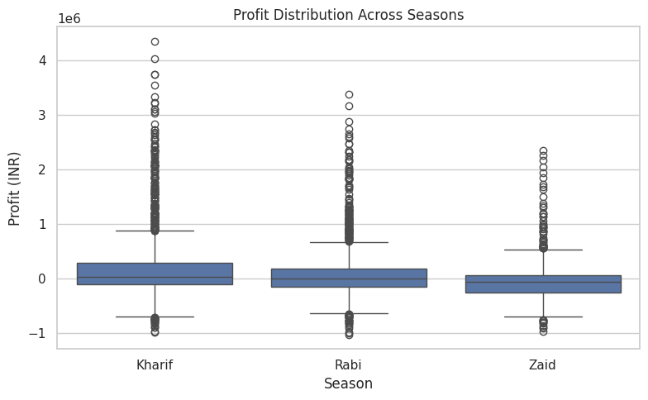
RESULTS
Seasonal
Kharif leads on both yield and profit; Zaid is the only season with a negative average profit.
Yield distribution across seasons
Profit distribution across seasons

Slide 9
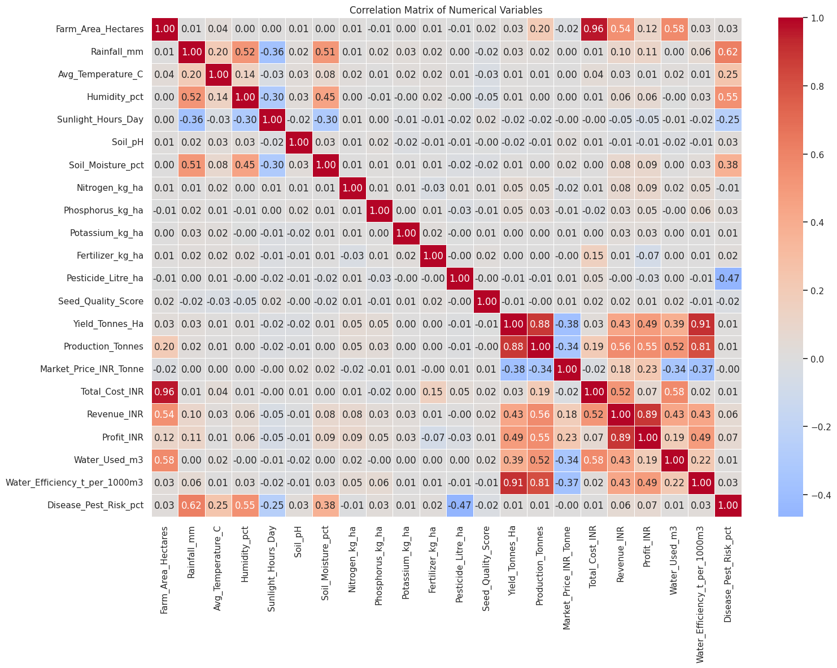
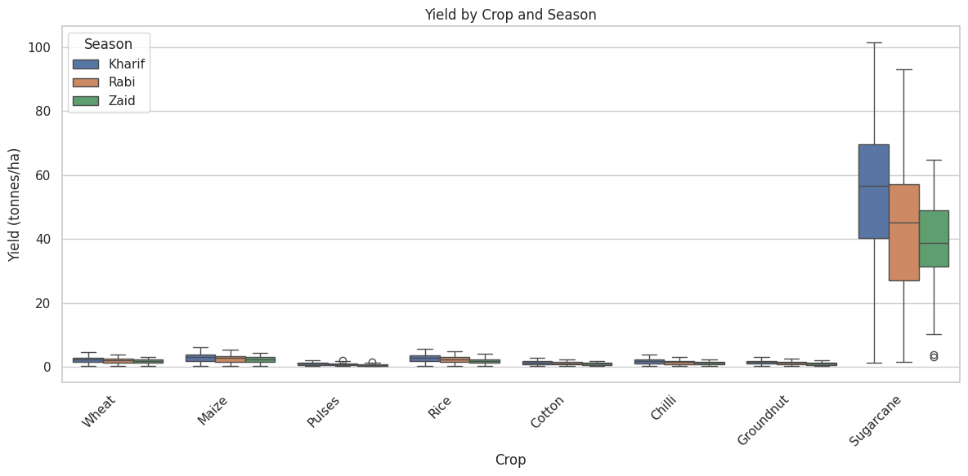
RESULTS
Crop and Correlation
Sugarcane's yield dwarfs all other crops in every season; Water Efficiency correlates most strongly with Yield (r=0.91).
Yield by crop and season
Correlation matrix of numerical variables

Slide 10
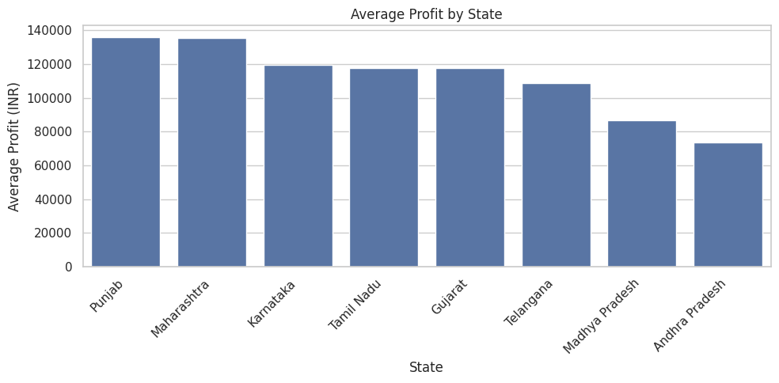
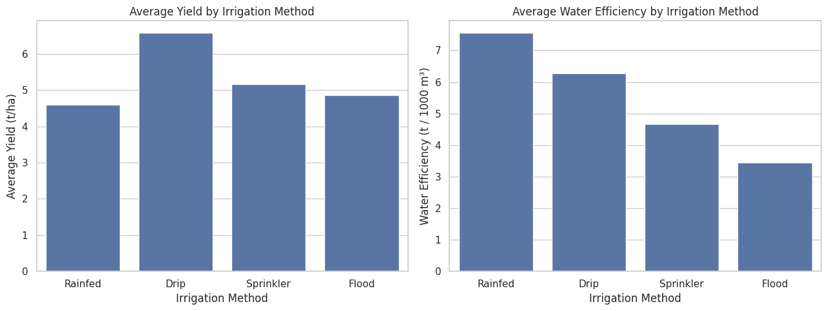
RESULTS
Regional
Punjab & Maharashtra lead on profit; Drip irrigation gives the best yield and water efficiency of all methods.
Average profit by state
Average yield by irrigation method

Slide 11
Future scope
• Extend the dataset to a multi-year panel to test whether the Kharif > Rabi > Zaid ranking holds across years, not just within one season snapshot.
• Bring in market-price time series (instead of a single price per record) to separate price-driven profit swings from yield-driven ones.
• Investigate the Zaid-season loss in more depth with targeted field data - soil moisture retention, heat-tolerant crop trials, and drip-irrigation pilot comparisons.
• Apply statistical significance testing (ANOVA / t-tests) to confirm whether the seasonal and irrigation-method differences found here are significant, not just descriptive.
• Build this into an interactive dashboard so agricultural cooperatives can filter by state, crop and season for their own decision-making.

Slide 12
GitHub Link
https://github.com/Om777-Stack/Seasonal-Agriculture-Performance-Analysis.git

Slide 13

VOIS Course completion certificate -
Course name- Data Visualization

Slide 14
Thank you
.
.

