Slide 1

Smart home
By: Omar Alaa Abd elrahman
Amr Mohamed Anwar
Mohamed saied sayed
Amr Moussa Moussa
AMIT PROJECT

Slide 2
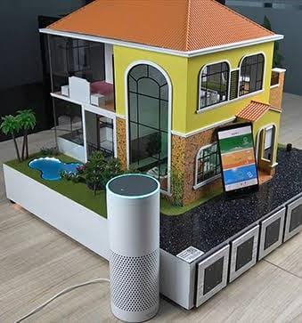
introduction
Smart home uses devices connected via the internet to allow for remote monitoring and management of appliances and systems, smart home technology also known as home automation provides homeowners with security, convenience and energy efficiency; it allows homeowners to control smart devices simply with an app on the smart phone or other networked devices, smart homeowners can control lighting system remotely; schedule and monitor thermostats; grant or deny home access through smart locks; check in on security cameras; and control the other smart home devices. A part of the internet of things (IoT), smart home systems and devices often operate together, sharing consumer usage data among themselves and automating actions based on the homeowners' preferences.
SMART HOME MODELL
1

Slide 3
our project
So In our project we are going to simulate a smart home project with five major elements: lighting system & dimmer system, air conditioning system, door control, admin/users login system and security.
2

Slide 4
PART .01
The application menu:
Lighting and dimming control
Door control and air conditioning .

Slide 5
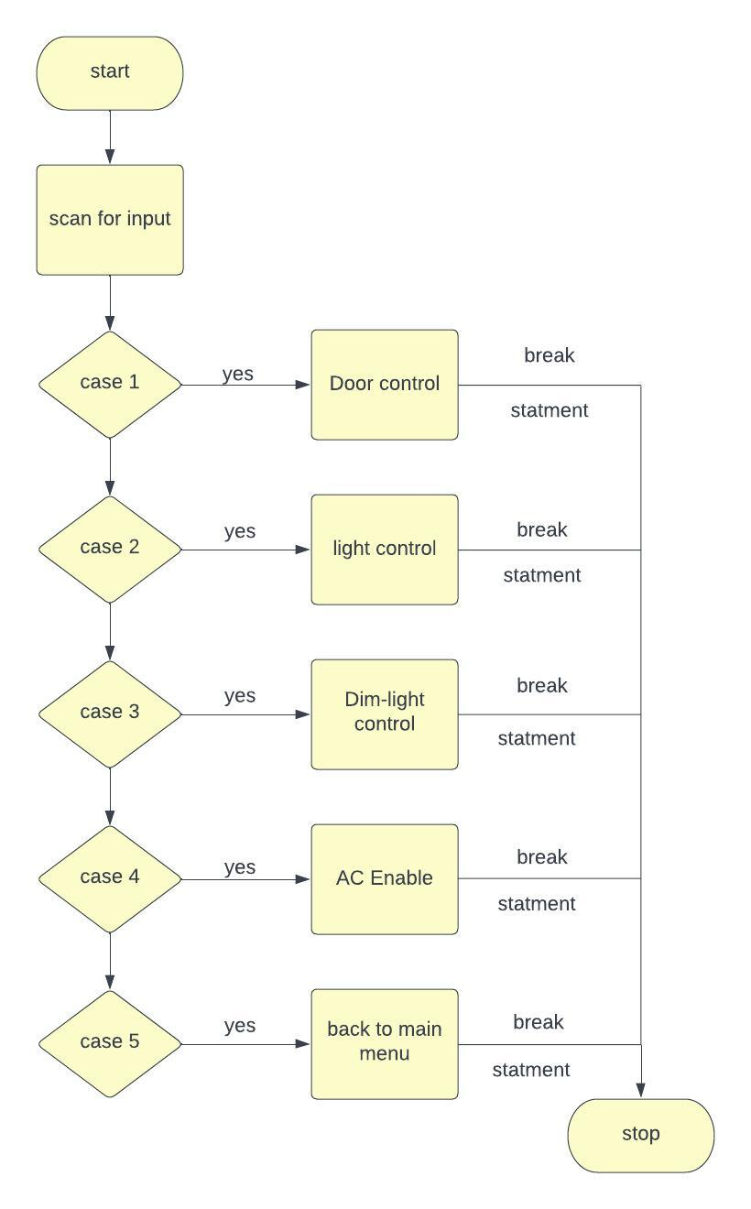
The Menu :
First a greeting message diplayed on screen and waiting the user to press A (A or a on keypad) to enter the system, in the application menu 1-Door control 2-light control 3-dimmer 4-air conditioning sensor.
3

Slide 6
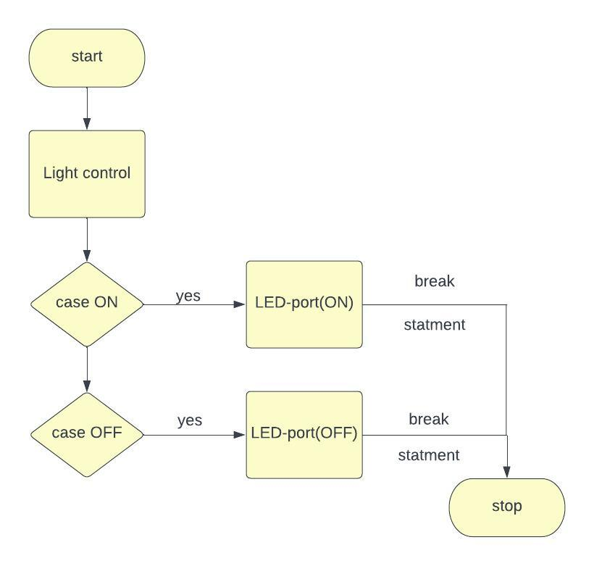
lighting control
In case user choose light control option then choose on then all light ports is high which means all LEDs are on,and in case he chooses off then all LEDs are off reset all LEDs ports low.
4

Slide 7
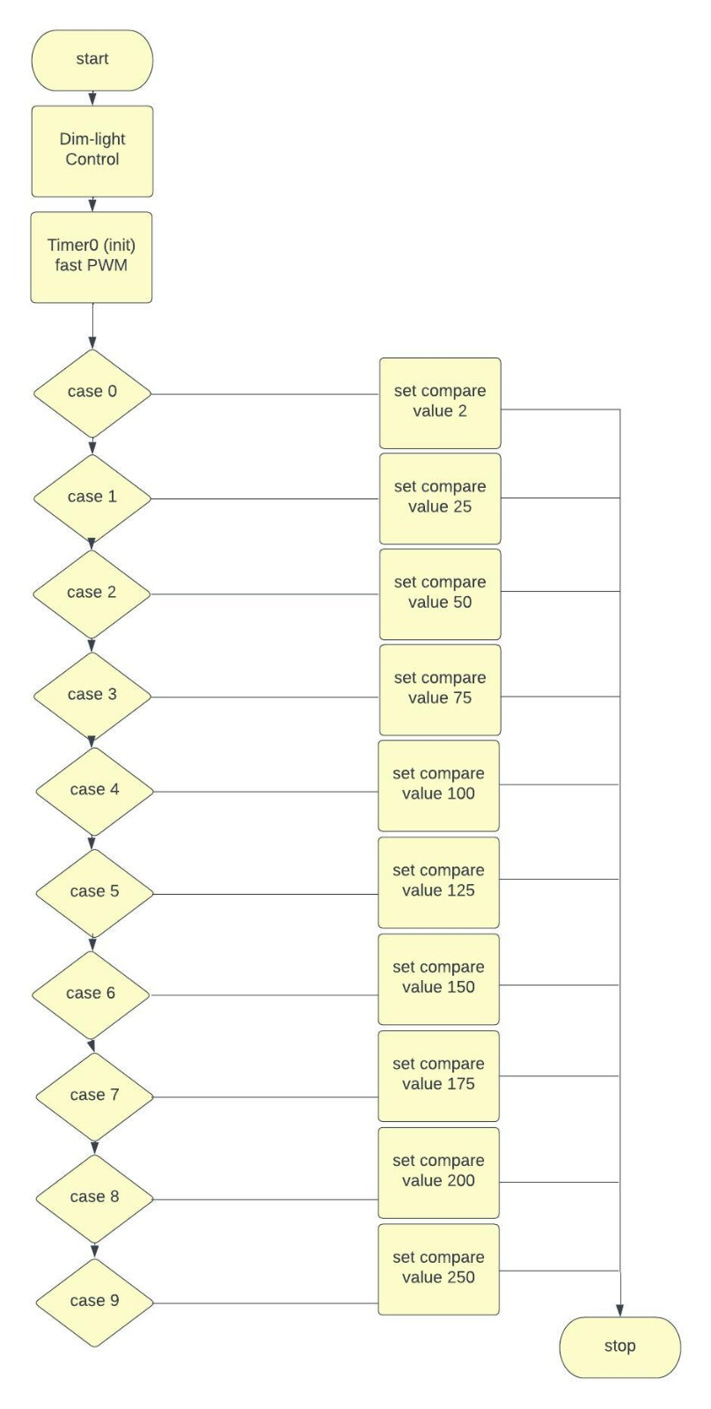
dimmer control
In case of dimmer circuit: we use PWM to control the intensity of an AC lamp and that can be achieved by using a solid state relay(phase controlled) and cannot be achived using mechanical switch; so user has to enter the intensity from 0 to 9 (off to max) and the input number is converted into the required intensity .
5

Slide 8
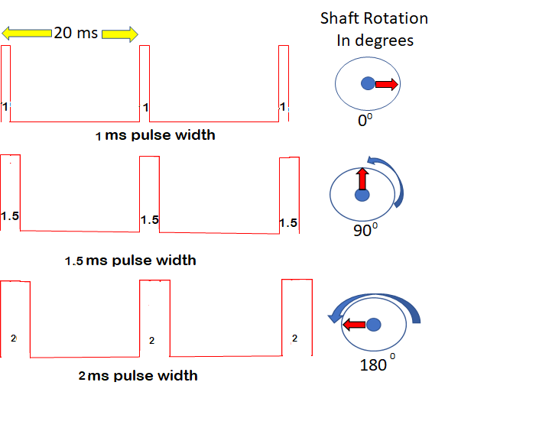
door control
AS shown in this figuer servo motor respond to 2(ms) on and rotate to 180 degree which in our case would be as closed door ,and at 1.5(ms) the motor rotates to 90 degree which in our case will means that the door is open.
6

Slide 9
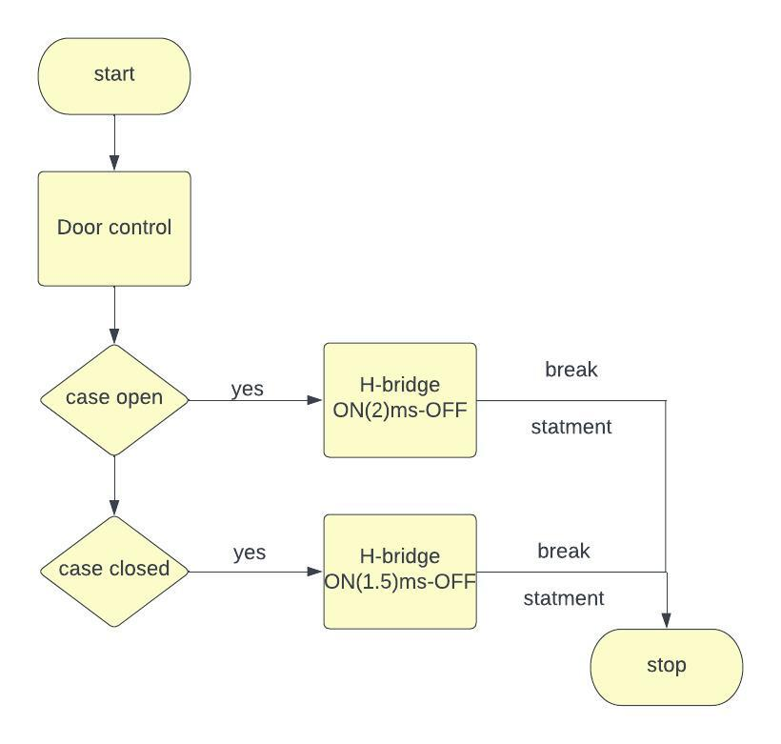
door control
In case of door control if user chooses ‘open’ option the H bridge supplies the servo motor for 2ms then off, in case of close H bridge supplies the motor for 1.5ms then off.
7

Slide 10
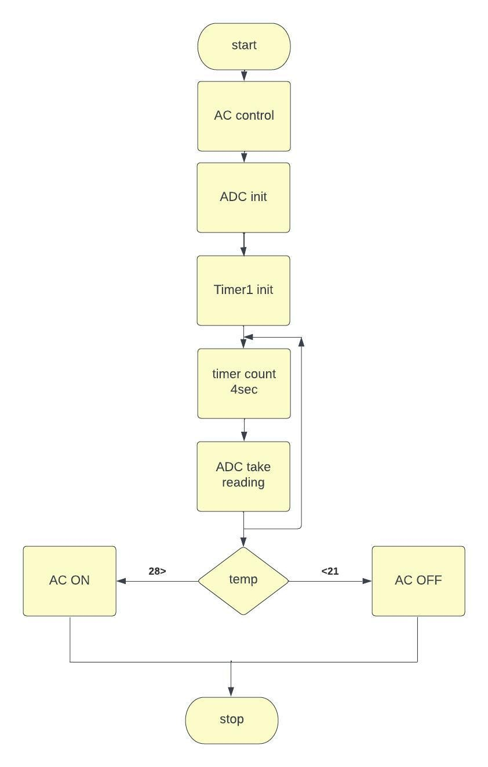
Air conditioning control
At first AC is off not responding to the environment temperature if the user(admin)
choose to enable the ac then every 4(sec) reading is taken through the lm35 sensor and in case the temperature was above 28 the AC would be enabled which is represented as DC motor enable ,and in case the temperature was below 21 then DC motor would stop.
8

Slide 11
PART .02
Login system
Admin login users adding
Remove users checking paswords.

Slide 12
Registering an Admin
Registering an Admin
We check if admin has registered in EEPROM by checking the first location in the EEPROM
The first location in the EEPROM is 0xFF and if it stores a value then the admin logged in so don’t register admin
And if 0xFF equal to zero (empty) then a message shows on the screen “the first time you need to create an admin” then name and password are taken from the user.
Taking ID & Password
• Checking if the user entered a value correctly
A variable (Error variable) is created in order to make sure user didn’t Entered a null mistakenly, the initial value of the variable is made to be =0 and the value changes only if user typed a value (Numbers or Characters).
So if user:
1- Pressed Enter without entering a value it displays a message “Error please try again”.
2- entered a value and pressed enter: ID is taken successfully (or password).
3- didn’t press enter button (still typing): Error variable is made =1 so that not check the error again during typing, admin ID (or password )is saved inside the EEPROM and displayed on screen or LCD.
The Error variable is reset to be =0 preparing for taking the password.
9

Slide 13
Registering an Admin
Taking password
Taking password process is similar to taking the ID:
• Error Variable makes sure user didn’t Entered a null mistakenly.
• When user Presses Enter without entering a value it displays a message “Error please try again”.
• When user entered a value and pressed enter: password is taken successfully.
• When user didn’t press the enter button (still typing): Error variable is made =1 so that not check the error again during typing, admins password is saved inside the EEPROM and displayed on screen or LCD.
• The Error variable is reset to be =0 again as the top case.
Checking the ID & password
ID and Password are entered combined and User has 3 trials to enter the correct id and password otherwise an alarm (buzzer) will be set on, eeprom counter is set to be zero and EEPROM is read consecutively until reach $ sign and if there is a wrong in id or password a message printed on screen “wrong ID/pass” a counter of number of tries decremented by one till reach 0 at this case a buzzer is turned on until restarting
10

Slide 14
Adding a user
Adding a user is similar to adding admin: checking if user entered the id and password correctly then saves them inside the EEPROM:
• Error Variable makes sure user didn’t Entered a null mistakenly.
• When user Presses Enter without entering a value it displays a message “Error please try again”.
• When user entered a value and pressed enter: ID or password is taken successfully.
• When user didn’t press the enter button : Error variable is made =1 so that not check the error again during typing, user ID or password is saved inside the EEPROM and displayed on screen or LCD.
• The Error variable is reset to be =0 again as the top case.
11

Slide 15
Deleting user
- Enter the ID & PASS on the same screen In a while loop. Every char is saved into an array of 40 char.
- In the same while loop along taking the ID & PASS, go into the eeprom, move to the last char of admin’s password and stay on it. (USERS are stored after the admin in the eeprom)
- In another while loop, loop on all places in the eeprom that’s after the credentials of the admin. If nothing was found identical to what was found in the array then user doesn’t exist.
- If it was identical just enter ‘checking’ state and keep checking every char in the array with what’s in the eeprom.
- Reaching the end of the credentials with making sure that every char is identical to the eeprom values then go ahead delete the credentials of that user till you hit the user/admin that was before him and stop right there. Break after that from the loop.
- If one char is wrong in the array, it won’t do any more checking.
12

Slide 16
Writing on the EEPROM
ATMEGA32 has an internal EEPROM 2K 256 bytes, Saving users information on the EEPROM is important otherwise it will be lost during shutdown and restarting in the volatile memory, so we use it to save IDs and Passwords of the logged users and admin, we separate between users inside EEPROM by $ sign starting from admin to facilitate the recognition and the access to each user (user ID, user Password, $).
During users login; a counter is incremented by one each time a user ID or Password is inserted as a pointer to the last empty address inside the EEPROM to facilitate the insertion; Another counter called EEPROM counter increments by one each time user entered in order to sum the total number of users inside EEPROM.
13

Slide 17
THANKS

