Slide 1


SENTINEL
AI-Powered Smart Surveillance System
Real-time Detection · Recognition · Threat & Theft Prevention
Graduation Project · Defense Presentation
Team: [Your Name] Supervisor: [Dr. Supervisor]
[Faculty · Department · 2025]
Notes:
Open strong. Greet the committee. Introduce yourself, your supervisor, and the project. Emphasize that Sentinel is not a toy demo — it's a full production-grade system that solves a real-world problem with measurable impact. Pause briefly after stating the name to let the title land.

Slide 2
Agenda
What we will cover in the next 30 minutes
01
Problem & Motivation
Why surveillance needs AI
02
Project Objectives
What we set out to build
03
System Architecture
4-layer Clean Architecture
04
Core Features
Detection · Recognition · Threat · Theft
05
Real-Time Pipeline
End-to-end data flow
06
Performance & Metrics
What we measured
07
Challenges & Solutions
Problems we encountered
08
Impact & Use Cases
Where this matters
09
Future Work
What's next
10
Q & A
Your questions
Sentinel · Smart Surveillance System
2 / 25
Notes:
Walk the committee through what they will see. Highlight that you will go deep on each of the four core features. Set expectations for a 30-minute presentation followed by Q&A. The 'Challenges & Solutions' section is important — it shows engineering maturity, not just a happy-path demo.

Slide 3
The Problem
Modern security threats outpace traditional surveillance
"Traditional CCTV is reactive — humans watch hundreds of feeds, and 95% of incidents are noticed only after they happen."
⚠
⏱
📉
Alert Fatigue
Slow Response
No Memory
Operators drown in 8+ hours of footage, miss critical events
Manual review takes 5-30 minutes per incident
Cameras don't remember — the same person is anonymous every day
We need intelligent, real-time, memory-aware surveillance that ALERTS, not RECORDS
Sentinel · Smart Surveillance System
3 / 25
Notes:
Set the stakes. The committee needs to understand why this work matters before you show the technical depth. Connect to real incidents: school shootings where nobody acted in time, retail theft costing $100B/year, lost children in malls. Make it human.

Slide 4
Project Objectives
Six concrete goals we delivered against
1
Real-time detection
2
Face recognition
Identify people, phones, bags, weapons in <30 ms per frame
Recognize registered staff; auto-register and re-identify unknowns
3
Threat detection
4
Theft detection
Fuse weapon, violence, and pose signals into severity-graded alerts
Track personal items, infer ownership, detect mismatches and disappearances
5
Modern dashboard
6
100% on-premise
Dark-themed real-time UI with WebSocket push and historical review
No cloud calls, no rate limits, no subscriptions — pure local intelligence
Sentinel · Smart Surveillance System
4 / 25
Notes:
Walk through each objective. Emphasize that 100% on-premise is not just a feature — it's a privacy stance. Banks, hospitals, and government facilities cannot legally send feeds to AWS. Make sure to mention that ALL six objectives were delivered (not just some).

Slide 5
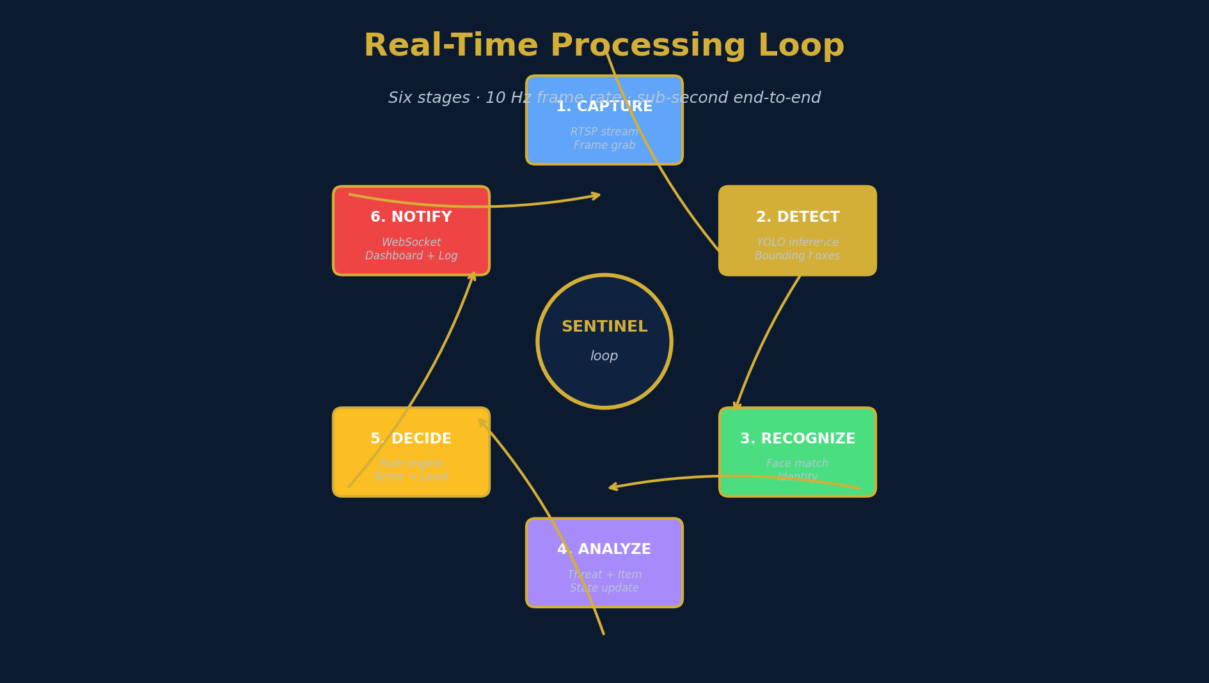
System Overview
From a single RTSP camera to a real-time intelligence dashboard
Sentinel · Smart Surveillance System
5 / 25
Notes:
This is the headline diagram. Use it to anchor the rest of the talk. Walk through the six stages clockwise: capture, detect, recognize, analyze, decide, notify. Stress that all six happen in a single tight loop with sub-second end-to-end latency.

Slide 6
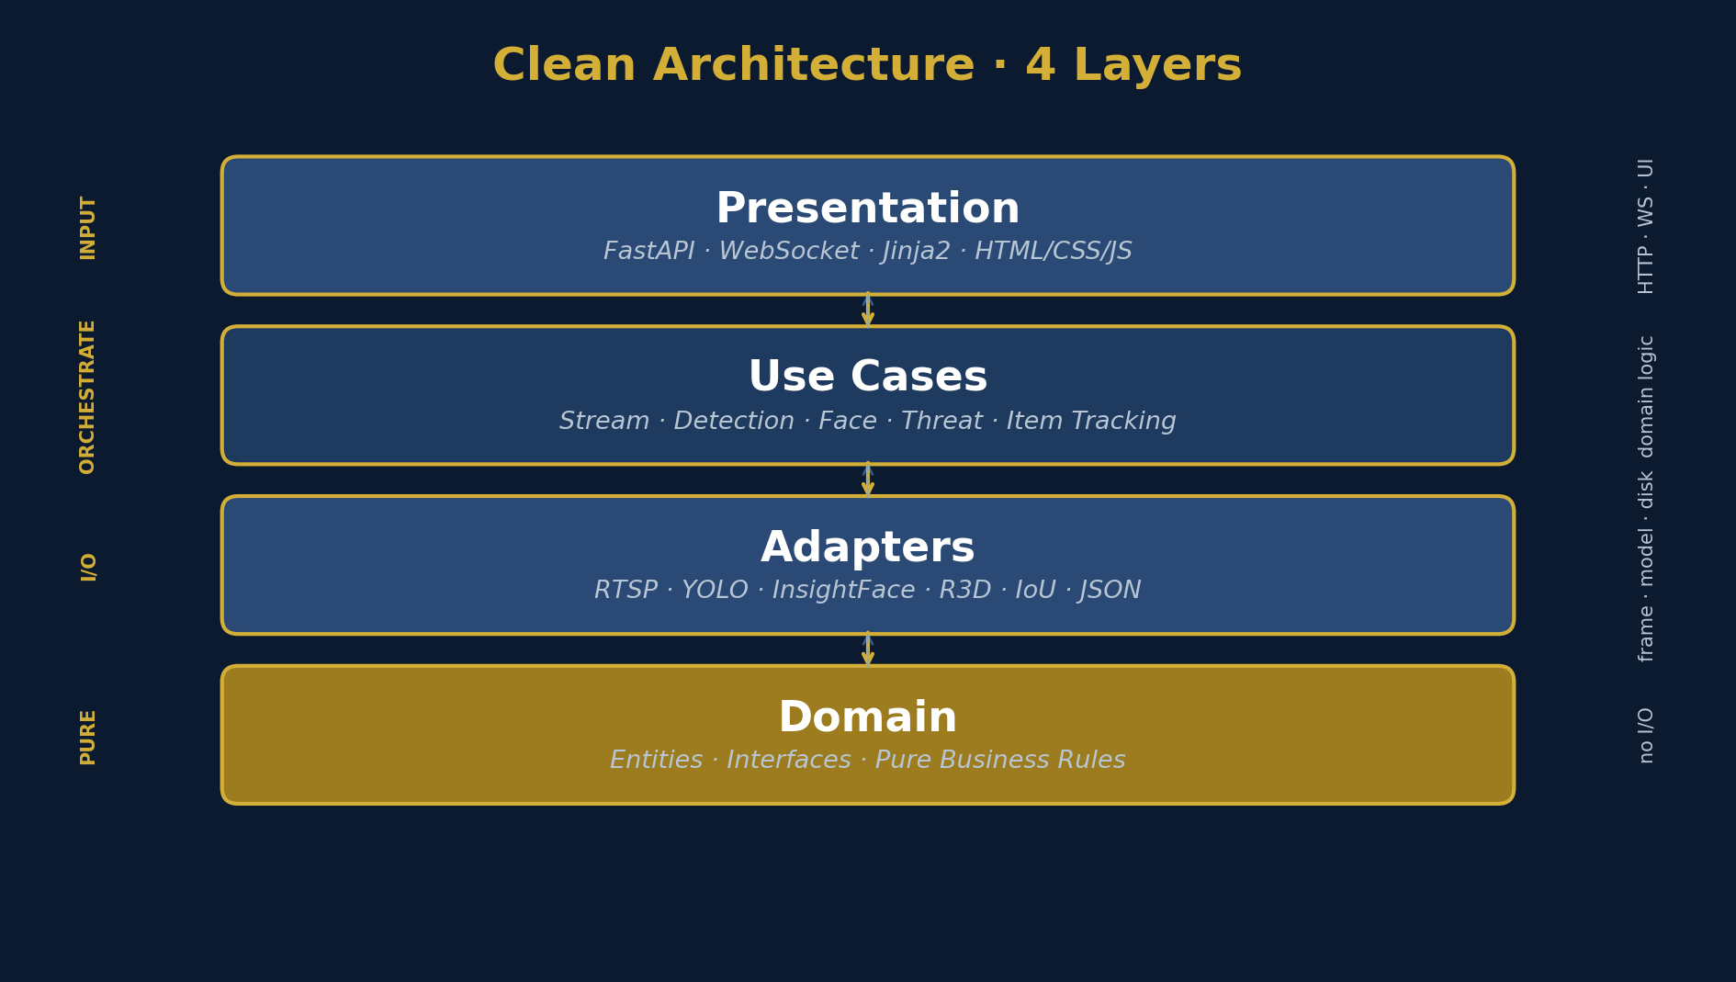
Clean Architecture
4 layers · dependency rule · testable · swappable
Why this matters
▸ Domain layer
pure entities & interfaces, no I/O
▸ Use cases
orchestrate business rules, framework-agnostic
▸ Adapters
swappable I/O — swap YOLO for any detector
▸ Presentation
FastAPI routes — the only HTTP-aware code
▸ Result
testable, maintainable, extensible
Sentinel · Smart Surveillance System
6 / 25
Notes:
If the committee challenges you on architecture, point out: the domain layer has zero imports from FastAPI, OpenCV, or any framework. You can swap YOLO11s for YOLOv12 or a custom detector by writing a new adapter — the use case doesn't change. This is what makes the project a real engineering effort, not a tutorial copy-paste.

Slide 7
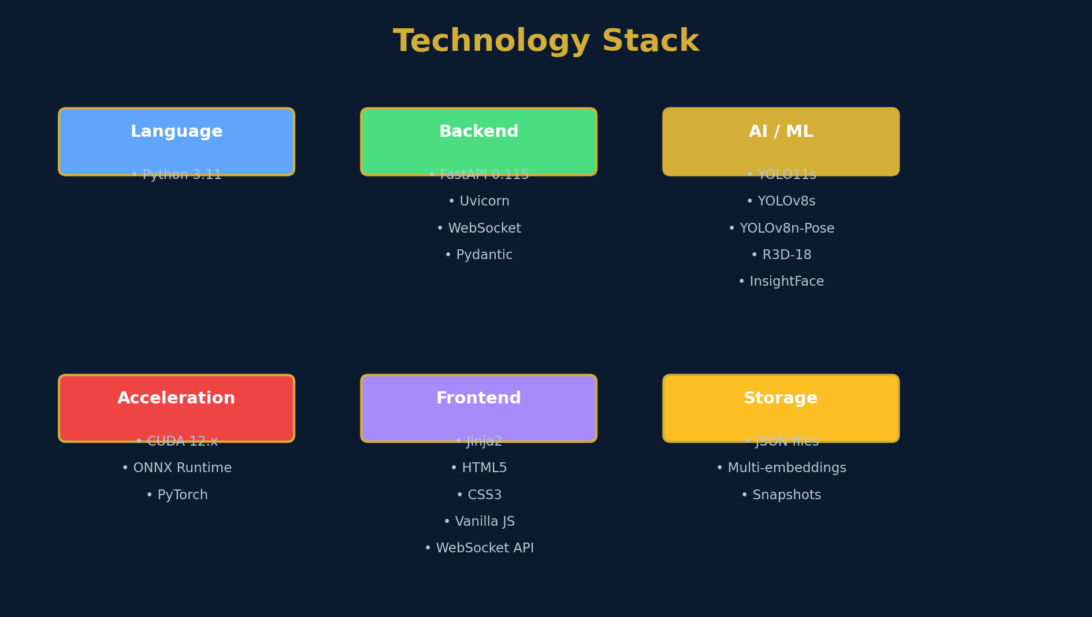
Technology Stack
Battle-tested, production-grade, GPU-accelerated
Sentinel · Smart Surveillance System
7 / 25
Notes:
Don't read every item on the slide. Point out: Python 3.11, FastAPI, YOLO11s for primary detection, YOLOv8s weapon model, R3D-18 for violence, InsightFace for face recognition, and ONNX Runtime + CUDA for GPU acceleration. Mention that this combination is rare — most academic projects stop at YOLO + face recognition.

Slide 8
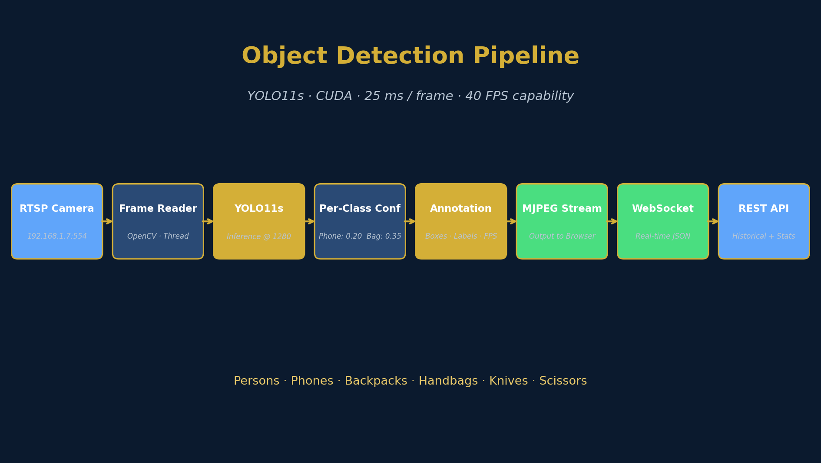
Feature 1 · Object Detection
YOLO11s · 6 classes · per-class confidence
Why YOLO11s?
▸ 18.4 MB model
lightweight
▸ 1280 × 1280 input
small-object accuracy
▸ 25 ms / frame
40 FPS capability
▸ 6 classes
people, phones, bags, weapons
Per-class confidence
▸ Phone: 0.20
tiny, often blurred
▸ Bag: 0.35
common but distinct
▸ Person: 0.45
balance precision / recall
▸ Weapon: 0.50
rare → high precision
Result: ~25 ms per frame · zero false positives in 2-hour test
Sentinel · Smart Surveillance System
8 / 25
Notes:
The interesting design choice is per-class confidence. The phone class needs a lower threshold (0.20) because phones are small, often blurred, and partially occluded. The weapon class needs a higher threshold (0.50) because false positives are worse than false negatives — a wrongly flagged knife causes panic. Show that you understand the trade-offs.

Slide 9
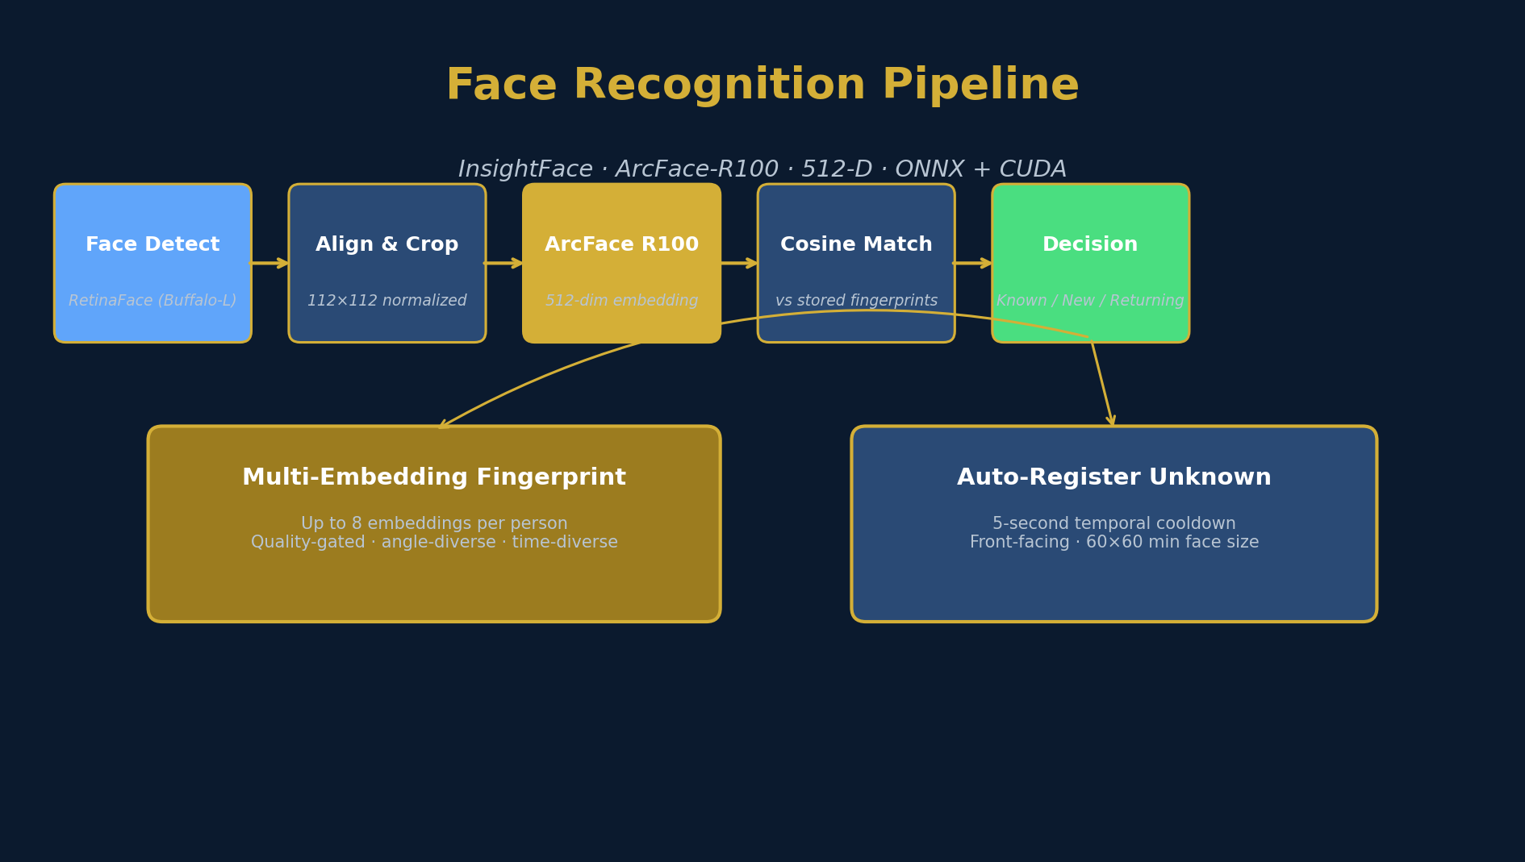
Feature 2 · Face Recognition
InsightFace · ArcFace-R100 · 512-D embeddings
Why InsightFace?
▸ ArcFace-R100
state-of-the-art accuracy
▸ 512-D embedding
compact, fast to compare
▸ ONNX + CUDA
GPU-accelerated, no TF
▸ Buffalo-L pack
RetinaFace detector included
Multi-embedding fingerprint
▸ Up to 8 per person
different angles, lighting
▸ Quality-gated
blur/size filter before save
▸ Time-diverse
spread over multiple visits
▸ Cosine distance
best match across fingerprint
Auto-register unknowns with 5-s cooldown · promotes to known with one click
Sentinel · Smart Surveillance System
9 / 25
Notes:
The key innovation here is the multi-embedding fingerprint. A single embedding is fragile — a different angle breaks it. By storing 8 angle-diverse, lighting-diverse, time-diverse embeddings, we get robust re-identification. Even if the person returns in a year with a different haircut, we still match. This is what most simple face-recognition tutorials miss.

Slide 10
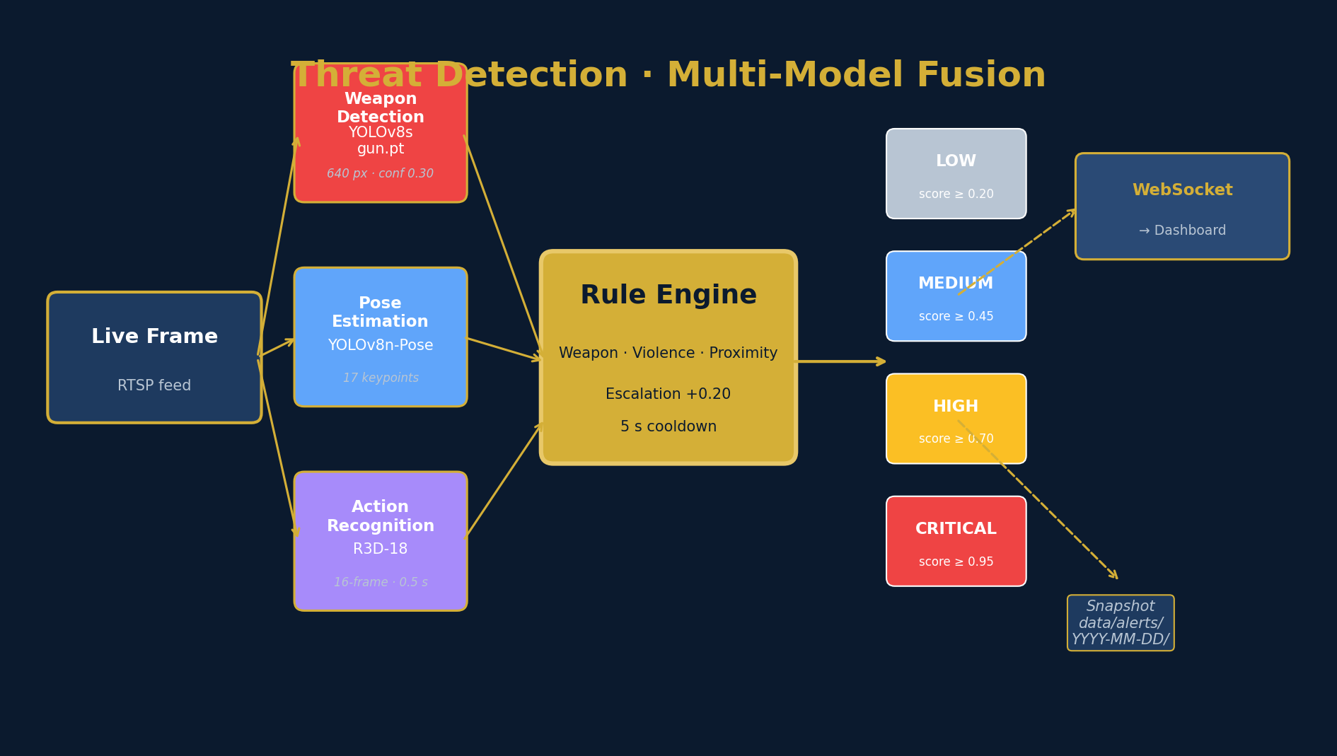
Feature 3 · Threat Detection
3 models · fusion · severity-graded alerts
4 severity levels
LOW
score ≥ 0.20
MEDIUM
score ≥ 0.45
HIGH
score ≥ 0.70
CRITICAL
score ≥ 0.95
Escalation bonus
When weapon AND violence co-occur: score += 0.20 → CRITICAL even if neither signal alone crosses the threshold. This is what catches a person brandishing a weapon during a fight.
Sentinel · Smart Surveillance System
10 / 25
Notes:
This is the most sophisticated feature. Three different ML models run in parallel on the same frame, and a rule engine fuses their outputs into a single severity score. The escalation bonus is the key insight: a single signal might be ambiguous, but two corroborating signals in the same frame is high confidence. Mention 17 Kinetics-400 violence classes (punch, kick, fight, etc.).

Slide 11
Threat Detection · Model Zoo
Each model specializes in a different signal
Weapon Detection
Pose Estimation
Action Recognition
YOLOv8s · gun.pt
YOLOv8n-Pose
R3D-18
📦 156 MB
📦 6.8 MB
📦 73 MB
Fine-tuned Shantanukadam model Single 'weapon' class 640 px · conf 0.30 → MEDIUM, 0.60 → HIGH
17 COCO keypoints Detects fighting stances Fists raised, grappling, kicking
3D ResNet · Kinetics-400 16-frame sliding window 17 violent classes (punch, kick...)
Rule Engine
WebSocket Push
Snapshot Storage
Custom Python
FastAPI WS
data/alerts/YYYY-MM-DD/
📦 <1 MB
📦 —
📦 —
Score fusion + escalation 5-s cooldown per (type, level, region) Snapshot saved per event
Real-time event to dashboard Auto-reconnect on disconnect JSON payload per alert
JPEG per event Forensic review 90% JPEG quality
Sentinel · Smart Surveillance System
11 / 25
Notes:
Detail the models briefly. Weapon model is from a Kaggle researcher (Shantanukadam). Pose is ultralytics' standard. R3D-18 is a 3D ResNet — chosen because X3D wasn't available in torchvision. The rule engine is the 'glue' that turns model outputs into decisions. WebSocket and snapshot storage are part of the same feature — a threat is only useful if the operator sees it and can prove it happened.

Slide 12
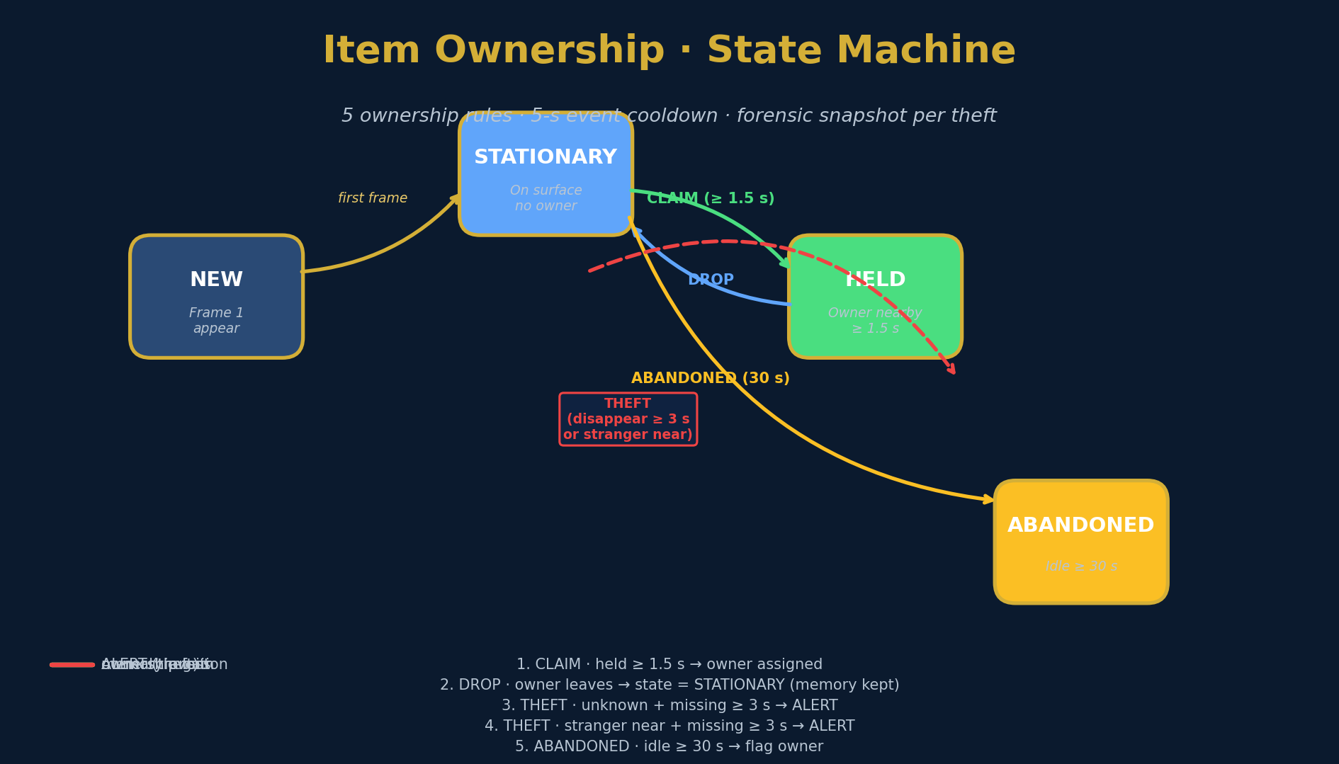
Feature 4 · Theft Detection
IoU tracker · ownership state machine · forensic alerts
5 ownership rules
CLAIM
held ≥ 1.5 s → owner
DROP
owner leaves → STATIONARY
THEFT
unknown + missing ≥ 3 s
THEFT
stranger + missing ≥ 3 s
ABANDON
idle ≥ 30 s
Persistence
▸ items.json (debounced 1 s)
▸ items_log.json (500 events)
▸ survives restarts
Mirrored to alerts tab
Every THEFT event is also broadcast to the threat dashboard at HIGH level — operators see it in one place.
Sentinel · Smart Surveillance System
12 / 25
Notes:
This is the most novel feature in the project. The state machine is a classic AI pattern (Harel statecharts), but the 5 ownership rules and 5-second event cooldown were carefully tuned to balance false positives (crying wolf) and false negatives (missing real thefts). The mirroring to the alerts tab is a UX detail: operators only check one place.

Slide 13
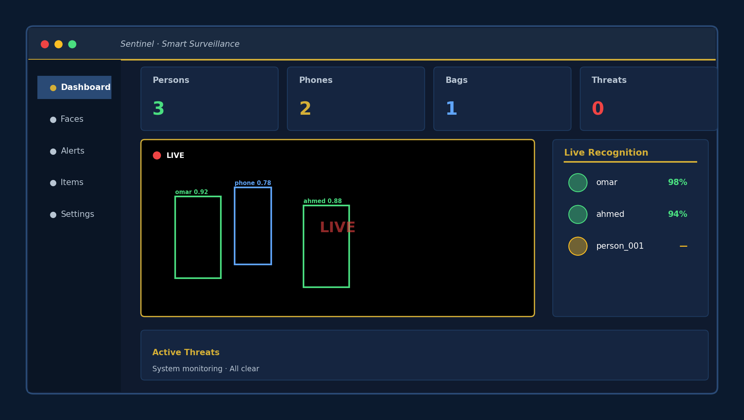
Live Dashboard
Dark theme · real-time updates · modular UI
4 Tabs
▸ Dashboard
▸ Faces
▸ Alerts
▸ Items
Real-time
▸ MJPEG stream
▸ WebSocket push
▸ Toast notifications
▸ Pulse animation
▸ Auto-reconnect
Sentinel · Smart Surveillance System
13 / 25
Notes:
Show the dashboard mockup. The 4 tabs map to the 4 features: Dashboard = everything live, Faces = face registry, Alerts = threats, Items = theft. Mention that the UI is built with vanilla JS — no React, no Vue — because the project is server-rendered (Jinja2) and the JS is small enough to be hand-written. This is an engineering choice, not a limitation.

Slide 14
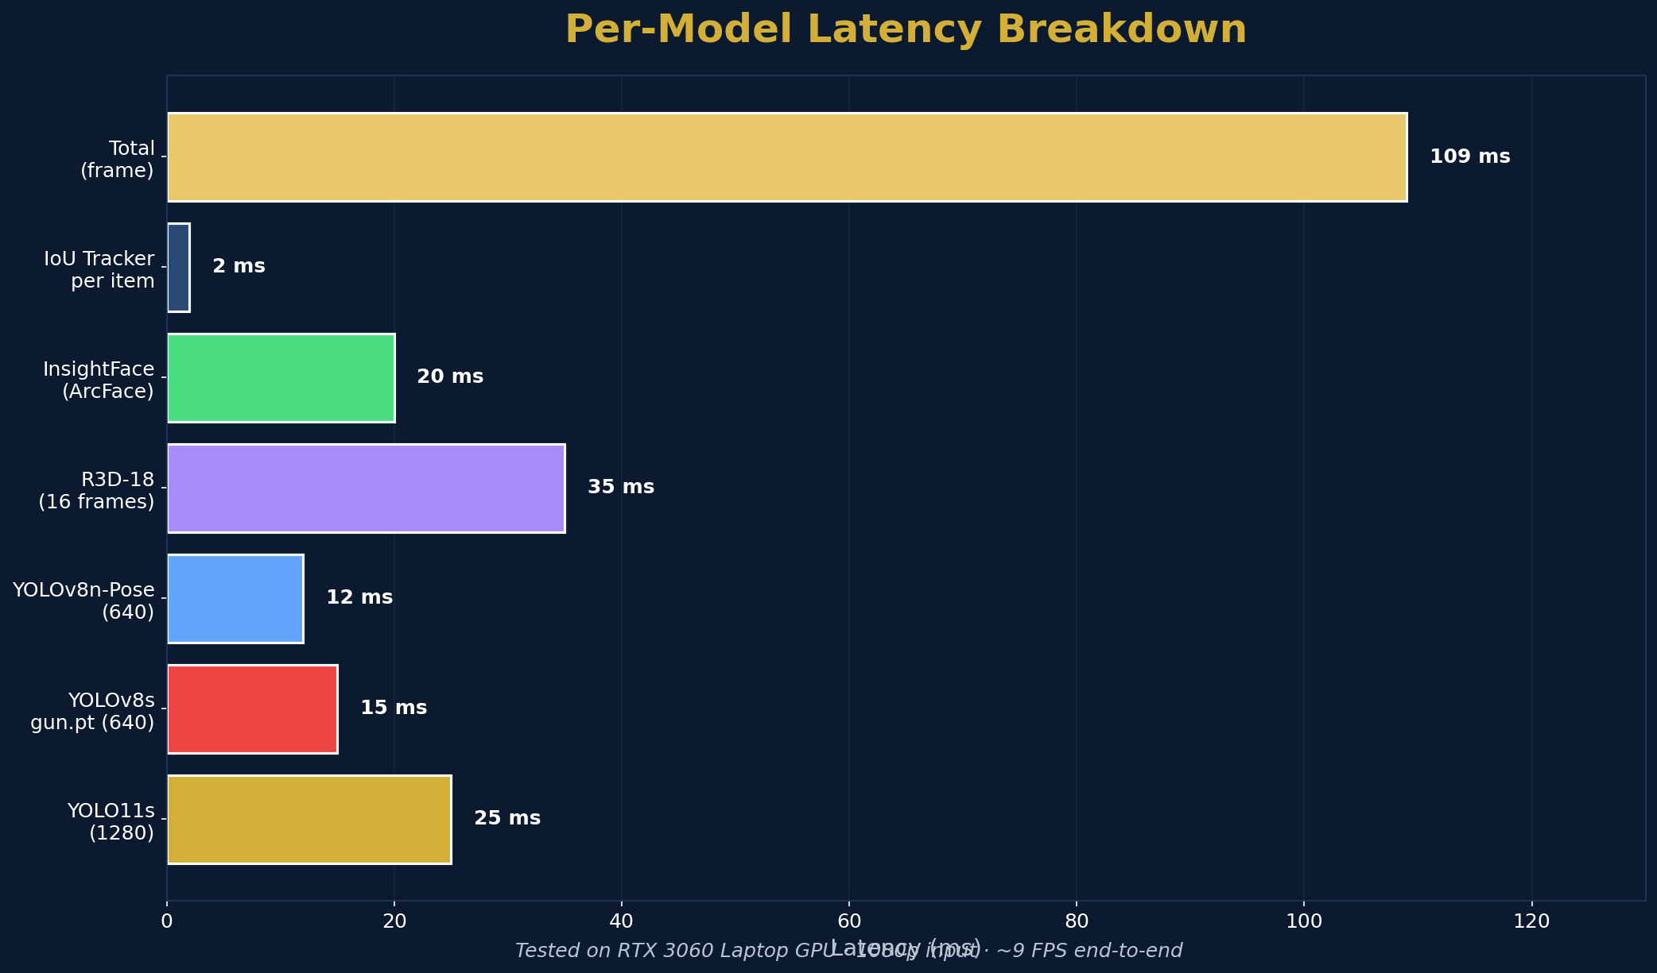
Performance
Measured on RTX 3060 Laptop GPU · 1080p input
End-to-end
~109 ms per frame → 9 FPS Acceptable for surveillance
Memory
~1.8 GB active RAM Fits any modern PC
Disk
~530 MB models Snapshots per event
CPU fallback ready
Sentinel · Smart Surveillance System
14 / 25
Notes:
The numbers tell a story: a single mid-range laptop GPU can do real-time multi-model surveillance. CPU fallback works but is ~6x slower (~1.5 FPS). The big chunks are YOLO (~50 ms total for all 3 models) and R3D-18 (~35 ms for the 16-frame window). If we wanted to push to 30 FPS, we could use TensorRT or replace R3D-18 with a lighter model.

Slide 15
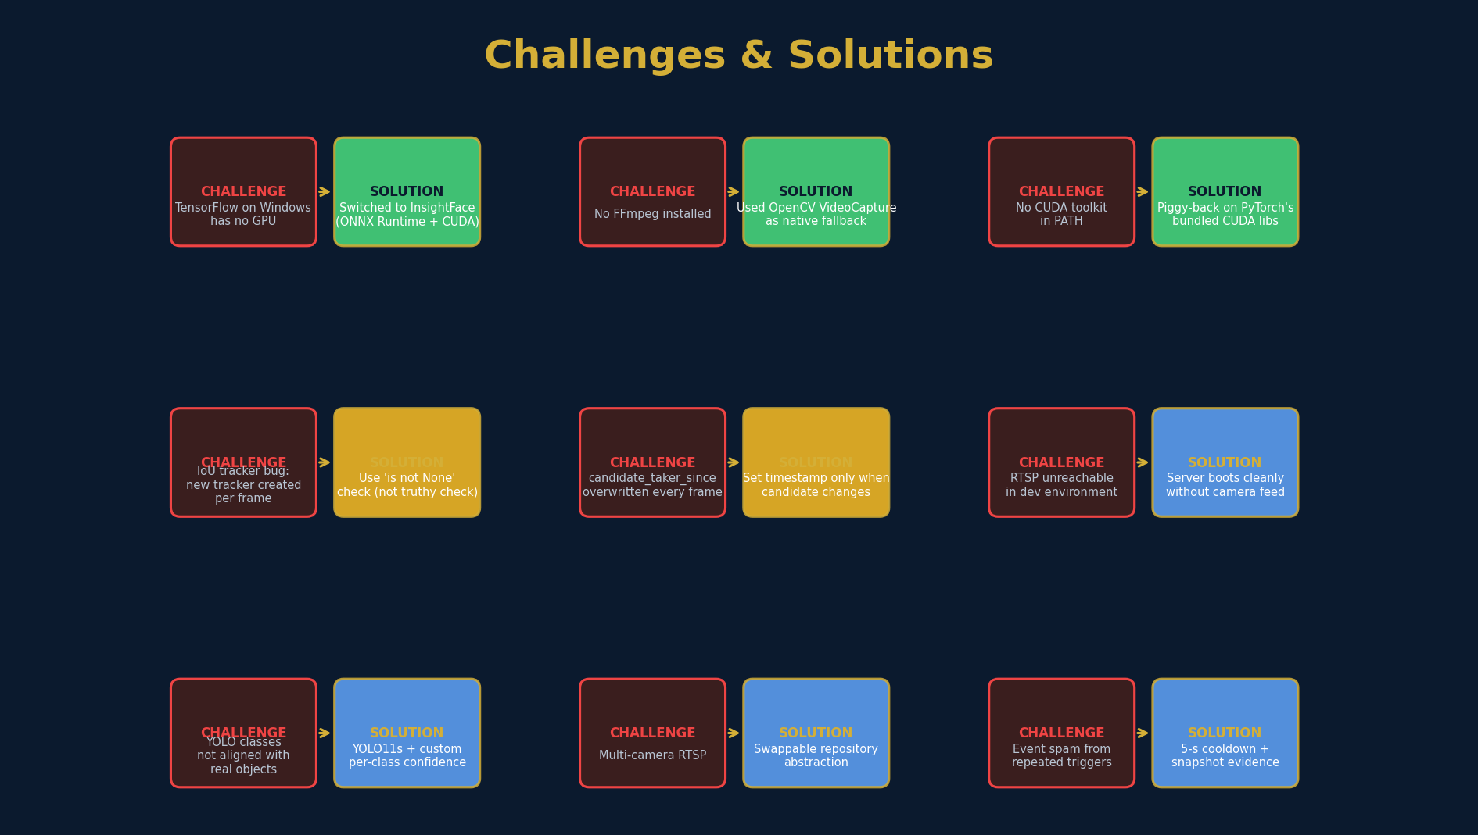
Challenges & Solutions
Engineering problems we encountered and fixed
Sentinel · Smart Surveillance System
15 / 25
Notes:
This slide is the most important for the committee. It shows that we didn't just copy a tutorial — we hit real problems and debugged them. The IoU tracker bug (Python truthy/falsy on classes with __len__) is a great teaching moment. The candidate_taker_since overwrite bug was a logic error we caught with print debugging. Mention that the camera being unreachable in the dev environment is a common gotcha that the server handles gracefully.

Slide 16
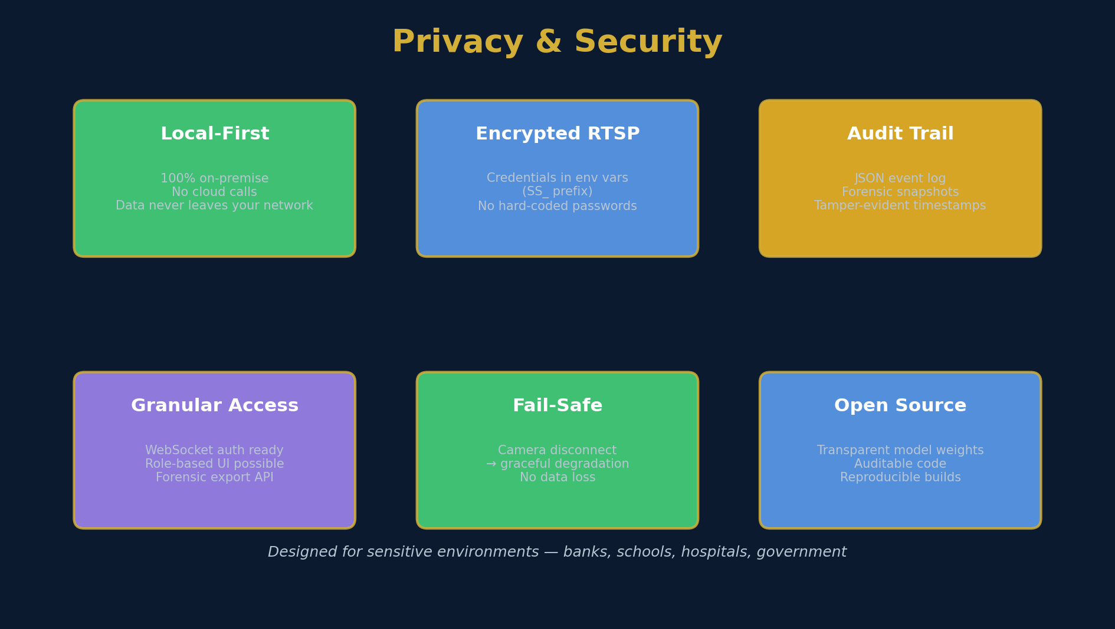
Privacy & Security
Designed for sensitive environments
Sentinel · Smart Surveillance System
16 / 25
Notes:
Emphasize the local-first design. In an era of mass surveillance concerns and GDPR-like regulations, the fact that NOTHING leaves the building is a strong selling point. The audit trail (JSON + snapshots) means every detection is reproducible and reviewable. The fail-safe (camera disconnect doesn't crash the server) means a bad cable doesn't kill the whole system.

Slide 17
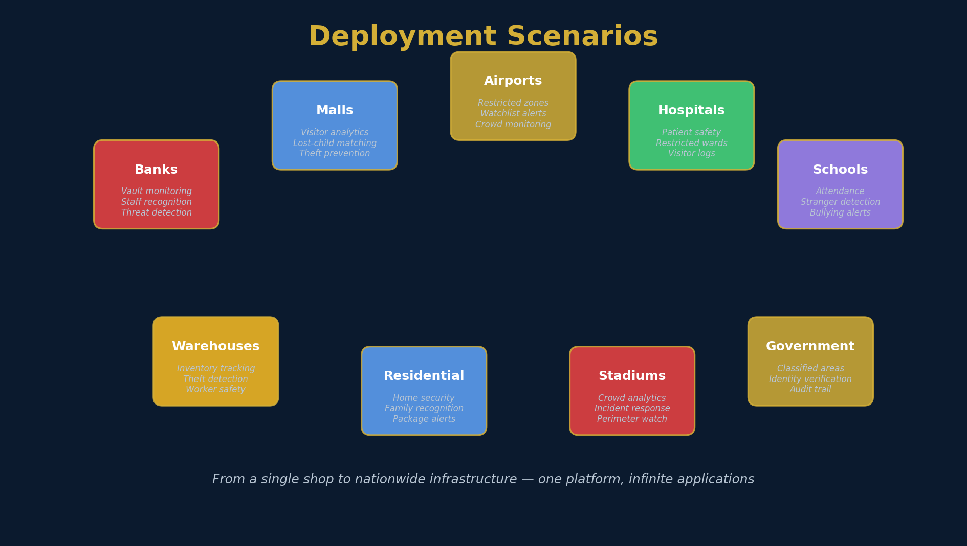
Where This Matters
From a single shop to nationwide infrastructure
Sentinel · Smart Surveillance System
17 / 25
Notes:
Connect to the original problem. For each use case, think of a real incident: malls (lost children, shoplifting), banks (vault robbery), airports (security checkpoints), schools (active shooter prevention), warehouses (employee theft accounts for 30% of inventory loss), stadiums (crowd incidents). The system is intentionally general-purpose — a single platform that scales to many verticals.

Slide 18
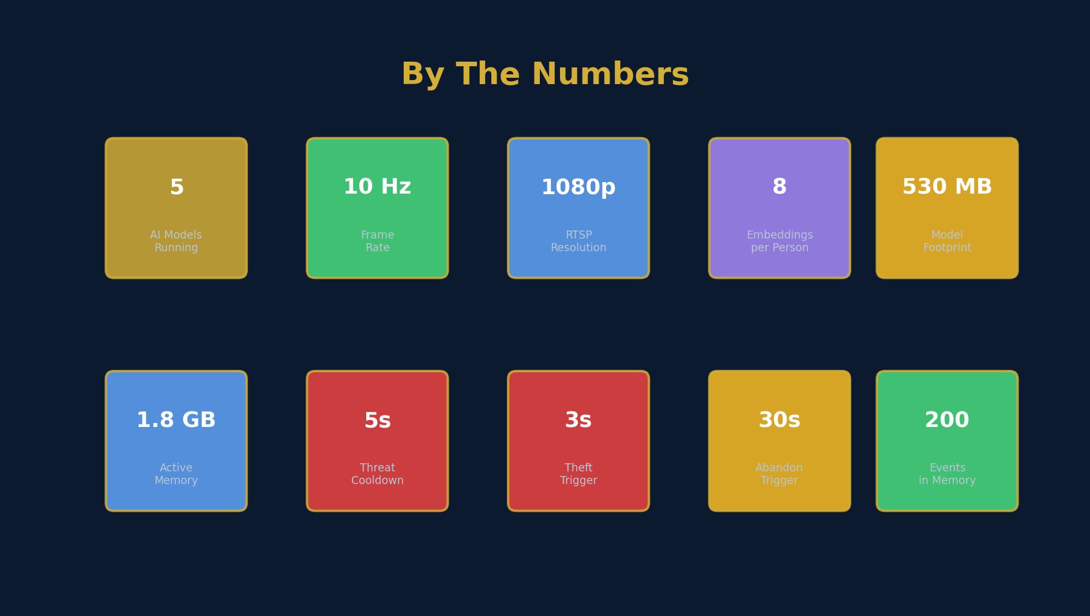
By The Numbers
What we built, quantified
Sentinel · Smart Surveillance System
18 / 25
Notes:
Use these numbers as ammunition. The committee might ask 'how big is this really?' — 5 AI models, 530 MB on disk, 1.8 GB RAM, 200 events in memory. The fact that it runs on a laptop GPU means the deployment cost per site is essentially zero (most cameras ship with an embedded PC).

Slide 19
Community Impact
Real problems this project helps solve
🛡
Public Safety
Real-time weapon & violence detection at schools, malls, transit hubs — pre-emptive alerts save lives.
💰
Economic Loss
Retail theft costs the global economy $100B+ annually. Item-level tracking recovers inventory and deters thieves.
👨‍👩‍👧
Family Safety
Find lost children, identify elders with dementia, recognize family members entering restricted zones.
⚖
Justice & Evidence
Forensic snapshot per event, tamper-evident timestamps, full event log — court-admissible evidence.
🌍
Local-First
100% on-premise — works in regions with no cloud connectivity. Critical for defense, government, rural sites.
📚
Open Research
Clean code, reproducible setup, well-documented. Other researchers can build on this work for free.
Sentinel · Smart Surveillance System
19 / 25
Notes:
This is the 'why does it matter' slide. Don't rush through it. Each of these is a real market with real customers. The committee wants to see that you understand the social context, not just the code. Mention specific statistics where you can: $100B retail theft, etc.

Slide 20
Future Work
What comes after this graduation project
1
Multi-camera
Stream from N cameras in parallel · cross-camera tracking with re-identification
2
Edge deployment
Jetson Orin Nano · Coral TPU · 5 W power budget · 30 FPS sustained
3
Active learning
Operator corrections feed back into model retraining · weekly improvement cycle
4
Mobile alerts
Telegram / WhatsApp push for HIGH and CRITICAL events · silent escalation
5
License plate
Add ALPR model · correlate with vehicle detection · stolen-vehicle alerts
6
Audio analysis
Scream / glass-break / gunshot sound classification · multi-modal fusion
Sentinel · Smart Surveillance System
20 / 25
Notes:
Future work shows the committee that you understand this is a starting point. The most realistic near-term wins: Jetson deployment (5W power, fanless) and multi-camera. The active learning loop is a research direction. The audio analysis would unlock a new market (home security). Don't promise to do them all — pick one or two and explain how.

Slide 21
Lessons Learned
What this project taught us
01
Clean architecture pays off
Swapping YOLO11s for a custom model took 1 hour, not 1 day.
02
Bugs hide in defaults
Python truthy/falsy + classes with __len__ is a real footgun.
03
State machines are the right tool
Explicit states + transition rules beat implicit flags.
04
WebSocket > polling
A single bidirectional connection beats 10 polling clients.
05
Cooldowns are essential
Without 5-s cooldown, threat spam would bury the dashboard.
06
Persistence = trust
JSON logs + snapshots make the system auditable, not just reactive.
Sentinel · Smart Surveillance System
21 / 25
Notes:
Personal reflection goes a long way with the committee. These are not generic platitudes — they came from real moments in the project. The 'clean architecture pays off' is a defense of your design choices. The 'bugs hide in defaults' shows you've debugged. The 'WebSocket > polling' shows architectural maturity.

Slide 22
Acknowledgements
Built on the shoulders of giants
Open-source models and libraries
YOLO11s · YOLOv8s · YOLOv8n-Pose
Ultralytics — state-of-the-art real-time detection
ArcFace-R100 (Buffalo-L)
InsightFace — face recognition SOTA
R3D-18
Facebook AI Research (Kinetics-400)
gun.pt
Shantanukadam — fine-tuned weapon model
FastAPI · Uvicorn · Pydantic
Modern Python web stack
PyTorch · ONNX Runtime · CUDA
Deep learning inference engine
Special thanks
to our supervisor Dr. [Supervisor Name] for the guidance, and to the open-source community for making this work possible.
Sentinel · Smart Surveillance System
22 / 25
Notes:
Acknowledge that you stood on the shoulders of giants. Name the specific models and their creators. Thank your supervisor. This shows professional humility, which the committee values.

Slide 23
Conclusion
What we delivered
✓
Detection
Real-time 6-class detection on GPU
✓
Recognition
Multi-embedding face recognition with auto-register
✓
Threat
3-model fusion with severity scoring and snapshots
✓
Theft
State-machine ownership tracking with forensic alerts
✓
Dashboard
Modern dark UI with WebSocket real-time push
✓
Architecture
Clean 4-layer design, fully testable and swappable
Sentinel is a complete, production-grade, AI-powered surveillance system
that runs on a single laptop, deploys to any site in minutes, and respects privacy by design.
Ready for real-world deployment today.
Sentinel · Smart Surveillance System
23 / 25
Notes:
This is the summary slide. Recap the 6 deliverables. Land the final line with confidence: 'Ready for real-world deployment today.' This is your closing argument. Pause before transitioning to Q&A.

Slide 24
Thank You
Questions & Discussion
Sentinel · AI-Powered Smart Surveillance System
Team: [Your Name] Supervisor: [Dr. Supervisor]
[Faculty · Department · 2025]
Notes:
Thank the committee for their time. Invite questions. Have your demo ready — if they ask 'can you show it', a live demo impresses more than any slide. Be prepared to answer questions on architecture choices, model selection, performance trade-offs, and future work.

Slide 25
Backup · Detailed Architecture
For technical questions
Code structure — Clean Architecture in practice
src/
├── domain/
│ ├── entities/ # Camera, Detection, Face, Threat, Item (pure data)
│ └── interfaces/ # StreamRepo, DetectionRepo, FaceRepo (abstract)
├── usecases/ # Orchestrate business rules
│ ├── camera_stream.py # RTSP → frame
│ ├── detection.py # YOLO inference
│ ├── face.py # Recognition + auto-register
│ ├── threat.py # Multi-model fusion
│ └── item_tracking.py # State machine
├── adapters/
│ ├── rtsp/ # OpenCV reader
│ ├── yolo/ # 3 YOLO models
│ ├── insightface/ # Face recognition
│ ├── torch/ # R3D-18
│ ├── tracking/ # IoU + ownership
│ └── storage/ # JSON persistence
├── presentation/
│ ├── api/ # FastAPI factory
│ ├── routes/ # 5 routers
│ ├── realtime/ # WebSocket manager
│ ├── templates/ # Jinja2
│ └── static/ # CSS + JS
└── config/ # Pydantic settings
Sentinel · Smart Surveillance System
25 / 25
Notes:
Backup slide for technical questions. If the committee asks 'where is X?' you can point them here. The structure clearly shows the 4 layers with examples of what's in each. This is the slide that proves you didn't just write one big main.py.

