Slide 1


Real-Time Traffic Data Analytics Using Azure
CIS 602 – Big Data Analytics
Team Members: Rama Satya Sai Prasad Appari (01) Bhadiyadra Om Sureshbhai (06) Patel Malav Vasantbhai (36)

Slide 2


Project Overview
Objective
Description
To create a real-time traffic monitoring and analytics solution using Azure cloud services. This system provides detailed, real-time insights into traffic conditions and weather impacts on traffic.
Traffic data is gathered from the HERE Traffic API, while weather data is retrieved from weather.com. An automated pipeline collects and processes this data every 10 minutes, storing it in Azure Blob Storage, streaming it through Azure Event Hub, and processing it in a KQL database. Power BI visualizes this data for real-time traffic insights.

Slide 3










Tools and Technologies
Data Collection
Data Storage
HERE API (Traffic data)
Web Scrapping (Weather data)
Azure Function
Azure Blob Storage (CSV file)
KQL Database
Data Processing
Visualization
Stream Analytics
Event Hub
Power BI (Real-time dashboards)

Slide 4




Data Pipeline
Traffic Data Api
Traffic Api
Weather Data
Azure Function
Event Hub
Stream Analytics
KQL Database
Power BI
Weather.com
Azure Blob Storage

Slide 5
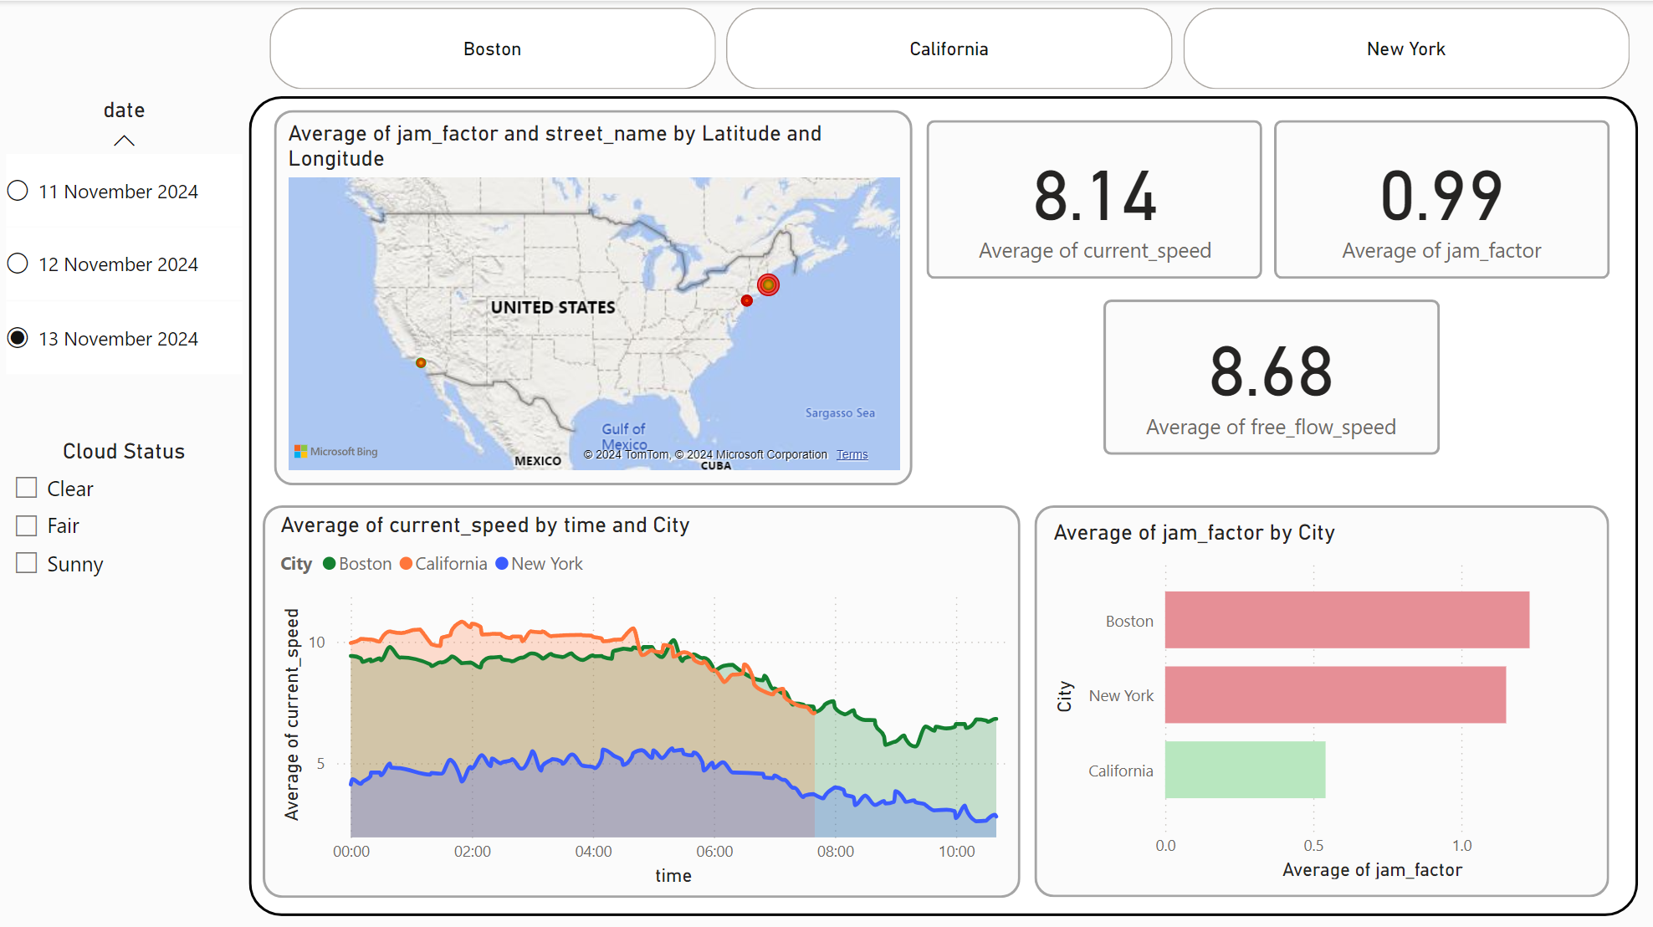

Power Bi

Slide 6


Conclusion
This project demonstrates how Azure’s cloud services can be leveraged to build a comprehensive, real-time traffic monitoring and analytics system. With Azure Functions, Event Hub, Fiber Event Stream, and the KQL database, the solution provides a seamless data pipeline. Power BI delivers real-time insights, enabling traffic management and route planning.
Notes:
Career Benefit: In addition to technical learning, this project serves as a strong portfolio piece for job interviews. It showcases our hands-on experience with big data tools, real-time data processing, and cloud services, which are highly relevant for roles in data analytics, engineering, and cloud computing. This practical experience provides us with concrete examples to discuss during interviews, enhancing our profile for potential employers.

Slide 7


Thank You 😊
Do you need any clarifications?

