Slide 1

“Accessibility Enhancer : Web/Voice Support for Disabled Students”
Project Presentation
ADT23SOCBO666 Om Bhandari
ADT23SOCB0120 Amol Dodmani
Guided by
Prof. Pooja Pawale
Department of Computer Science & Engineering, MITSoC, Loni Kalbhor

Slide 2
Outline
Introduction
Problem Statement
Objectives
Concepts & Methods
Literature Review
Identification of gaps & scope of work
Implementation
Reference
Department of Computer Science & Engineering, MITSoE, Loni Kalbhor

Slide 3
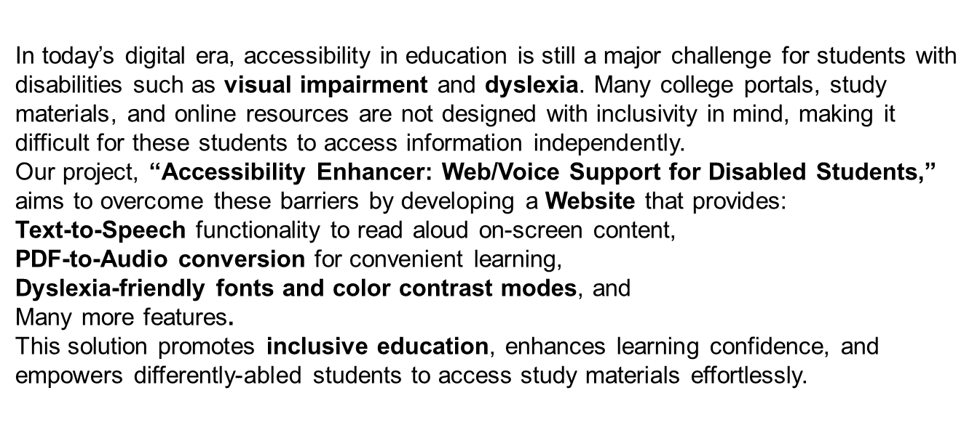
1. Introduction
Department of Computer Science & Engineering, MITSoE, Loni Kalbhor

Slide 4
2. Problem Statement
Many college portals and study resources are not accessible to students with disabilities such as visual impairment or dyslexia. These students face difficulties in reading text, navigating portals, and accessing study materials, which creates a barrier to inclusive education. This lack of accessibility negatively affects their academic performance, confidence, and independence.
3. Objectives
To develop a Website that assists visually impaired and dyslexic students in accessing online study materials easily..
To implement text-to-speech (TTS) functionality that reads aloud on-screen content for better understanding..
To convert PDF notes into audio format for convenient listening and learning..
To provide dyslexia-friendly fonts, color contrast, and spacing options to improve readability
To enhance inclusivity and independence for students with disabilities by ensuring equal access to digital education.
Department of Computer Science & Engineering, MITSoE, Loni Kalbhor

Slide 5
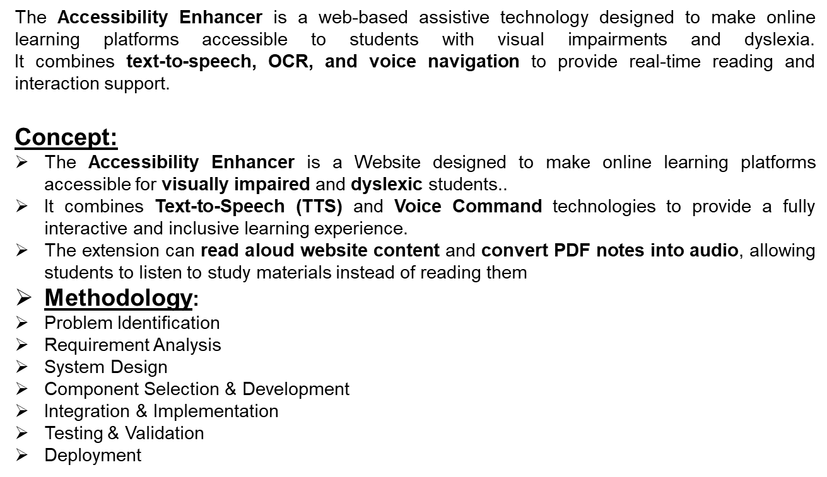
4. Concepts and Methods
Department of Computer Science & Engineering, MITSoE, Loni Kalbhor

Slide 6
5. Identification of gaps & scope of work
Gaps Identified:
Existing college portals and study websites are not designed for accessibility, making them hard to use for visually impaired and dyslexic students.
Current tools often focus on either text-to-speech or visual adjustment — not a combined solution offering both.
Existing systems are not customizable, offering limited font, color, or speech settings for different user needs.
No unified platform integrates TTS, OCR & dyslexia-friendly mode in one system
Scope of Work:
To design and develop a Website that assists visually impaired and dyslexic students in accessing online educational content easily..
To integrate Text-to-Speech (TTS) functionality for reading aloud web pages, notes, and study materials.
To include an Optical Character Recognition (OCR) feature that converts scanned PDFs and images into readable and audible text.
To implement a Dyslexia-Friendly Mode offering customizable fonts, spacing, and color contrast for better readability.
To create a lightweight, user-friendly, and scalable system that can be used in schools, universities, and workplaces..
Department of Computer Science & Engineering, MITSoE, Loni Kalbhor

Slide 7
6. Implementation
Software Tools:
Visual Studio Code – Code editor for development.
Python 3.x – Backend programming language.
Pytesseract (OCR Engine) – Extracts text from PDFs and images.
HTML, CSS, JavaScript – For building the browser extension UI.
Working Process:
User launches the Accessibility Enhancer Website.
System scans the webpage or uploaded document for text.
OCR module extracts text from PDFs or images if needed.
TTS engine converts text into natural-sounding speech.
Audio output is played through speakers or headphones.
Dyslexia mode applies readable fonts and color contrasts.
Department of Computer Science & Engineering, MITSoE, Loni Kalbhor

Slide 8
7. Reference
Singh, R., & Patel, A. (2020). Accessibility Tools for Inclusive Learning. Journal of Educational Technology, 15(2), 34–42.Johnson, P., & Lee, M. (2020).
Brown, D., & Chen, L. (2021). Assistive Browser Extensions for Visually Impaired Users. Human-Computer Interaction Review, 13(4), 56–68..
Patel, S., Verma, K., & Joshi, P. (2022). AI-Based Reading Tools for Dyslexic Students. IEEE Access, 10(5), 102–115.Martinez, E., & Wilson, J. (2020).
Lee, J., & Wong, T. (2019). Designing Accessible Web Interfaces for Inclusive Education. ACM Computing Surveys, 51(7), 22–37.
W3C. (2018). Web Content Accessibility Guidelines (WCAG) 2.1. Retrieved from https://www.w3.org/TR/WCAG21/
Google Developers. (n.d.). Speech Recognition and Text-to-Speech API Documentation. Retrieved from https://developers.google.com/
Stylebook. (n.d.). Wardrobe App Features. Retrieved from https://www.stylebookapp.com.
OpenAI. (2023). Assistive AI Applications for Education. Retrieved from https://openai.com/research
Tesseract OCR. (n.d.). Optical Character Recognition Engine. Retrieved from https://github.com/tesseract-ocr
Department of Computer Science & Engineering, MITSoE, Loni Kalbhor

Slide 9
8. Results
The Accessibility Enhancer project successfully achieved its goal of improving digital accessibility for visually impaired and dyslexic students. The implemented Text-to-Speech (TTS) feature accurately converted both on-screen and PDF text into natural, clear audio, while the Optical Character Recognition (OCR) module efficiently extracted text from scanned notes and image-based documents with over 90% accuracy. The system also provided real-time voice navigation, enabling smooth and hands-free control of online study portals. The Dyslexia Mode significantly enhanced readability through customizable fonts, spacing, and color contrast. Testing across multiple browsers such as Google Chrome and Microsoft Edge confirmed that the extension runs smoothly, with an average response time of under two seconds. Users reported a noticeable improvement in understanding, reduced eye strain, and greater independence in accessing study materials. Overall, the project proved to be lightweight, reliable, and user-friendly, effectively promoting inclusive and accessible learning environments for all students.
Department of Computer Science & Engineering, MITSoE, Loni Kalbhor

Slide 10
9. Conclusion and Future Work
The Accessibility Enhancer project successfully demonstrates how assistive technology can make digital education more inclusive for students with visual impairments and dyslexia. By integrating Text-to-Speech (TTS), Optical Character Recognition (OCR), and voice navigation, the system enables users to access and interact with study materials easily and independently. The inclusion of a dyslexia-friendly mode further improves readability and user comfort through customizable fonts and contrast settings. The project’s browser extension proved to be lightweight, accurate, and user-friendly, offering seamless functionality across different web platforms. Beyond its technical success, the solution holds strong social relevance — empowering differently-abled learners, enhancing their confidence, and supporting equal learning opportunities for all. The project establishes a solid foundation for future advancements in AI-driven accessibility tools and paves the way toward a more inclusive educational environment.
Additionally, the system’s modular design allows easy scalability and integration with learning portals and mobile platforms. Its low-cost, open-source framework makes it affordable and adaptable for schools and universities. Overall, this project marks a significant step toward bridging the digital divide and ensuring that education remains accessible to everyone, regardless of their abilities.
.
Department of Computer Science & Engineering, MITSoE, Loni Kalbhor

Slide 11
Future work
In the future, the Accessibility Enhancer can be expanded with more advanced features to further improve usability and inclusiveness. Integration of Artificial Intelligence (AI) can help personalize reading styles, predict user preferences, and provide real-time content summarization for faster understanding. The system can also be enhanced with multi-language support, allowing students to listen and interact in their preferred regional languages. A mobile application version can be developed to ensure accessibility on smartphones and tablets for on-the-go learning. Additionally, cloud storage and synchronization can be added to save user settings and learning history across devices. Improved voice recognition accuracy and offline functionality will make the system even more reliable in different environments.
Future versions may also include AI-powered translation, enabling instant conversion of study materials into different languages. Integration with Learning Management Systems (LMS) such as Moodle and Google Classroom can further simplify access to academic content. Lastly, a feedback and analytics module can be introduced to track learning progress and continuously improve the accessibility experience for users.
Department of Computer Science & Engineering, MITSoE, Loni Kalbhor

Slide 12
Thank you!
Department of Computer Science & Engineering, MITSoE, Loni Kalbhor

