Slide 1

PROJECT PRESENTATION
On
Building A Machine Learning Model to Forecast Sales
(CSE VI Semester Mini project )
2023-2024
Submitted to: Submitted by:
Miss. Manika Mr.Om Bijalwan
(CC-CSE-G-VI-Sem) Roll. No:2118865
Session: 2023-2024
DEPARTMENT OF COMPUTER SCIENCE AND INFORMATION TECHNOLOGY
GRAPHIC ERA HILL UNVERSITY, DEHRADUN

Slide 2
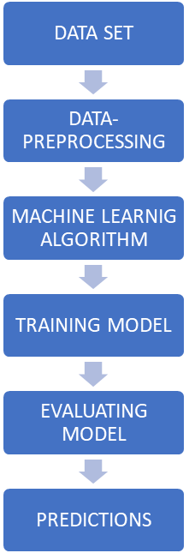
TABLE OF CONTENTS 1.Introduction 2. Data Cleaning 3. Preprocessing Label Encoding Splitting of data Standardization 4. Model Building >Linear Regression >Random Forest Regressor 5.Conclusion

Slide 3
INTRODUCTION
Machine learning is a powerful subfield of Artificial Intelligence that allows computers to learn and improve without being explicitly programmed. Instead of relying on detailed instructions, machine learning algorithms are trained on massive amounts of data. By analyzing this data, the algorithms identify patterns and relationships that enable them to make predictions, classify information, and uncover hidden trends. This data-driven approach essentially allows machines to learn from experience, much like a child learning a new language through exposure and practice..

Slide 4
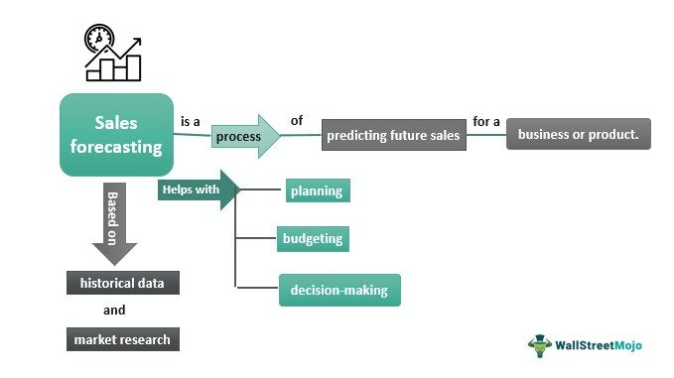
Sales Forecasting
In the ever-changing landscape of business, navigating uncertainty is crucial. For any company, understanding what lies ahead in terms of sales is not just desirable, it's essential. This is where the art and science of sales forecasting comes into play.

Slide 5
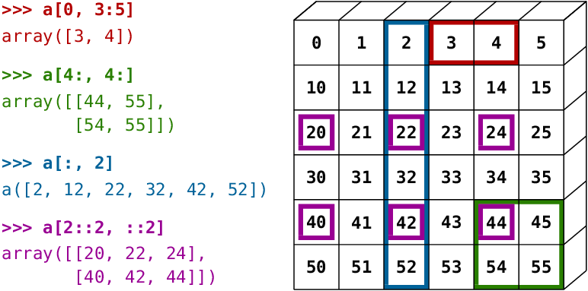
Important Libraries
1. Pandas
Pandas is your data maestro, the master organizer who transforms raw numbers into structured Data Frames and Series. Think of it as a supercharged spreadsheet on steroids, where data manipulation becomes a seamless ballet of filtering, cleaning, and merging. With Pandas, you can explore trends, calculate statistics, and slice your data with laser precision, uncovering hidden insights within.
2. Numpy
NumPy is the computational powerhouse, the behind-the-scenes magician who crunches numbers with lightning speed. Its multidimensional arrays, akin to powerful matrices, are the playgrounds for complex calculations, vectorized operations, and advanced scientific computations. NumPy fuels the engine of your analysis, ensuring even the most demanding tasks are tackled with effortless efficiency.

Slide 6
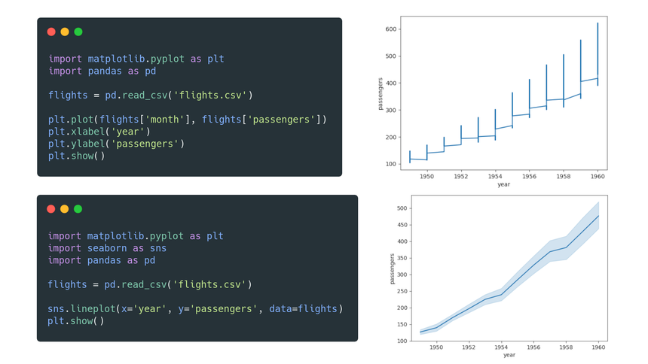
3. Matplotlib
Matplotlib is the visual storyteller, the artist who breathes life into your data. Its canvas is diverse, offering a multitude of plot types, from simple line graphs to intricate histograms and bar charts. You can customize fonts, colors, and layouts to your heart's content, shaping your data into compelling narratives that speak a thousand words. Matplotlib's interactive capabilities let you zoom, pan, and explore, adding a dynamic layer to your visualizations.
4. Seaborn
Seaborn is the statistician's stylist, the artist who elevates Matplotlib's creations to stunning heights. It builds upon Matplotlib's foundation, infusing statistical knowledge into the aesthetic. Seaborn focuses on revealing relationships and trends within your data, crafting visually appealing histograms, boxplots, and violin plots that highlight statistical significance. With Seaborn, your visualizations not only tell a story, but they do so with statistical rigor and undeniable beauty.

Slide 7
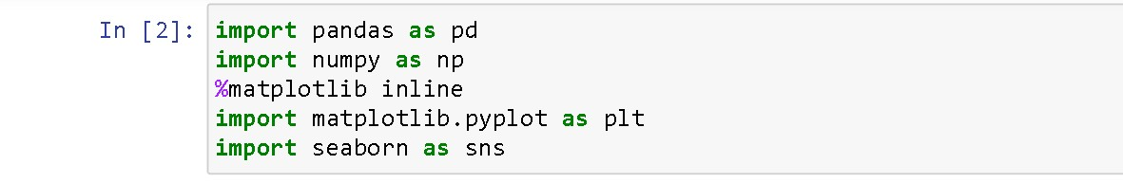

Slide 8
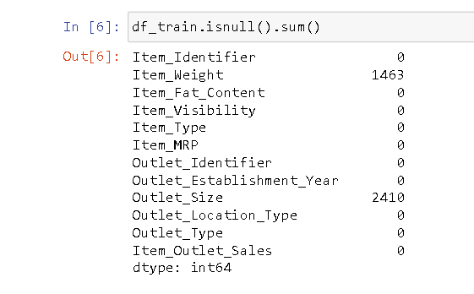
Data Cleansing
Data cleansing is the process of identifying and correcting or removing errors and inconsistencies from a dataset to ensure its quality, accuracy, and usefulness for analysis and modelling. It's a crucial step in any data-driven project, as it directly impacts the reliability of your insights and predictions.
Common data cleansing tasks include:
1. Handling Missing Values:
Identify missing values (NaNs, blanks, or inconsistent placeholders).
Choose appropriate strategies based on data type and importance:
Remove rows or columns with excessive missingness.
Impute missing values using mean, median, mode, or predictive models.

Slide 9
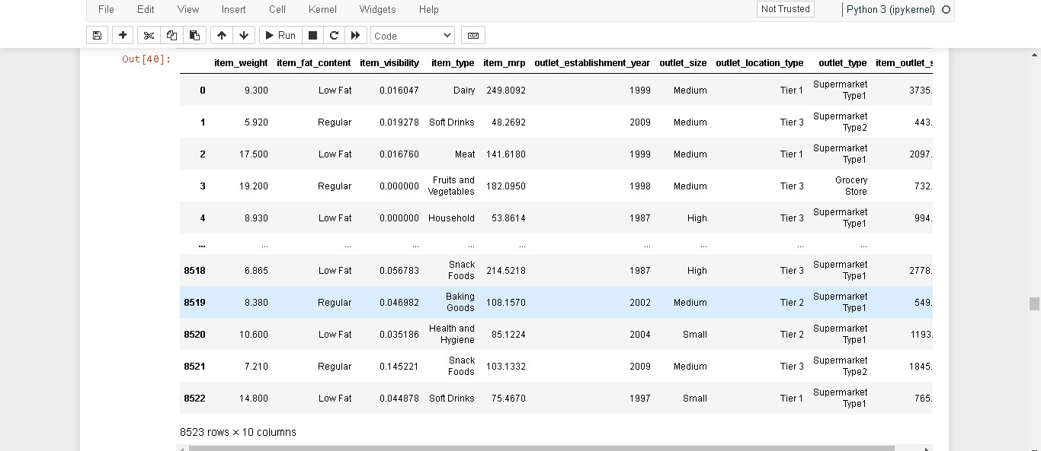
2, Identifying and Correcting Errors:
Detect typos, inconsistencies, out-of-range values, or invalid formats.
Correct errors based on domain knowledge or data validation rules.
3. Removing Duplicates:
Identify and remove duplicate rows that represent the same data point.

Slide 10
Preprocessing
Before feeding your data to hungry machine learning models or building insightful analyses, it needs a good pre-processing makeover. Think of it as taking your data from raw ingredients to a perfectly seasoned dish ready to impress. Here's a breakdown of the three processes you mentioned:
1. Label Encoding: Transforming Categories into Numbers
Imagine your data has categories like "red", "green", and "blue". While models understand numbers better than colors, directly feeding these strings wouldn't do! Label encoding comes to the rescue by assigning unique numerical values to each category. Now, "red" might be 1, "green" might be 2, and "blue" might be 3, making the data machine-friendly without losing the meaning of categories.

Slide 11
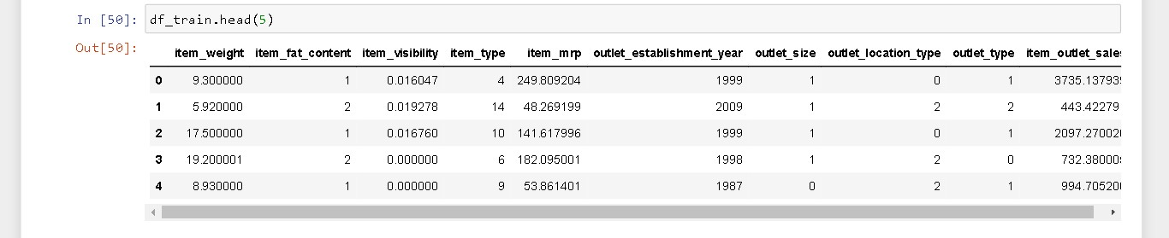

Slide 12
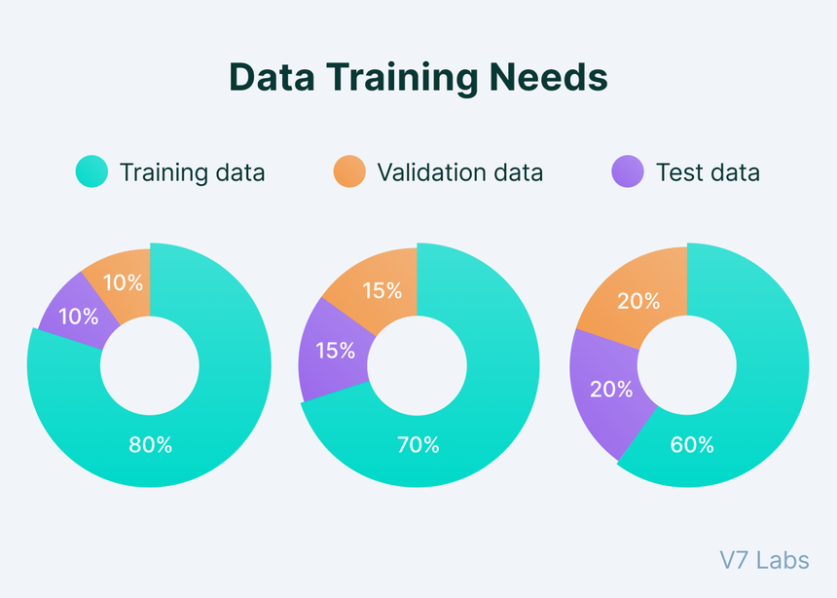
2. Splitting the Data: Training, Validation, and Testing
Think of your data as a delicious cake. You wouldn't eat the whole cake before knowing how good it is, right? Similarly, we split our data into training, validation, and testing sets. The training set is the main course, where the model learns the patterns and relationships within the data. The validation set is like a small side dish, used to fine-tune the model and check its performance on unseen data. Finally, the testing set is the dessert, revealing the model's true accuracy on completely new data
3. Standardization: Scaling Everyone to the Same Level
Imagine athletes competing in a race where some have longer legs than others! To ensure a fair contest, we standardize the data by scaling features to a common range, often between 0 and 1. This removes biases caused by features with vastly different scales, ensuring all features get equal consideration when the model learns.

Slide 13
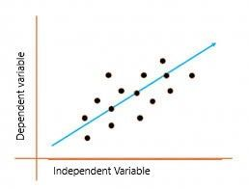
Model Building
Model building in machine learning is like constructing a magnificent building; you lay the foundation with data, choose the right architectural style (model type), and carefully assemble the components to achieve your desired outcome. In this case, we'll explore two popular building materials for regression tasks: linear regression and random forest regressor.
Linear Regression: Imagine a clean, minimalist building with elegant lines. That's linear regression! It assumes a linear relationship between your feature variables (independent variables) and your target variable (dependent variable). Think of it as a straight line that best fits the points in your data.

Slide 14
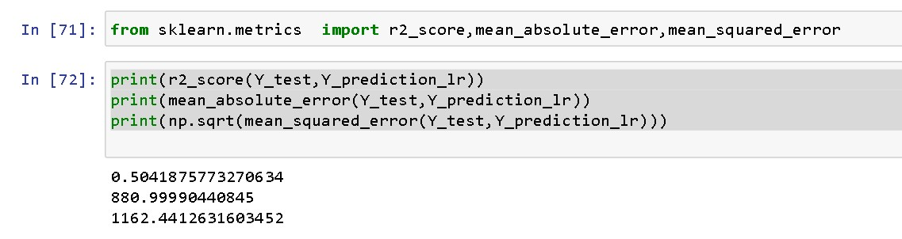
RESULT
linear regression(50.4%)

Slide 15
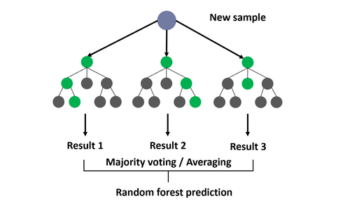
Random Forest Regressor:
Picture a vibrant, eclectic building formed by combining different architectural styles. This is the random forest regressor! It creates an ensemble of many decision trees, each predicting the target variable based on a subset of features and random splits. The final prediction is the average of all individual trees.

Slide 16
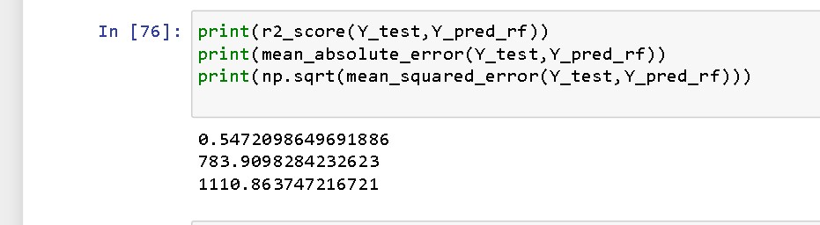
Result:
random forest (54.7%)

Slide 17
Conclusion
While algorithms for sales and price prediction offer immense potential for businesses, they are not a silver bullet. Their accuracy relies heavily on good data, and their limitations, like lagging indicators and overfitting, must be considered.
While Random Forest Regression offers a simple and effective starting point, exploring other models and prioritizing data quality are crucial for reliable predictions.
Ultimately, success lies in combining the power of algorithms with human expertise and business acumen to navigate the evolving market landscape.
S.no | Model | R2 Score
1. | Linear regression | 0.50418757732706
2. | Random forest | 0.54720986486918

