Slide 1


NOAH PROGRAMMING LANGUAGE
SER502 Team 15 |Notation for Optimized Algorithmic Handling

Slide 2
TEAM MEMBERS
1. Om Rajesh Chauhan (1233682894)
2. Aksh Rajesh Chauhan (1233618037)
3. Harsh Sanjay Gohel (1233613227)
4. Nisarg Hemal Desai (1233606714)

Slide 3

PROJECT OVERVIEW
NOAH (Notation for Optimized Algorithmic Handling) is a programming language designed to blend robust static typing with the flexibility of modern paradigms. This project, developed as part of the SER502 course, demonstrates the implementation of a high-performance, compiled language with advanced constructs for real-world use cases.

Slide 4
PROJECT OBJECTIVES
Design a statically typed, high-performance language.
Implement a robust parser and interpreter using ANTLR. Provide modern programming constructs for flexibility and usability.
Demonstrate key features with well-documented sample programs.
Ensure cross-platform compatibility and ease of use.

Slide 5
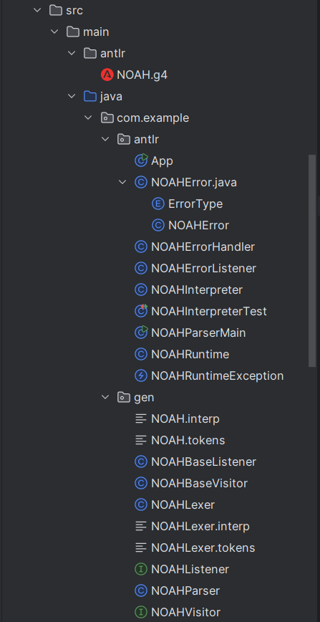
PROJECT ARCHITECTURE
Components:
1. Lexical Analyzer
Token generation
Pattern matching
Error detection
2. Parser
Abstract Syntax Tree creation
Grammar rule implementation
Syntax validation
3. Interpreter/Runtime Environment
Code execution
Memory management
Output handling

Slide 6
CORE LANGUAGE FEATURES
Data Types:*
- Boolean (true/false)
- Numeric (int, float)
- String with operations
Operators:*
- Arithmetic: +, -, *, /
- Boolean: and, or, not
- Relational: <, >, ==, !=
Control Structures:*
- Conditional statements
- Loop constructs
- Basic I/O operations
• Statically typed with compile-time type checking.
• Supports modern constructs such as conditional statements, loops, and operators.
• It Includes robust error handling mechanisms.
• Provides clear syntax and readability for developers.

Slide 7
GRAMMAR IMPLEMENTATION AND TOKEN DEFINITIONS
grammar NOAH;
program: statement* EOF;
statement: assignment
| ifStatement
| forLoop
| whileLoop
| printStatement;
*Features:*
- EBNF notation
- Clear syntactic rules
- Comprehensive expression handling
Token Types:*
- Keywords: if, else, for, while, print, true, false
- Operators: +, -, *, /, <, >, ==, !=, and, or, not, ?, :
- Delimiters: (, ), {, }, ;, =
- Identifiers: [a-zA-Z_][a-zA-Z0-9_]*
- Numeric literals: [0-9]+(\.[0-9]+)?
- String literals: "[^"]*"

Slide 8
PARSER AND INTERPRETER
The NOAHParserMain module converts NOAH code into an Abstract Syntax Tree (AST) and provides detailed error messages for syntax issues, ensuring code validity.
The NOAHInterpreter processes the AST, executing nodes sequentially while managing variable declarations, evaluating expressions, and implementing control structures for program execution.

Slide 9
SAMPLE PROGRAMS
Program Types:-
variables.noah: Variable operations
operators.noah: Operator demonstrations
booleans.noah: Logical operations
control_flow.noah: Control structures
loops.noah: Iteration examples
logical1.noah: Nested conditionals

Slide 10
RUN INSTRUCTIONS
How to Run NOAH Programs
Steps:-
Navigate to project root
2. Execute command:Bash
java -cp target/classes com.example.antlr.NOAHParserMain data/sample.noah

Slide 11
SYSTEM SUPPORT AND DEVELOPMENT TOOLS
Supported Operating Systems:
Windows 10 and above
macOS 10.15 (Catalina) and above
Linux (Ubuntu 20.04 LTS and above)
Development Tools:
ANTLR (4.13.2): Lexer and parser generation.
GitHub: Version control and CI/CD pipelines.

Slide 12
FUTURE DEVELOPMENT
Planned Features:-
Extended type system
Advanced error recovery
Performance optimization
Additional language constructs
Enhanced testing framework

Slide 13
CONCLUSION
Key Achievements:-
- Successful implementation of a new programming language
- Robust grammar and parser development
- Comprehensive testing and documentation
- Efficient team collaboration

Slide 14
TEAM CONTRIBUTIONS
Aksh Rajesh Chauhan:-
- Grammar rule definition
- Regular expression development
- Lexer optimization
Om Rajesh Chauhan:-
- ANTLR configuration
- Parser integration
- Error handling implementation
Nisarg Hemalkumar Desai:-
- Test program development
- Parser verification
- Designed sample NOAH programs
Harsh Sanjay Gohel:-
- Developed Interpreter
- Assisted in Testing & Integration
- Documentation & Repository management

Slide 15
THANK YOU

