Slide 1
E-Commerce Performance & Cart Abandonment Risk Analysis
Business Analyst Final Project

Slide 2
Executive Summary
• Scenario: High cart abandonment & declining sales • Analysis performed using SQL, BPMN, Tableau • Key finding: Abandonment proxy = 0.63% • Major risk: Delivery delays affecting satisfaction • Recommendation: Proactive operational & retention strategy

Slide 3
Business Problem
Business Concerns: • High cart abandonment • Revenue volatility • Customer dissatisfaction
Challenge: No explicit cart event data available.
Solution: Use behavioral and operational proxies.

Slide 4
Data Sources & Analytical Approach
Tools Used: • SQL (BigQuery) • BPMN Process Modeling • Tableau Dashboard
Analysis Focus: • Revenue trends • Order volume • Abandonment proxy • Customer segmentation • Delivery performance

Slide 5
SQL Key Findings
Revenue: • Strong growth in 2017 • Volatile 2018
Cart Abandonment (Proxy): • 0.63% cancellation rate
Delivery Impact: • 1-star reviews → 20.85 days delivery • 5-star reviews → 10.22 days delivery

Slide 6
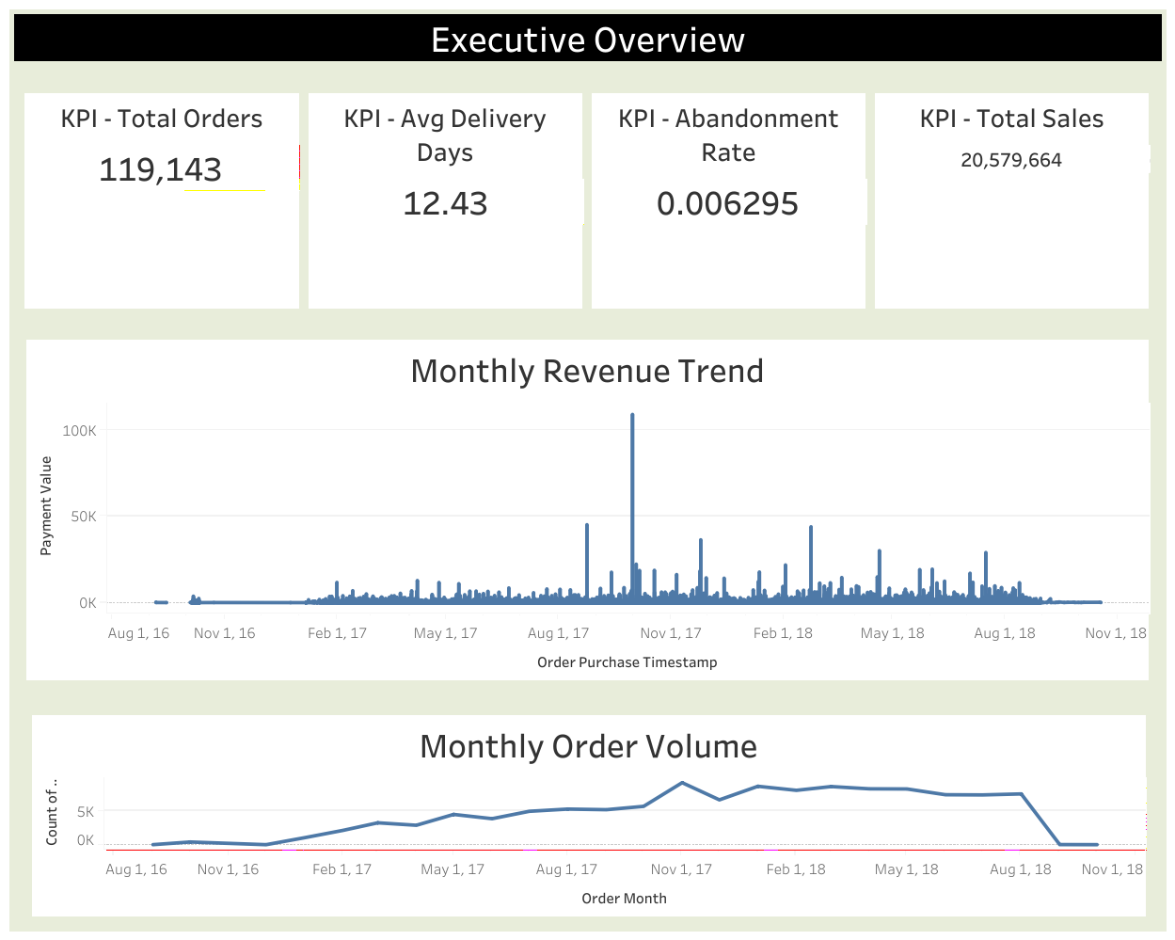
Dashboard Overview
Executive KPIs: • Total Sales • Total Orders • Abandonment Rate • Avg Delivery Days
Interactive Filters: • Month • State • Customer Segment

Slide 7
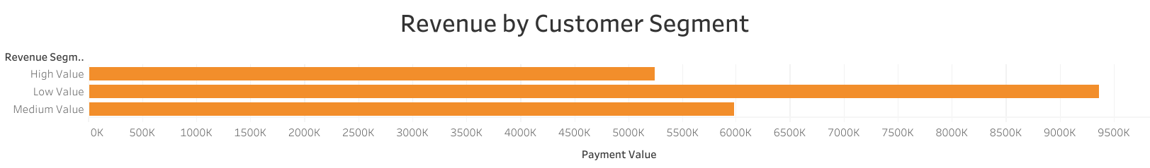
Customer Insights
Customer Segmentation: • High Value • Medium Value • Low Value
Observation: Low-value customers collectively generate the largest revenue share due to volume.
Insight: Revenue is volume-driven rather than dependent on a small premium segment.
Risk: Operational inefficiencies affecting mass customers may impact revenue stability.

Slide 8
Customer Insights
Customer Segmentation: • High Value • Medium Value • Low Value
Observation: Revenue concentrated among high-value customers.
Risk: Service failures may impact revenue disproportionately.

Slide 9
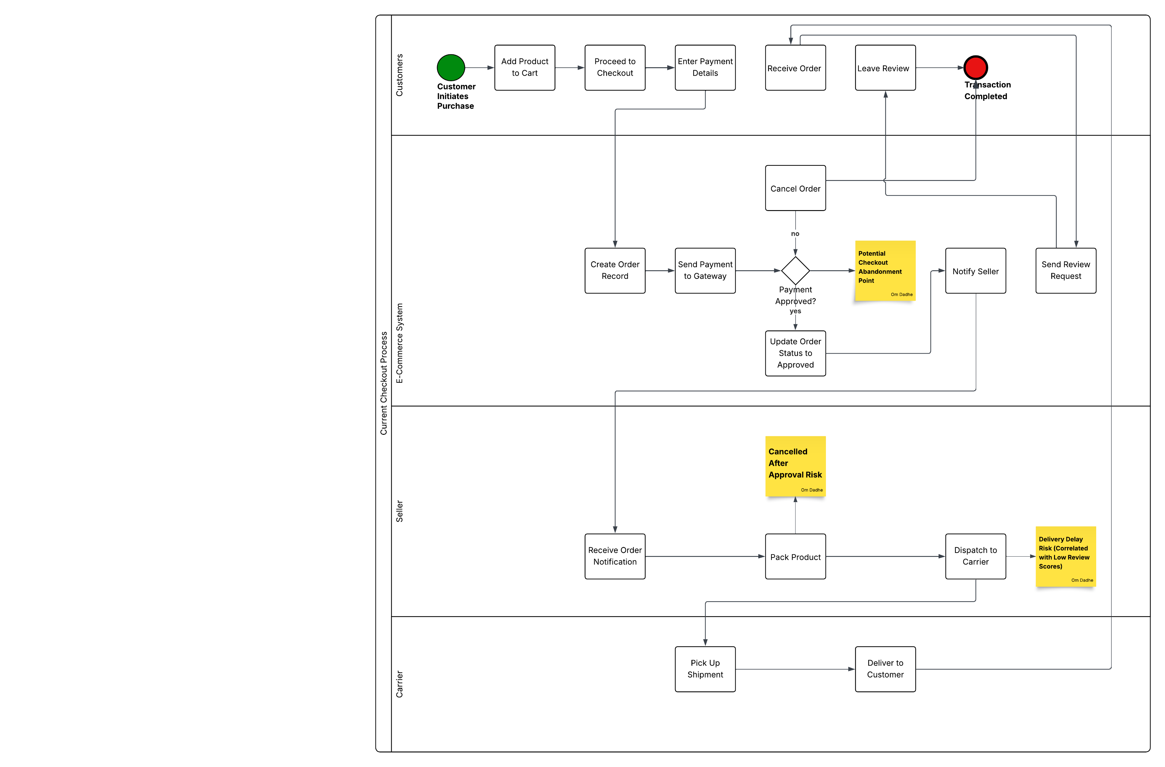
Checkout Process (BPMN) - 1
Current State: • No payment retry • No SLA monitoring • Reactive process

Slide 10
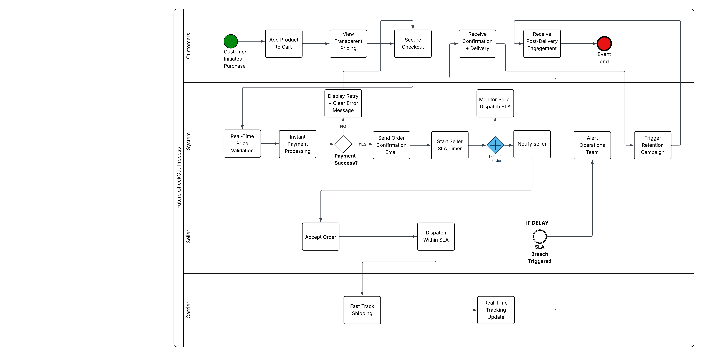
Checkout Process (BPMN) - 2
Future State: • Transparent pricing • Retry mechanism • SLA alerts • Retention triggers

Slide 11
Recommendations
Improve Delivery SLA Monitoring
Introduce Checkout Retry Mechanism
Launch Retention & Loyalty Programs
Monitor Cancellation Spikes
Target High-Value Customers

Slide 12
Business Impact Projection
Expected Improvements: • Reduced dissatisfaction • Improved retention • Revenue stability • Lower operational risk
Projected Outcome: • 5–10% revenue stabilization • Improved review scores • Higher repeat purchase probability

Slide 13
Next Steps
Phase 1: Implement SLA monitoring
Phase 2: Enhance checkout recovery
Phase 3: Deploy retention campaigns
Phase 4: Monitor dashboard KPIs monthly

Slide 14
Q&A
That concludes my presentation. I welcome any questions.
Thank You!

