Slide 1

project Presentation Om Dankhra (040998226) Jeel Asalalia (041002504)
business intelligence and data analytics

Slide 2
Data collection
Maryland Department of the Environment (MDE) - Air and Radiation Administration (ARA) Complaints
Reference for the Dataset: https://opendata.maryland.gov/Energy-and-Environment/Maryland-Department-of-the-Environment-MDE-Air-and/crti-ybyp
There are 10 attributes and 625 instances in this dataset. The Maryland Department of the Environment (MDE) provides this data. This dataset gives a comprehensive overview of air quality and other radiological health complaints. We will be able to track the complaints made by people living in different areas of Maryland.

Slide 3

Introductory question
Out of all the categories, why odor complaints were reported more and in which city of the state is have more complaints? Were all the complaints were solved and how?

Slide 4

Pre-processing
With the use of Microsoft Excel software, the attributes that were not beneficial in the observation and analysis for the final conclusions were eliminated from the dataset, and some were transformed to nominal attributes with ranges for better comprehension.
There were 10 attributes at the initial stage of this dataset later after the data cleaning After cleaning the dataset we got 6 attributes only which can be helpful for our data observation.

Slide 5
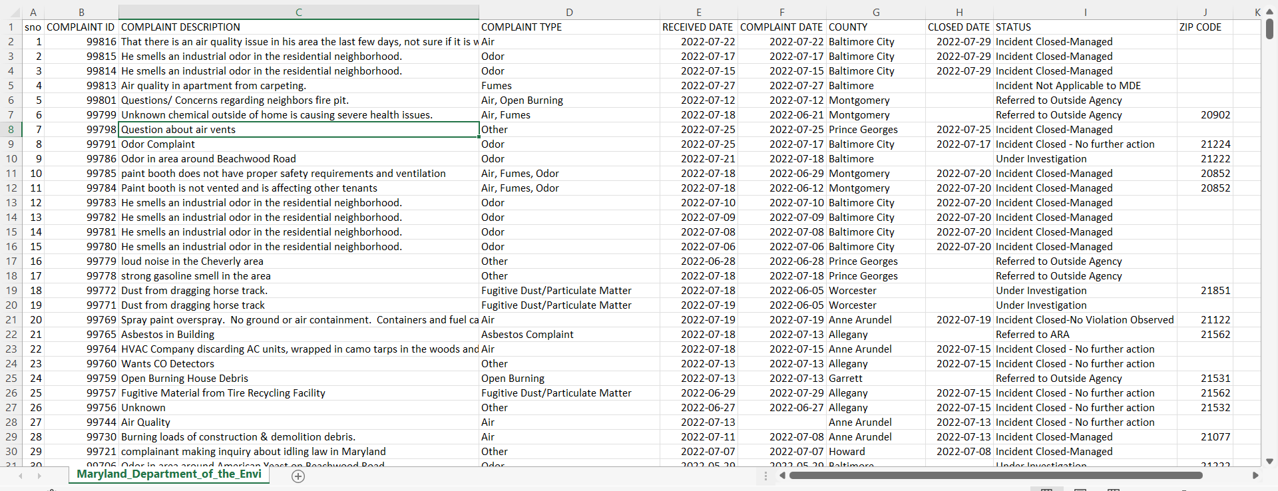
Pre-processing
This was the dataset which we got initially before pre-processing.
After cleaning the dataset we got 6 attributes only which can be helpful for our data observation. The final attributes will be presented in next slide.

Slide 6
After cleaning data
Attribute Name | Description of Attribute
Complaint Description | Contains detailed description on the issue.
Complaint Type | Breakdown of complaint types.
Complaint Received Date | The date complaint was received.
County | Region used for administrative or other purposes
Closed Date | Date on which the complaint was closed due to completion (if has any).
Status | Status of the complaint raised.
This are the final 6 attributes which we have pulled out of the 10 attributes. This attributes can help us defining our question properly.

Slide 7
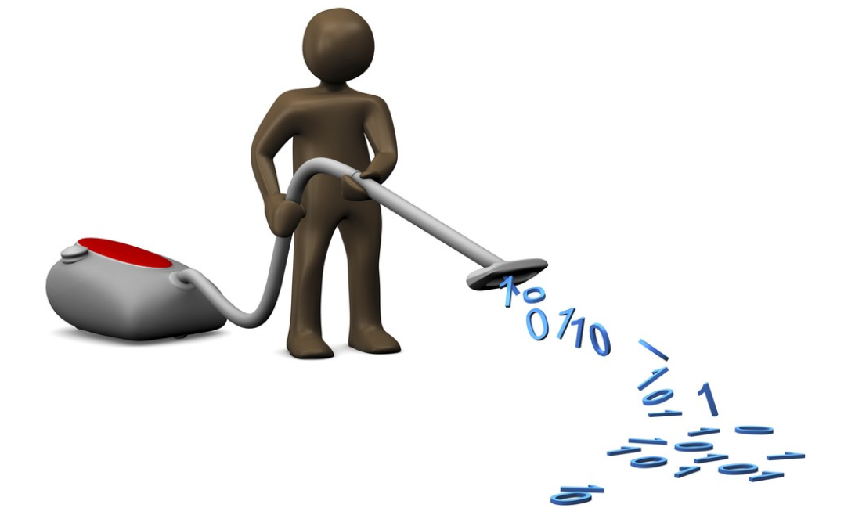
Cleaning data
We deleted four attributes: "SNO," "COMPLAINT_ID," "COMPLAINT_DATE," and "ZIP-CODE," as well as removing duplicates of the data. We made those adjustments after sorting out our dataset and noticing that a few properties will not be required to identify our main aim.
Going forward, we renamed “received date” to “complaint received date”, because earlier we deleted the complaint date attribute, which displayed the date the complaint was made on, and received date was original date the complaint was received, so we merged the two.

Slide 8
Cleaning data
We later removed Zip code because it was missing in more than 70% of the data.

Slide 9
Value types and count
Attributes | Value Type | Count
Complaint Description | String | 440
Complaint Type | Nominal | 38
Received Date | Numeric | 338
County | Nominal | 25
Closed Date | Numeric | 228
Status | Nominal | 9
This is the data which we have finalized and the number of counts.

Slide 10
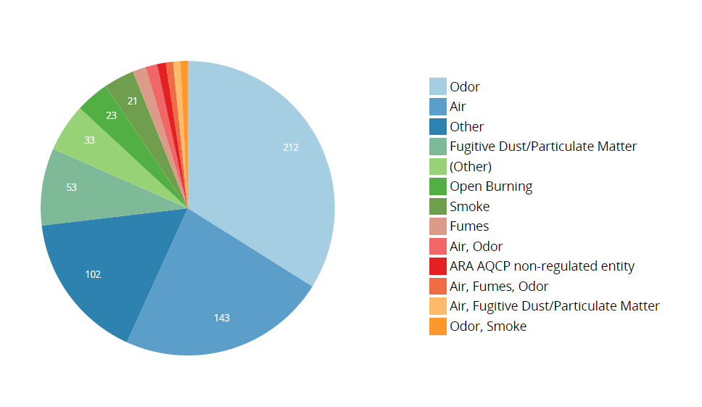
Data analysis
Complaint Types
We differentiated the complaint types, who were allocated into the following nominal categories: Odor, Air, Other, Fugitive Dust/Particulate Matter, Open Burning, Smoke, Fumes, etc.
As you can see, the overall number of complaints was 625 with 34% of complains were about Odor (212), 23% of Air (143), 16% of Other (102) complaints as mentioned by people while reporting the complaint that means complaint type was mentioned while reporting it and all other complaint types like Open burning, Fumes, Fugitive dust, smoke and ARA AQCP non-regulated entity was 27% (168).

Slide 11
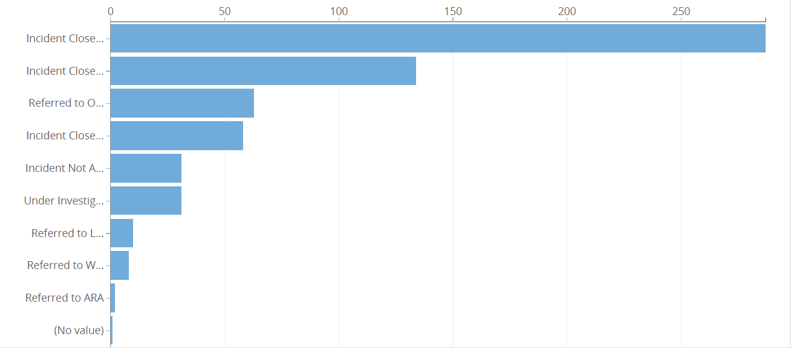
Data analysis
We now proceed to examine the last known status of the complaint. As we can see, this quality has 10 different types: Incident Closed-Managed, Incident Closed - No further action, Referred to Outside Agency, Incident Closed-No Violation Observed, Incident Not Applicable to MDE, Under Investigation, Referred to LMA, referred to WMA, referred to ARA, no value (Unknown/ not completed).
A given photo can be used to see the different completion numbers of the Complaint types.
Last known status of the complaint

Slide 12
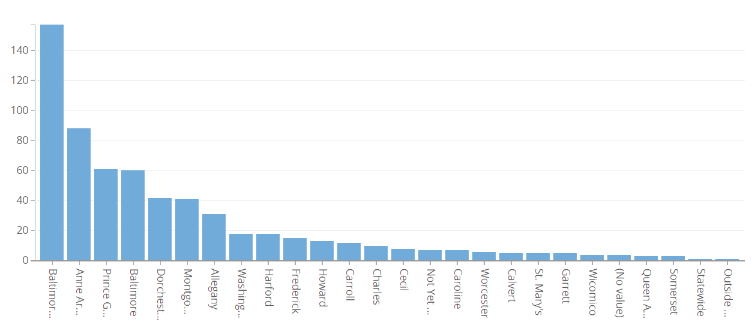
Data analysis
number of complaints from different county
The highest number of complaints raised are from Baltimore City 35% (217) that is total of one third of the data. People of Anne Arundel also had issues and raised 88 complaints that’s 14%. So, these two cities had nearly 50% of the air and radiation related issues. By this data we can assume that the amount of air pollution in these two cities of Maryland is highest.
Carroll and Fredrick have only 2% of total complaints each and would be great in keeping the cities are clean.

Slide 13

Data analysis
For further categorization, we chose basic K Nearest Neighbor (KNN).

Slide 14
Knn algorithms
Status | TP Rate (KNN 1) | TP Rate (KNN 3) | TP Rate (KNN 5) | TP Rate (KNN 7)
Incident Closed-Managed | 0840 | 0.804 | 0.797 | 0.811
Incident Not Applicable to MDE | 0.129 | 0.129 | 0.000 | 0.000
Referred to Outside Agency | 0.290 | 0.306 | 0.306 | 0.306
Incident Closed - No further action | 0.556 | 0.444 | 0.421 | 0.389
Under Investigation | 0.161 | 0.065 | 0.065 | 0.065
Incident Closed-No Violation Observed | 0.632 | 0.544 | 0.596 | 0.596
Referred to ARA | 0.000 | 0.000 | 0.000 | 0.000
Referred to LMA | 0.444 | 0.000 | 0.000 | 0.000
Referred to WMA | 0.000 | 0.000 | 0.000 | 0.000
Correctly Classified Instances | 61.4498 % | 55.6837 % | 54.6952 % | 54.6952 %
KNN algorithms were used on this data set to determine Is the complaints were solved or not and to check how it was completed.
KNN algorithms was run on the different values of K (1, 3, 5, 7, 9, 11, 13, 15).
As an outcome, the accuracy obtained for the K value of 1 is 61.4498 percent.

Slide 15
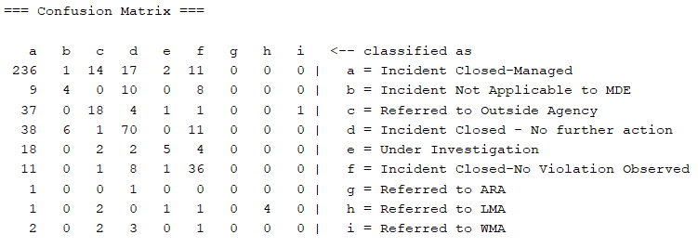
Confusion matrix of knn”1”
From the matrix, it is clearly determined that most of the Incident Closed by Managing it.

Slide 16

Results of KNN
Now, I would like to discuss results from our data analysis.
While performing K nearest neighbour(KNN) we concluded that 86% of complaints were closed by managing it.

Slide 17

Conclusion
For the conclusion I would like to address our question for which we did this analysis.
I'd want to break down my questions into three parts: 1) “Out of all kinds of complaints, which type of complaint was reported the most ?" As we previously noted in data analysis, "Odor" was the most reported complaint. 2) “Where was the more complaints reported?" According to our findings, We got almost 1/3 complaints from “Baltimore city". 3) “Were all complains were solved and how?" according to our KNN analysis, we can clearly state that 86% of the complaints were closed/solved by managing them.

Slide 18

Thank you so much everyone

