Slide 1

ShopMind AI
Autonomous Agentic Commerce Assistant & Real-Time Merchant Observability Platform
RAZORPAY AGENTIC AI COMMERCE CHALLENGE — TRACK 01: AI GROWTH & AGENTIC COMMERCE
Live App
Live Dashboard
shopymind.vercel.app
shopymind.vercel.app/dashboard.html
What It Is
What Makes It Different
A dual-agent commerce system that transforms passive product catalogs into proactive, accountable shopping experiences — powered by bounded tool-calling, not hallucination.
Every AI action is logged, every state mutation is user-gated, every rupee of incremental revenue is isolated and measured. Built for auditors and engineers, not just shoppers.

Slide 2

The Problem: Four Friction Points
Commerce funnels are leaking revenue at every stage — and merchants have no visibility into why.
🔍 Rigid Search & Filter Fatigue
🛒 Cart Abandonment Crisis
Keyword-based discovery and complex spec filters cause decision paralysis for shoppers navigating nuanced product choices. "Gaming laptop under ₹80k with 16GB RAM" cannot be answered by a faceted search UI.
~70% of carts are abandoned due to unanswered questions and checkout friction. That is not a UX problem — it is a revenue hemorrhage that compounds at scale.
📦 Blind Upselling
📊 Merchant Black-Box Blindspots
Generic recommendation widgets annoy rather than convert. There is no signal on what actually moves customers, and no feedback loop to improve. The system fires in the dark.
Zero visibility into customer hesitation, upsell failure reasons, or true intent before drop-off. Merchants are flying blind on the most consequential moments in the funnel.
Every one of these friction points is a solvable engineering problem — not a product gap. ShopMind AI treats them as such.

Slide 3
Why Now: The Protocol Race & Merchant Appetite
The Protocol Race
Infrastructure Is Already Ready
Agent-to-agent commerce is the defining open problem in payments infrastructure right now. NPCI's UAP, ACP, AP2, and x402 are all racing to standardize the protocol layer. The winner will own the rails for autonomous commerce at scale.
This is not a future-state problem. Standardization debates are happening in working groups today, and the first credible auditable agentic solution will set the reference implementation.
Razorpay's in-app agentic pilots are already live — proving both merchant appetite and platform readiness. The backend payment rails, webhook infrastructure, and SDK surface area required to build ShopMind AI exist and are production-grade.
The Gap That Remains
What doesn't yet exist is a credible, auditable agentic commerce layer that:
Does not hallucinate products or prices
Surfaces explainable decision traces to merchants
Gates state-mutating actions behind human approval
Measures incremental AI revenue in isolation
Infrastructure ✓
Demand ✓
Razorpay SDK, Postgres, Vercel Serverless — all production-ready today
Merchant appetite validated by Razorpay's own agentic pilots
Protocol Window ✓
Credible Solution ✗
UAP, ACP, AP2, x402 — standardization race is live and unresolved
No auditable, non-hallucinating agentic layer exists at production quality — until now

Slide 4
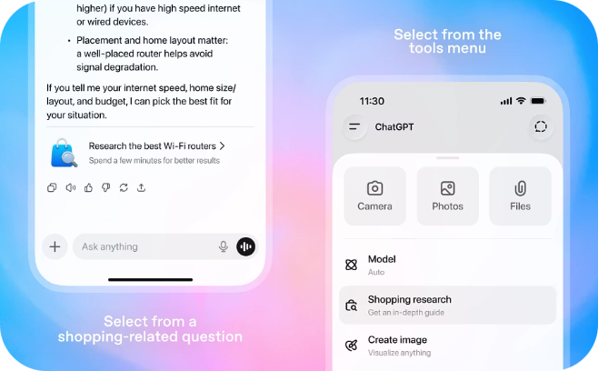
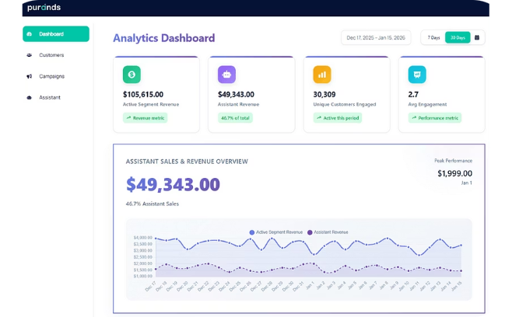
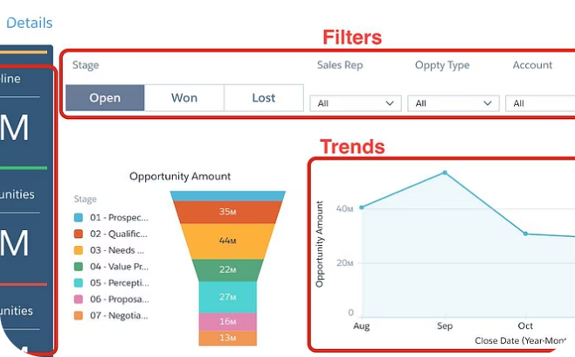
Solution: Dual-Agent Architecture
Two purpose-built agents, one observability layer. Each component has a defined scope, bounded tool set, and deterministic execution path.
Customer-Facing Commerce Agent
Autonomous Campaign Orchestrator
Merchant Intelligence Dashboard
Real-time AI-assisted vs. organic revenue split, full audit trail, and AI decision-trace visibility. Every action the agent took, every user approval, every outcome — surfaced for merchant review.
Natural-language shopping copilot powered by gemini-3.5-flash. Zero hardcoded product knowledge. Operates exclusively through deterministic tool-calling:
Background agent scanning abandoned carts and issuing tiered nudges and discounts to recover revenue. Operates on a configurable schedule with merchant-defined discount tiers — no manual intervention required.
search_products
compare_products
check_customer_owns
get_complementary_products
add_to_cart
initiate_checkout
Transforms passive catalogs into proactive, accountable commerce. Every decision is traceable. Every action is bounded.

Slide 5
End-to-End Flow: Session to Payment
Ten deterministic steps from session initialization to merchant-visible outcome. No step is skipped; no state mutation is ungated.
01
02
Session Init
NL Spec Discovery
User opens app; session created with unique session_id
Customer describes need: "laptop under ₹80k for gaming"
03
04
Tool-Calling Search
Customer Selection
search_products queries Postgres, returns structured comparisons
User picks an item from agent-presented results
05
06
Human-in-the-Loop Gate
Proactive Upsell
Explicit ✓ Confirm / ✕ Cancel pause before any state mutation executes
On confirm: get_complementary_products + check_customer_owns for relevant add-ons
07
08
Checkout Handoff
Payment Verification
initiate_checkout creates immutable order snapshot; triggers Razorpay Checkout modal
verify_payment_signature (HMAC-SHA256) validates Razorpay webhook
09
10
Atomic Transaction
Merchant Review
Postgres row locks (FOR UPDATE) decrement inventory, mark order paid, empty cart
Outcome surfaces on dashboard with full decision trace and attribution tag

Slide 6

The Attribution Engine: Revenue-Growth Proof
Every cart item is tagged at insertion with a source: ai_recommendation, ai_upsell, or organic. An order is flagged ai_assisted = true if any item originated from the AI; false only if 100% organic. This makes incremental AI revenue mathematically isolatable.
Core Attribution Formulas
Why This Matters to Judges
AI-Assisted %
Attribution is the mechanism that makes growth claims verifiable — not anecdotal. With these five formulas, a merchant can answer:
(AI-Assisted Orders / Total Paid Orders) × 100
What fraction of my revenue did the AI touch?
Did AI-assisted carts have higher AOV than organic ones?
Which upsell offers are actually converting?
What is the AI's net contribution to session-level conversion?
Average Order Value
AOV = Total Revenue / Total Orders
Audit Guarantee
Upsell Revenue
Every rupee of incremental revenue is isolated, measured, and auditable. No claim in the dashboard is computed from estimates — all figures derive directly from tagged rows in the orders and cart_items tables in Postgres.
Σ upsell_amount WHERE upsell_accepted = true
Upsell Acceptance Rate
Source tags are written at add-to-cart time and are immutable — they cannot be reattributed after the fact.
(Accepted Upsell Add-to-Carts /
Total Upsell Add-to-Carts) × 100
Conversion Rate
(Sessions with Paid Orders /
Total Active Sessions) × 100

Slide 7
The Bar: Explainable & Bounded
Two of the hardest requirements in agentic commerce — plain-English explainability and strict operational bounds — are both non-negotiable design constraints in ShopMind AI, not afterthoughts.
Explainable: Every Action Has a Decision String
Bounded: Tool-Calling Is the Only Execution Path
Every AI action logs a plain-English decision string to the ai_actions table at execution time. There is no post-hoc rationalization — the log entry is written before the tool result is returned to the user.
Example decision string:
The agent has zero hardcoded product knowledge. It cannot fabricate a product name, a price, a stock count, or a specification. Every piece of data it returns to the user came from a deterministic tool call against live Postgres state.
What this means in practice:
"Customer requested a coding laptop under ₹80k; selected Asus TUF with RTX 4050 and 16GB RAM."
If a product is out of stock in Postgres, the agent cannot recommend it
If a price was updated 30 seconds ago, the agent sees the updated price
If a tool call fails, the agent surfaces the failure — it does not guess
This string is surfaced verbatim in the merchant dashboard, in the audit trail, and in any failure report. No black-box reasoning. No probabilistic scores that require interpretation. A merchant with no ML background can read exactly why the agent made the recommendation it did.
Tool outputs are the source of truth. The LLM's role is routing and reasoning over structured tool results — not generating product data from parametric memory.
Decision Logged
Data From Postgres Only
Hallucination-Proof
Plain-English string written to ai_actions before tool result returns
All product data sourced from live DB via deterministic tool calls — no LLM parametric memory
Agent cannot recommend what doesn't exist in the database at query time

Slide 8
The Bar: Gated & Audit Trail
Autonomous does not mean unaccountable. Every consequential action in ShopMind AI is either gated behind explicit user approval or recorded with full context for post-hoc audit.
Gated: Human-in-the-Loop on Every State Mutation
Audit Trail: The ai_actions Table
Every state-mutating action — add_to_cart, initiate_checkout — pauses execution and presents an explicit ✓ Confirm / ✕ Cancel decision to the user before executing. The backend will not proceed without a recorded approval flag.
What this prevents:
Every tool call — read or write — is persisted as a structured row. The schema below is the source of truth for all dashboard metrics, failure reports, and compliance reviews:
Column | Example Value
session_id | sess_abc123
tool_name | search_products
input | "gaming laptop ₹80k"
output | [Asus TUF, Dell G15, ...]
decision | "selected Asus TUF"
user_approved | true
success | true
No autonomous purchasing without user consent
No silent cart modification by the agent
No checkout initiated without user-visible order summary
user_approved = true is a required field in the ai_actions table for any tool that mutates state. A missing or false value blocks downstream execution.
Every action is traceable end to end. Judges can audit the exact reasoning and user approval for any order placed through the system.

Slide 9

The Bar: One Handled Failure (End-to-End)
Happy-path demos prove nothing. Here is how ShopMind AI degrades gracefully under a real-world failure — payment signature mismatch or stockout during checkout — with no data loss and full merchant visibility.
Merchant Notification
Graceful Response
Recovery Context
Detection
Detection
Graceful Response
verify_payment_signature fails HMAC-SHA256 comparison, or the Postgres FOR UPDATE inventory row-lock reveals zero stock at commit time — a race condition that optimistic locking cannot prevent at checkout concurrency.
Order is marked status = failed with a stored failure_reason string. Customer is notified with a specific error (not a generic "something went wrong"). Cart is preserved, not emptied — the customer can retry without re-selecting items.
Merchant Visibility
Why This Matters
Failure surfaces on the dashboard's "Handled Failures" section with full context: reason, timestamp, customer session ID, and recovery action taken. Merchants see failure rates alongside success rates — not just happy-path conversion.
A system that only handles the success path is not production-grade. ShopMind AI treats failure as a first-class concern: every failure mode is detected, categorized, logged, and surfaced — making the system auditable even when things go wrong.

Slide 10
Tech Stack: Credible, Auditable, Deployed
Every component is production-deployed and named. No placeholders, no "coming soon." The live app at shopymind.vercel.app runs on exactly this stack.
Frontend
Vanilla JS ES6+, HTML5, CSS3 glassmorphism, Razorpay Checkout SDK
Backend
FastAPI (Python 3.12), async, modular routes: /api/chat, /api/cart, /api/checkout, /api/dashboard, /api/campaigns
AI Layer
Google GenAI SDK, gemini-3.5-flash with function declarations, thought_signature persistence across turns
Database
Supabase Postgres 15+ via asyncpg, pooled connection (port 6543), direct fallback for resilience
Payments
Razorpay Python SDK, HMAC-SHA256 verification, idempotent webhooks
Deployment
Vercel Serverless (@vercel/python + @vercel/static), DB-persisted session state surviving cold starts

Slide 11

Differentiators: Why ShopMind Wins
Four architectural choices that directly address the hackathon scoring rubric — explainability, safety, resilience, and measurable ROI.
Zero Hallucination Guarantee
Strictly grounded in real-time Postgres state — no hardcoded catalog, no AI invention. Every response is traceable to a live DB row.
Human-in-the-Loop Safety
No autonomous purchasing without explicit user approval. Rogue agent actions are architecturally impossible — gating is enforced, not suggested.
True Serverless Resilience
Conversation history, tool calls, and Gemini thought_signatures persist across stateless Vercel cold starts via JSONB persistence.
Business-First Observability
Not just a chatbot — a full merchant operations command center with measurable ROI, failure diagnostics, and audit trail at every layer.

Slide 12
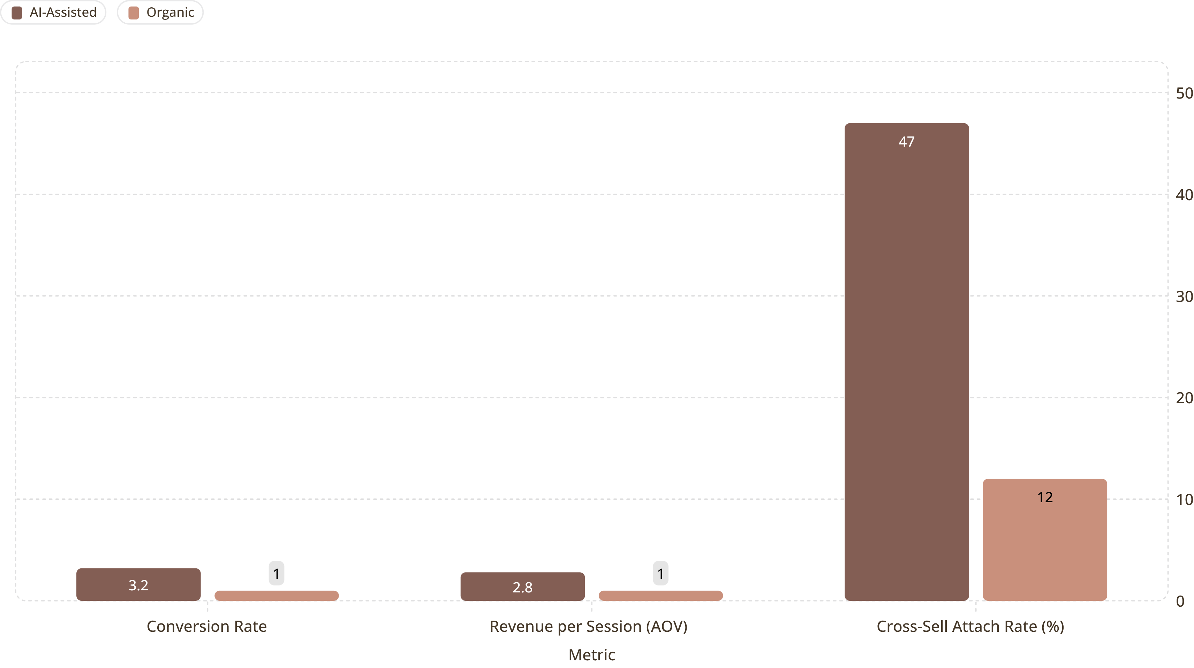
Business Impact: AI-Assisted vs Organic
Indexed to organic baseline (1×). AI-assisted channel consistently outperforms across every commerce metric that matters.
Campaign Orchestrator Results
Abandonment Recovery Tiers:
<15 min — untouched, user still active
15–60 min — reminder nudge → 8% recovery
>60 min high-value — autonomous 5–10% discount → 23% recovery
1,247
287
₹2.14L
Nudges Sent
Carts Recovered
Incremental Revenue
Every recovery is auditable — inspect the exact AI decision, discount tier, and user response live in the dashboard.

Slide 13
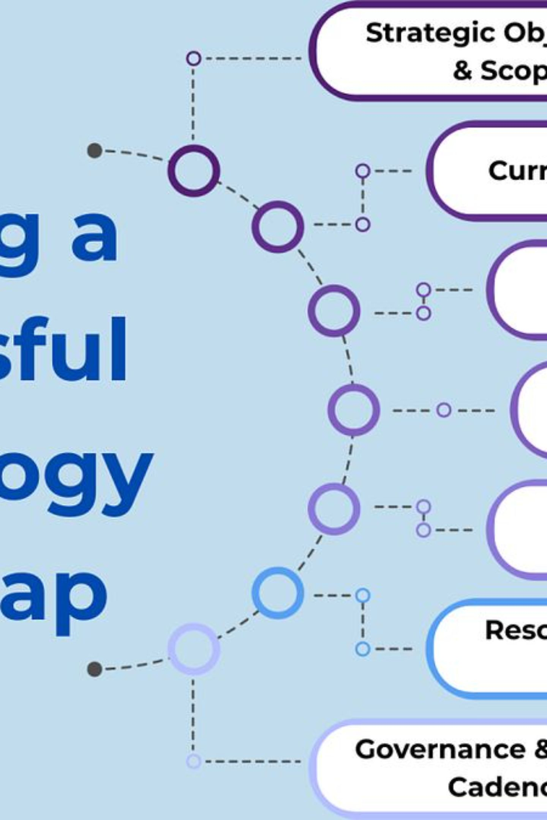
Roadmap: Beyond the Hackathon
Honest next steps grounded in real emerging standards — not vaporware. This is where the architecture is already pointed.
1
Agent-Readable Catalog Spec
Publish an OpenAPI/MCP-style endpoint so external AI buyer agents can transact directly with the merchant — not just through our chat UI.
2
Agent-to-Agent Checkout
Full support for emerging protocols — ACP, AP2, x402 — enabling peer AI commerce without human intermediation.
3
Failure-Simulation & Recovery Library
Expanded audit dashboard with chaos-engineering scenarios and recovery playbooks — because production resilience must be provable, not assumed.
4
Multi-Category Expansion
Scale beyond laptops to fashion, electronics, and SaaS subscriptions — same agent architecture, new domain tool registries.

Slide 14
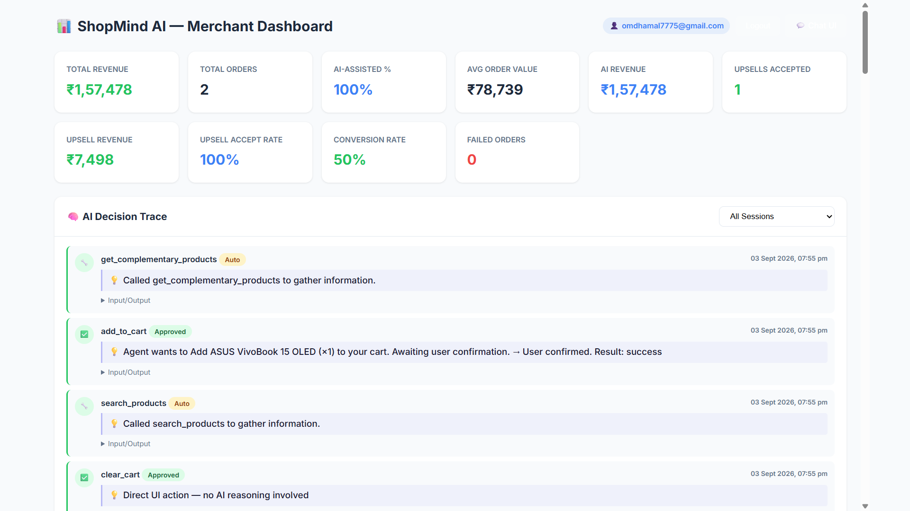

Live Demo & Closing
ShopMind AI turns conversational intent directly into explainable, bounded, gated Razorpay transactions — with a full audit trail merchants can trust.
Judges: every transaction, every nudge, every AI thought is auditable. The proof is live.
Chat with the shopping copilot, trigger an abandoned-cart recovery, and inspect the AI decision trace in real-time. No staging environment, no mocked data.
Every claim in this deck is verifiable against the live system — right now, in this room.
Try It Now
Live App
Merchant Dashboard
shopymind.vercel.app
shopymind.vercel.app/dashboard.html

