Slide 1


SMART INDIA HACKATHON 2024
Problem Statement ID – 1656
Problem Statement Title- Development of a mobile application to provide
recreational suitability information of beach locations across India.
Theme- Travel & Tourism
PS Category- Software
Team ID- thephoenixteam06@gmail.com
Team Name-Travel Tech Titans

Slide 2
The Coastal Tourism Suitability Mobile App
Travel Tech Titans
Proposed Solution Overview:
Develop a mobile app for Android that provides real-time assessments of coastal locations' suitability for tourism
using INCOIS data.
Problem Addressed:
Ensures tourist safety by offering real-time environmental data and provide personalize information.
Core Features:
Interactive coastline map with color-coded safety statuses.
Advanced geospatial tools (Google Maps API) and machine learning for enhanced predictions.
User Engagement:
Personalized
Alerts
User feedback on beach conditions
Weather forecasts
Ability to save favorite beaches.
Security and Maintenance:
Data encryption, secure authentication, compliance with privacy laws, regular updates, and real-time monitoring.

Slide 3



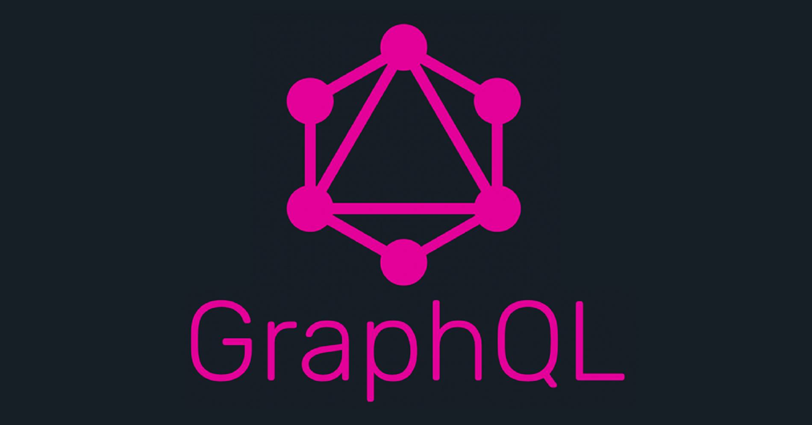

TECHNICAL APPROACH
Travel Tech Titans
Technologies Stack:
Overview
Admin
Add Location
User
Select beach according to current climatic condition indicated by colored indexing
Climatic Details of Beach Displayed
Search desired Beach
Location
Send details of selected Beach
(Alert and Warn if not suitable)
Fetch Details of all Beaches from API
Store in Database
Wind_speed
Wave_height
Water_quality
Ocean_current
PROTOTYPE

Slide 4
FEASIBILITY AND VIABILITY
Travel Tech Titans
Feasibility Analysis:
Challenges and Risks:
Technological Feasibility: The app can be built using existing tools (Flutter, INCOIS API(Application Programming Interface), Google Maps API).
Data Accuracy: Reliability of real-time data from INCOIS is crucial; any inaccuracies could erode user trust.
User Engagement: Maintaining engagement, especially off-season, could be challenging.
Market Feasibility:
High demand for real-time safety information in coastal tourism indicates strong market potential.
Scalability:
Managing increased user load and real-time processing could strain infrastructure.
Security:
Handling sensitive user data poses risks related to privacy and potential breaches.

Slide 5
IMPACT AND BENEFITS
Travel Tech Titans
Impact on Target Audience:
Benefits of the Solution:
Enhanced Safety:
Tourists gain real-time insights into coastal conditions, improving their safety and decision-making when visiting beaches
Social:
Promotes public safety and awareness, reducing accidents related to unpredictable coastal conditions.
Economic:
Encourages tourism by providing reliable safety information, potentially increasing local business revenues.
Environmental:
Helps preserve natural environments by advising against activities during unsafe conditions, preventing environmental
Damage.
Informed Decisions:
Locals and businesses can make better-informed decisions about beach activities, leading to optimized tourism experiences.

Slide 6
RESEARCH AND REFERENCES
Travel Tech Titans
References and Research Work:
INCOIS API: Used for real-time coastal data on environmental conditions.
Geospatial Tools: Integration of Google Maps API for interactive mapping.
Machine Learning: Predictive models enhance the app's accuracy, based on recent research.
Microservices Architecture: Ensures app scalability and reliability.
Links:
INCOIS API Documentation-ESSO-INCOIS-Indian National Centre for Ocean Information Services
Google Map API-https://console.cloud.google.com/apis/library?hl=en&project=zinc-bucksaw-433313-u2

