Slide 1

IA-H_DV_OM&SUHIL
Om Doshi – 16010120166
Suhil mir - 16010120206

Slide 2
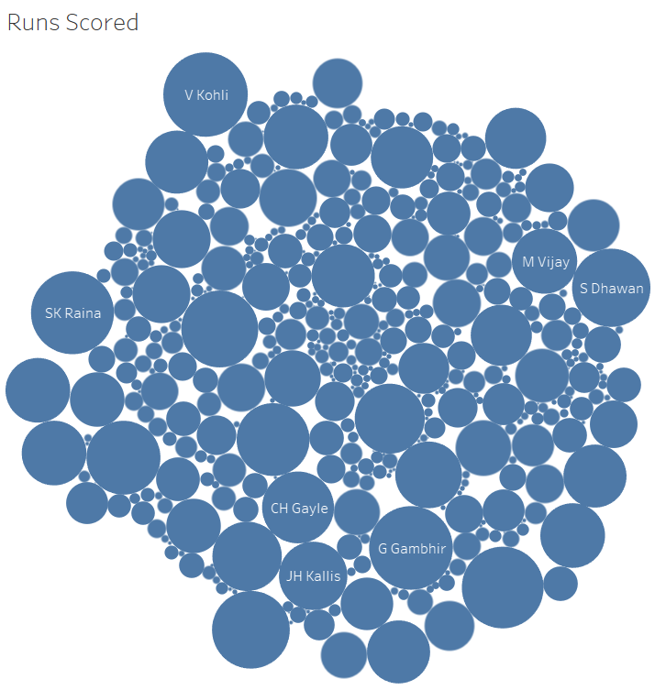

Slide 3
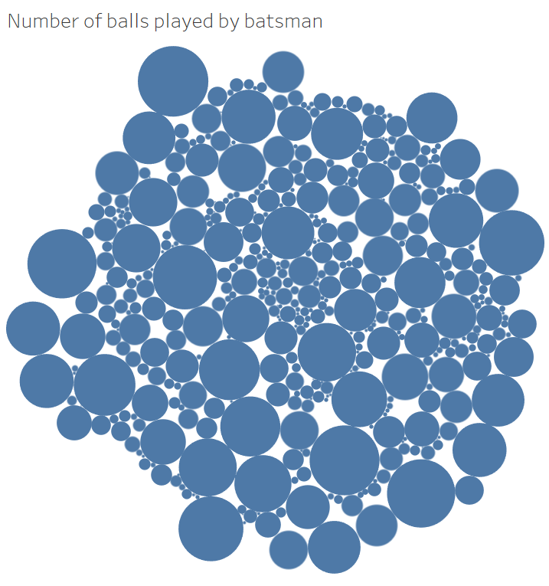

Slide 4
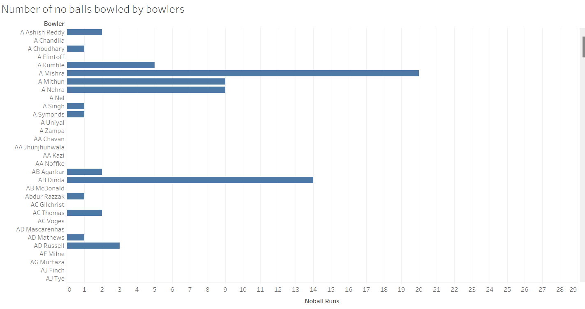

Slide 5
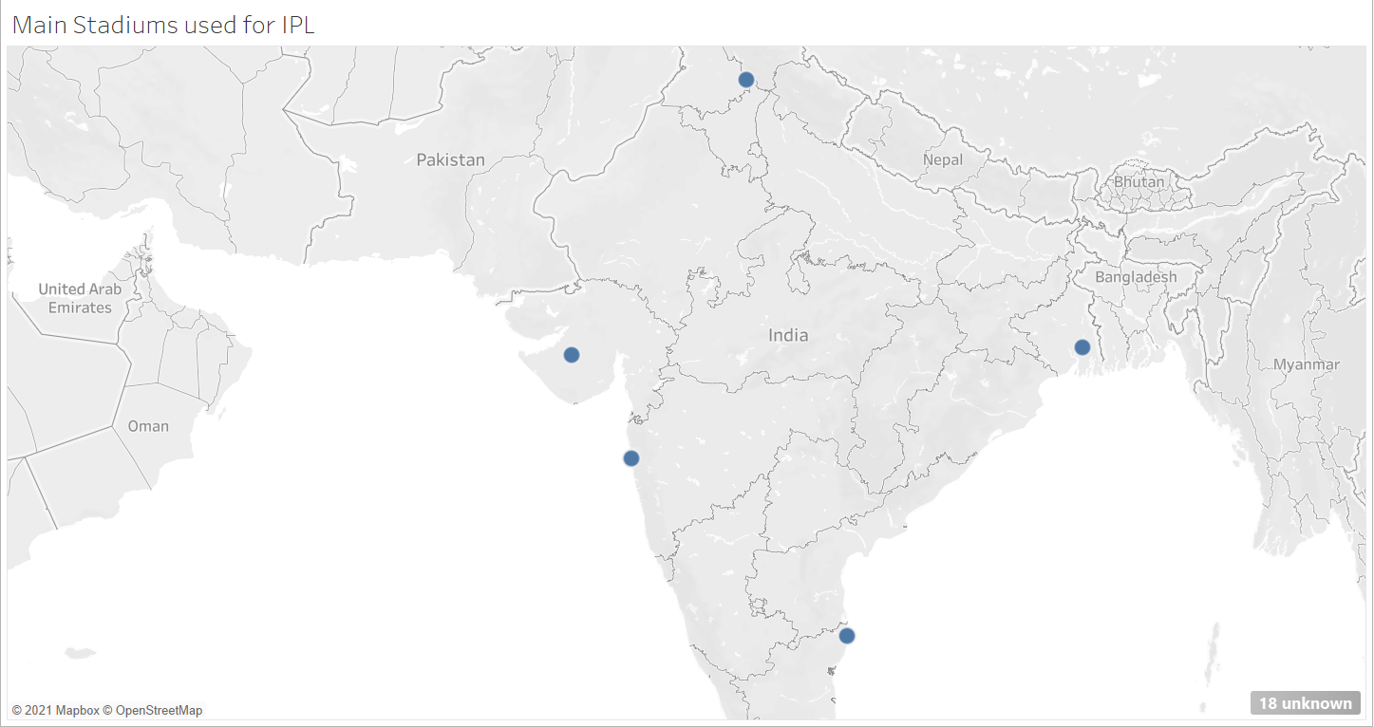

Slide 6


Slide 7


Slide 8
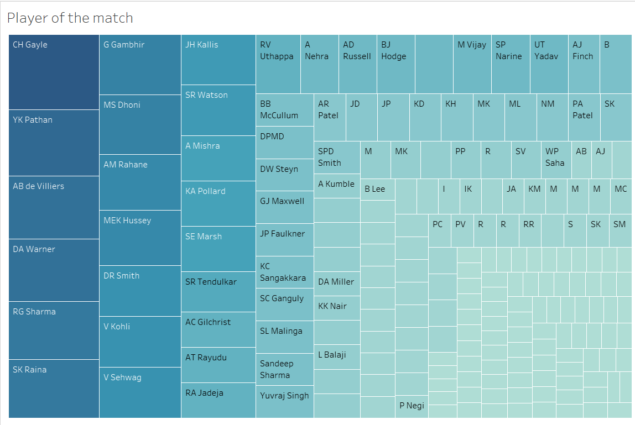

Slide 9
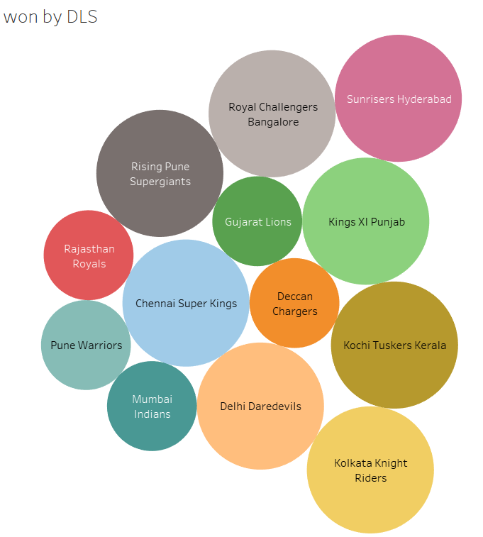

Slide 10
THANK YOU!!

