Slide 1
Activity Recognition using HOG+HOF with Additive Kernels on a Sports Dataset
Sumit Kumar
Anirudh Kumar

Slide 2
Project Idea
Activity Recognition on Sports Dataset.
Key Approaches:
HOG + HOF
Flow Histogram models a motion better than Gradient Histogram [Laptev 08]
HOG is used to retain the discriminative power of previous models.
Additive Kernels
Faster and as accurate as Non-Linear Kernels [Maji 12].

Slide 3
Approach
Hog + Hof descriptors (from other videos)
Hog + Hof descriptors
1000 visual words
Video
Cluster
.
.
.
.
.
.
.
Hog + Hof descriptors (from other videos)
STIP

Slide 4
Video Representation
Approximately 10,000 STIP’s for a video using Harris-3D corner detector
Then we calculate 72 HOG + 90 HOF descriptors over these STIP’s
Video is converted to a 162 dimension feature vector
Finally, the video is represented as a histogram of frequency over the visual words obtained by clustering.

Slide 5
Classification
SVM Classifier using Additive Approximation of Chi² Kernel
Concatenated HOG and HOF
Class
INPUT
CLASSIFIER
OUTPUT

Slide 6
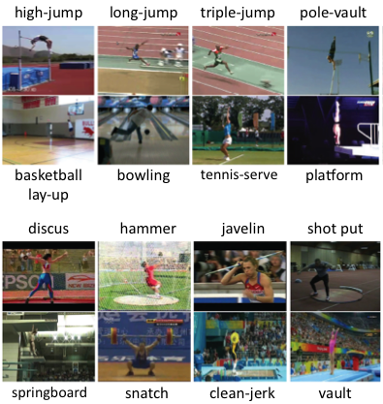
Dataset
Olympic Sports Dataset.
16 different classes of Sport events.
Localized Videos.
Around 40 instances of each event labeled with classes.

Slide 7
Experiments
We consider only 3 classes out of the 16 available in the Olympic dataset; long jump, high jump and triple jump.

Slide 8
Results

Slide 9
References
http://www.vlfeat.org/
Piotr’s MATLAB Toolbox
http://vision.ucsd.edu/~pdollar/toolbox/doc/
[Laptev 05] “On Space-Time Interest Points,” Ivan Laptev. IJCV 2005.
[Niebles 10] “Modeling Temporal Structure of Decomposable Motion Segments for Activity Classification,” J Niebles, CW Chen, L Fei-Fei. ECCV 2010.
[Laptev 08] “Learning realistic human actions from movies”. I. Laptev, M. Marszałek, C. Schmid and B. Rozenfeld. CVPR 2008.
[Maji 12] "Efficient Classification for Additive Kernel SVMs," S. Maji, A. Berg and J. Malik. PAMI 2012.

