Slide 1
Housepredicto.com
“Anything and everything about your new home available at your fingertips “

Slide 2

Outline
Introduction
Project summary
Tools used
How it works?
What it does?
LETS GET STARTED

Slide 3

Introduction
To find a perfect house these days is a tedious task and also its not just about the house its about the locality, place, view, amenities and a lot of other parameters. Don’t worry we are here to help you
At housepredicto.com, you will get a lot of information about your new house just at your fingertips.
Our moto is “Anything and everything about your new home available just at your fingertips”.

Slide 4
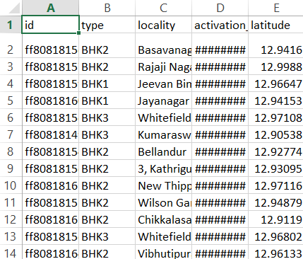
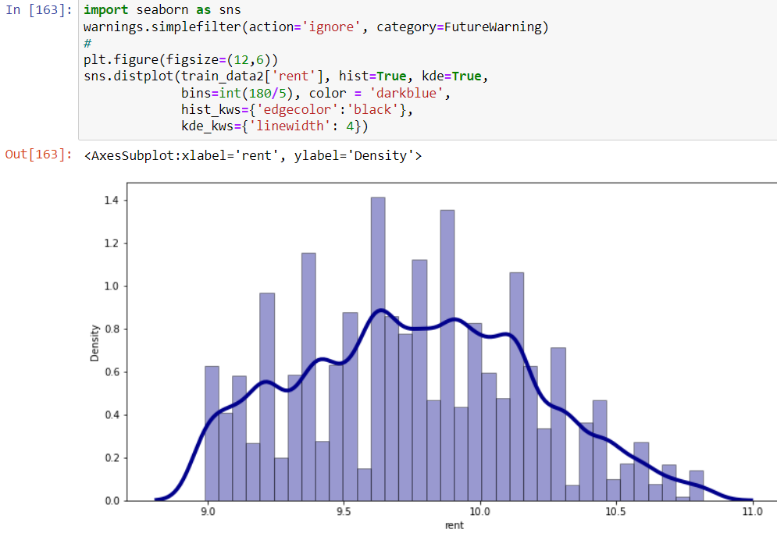
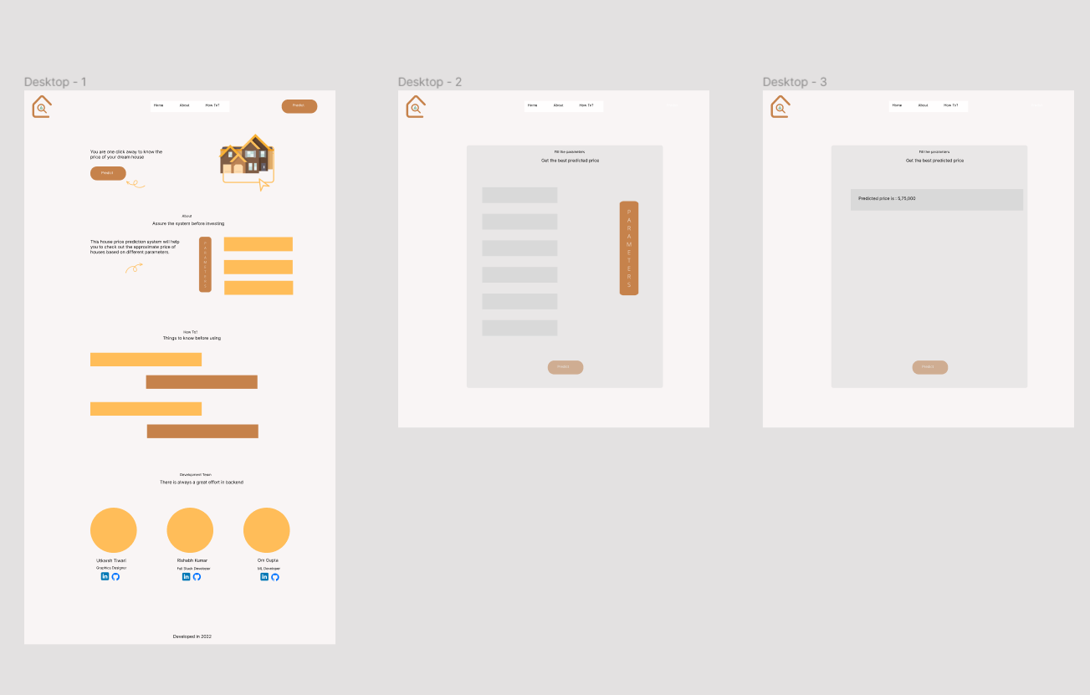
Project summary
1.
2.
3.
We got the dataset of the house prediction
We build a model of supervised machine learning (multi-linear regression)
Then we built the UI of the website

Slide 5
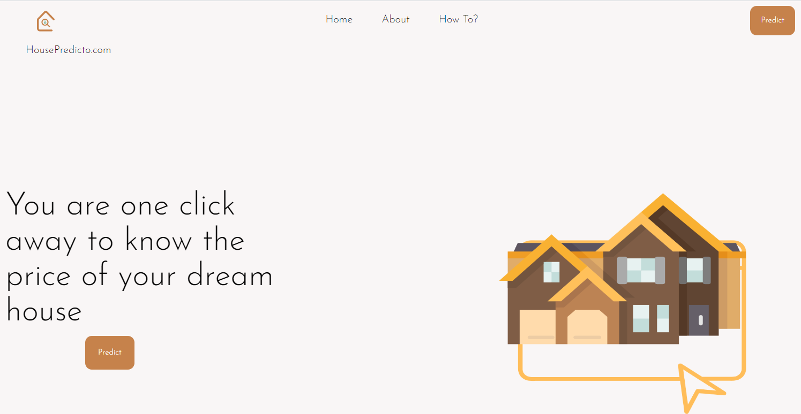
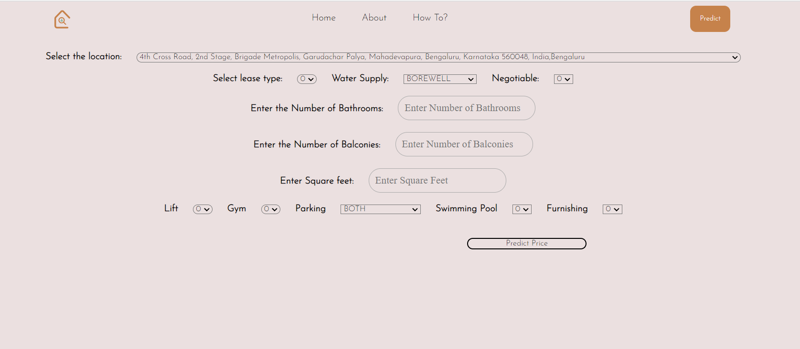
4.
5.
We connected the machine learning model to the front end..
We connected our machine learning model to the front end.

Slide 6



Technology used
jupyter
Figma
Pycharm
We used jupyter notebook to make the multi-linear regression model.
We used figma to create the UI of the website
We used pycharm to create the front end of the website

Slide 7

Github
We used Github to deploy our web app.

Slide 8
How it works?
Data Preparation
Data Pre Processing
Model Building
API Creation

Slide 9
What it does?
ELABORATE ON THE DATA YOU WANT TO DISCUSS
STEP 1
STEP 2
STEP 3
STEP 4
Take user input according to their requirements
Send the data to our machine learning model through API
Predict the approximate price
Display the price to user

Slide 10

thanks for watching

