Slide 1

Project Title - Seasonal Agriculture Performance Analysis
Student Name – Om Chandrakant Joshi
College Name - D. Y. Patil College of Engineering and Technology, Kolhapur
AICTE STU ID : STU6699fa5ca8a7f1721367132

Slide 2

PROBLEM STATEMENT
Agricultural activities are influenced by seasonal variations in environmental conditions,
farming practices, resource availability and market conditions. As a result, agricultural
performance may differ from one season to another.
However, raw agricultural data does not clearly explain how agricultural performance changes
across seasons or what patterns can be observed in different seasonal conditions.
The problem is to analyze the given agricultural dataset and investigate seasonal differences
in agricultural performance by identifying meaningful patterns, trends, relationships and
variations within the available data.

Slide 3
Project Description
Seasonal Agriculture Performance Analysis is a data analytics project that focuses on understanding how agricultural performance varies across different seasons due to changes in environmental conditions, farming practices, resource availability, geographical factors, and market conditions. The project aims to analyse the agricultural dataset to identify meaningful seasonal patterns, trends, relationships, and variations in crop production, resource usage, and economic performance. Through data cleaning, statistical analysis, comparison, and visualization techniques, the project will examine differences across seasons and identify significant or unusual patterns. The findings will be interpreted to generate evidence-based insights, conclusions, and recommendations that can support better seasonal agricultural planning and decision-making.

Slide 4

WHO ARE THE END USERS?
Farmers – to understand seasonal patterns and improve farming decisions.
Agricultural planners – to support evidence-based seasonal agricultural planning.
Agricultural researchers – to study seasonal trends, environmental conditions, and crop performance.
Government and agricultural departments – to support planning and resource allocation.
Agribusinesses and market stakeholders – to understand seasonal production and economic outcomes.
Students/Data Analysts – to explore and analyze real-world agricultural data.

Slide 5

Technology Used
Python – Main programming language for data analysis.
Jupyter Notebook – For developing and documenting the complete analysis.
Pandas – For data cleaning, preprocessing, and manipulation.
NumPy – For numerical and statistical operations.
Matplotlib & Seaborn – For creating charts and visualizing seasonal patterns and trends.
Scikit-learn – For applicable statistical/data-analysis or machine-learning techniques.
SQL – If required, for querying and managing structured agricultural data.
Microsoft Excel/CSV – For initial data storage, inspection, and preparation.

Slide 6
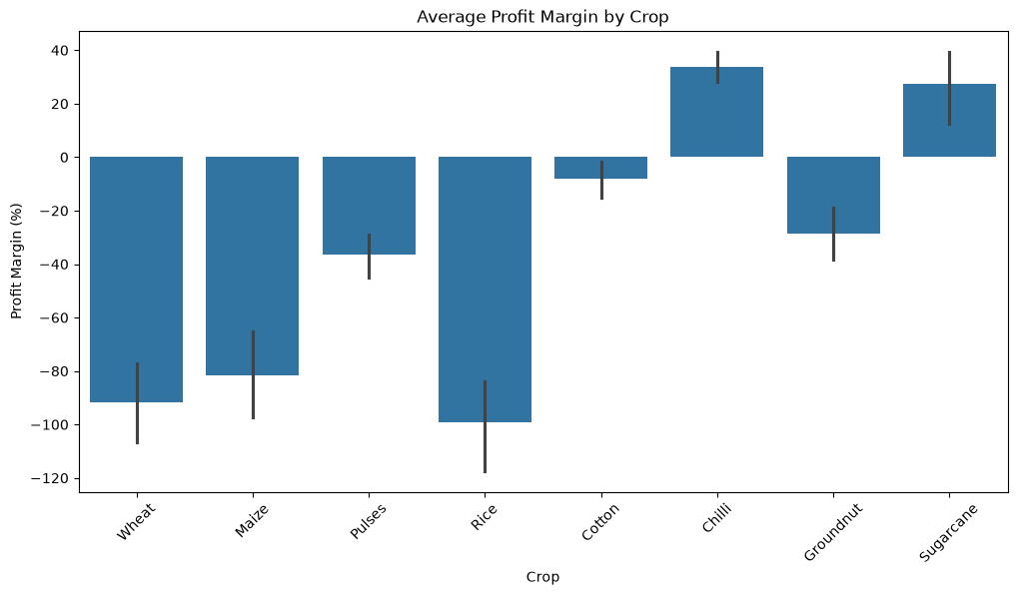
RESULTS
Description - This analysis compares the average profit margin across different crops. Chilli and Sugarcane have positive profit margins, while crops like Rice, Wheat, and Maize show negative profit margins, indicating lower profitability.

Slide 7
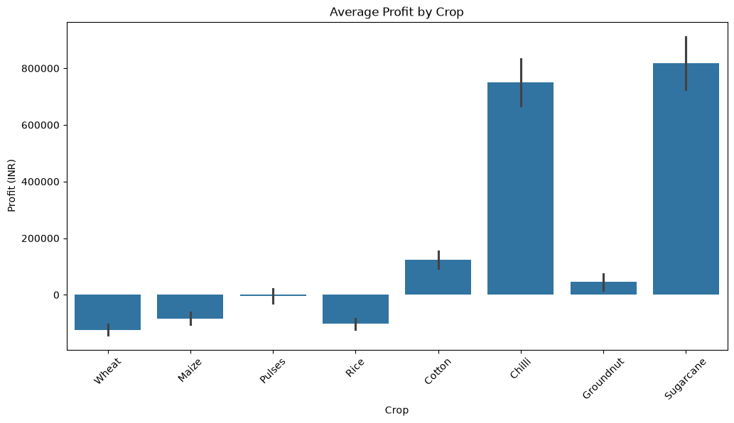
RESULTS
Description - This analysis compares the average profit earned by different crops. Sugarcane and Chilli have the highest average profits, while Wheat and Rice show negative average profits, indicating lower financial performance.

Slide 8
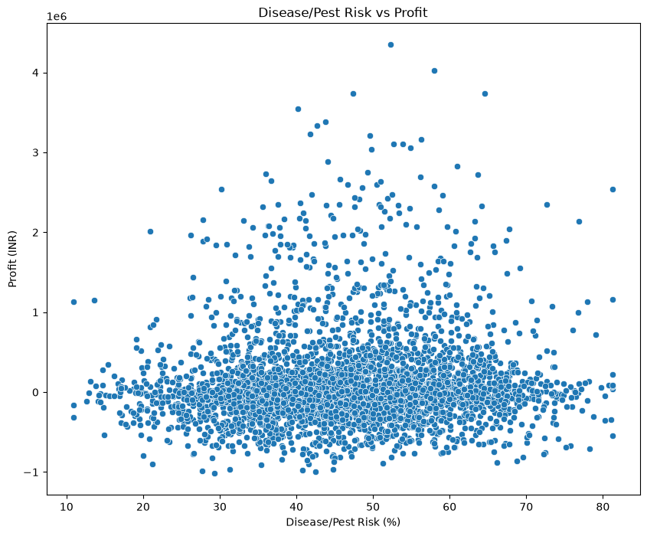
RESULTS
Description - This analysis shows the relationship between Disease/Pest Risk and Profit across farms. The points are widely scattered, indicating no clear direct relationship, with both profits and losses occurring at different risk levels.

Slide 9
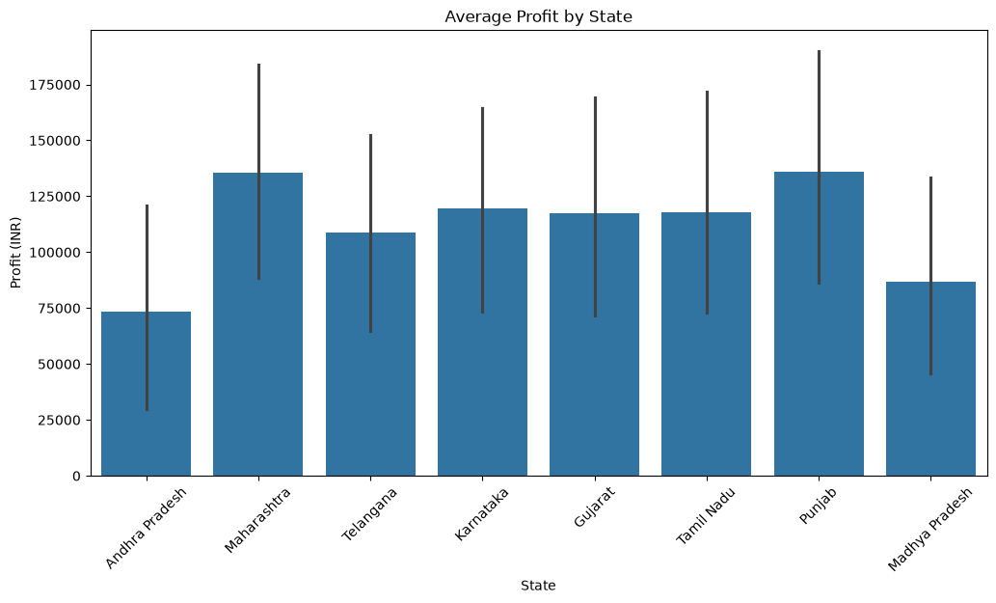
RESULTS
Description - This analysis compares the average profit across different states. Maharashtra and Punjab have the highest average profits, while Andhra Pradesh and Madhya Pradesh show comparatively lower profits.

Slide 10
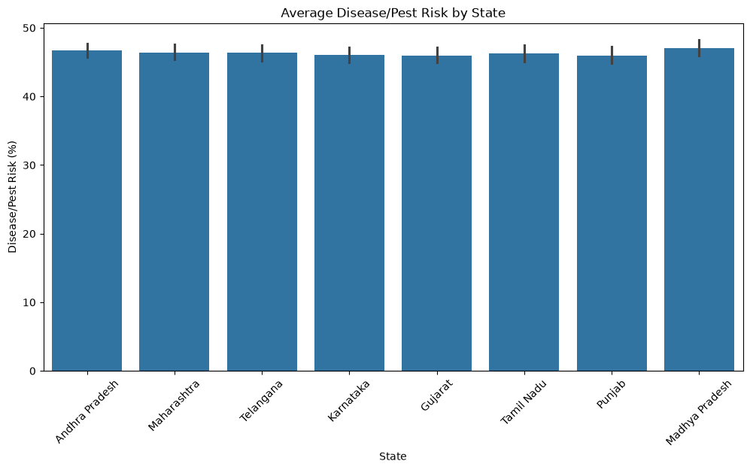
RESULTS
Description - This analysis compares the average disease/pest risk across different states. The risk levels are quite similar across all states, with Madhya Pradesh showing the highest average riskand Punjab showing the lowest.

Slide 11
Future scope
Crop Recommendation System – The analysis can be extended to recommend suitable crops based on season, soil conditions, rainfall, temperature, and expected profitability.
Yield Prediction – Machine learning models can be developed to predict crop yield using environmental conditions, fertilizer usage, irrigation, and seed quality.
Profit Prediction – Future models can predict expected revenue, cost, profit, and ROI before cultivation begins, helping farmers select more profitable crops.
Smart Irrigation – Water usage and water-efficiency analysis can be integrated with IoT sensors to provide recommendations for efficient irrigation and reduce water wastage.
Disease and Pest Prediction – Disease/pest risk data can be combined with weather and crop information to predict potential risks and support early preventive actions.
Real-Time Agricultural Dashboard – The project can be converted into an interactive dashboard showing seasonal, crop-wise, state-wise, financial, water, and risk performance.
Real-Time Data Integration – Weather forecasts, market prices, soil sensors, and satellite data could be incorporated to make the analysis more dynamic and useful for real-world farming.

Slide 12
GitHub Link
https://github.com/OmJoshi02/Seasonal-Agriculture-Performance-Analysis.git

Slide 13

VOIS Course completion certificate - Course name- Data Visualization

Slide 14
Thank you
.
.

