Slide 1
Wainganga College of Engineering and Management Customer Churn Prediction and Analysis Using Machine Learning.
Presented by : Om Kale

Slide 2
Introduction
Predict customer churn in e-commerce using machine learning
Analyze customer behavior, transaction history, and engagement data
Use models: Decision Trees, Random Forest, Logistic Regression
Visualize insights with PowerBI and Python libraries
Identify at-risk customers for proactive retention
Support strategies to improve customer satisfaction and drive growth

Slide 3
Area of your research
Overview:
This research focuses on identifying patterns and factors that contribute to customer churn in the e-commerce sector. Churn prediction helps businesses minimize revenue loss by retaining valuable customers through data-driven strategies.
Key Focus Areas:
Understanding customer behavior based on demographics, purchase trends, and engagement.
Building a predictive model using machine learning techniques such as Random Forest.
Interpreting churn patterns through visualizations and dashboards.
Providing actionable insights to improve customer retention and business performance.

Slide 4
Objective of your study
To identify patterns in customer behavior that lead to churn in an e-commerce environment.
To develop predictive models using machine learning algorithms (Decision Trees, Random Forest, Logistic Regression) for churn prediction.
To analyze transactional, demographic, and behavioral data to understand key drivers of customer attrition.
To visualize insights using Python libraries and PowerBI for strategic decision-making.
To support businesses in designing targeted retention strategies and reducing customer churn rates.

Slide 5
Hypothesis if any :
Main Hypothesis
Customer behavior and attributes significantly impact churn in e-commerce.
Supporting Hypotheses
Low engagement and fewer purchases increase churn risk.
Shorter subscription duration leads to higher churn.
Product category and return behavior affect churn likelihood.
Low loyalty customers are more prone to churn.
Demographics (age, gender, location) influence churn patterns.
Machine learning models like Random Forest improve churn prediction accuracy.

Slide 6
Research Methodology
Sampling Design
Sample Size: 1,500 customer records
Sampling Technique: Stratified random sampling on secondary data
Data Source: Publicly available dataset from Kaggle (e-commerce transactions)
Data Collection Method
Data imported using Python (Pandas) from a CSV file
Preprocessing steps:
Handling missing values
Encoding categorical variables
Normalizing numeric data

Slide 7
Research Methodology
Data Analysis Tools & Technologies.
Power BI:
Used for building interactive dashboards and visualizing customer churn trends.
Python Libraries:
pandas, numpy: Data wrangling and numeric analysis
seaborn, matplotlib: Data visualization and correlation insights
scikit-learn: Model building, training, and churn prediction using Random Forest
Modeling Approach
Applied Random Forest Classifier for churn prediction
Evaluated using confusion matrix, accuracy score, and classification report
Results visualized and interpreted for actionable business insights

Slide 8
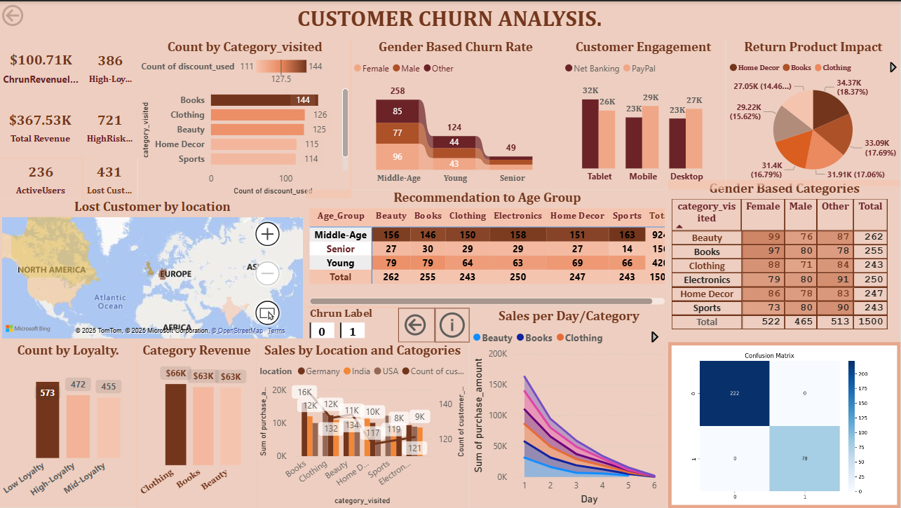

Slide 9
Data Analysis and Interpretation
Exploratory Data Analysis (EDA)
Key Observations:
📌 Category Visited: Majority churned customers visited Books, followed by Clothing.
👥 Churn by Age Group: Middle-aged users are more prone to churn compared to seniors or youth.
💸 Loyalty Impact: Customers with low loyalty showed significantly higher churn.
Visuals to Insert:
Insert bar chart from your dashboard: Count by Category_visited and Count by Loyalty
Map for Lost Customer by Location

Slide 10
Data Analysis and Interpretation
Customer Behavior Insights
Key Findings:
📱 Device Usage: Desktop users showed slightly lower engagement than tablet or mobile users.
🛒 Return Rate Impact: Higher product return requests (esp. Books & Clothing) correlate with increased churn.
👗 Category & Gender: Clothing and Beauty categories have higher churn among female customers.
Visuals to Insert:
Pie chart of Return Product Impact
Bar chart of Customer Engagement
Table: Gender Based Categories

Slide 11
Data Analysis and Interpretation.
Model Results & Interpretation
Model Used:
Random Forest Classifier
Evaluation Metrics:
📈 Accuracy: High (based on confusion matrix)
✅ True Positives (222): Accurately identified non-churners
🚨 True Negatives (78): Correctly predicted churners
🧠 Interpretation: The model has strong prediction capability with minimal misclassifications.
Visuals to Insert:
Confusion Matrix image
Classification report (if available)

Slide 12
Findings & Suggestions
🔍 Key Findings
Most churned customers were middle-aged, and visited Books and Clothing categories.
Low loyalty levels and frequent product returns are strong churn indicators.
Desktop users showed slightly lower engagement than mobile and tablet users.
Churners had fewer transactions and lower purchase frequency.
💡 Suggestions
Launch targeted retention campaigns for middle-aged and low-loyalty users.
Improve customer experience and reduce churn by:
Enhancing product quality in high-return categories.
Offering personalized discounts and loyalty rewards.
Increase mobile engagement via app-based incentives and push notifications.

Slide 13
Conclusion
✅ Conclusion
Machine Learning (Random Forest) achieved high prediction accuracy, validating that customer behavior patterns can predict churn effectively.
With actionable insights from the churn model, businesses can proactively engage at-risk customers and reduce churn.
This project demonstrates the impact of data-driven strategies in improving customer retention and long-term profitability.

Slide 14
Thank You

