Slide 1

A PROJECT PRESENTATION ON
Smart FinGuard – Finance Fraud Detection
MASTER OF SCIENCE IN DATA SCIENCE
SUBMITTED BY
GROUP NO 1
PRN | NAME OF THE STUDENT
2501208018 | Riya Dhorajiya
2501208020 | Om Mamtora
2501208063 | Hemangi Vaghasiya
2501208064 | Varun Kumbhani
2501208065 | Mitali Rafaliya
UNDER THE GUIDANCE OF
(DR. ABHIJEET THAKUR)
SCHOOL OF DATA SCIENCE
SYMBIOSIS SKILLS AND PROFESSIONAL UNIVERSITY, PUNE
ACADEMIC YEAR 2025-26

Slide 2
CONTENTS
01
Introduction
Overview, Objectives & Scope
02
Literature Review
Background Study & Existing Approaches
03
System Design & Methodology
Architecture & Tech Stack
04
Data Collection & Preprocessing
Dataset, Cleaning & Feature Engineering
05
Model Development
ML Pipeline & Algorithm Selection
06
Results & Analysis
Metrics, Confusion Matrix & Insights
07
Integration of Subjects
Interdisciplinary Contributions
08
Conclusion & Future Work
Findings & Next Steps
2

Slide 3
INTRODUCTION
5M+
Transactions
Analyzed
3.59%
Fraud
Prevalence
4
ML
Algorithms
27
Engineered
Features
Project Overview
Key Objectives
Financial fraud is one of the costliest risks facing digital banking ecosystems today. Manual review of millions of daily transactions is simply impossible at scale. Smart FinGuard is an end-to-end fraud intelligence platform that combines:
• Data Engineering with Apache Spark & Airflow • Machine Learning (Logistic Regression, RF, XGBoost,LBGMClassifier) • Real-time inference via FastAPI • Analyst dashboards via POWER BI • Cloud-ready S3 architecture
Build a modular fraud pipeline from ingestion → training → deployment
1
2
Engineer 27 behavioral features: timing, amount deviation, merchant freq, anomaly flags
3
Compare ML algorithms using recall-focused criteria for imbalanced data
4
Expose model via API, dashboard & web UI for business demonstration
5
Integrate cloud-scale S3 storage + Airflow orchestration for production readiness
SCHOOL OF DATA SCIENCE
3

Slide 4
LITERATURE REVIEW / BACKGROUND STUDY
Fraud as a Data Science Problem
Established Technical Approaches
Rare-event classification with severe class imbalance (~3.59% fraud)
Concept drift & evolving attacker behavior add complexity
High accuracy alone is misleading — focus on Recall & F1-Score
False negatives are costlier than false positives in fraud detection
Rules-based systems → Statistical anomaly detection → ML pipelines
Logistic Regression: interpretable baseline for probability scoring
Tree-based ensembles (RF, XGBoost): handle non-linear feature interactions
Modern systems combine rules + supervised learning + graph analytics
Big Data & Pipeline Engineering
Research Gap Addressed
Apache Spark for scalable preprocessing of 5M+ transaction records
S3-compatible object storage for durable raw + processed data layers
Apache Airflow for orchestrated, reproducible model-refresh workflows
Fraud detection = full platform, not just a single algorithm
Most student projects separate analytics from deployment — we bridge this
We cover ingest pipelines, storage, reproducibility & user-facing interfaces
Operational interpretation for imbalanced classification metrics included
Positions this as an end-to-end fraud intelligence prototype
SCHOOL OF DATA SCIENCE
4

Slide 5
SYSTEM DESIGN & METHODOLOGY
1
2
3
4
5
6
7
S3
Ingestion
Spark
ETL
Feature
Eng.
Model
Training
Airflow
Orch.
FastAPI
Serving
Streamlit
Dashboard
Upload raw
transactions
Clean &
standardize
27 fraud-
focused features
LR / RF /
XGBoost
Daily batch
scheduling
REST inference
endpoint
Analyst &
business UI
TECHNOLOGY STACK
LAYER
TOOL
PURPOSE
Storage / Data Lake
Amazon S3
Store raw data, cloud-ready architecture
Processing
Apache PySpark
Scalable ETL and cleaned parquet output
Feature Engineering
pandas
Domain-specific fraud feature creation
Modeling
scikit-learn, XGBoost
Classification pipelines for fraud detection
Orchestration
Apache Airflow
Daily batch scheduling & task dependency
Serving
FastAPI
Real-time REST inference endpoint
Visualization
Streamlit + Jinja2
Analyst and demo web interfaces
5

Slide 6
DATA COLLECTION & PREPROCESSING
5,000,000
Total Records
18
Original Columns
179,553
Fraud Cases
3.59%
Fraud Ratio
₹358.93
Avg Amount
₹3,520
Max Amount
Data Cleaning & ETL (Apache Spark)
Engineered Features (27 Total)
1
Remove Duplicates Deduplicate 5M transaction records
transaction_hour
Captures time-of-day behaviour
transaction_dayofweek
Weekly pattern differences
2
Drop Empty Rows Remove fully null entries
is_night_transaction
Late-night risk window flag
3
Timestamp Parsing Convert to datetime, extract date fields
customer_avg_amount
Normal spending baseline
amount_deviation
Deviation from usual amount
4
Text Standardization Lowercase & trim categorical columns
seconds_since_last_txn
Transaction burst intensity
5
Null Handling Fill missing amounts with 0, fraud_type handled separately
merchant_frequency
Sender-merchant recurrence
high_velocity_flag
Binary: suspicious velocity
6
Parquet Output Write processed data in partition-friendly format
high_geo_anomaly_flag
Binary: geo suspiciousness
SCHOOL OF DATA SCIENCE
6

Slide 7
MODEL DEVELOPMENT / IMPLEMENTATION
12-STAGE ML TRAINING PIPELINE
1
Data Loading
2
Cleaning
3
Train/Test Split
4
Feature Typing
5
Preprocessing
6
Model Init
7
Training
8
Prediction
9
Threshold Tuning
10
Evaluation
11
Model Saving
12
Plot Generation
XGBOOST[Baseline]
Random Forest [Ensemble]
Logistic Regression (Stacking) [Final Model]
Class-balanced
n_estimators=150, depth=10
RF + XGBoost + LBGM base learners
Interpretable coefficients
Non-linear relationships
Meta Logistic Regression estimator
F1 baseline: 0.065
Class weighting applied
scale_pos_weight dynamic
Good for linear boundaries
Baseline: F1=0.080, AUC=0.55
Threshold tuned to 0.6
7

Slide 8
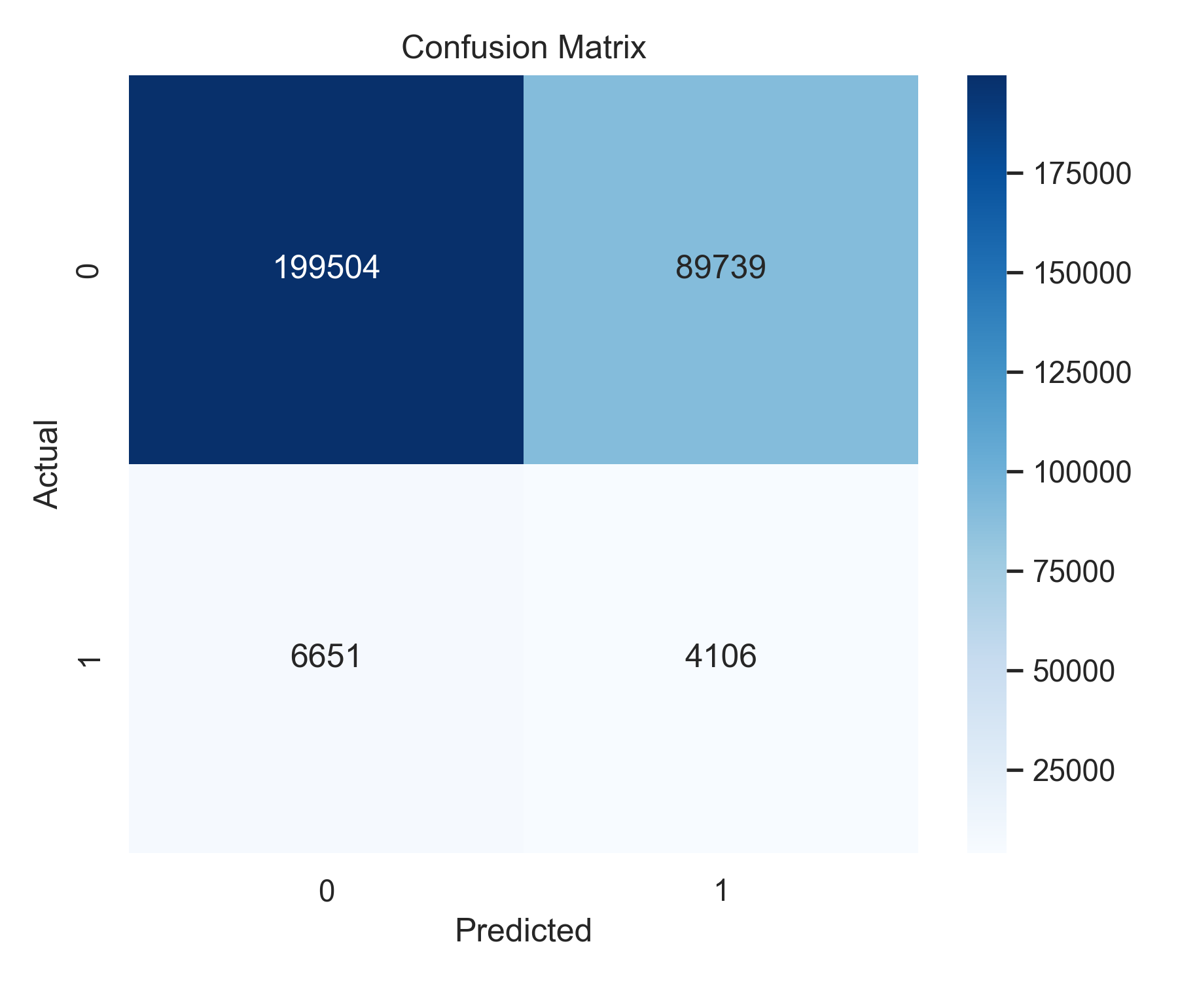
RESULTS & ANALYSIS
67.87%
Accuracy
Overall
38.17%
Fraud Recall
Key Metric
4.37%
Fraud Precision
Flagged
7.85%
Fraud F1-Score
Harmonic
0.6
Threshold
0.5881
ROC-AUC
Discrimination
Confusion Matrix Breakdown
Model Performance & Business Interpretation
⚠
Low fraud recall (9.95%) — model misses many real fraud cases
✓
High overall accuracy (89.64%) driven by the 96.41% legitimate class
→
Further threshold tuning, SMOTE resampling & cost-sensitive learning needed
★
Platform establishes strong engineering base for production extension
SCHOOL OF DATA SCIENCE
8

Slide 9
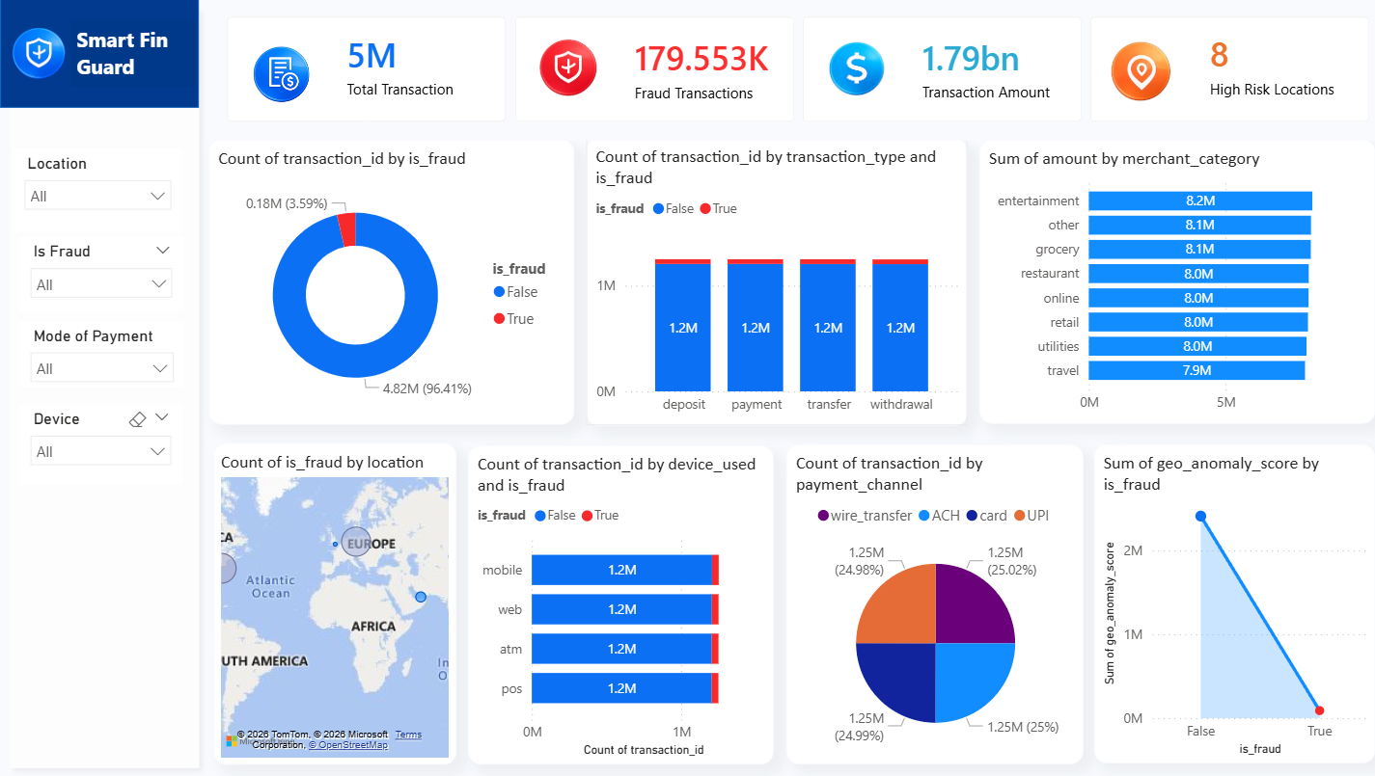
RESULTS & ANALYSIS
SCHOOL OF DATA SCIENCE
8

Slide 10
INTEGRATION OF SUBJECTS
MSDS201 Linear Models
MSDS202 Multivariate Analysis
MSDS203 Data Visualization
Logistic Regression baseline model
ColumnTransformer pipeline
8 diagnostic plots auto-generated
Threshold tuning via F1-precision-recall
Correlation heatmap in EDA
Streamlit analyst dashboard
Error metrics: RMSE, MAE, F1, ROC-AUC
amount_ratio = amount / (avg+1)
ROC, PR curves, confusion matrix
MSDS204 AI for Data Science
MSDS205 Big Data & Clouds
MSDS206 ML & Data Mining
Stacking Classifier (RF + XGBoost)
Apache Spark ETL (10M+ records)
Full 12-stage training pipeline
SHAP explainability principles
AWS S3 object storage
Stratified sampling for imbalance
joblib model serialization
Apache Airflow DAG scheduling
OneHotEncoding + Median imputation
SCHOOL OF DATA SCIENCE
9

Slide 11
CONCLUSION & FUTURE WORK
✓ CONCLUSION
→ FUTURE WORK
Successfully demonstrated an end-to-end fraud detection platform on 5M transactions
1
Improve Fraud Recall
Resampling (SMOTE), threshold tuning & cost-sensitive learning
Covered full lifecycle: ingestion → ETL → feature engineering → training → evaluation → deployment
2
Sequential Features
Graph-based & customer history features for linked-account behavior
Modular design with cloud-aware S3 storage and deployment-ready FastAPI + Streamlit interfaces
3
Real-Time Streaming
Kafka integration for live transaction event scoring
Model achieves 67.87% accuracy — meaningful baseline, not yet production-grade
4
Model Monitoring
Drift detection, latency tracking & recall degradation alerts
Honestly exposes pipeline limitations: fraud recall at 38.17% needs improvement
5
CI/CD & Containerization
Docker + model registry for controlled production deployment
Academic objective achieved: combines technical implementation with critical interpretation
6
Expanded Testing
Inference validation, data quality checks & end-to-end pipeline tests
Interdisciplinary contribution across 6 M.Sc. Data Science core subjects
SCHOOL OF DATA SCIENCE
10

Slide 12
Thank You
Smart FinGuard — Finance Fraud Detection using Big Data & Machine Learning
SCHOOL OF DATA SCIENCE | SYMBIOSIS SKILLS AND PROFESSIONAL UNIVERSITY, PUNE

