Slide 1

Presented by:
Om Mishra · Yash Agarwal · Divyanshu Pandey
2023ebcs786 · 2023ebcs753 · 2023ebcs728
Claw – A Mobile-First Operations Hub
for Solo Service Providers
BSc Computer Science · Group 82 (CodingNinjas) · 2025–26
Under the guidance of
Swapnil Saurav
Notes:
Introduce the team and the one-line pitch: Claw replaces the four disconnected tools a solo practitioner uses today with one app built for their phone.
Keep this slide short — the marks are in the explanation, the demo and the questions.

Slide 2
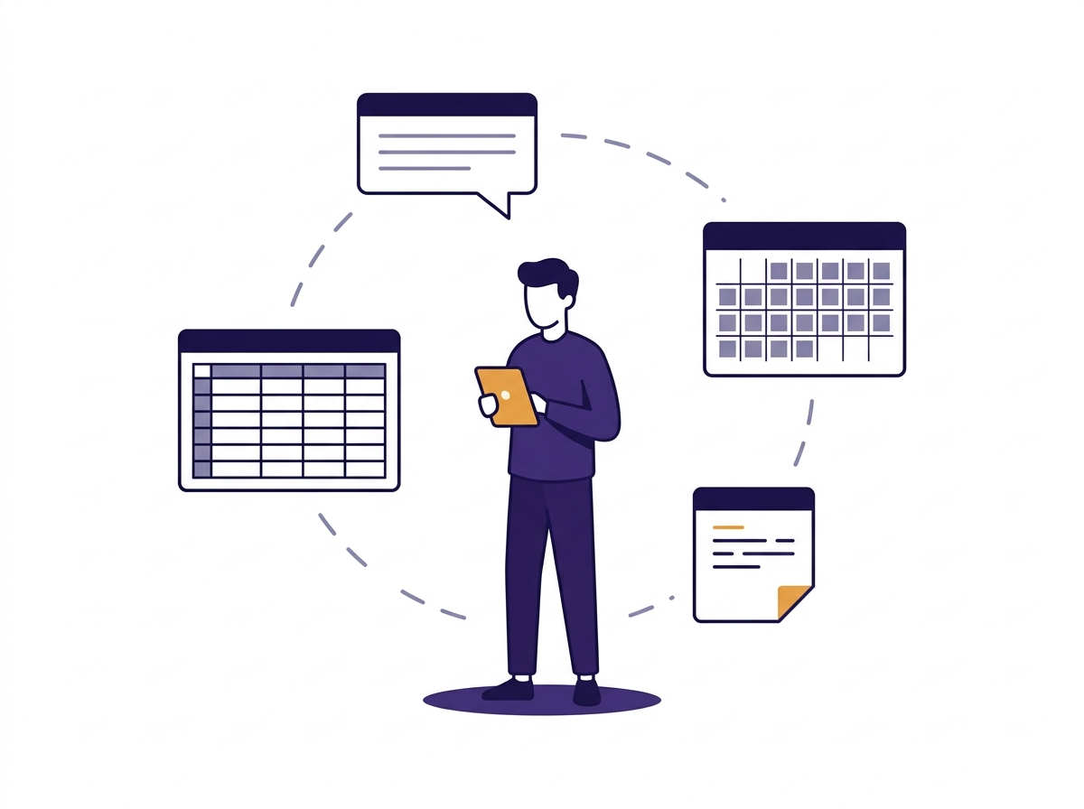
Problem Statement
WhatsApp, Calendar, Sheets, memory
Double bookings
Revenue leakage
5–10 messages per appointment
No business visibility
Notes:
Lead with the double-booking story. It is the most concrete failure and the one the whole product is built to prevent.
The four failures are not independent: they all follow from the negotiation channel being disconnected from the record channel. A slot agreed in WhatsApp never reaches the calendar, so the same hour gets promised twice.
Market size: 7.7 million gig workers in 2020–21, projected to 23.5 million by 2029–30 (NITI Aayog). If asked why this segment specifically: they cannot afford admin staff or per-seat SaaS, so operational friction converts directly into lost income.

Slide 3
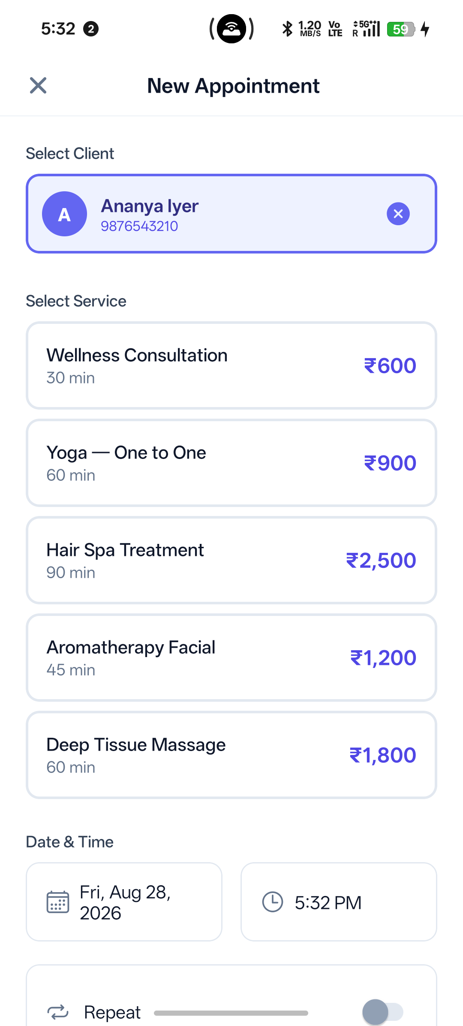
Objectives & Scope
Client records with full history
Scheduling without negotiation
Revenue and trend analytics
Recurring appointments
One-handed gesture interface
Out of scope: payments, self-booking, offline
Notes:
All five primary objectives were met, plus three secondary ones: WhatsApp reminders, inactive-client recovery, and the active/inactive service catalogue.
The exclusions are deliberate product decisions, not things we ran out of time for. Client self-booking in particular: research showed this market still prefers to negotiate over WhatsApp, so a booking portal would have been built for a behaviour that does not exist yet.
The diagram is the real screen flow from the report, Figure 2.3.

Slide 4
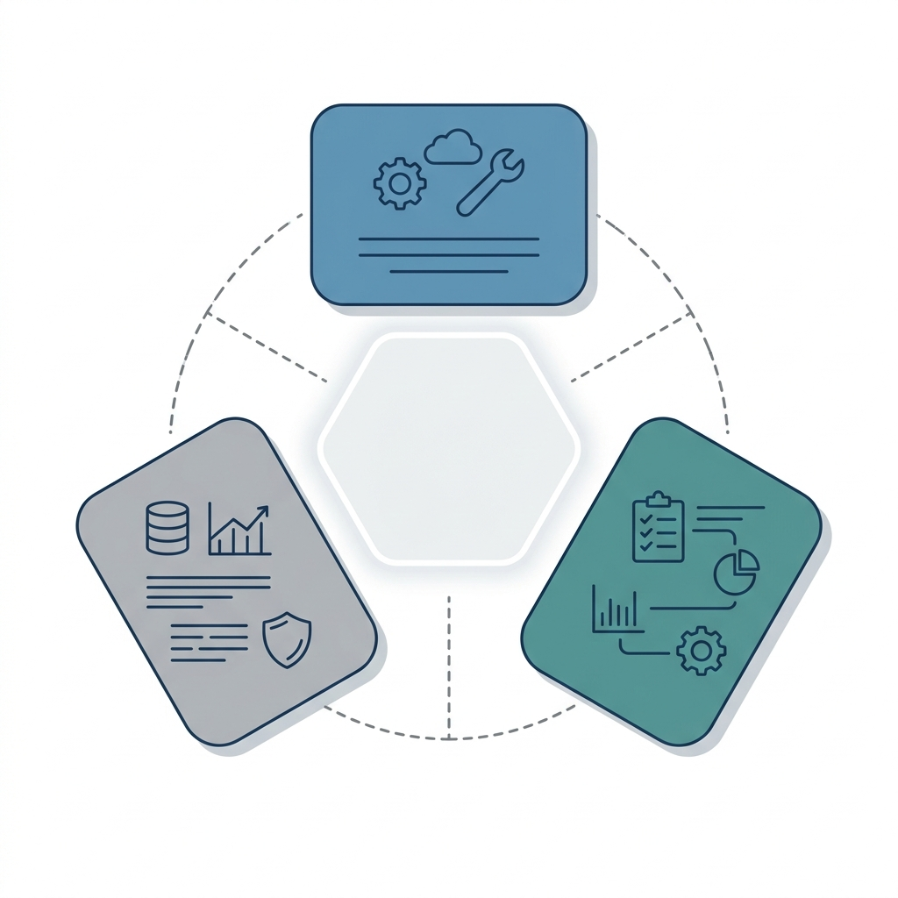
Existing System / Literature Review
Calendly, Zoho: scheduling only, no CRM
HubSpot, Pipedrive: built for sales teams
SimplePractice: USD-priced, healthcare
Gap: no affordable mobile hub for India
Notes:
The point is not that these tools are bad. Each is good at what it does. It is that a solo practitioner would need three of them, and the seams between them are exactly where the failures on the previous slide happen.
Calendly has added lightweight contact records and team scheduling analytics, but it holds no relationship history and reports nothing on revenue, service mix or completion rates.
If pushed on why not just use Calendly plus a spreadsheet: that IS the status quo, and it is what produces double bookings.

Slide 5
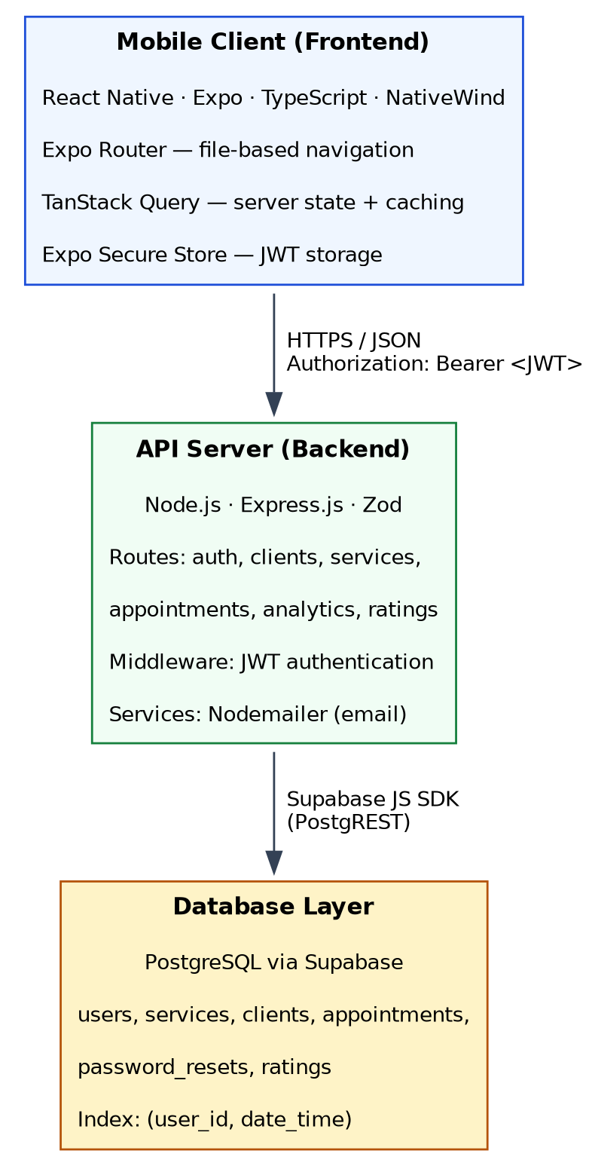
Proposed System Architecture
React Native · Express REST · PostgreSQL
Stateless JWT in Secure Store
27 endpoints across six resources
Every query filters by user_id
Notes:
Why a separate backend rather than calling Supabase directly with row-level security: recurring generation and conflict detection are far clearer in server-side JavaScript than in SQL policies, and the password-reset email needs a secret that cannot ship inside a mobile binary.
The user_id filter on every query is the entire authorisation model. There is no cross-user sharing by design, which keeps it simple enough to verify by inspection.
Six tables, with a composite index on (user_id, date_time) serving the three hottest reads: the dashboard, the client profile and the analytics aggregation.

Slide 6
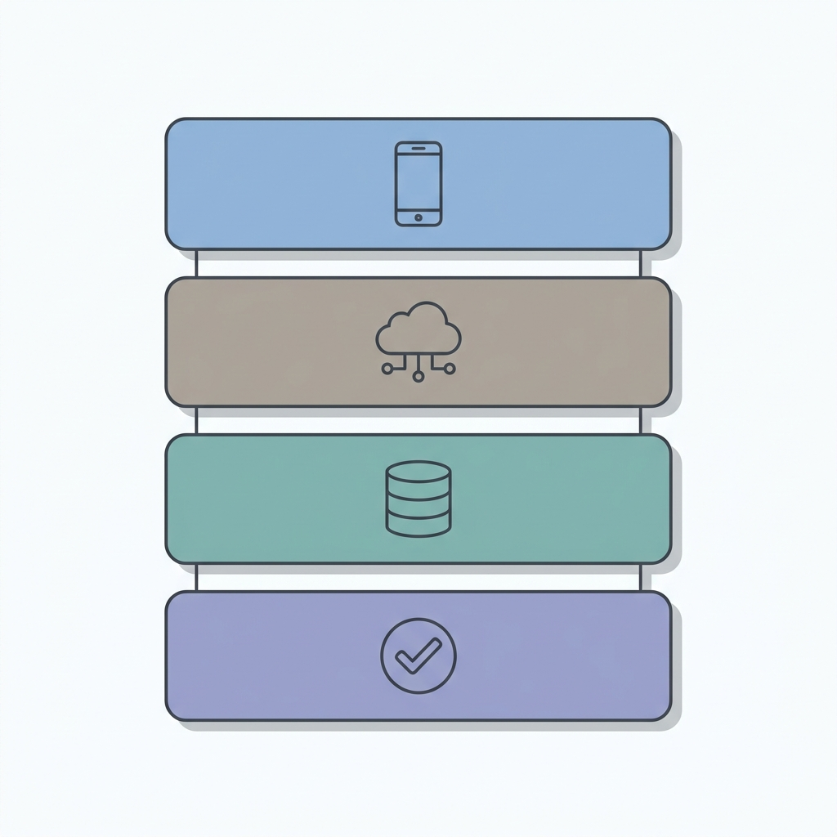
Tools & Technologies
Mobile: React Native, Expo, TypeScript
UI: NativeWind, Reanimated, Gestures
State: TanStack Query
Backend: Express, Zod, JWT, bcrypt
Database: PostgreSQL on Supabase
Quality: Jest, ESLint, GitHub Actions
Notes:
Every choice has an alternative we rejected: Flutter (the team knows TypeScript), MongoDB (the data is relational, clients own appointments own services), Firebase (no joins and weak aggregation, which would have made analytics painful).
TanStack Query is the one worth calling out. Its cache invalidation removed an entire class of stale-data bugs we had been fighting by hand, and its optimistic updates are why a swipe feels instant.
The stack diagram mirrors the four bullets: client, API, database, and the quality tooling that runs over all three.

Slide 7
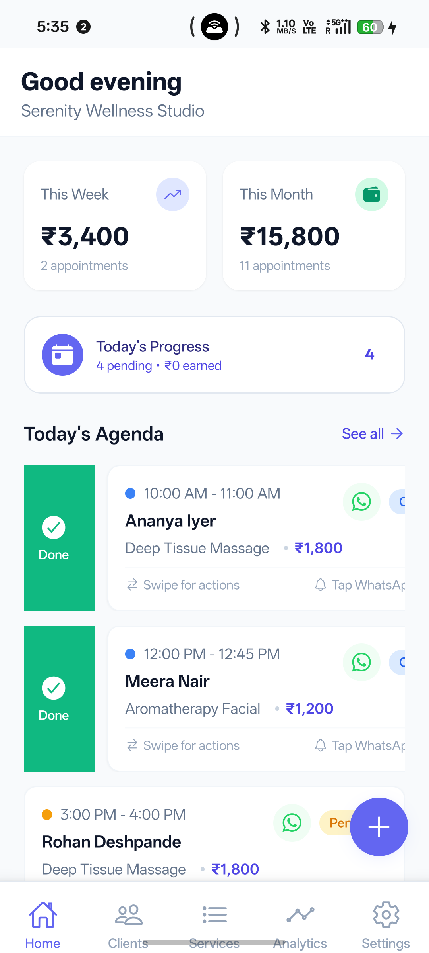
Implementation / Demo
Twelve modules, all implemented
Booking in four taps
Overlap checked before every write
Recurring series, all-or-nothing
Swipe to complete or cancel
WhatsApp deep links
Notes:
This is the slide to stop talking on and switch to the live device.
Demo order that works: dashboard, book an appointment, deliberately book a clashing slot to show the conflict being refused, swipe one complete, then analytics.
The conflict refusal is the moment worth engineering the demo around. It is the product's central promise and takes ten seconds to show.
Four taps replaces a five-to-ten message WhatsApp negotiation. End time is calculated from the service duration rather than entered.

Slide 8
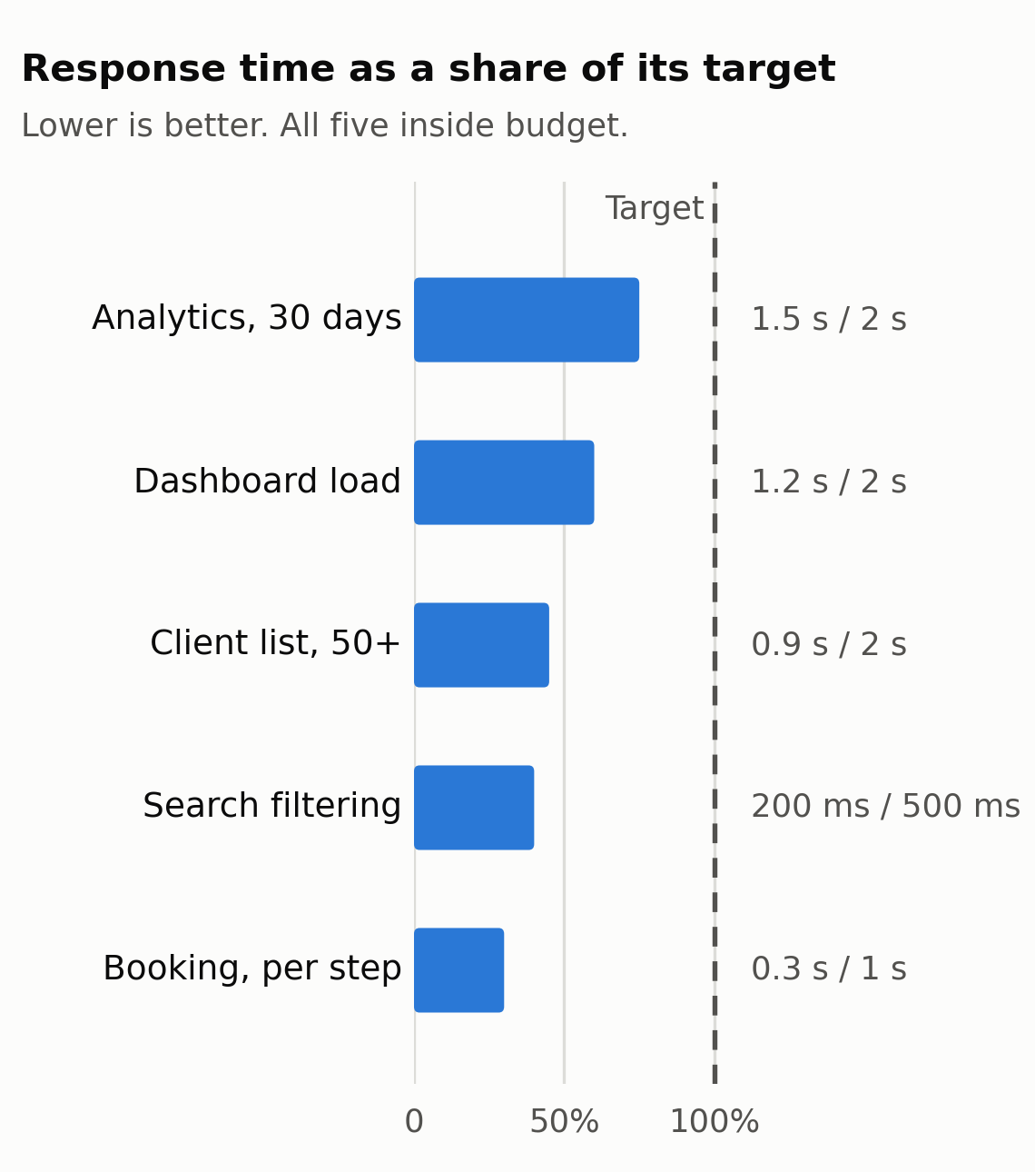
Results & Analysis
49 manual test cases, 100% pass
27 automated tests on the scheduling core
Every performance target met or exceeded
No crashes; 53-appointment series
All six Phase 1 risks mitigated
Notes:
Distinguish the two kinds of testing if asked: 49 manual cases cover the system end to end on a real device; 27 automated tests cover the pure scheduling logic, the overlap rule and recurring date generation.
Writing the automated tests found two real defects that manual testing had missed. The recurring cap was set at 52 and so refused a weekly booking running a full calendar year, which needs 53 because both endpoints are included. It is now 53. Monthly series starting on the 31st overflow short months, producing 3 March from a run beginning 31 January; that behaviour is asserted in the tests so any future change to it is deliberate.
Both are recorded in the report rather than quietly fixed. If asked what we would do differently: write the automated tests first.

Slide 9
Challenges & Limitations
Month-end overflow in recurring series
Stale UI after mutations
Scope discipline through MoSCoW
No payments; UPI or cash
No offline mode
Push limited inside Expo Go
Notes:
Answer honestly on limitations. Each was a decision with a reason, and the report records them in §6.3.
Month-end overflow: 31 January has no equivalent in February. Stale UI was solved with TanStack Query invalidation after every mutation.
The strongest answer on payments: integrating a gateway is a compliance and reconciliation problem, not a coding one, and it would have consumed the time that went into making scheduling correct. Research also showed this market negotiates payment over WhatsApp already.
Push notifications are limited inside Expo Go specifically. A production build runs the full notification system as designed, so it is a platform constraint, not a defect.

Slide 10
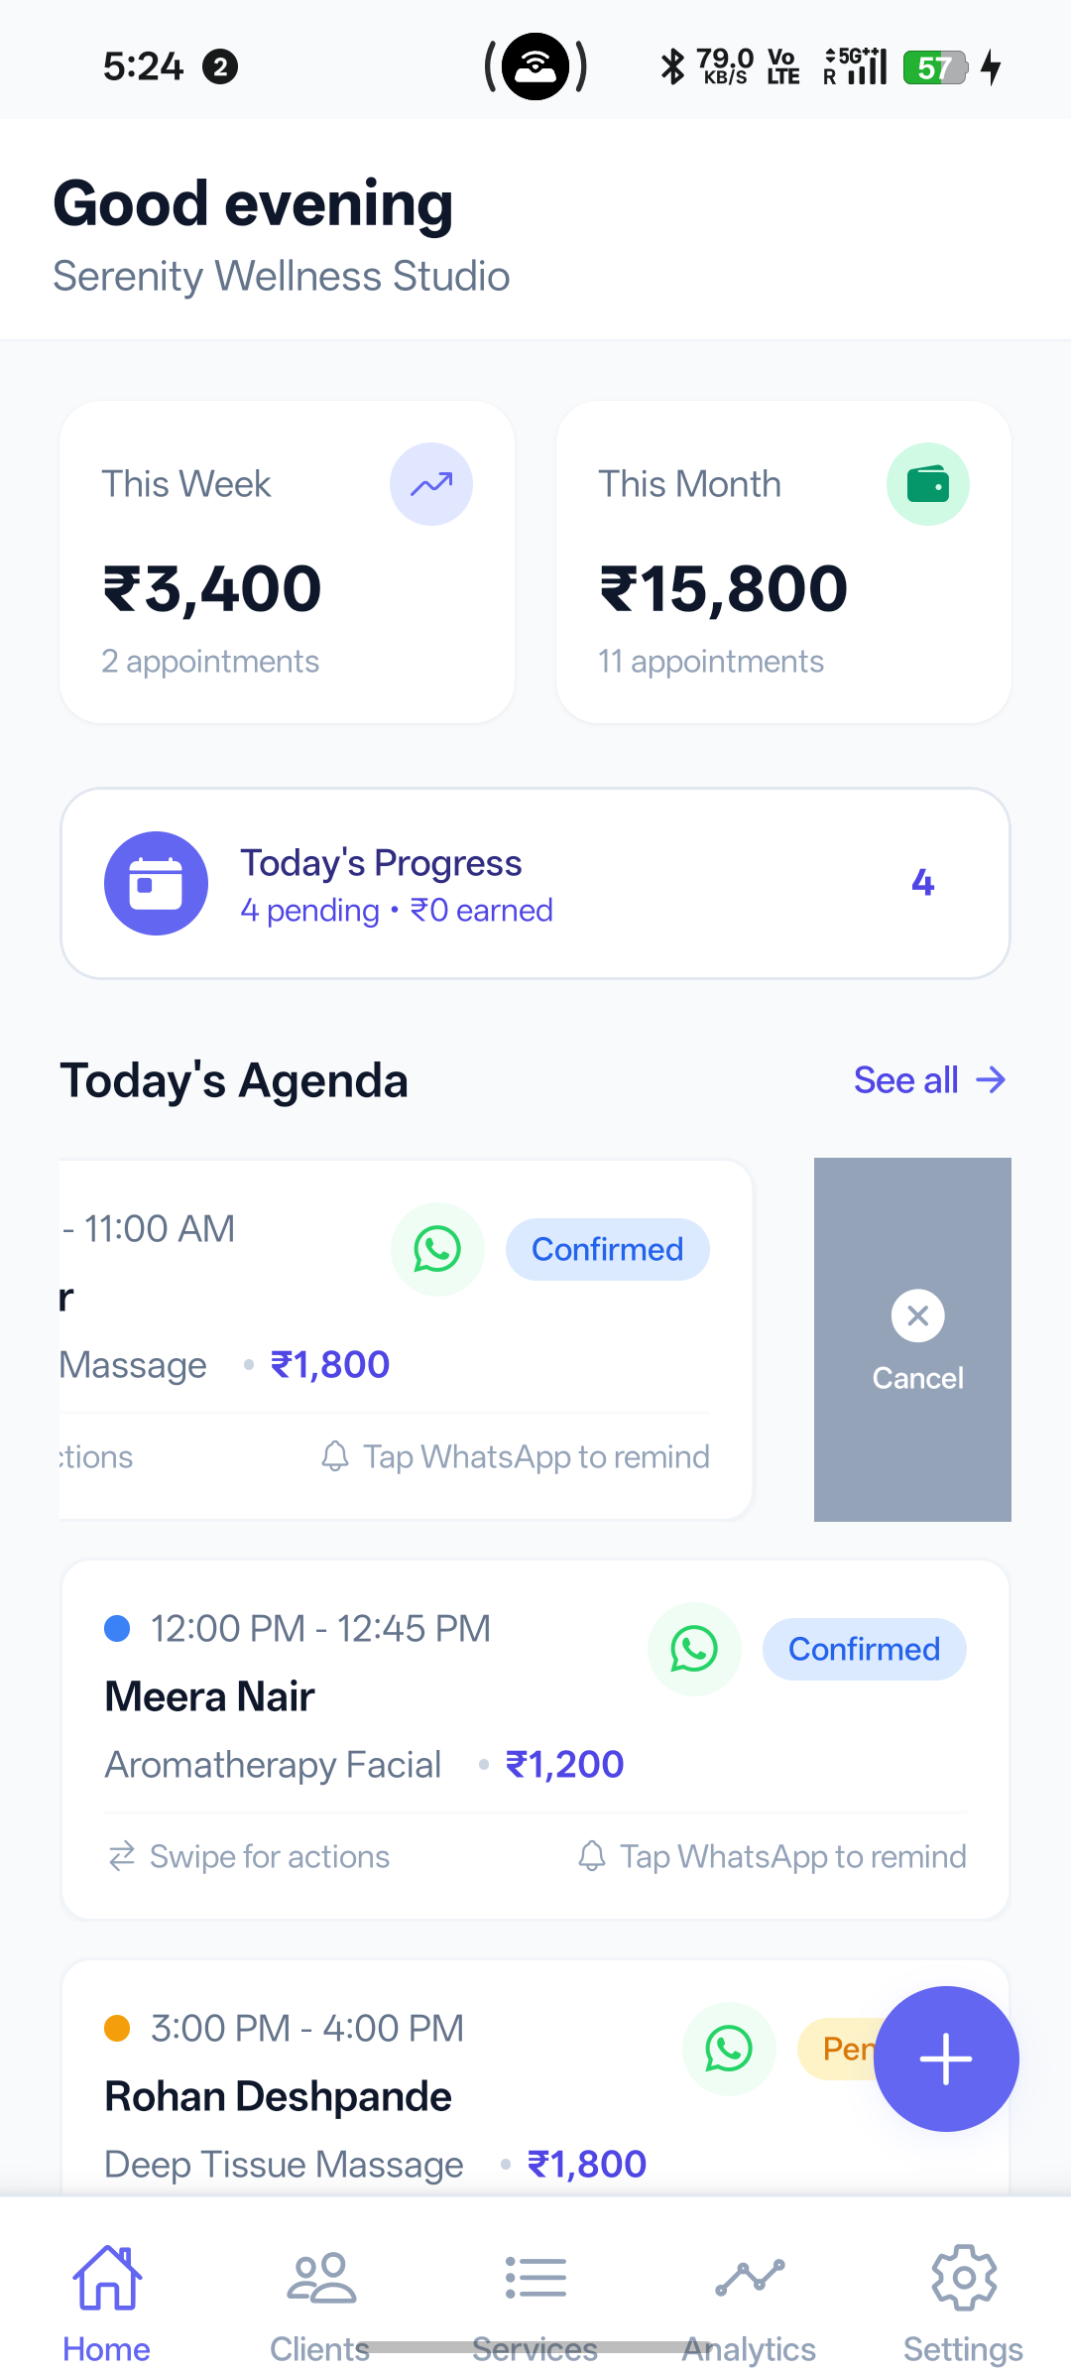
Conclusion & Future Work
Working product, installable today
Five primary, three secondary objectives met
Short term: self-booking, UPI, release
Medium term: offline sync, invoices, Hindi
Long term: AI insights, team accounts
Notes:
Close on the point that the most valuable feature is the least technically impressive: conflict detection is a single interval-overlap query, and it solves the most damaging problem these users have.
The broader lesson was starting from the user's actual context rather than the technology: WhatsApp deep links instead of building chat, INR by default, and gestures designed for use between sessions rather than at a desk.

