Slide 1

Chapter 22
World Wide Web
and
HTTP
Copyright © The McGraw-Hill Companies, Inc. Permission required for reproduction or display.

Slide 2
OBJECTIVES:
To discuss the architecture of WWW and describe the concepts of hypertext and hypermedia.
To describe Web clients and Web servers and their components.
To define URL as a tool to identify a Web server.
To introduce three different Web documents: static document, dynamic document, and active document.
To discuss HTTP and its transactions.
To define and list the fields in a request message.

Slide 3
OBJECTIVES (continued):
To define non-persistent and persistent connections in HTTP.
To introduce cookies and their applications in HTTP.
To discuss Web caching, its application, and the method used to update the cache.

Slide 4
Chapter
Outline
22.1 Architecture
22.2 Web Document
22.3 HTTP

Slide 5
22-1 ARCHITECTURE
The WWW today is a distributed client-server service, in which a client using a browser can access a service using a server. However, the service provided is distributed over many locations called sites. Each site holds one or more documents, referred to as Web pages. Each Web page, however, can contain some links to other Web pages in the same or other sites. In other words, a Web page can be simple or composite.

Slide 6
Topics Discussed in the Section
Hypertext and Hypermedia
Web Client (Browser)
Web Server
Uniform Resource Locator (URL)

Slide 7
Example 22.1
Assume we need to retrieve a Web page that contains the biography of a famous character with some pictures, which are embedded in the page itself. Since the pictures are not stored as separate files, the whole document is a simple Web page. It can be retrieved using one single request/ response transaction, as shown in Figure 22.1.

Slide 8
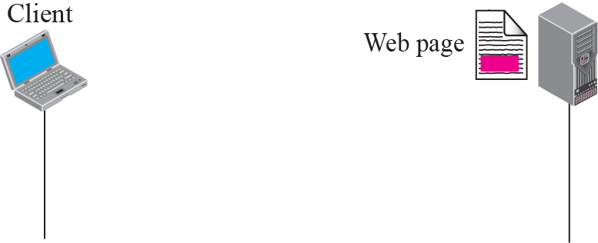
Figure 22.1 Example 22.1

Slide 9
Example 22.2
Now assume we need to retrieve a scientific document that contains one reference to another text file and one reference to a large image. Figure 22.2 shows the situation. The main document and the image are stored in two separate files in the same site (file A and file B); the referenced text file is stored in another site (file C). Since we are dealing with three different files, we need three transactions if we want to see the whole document. The first transaction (request/response) retrieves a copy of the main document (file A), which has a reference (pointer) to the second and the third files.

Slide 10
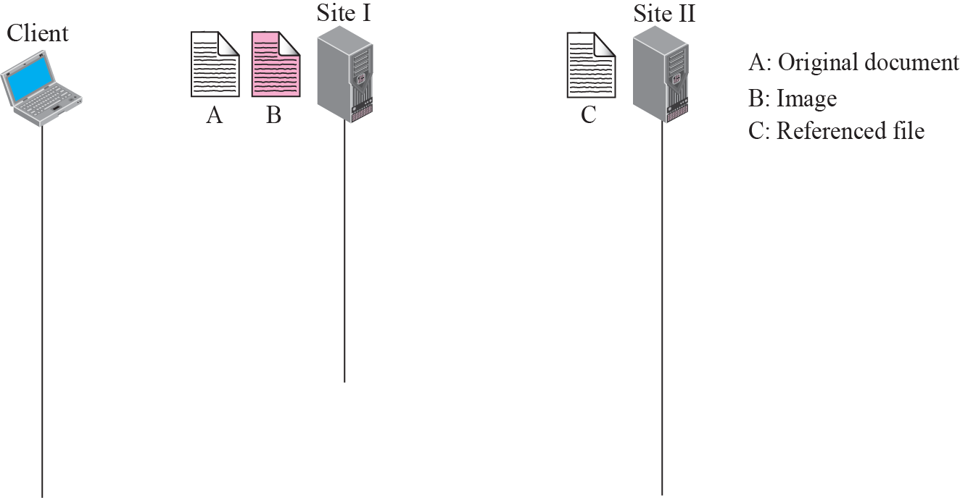




Figure 22.2 Example 22.2

Slide 11
Example 22.3
A very important point we need to remember is that file A, file B, and file C in Example 22.2 are independent Web pages, each with independent names and addresses. Although references to file B or C are included in file A, it does not mean that each of these files cannot be retrieved independently. A second user can retrieve file B with one transaction. A third user can retrieve file C with one transaction.

Slide 12
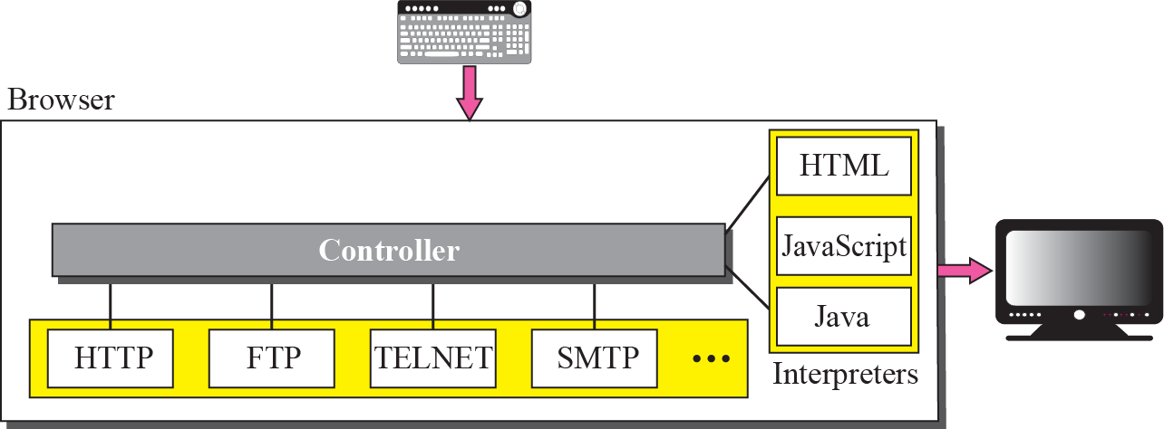
Figure 22.3 Browser

Slide 13
Figure 22.4 URL

Slide 14
22-2 WEB DOCUMENTS
The documents in the WWW can be grouped into three broad categories: static, dynamic, and active. The category is based on the time the contents of the document are determined.

Slide 15
Topics Discussed in the Section
Static Documents
Dynamic Documents
Active Documents

Slide 16
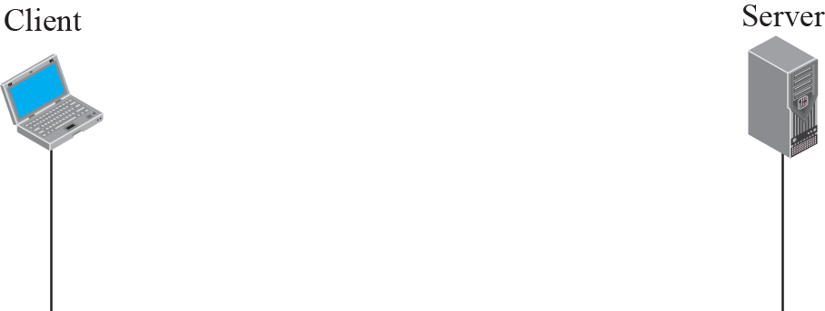
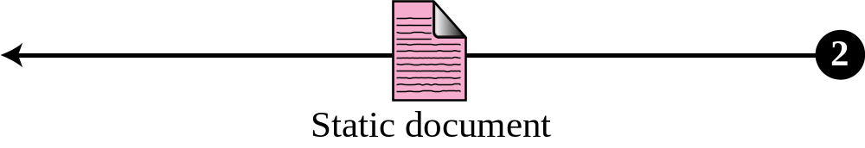
Figure 22.5 Static document

Slide 17

Note
HTML, XML, XSL, and XHTML are discussed in Appendix E.

Slide 18
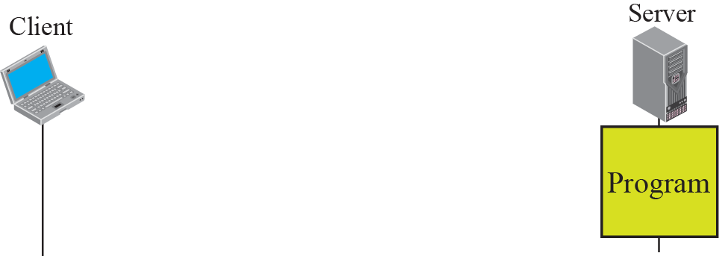
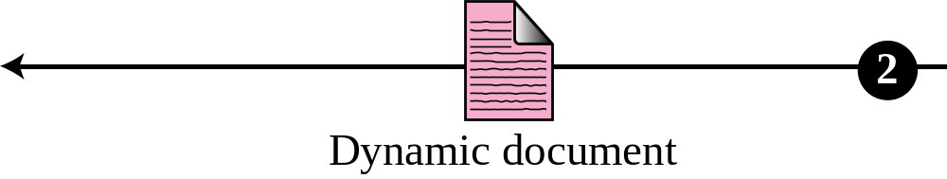
Figure 22.6 Dynamic document using CGI

Slide 19
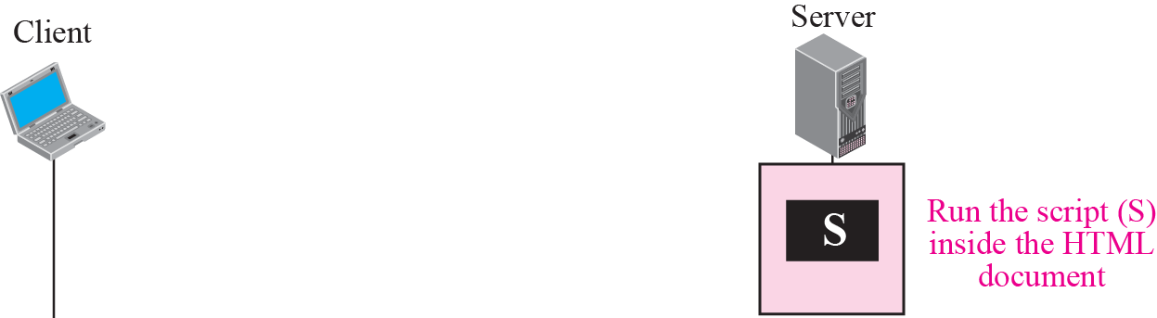
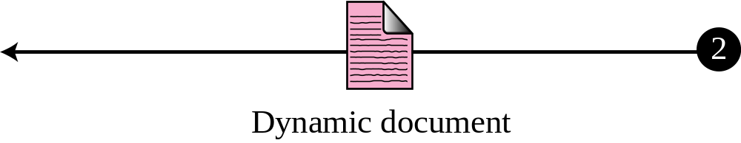
Figure 22.7 Dynamic document using server-site script

Slide 20
Note
Dynamic documents are sometimes referred to as server-site dynamic documents.

Slide 21
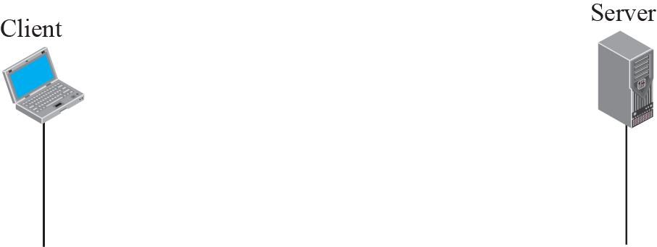
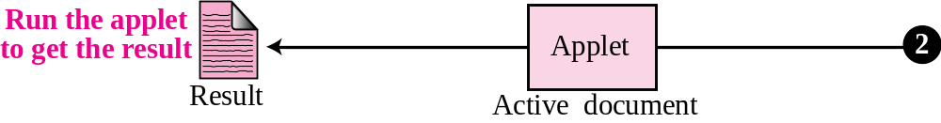
Figure 22.8 Active document using Java applet

Slide 22
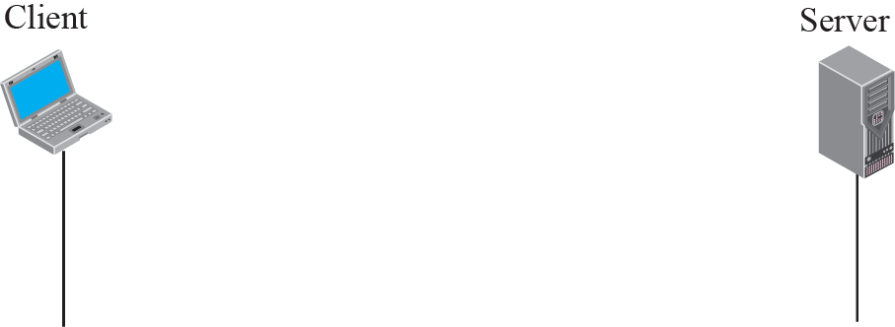
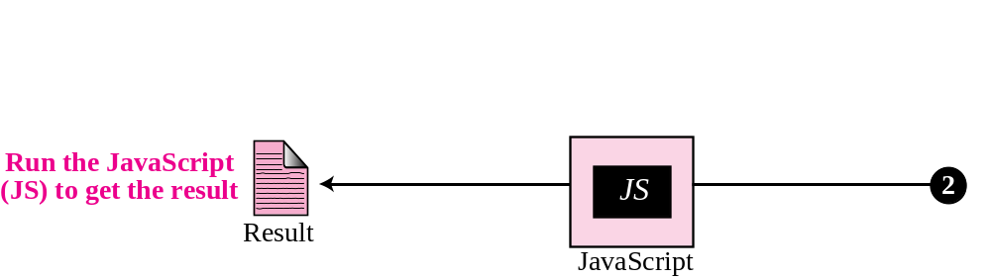
Figure 22.9 Active document using client-site script

Slide 23
Note
Active documents are sometimes referred to as client-site dynamic documents.

Slide 24
22-3 HTTP
The Hypertext Transfer Protocol (HTTP) is a protocol used mainly to access data on the World Wide Web. HTTP functions like a combination of FTP (Chapter 21) and SMTP (Chapter 23). It is similar to FTP because it transfers files and uses the services of TCP. However, it is much simpler than FTP because it uses only one TCP connection. There is no separate control connection; only data are transferred between the client and the server.

Slide 25
Topics Discussed in the Section
HTTP Transaction
Conditional Request
Persistence
Cookies
Web Caching: Proxy Server
HTTP Security

Slide 26
Note
HTTP uses the services of TCP on well-known port 80.

Slide 27
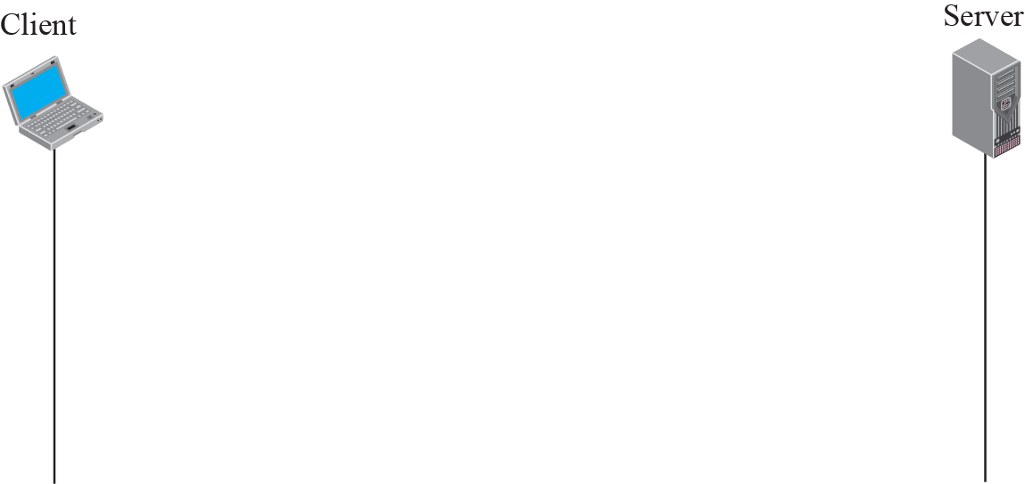
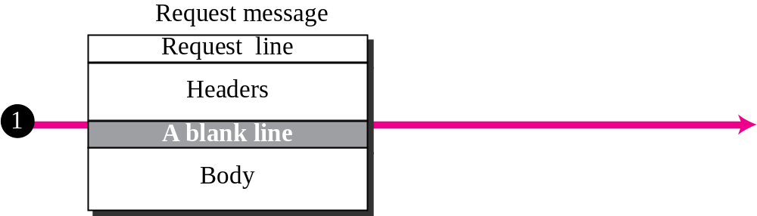
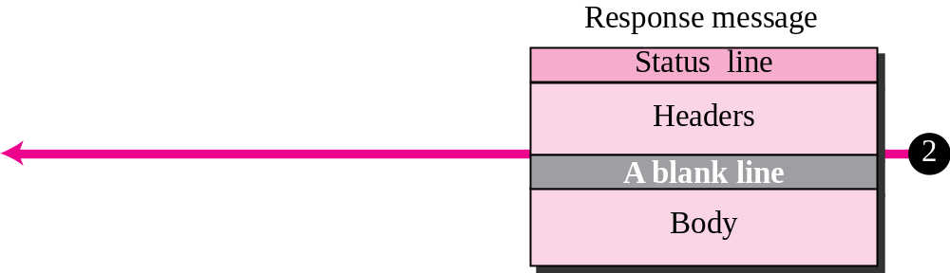
Figure 22.10 HTTP transaction

Slide 28
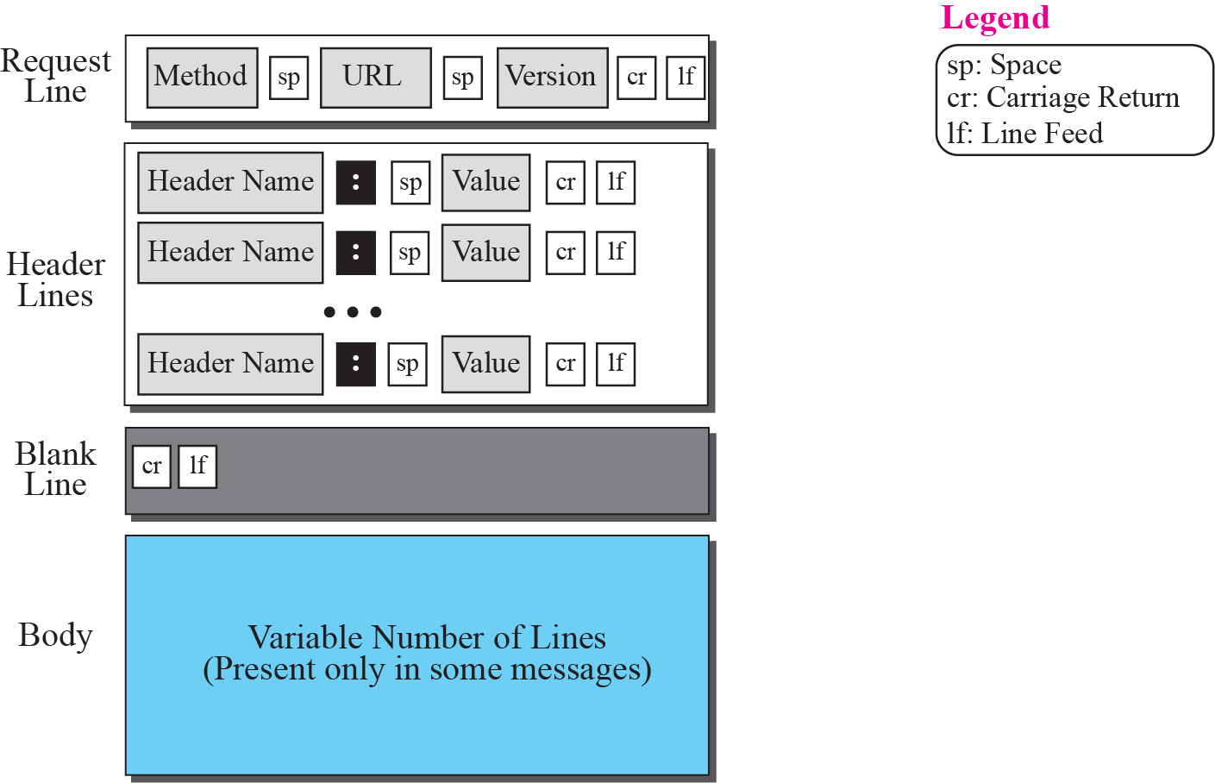
Figure 22.11 Format of the request message

Slide 29
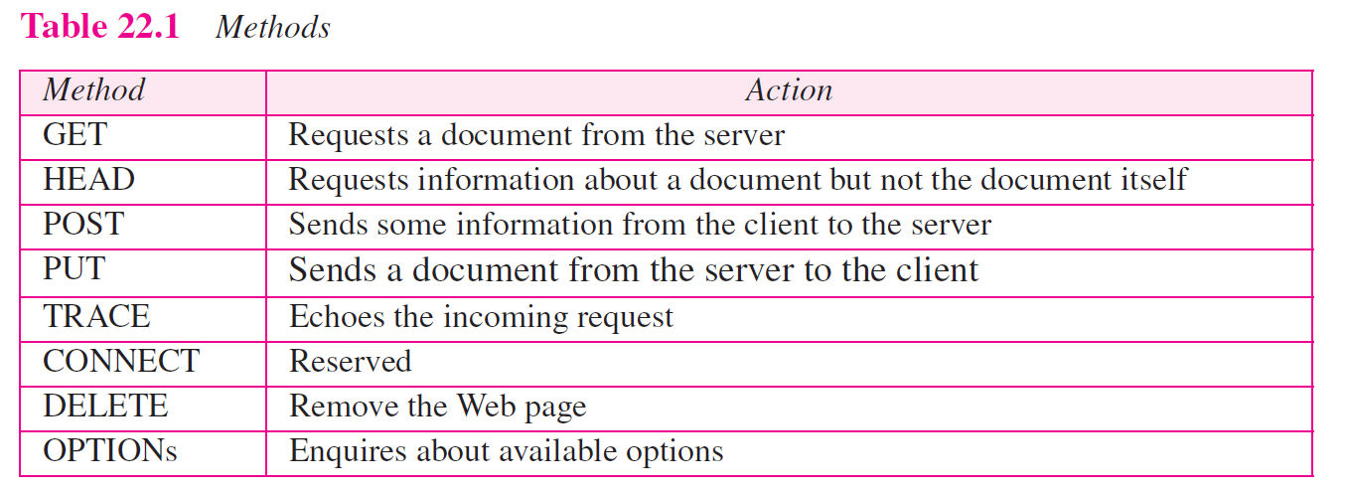

Slide 30
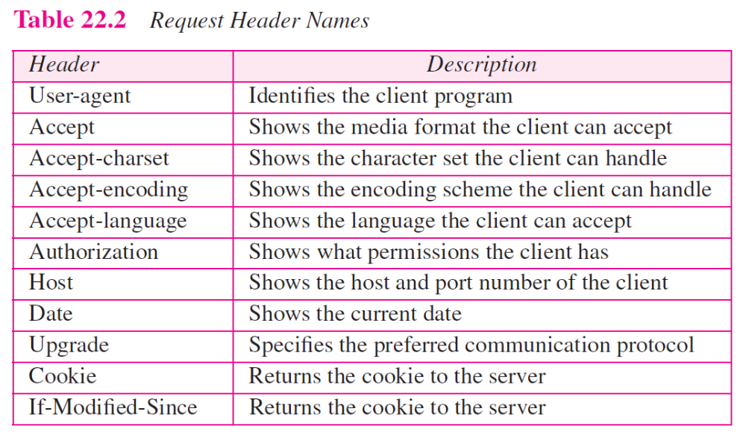

Slide 31
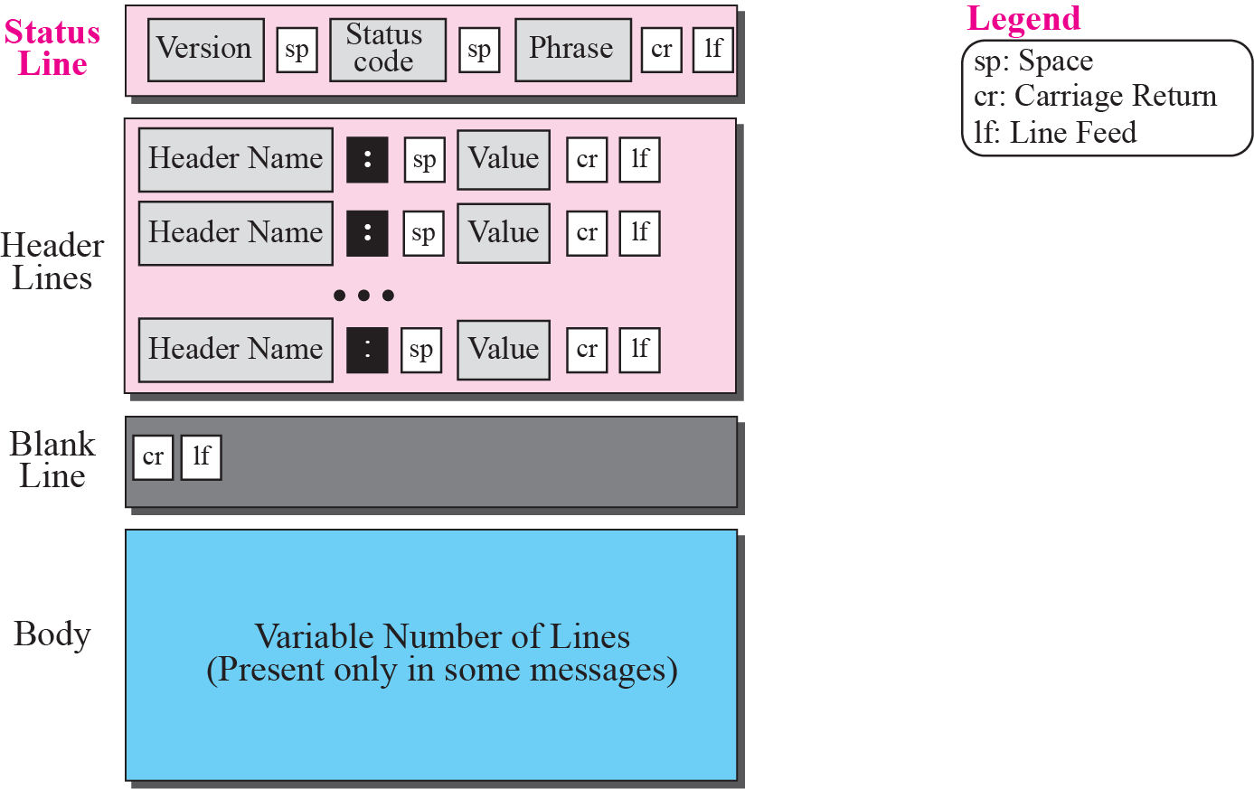
Figure 22.12 Format of the response message

Slide 32
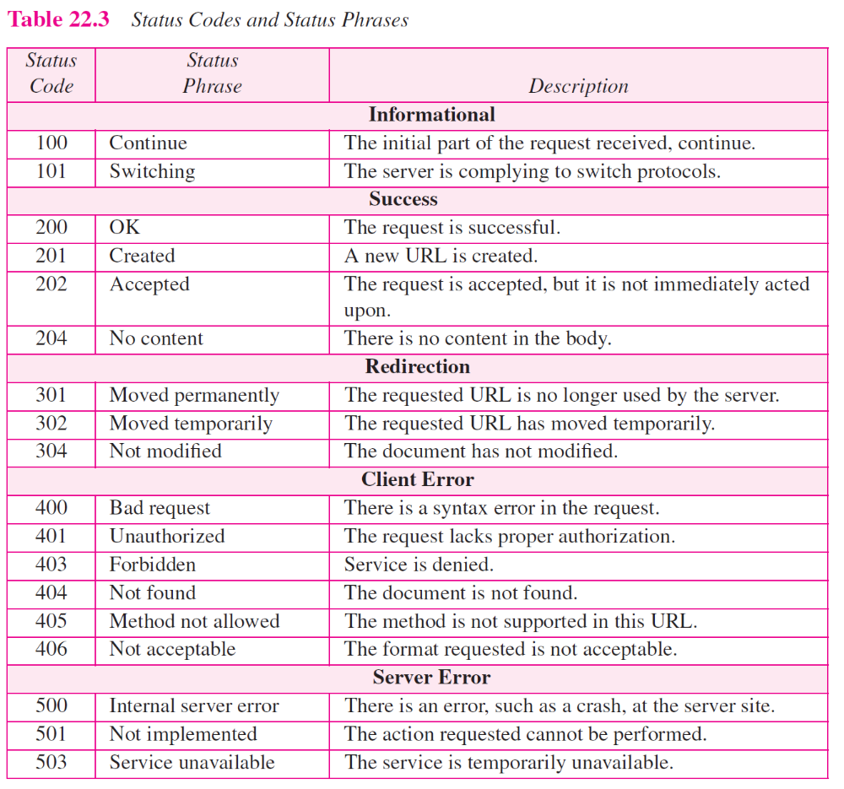

Slide 33
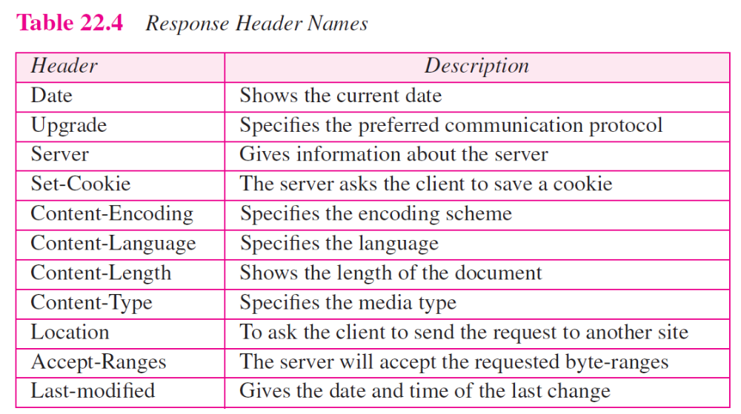

Slide 34
Example 22.4
This example retrieves a document (see Figure 22.13). We use the GET method to retrieve an image with the path /usr/bin/image1. The request line shows the method (GET), the URL, and the HTTP version (1.1). The header has two lines that show that the client can accept images in the GIF or JPEG format. The request does not have a body. The response message contains the status line and four lines of header. The header lines define the date, server, MIME version, and length of the document. The body of the document follows the header.

Slide 35
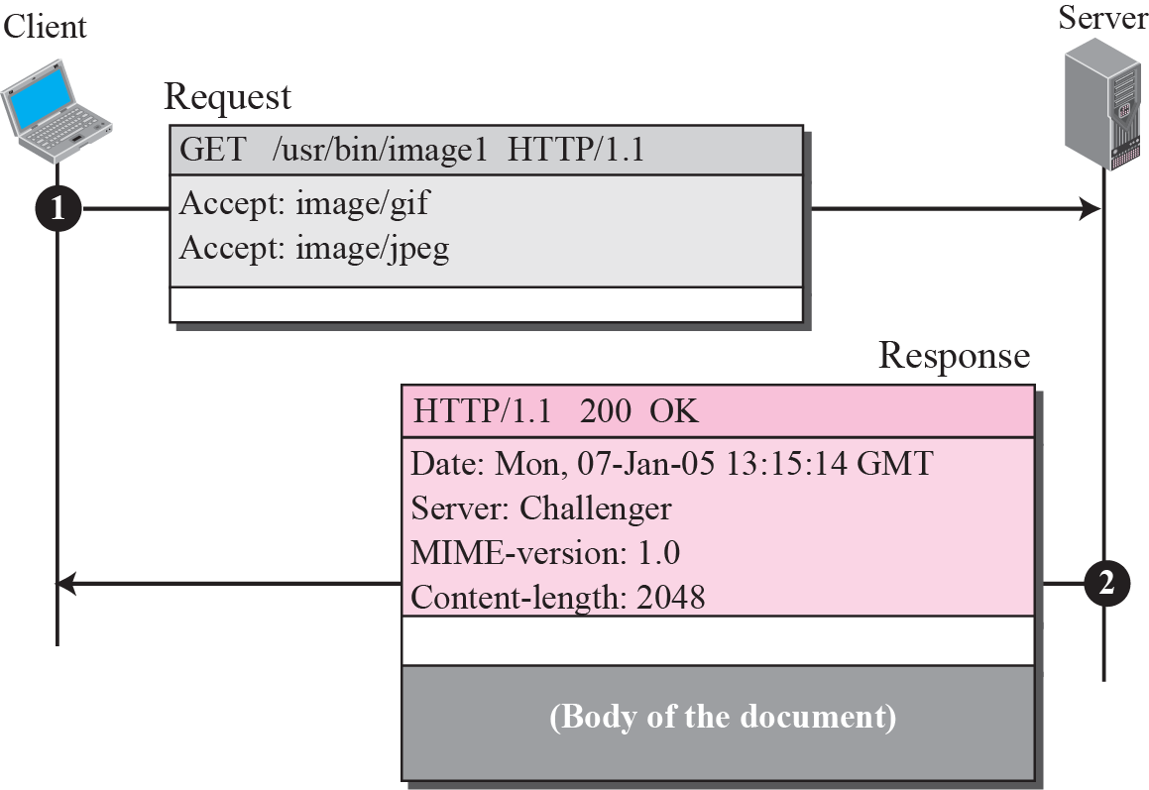
Figure 22.13 Example 22.4

Slide 36
Example 22.5
In this example, the client wants to send data to the server. We use the POST method. The request line shows the method (POST), URL, and HTTP version (1.1). There are four lines of headers. The request body contains the input information. The response message contains the status line and four lines of headers. The created document, which is a CGI document, is included as the body (see Figure 22.14).

Slide 37
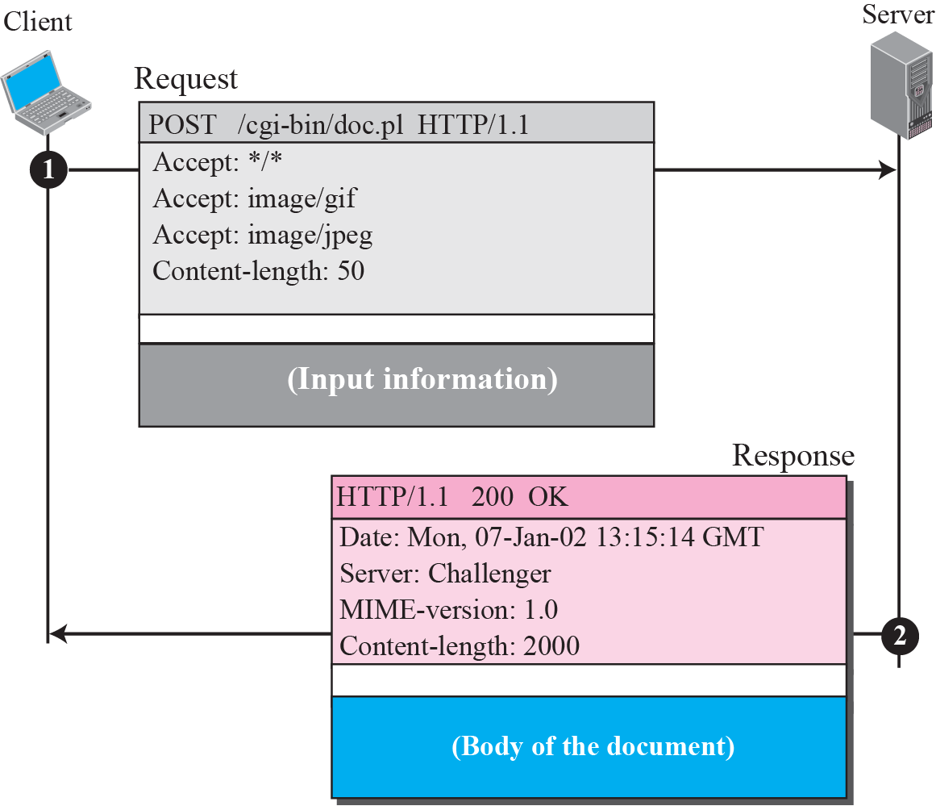
Figure 22.14 Example 22.5

Slide 38
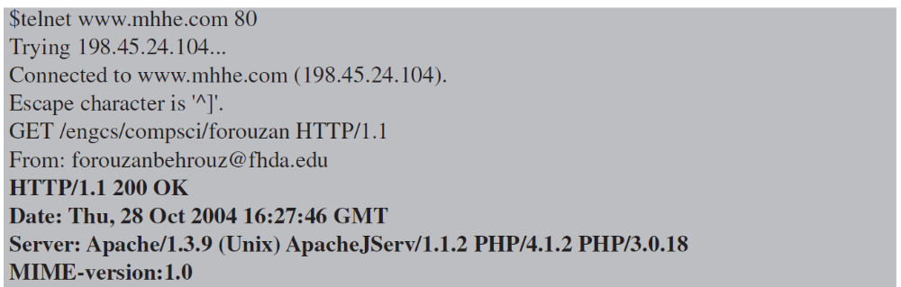
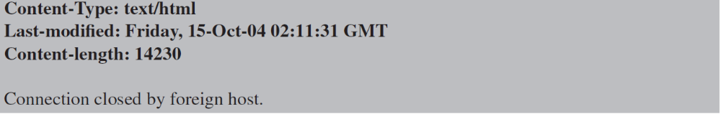
Example 22.6
HTTP uses ASCII characters. The following shows how a client can directly connect to a server using TELNET, which logs into port 80.

Slide 39
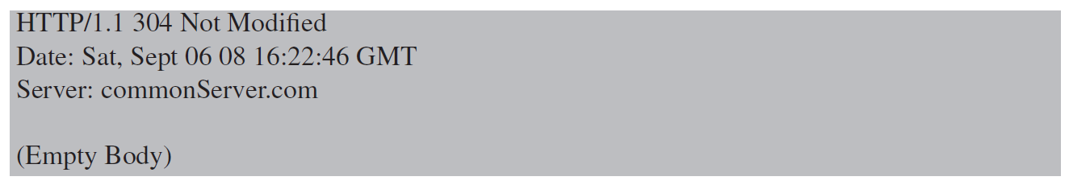
Example 22.7
The following shows how a client imposes the modification data and time condition on a request.
The status line in the responds shows the file is not modified after the defined point of time. The body of the response message is also empty.

Slide 40
Example 22.8
Figure 22.15 shows an example of a nonpersistent connection. The client needs to access a file that contains two links to images. The text file and images are located on the same server.

Slide 41
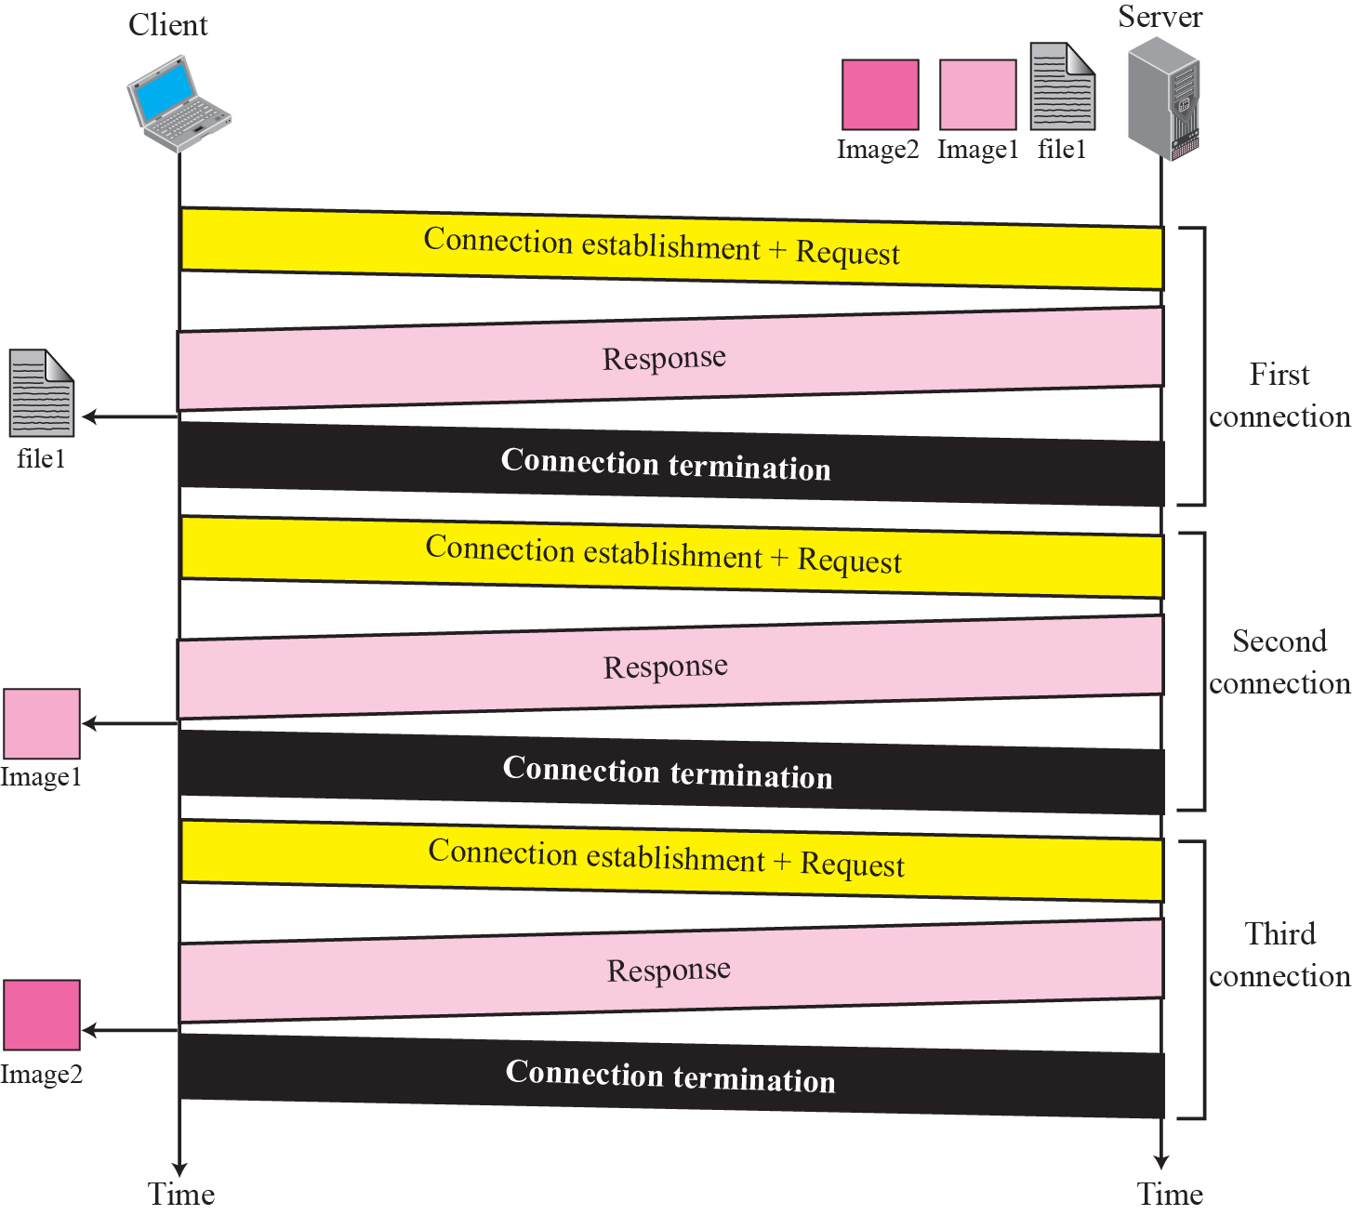
Figure 22.15 Example 22.8

Slide 42
Note
HTTP version 1.1 specifies a persistent connection by default.

Slide 43
Example 22.9
Figure 22.16 shows the same scenario as Example 22.8, but using persistent connection.

Slide 44
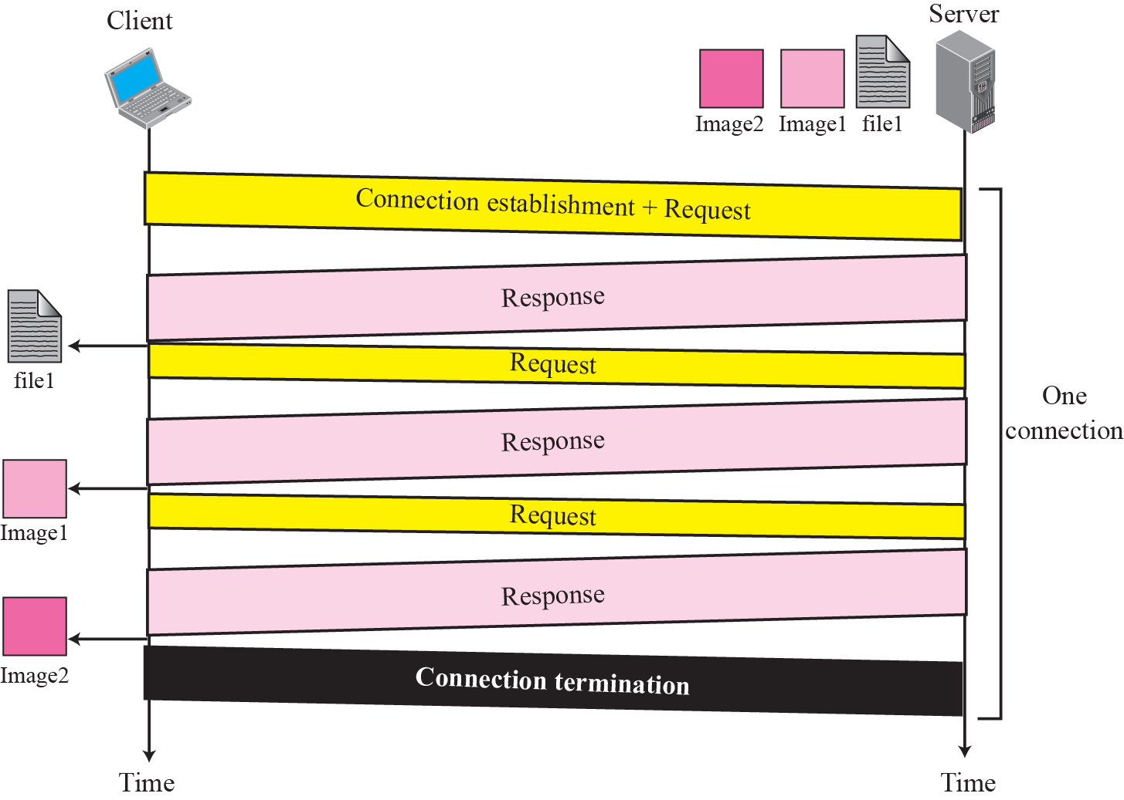
Figure 22.16 Example 22.9

Slide 45
Example 22.10
Figure 22.17 shows a scenario in which an electronic store can benefit from the use of cookies. Assume a shopper wants to buy a toy from an electronic store named BestToys. The shopper browser (client) sends a request to the BestToys server.

Slide 46
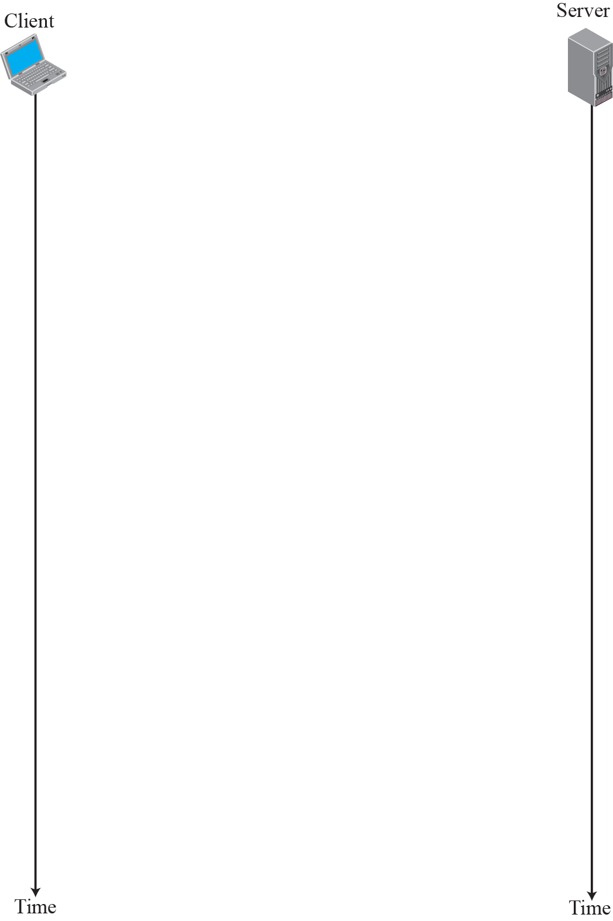
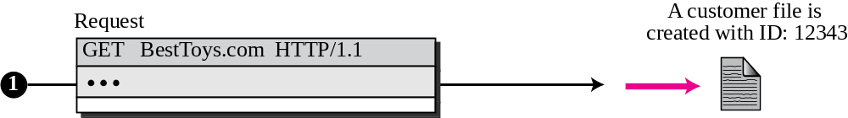

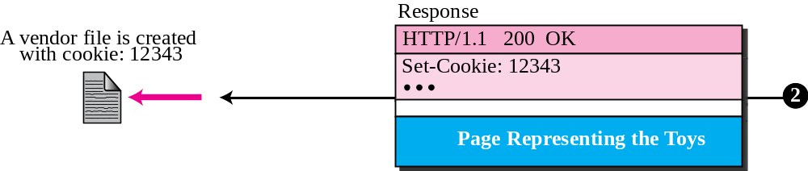
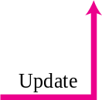

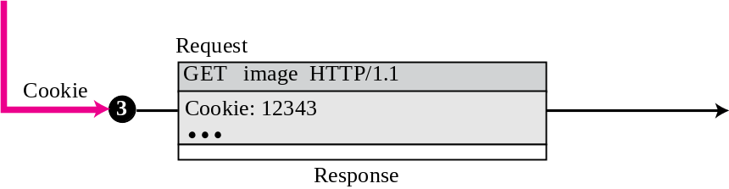
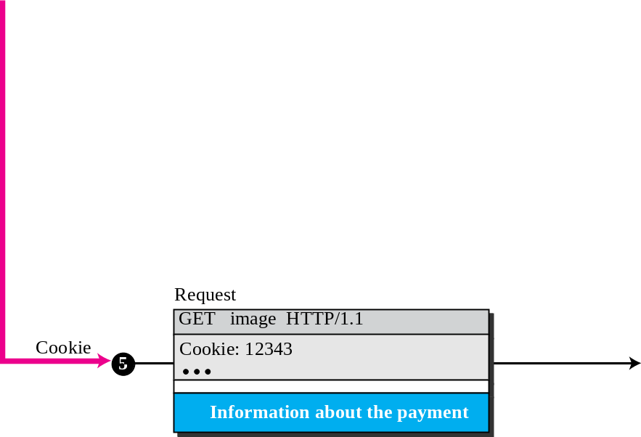
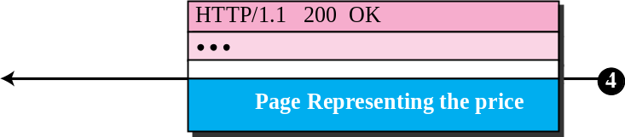
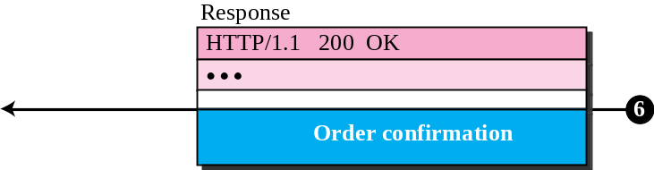
Figure 22.17 Example 22.10

