Slide 1
MACHINE LEARNING PROJECT · PBL REVIEW 1 · 28 SEPTEMBER 2026
Mobile App Ecosystem Dynamics and Direct Bank Marketing Pipelines
Exploratory analysis, regression and classification on four real-world datasets
EDA 1
Google Play Store
EDA 2
Video Game Sales
REGRESSION
Power Plant (CCPP)
CLASSIFICATION
Bank Marketing
GROUP 10
Sanskriti Rastogi
RA2411003012439
Sahil Raj
RA2411003012492
Yash Santosh Lohare
RA2411003012493
Om Pathania
RA2411003012495
Guide: Dr. Arnab Maity
Notes:
Introduce the team and the problem statement. One line: we study the digital economy from two sides, app/game markets (EDA) and a bank's direct-marketing campaign (classification), plus a regression benchmark on power plant output. Total talk: 10 minutes, about 35-40 seconds per slide.

Slide 2
Rubric 1 · Problem Identification & Dataset Selection · 4 marks
Problem statement and objectives
The problem
Digital businesses make decisions on huge, messy data: which apps and games succeed, where demand comes from, and which customers are worth contacting.
Our approach
Build end-to-end ML pipelines that turn raw data into decisions: understand two digital markets, then predict a continuous and a binary business outcome.
01
02
Mobile app ecosystem
What drives app ratings and installs? Free vs paid, categories, maintenance.
Video game industry
How did sales evolve (1980–2016)? Which genres, platforms, regions dominate?
03
04
Regression
Predict a power plant's hourly energy output (MW) from ambient conditions.
Classification
Predict which bank clients will subscribe to a term deposit before calling them.
1 Clean
2 Explore
3 Model
4 Compare
5 Interpret
Group 10 · PBL Review 1
2
Notes:
Explain WHY: app stores and games are crowded, hit-driven markets, so knowing what drives installs/ratings guides product decisions. Banks waste most outbound calls: 89% of clients say no. Predicting who will say yes before calling saves cost. The regression task shows the same pipeline on a continuous target.

Slide 3
Rubric 1 · Problem Identification & Dataset Selection · 4 marks
Four datasets, each chosen for a specific ML task
Task | Dataset | Source | Size | Target | Why it suits the task
EDA 1 | Google Play Store Apps | Kaggle · lava18 | 10,841 × 13 | — (exploratory) | Real, messy data: numbers stored as text, duplicates, 15% missing ratings → full cleaning exercise
EDA 2 | Video Game Sales | Kaggle · gregorut | 16,598 × 11 | — (exploratory) | 37 years × 4 regions × 12 genres: time trends, market concentration, regional taste
Regression | Combined Cycle Power Plant | UCI #294 | 9,568 × 5 | PE: energy output (MW) | Clean sensor data with clear physical drivers; ideal to benchmark linear vs non-linear models
Classification | Bank Marketing (additional-full) | UCI #222 | 41,188 × 21 | y: subscribed? (yes / no) | Real campaign with only 11% positives → tests imbalance handling and the right metrics
Problem statement fixed by faculty; we use the assigned datasets. Links: kaggle.com/datasets/lava18/google-play-store-apps · kaggle.com/datasets/gregorut/videogamesales · archive.ics.uci.edu/dataset/294 · archive.ics.uci.edu/dataset/222
Group 10 · PBL Review 1
3
Notes:
Walk through the table row by row: source, size, target and why each dataset suits its task. Stress that the Play Store data is deliberately messy (good for EDA), CCPP is clean sensor data (good benchmark for regressors), and Bank Marketing is imbalanced (tests metric choice).

Slide 4
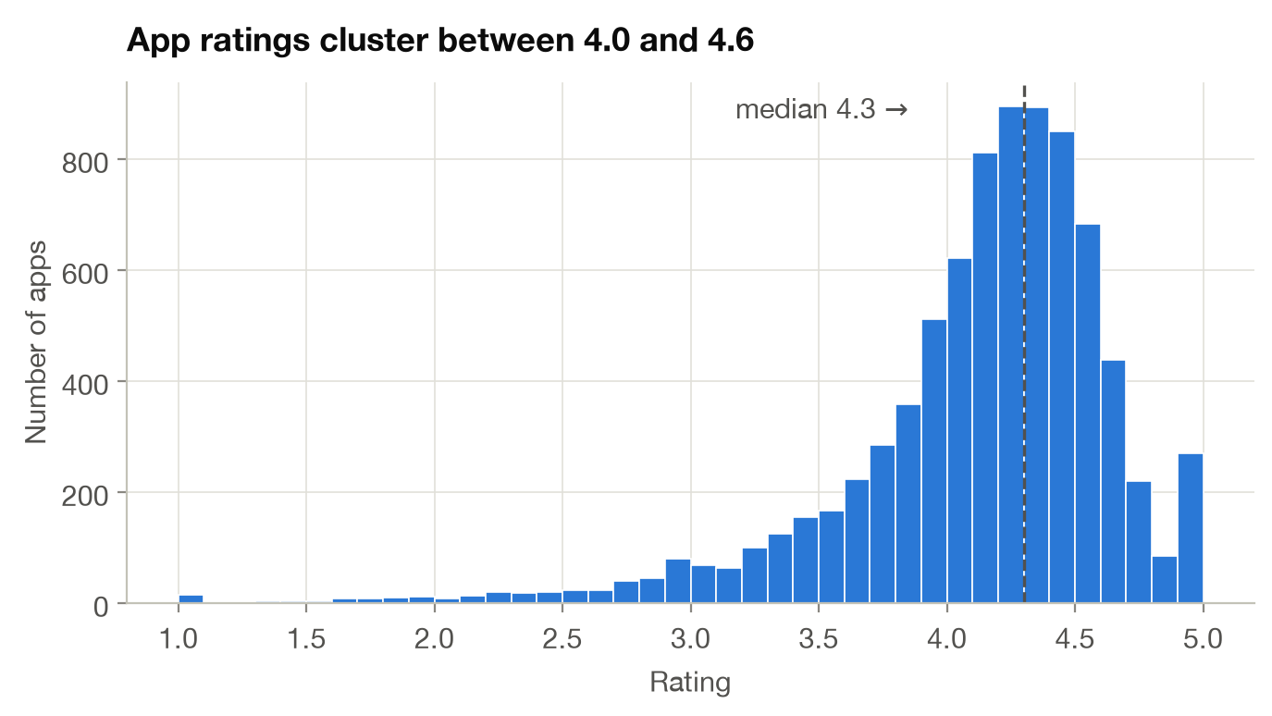
Rubric 2 · Exploratory Data Analysis & Insights · 4 marks
Play Store: cleaning 10,841 messy rows into 9,659 apps
1,182
duplicate / corrupt rows removed
15.1%
apps with no rating
92%
of those have ≤ 1K installs
Cleaning steps
Corrupted row: row 10472 had shifted columns (Rating = 19, Category = "1.9") → dropped
Duplicates: 483 exact duplicates + repeated scrapes of the same app → kept the latest (most reviews)
Text → numbers: Reviews; Size "19M"/"91k" → MB; Installs "10,000+" → 10000; Price "$4.99" → 4.99
"Varies with device": 1,695 app sizes set to missing instead of guessed
New features: days since last update, primary genre, log(installs), log(reviews)
Ratings are inflated: median 4.3, and 77% of rated apps score ≥ 4.0, so rating on its own separates apps only weakly.
Group 10 · PBL Review 1
4
Notes:
Explain each problem we found and how we fixed it. Key point: missing ratings are NOT random. 92% belong to apps with ≤1,000 installs, so imputing the mean would invent fake scores; we keep them as missing for rating analysis.

Slide 5
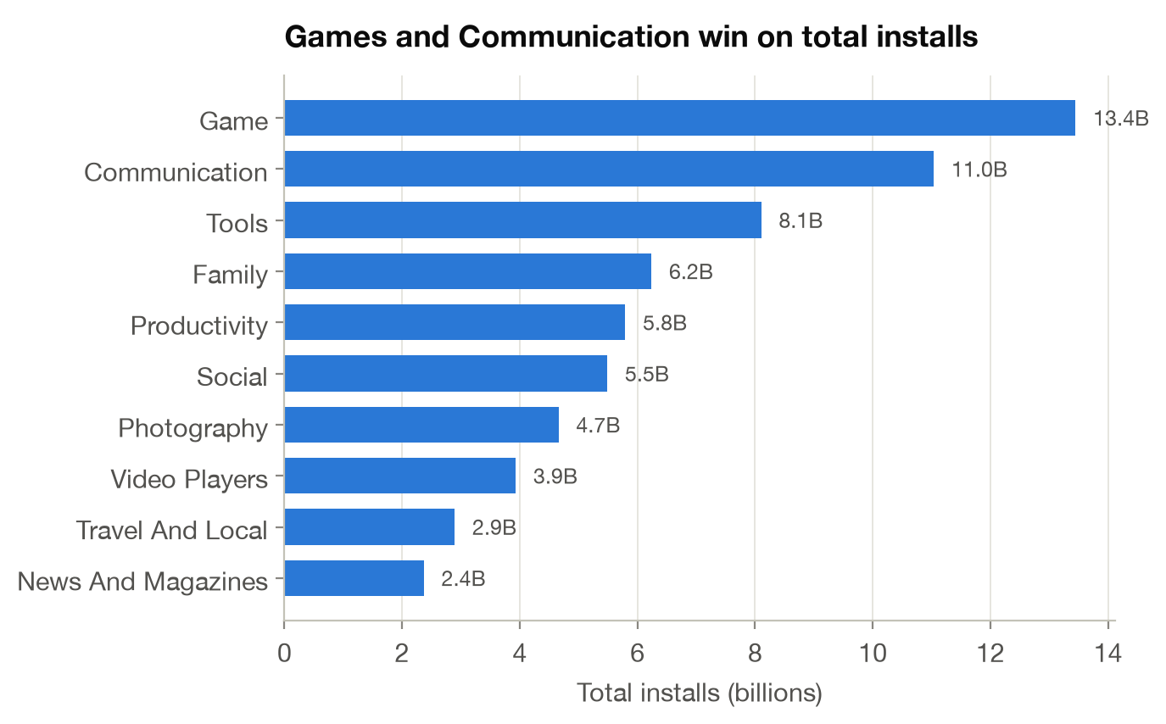
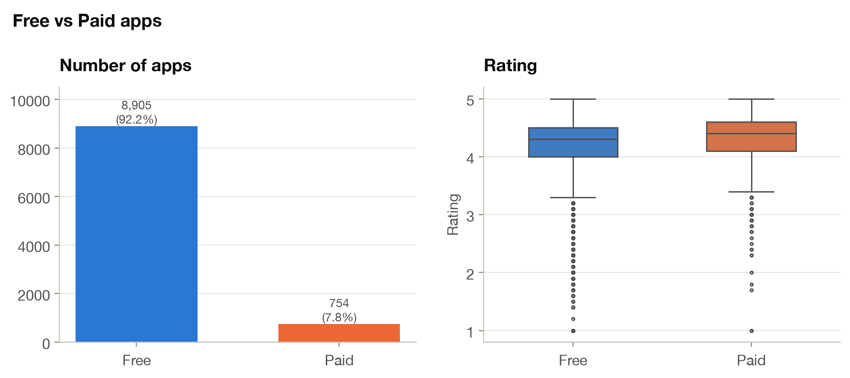
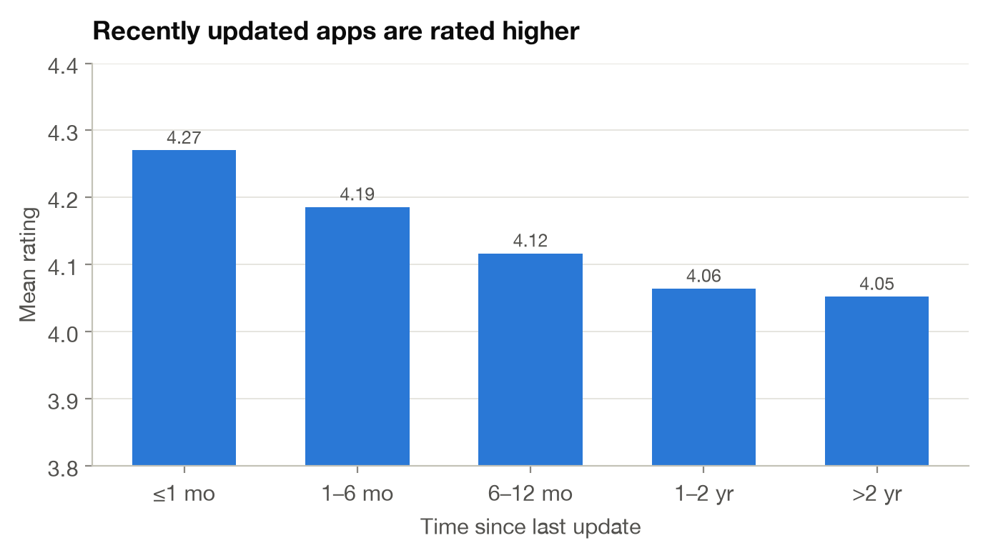
Rubric 2 · Exploratory Data Analysis & Insights · 4 marks
Play Store: games win installs, free apps dominate
Supply ≠ demand
Family has the most apps, but Game (13.4B) and Communication (11.0B) collect the most installs.
Free dominates
92.2% of apps are free, with a median of 100K installs vs 1K for paid. Paid apps rate slightly higher (4.26 vs 4.17).
Maintenance pays
Apps updated within a month average 4.27 vs 4.05 for apps untouched for 2+ years. Reviews track installs (ρ = 0.97).
Group 10 · PBL Review 1
5
Notes:
Three findings, one per chart. (1) Supply is not demand: Family has the most apps, but Game and Communication get the most installs. (2) Free apps are 92% of the store and get 100x the median installs. (3) Apps updated recently are rated higher, so maintenance matters. Also mention: reviews track installs almost perfectly (rho 0.97).

Slide 6
Rubric 2 · Exploratory Data Analysis & Insights · 4 marks
Video games: a hit-driven market that peaked in 2008
679M
units sold by games released in the peak year 2008
0.17M
median game sales, while Wii Sports sold 82.7M
21%
of all sales come from the top 1% of games
53%
of sales held by the top 5 of 576 publishers
Cleaned: 16,598 → 16,323 games (271 with no year removed; kept 1980–2016). Post-2012 drop partly reflects the shift to digital sales not covered by this dataset.
Group 10 · PBL Review 1
6
Notes:
Cleaning: dropped 271 games with no year and cut at 2016 (2017/2020 have only 4 games; the data was scraped in 2016). The chart shows growth from the mid-90s to a 2008 peak, then decline. Part of the decline is real (shift to mobile and digital sales), part is because this dataset only counts boxed retail copies. Sales are extremely skewed.

Slide 7
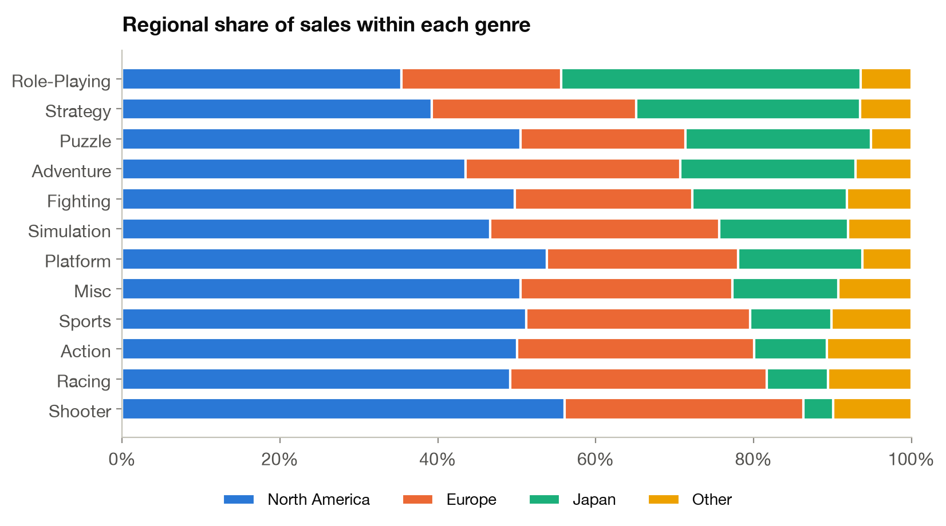
Rubric 2 · Exploratory Data Analysis & Insights · 4 marks
Video games: tastes differ sharply by region
Share of global sales
North America
49.1%
Europe
27.3%
Japan
14.6%
Other
8.9%
Japan is its own market: Role-Playing is #1 there; 38% of all RPG sales are Japanese. JP sales correlate only 0.61 with global (NA: 0.94).
Shooters are Western: 56% of shooter sales come from North America.
Leaders: Action sells most overall; Platform games sell most per title (0.95M avg). Top platform: PS2; top publisher: Nintendo (1,784M).
Group 10 · PBL Review 1
7
Notes:
North America is half the market and moves together with global sales (r 0.94). Japan is different (r 0.61): Role-Playing is its number one genre, and 38% of all RPG sales come from Japan, while Shooters are 56% North American. Business meaning: localise the genre mix per region rather than one global strategy.

Slide 8
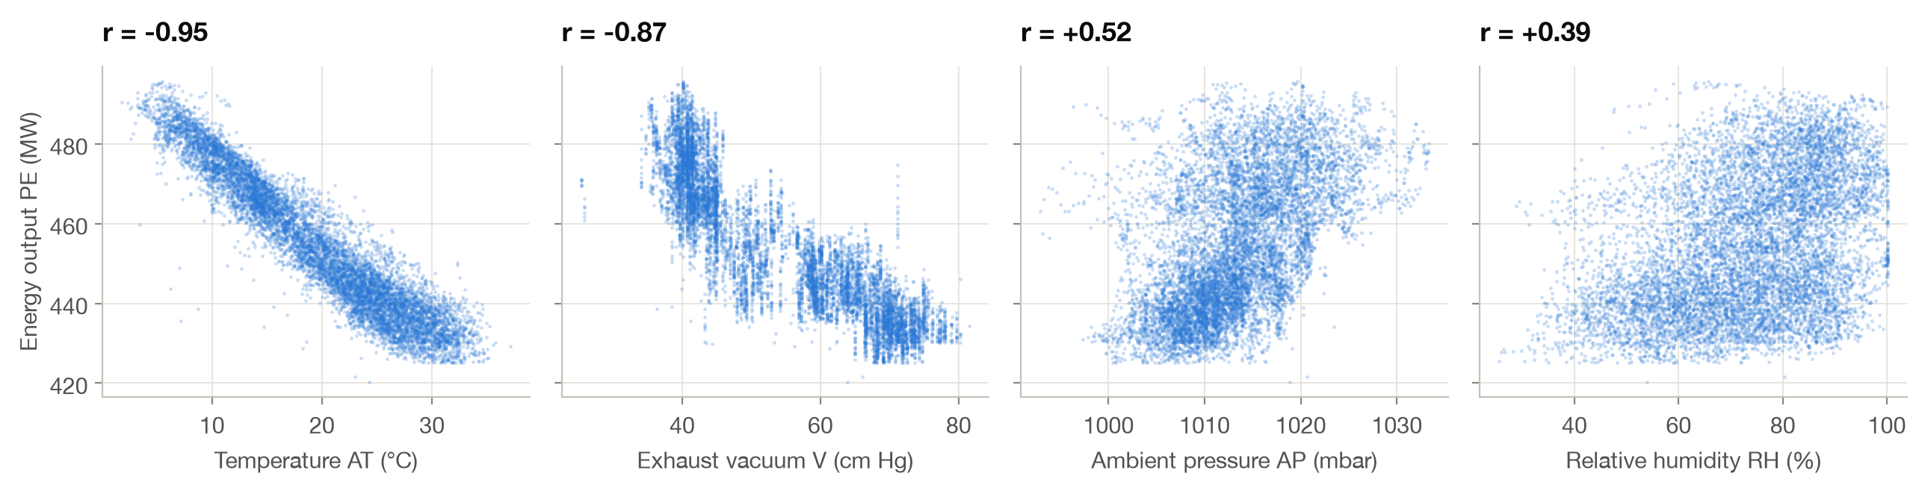
Rubric 3 · Regression & Classification Implementation · 4 marks
Regression: predicting power output from 4 sensors
1 Clean
9,568 rows, no missing values; 41 duplicates removed → 9,527 rows
2 Split
80 / 20 train–test (7,621 / 1,906), random_state = 42
3 Scale
StandardScaler inside a Pipeline, fitted on training folds only (no leakage)
4 Train 10 models
Linear, Ridge, Lasso, Polynomial, KNN, SVR, Decision Tree, RF, Gradient Boosting, XGBoost
5 Validate & tune
5-fold CV on train; GridSearchCV over 16 XGBoost settings; test set used once
Group 10 · PBL Review 1
8
Notes:
Target PE is net hourly electrical output in MW. Temperature and exhaust vacuum are strongly negative and almost linear; pressure and humidity are weak. AT and V are correlated (VIF 6.0 and 3.9): moderate multicollinearity, fine for prediction. Pipeline: scaling happens inside the pipeline so the test data never leaks into training. We compared 10 model families with 5-fold CV and tuned the best family with GridSearchCV.

Slide 9
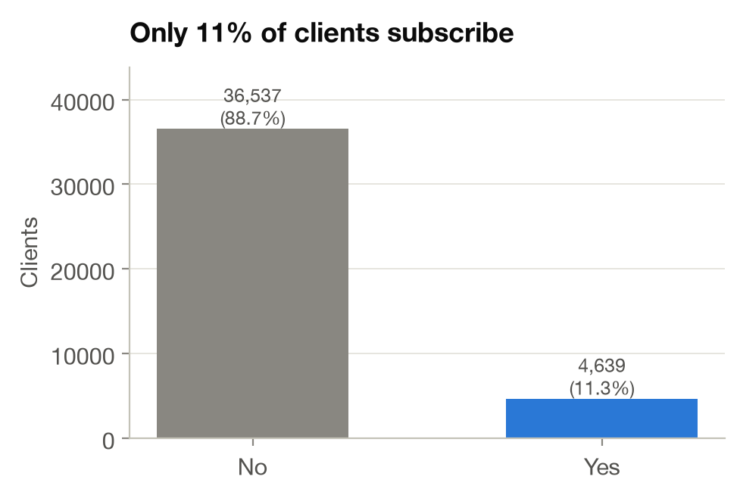
Rubric 3 · Regression & Classification Implementation · 4 marks
Classification: a leakage-free pipeline for 11% positives
1
Clean
12 duplicate rows removed; 'unknown' kept as its own category (it carries signal)
2
Remove leakage
Dropped 'duration': known only after the call ends (r = 0.41 with target)
3
Engineer
pdays = 999 (never contacted, 96%) → binary prev_contacted flag
4
Encode & scale
ColumnTransformer: one-hot for 10 categorical, StandardScaler for 9 numeric features
5
Split
Stratified 80 / 20 (32,940 / 8,236), keeps 11.3% positives in both sets
Why not accuracy?
A model that always says "no" is 88.7% accurate and finds zero subscribers. We judge models by F1, recall, ROC-AUC and PR-AUC.
6
Handle imbalance
Class weights · SMOTE (inside CV folds) · decision-threshold tuning on out-of-fold predictions
7
Models
Baseline, Logistic Regression ×3, Naive Bayes, KNN, Decision Tree, Random Forest, Gradient Boosting, XGBoost
Group 10 · PBL Review 1
9
Notes:
Most important design decision: we DROPPED 'duration' (call length). It's the most correlated feature, but it's only known after the call ends, so a model using it can't be used to decide whom to call. That's target leakage. The target is imbalanced (11% yes), so we compared three fixes: class weights, SMOTE inside CV folds, and tuning the decision threshold on out-of-fold training predictions.

Slide 10
Rubric 4 · Comparative Performance Analysis · 4 marks
Regression: tuned XGBoost cuts error by 31%
3.17 MW
test RMSE of tuned XGBoost (Linear: 4.59)
−31%
error vs Linear Regression baseline
R² 0.966
on test; 5-fold CV 0.967 ± 0.003
2.17 MW
mean absolute error (output range 420–496 MW)
Group 10 · PBL Review 1
10
Notes:
All 11 models were evaluated with 5-fold CV and on the held-out test set. Linear models already reach R² 0.93 because AT and V act almost linearly. Ridge and Lasso equal plain linear regression: with 4 features there is nothing to regularise. Tree ensembles win by capturing curvature and interactions. CV R² ≈ test R² with tiny std, so the ranking is stable.

Slide 11
Rubric 4 · Comparative Performance Analysis · 4 marks
Classification: 10 models compared on the right metrics
Model | Accuracy | Precision | Recall | F1 | ROC-AUC | PR-AUC | CV ROC-AUC
XGBoost (weighted) @ thr 0.65 | 0.881 | 0.479 | 0.595 | 0.531 | 0.812 | 0.484 | 0.801
Random Forest (balanced) | 0.873 | 0.454 | 0.617 | 0.523 | 0.807 | 0.484 | 0.794
XGBoost (weighted) | 0.845 | 0.388 | 0.654 | 0.487 | 0.812 | 0.484 | 0.801
Decision Tree (balanced) | 0.847 | 0.390 | 0.637 | 0.484 | 0.801 | 0.460 | 0.781
Logistic Reg. (balanced) | 0.831 | 0.360 | 0.645 | 0.462 | 0.800 | 0.446 | 0.791
Logistic Reg. + SMOTE | 0.822 | 0.347 | 0.654 | 0.453 | 0.799 | 0.445 | 0.787
Naive Bayes | 0.808 | 0.320 | 0.624 | 0.423 | 0.776 | 0.359 | 0.766
KNN (k=15) | 0.898 | 0.612 | 0.263 | 0.368 | 0.773 | 0.419 | 0.759
Gradient Boosting | 0.899 | 0.645 | 0.233 | 0.342 | 0.811 | 0.480 | 0.797
Logistic Regression | 0.898 | 0.652 | 0.212 | 0.320 | 0.801 | 0.453 | 0.790
Baseline (always 'no') | 0.887 | 0.000 | 0.000 | 0.000 | 0.500 | 0.113 | 0.500
Accuracy trap: "always no" scores 88.7% accuracy with 0 recall. Plain Logistic Regression looks just as accurate (89.8%) but finds only 21% of subscribers. Sorted by test F1; CV = stratified 5-fold on the training set.
Group 10 · PBL Review 1
11
Notes:
Read the table from the bottom: the baseline and unweighted models (plain Logistic Regression, Gradient Boosting, KNN) look accurate but miss 75-80% of subscribers. Class weights or SMOTE roughly triple recall. XGBoost with class weights has the best ROC-AUC, and with the tuned threshold it has the best F1. Random Forest is a close second.

Slide 12
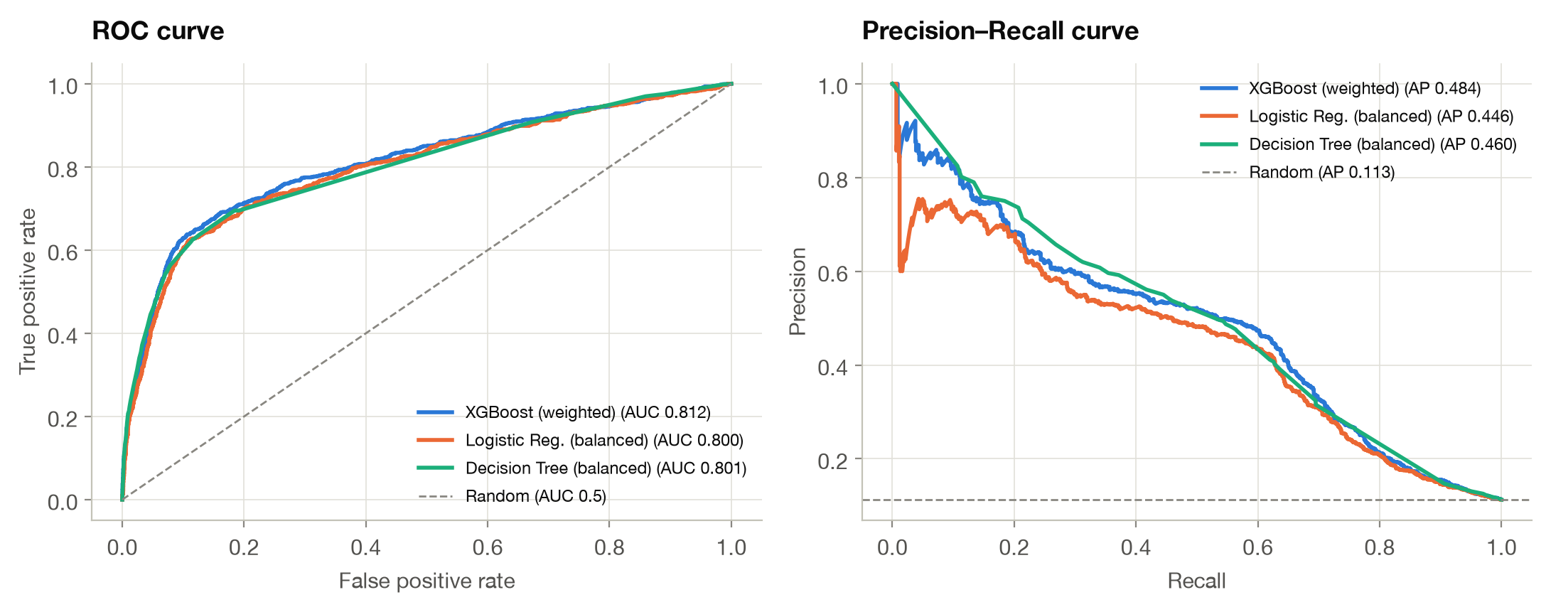
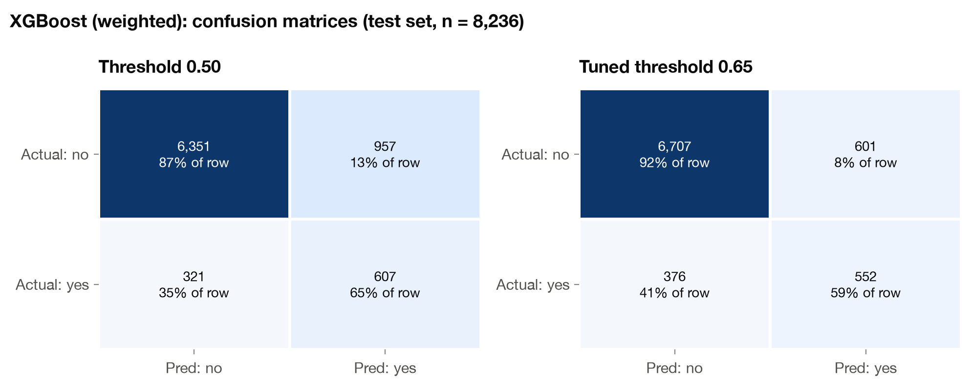
Rubric 4 · Comparative Performance Analysis · 4 marks
Classification: ranking quality and the threshold trade-off
Similar ranking ability
ROC-AUC 0.812 for XGBoost vs 0.800 for balanced Logistic Regression. All good models are 4× better than random at precision–recall (PR-AUC 0.484 vs 0.113).
Threshold 0.50 → 0.65
Wasted calls (false positives) drop from 957 to 601 (−37%), while subscribers found fall only from 607 to 552. Precision rises from 0.39 to 0.48.
Group 10 · PBL Review 1
12
Notes:
Left: ROC and precision-recall curves for the three best model families. They are close, which means the signal available before a call is limited. Right: the same XGBoost model at two thresholds. The threshold is a business lever: 0.65 was chosen to maximise F1 on out-of-fold training predictions, not on the test set.

Slide 13
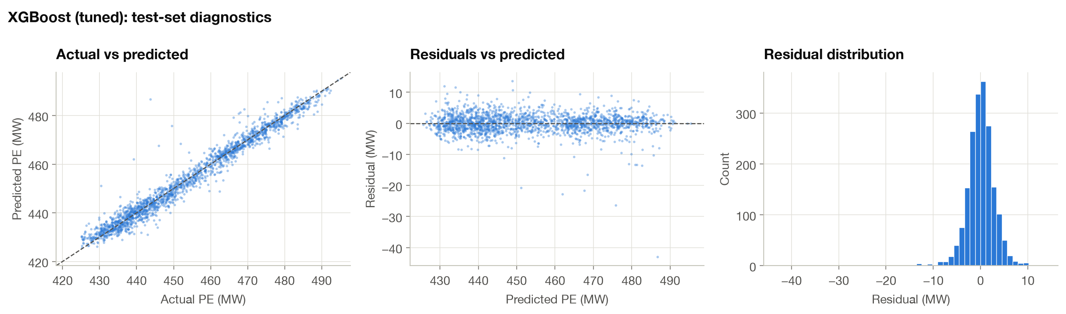
Rubric 5 · Result Interpretation & Presentation · 4 marks
Regression results: accurate, unbiased, temperature-driven
Accurate
92% of hourly predictions fall within ±5 MW of the true output; R² 0.966.
Unbiased
Residuals are centred at 0, symmetric and show no pattern across the output range → no systematic error.
Temperature drives output
Shuffling AT drops R² by 1.37 (V: 0.13). Linear model: -14.7 MW per +1 std of AT. Hot air = less power.
Group 10 · PBL Review 1
13
Notes:
Actual vs predicted lies on the diagonal, residuals are centred at zero with no pattern, so there's no systematic bias. Temperature is by far the most important feature: hotter air is less dense, so the turbine produces less power. Practical use: feed a weather forecast into the model to forecast plant output for grid dispatch planning.

Slide 14
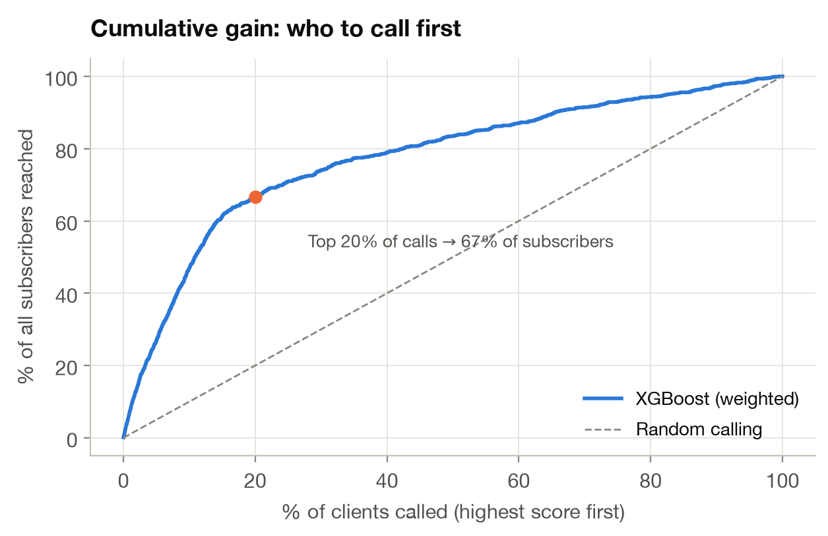
Rubric 5 · Result Interpretation & Presentation · 4 marks
Classification results: who to call, and why
What drives subscription
nr.employed
emp.var.rate
contact
euribor3m
campaign
month
Macro-economy (employment, Euribor) dominates, then contact channel, number of calls and month.
Recommendations for the bank
1
Call by model score
Work down the ranked list; stop where call cost exceeds expected deposit value.
2
Re-target past successes
Previous-campaign successes convert at 65% (vs 11% overall).
Top 20% of scored clients → 67% of all subscribers (3.3× lift)
3
Use mobile, cap repeat calls
Cellular beats landline; each extra call in a campaign lowers the success rate.
Group 10 · PBL Review 1
14
Notes:
The gain curve is the business view: if the bank calls clients in the order our model ranks them, the first 20% of calls reach two-thirds of all subscribers, 3.3 times better than random. The drivers are mostly the economic context, the contact channel, and how often the client was already called. Close with the recommendations.

Slide 15
Rubric 5 · Result Interpretation & Presentation · 4 marks
Conclusion, limitations and next steps
What we found
Limitations
Next steps (PBL 2)
Apps: installs concentrate in Games & Communication; free apps dominate; maintained apps rate higher.
Games: hit-driven, peaked in 2008; NA is half the market, Japan prefers RPGs.
Regression: tuned XGBoost, RMSE 3.17 MW, R² 0.966 (−31% error vs linear).
Classification: weighted XGBoost, F1 0.53, ROC-AUC 0.812, 3.3× lift in the top 20%.
Play Store data is a 2018 snapshot; ratings are self-selected.
Game sales count boxed retail only; post-2012 sales are under-counted.
Bank data (2008–2010) spans the financial crisis; macro effects may not transfer.
Only XGBoost was tuned; other models use sensible defaults.
Hyper-parameter tuning for all top models; SHAP explanations.
Cost-sensitive threshold using call cost vs deposit value.
Time-based validation for the bank campaign.
Package the best models into a simple prediction app.
15
Notes:
Summarise one line per task, be honest about limitations (evaluators reward this), and say what PBL 2 will add.

Slide 16
Thank you
Questions?
Group 10 · Sanskriti Rastogi · Sahil Raj · Yash Santosh Lohare · Om Pathania
Code: 4 Jupyter notebooks (EDA × 2, regression, classification) · Python, pandas, scikit-learn, XGBoost, imbalanced-learn
Notes:
Likely questions: Why drop duration? (leakage). Why not accuracy? (imbalance). Why is Ridge = Linear? (4 features, nothing to regularise). How was the threshold chosen? (out-of-fold on train, not test). Why XGBoost? (best CV score, handles non-linearity and interactions).

