Slide 1
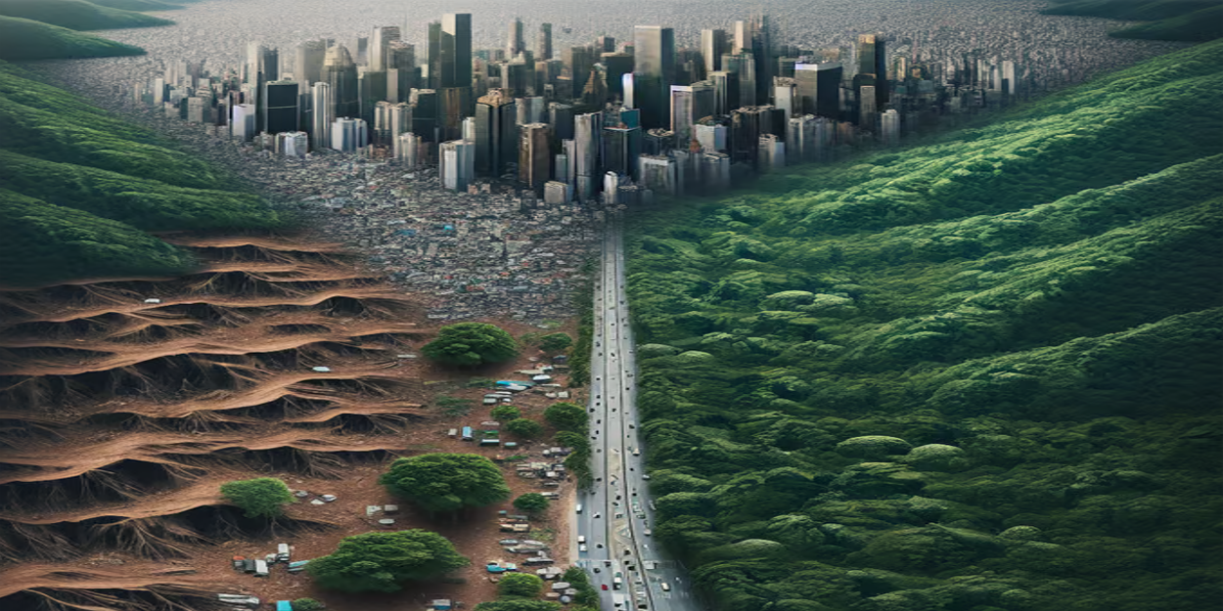
SMART WASTE MAPPING SYSTEM

Slide 2
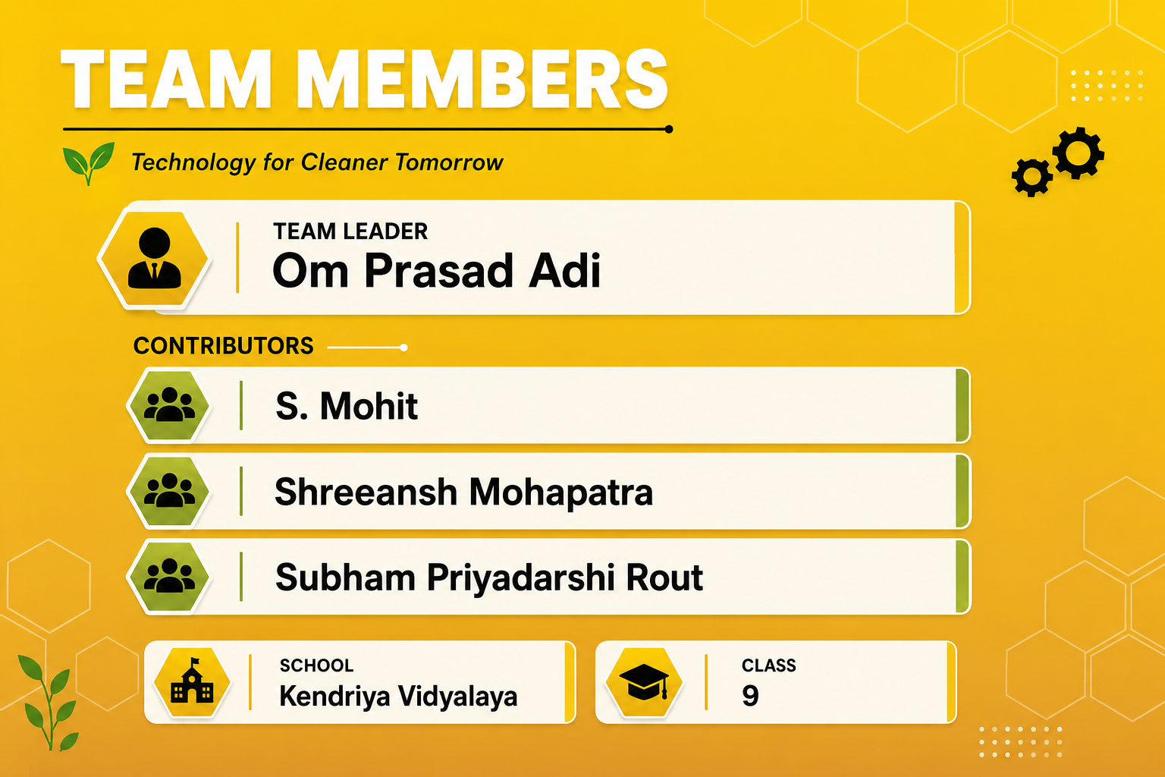
h

Slide 3
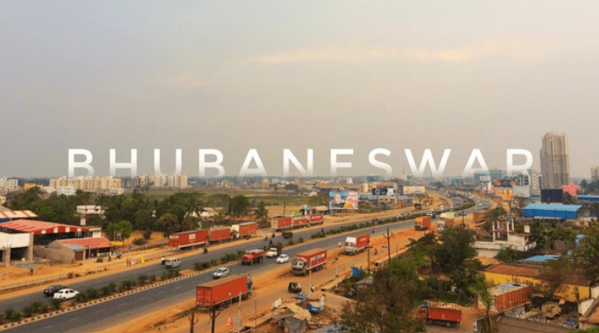
Why Does Waste Matter?
We consume natural resources and produce waste every day of our lives. In fact, each year, nations generate over 2 billion tons of waste worldwide. This number is expected to soar to 3.4 billion tons by 2050. In India, over 62 million tons of waste is generated every year and by 2047, it is expected that 1,400 sq km of landfill area would be required for dumping India's increasing volumes of municipal solid waste; this space is roughly equal to the combined area of three out of the top five most populous cities in Odisha.
Our overall lack of understanding of how to use and manage resources has us regarding waste as something to be thrown away and not as a resource. Perhaps we have never asked "Where do all the materials that make up our waste come from?", "What happens to waste when we throw it away?" or "Where is this 'away', anyway?“
This lack of understanding of waste has had disastrous effects on the environment. Answering these questions will help us realize that learning about waste is more than just understanding how to manage it. Rather, it is essential that we tackle the waste problem at its source and reduce the amount we produce in the first place.

Slide 4
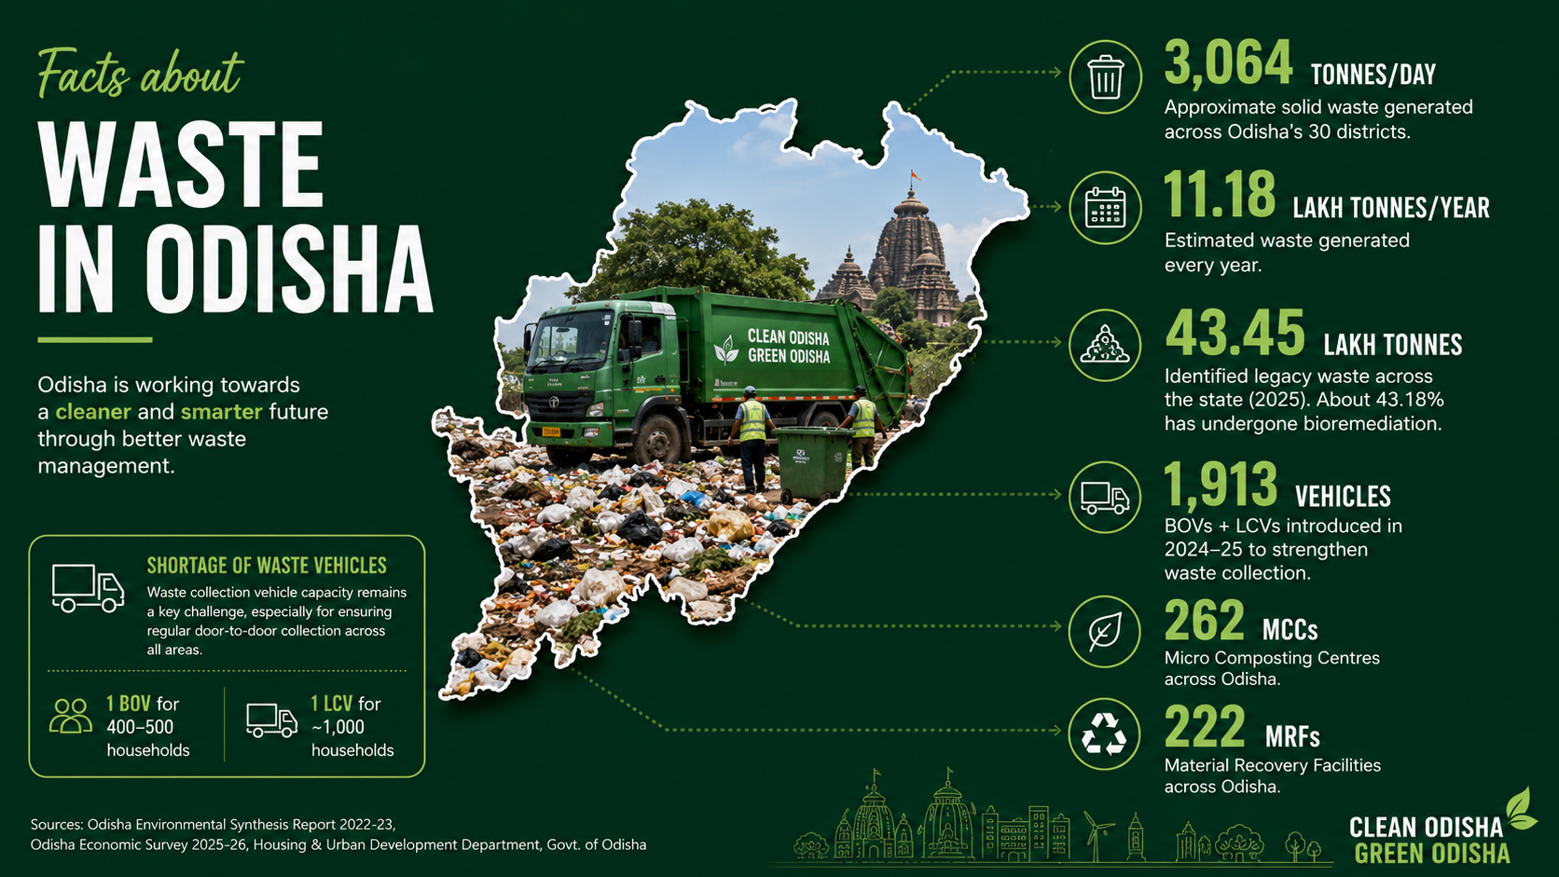

Slide 5

SMART WASTE
MAPPING HELMET
Smart Waste Mapping Helmet → detects waste → records location/time/type → creates a waste-hotspot map → generates reports for the municipal authority

Slide 6
SMART WASTE
MAPPING HELMET
Smart Waste Mapping Helmet → detects waste → records location/time/type → creates a waste-hotspot map → generates reports for the municipal authority

Slide 7
🔄 How the Smart Waste Mapping Helmet Works
SWMH
Records Data
Generates Reports
Wearable system for waste monitoring.
Saves location, time, and waste type.
Prepares reports for municipal authorities.
Step 2
Step 4
Step 6
Step 1
Step 3
Step 5
AI identifies waste through the camera.
Shows areas with recurring waste.
Evaluate results and fix issues
Detects Waste
Maps Hotspots
Review

Slide 8





Our Objectives
1
2
3
4
4
Identification
Classification
Record
Mapping
Verification
Identify waste hotspots in our locality.
Classify commonly observed waste types.
Record the location, date and time of observations.
Use technology to make waste mapping faster.
Verify AI detections through human observation.

Slide 9
Our Objectives
6
7
8
Analyzing
Generation
Measuring
Analyze patterns in waste accumulation.
Generate useful information for appropriate municipal action.
Measure whether the situation improves after intervention.

Slide 10
HARDWARE REQUIRED
-Hardware
-Camera
  Raspberry
  GPS module
  Power source
  Safe helmet mounting
1
2
3

Slide 11
SOFTWARE REQUIRED
-Python
-VS Code
  Computer Vision
  AI Model
  Database
  Mapping Software
4
5
6

Slide 12
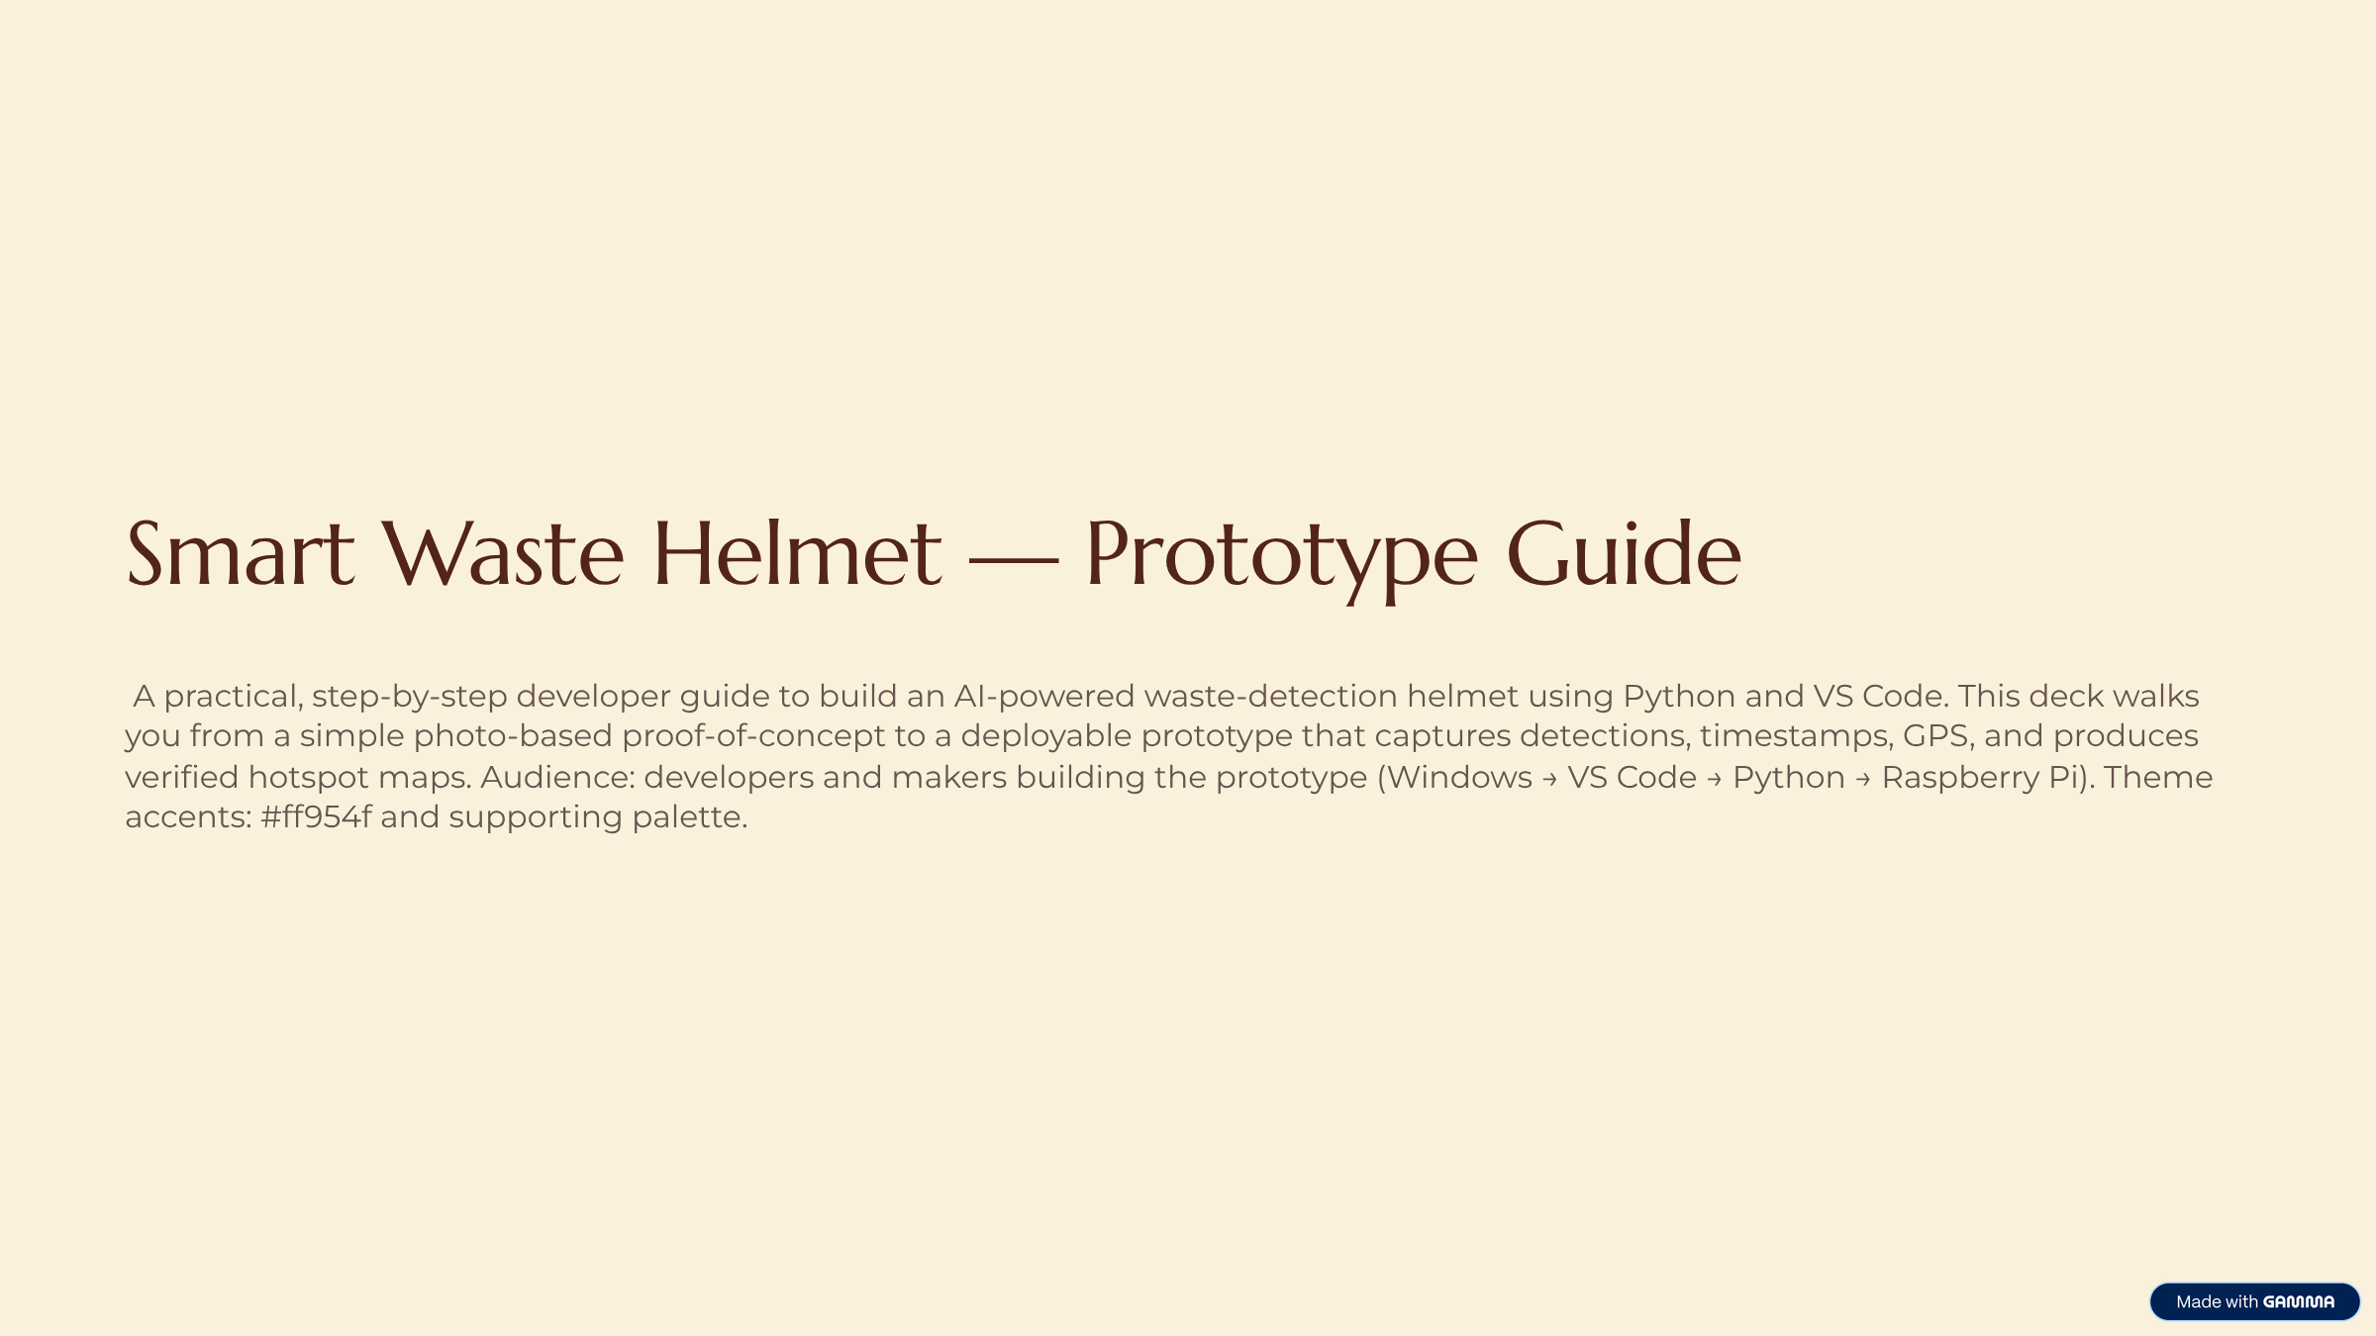

Slide 13
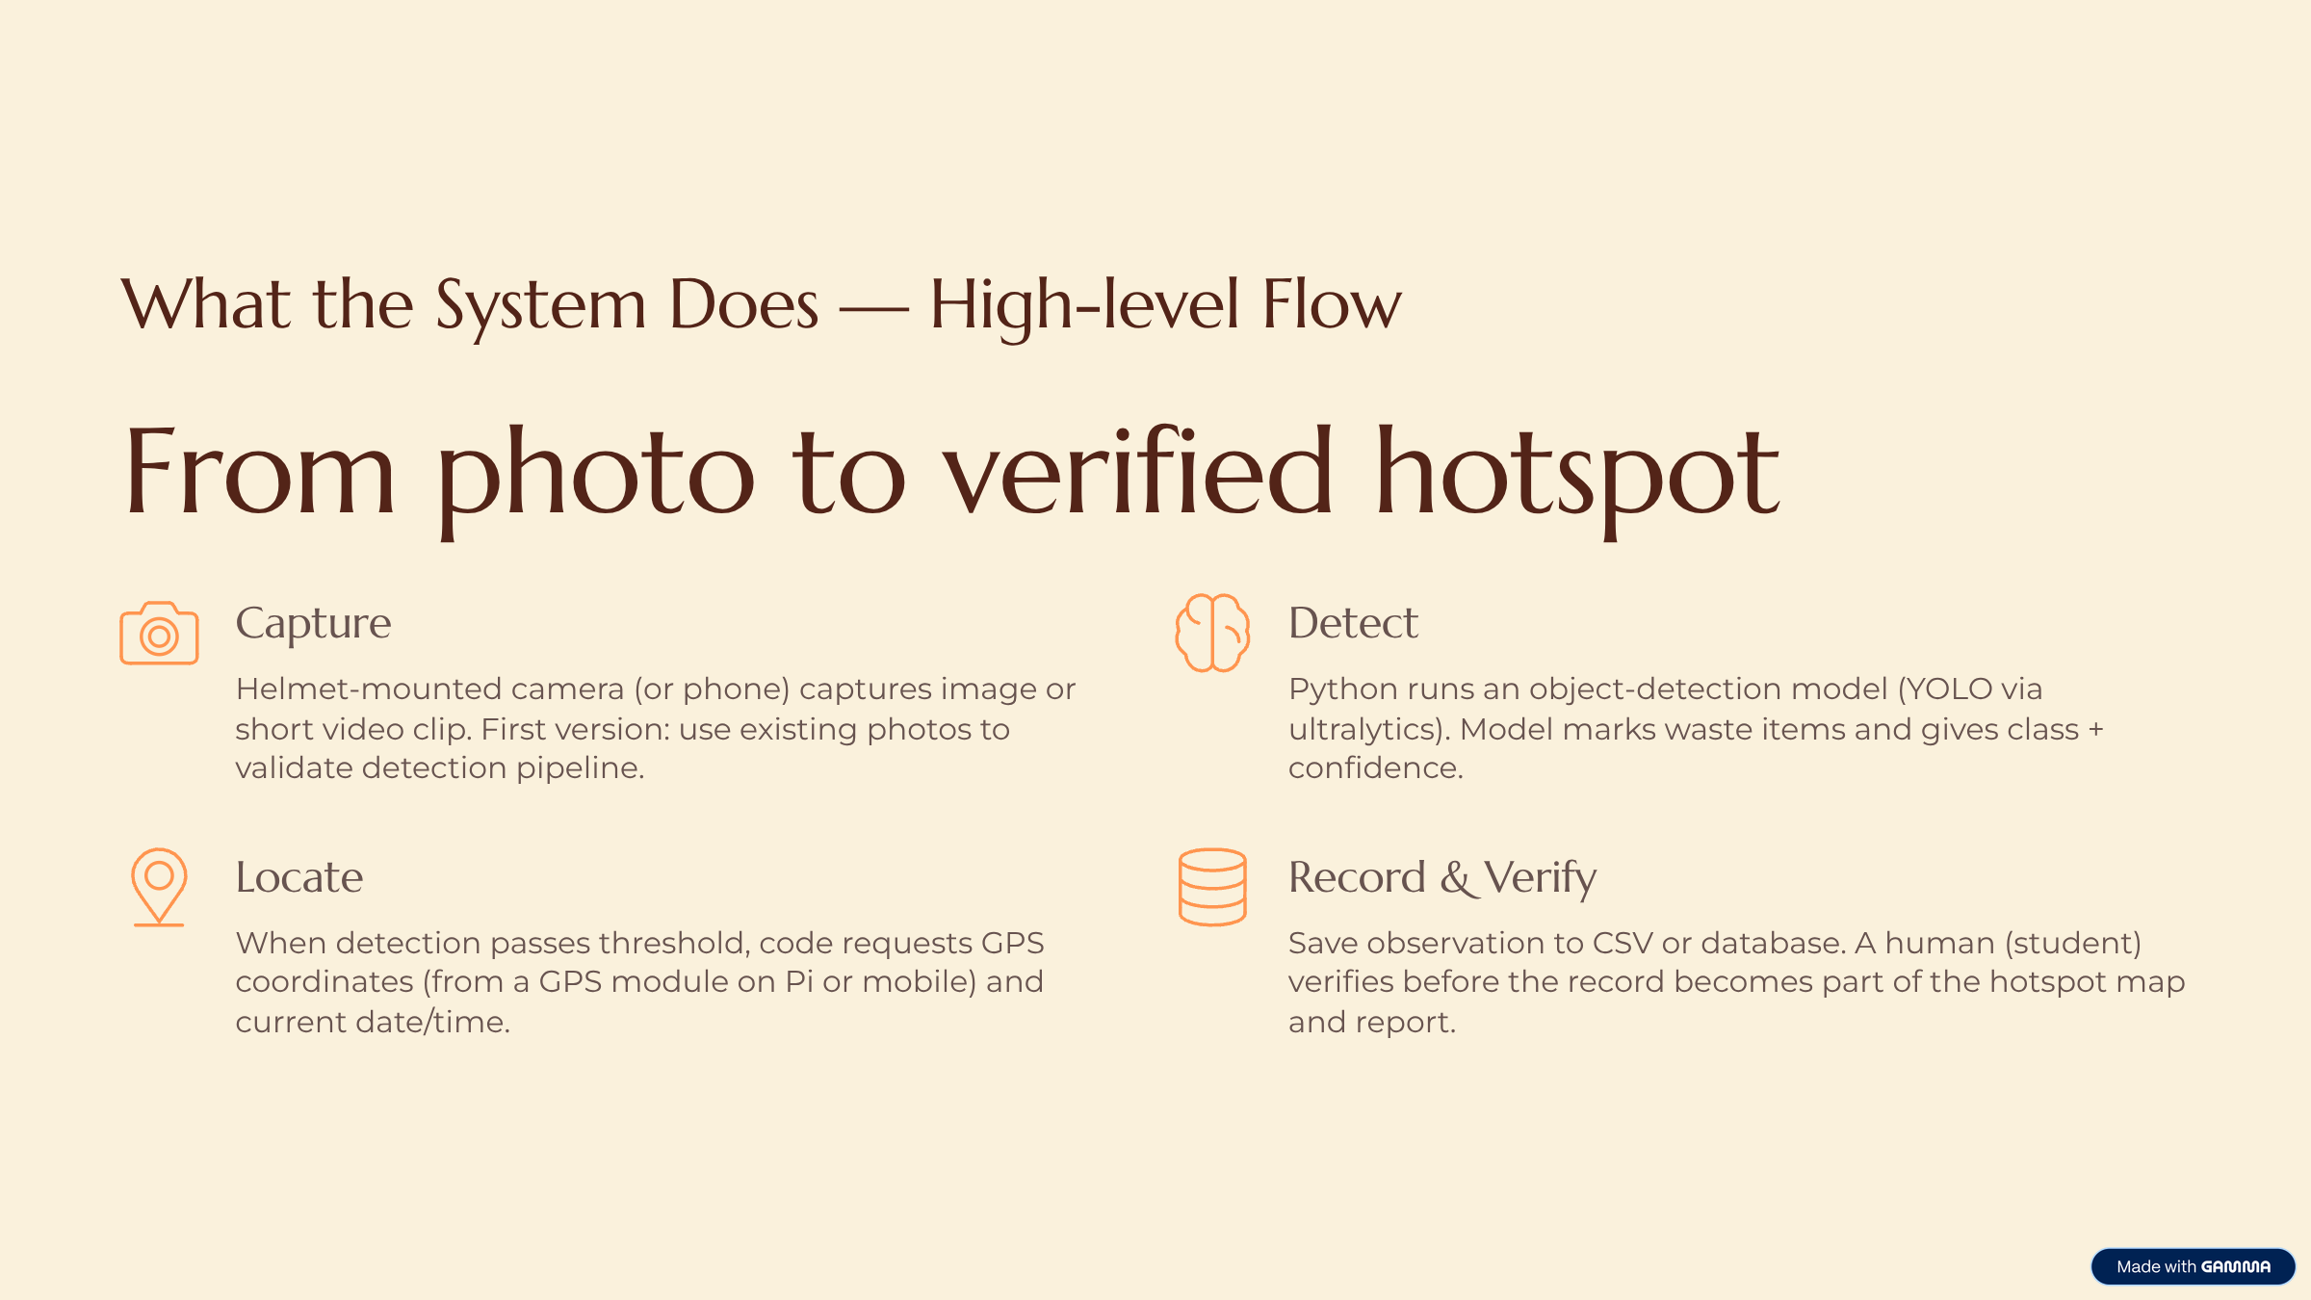

Slide 14
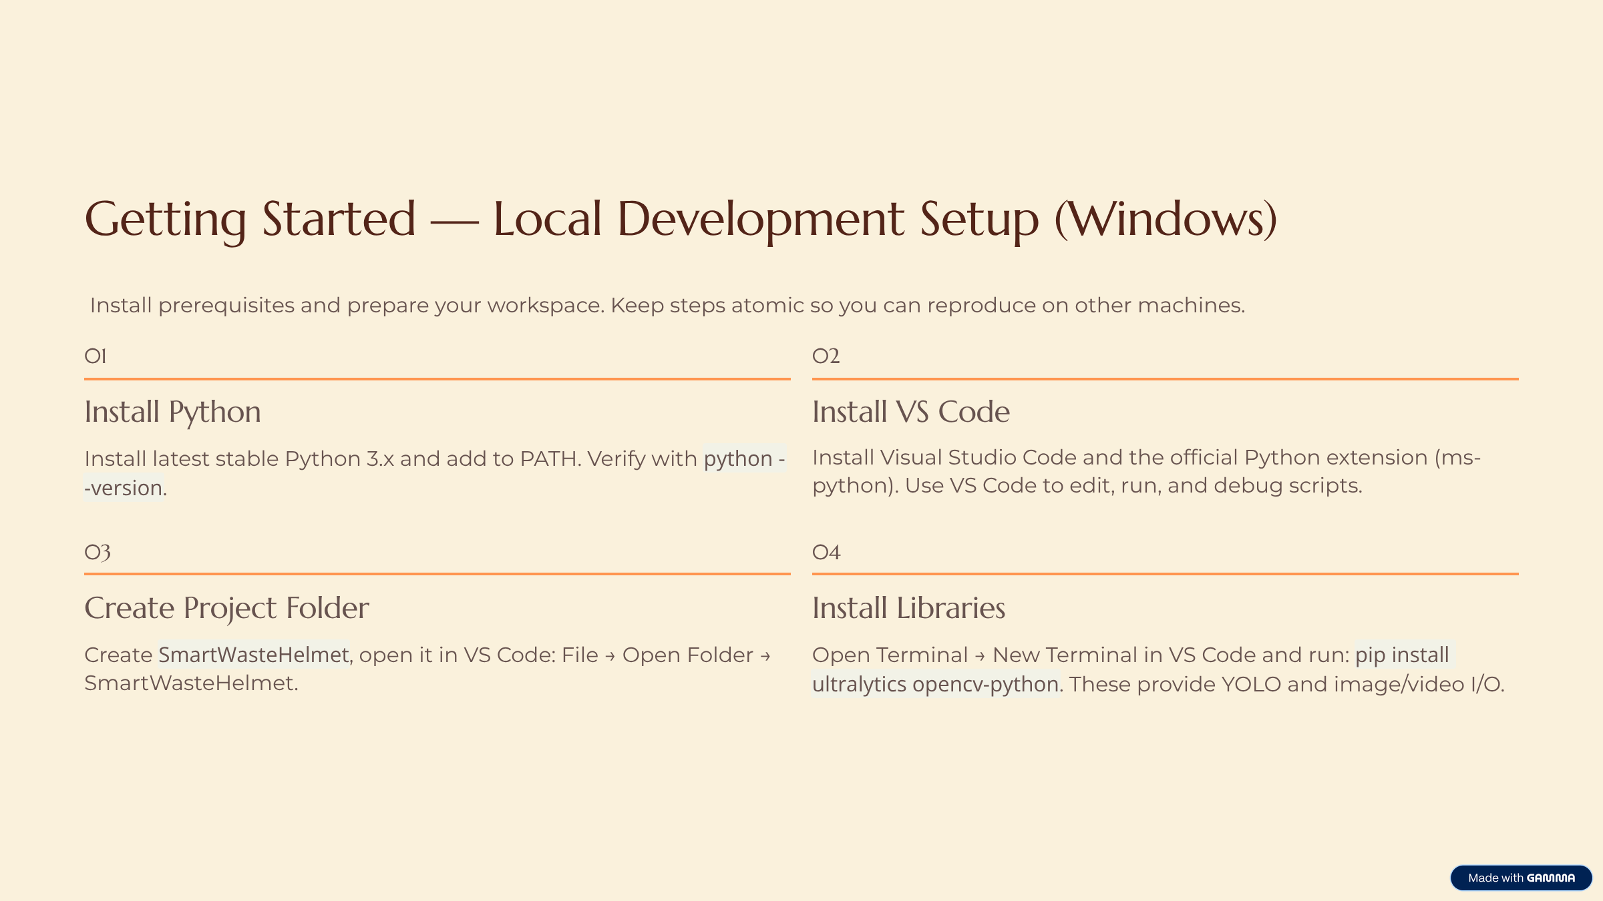

Slide 15
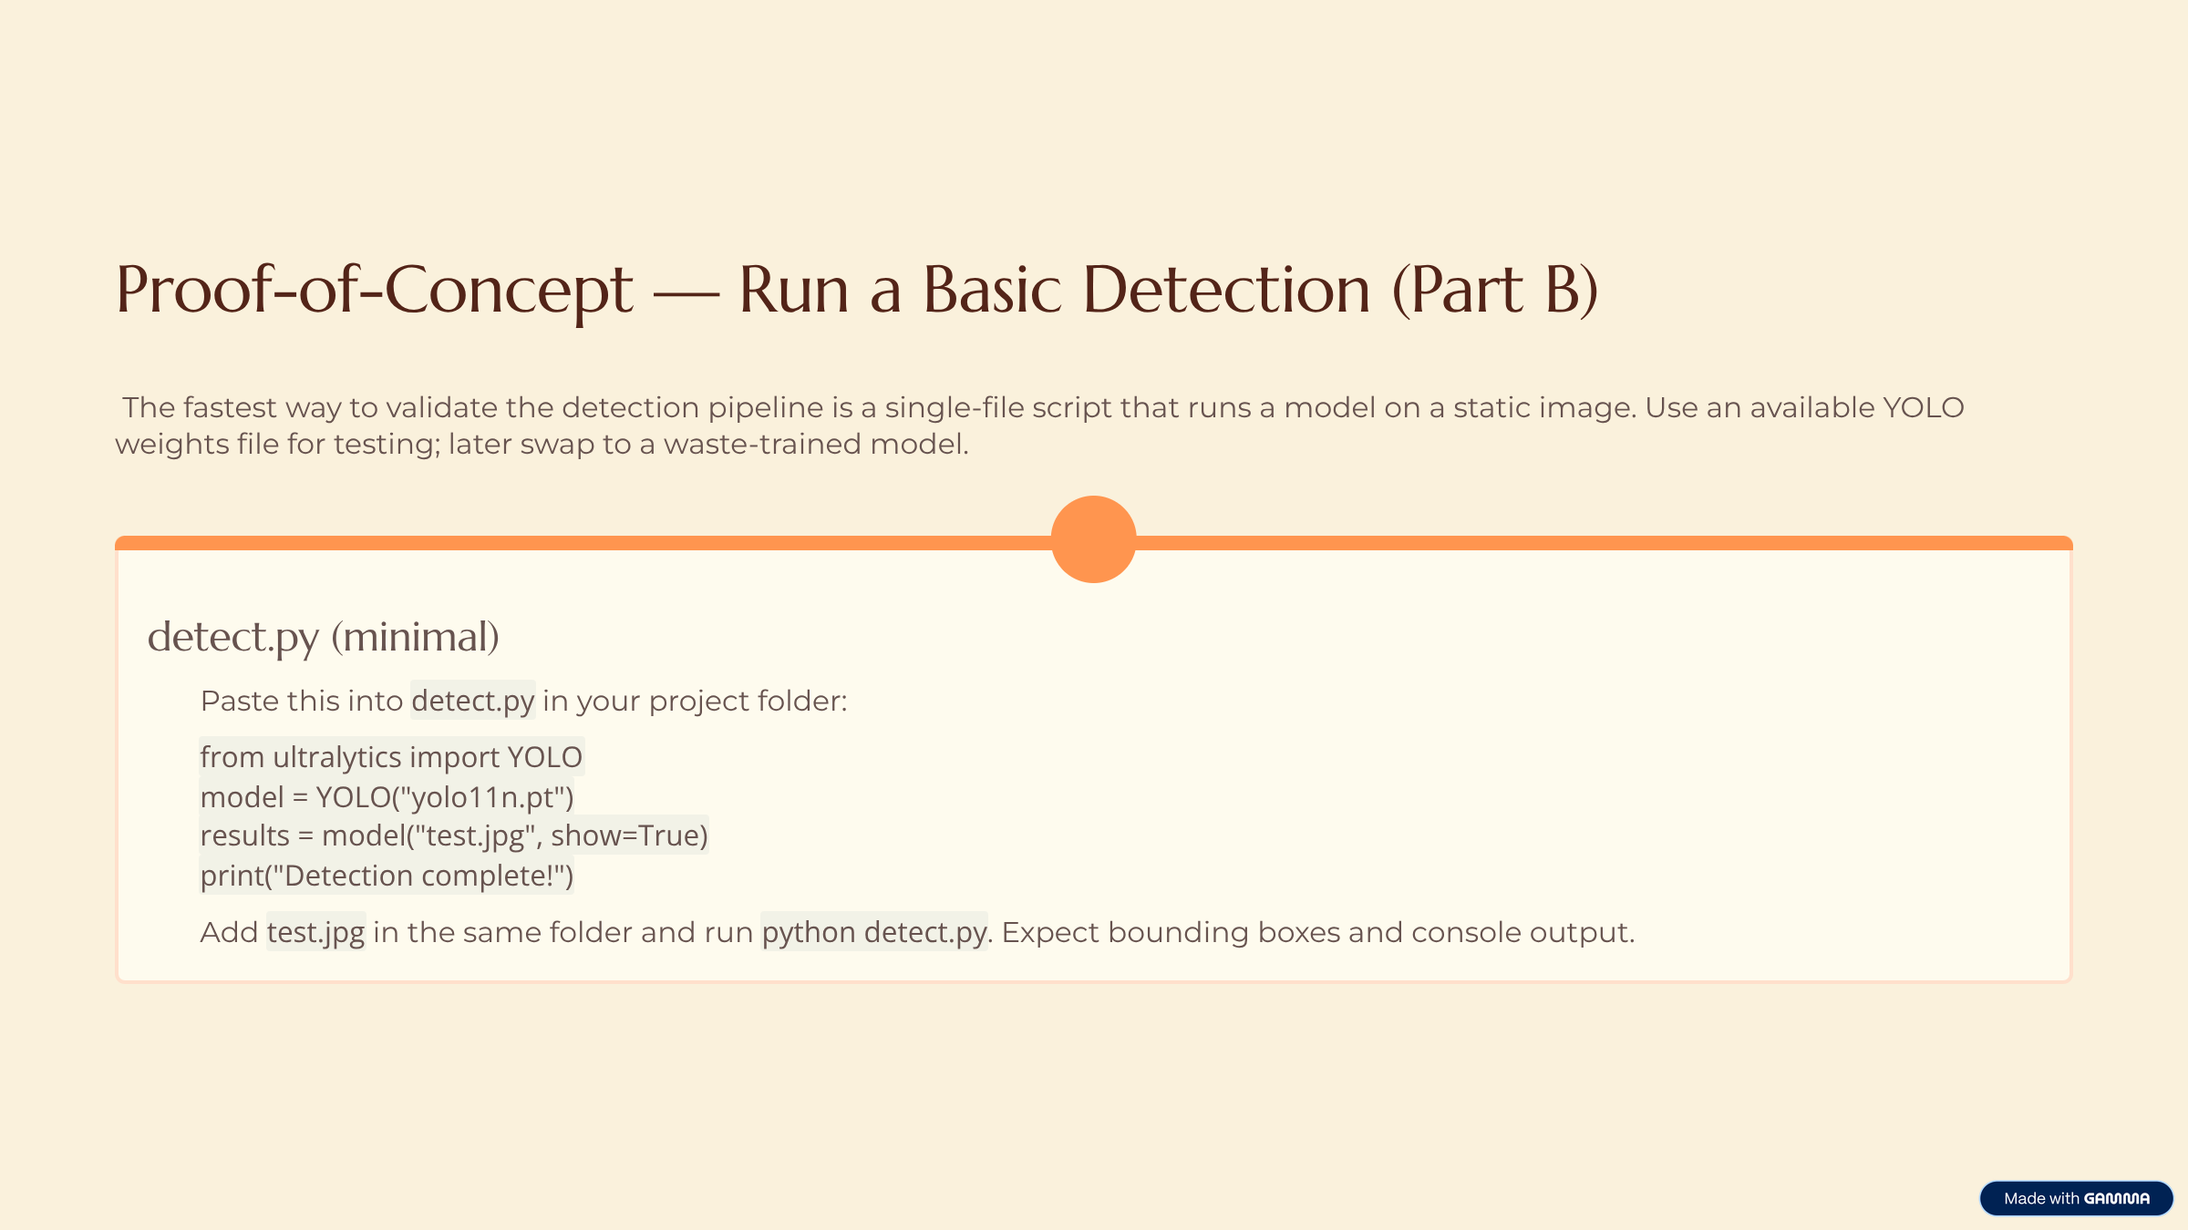

Slide 16
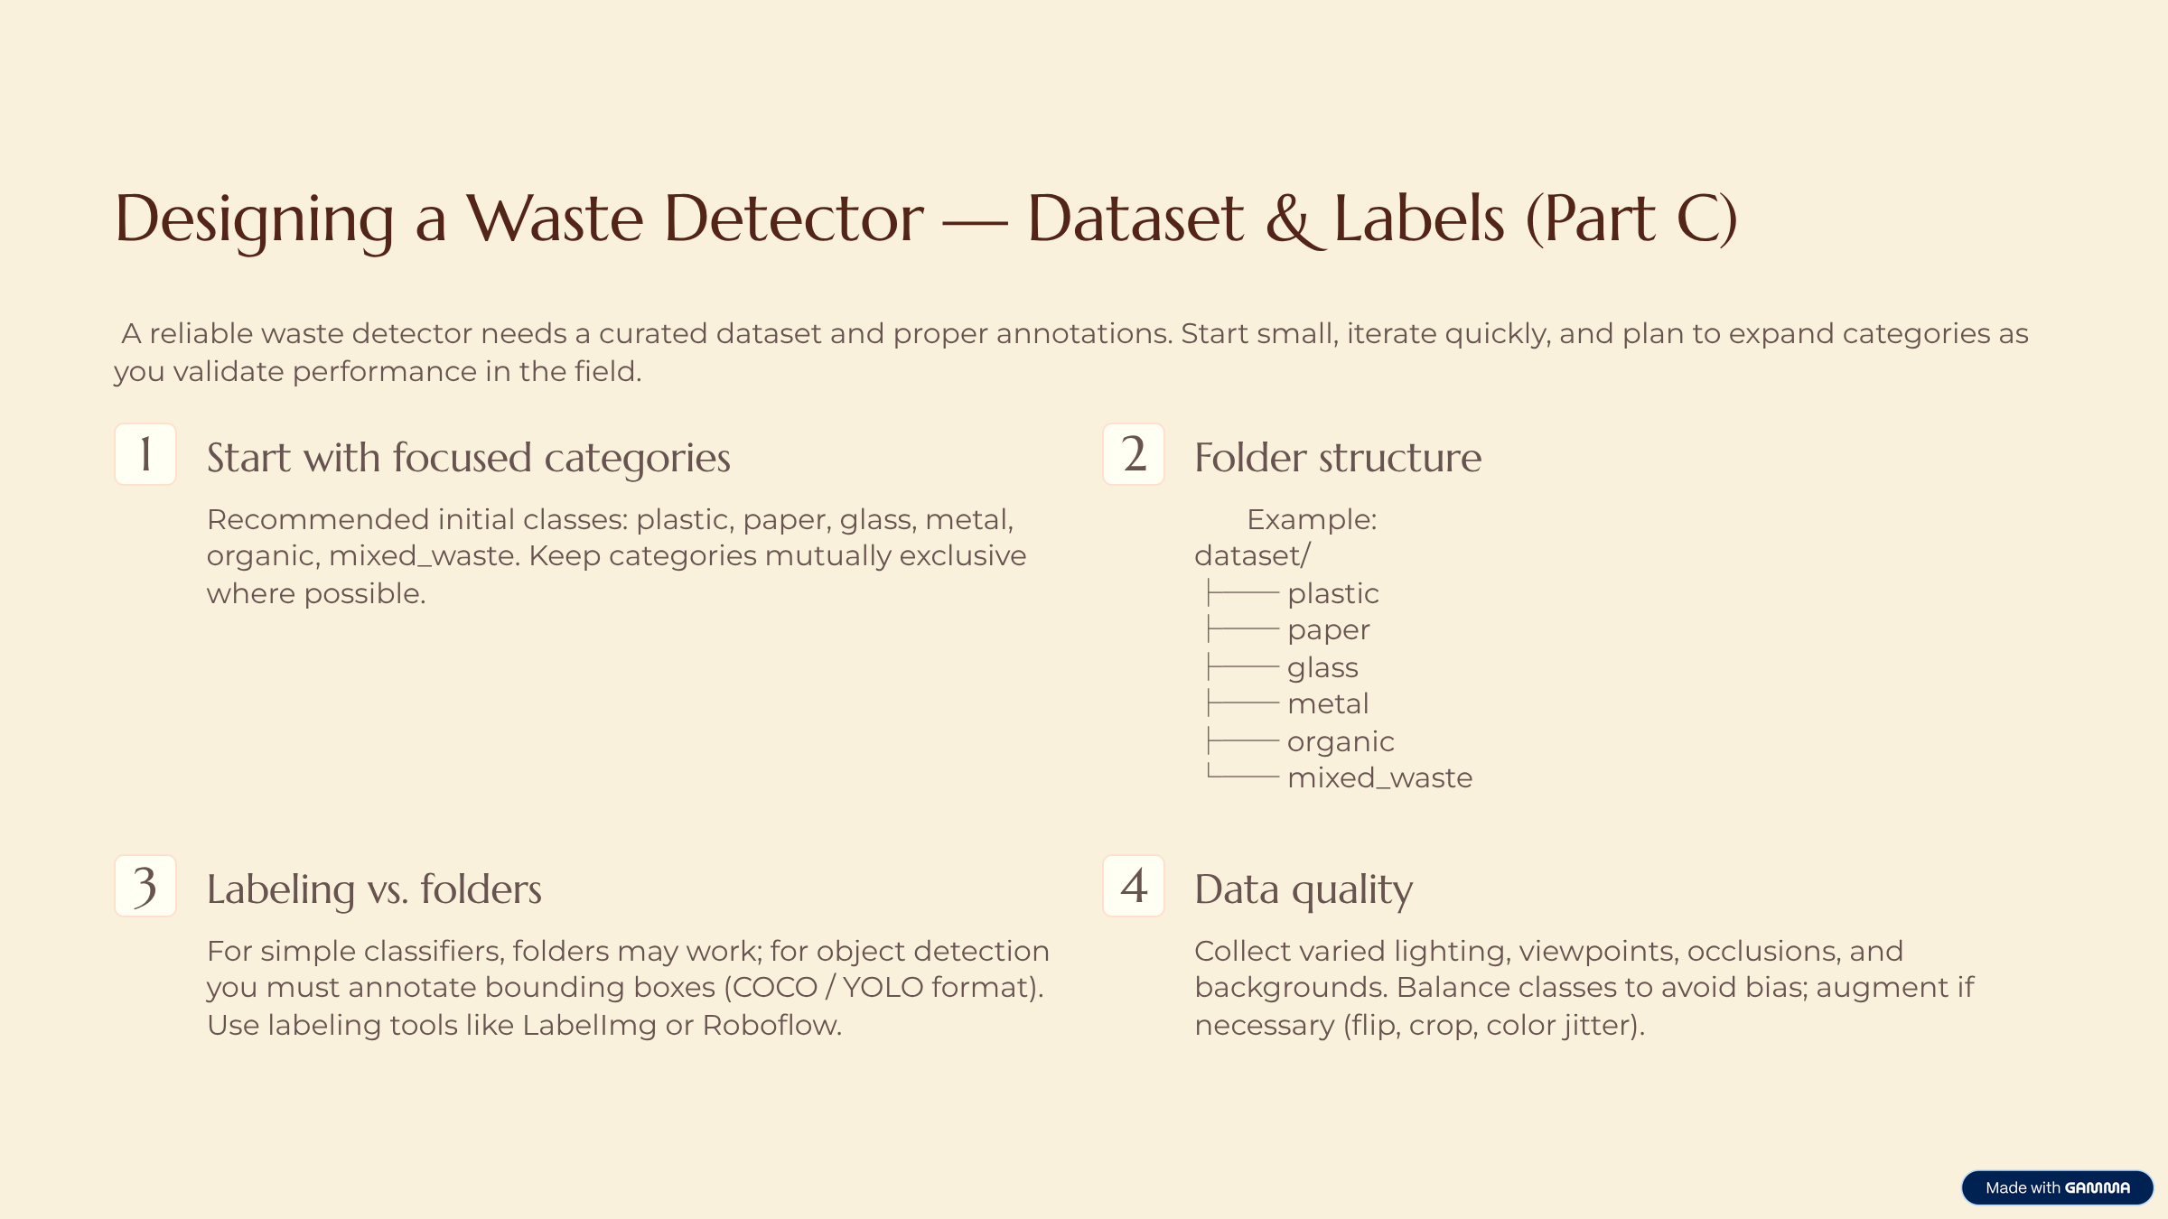

Slide 17
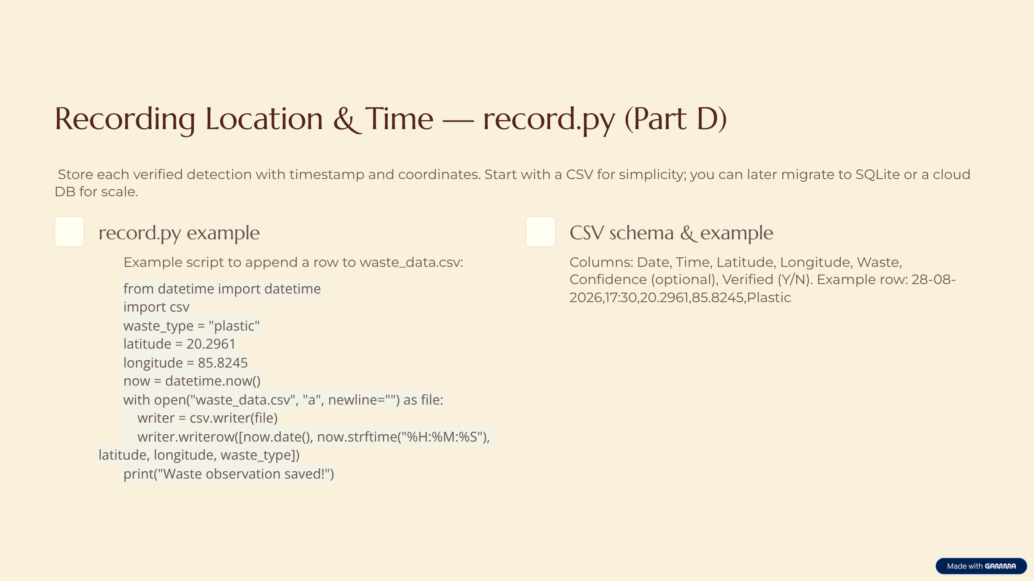

Slide 18
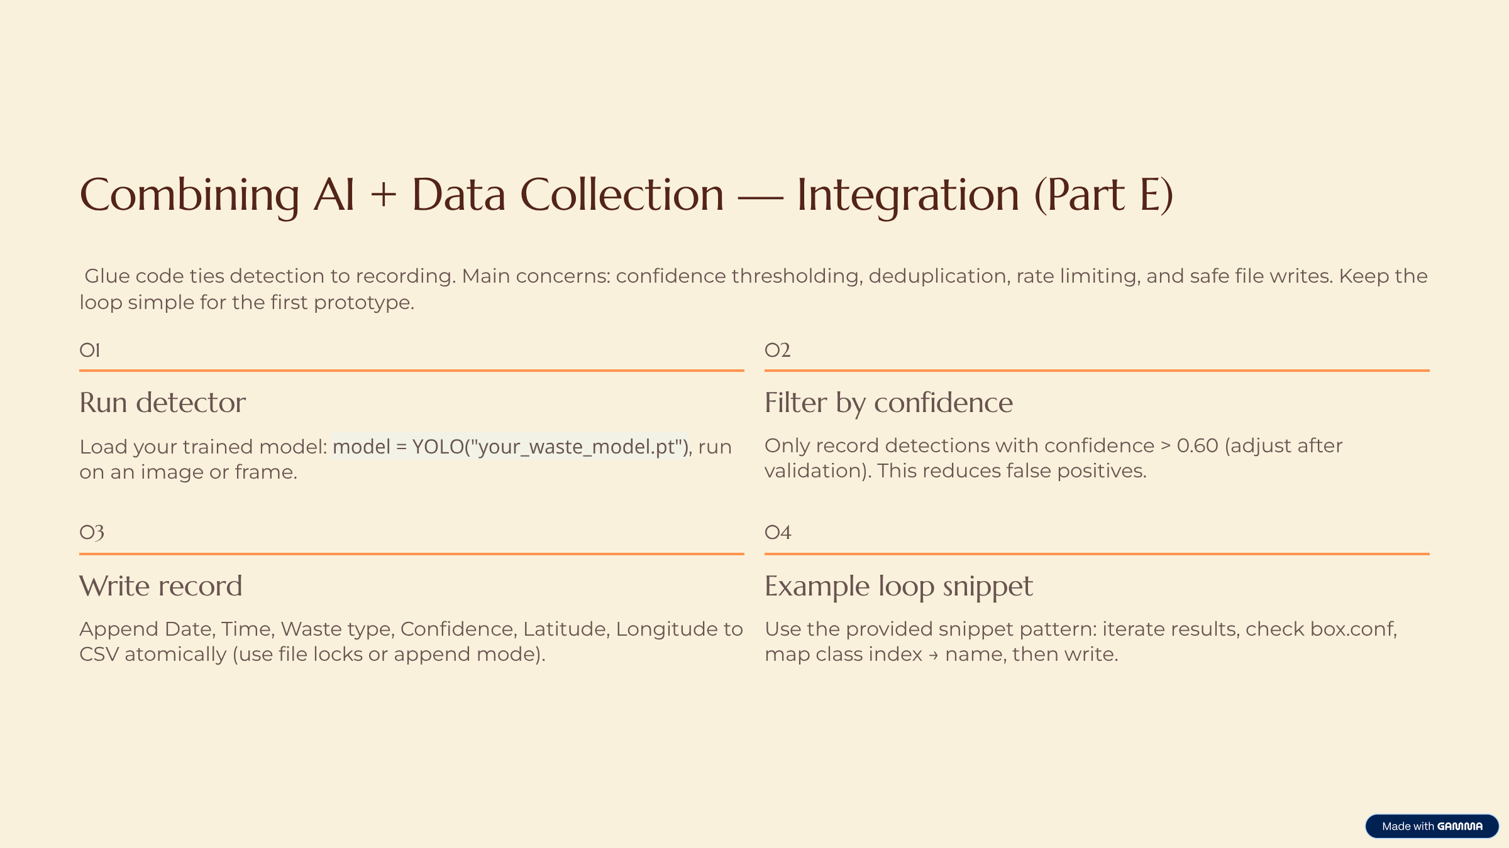

Slide 19
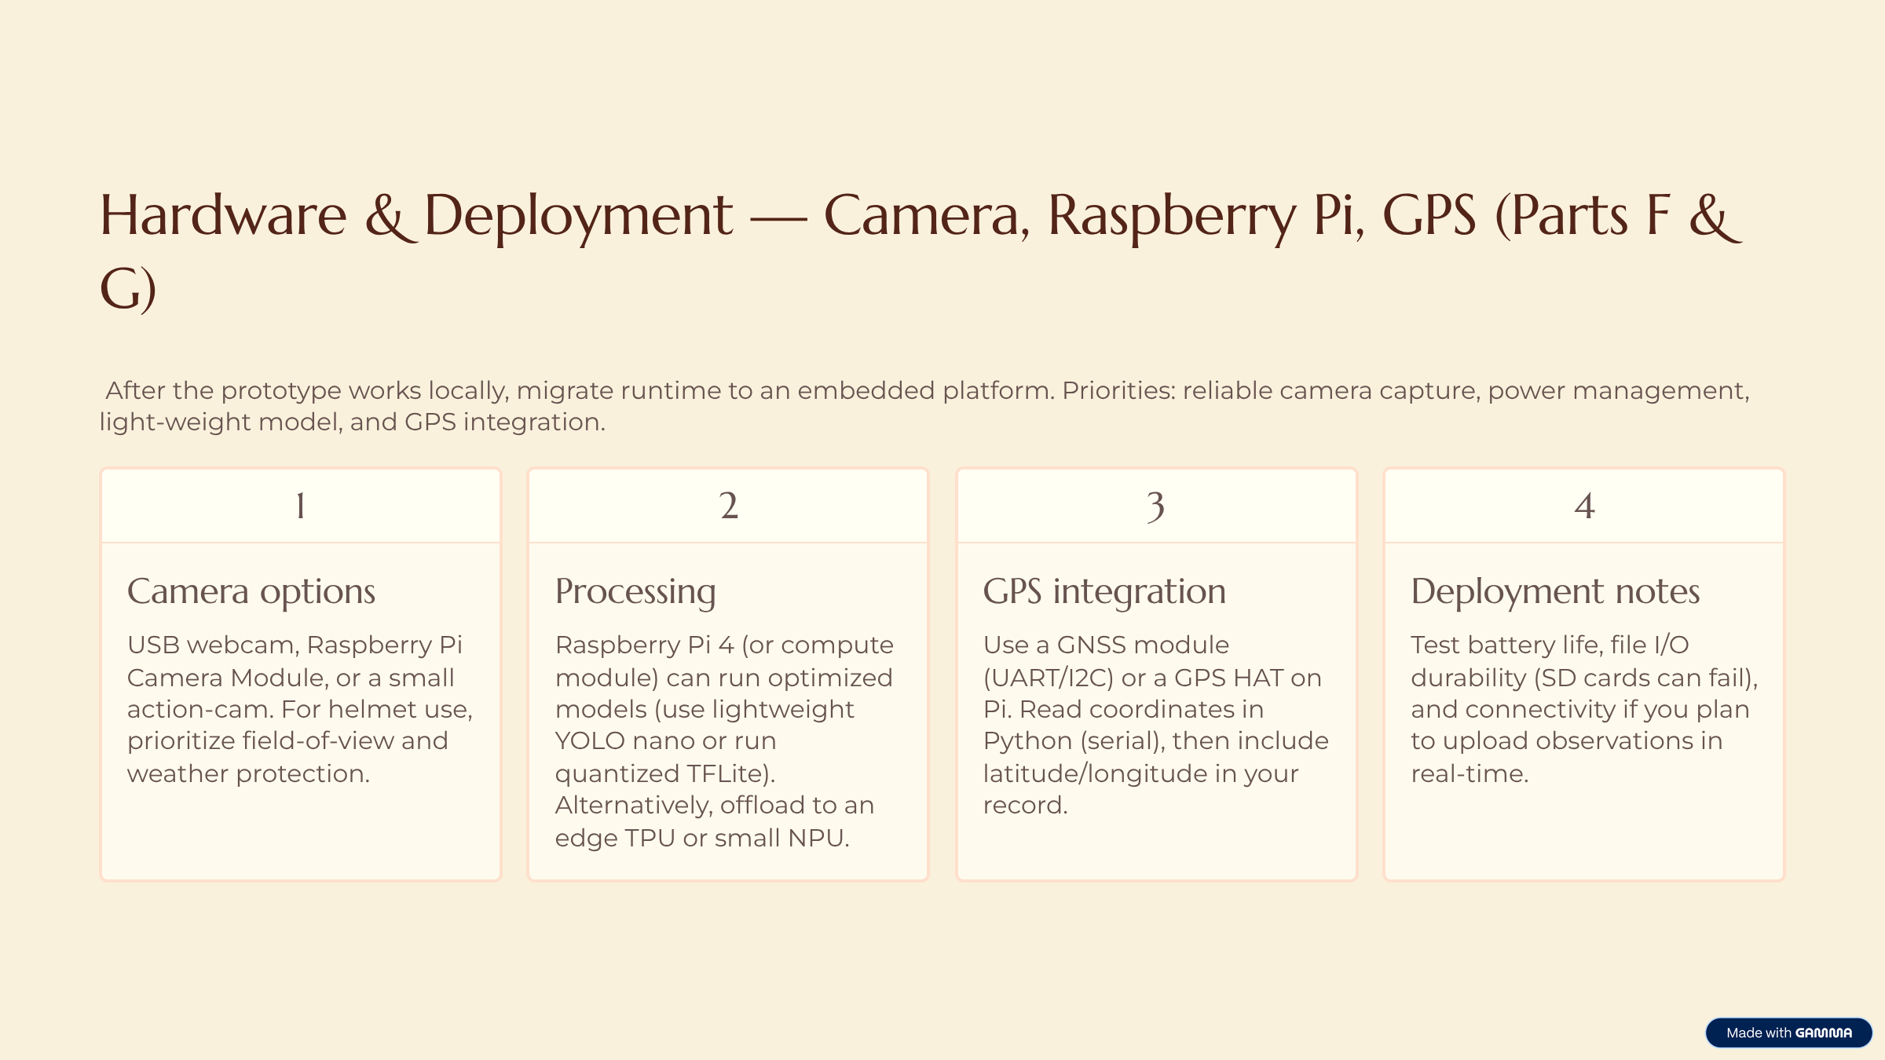

Slide 20
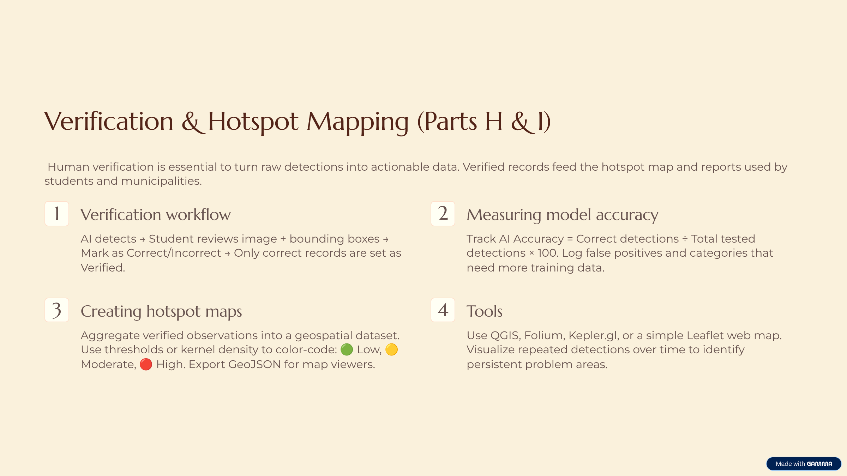

Slide 21
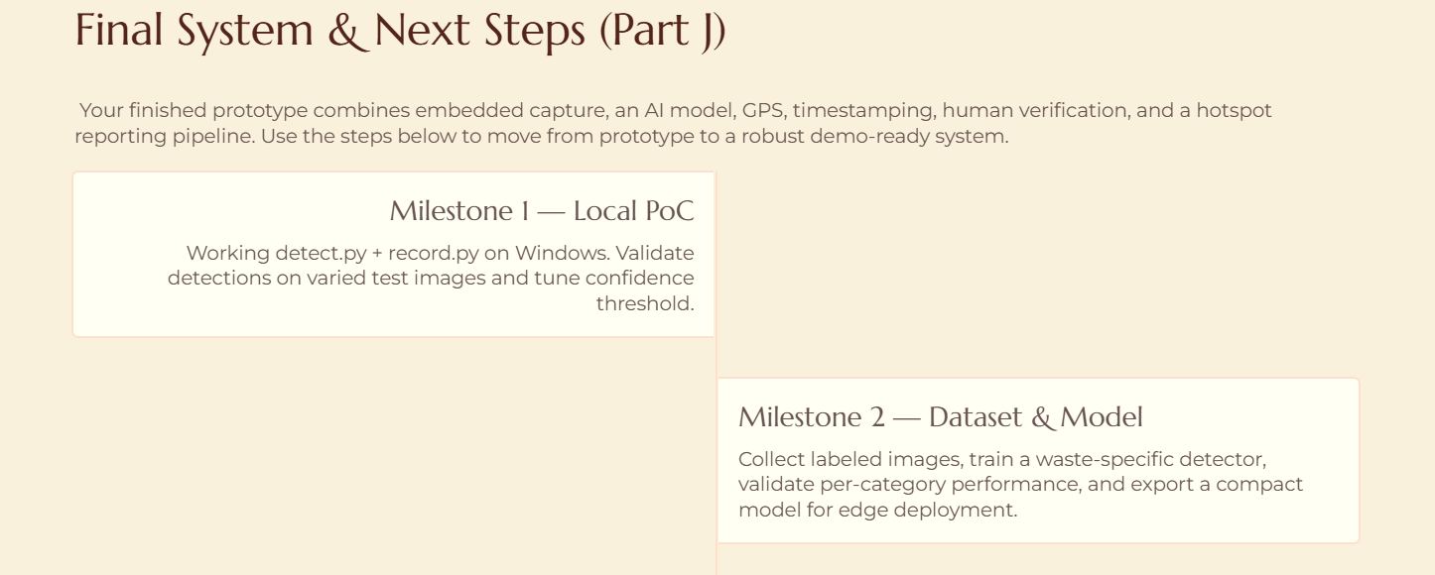
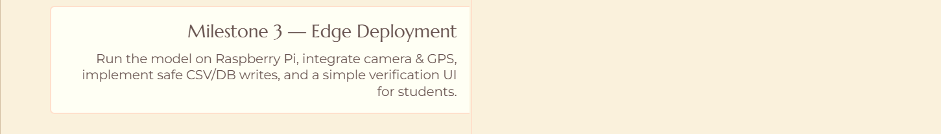

Slide 22
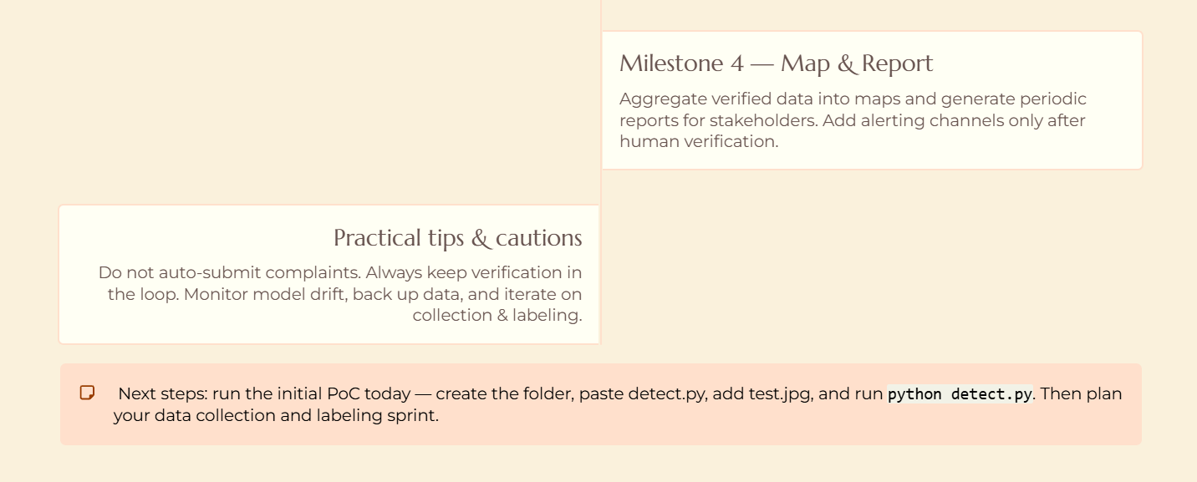

Slide 23
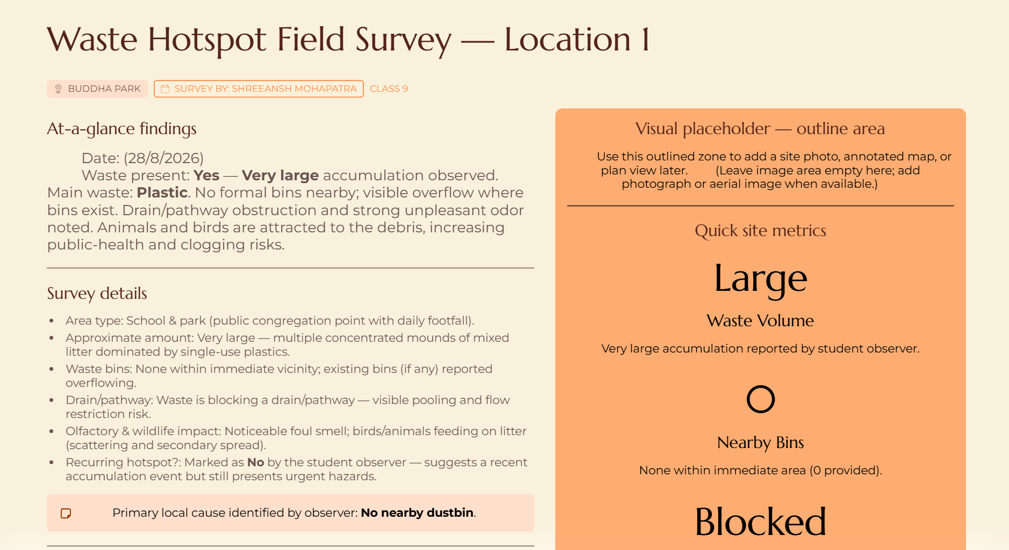
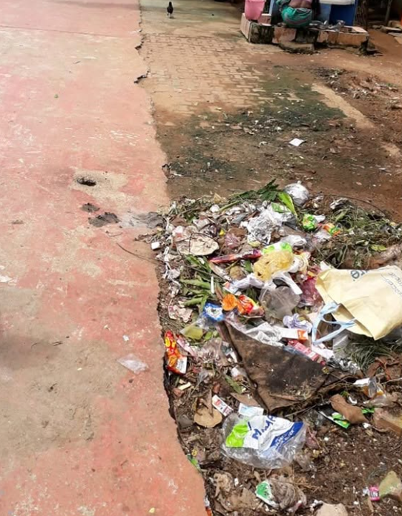

Slide 24

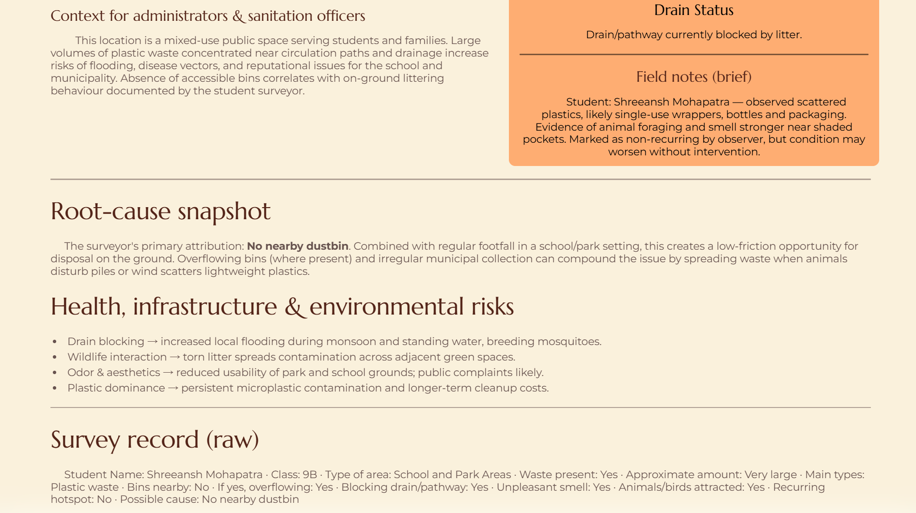

Slide 25
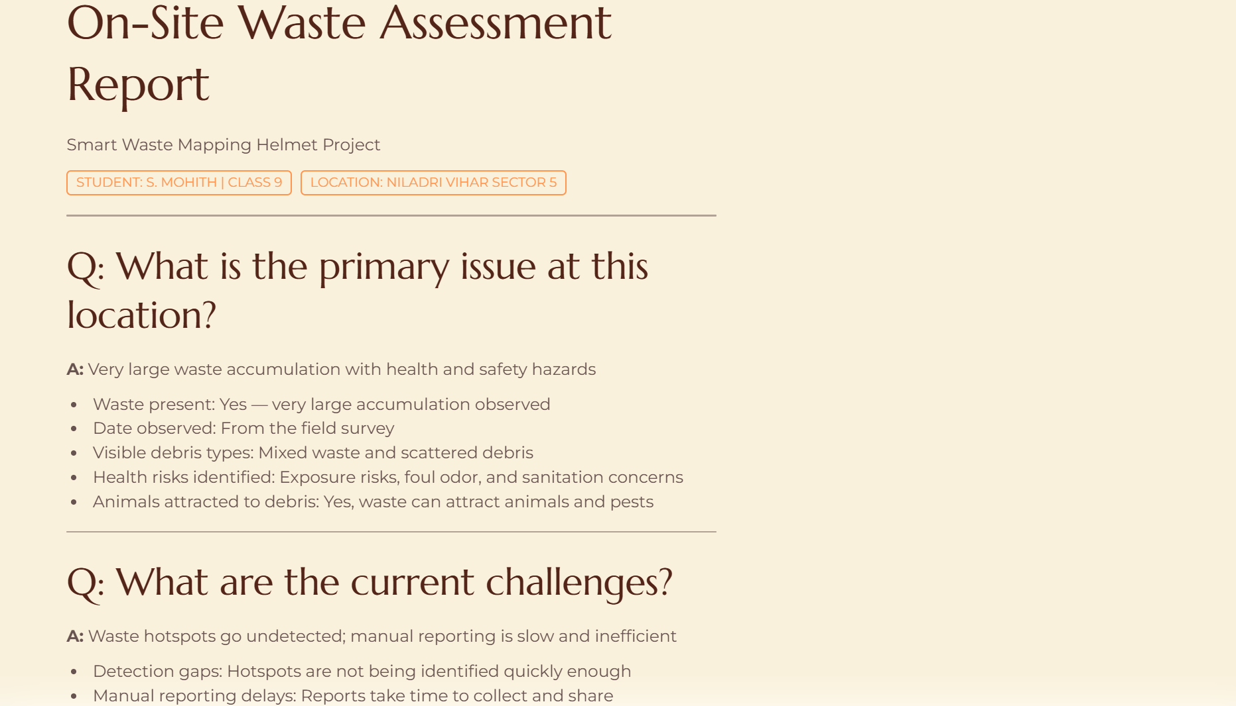
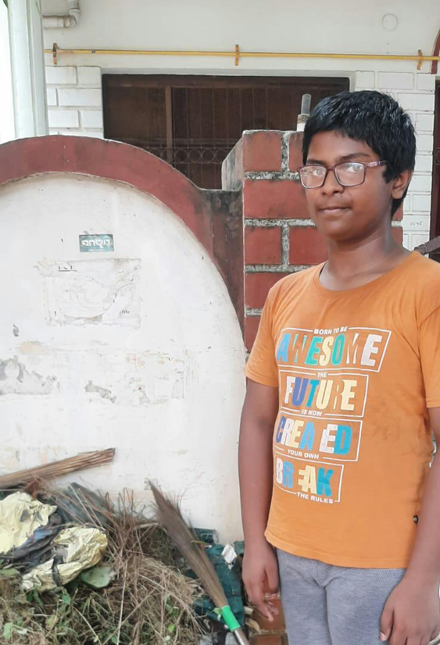

Slide 26
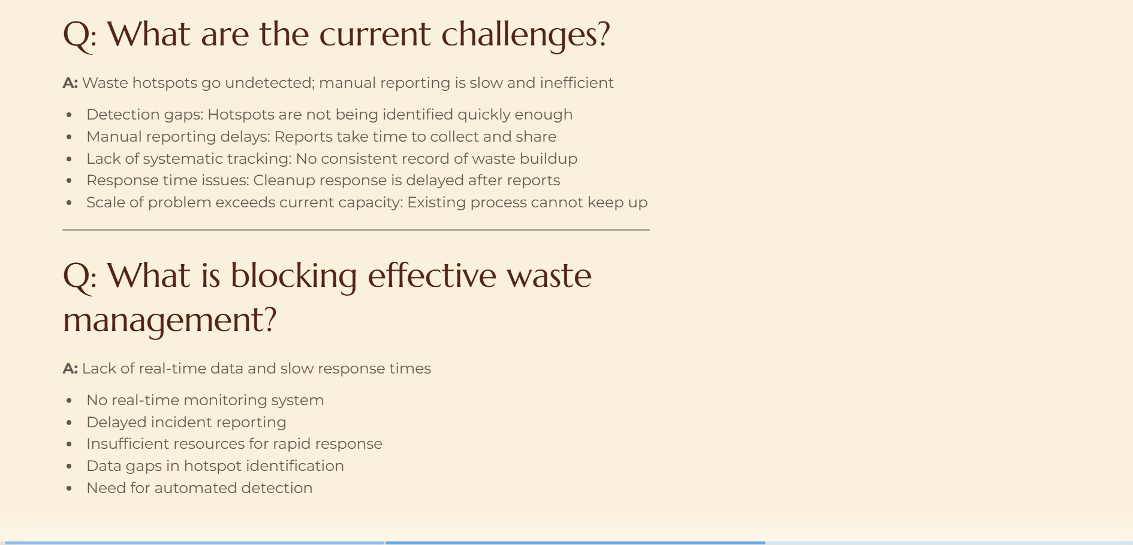
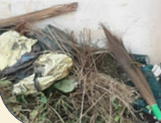

Slide 27
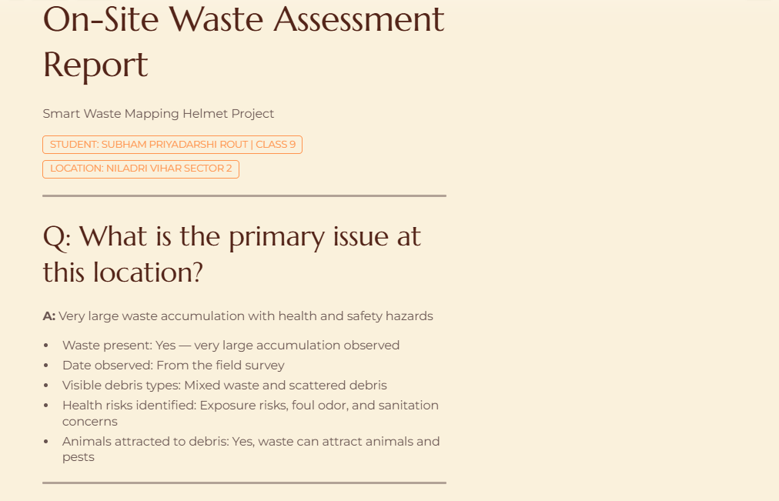

Slide 28
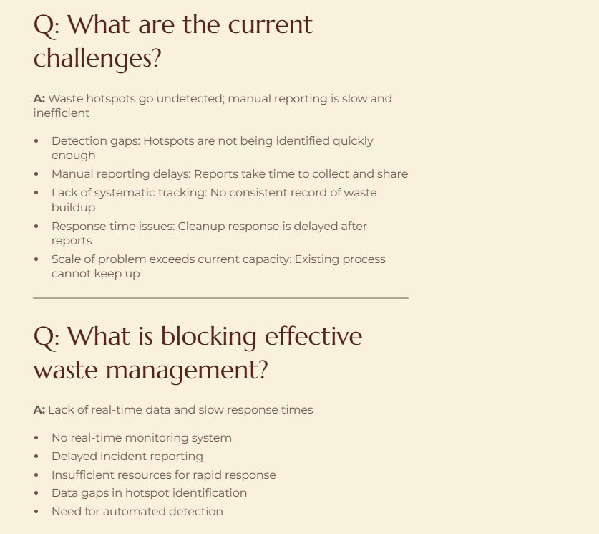

Slide 29
