Slide 1

Anomaly Detection in Network Traffic
Bandi, Om Preetham | Korlakunta, Reddy Bhuvan | Polsani, Akhil | Ullendula, Thriveen

Slide 2
Introduction
Literature Survey
System Design
System Implementation
Demo
Conclusion & Future Work

Slide 3
Introduction

Slide 4
?

Slide 5
Anomaly | NOUN
something different, abnormal, peculiar, or not easily classified

Slide 6
Anomaly Detection in Network Traffic

Slide 7
process of identifying unusual or unexpected patterns or behaviors within network traffic data.

Slide 8
Unusual spikes or drops in network traffic volume
Unexpected patterns in the timing or frequency of data packets.
Unauthorized access attempts or suspicious login activity.

Slide 9
Literature Survey

Slide 10
It emphasizes the cost-effectiveness of the approach by eliminating 13 expensive features, significantly reducing the computational load for real-time network monitoring.
F. Iglesias and T. Zseby, “Analysis of network traffic features for anomaly detection,” Machine Learning, vol. 101, pp. 59–84, 2015.

Slide 11
It highlights the prevalence of unsupervised ML methods, identifies 29 distinct models, 43 applications, and 22 datasets used, offering guidelines for future research in this field.
A. B. Nassif, M. A. Talib, Q. Nasir, and F. M. Dakalbab, “Machine learning for anomaly detection: A systematic review,” Ieee Access , vol. 9, pp. 78 658–78 700, 2021.

Slide 12
It highlights the effectiveness of the Random Forest classifier, which performed best due to optimal training-test data ratios, feature reduction, and encoding methods.
I. Fosic, D.Zagar, K. Grgic, and V. Kriˇ zanovic, “Anomaly detection in netflow network traffic using supervised machine learning algorithms,” Journal of Industrial Information Integration, vol. 33, p. 100466, 2023.

Slide 13
Enhanced SVM approach that combines the strengths of soft-margin and one-class SVM methods for detecting zero-day cyber attacks.
T. Shon and J. Moon, “A hybrid machine learning approach to network anomaly detection,” Information Sciences, vol. 177, no. 18, pp.3799–3821, 2007.

Slide 14
Anomaly detection in both traditional and next-generation networks, reviewing how machine learning can flexibly address these challenges across various network structures.
S. Wang, J. F. Balarezo, S. Kandeepan, A. Al-Hourani, K. G. Chavez, and B. Rubinstein, “Machine learning in network anomaly detection: A survey,” IEEE Access, vol. 9, pp. 152 379–152 396, 2021.

Slide 15
System Design

Slide 16
Process Flow for ML Model Development
Data Preprocessing
Feature Engineering
Model Training
Model Evaluation
Data Collection

Slide 17
Process Flow for ML Model Development
Data Preprocessing
Feature Engineering
Model Training
Model Evaluation
Data Collection

Slide 18
Process Flow for ML Model Development
Data Preprocessing
Feature Engineering
Model Training
Model Evaluation
Data Collection

Slide 19
Process Flow for ML Model Development
Data Preprocessing
Feature Engineering
Model Training
Model Evaluation
Data Collection

Slide 20
Process Flow for ML Model Development
Data Preprocessing
Feature Engineering
Model Training
Model Evaluation
Data Collection

Slide 21
Process Flow for ML Model Development
Data Preprocessing
Feature Engineering
Model Training
Model Evaluation
Data Collection

Slide 22
System
Implementation

Slide 23

Logistic Regression Model

Slide 24

Random Forest Model

Slide 25

Support Vector Machine Model

Slide 26

K-Nearest Neighbor Model

Slide 27

Decision Tree Model

Slide 28

Gradient Boasting Model

Slide 29

Artificial Neutral Network Model

Slide 30
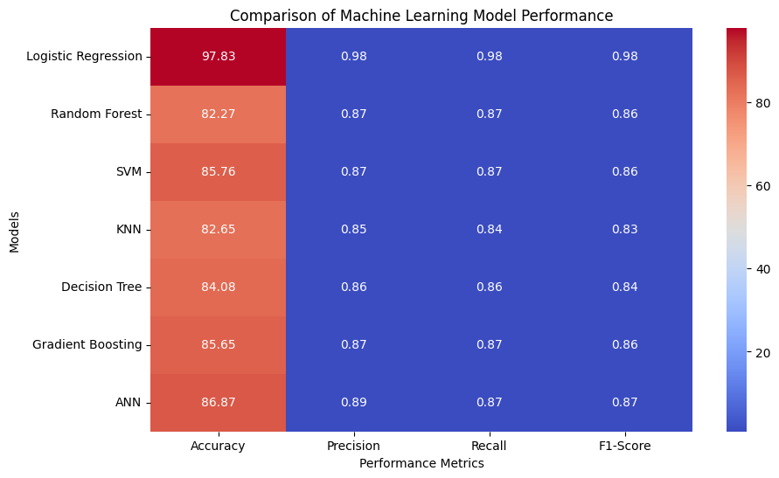

Slide 31
Demo

Slide 32
Conclusion

Slide 33
Utilizing machine learning models, particularly Artificial Neural Networks (ANN), holds promise for enhancing network traffic anomaly detection, bolstering cybersecurity measures against evolving threats.

Slide 34
Future Work

Slide 35
Deep Learning Architectures
Real-time Monitoring
Response Mechanisms

Slide 36
Presented
By
Bandi, Om Preetham
Korlakunta, Reddy Bhuvan
Polsani, Akhil
Ullendula, Thriveen

Slide 37
References
F. Iglesias and T. Zseby, “Analysis of network traffic features for anomaly detection,” Machine Learning, vol. 101, pp. 59–84, 2015.
A. B. Nassif, M. A. Talib, Q. Nasir, and F. M. Dakalbab, “Machine learning for anomaly detection: A systematic review,” Ieee Access , vol. 9, pp. 78 658–78 700, 2021.
I. Fosic, D.Zagar, K. Grgic, and V. Kriˇ zanovic, “Anomaly detection in netflow network traffic using supervised machine learning algorithms,” Journal of Industrial Information Integration, vol. 33, p. 100466, 2023.
T. Shon and J. Moon, “A hybrid machine learning approach to network anomaly detection,” Information Sciences, vol. 177, no. 18, pp.3799–3821, 2007.

Slide 38
References
S. Wang, J. F. Balarezo, S. Kandeepan, A. Al-Hourani, K. G. Chavez, and B. Rubinstein, “Machine learning in network anomaly detection: A survey,” IEEE Access, vol. 9, pp. 152 379–152 396, 2021.
A. B. Shaik and S. Srinivasan, “A brief survey on random forest ensem- bles in classification model,” in International Conference on Innovative Computing and Communications: Proceedings of ICICC 2018, Volume 2. Springer, 2019, pp. 253–260
S. B. Maind, P. Wankar et al., “Research paper on basic of artificial neural network,” International Journal on Recent and Innovation Trends in Computing and Communication, vol. 2, no. 1, pp. 96–100, 2014.
Images are generated by project code

