Slide 1
Build an NLP System to Identify the Sentiment of a Document by Document Scoring Method
by
Group 3
Korlakunta, Reddy Bhuvan
Bandi, Om Preetham
Ullendula, Thriveen
Virigineni, Sravya Sri

Slide 2
Introduction to NLP and Sentiment Analysis
Natural Language Processing (NLP):
The technology behind understanding and processing human languages.
Sentiment Analysis:
Analyzing text to detect its underlying sentiment—positive, negative, or neutral.
Project Objective:
To build an NLP system using the Document Scoring Method to identify document sentiment.

Slide 3
Overview of the Dataset
Data Sources:
TrainData.csv
TestData.csv
Data Structure:
Documents paired with Sentiment Labels
Labels: Positive, Negative, Neutral
Size of the Dataset:
Training Data: 3394 documents
Testing Data: 1454 documents

Slide 4
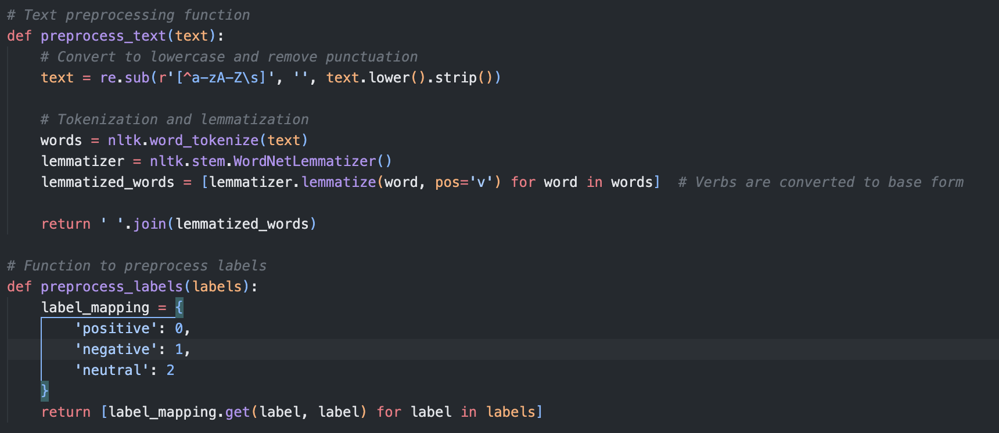
Methodology - Text Preprocessing

Slide 5

Methodology - Text Preprocessing
Convert to Lowercase
Standardizes text for consistent processing.
Remove Punctuation
Cleans text of non-alphabetic characters.
Tokenization
Splits text into individual words or tokens.
Lemmatization
Reduces words to their base or dictionary form.

Slide 6

Methodology - Text Preprocessing
Convert to Lowercase
Standardizes text for consistent processing.
Remove Punctuation
Cleans text of non-alphabetic characters.
Tokenization
Splits text into individual words or tokens.
Lemmatization
Reduces words to their base or dictionary form.

Slide 7

Methodology - Text Preprocessing
Convert to Lowercase
Standardizes text for consistent processing.
Remove Punctuation
Cleans text of non-alphabetic characters.
Tokenization
Splits text into individual words or tokens.
Lemmatization
Reduces words to their base or dictionary form.

Slide 8

Methodology - Text Preprocessing
Convert to Lowercase
Standardizes text for consistent processing.
Remove Punctuation
Cleans text of non-alphabetic characters.
Tokenization
Splits text into individual words or tokens.
Lemmatization
Reduces words to their base or dictionary form.

Slide 9
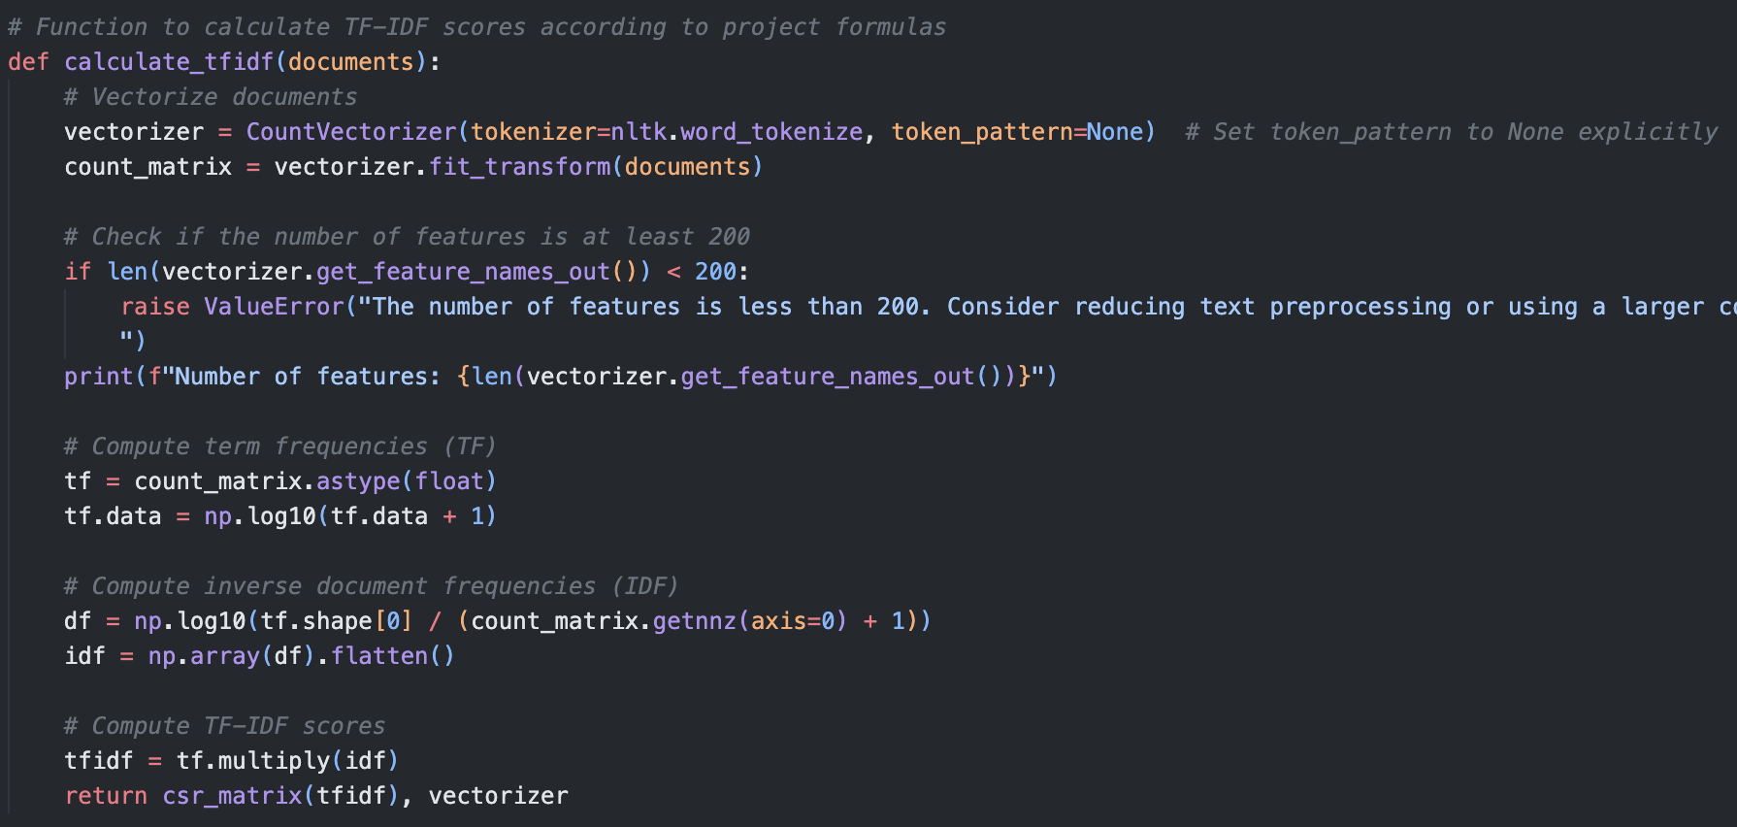
Methodology - Feature Vector Creation

Slide 10

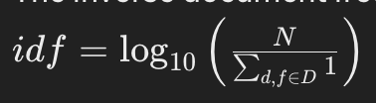
Methodology - Feature Vector Creation
Use of CountVectorizer
Converts text to a matrix of token counts.
TF-IDF Transformation
Weighs tokens' importance uniquely across documents.
Feature Vector Dimension
Over 200 features to capture text nuances.

Slide 11
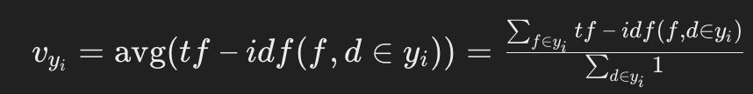
Building the Predictive Model
TF-IDF Calculation
Converts raw text into a weighted feature matrix.
Training the Model
Averages TF-IDF scores by category to form category vectors.
Model Components
Vectorizer, Label Encoder, and Averaged Vectors.

Slide 12
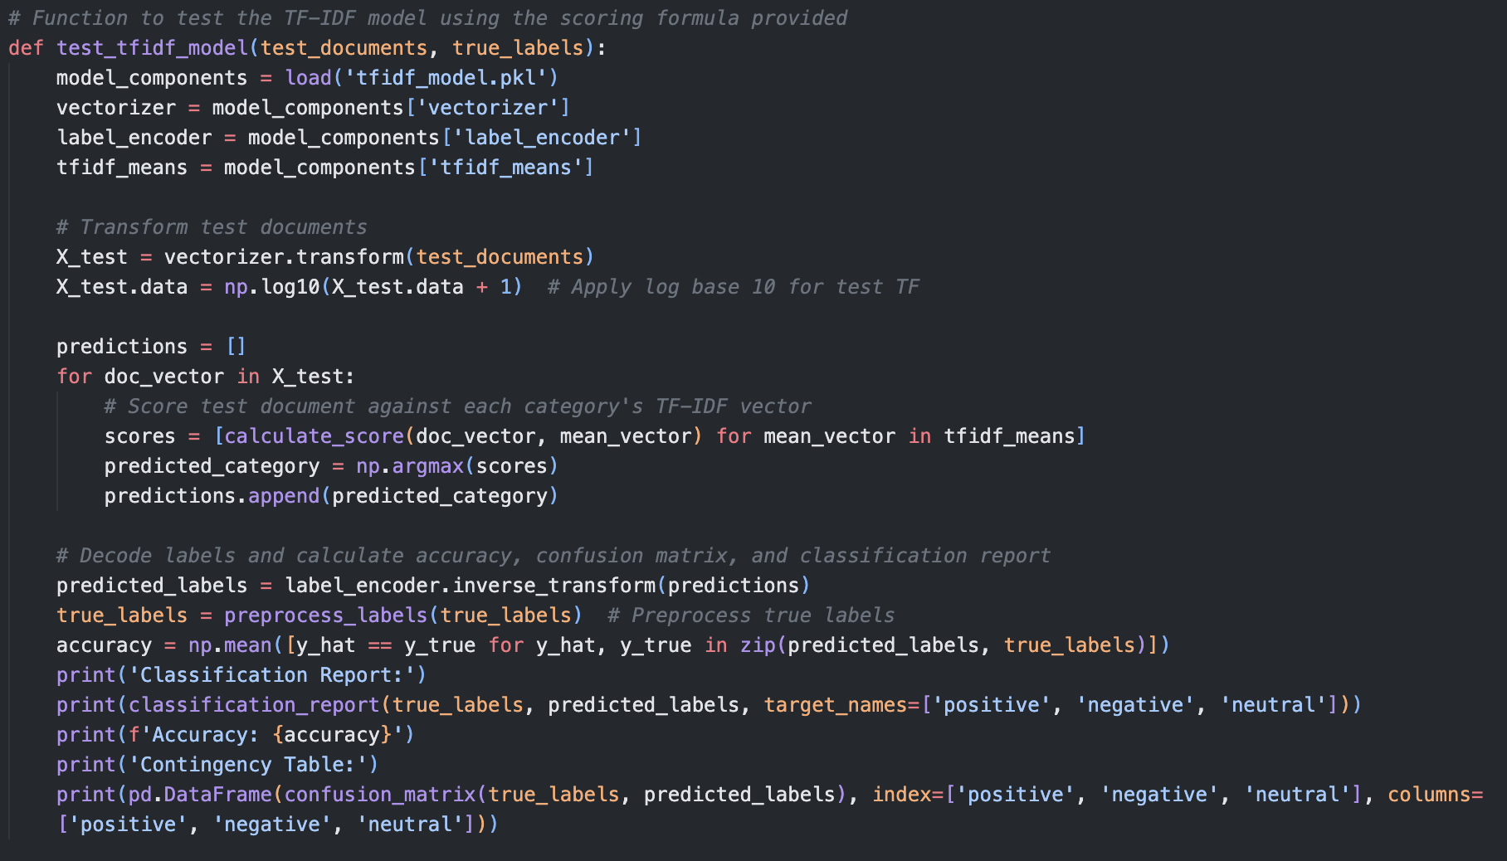
Testing and Evaluating the Model

Slide 13
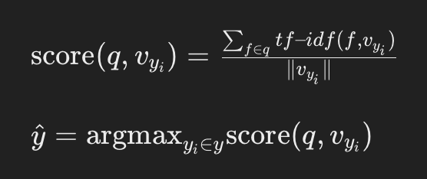

Testing and Evaluating the Model
Using the Test Dataset
Apply the model to unseen documents.
Scoring Method
Compare new document vectors against category vectors.
Performance Metrics
Accuracy
Precision
Recall
F1-Score

Slide 14
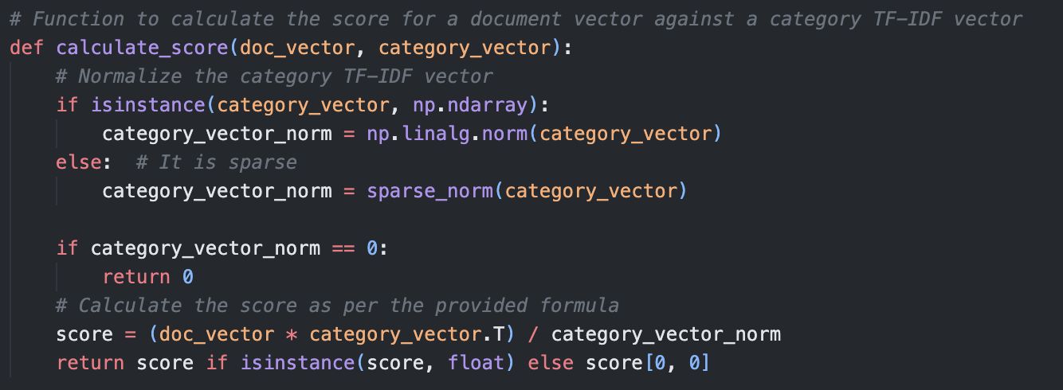
Model Performance Results - Contingency Table

Slide 15
Model Performance Results - Contingency Table
 | Predicted Positive | Predicted Negative | Predicted Neutral
Actual Positive | 137 | 54 | 217
Actual Negative | 18 | 82 | 81
Actual Neutral | 68 | 30 | 766

Slide 16
Results
Overall Accuracy
"67.79% - Indicates general model effectiveness.”
Best Performing Category
"Neutral sentiments identified with high precision and recall.”
Challenges Noted
"Positive sentiments often misclassified as Neutral.”
Significant Metrics
Precision, Recall, and F1-Score for each category.

Slide 17
Future Directions for Our System
Algorithm Optimization
Explore advanced models like neural networks.
Data Augmentation
Increase dataset size, particularly for underrepresented sentiments.
Address Class Imbalance
Implement techniques such as SMOTE or targeted resampling.
Continuous Model Evaluation
Use cross-validation to assess model robustness.

Slide 18
Conclusion
Achievements
Successfully developed an NLP system for sentiment analysis.
Achieved 67.79% accuracy in identifying document sentiments.
Challenges Addressed
Overcame data preprocessing hurdles.
Improved model handling of diverse sentiment expressions.
Key Takeaways
Importance of comprehensive data preprocessing.
Need for continuous model evaluation and improvement.

Slide 19
thank you
Notes:
Thank You Everyone

