Slide 1
Challenges
in
Education System
E. Ramanji Reddy

Slide 2

MisAlignment with Job Industry
Companies
SKILLS
IIT
Schools

Slide 3
Reasons for Misalignment
SKILLS
IIT
No academic - industry shuffle
Schools have no idea what industry wants
Schools overhype what they can deliver (IIT/NEET)
Faculty teaches what they learn at school
No one from industry come back to teaching

Slide 4

2. Memorization Vs Thinking
Over Emphasis on Memorizing
Teaching too much of theory
Lot of time in writing material
No scope or time for
Critical Thinking
Fun with Creativity
Reasoning Skills

Slide 5

3. Outdated after 16 years of schooling — where did education go wrong
Static Curriculum
No major changes in last 100 years
No exposure to technical advancements
Losing confidence in IIT race
98% applicants don't get into IIT/NIT
No grounds. No time to play
Low physical/mental health

Slide 6
Every change begins with a first step

Slide 7
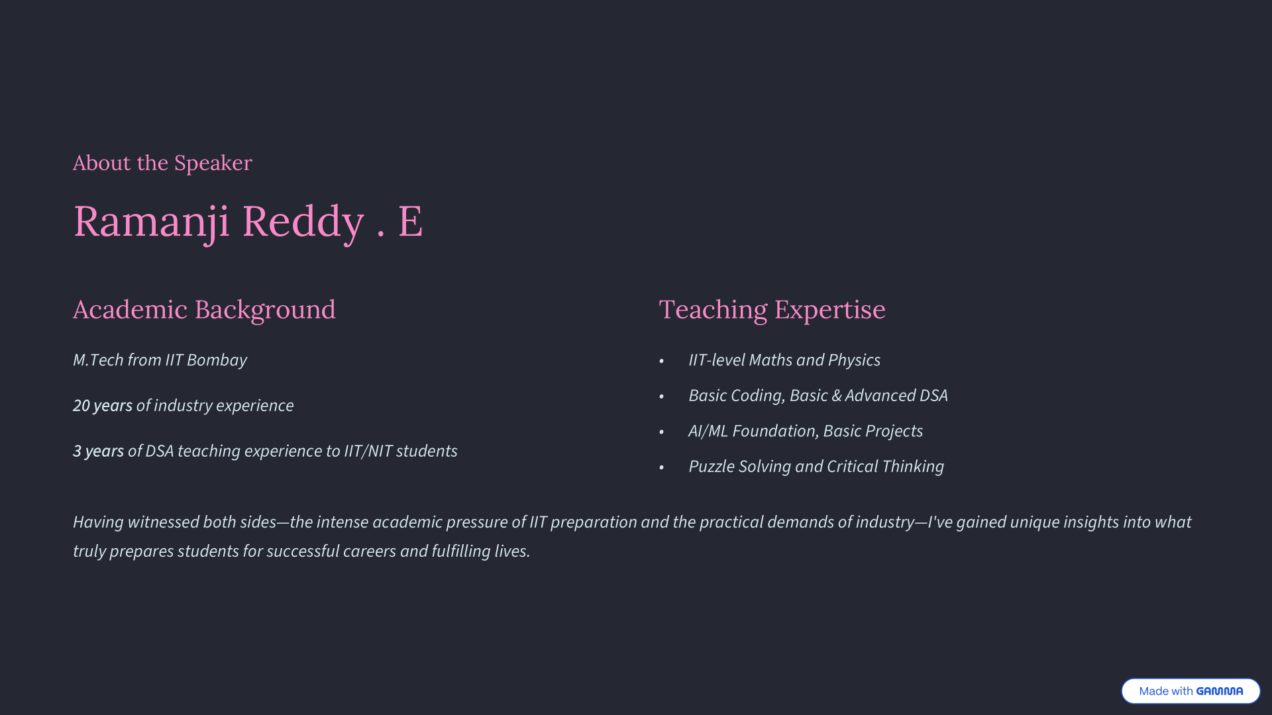

Slide 8
Tharka High School
A meaningful alternative to conventional education
2026

Slide 9
Relevant Curriculum with Industry Skills
Covering Basics Right (daily one hour in computer Lab)
How things Work?
Electronics (Hardware), Computers (Software), Internet
Computer Operation for Daily Life
Typing, word/excel/PPT, Mail, Audio/Video basics
Programming Languages (C++, Java, Python)
Exposure to LLMs (ChatGPT, Cursor) for vibe coding
Strong foundation in Data Structures Algorithms (DSA)
Leetcode, Codeforces, Programming Olympiad
AI/ML Math Foundation
Beginner level projects in Data Science
SKILLS
IIT

Slide 10
Reshaping existing curriculum
Prioritizing Maths/Physics/Chemistry for competitive exams
Focus more on concepts, encourage bullet point learning
Remove unnecessary writing and memorization time

Slide 11
Prioritizing Skills and Sports
Mandatory daily session for sports and Arts
Sports: BasketBall, VolleyBall, ThrowBall, KhoKho, Athletics (1.5 Acre Ground)
Arts: Dancing, Singling, Violin, Keyboard
Soft Skills training
Spoken English, Public Speaking, Communication and Body Language Fundamentals
Hostlers: Safety is the utmost priority
Food with homemade organic products
Hostel located inside the school, with proper compound wall

