Slide 1






Graphical Neural Networks
Group Project
Chinmay Bhagat (781), Harsh Kumar (785), Om Sagar Mishra (800)
Indian Institute of Information Technology, Kalyani
Supervisor: Dr. Bapi Kar
Department: Electronics and Communication
ECC-791(Project II-A) (IIITK)
Graphical Neural Networks
AUTUMN 2024
1 / 18

Slide 2




Contents
1
Algorithms/Approaches Used
1
² Knowledge Graph for Actors
3
Knowledge Graph for Movies
4
ECC-791(Project II-A) (IIITK)
Graphical Neural Networks
AUTUMN 2024
1 / 9
2 / 18

Slide 3

Algorithms/Approaches Used
Entity Recognition and Linking Knowledge Graph Construction
Knowledge Graph Population and Expansion Semantic Search and Entity Ranking
ECC-791(Project II-A) (IIITK)
Graphical Neural Networks
AUTUMN 2024
3 / 18

Slide 4
Contents
1
Algorithms/Approaches Used
² Knowledge Graph for Actors
3
Knowledge Graph for Movies
ECC-791(Project II-A) (IIITK)
Graphical Neural Networks
AUTUMN 2024
4 / 18

Slide 5
Knowledge Graph for Actors
Data Processing: Sentences were tokenized to extract
Entity-Relation-Entity pairs, which were then organized into the graph.
Visualization: The graph, representing the top 250 actors and their relationships, was visualized using Networkx as a directed graph, where nodes represent entities and edges indicate one-way relationships.
ECC-791(Project II-A) (IIITK)
Graphical Neural Networks
AUTUMN 2024
5 / 18

Slide 6
Knowledge Graph for Actors
Information of all the Movies by Robert D. Jr.
 | Directors | Production Company | Companied By
Iron Man | John Favreau | Marvels Studio | Gwyneth Paltrov
Captain America Civil War | Antony Russo | Paramount Pictures | Chris Evans
Avengers age of Ultron | Joss Whendon | Marvels Studio | Chris Hemsworth Scarlett Johanson
Movies
ECC-791(Project II-A) (IIITK)
Graphical Neural Networks
AUTUMN 2024
6 / 18

Slide 7
Knowledge Graph for Actors
Movies
Directed By
Production Company
Companied by
Companied by
Iron
Man
John
Favreau
Marvels Studio
Gwyneth
Paltrov
Production Company
ROBERT
D JR.
Movies
Directed By
Captain
America
Civil war
Antony
Russo
Paramount Pictures
Chris
Evanz
Movies
Production Company
Age of
Ultron
Companied by
Joss
Whendon
Marvels Studio
Chris
Hemsworth
Scarlett Johanson
Directed By
Companied by
ECC-791(Project II-A) (IIITK)
Graphical Neural Networks
AUTUMN 2024
7 / 18

Slide 8
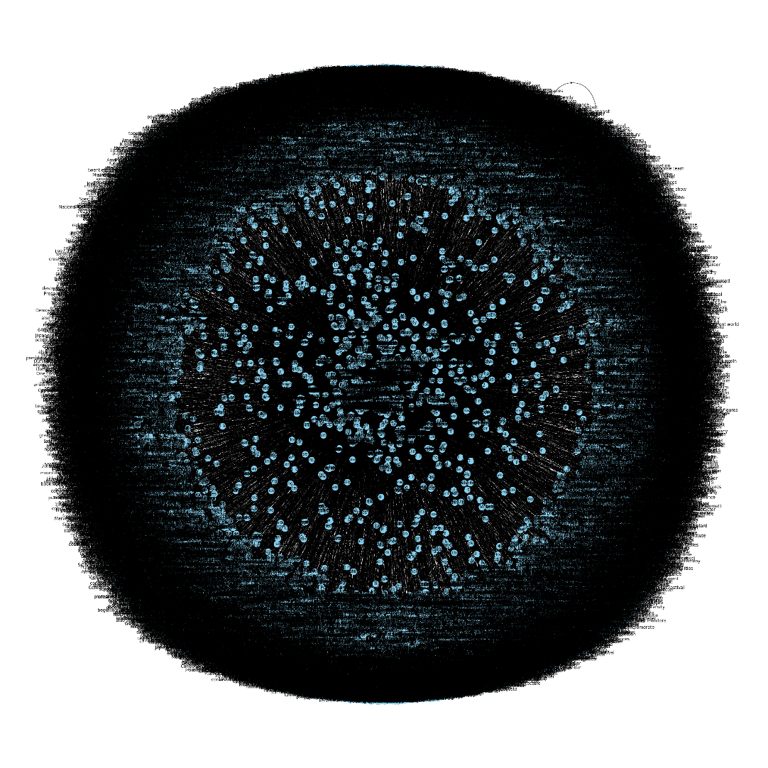
Knowledge Graphs
Knowledge Graph for Actors and Movies
ECC-791(Project II-A) (IIITK)
Graphical Neural Networks
AUTUMN 2024
8 / 18

Slide 9
Contents
1
Algorithms/Approaches Used
² Knowledge Graph for Actors
3
Knowledge Graph for Movies
4
ECC-791(Project II-A) (IIITK)
Graphical Neural Networks
AUTUMN 2024
9 / 18

Slide 10
Knowledge Graph for Movies
Data Collection: Scraped top 500 movies from IMDb.
Graph Structure: Nodes for movies, genres, directors, and actors; edges for relationships.
Entity Linking: Unique identification using metadata like release year.
Visualization: Interactive graph created with Networkx.
Applications: Enables semantic search and trend analysis in film.
ECC-791(Project II-A) (IIITK)
Graphical Neural Networks
AUTUMN 2024
10 / 18

Slide 11
What did we do?
Movie:
The Matrix
Genre
Sci-fi
Director
Lana W
Language
English
Production
Warner Bros
Cast
Keanu Reevs
ECC-791(Project II-A) (IIITK)
Graphical Neural Networks
AUTUMN 2024
1 / 9
11 / 18

Slide 12
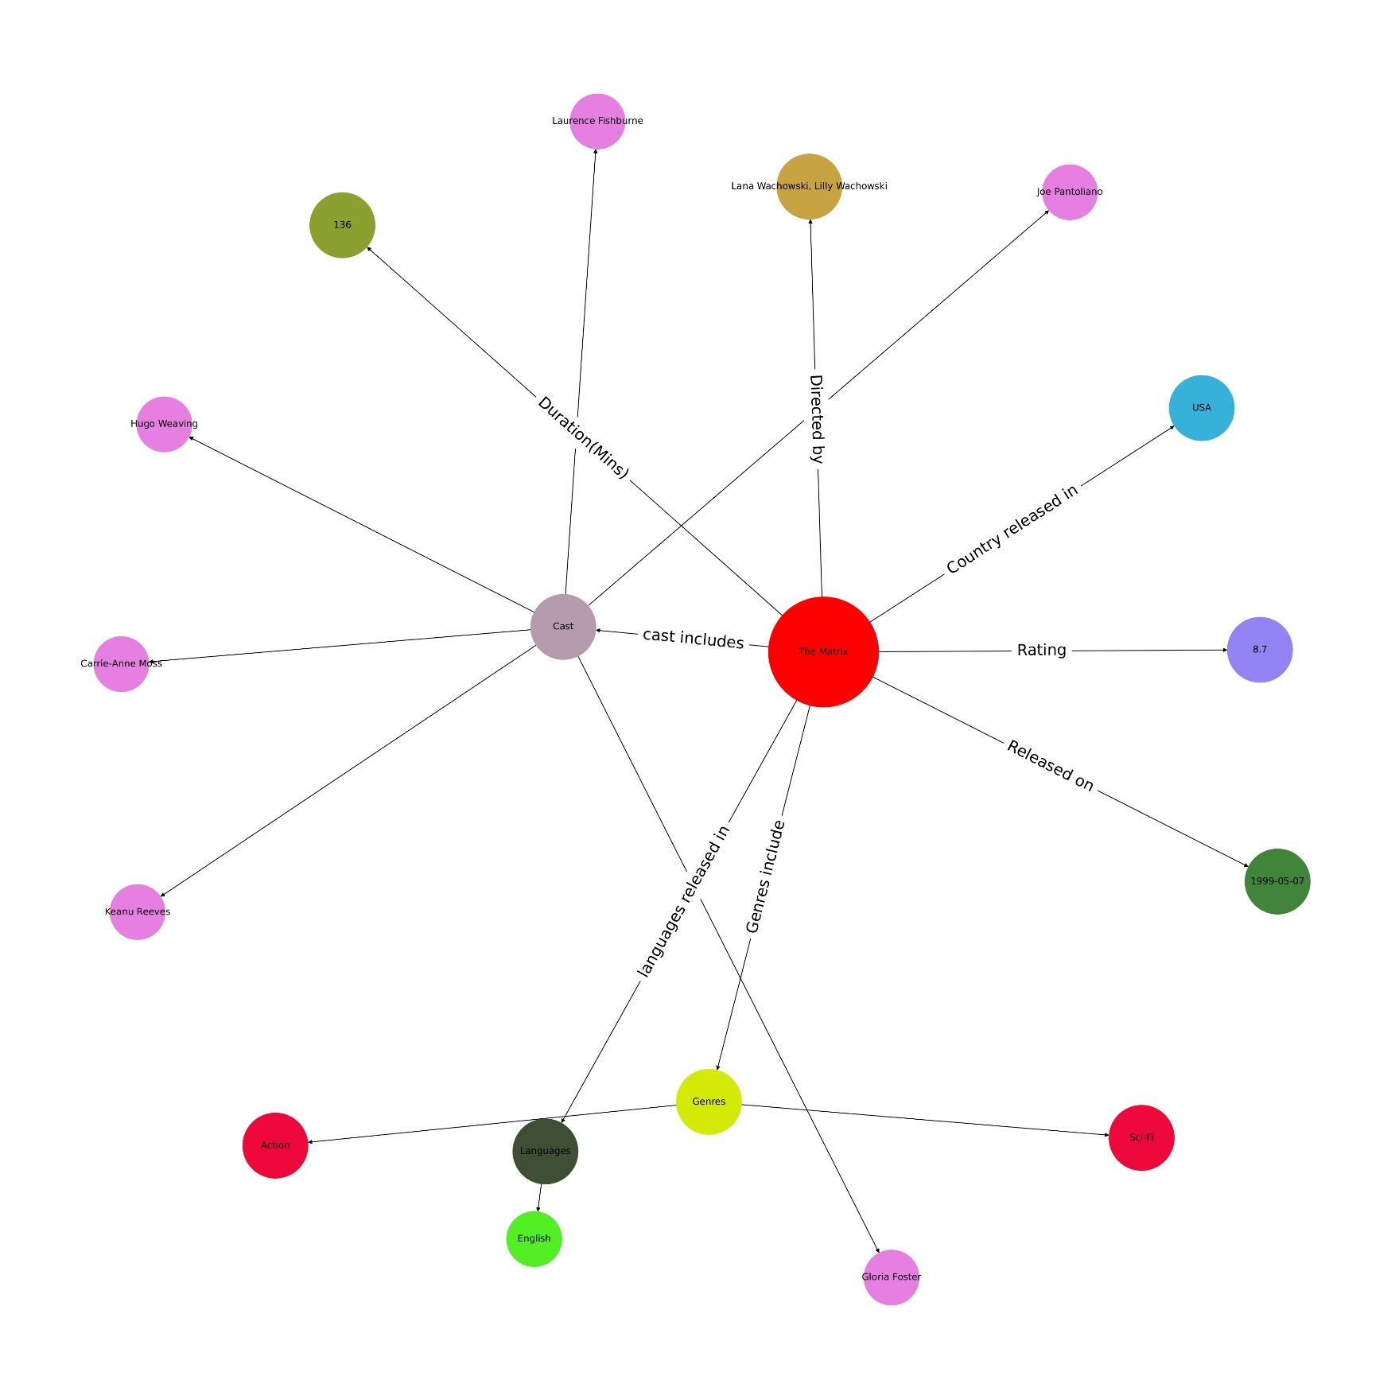
ECC-791(Project II-A) (IIITK)
Graphical Neural Networks
AUTUMN 2024
12 / 18

Slide 13
Movie Comparision
Movie:
Iron Man
Movie:
Captain America
Civil War
Genre
Sci-fi
Genre
Sci-fi
Action
Director
Antony Russo
Director
John Favreau
Language
English
Persian
Language
English
German
Production
Marvels Studios
Production
Paramount Pictures
Cast
Robert D. Jr
Cast
Chris Evans
Terrance Howard
Robert D. Jr
ECC-791(Project II-A) (IIITK)
Graphical Neural Networks
AUTUMN 2024
13 / 18

Slide 14
Movie:
Iron Man
Movie:
Captain America
Civil War
Genre
Sci-fi
Genre
Sci-fi
Action
Language
English
Persian
Language
English
German
Production
Marvels Studios
Production
Paramount Pictures
Cast
Robert D. Jr
Cast
Chris Evans
Terrance Howard
Robert D. Jr
ECC-791(Project II-A) (IIITK)
Graphical Neural Networks
AUTUMN 2024
14 / 18

Slide 15
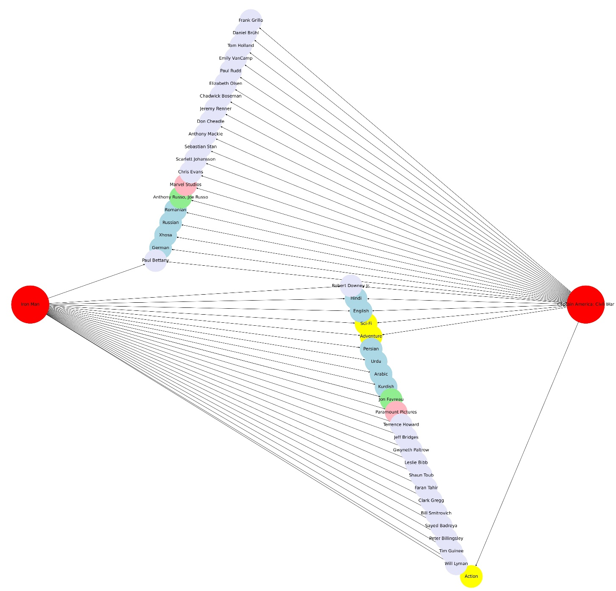
Movie Comparison
ECC-791(Project II-A) (IIITK)
Graphical Neural Networks
AUTUMN 2024
15 / 18

Slide 16
Recommendation System
Various criteria has been set up based on which we score the movie and recommend the movies to the people.
QUALITIES | MATCH SCORE | MISMATCH SCORE
Language | +1 | 0
Genre | +7 | -1
Director | +3 | 0
Production Company | +7 | 0
Actors | +4 | 0
ECC-791(Project II-A) (IIITK)
Graphical Neural Networks
AUTUMN 2024
16 / 18

Slide 17
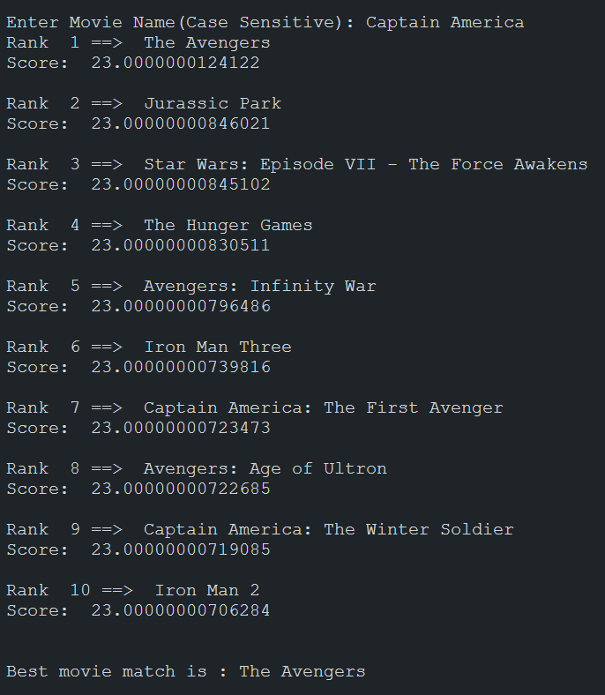
Recommendation System
ECC-791(Project II-A) (IIITK)
Graphical Neural Networks
AUTUMN 2024
17 / 18

Slide 18
Thank You!
Questions?
Indian Institute of Information Technology, Kalyani
Presentation by Chinmay Bhagat, Harsh Kumar, Om Sagar Mishra
ECC-791(Project II-A) (IIITK)
Graphical Neural Networks
AUTUMN 2024
18 / 18

