Slide 1

Microstrip Line Fed Dielectric Resonator Antenna Optimization using ML Algorithms
Department of Electronics and Communication Engineering.
Group 50
Om Singh 20185092
Prateek 20185036
Pritam Rauniyar 20185144
Project Supervisor
Dr. Anand Sharma
Assistant Professor
ECED
Notes:
Ask @Pritam for another image.

Slide 2
Contents
Overview
Introduction
Study
Implementation
Analysis
Conclusion
References

Slide 3


Machine Learning
#Overview
Recently there has been an immense growth in the demand of application-specific antennas. Hence an efficient way to design antennas is required.
This is where ML techniques can be really beneficial . It can be used as an data analysis and decision making tool which can optimize antenna design even with large no. of parameters in an efficient way .

Slide 4
Objective
#Introduction
Detailed analysis and systematic comparison of various ML techniques for antennas.
Work on ML-based methods for automated antenna design optimization.
Evaluating, the performance in terms of prediction accuracy and robustness and making comparisons with EM simulations
Conclude on the feasibility and versatility of ML in automated antenna design which could be beneficial in a number of applications.

Slide 5
ML Techniques
#Study
ANN (Artificial Neural Networks)
KNN (K-nearest neighbours)
Decision Tree
Random Forest
XGBoost
The main advantage of these techniques is once we have the relation model , we can predict the output for any data point .
The other potential algorithms could have been genetic algorithms or particle swarm optimization but the problem with these is that we need to identify a global maxima or minima

Slide 6





Leveraged Tools
#Implementation
HFSS
The acronym stands for High-Frequency Structure Simulator. A commercial tools used for antenna design, and the design of complex radio frequency electronic circuit elements including filters, transmission lines, and packaging.
Python, Jupyter Notebook, Git, Github
Libraries: sk_learn, keras, xg_boost, matplotlib, numpy, pandas

Slide 7
Project Phases
#Implementation
Phase 1
Phase 2
Phase 3
Phase 4
Phase 5
Phase 6
Understanding
Antenna Design
Optimization
Data Sets
Training
Exploration
Going through research papers and learning HFSS.
Designing antenna on HFSS and deciding dimensions.
Optimising current dimensions
Generate appropriate dataset for better results.
Implementing different ML techniques.
Extending the same idea for different dimension antennas.

Slide 8
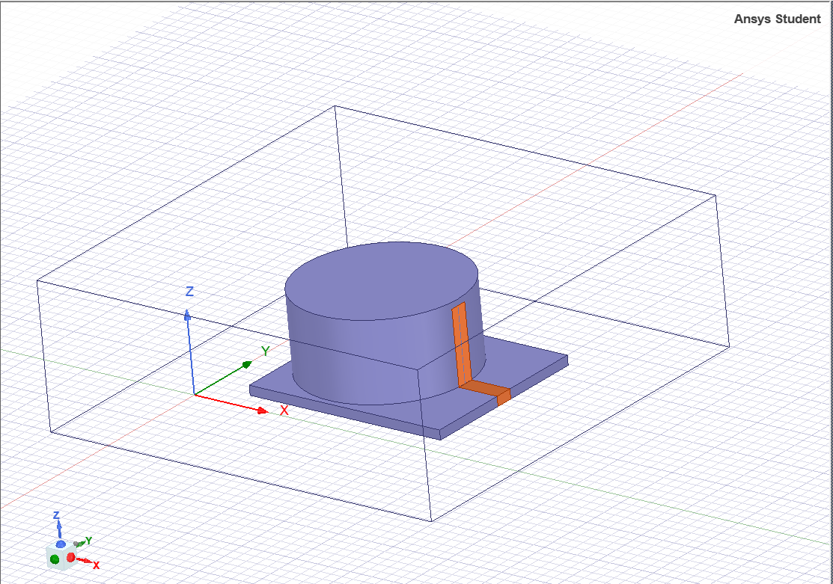
Antenna Model
#Implementation
Considered Cylindrical DRA as a reference antenna.
The material of the cylindrical-substrate is Al2O3 ceramic.
A microstrip feed line is used for excitation.
Designed in HFSS, the antenna has 2 variable dimensional-parameters which can be optimized, i.e. Radius (r), Height (h).
HFSS model of CDRA

Slide 9
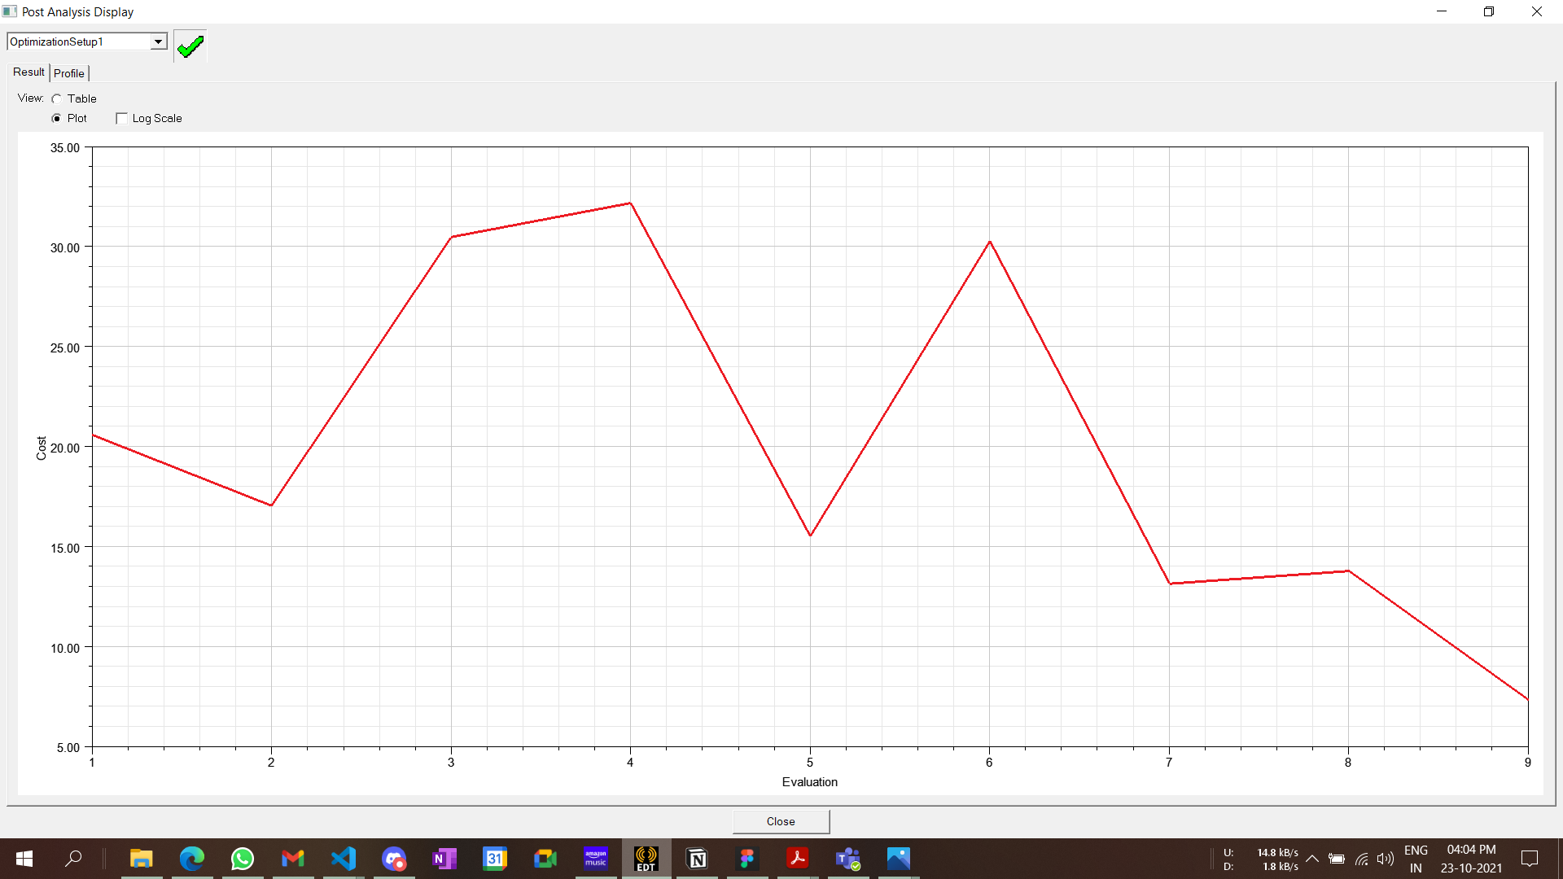
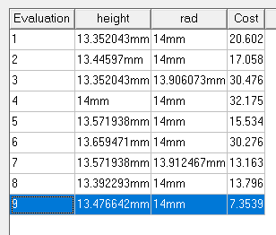
Optimetrics
#Implementation
Added an HFSS optimetrics with h and r as parameters, frequency band of 1-5 GHz was selected and the goal was dBS11 <= -20 dB.
Quasi Newton optimizer was used. Overall 9 iterations were done with the cost as shown in the graph.
Cost vs Iteration line chart
Cost value for each iteration

Slide 10
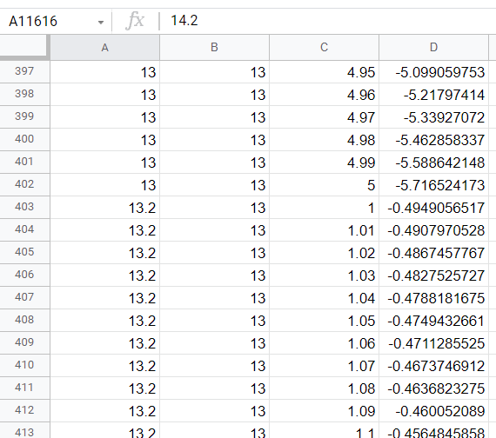



Datasets
#Implementation
HFSS parametric was used to vary dimensions of the substrate, and with this variation a dataset was generated.
Generated dataset in a .csv format.

Slide 11
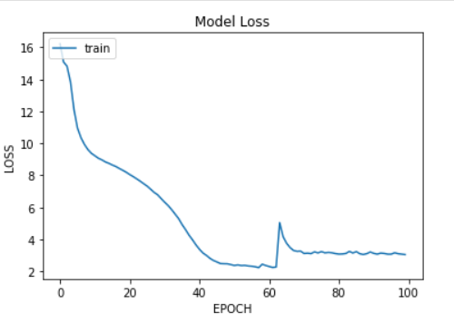
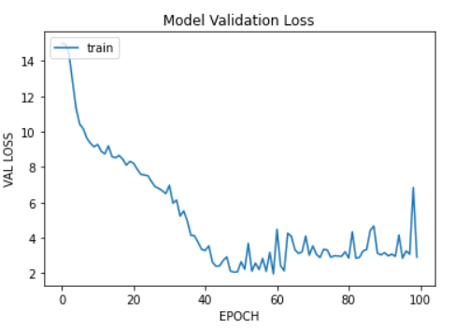
Training
#Implementation
The dataset was separated into test and training set. The training set was used to train all the models.
Training of ANN model was done with a batch size of 10 and 100 epochs.
For KNN the value of k = 5 was taken.
The models are trained to predict the values of S11 for a particular frequency with a given antenna parameter.
Training Analysis of ANN

Slide 12
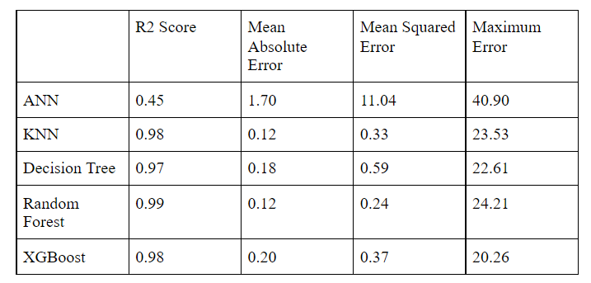
Prediction
#Implementation
The test dataset was used to check the prediction accuracy of each model.
Predicted values were compared with the actual values to determine few accuracy metrics.
On analysing these metrics, models were tuned to get better prediction results.
Prediction metrics

Slide 13
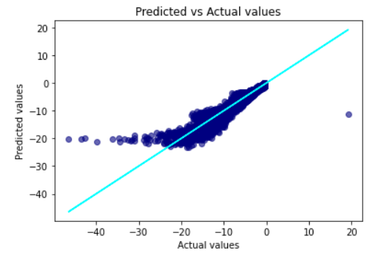
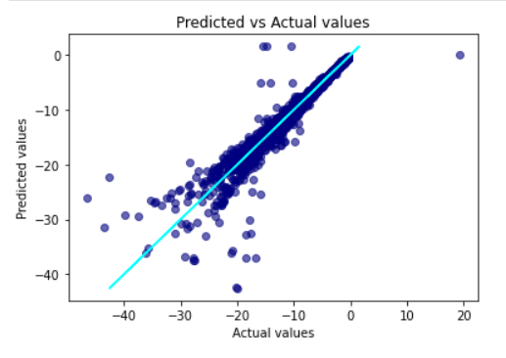
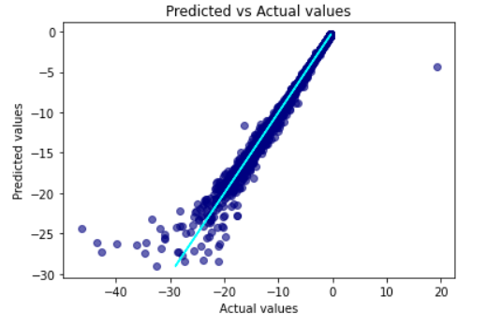
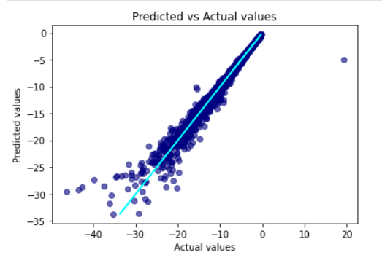
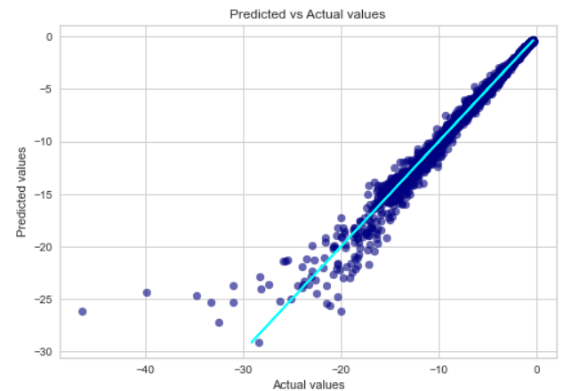
Accuracy
#Analysis
ANN
Decision Tree
KNN
Random Forest
XGBoost

Slide 14
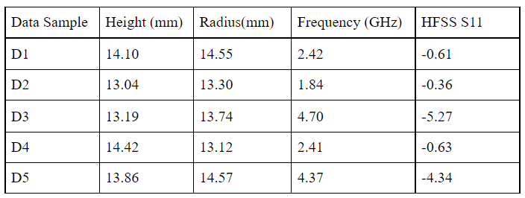
Comparison
#Analysis
After prediction and accuracy analysis, some random data-samples were generated.
For these samples the S11 value was determined from HFSS and from each values.
On comparing both the values the percentage error was calculated.
Though ANN is considered better for prediction, outputs are not satisfactory comparatively as we are dealing with small dataset.
Random data samples

Slide 15
Inference
#Conclusion
Prediction of antenna performance proved to be way optimized and faster then the traditional optimization method.
Once the model was predicted for some training data, it was able to do the prediction for a variety of sample inputs.
The computation power required to train the model initially was quite high but with a trained model making prediction was very much compute feasible.
Our study thus shows that ML techniques may be able to enable versatile and potentially automated design of antennas which will be beneficial for a number of applications including IoT.

Slide 16
Future Prospects
#Conclusion
For now these techniques have only been applied to CDRA, these could be extended to other antenna designs in later iterations.
In our study we have just considered S11 for optimization but other parameters can also be studied like radiation pattern and beam tilting.
Physical antenna fabrication can be done to better test out the optimization feasibility and accuracy practically.
Notes:
Ask from Harshit Sir for some ideas.

Slide 17
References
Yashika Sharma , Hao Helen Zhang, and Hao Xin , Fellow, IEEE, “Machine Learning Techniques for Optimizing Design of Double T-Shaped Monopole Antenna”, IEEE TRANSACTIONS ON ANTENNAS AND PROPAGATION, VOL. 68, NO. 7, JULY 2020.
Qi Wu , Member, IEEE, Haiming Wang , Member, IEEE, and Wei Hong , Fellow, IEEE, “Multistage Collaborative Machine Learning and Its Application to Antenna Modeling and Optimization”, IEEE TRANSACTIONS ON ANTENNAS AND PROPAGATION, VOL. 68, NO. 5, MAY 2020.
Web References
Keras API reference
scikit-learn: machine learning in Python — scikit-learn 1.0.1 documentation
Notes:
Add in few website references also

Slide 18
Thankyou!

