Slide 1

Microstrip Line Fed Dielectric Resonator Antenna Optimization using ML Algorithms
Department of Electronics and Communication Engineering.
Group-50
Om Singh 20185092
Prateek 20185036
Pritam Rauniyar 20185144
Project Supervisor
Dr. Anand Sharma
Assistant Professor
ECED
Notes:
Ask @Pritam for another image.

Slide 2
Objective
Contents
Detailed analysis and systematic comparison of various ML techniques for antenna design application.
Analysing the implementation of advanced techniques like KBNN.
Evaluating, the performance and making comparisons with EM simulations.
Overview
Implementation
Study
Extension
Analysis
Outcomes
Conclusion
References

Slide 3
Project Phases (Sem 7)
#Overview
Phase 1
Phase 2
Phase 3
Phase 4
Phase 5
Phase 6
Understanding
Antenna Design
Optimization
Data Sets
Training
Exploration
Going through research papers and learning HFSS.
Designing antenna on HFSS and deciding dimensions.
Optimising current dimensions
Generate appropriate dataset for better results.
Implementing different ML techniques.
Extending the same idea for different dimension antennas.

Slide 4
Project Phases (Sem 8)
#Overview
Phase 1
Phase 2
Phase 3
Phase 4
Extending
Testing
Analysing
Paper
Design Space exploration and implementing potential algorithms yielding better results.
Applying the ML models on the fabricated antenna.
Recording results, generating graphs and analysing the best possible approach.
Writing a paper mentioning the work and conducted analysis.

Slide 5





Leveraged Tools
#Implementation
HFSS
The acronym stands for High-Frequency Structure Simulator. A commercial tools used for antenna design, and the design of complex radio frequency electronic circuit elements including filters, transmission lines, and packaging.
Python, Jupyter Notebook, Git, Github
Libraries: sk_learn, keras, xg_boost, matplotlib, numpy, pandas

Slide 6
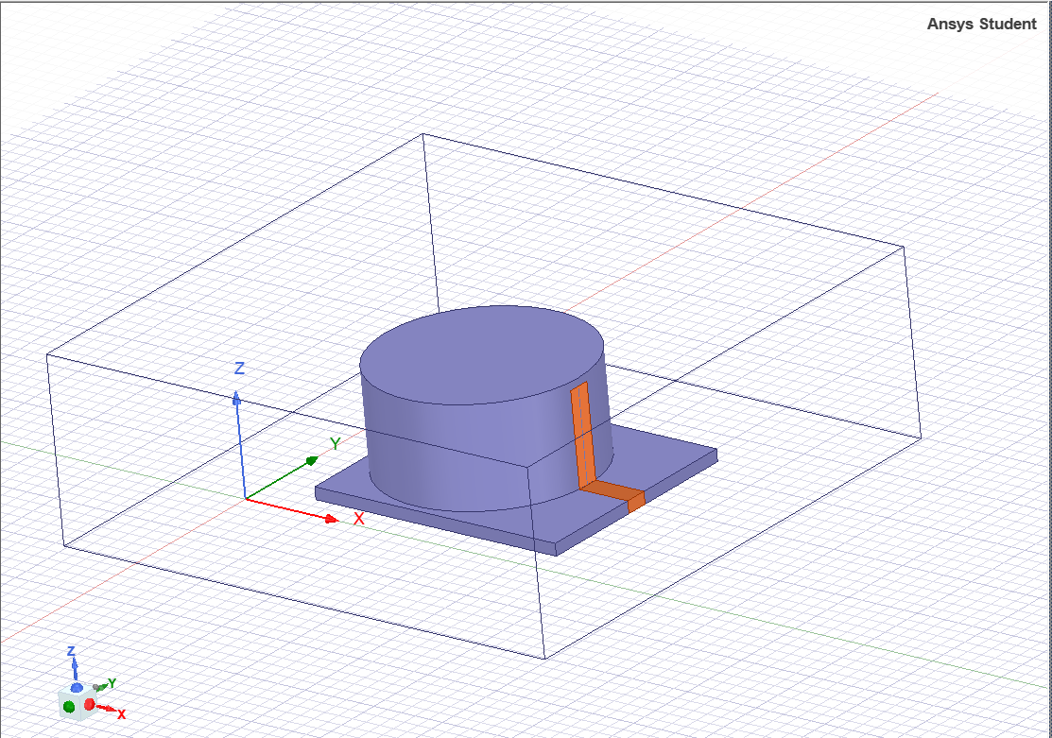
Antenna Model
#Implementaion
Considered Cylindrical DRA as a reference antenna.
The material of the cylindrical-substrate is Al2O3 ceramic.A microstrip feed line is used for excitation.
Designed in HFSS, the antenna has 4 variable dimensional-parameters which can be optimized, i.e. Radius (r), Height (h), Feed-line width (w1), Conformal-line width (w2).
HFSS model of CDRA

Slide 7


Machine Learning
#Implementaion
Models were trained corresponding to each algorithm, followed by detailed and comparative analysis, with the simulated datasets.
ANN (Artificial Neural Networks)
KNN (K-nearest neighbours)
Decision Tree
Random Forest
XGBoost
The main advantage of these techniques is once we have the relation model , we can predict the output for any data point .

Slide 8
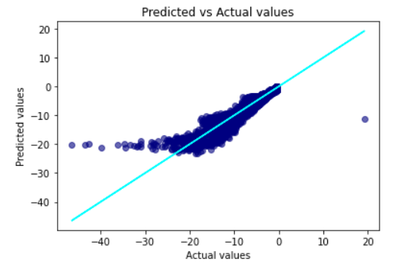
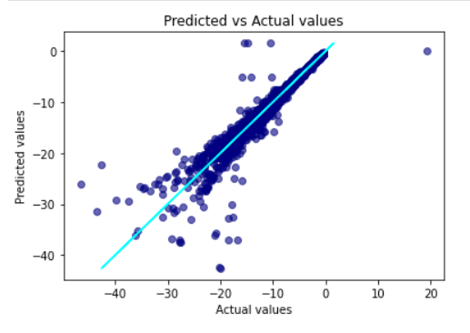
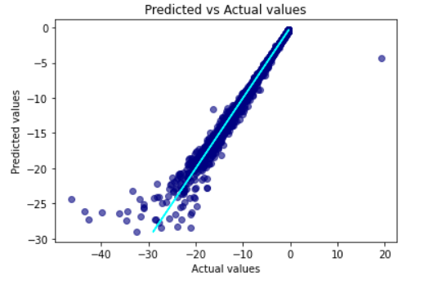
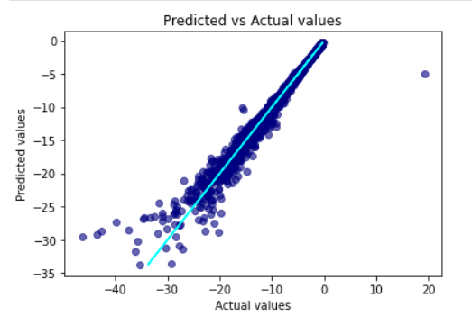
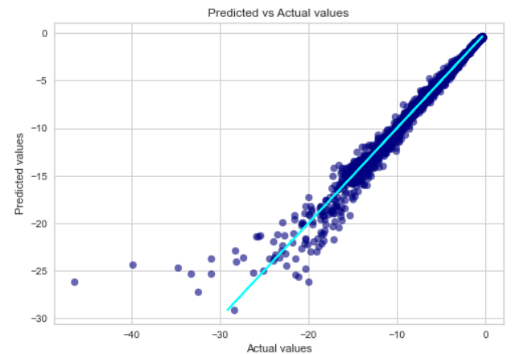
Results
#Implementaion
ANN
Decision Tree
KNN
Random Forest
XGBoost

Slide 9
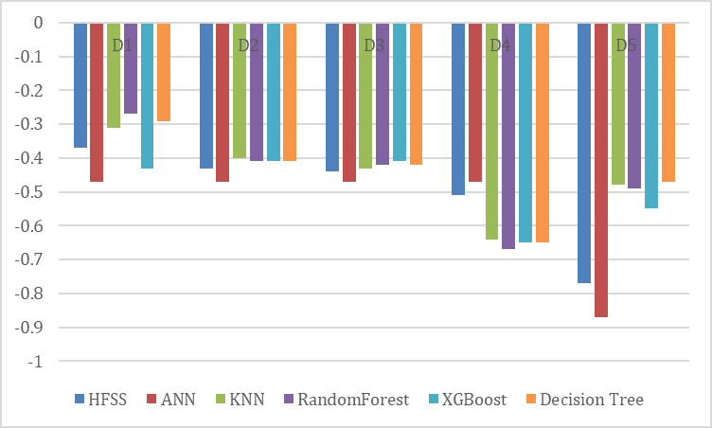
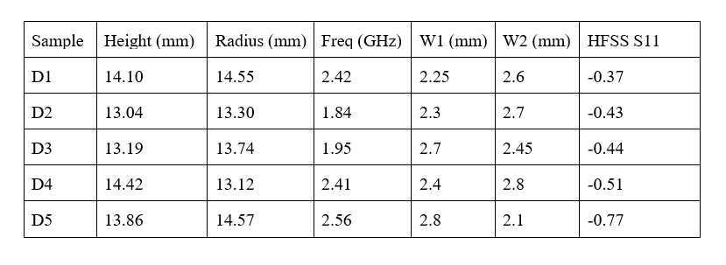
Comparison
#Study
For some random data samples the S11 value was determined from HFSS by simulation, and by each of the trained ML models.
The chart represents the output S11 values from HFSS and each trained model.
Random data samples

Slide 10
Implications
#Study
Prediction of antenna performance proved to be way optimized and faster then the traditional optimization method.
Once the model was predicted for some training data, it was able to do the prediction for a variety of sample inputs.
The computation power required to train the model initially was quite high but with a trained model making prediction was very much compute feasible.

Slide 11
Shortcomings
#Study
According to the previous results, the accuracy of ANN was less as compared to other algorithms. The primary reason of this was lack of training data samples.
Generating datasets with large samples with HFSS EM solvers will be a highly inefficient task as each parametric iteration will take time.
For the purpose of design-space exploration employing ANN’s could be highly time consuming, as the required training time is more.
The data used to training is obtained through simulated HFSS model, because of which the practical application is not yet considered.

Slide 12
KBNN
#Extension
In order to mitigate the high compute requirement of EM solvers in generating the dataset for ANN, some problem specific additional knowledge can be used. This would accelerate the training of ANNs.
Various techniques such as source difference, prior knowledge input, and space-mapping have been developed in order to expedite the training of KBNNs over conventional ANNs.
Empirical models have to be developed which could represent this additional knowledge.

Slide 13
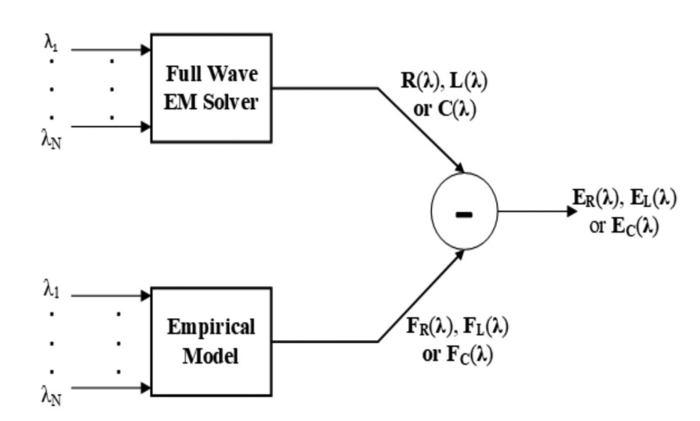
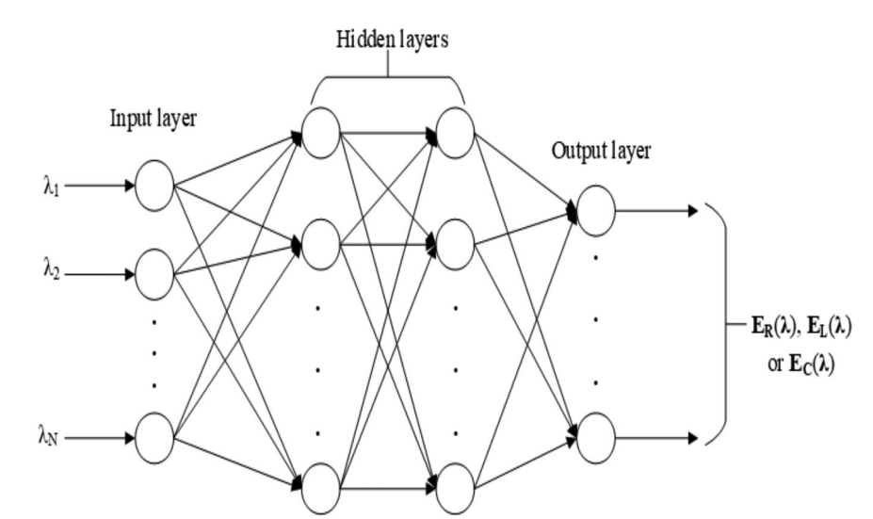
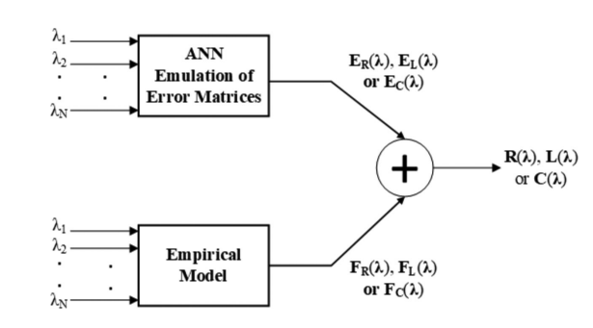
Source Difference
#Extension
In the source-difference technique it is proposed to employ ANNs to emulate the error matrices. Thereafter the accurate values are recovered by obtaining the sum of the ANNs and these empirical models.
(a) Source difference formalism of KBNNs depicting the functional dependency of the error matrices of
Multilayer perceptron architecture of ANNs to emulate the error matrices
Recovering the accurate values of the p. u. l. R, L, and C matrices from the source difference formulation

Slide 14
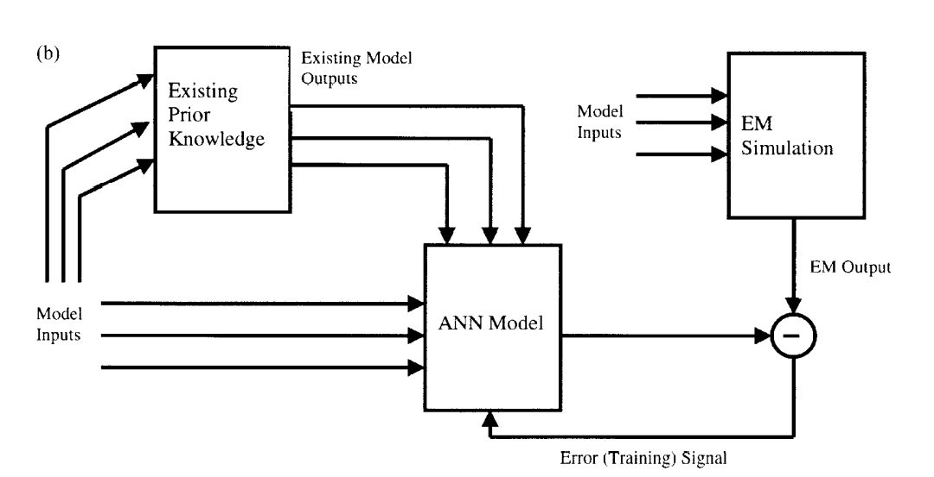
Prior-Knowledge Input
#Extension
Utilization of prior knowledge for new model development results in a reduction of the amount of training data necessary for a desired accuracy.
In the PKI method, the source model outputs are used as inputs for the ANN model in addition to the other inputs as explained in the figure.
The input]output mapping that must be learned by the ANN is that between the output response of the existing model and that of the target model.
Flow diagram representing the PKI technique.

Slide 15
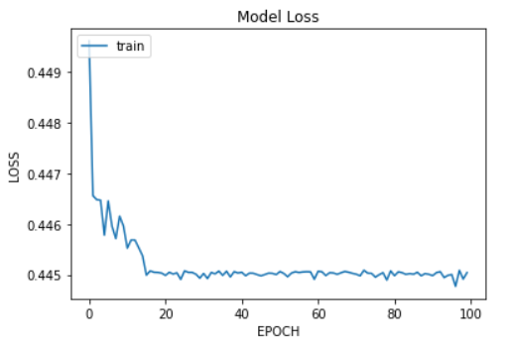
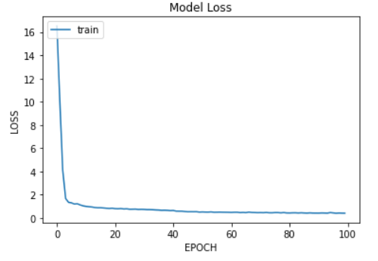
Training
#Extension
Source Difference
The empirical model taken in this case is KNN (since it had the best accuracy performance). The ANN is trained on the difference between the simulated data-set and the KNN outputs.
PKI
To increase the range of the dataset, all the previously trained model were used. The output of these models and the simulated data-set was collectively used to train the ANN for S11.
Training Analysis of ANN

Slide 16
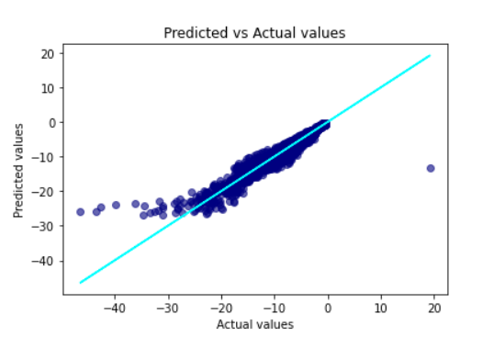
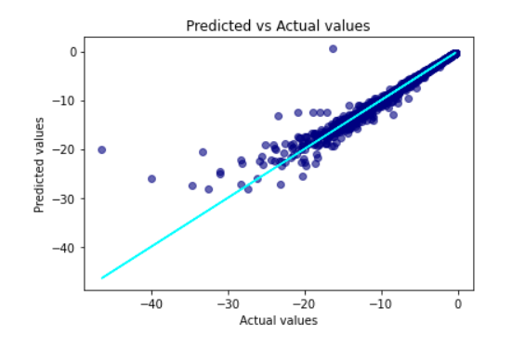
Accuracy
#Analysis
Prior knowledge Input KBNN
Source Difference KBNN

Slide 17
#Analysis
Comparison
Both the KBNN techniques provided better accuracy results as compared to ANN. This is evident by comparing the MSE and R2-Score
In source difference technique the training time is less as the difference-matrix has a simpler input output mapping.
The accuracy results of both the SD and PKI techniques are in close similarity.
 | MSE | R2
ANN | 11.04 | 0.45
SD KBNN | 0.51 | 0.97
PKI KBNN | 0.73 | 0.96
Prediction Metrics

Slide 18
Implications
#Analysis
Fewer training samples were required for the training of KBNN
Total training time cost of the KBNNs will be significantly smaller than that of conventional ANNs.
Useful in fast high-dimensional parametric sweeps and design space exploration.
Can be widely applied to quick electromagnetic optimization even for the complex microwave devices.
Despite of above mentioned abilities the key challenge for KBNN is selecting appropriate empirical models, which have to be known and trained beforehand.
Moreover these models must be highly accurate in order to yield good results.

Slide 19
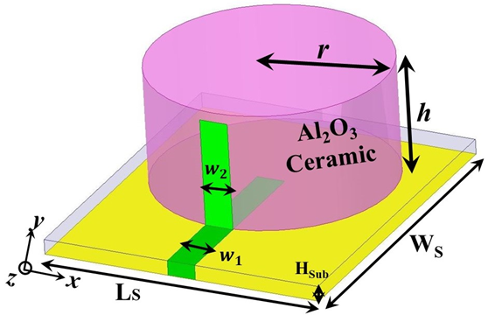
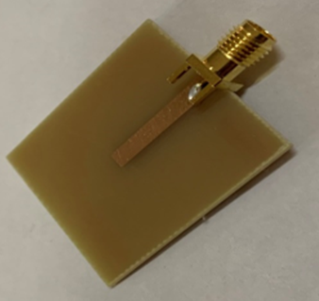
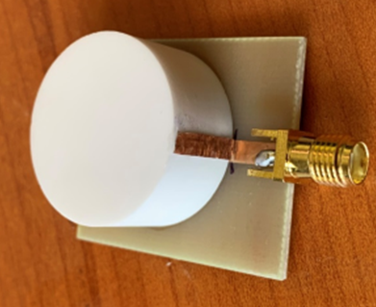
#Outcomes
Fabrication
The antenna structure consists of cylindrical ceramic (ε = 9.8). Microstrip line is printed on FR4 (ε = 4.4)
Proposed dimension ; LS= 30mm; WS= 35mm; w1=3.0 mm; w2=3.0 mm; HSub=1.6 mm; r=12.5 mm; h=12.5 mm
Cylindrical DRA
3D View
Feeding Structure

Slide 20
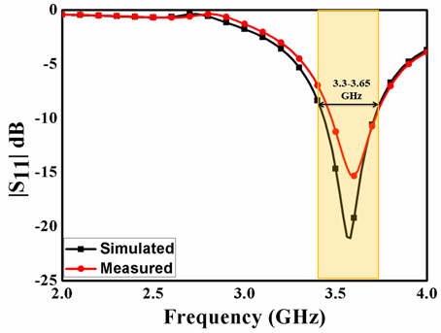
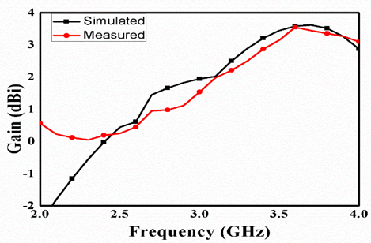
#Outcomes
Results
The suggested antenna reflection coefficient (|S11|) is measured using a Keysight VNA E5071C.
The antenna works in the 3.3-3.65 GHz frequency band.
Measured/Simulated |S11|
Measured/Simulated Gain variation

Slide 21
#Conclusion
Inference
Future Prospects
The study implicates that ML techniques may be able to enable versatile and potentially automated design of antennas which will be beneficial for a number of applications including IoT.
A research-article covering all the work has been communicated through Journal of Indian Academy of Science- Sadhana, which could extend the work by other researchers on same field and could extend the implications.
These techniques have only been applied to CDRA, however these could also be extended to other antenna designs in later iterations.
In our study we have just considered S11 and gain for optimization but other parameters can also be studied like radiation pattern and beam tilting.

Slide 22
References
P. M. Watson, K. C. Gupta, and R. L. Mahajan, “Applications of knowledge-based artificial neural network modeling to microwave components,” Int. J. RF Microw. Comput.-Aided Eng., vol. 9, pp. 254–260, 1999.
Rahul Kumar, S. S. Likith Narayan, Somesh Kumar , Sourajeet Roy , Senior Member, IEEE, Brajesh Kumar Kaushik, Senior Member, IEEE, Ramachandra Achar , Fellow, IEEE, and Rohit Sharma , Senior Member, IEEE, “Knowledge-Based Neural Networks for Fast Design Space Exploration of Hybrid Copper-Graphene On-Chip Interconnect Networks”, IEEE TRANSACTIONS ON ELECTROMAGNETIC COMPATIBILITY
Yashika Sharma , Hao Helen Zhang, and Hao Xin , Fellow, IEEE, “Machine Learning Techniques for Optimizing Design of Double T-Shaped Monopole Antenna”, IEEE TRANSACTIONS ON ANTENNAS AND PROPAGATION, VOL. 68, NO. 7, JULY 2020.
Qi Wu , Member, IEEE, Haiming Wang , Member, IEEE, and Wei Hong , Fellow, IEEE, “Multistage Collaborative Machine Learning and Its Application to Antenna Modeling and Optimization”, IEEE TRANSACTIONS ON ANTENNAS AND PROPAGATION, VOL. 68, NO. 5, MAY 2020.
Web References
Keras API reference
scikit-learn: machine learning in Python — scikit-learn 1.0.1 documentation
Notes:
Add in few website references also

Slide 23
Thankyou!

