Slide 1
IITJ Voting System (Android App)
forensic breakthrough
forensic breakthrough
forensic breakthrough
forensic breakthrough
forensic breakthrough
forensic breakthrough
Cryptography Based
forensic breakthrough
By :
Nikhil Raj ( B19CSE059 )
Om Solanki ( B19CSE061 )
Raunak Gandhi ( B19CSE117 )
forensic breakthrough

Slide 2
Various Stages of Implementation
Wireframing
01
05
Final tweaks
Made wireframe of entire idea
Final Changes in the last to resolve bugs
03
OCR
02
Cryptography
04
Result Evaluation
Implemented OCR
Learnt and implemented various algorithms
Worked to gather election result in the application

Slide 3
Major highlights
01
02
OCR
Secure
03
04
Live Result Declaration
Dynamic UI
Detect and fill details from the ID card automatically.
Encompass cryptography along with device biometric to encode and decode entities when needed
Visible real time UI updates
Automatically declares result when time’s over

Slide 4
01
Extraction
forensic breakthrough
OCR
forensic breakthrough
forensic breakthrough
forensic breakthrough
forensic breakthrough
forensic breakthrough
forensic breakthrough
forensic breakthrough

Slide 5
Optical Character Recognition
Detects images that contain and don’t contain ID card
Extracts Name, Roll, Branch and DOB from the ID card.
Integrated Google’s tensor model in the Android app ( not using any API hence works offline)
Uses phone hardware to execute classification
Image to be passed in bitmap format
Implemented self-made camera module using CameraKit dependency to click the image

Slide 6
02
Cryptography
forensic breakthrough
Security
forensic breakthrough
forensic breakthrough
forensic breakthrough
forensic breakthrough
forensic breakthrough
forensic breakthrough
forensic breakthrough

Slide 7
Encrypted Entities
Personal Questions selected by users
Answers of those questions
Name of the candidate the user has selected to vote for

Slide 8
Encryption of Personal Questions
Out of 7 questions, users can select any 4 questions of their choice
All 7 questions have random prime numbers attached to them
Hence in the database, binary form of those selected prime numbers are stored.

Slide 9
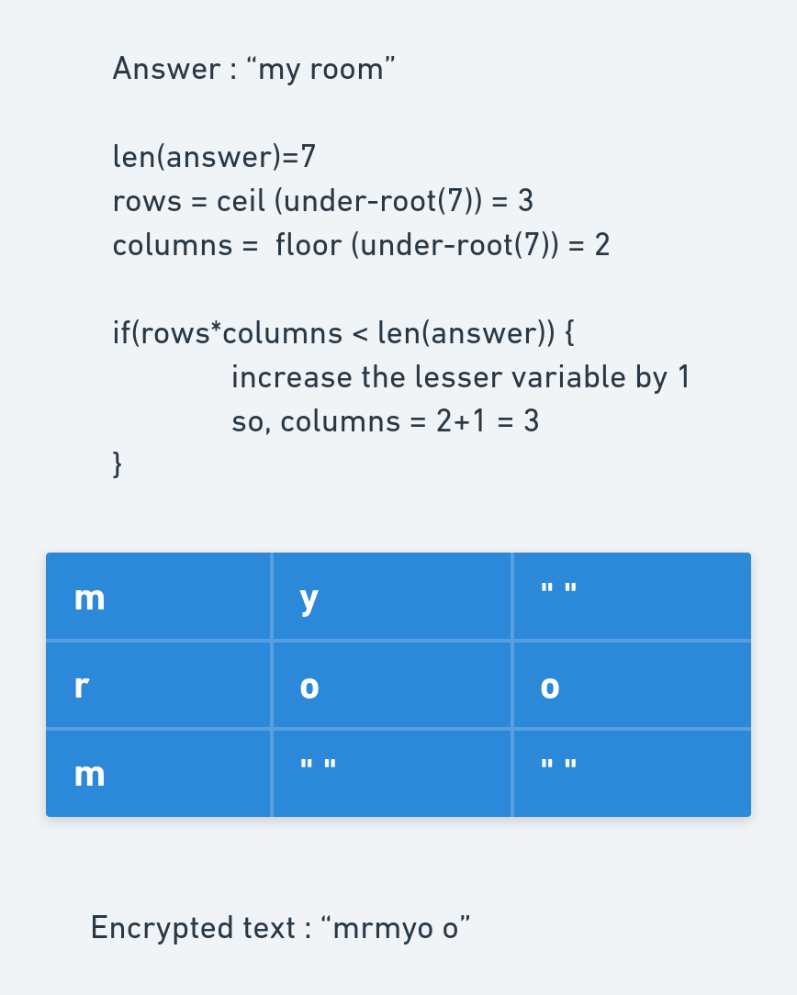
Encryption of Answers for those questions
The answers are encrypted using a 2-Dimensional matrix.
The matrix is filled with the answer column-wise and stored in the database row-wise.

Slide 10
Encrypting Candidate names the users have voted
01
Making the key
Key is obtained from decrypting the answers and then adding 1st character of every answer
02
Preparing the candidate name
This involves removing all the spaces from the names and Upper-casing the entire string
03
Vigenère Cipher
Using Vigenere Cypher to encrypt the name of the candidate being voted
04
Database Storage
Storing the encrypted information to the database hosted online.

Slide 11
03
Declaration
forensic breakthrough
Result
forensic breakthrough
Announcing the winning candidate
Involves Decryption of entire database in real-time
forensic breakthrough
forensic breakthrough
forensic breakthrough
forensic breakthrough
forensic breakthrough
forensic breakthrough

Slide 12
Different phases of computation to declare the result
Phase 1
Phase 2
Phase 3
Phase 4
Phase 5
For every user in votes table, access the his/her tuple in Questions table
Decrypt the answers from the Questions table
Make key from the answers decrypted
Decrypt the candidate name using the key
Count the votes and declare the result
Votes table and Personal_Questions table access
Decrypting Answers from matrix method
Making key using 1st char of answers
Decryption using Vigenere Cypher
Displaying the result in real-time

Slide 13
04
User Interface
forensic breakthrough
Dynamic
forensic breakthrough
forensic breakthrough
forensic breakthrough
forensic breakthrough
forensic breakthrough
forensic breakthrough
forensic breakthrough

Slide 14
Features
Querying
Redirection
Single vote
Biometric
Hostel location
Personal Questions
On login, if the user is already there in database, redirect to voting activity
If the voter has voted, don’t allow him/her to vote again
Iterate different tables everytime there’s a change in database
Wrong biometrics means no vote !
Resident of other hostel trying to vote in other lobby : not allowed !
Wrong answer of any personal question means no vote !

Slide 15
—Claude Shannon
(Father of Information Theory)
forensic breakthrough
forensic breakthrough
forensic breakthrough
forensic breakthrough
forensic breakthrough
forensic breakthrough
“The enemy knows the system”
forensic breakthrough
forensic breakthrough

Slide 16
Thanks!
Thanks!
Time for the demo !

