Slide 1
DEA GAME CROSS-EFFICIENCY APPROACH TO PORTFOLIO SELECTION
By
Sofiene Omri
Under the Supervision of
Dr. Hédi Essid
IN PARTIAL FULFILLMENT OF THE REQUIREMENTS FOR THE DEGREE OF RESEARCH MASTER IN MODELING OF INFORMATION AND DECISION SYSTEMS.
BADEM Tunis Business School Saturday 08th 2017

Slide 2
Outlines
Context & objectives
Contribution
DEA & Cross Efficiency
Game Cross Efficiency
Portfolio selection
Results and Discussion
Conclusion and limits
BADEM Tunis Business School Saturday 08th 2017

Slide 3
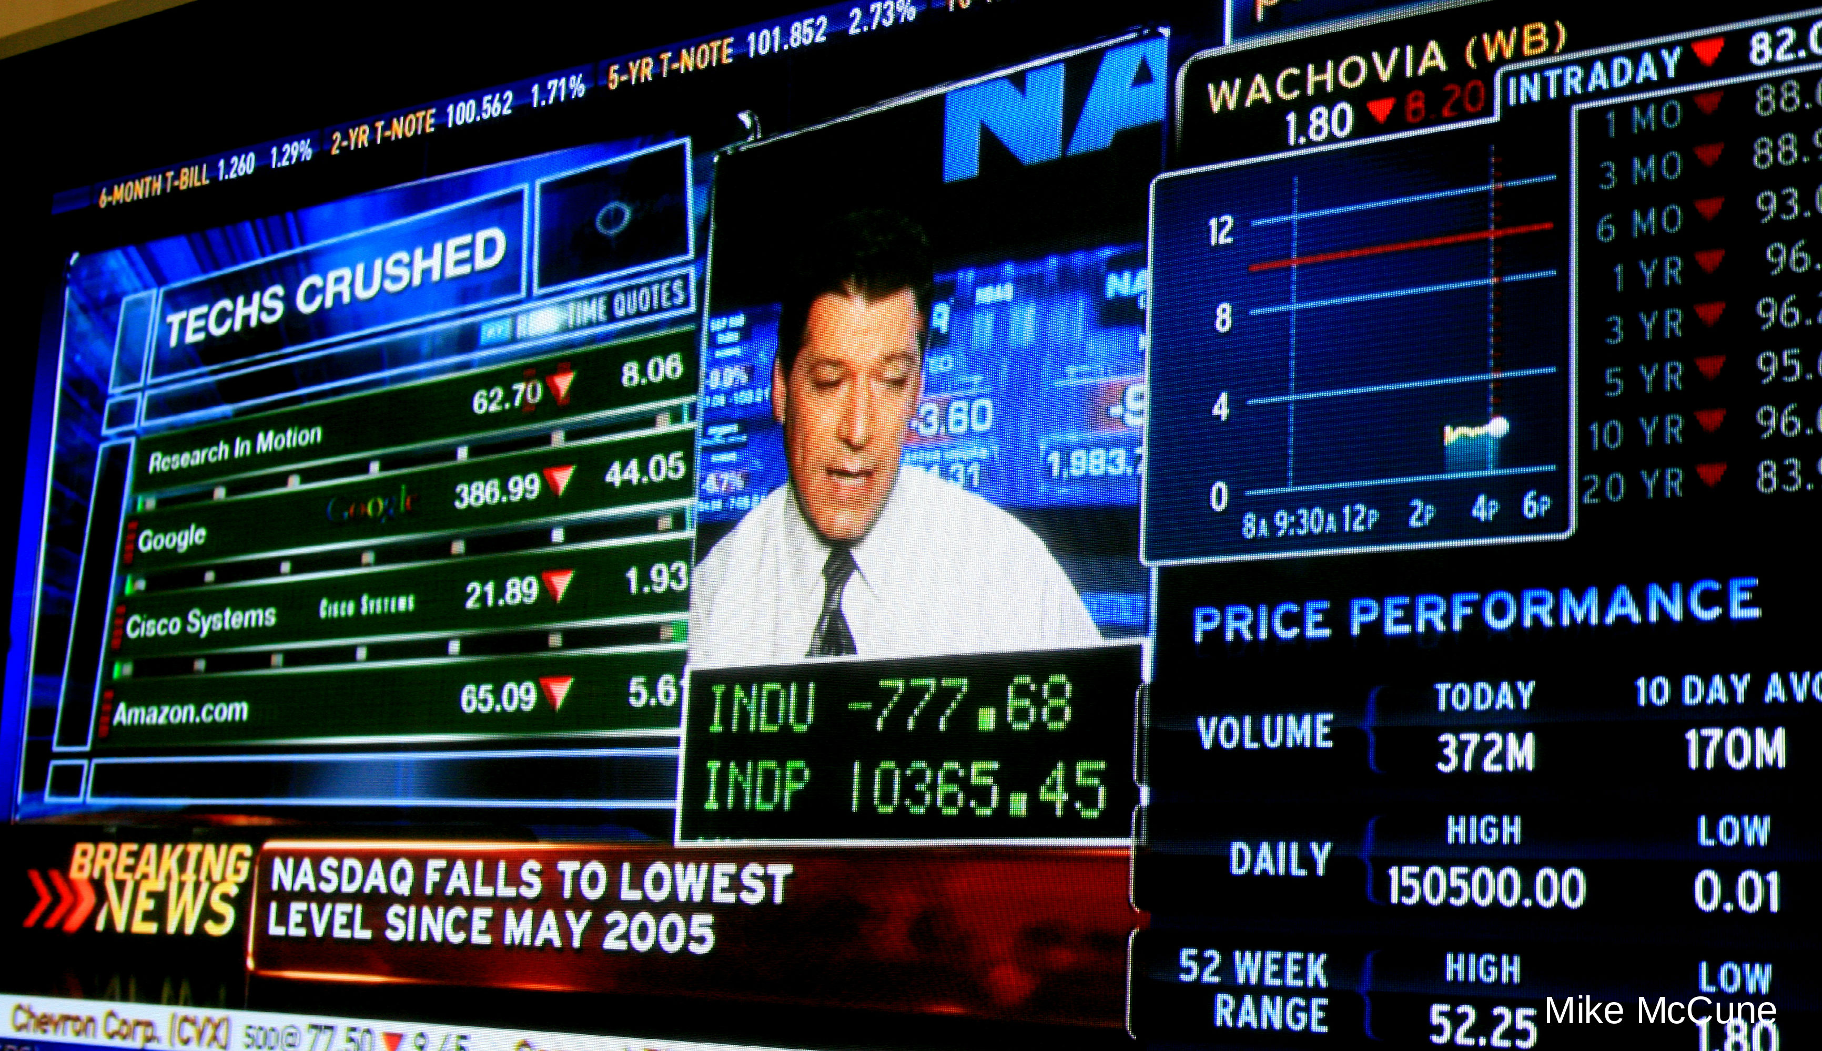
Context & objectives
“Lehman Files for Bankruptcy, Merrill Sold, AIG Seeks Cash”, The Wall Street Journal
Portfolio selection present one of the most challenging, complex and dynamic problems.
BADEM Tunis Business School Saturday 08th 2017
Notes:
Highly qualified money manager can run into difficulties making and make poor decisions.
The main problem is finding the stock portfolio which will achieve the highest possible return for a given level of risk
We examine the investment strategy based on Game Cross Efficiency which is an extension of DEA

Slide 4
Contributions
Aggregation of investor preferences into a Nash equilibrium performance indicator.
Incorporate Firms' behaviors (competition for investment Funds) as a part of portfolio selection strategy.
Incorporate the investor reserve utility
CISEM, Mahdia 2017
DEA 2017, Prague
BADEM Tunis Business School Saturday 08th 2017

Slide 5
DEA & Cross Efficiency 1/3
BADEM Tunis Business School Saturday 08th 2017

Slide 6
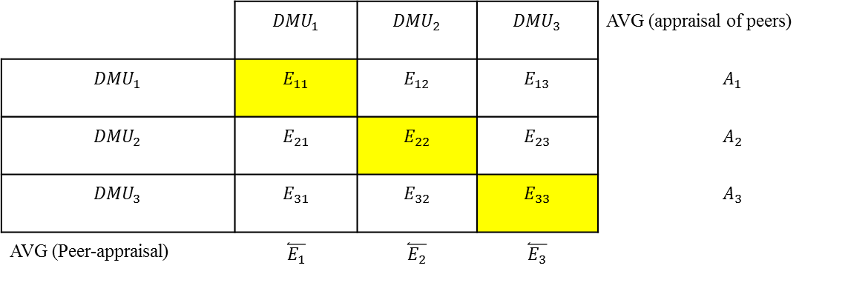
DEA & Cross Efficiency 2/3
 | $${DMU}_{1}$$ | $${DMU}_{2}$$ | $${DMU}_{3}$$ | AVG (appraisal of peers)
$${DMU}_{1}$$ | $$E_{11}$$ | $$E_{12}$$ | $$E_{13}$$ | $$A_{1}$$
$${DMU}_{2}$$ | $$E_{21}$$ | $$E_{22}$$ | $$E_{23}$$ | $$A_{2}$$
$${DMU}_{3}$$ | $$E_{31}$$ | $$E_{32}$$ | $$E_{33}$$ | $$A_{3}$$
AVG (Peer-appraisal) | $$\overset{⃐}{E_{1}}$$ | $$\overset{⃐}{E_{2}}$$ | $$\overset{⃐}{E_{3}}$$
Efficiency score of DMU 1 when evaluated
with the optimal weights of DMU 2
BADEM Tunis Business School Saturday 08th 2017

Slide 7
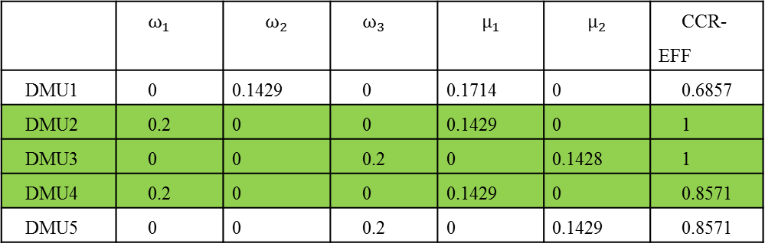
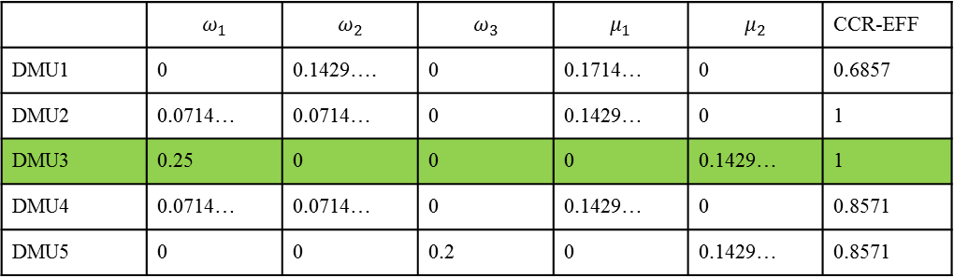
DEA & Cross Efficiency 3/3
 | $$ω_{1}$$ | $$ω_{2}$$ | $$ω_{3}$$ | $$μ_{1}$$ | $$μ_{2}$$ | CCR-EFF
DMU1 | 0 | 0.1429…. | 0 | 0.1714… | 0 | 0.6857
DMU2 | 0.0714… | 0.0714… | 0 | 0.1429… | 0 | 1
DMU3 | 0.25 | 0 | 0 | 0 | 0.1429… | 1
DMU4 | 0.0714… | 0.0714… | 0 | 0.1429… | 0 | 0.8571
DMU5 | 0 | 0 | 0.2 | 0 | 0.1429… | 0.8571
LPS output: 5 DMUs, 3 Inputs, 2 Outputs
 | $$ω_{1}$$ | $$ω_{2}$$ | $$ω_{3}$$ | $$μ_{1}$$ | $$μ_{2}$$ | CCR-EFF
DMU1 | 0 | 0.1429 | 0 | 0.1714 | 0 | 0.6857
DMU2 | 0.2 | 0 | 0 | 0.1429 | 0 | 1
DMU3 | 0 | 0 | 0.2 | 0 | 0.1428 | 1
DMU4 | 0.2 | 0 | 0 | 0.1429 | 0 | 0.8571
DMU5 | 0 | 0 | 0.2 | 0 | 0.1429 | 0.8571
SAS output: 5 DMUs, 3 Inputs, 2 Outputs
BADEM Tunis Business School Saturday 08th 2017

Slide 8

Game Cross Efficiency 1/2
$$Max Z=\sum_{r}^{s}{{μ_{rj}^{d}y}_{rj}}$$
$Subject to$ (3.2)
$\sum_{r}^{s}{μ_{rj}^{d}y_{rl}} −\sum_{i}^{m}{{ω_{ij}^{d}x}_{il}}≤0$ $∀ l=1,2,…n$
$$\sum_{i}^{m}{{ω_{ij}^{d}x}_{ij}}=1$$
$$α_{d}\sum_{i}^{m}{{ω_{ij}^{d}x}_{id}}−\sum_{r}^{s}{μ_{rj}^{d}y_{rd}} ≤0$$
$$μ_{rj}^{d}≥0 ∀ r=1,2,…s,$$
$$ω_{ij}^{d}≥0 ∀ i=1,2,…m,$$
Payoffs
Strategy set
Ensure the Non-deviation from the Nash equilibrium solution
BADEM Tunis Business School Saturday 08th 2017

Slide 9
Game Cross Efficiency 2/2
Simple Average Cross Efficiency
Stopping condition
BADEM Tunis Business School Saturday 08th 2017
Notes:
The constructed portfolio will be revised at the end of each investment horizon
Fixed portfolio size of 50 with the same dollar amount being invested in each of the stocks.

Slide 10
Portfolio Selection: A DEA Approach
Production-DEA
Multicriteria-DEA
Inputs/outputs choices exhibit the characteristics of a production process.
Investment expenses and undesirable outcomes as inputs
Desired outcomes as outputs
Controversy in defining a Financial production system
To be minimized attributes as inputs
To be maximized ones as outputs
Aggregating multi performance measure
Ignores the basic assumption of DEA
BADEM Tunis Business School Saturday 08th 2017
Notes:
A bare of the DEA-portfolio literature reveals on the one hand, that several investment expenses and undesirable outcomes have been the corner stone of input choice.

Slide 11
Portfolio Construction
Data & Selection Strategy
Inputs/outputs Selection
We report a case study involving 490 ~507 firms from the Paris Exchange over 6 year period (2010-2015)
Buy & hold Strategy
1 year time horizon
Equi-investement
Mean
Variance
Prudence: Skewness
Temperance: Kurtosis
Solve for efficiency scores and select the best 30 stocks to be included in each portfolio.
BADEM Tunis Business School Saturday 08th 2017
Notes:
We check the completeness of the monthly stock return information and include only those firms without missing values in the sample.
The problem can be casted in a “Multicriteria-DEA” framework through taking the to be minimized attributes as inputs or expected costs and that to be maximized as outputs or expected benefits
In terms of probability mass, kurtosis represents the reallocation of dispersion from the center, thus creating more peaks and more prominent tails. (Menezes & Wang, 2005) showed that temperance can be characterized as outer risk and temperate individuals are outer risk averse. They dislike reallocation of probability mass to the tails.
Prudence, which is characterized by preference for skewness, was associated by (Menezes, Geiss, & Tressler, 1980) as being analogous to an aversion to “increase in downside risk”.
a prudent investor would prefer skewness, in hope to minimize downside risk.

Slide 12
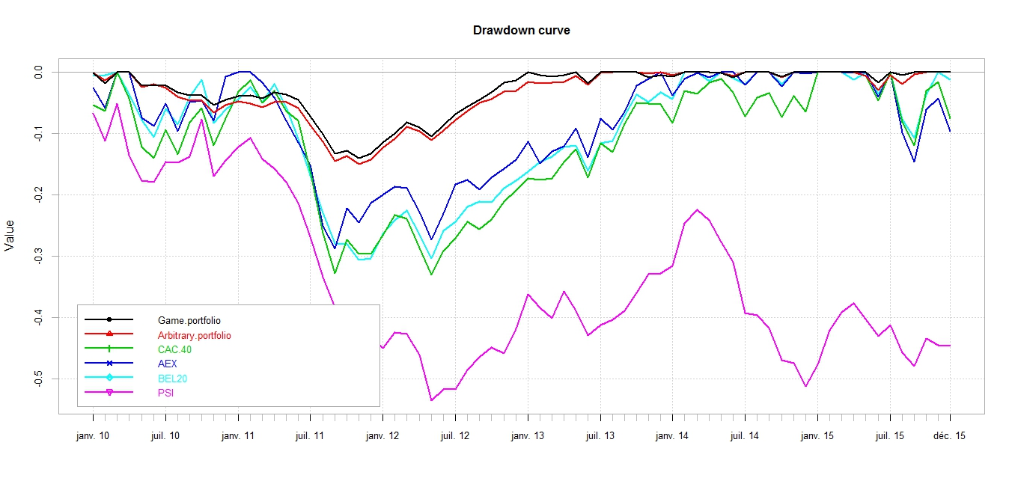
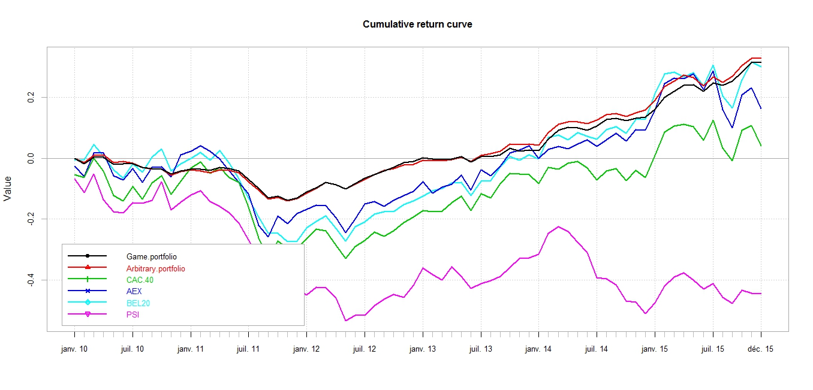
Results and Discussion
Performance Summary (K=30)
BADEM Tunis Business School Saturday 08th 2017
Notes:
The game portfolio yields higher risk-adjusted returns the DEA and DEA-Cross Efficiency ones.
Performs far more better than the leading Euronext Benchmark portfolios.
while having a maximum drawdown of -0.12 compared to CAC40 (-0.28), AEX (-0.22), BEL20 (-0.25) and PSI20 (-0.48). Furthermore figure (4.3), demonstrates that “Game Portfolio” has lower and more stable drawdown compared to “Arbitrary Portfolio”. In addition, our portfolio still performs quite good relatively (given drawdown) to the cumulative return which is similar to that of the “Arbitrary Portfolio” until the end of 2013, then the “Game Portfolio” experiences a minor drop down till the end of 2015.

Slide 13
Results and Discussion
VS |  | CAC 40 | AEX | BEL20 | PSI20 | Game Cross | Arbitrary Portfolio
Game | Difference | 0.2282 | 0.1938 | 0.1489 | 0.3832 | --------- | 0.0026
 | P value | (0.087) * | (0.2244) | (0.1722) | (0.0788) ** | --------- | (0.9398)
Arbitrary | Difference | 0.2256 | 0.1912 | 0.1463 | 0.3806 | -0.0026 | ---------
 | P value | (0.0768) * | (0.175) | (0.167) | (0.0482) ** | (0.9392) | ---------
Tow sided Sharpe difference test [Significance level 1%***, 5%**, 10%*]: the Studentized Circular Block Bootstrap (B=10. M=4999)
BADEM Tunis Business School Saturday 08th 2017

Slide 14
Results and Discussion
2013
 | Arbitrary | Rank | Game cross | Rank G
EULER HERMES GROUP | 0,979 | 1 | 1 | 1
MAROC TELECOM | 0,7624 | 2 | 0,8447 | 2
TURENNE INV | 0,7453 | 3 | 0,8299 | 3
VIEL ET COMPAGNIE | 0,6872 | 4 | 0,8093 | 4
HI-MEDIA | 0,6616 | 5 | 0,7232 | 5
RUBIS | 0,6099 | 6 | 0,6736 | 6
VETOQUINOL | 0,6008 | 7 | 0,6512 | 7
QUANTEL | 0,57 | 9 | 0,643 | 8
EUROGERM | 0,5397 | 13 | 0,641 | 9
UNIBAIL-RODAMCO | 0,5434 | 12 | 0,6238 | 10
CIC | 0,5784 | 8 | 0,6146 | 11
PROCTER GAMBLE | 0,563 | 10 | 0,6016 | 12
AIR LIQUIDE | 0,5178 | 16 | 0,5899 | 13
LEGRAND | 0,5572 | 11 | 0,5884 | 14
GROUPE PARTOUCHE | 0,4993 | 21 | 0,5833 | 15
NETBOOSTER | 0,4513 | 25 | 0,5736 | 16
SCOR SE | 0,5037 | 19 | 0,5694 | 17
AXA | 0,5247 | 15 | 0,5556 | 18
ATOS | 0,5109 | 17 | 0,5547 | 19
BADEM Tunis Business School Saturday 08th 2017
Notes:
However, a major shortcoming of this approach is the lack of investor control over the expected return. Indeed, a rational investor would have a reserve utility, in other words he would want to set a minimum expected return level. This motivates our development of a Mean Cross (MC) framework of portfolio selection based on DEA game cross efficiency evaluation, in which we seek to maximize the overall portfolio efficiency score subject to a tradeoff level of expected return, which will be detailed in the subsequent section

Slide 15
Results and Discussion
Wilcoxon Signed-Rank Test “Game Cross Efficiency ranking” vs “Annual return based ranking”
BADEM Tunis Business School Saturday 08th 2017
Notes:
However, a major shortcoming of this approach is the lack of investor control over the expected return. Indeed, a rational investor would have a reserve utility, in other words he would want to set a minimum expected return level. This motivates our development of a Mean Cross (MC) framework of portfolio selection based on DEA game cross efficiency evaluation, in which we seek to maximize the overall portfolio efficiency score subject to a tradeoff level of expected return, which will be detailed in the subsequent section

Slide 16

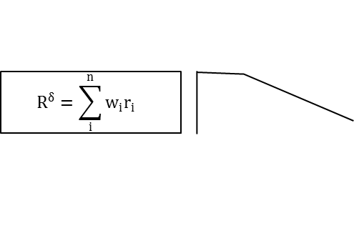
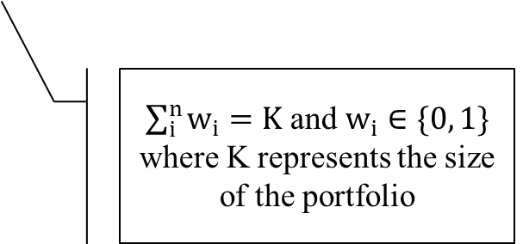
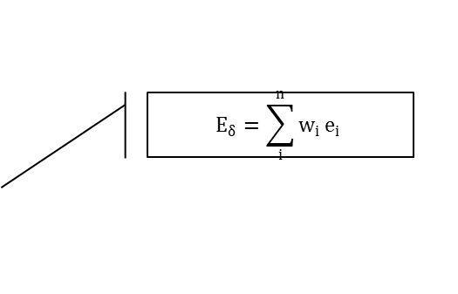
Mean Cross Portfolio
$$E_{δ}=\sum_{i}^{n}{w_{i}}e_{i}$$
$$max E_{δ}$$
$Subject to R^{δ}≥(1−γ)R_{m}^{δ}$
$$\sum_{i}^{n}{w_{i}}=1$$
$$w_{i}≥0, i=1…n$$
$$R^{δ}=\sum_{i}^{n}{w_{i}r_{i} }$$
Maximum achievable returns
$\sum_{i}^{n}{w_{i}}=K$ and $w_{i}∈\{0, 1\}$ where K represents the size of the portfolio
BADEM Tunis Business School Saturday 08th 2017

Slide 17
Results and Discussion
Performance Summary
BADEM Tunis Business School Saturday 08th 2017

Slide 18
Results and Discussion
VS |  | CAC 40 | AEX | BEL20 | PSI20 | Game Portfolio | Arbitrary Portfolio
γ=10% | Difference | 1.1383 | 1.1039 | 1.059 | 1.2933 | 0.9101 | 0.9127
 | P value | (0.0016) *** | (0.004) *** | (0.0078) *** | (0.0018) *** | (0.008) *** | (0.0098) ***
γ=20% | Difference | 1,0804 | 1,046 | 1,0011 | 1,2354 | 0,8522 | 0,8548
 | P value | (0.0104) ** | (0.0204) ** | (0.0258) ** | (0.0084) *** | (0.0346) * | (0.0598) *
γ=30% | Difference | 0.9011 | 0.8667 | 0.8218 | 1.0561 | 0.6729 | 0.6755
 | P value | (0.1258) | (0.1826) | (0.332) | (0.0692) ** | (0.378) | (0.3938)
Game | Difference | 0.2282 | 0.1938 | 0.1489 | 0.3832 | --------- | 0.0026
 | P value | (0.087) * | (0.2244) | (0.1722) | (0.0788) ** | --------- | (0.9398)
Arbitrary | Difference | 0.2256 | 0.1912 | 0.1463 | 0.3806 | -0.0026 | ---------
 | P value | (0.0768) * | (0.175) | (0.167) | (0.0482) ** | (0.9392) | ---------
Tow sided Sharpe difference test
BADEM Tunis Business School Saturday 08th 2017

Slide 19
Conclusion & Future research
Developed a new approach of using DEA Game cross-efficiency evaluation in portfolio selection.
Traditional use of DEA doesn’t not incorporate Firms Behaviors (competition)
DEA game Cross Efficiency Can be a promising tool for portfolio selection
Aggregate performance indicators
A major shortcoming of this study is the neglection of game cross efficiency variation
Well definition of the so called financial production system
BADEM Tunis Business School Saturday 08th 2017

Slide 20
DEA GAME CROSS-EFFICIENCY APPROACH TO PORTFOLIO SELECTION
By
Sofiene Omri
Under the Supervision of
Dr. Hédi Essid
IN PARTIAL FULFILLMENT OF THE REQUIREMENTS FOR THE DEGREE OF RESEARCH MASTER IN MODELING OF INFORMATION AND DECISION SYSTEMS.
BADEM Tunis Business School Saturday 08th 2017

Slide 21
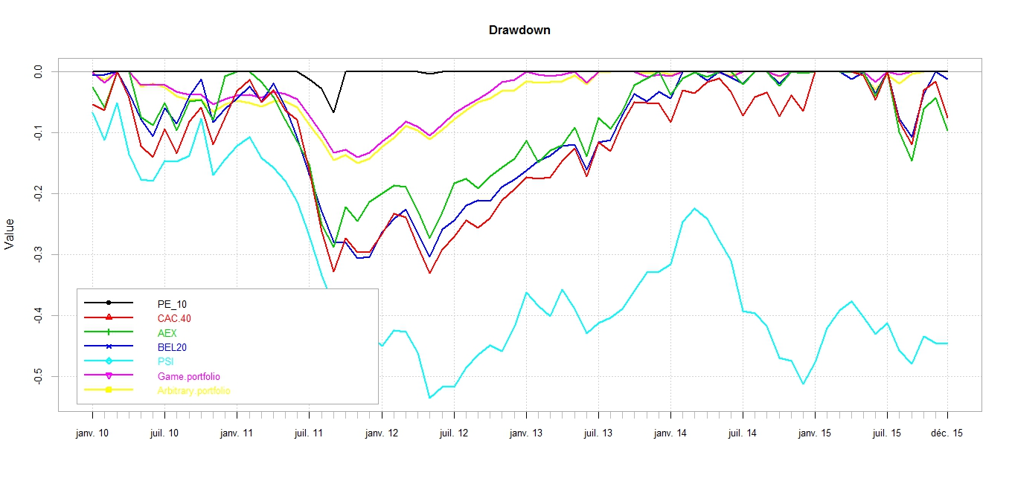
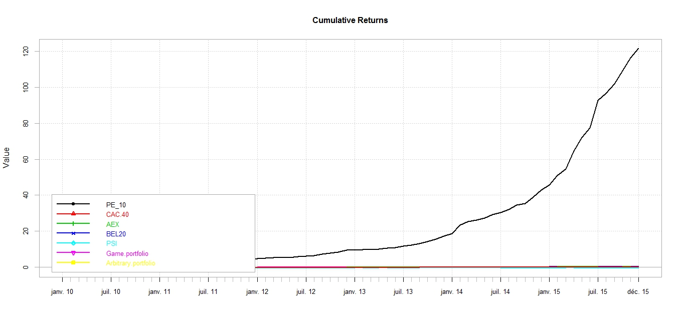
Backup

Slide 22

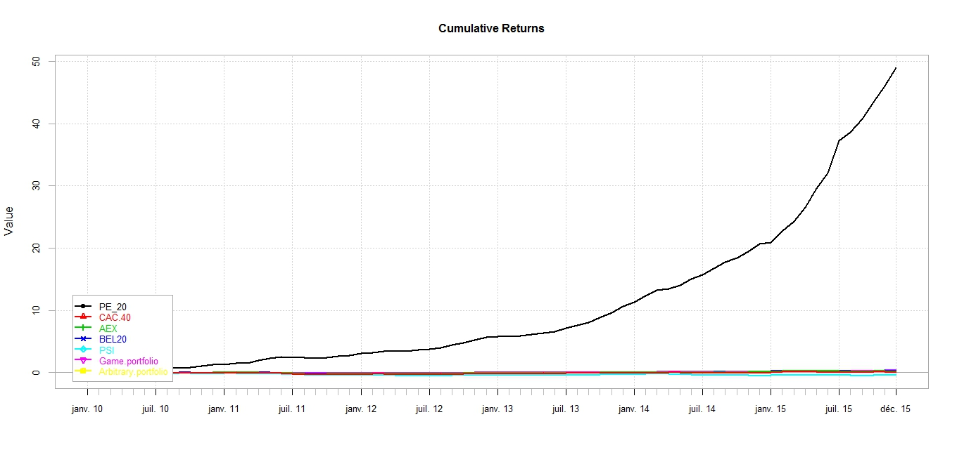
Backup

Slide 23

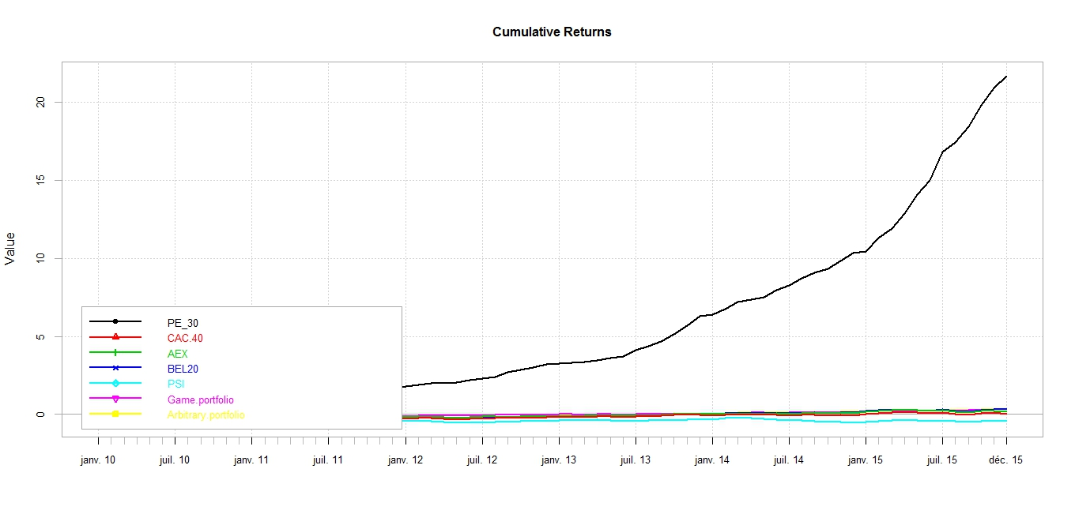
Backup

