Slide 1
Secure Data Hiding In Images Using Steganography
CAPSTONE PROJECT
Presented By:
Om Tiwari
St. Andrew’s Institute of Technology & Management / Artificial Intelligence & Machine Learning
AICTE Internship Student Registration ID :
STU676842cb432331734886091

Slide 2
OUTLINE
Problem Statement
Technology used
Wow factor
End users
Result
Conclusion
Git-hub Link
Future scope

Slide 3
Problem Statement
In today's digital age, the risk of confidential data leakage is a significant concern. To address this issue, the project aims to develop an effective steganographic system capable of concealing sensitive information within digital images. By embedding data covertly into images, the system ensures that the hidden information remains undetectable to unauthorized users, thereby enhancing data confidentiality and mitigating the risks associated with data leakage.

Slide 4
Technology used
Programming Language: Python
Libraries:
OpenCV for image processing
Tkinter (with ttk) for the GUI
NumPy for efficient array manipulation
Platform: Windows 11
Tools: Visual Studio Code

Slide 5
Wow factors
Implements robust LSB steganography that embeds both the passcode and message length in the image header.
Uses lossless PNG format to preserve hidden data integrity.
Features a modern, user-friendly GUI for both encryption and decryption processes.
Combines advanced image processing techniques with secure data transmission.

Slide 6
End users
Government Agencies: For securely transmitting classified information.
Businesses: To protect sensitive corporate data and intellectual property.
Healthcare Providers: For safeguarding patient records and confidential medical information.
Military: For secure communication and strategic information sharing.
Journalists: To protect sources and sensitive data.
Financial Institutions: For secure transmission of financial data.
Individuals: For personal data security and privacy in digital communication.
Digital Forensics Experts: For investigating digital crimes without alerting suspects.

Slide 7
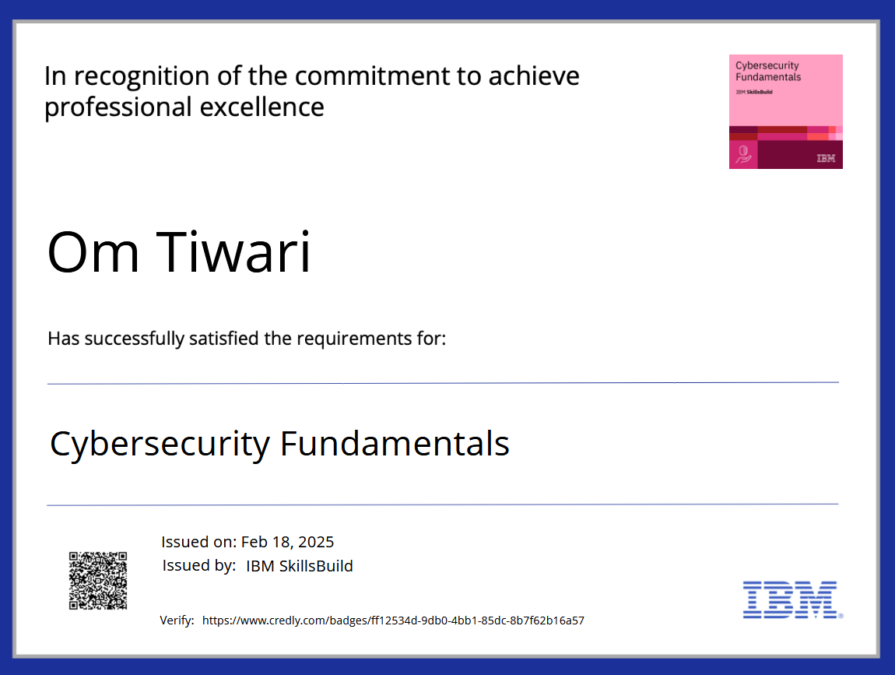
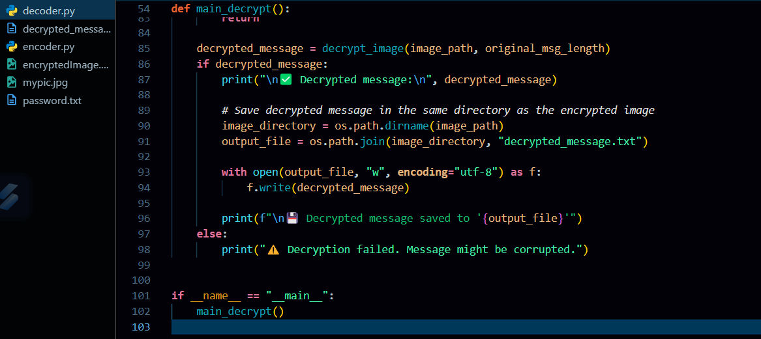
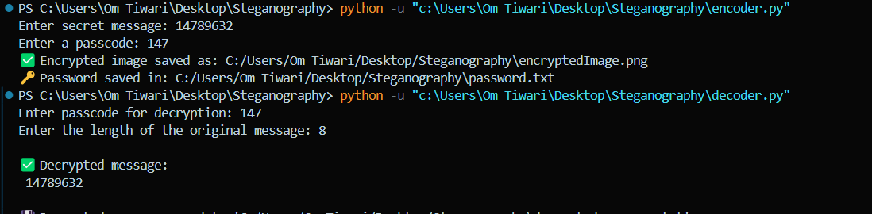

Results

Slide 8
Conclusion
Our project successfully demonstrates a novel approach to data security by hiding information within an image using LSB steganography.
The technique is both secure and undetectable, thanks to embedding critical header information such as passcode and message lengths.
The user-friendly GUI enhances the accessibility of the method, making it a practical tool for secure communication.
This project contributes to the broader field of digital privacy and secure data transmission.

Slide 9
GitHub Link
https://github.com/OmTiwari-1/MySter.git

Slide 10
Future scope(optional)
Support for multiple image formats and higher resolution images.
Extend the approach to video steganography for dynamic data hiding.
Incorporate advanced encryption algorithms to further secure the hidden message.
Develop a web-based or mobile application for broader accessibility.
Explore automated detection and extraction tools for steganographic content.

Slide 11
THANK YOU

