Slide 1
University Management System
Group Members:
Omaima Sarfaraz
Mariam Salman

Slide 2
Introduction
What is it?
A C++ program to manage students, courses, and attendance.
Purpose:
Simplify record-keeping and attendance tracking.
Key Features:
User authentication
Student and course management
Attendance marking and viewing

Slide 3
Features Overview
1. User Authentication:
Ensures only authorized users can access the system.
2. Student Management:
Add, view, and save student records.
3. Course Management:
Add, view, and save course details.
4. Attendance Tracking:
Mark and view attendance for students.
5. File Handling:
Data persistence through text files.

Slide 4
Technology Used
Programming Language: C++
Key Concepts:
File handling
Structures
Arrays
Loops and conditional statements
Modular programming

Slide 5
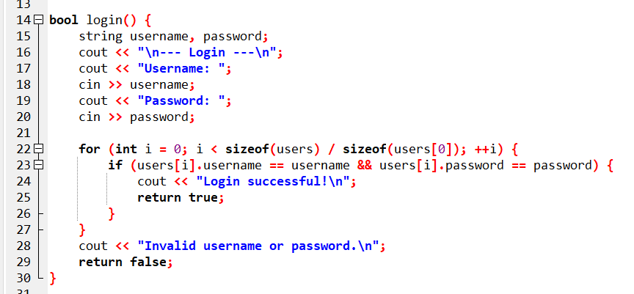
Code Walkthrough - User Authentication
Purpose: Restricts access to authorized users.
Key Code:

Slide 6
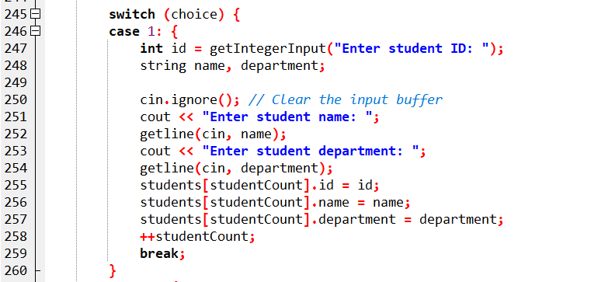
Adding Students
Purpose: To allow administrators to efficiently add new students by capturing their ID, name, and department, and storing this information in the system.
Key Code:

Slide 7
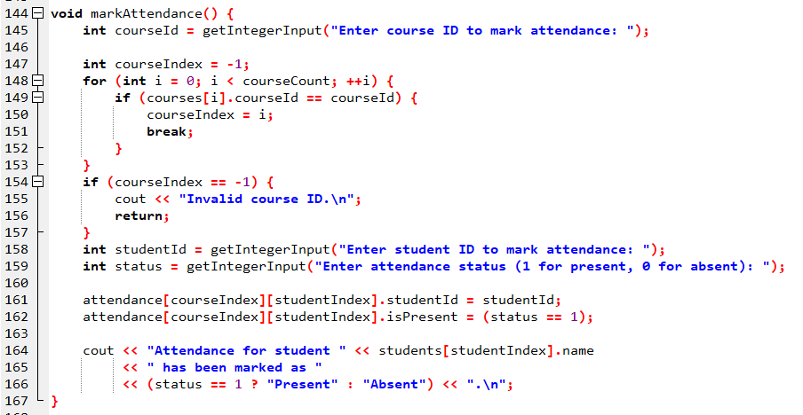
Marking Attendance
Purpose: Tracks attendance status for each student in a course.
Key Code:

Slide 8
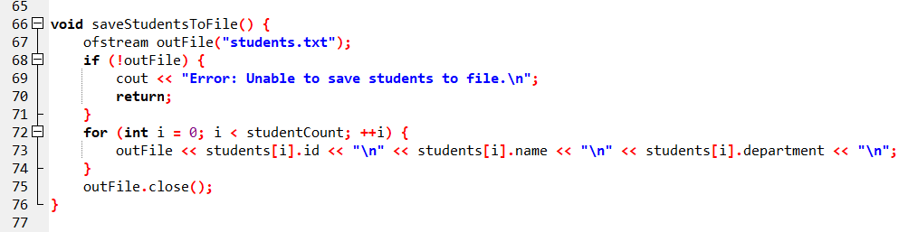
File Handling
Purpose: Saves and loads data to ensure persistence.
Example: Saving Students to File

Slide 9
Program Flow
Login: Authenticates the user.
Menu: Displays options to manage students, courses, and attendance.
File Operations: Ensures data is saved and loaded correctly.
Repeat: Allows the user to perform multiple operations until exiting.

Slide 10
Demo
Steps:
Login as admin.
Add students and courses.
Mark attendance for a course.
View attendance records.
Save and exit the program.

Slide 11
Conclusion
The University Management System simplifies academic record management.
Combines core programming concepts to build a functional application.
Offers opportunities for future enhancements.

Slide 12
Thank You!

