Slide 1
File System Implementation

Slide 2
File System Implementation
File-System Structure
File-System Implementation
Allocation Methods
Free-Space Management
Efficiency and Performance
Recovery

Slide 3
Objectives
To describe the details of implementing local file systems and directory structures
To describe the implementation of remote file systems
To discuss block allocation and free-block algorithms and trade-offs

Slide 4
File-System Structure
File structure
Logical storage unit
Collection of related information
File system resides on secondary storage (disks)
I/O transfers between memory and disks are performed in units of blocks
File control block (FCB) – storage structure consisting of information about a file
Device driver - controls the physical device
Disks have 2 important characteristics:
They can be rewritten in place
We can access directly any given block of information on the disks

Slide 5
File system organization
To provide an efficient and convenient access to the disks, the operating system imposes a file system to allow the data to be stored, located, and retrieved easily.
File system poses 2 different design problems :
Defining how the file system should look to the user
This involves defining of a file and its attributes, operations, the directory structure etc
Algorithms and data structures must be created to map the logical file system onto the physical secondary- storage devices.
File system is itself composed of many different levels
Each level in the design uses the features of lower levels to create new features for use by higher levels

Slide 6
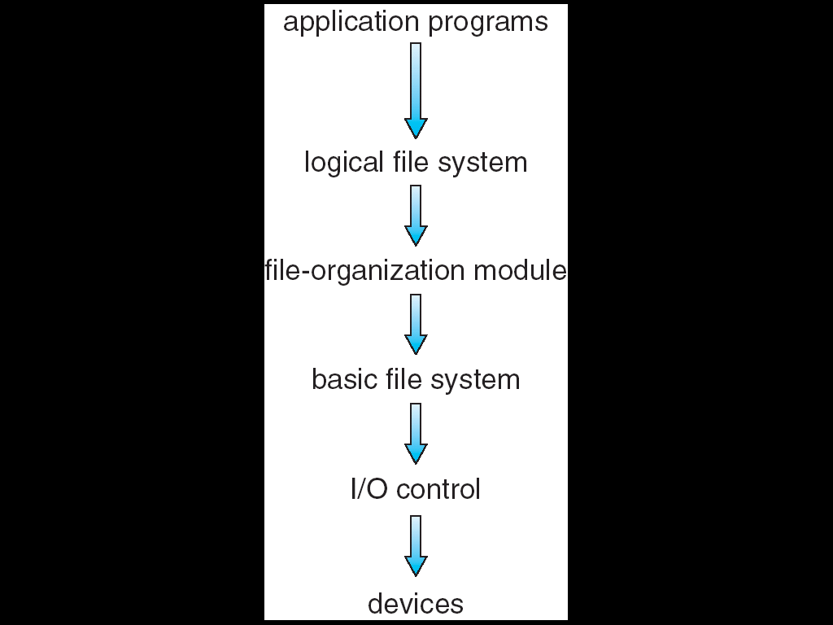
File system organization
Layered file system

Slide 7
File system organization
I/O control
lowest level
consists of device drivers and interrupt handlers to transfer information between the memory and the disk system
Basic file system
issues generic commands to the appropriate device driver to read and write physical blocks on the disks
Also manages memory buffers and caches (allocation, freeing, replacement)
Buffers hold data in transit
Caches hold frequently used data

Slide 8
File system organization
File organization module
knows about files and their logical blocks, as well as physical blocks, which helps them to translate logical block addresses to physical block addresses for basic file system to transfer
Logical file system
Uses the directory structure to provide the file organization module with the information that it needs, given the symbolic file name
Directory management
Also responsible for protection and security

Slide 9
File Systems are many
Many file systems, sometimes many within an operating system
Each with its own format
(CD-ROM is ISO 9660;
Unix has UFS, FFS;
Windows has FAT, FAT32, NTFS as well as floppy, CD, DVD Blu-ray
Linux has more than 130 types, with extended file system ext3 and ext4 leading; plus distributed file systems, etc.)
New ones still arriving – ZFS, GoogleFS, Oracle ASM, FUSE

Slide 10
File system mounting
A file must be opened before it is used, a file system must be mounted before it can be available to processes on the system
Procedure for mounting:
Operating system is given the name of the device, and the location within the file structure at which to attach the file system ( called mount point)
Example: on UNIX -- /home
/home/ jaikishan
Operating system verifies that device contains a valid file system
It does so by asking the device driver to read the device directory and verifying that the directory has the expected format
Operating system notes in its directory structure that a file system is mounted at the specified mount point

Slide 11
Allocation Methods
An allocation method refers to how disk blocks are allocated for files:
Types of allocation
Contiguous allocation
Linked allocation
Indexed allocation

Slide 12
Contiguous Allocation
Each file occupies a set of contiguous blocks on the disk
Simple – only starting location (block #) and length (number of blocks) are required
Accessing block b + 1 after block b normally requires no head movement
Contiguous allocation of a file is defined by the disk address and length ( in block units) of the first block
The directory entry for each file indicates the address of the starting block and the length of the area allocated for this file
Accessing a file that has been allocated contiguously is easy:
for sequential access, the file system remembers the disk address of the last block referenced and whenever necessary reads the next block
for direct access to block i of a file that starts at block b, we can immediately access block b + i

Slide 13
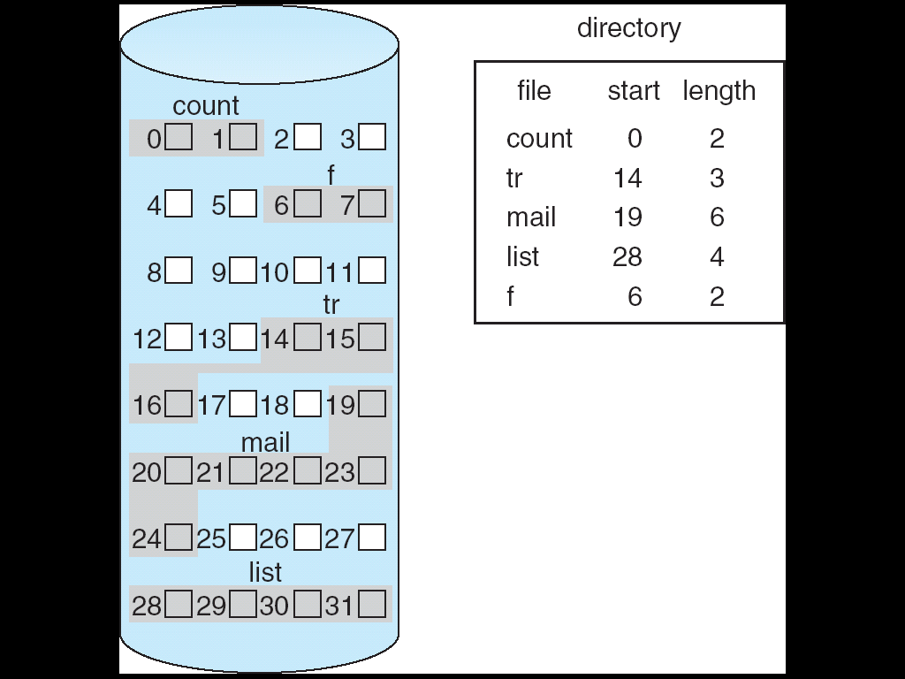
Contiguous Allocation of Disk Space

Slide 14
Contiguous allocation - Disadvantages:
Finding space for a new file
It can be seen as general dynamic storage allocation problem, which is how to satisfy a request of size n from a list of free holes
First fit and best fit are the most common strategies
External fragmentation
Exists whenever free space is broken into chunks
Some older systems used contiguous allocation on floppy disks.
This effectively compacts all the free space into one contiguous space, solving fragmentation problem
Cost of compaction is time --- it may take hours and may be weeks
Normal system operation cannot continue during this down time, so compaction is avoided
Major problem is determining how much space is needed for a file

Slide 15
Contiguous allocation
To avoid all the drawbacks some newer file systems (i.e. VERITAS File System) use a modified contiguous allocation scheme
Contiguous chunk of space is allocated initially, and then, when that amount is not large enough, another chunk of contiguous space, an extent, is added to the initial chunk of contiguous space
The location of a files blocks is then recorded as a location and a block count, plus a link to the first block of next extent

Slide 16
Linked Allocation
Data
ptr
Data
ptr
Data
ptr
1 block
Each file is a linked list of disk blocks: blocks may be scattered anywhere on the disk.
Directory contains a pointer to the first and last blocks of the file.
Pointers are not made available to the user

Slide 17
Linked Allocation
Data
ptr
Data
ptr
Data
ptr
1 block
To create a new file we simply create a new entry in the directory
With linked allocation each directory has a pointer to the first disk block of the file ---initialized to 0, the size field is also set to 0
Write to the file causes a free block to be found, and this block is written to, and linked to the end of the file
To read a file, we simply read blocks by following the pointers from block to block

Slide 18
Linked Allocation
Advantages:
No external fragmentation. Any free block on the free-space list can be used to satisfy the request
No need to declare the size of a file when it is created
A file can continue to grow as long as there are free blocks
There is no necessary to compact disk space
Disadvantages:
Can be used effectively only for sequential-access files. To find i^{th} block of a file, start from the beginning and follow the pointers until i^{th} block
Space required for the pointers
User solution to this problem is to collect blocks into multiples, called clusters
reliability

Slide 19
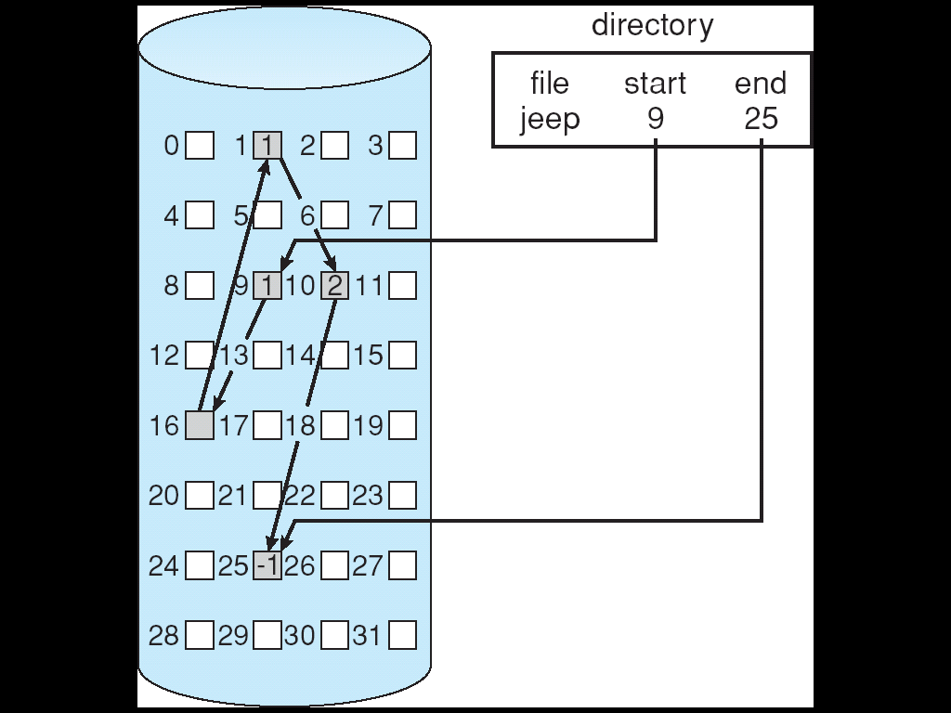
Linked Allocation of disk space

Slide 20
File-Allocation Table(FAT)
An important variation on linked allocation is FAT
Simple and efficient method of disk-space allocation used by the MS-DOS and OS/2 OS
A section of disk at the beginning of each partition is set aside to contain the FAT
FAT has one entry for each disk block, and is indexed by block number
The directory entry contains the block number of the first block of the file
FAT entry is indexed by that block number that contains the block number of the next block in the file
Chain continues until last block
Last block has a special entry
Unused blocks are indicated by a 0 table value

Slide 21
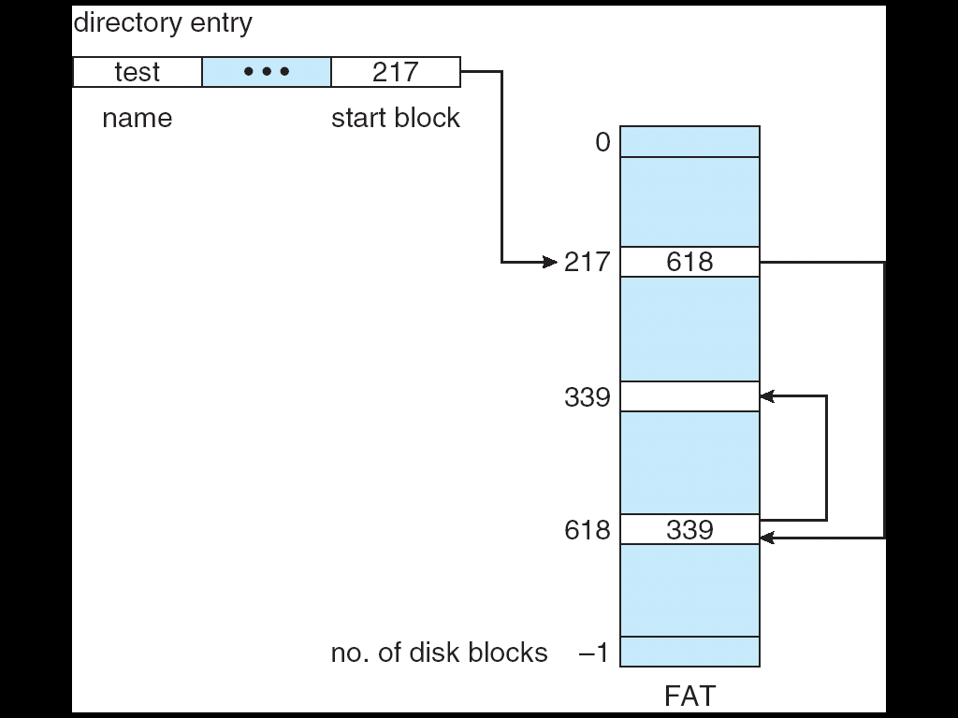
File-Allocation Table

Slide 22
Indexed Allocation
Linked allocation solves external fragmentation and size-declaration problems of contiguous allocation
It cannot support efficient direct access, since the pointers to the blocks are scattered with the blocks themselves all over the disk and need to be retrieved in order
Indexed allocation solves this problem by bringing all pointers together into one location : the index block
Each file has its own index block, which is an array of disk-block addresses
The i^{th} entry in the index block points to i^{th} block of the file
Directory contains the address of the index block
When file is created, all pointers in the index block are set to nil
When i^{th} block is first written, a block is obtained from the free-space manager, and its address is put in the i^{th} index block entry

Slide 23
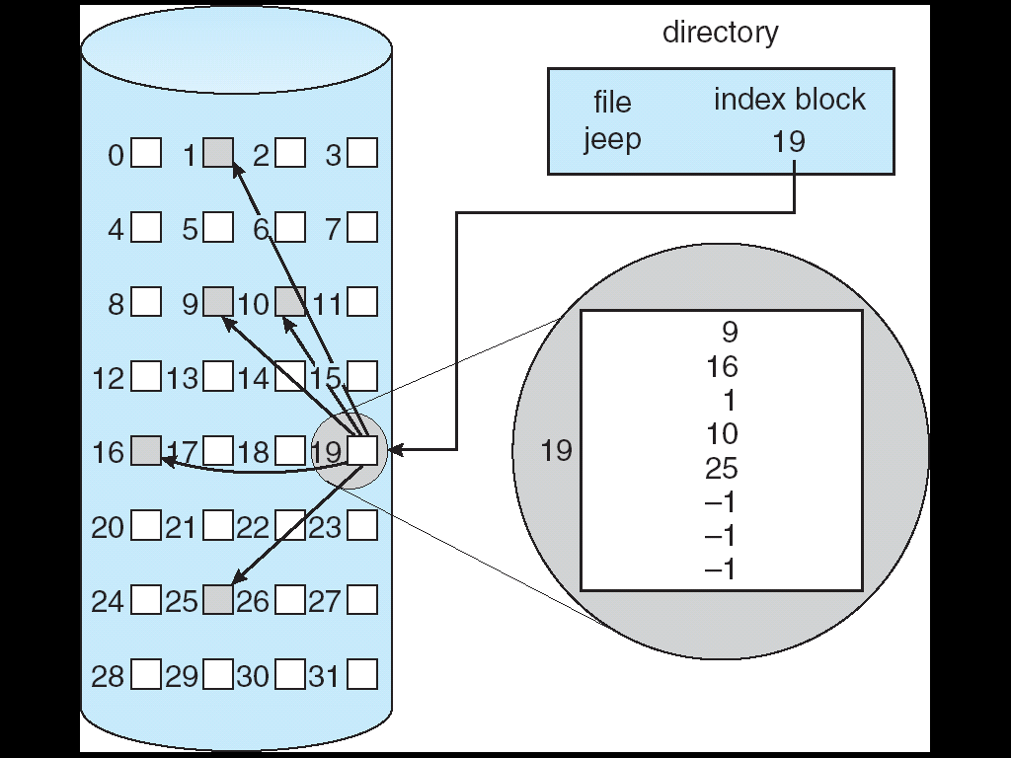
Example of Indexed Allocation

Slide 24
Indexed Allocation
Advantages:
Supports direct access
No external fragmentation
Any free block on the disk can satisfy a request for more space
Disadvantages:
Suffers from wasted space
The pointer overhead of the index block is generally greater than the pointer overhead of linked allocation
An entire index block must be allocated, even if only one or two pointers will be non-nil

Slide 25
Indexed Allocation
How large the index block should be?
Small files —> as small as possible
Large files —> as large as needed
Mechanisms to deal with size of index
Linked Scheme
Multilevel index
Combined Scheme

Slide 26
Indexed Allocation
Linked scheme:
An index block is normally one disk block
Can be read and written directly by itself
For large files, we may link together several index blocks
Multilevel index:
Use separate index block to point to index blocks, which point to the file bocks themselves
To access a block, the OS uses the first level index to find second level index to find the desired data block.
Combined scheme:
Keep the first n pointers of the index block in the files index block ( or inode)

Slide 27
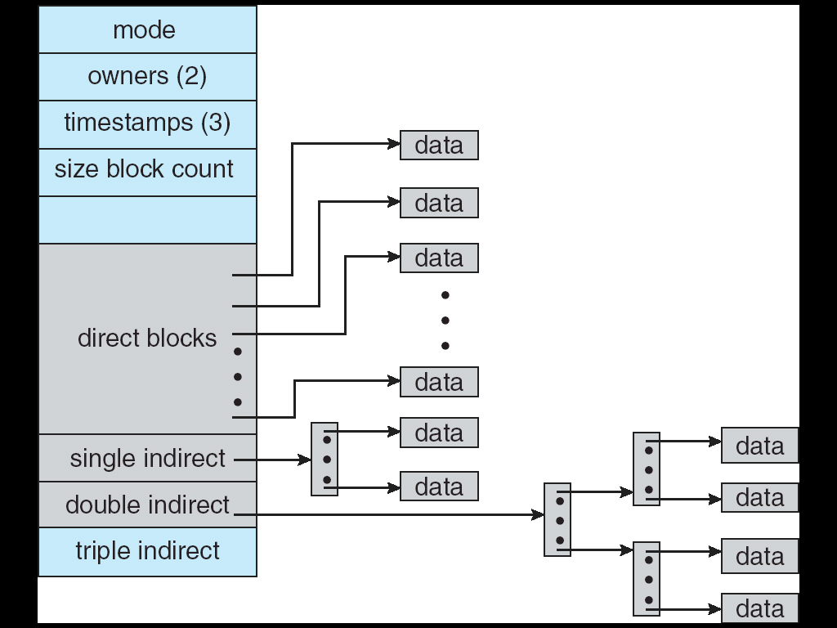
Combined Scheme: UNIX (4K bytes per block)

Slide 28
Free-Space Management
To keep track of free disk space, the system maintains a free-space list
Free-space list records all disks blocks that are free – those are not allocated to some file or directory
To create a file :
Search the free space list for the required amount of space, and allocate the space to the new file
This space is then removed from the free-space list
Implementation of Free Space List
Bit vector 2. Linked List 3.Grouping 4. Counting
1. Bit vector
Free space list is implemented as a bit map or bit vector
Each block is represented by 1 bit.
If block is free, bit is 1; if allocated, bit is 0

Slide 29
Free-Space Management
0
1
2
n-1
…

1 ⇒ block[ i ] free
0 ⇒ block[ i ] occupied
Bit [ i ] =
Main advantage is that it is relatively simple and efficient to find the first free block, or n consecutive free blocks on the disk
Sequentially check each word in the bit map to see whether that value is non zero. First non zero word scanned for first 1 bit, which is the location of the first free block

Slide 30
Free-Space Management
0
1
2
n-1
…

1 ⇒ block[ i ] free
0 ⇒ block[ i ] occupied
Bit [ i ] =
Block number calculation :
(number of bits per word) * (number of the 0-value words) + offset of first 1 bit
Main advantage is that it is relatively simple and efficient to find the first free block, or n consecutive free blocks on the disk
Sequentially check each word in the bit map to see whether that value is non zero. First non zero word scanned for first 1 bit, which is the location of the first free block

Slide 31
Free-Space Management
Disadvantage is that – bit vectors are inefficient unless the entire vector is kept in main memory and written to disk occasionally for recovery needs
Keeping in main memory is possible for smaller disks, but not for larger ones
Bit map requires extra space
Example:
block size = 1 KB = 1024 bytes
disk size = 40GB = 41943040 KB = 41943040 blocks
So, 41943040 bits are required to represent it in bitmap
i.e., 41943040 / 8 = 5242880bytes =5120kb=5mb
5 MB extra space is required for keeping bit map

Slide 32
Free-Space Management
2. Linked list:
Link together all the free disk blocks, keeping a pointer to the first free block in a special location on the disk and caching it in memory
First block contains a pointer to the next free disk block, and soon
Disadvantages :
Not efficient to traverse the list, we must read each block, which requires substantial I/O time

Slide 33
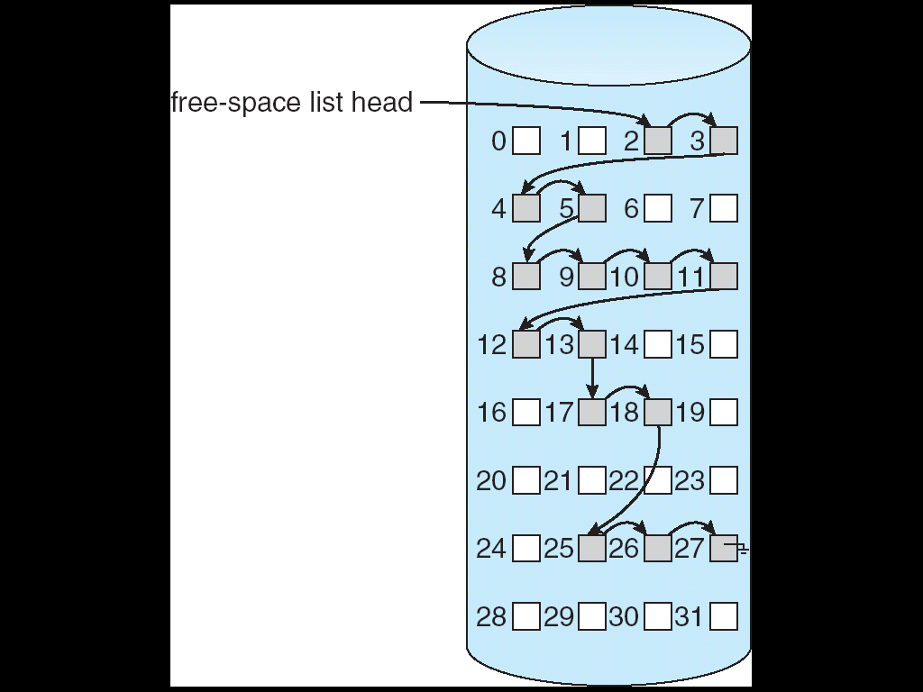
Linked Free Space List on Disk

Slide 34
Free-Space Management
3. Grouping:
Store the addresses of ‘n’ free blocks in the first free block.
The first ‘n – 1’ of these blocks are actually free
Last block contains the address of another n free blocks, and so on
Advantage:
Addresses of a large number of free blocks can be found quickly, unlike linked list approach

Slide 35
Free-Space Management (Cont.)
Generally several contiguous blocks are allocated or freed simultaneously.
4. Counting :
Rather than keeping a list of ‘n’ free disk addresses, we can keep the address of the first free block and the number ‘n’ of free contiguous blocks that follow the first block
Each entry in the free space list then consists of a disk address and a count
Although each entry requires more space than a simple disk address, the overall list will be shorter, as long as the count is generally greater than 1

Slide 36
Directory Implementation
Linear list of file names with pointer to the data blocks
simple to program
time-consuming to execute
Hash Table – linear list with hash data structure
decreases directory search time
collisions – situations where two file names hash to the same location
fixed size

Slide 37
Efficiency and Performance
Efficiency dependent on:
disk allocation and directory algorithms
types of data kept in file’s directory entry
Performance
disk cache – separate section of main memory for frequently used blocks
free-behind and read-ahead – techniques to optimize sequential access
improve PC performance by dedicating section of memory as virtual disk, or RAM disk

Slide 38
Page Cache
A page cache caches pages rather than disk blocks using virtual memory techniques
Memory-mapped I/O uses a page cache
Routine I/O through the file system uses the buffer (disk) cache

Slide 39
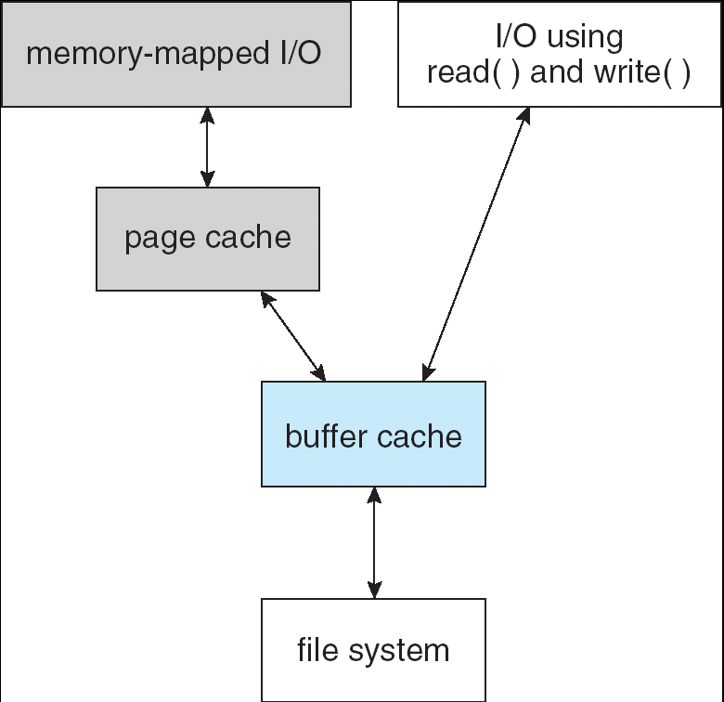
I/O Without a Unified Buffer Cache

Slide 40
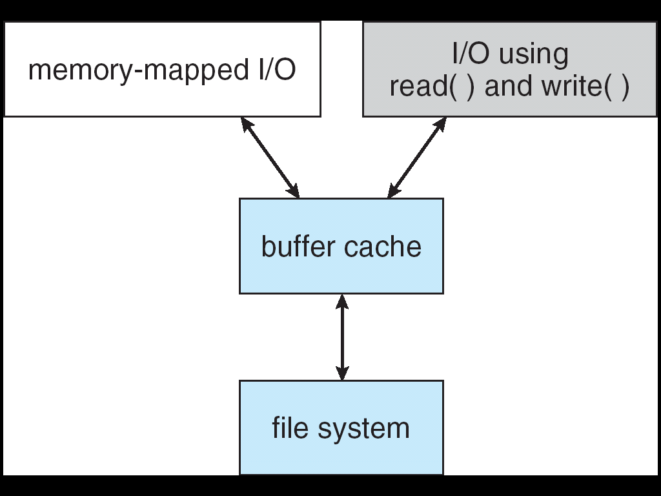
Unified Buffer Cache
A unified buffer cache uses the same page cache to cache both memory-mapped pages and ordinary file system I/O

Slide 41
Recovery
Consistency checking – compares data in directory structure with data blocks on disk, and tries to fix inconsistencies
Use system programs to back up data from disk to another storage device (floppy disk, magnetic tape, other magnetic disk, optical)
Recover lost file or disk by restoring data from backup

Slide 42
End of Chapter

