Slide 1
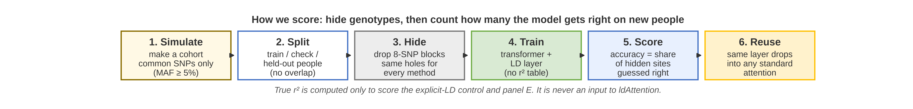
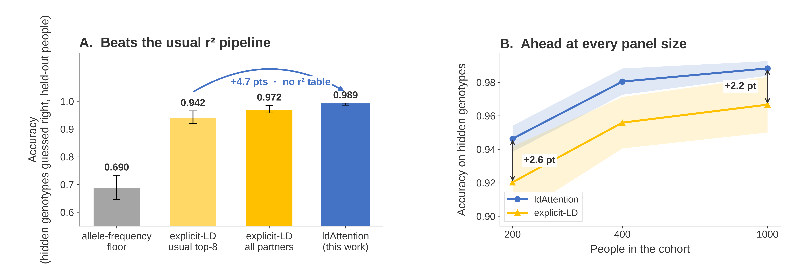
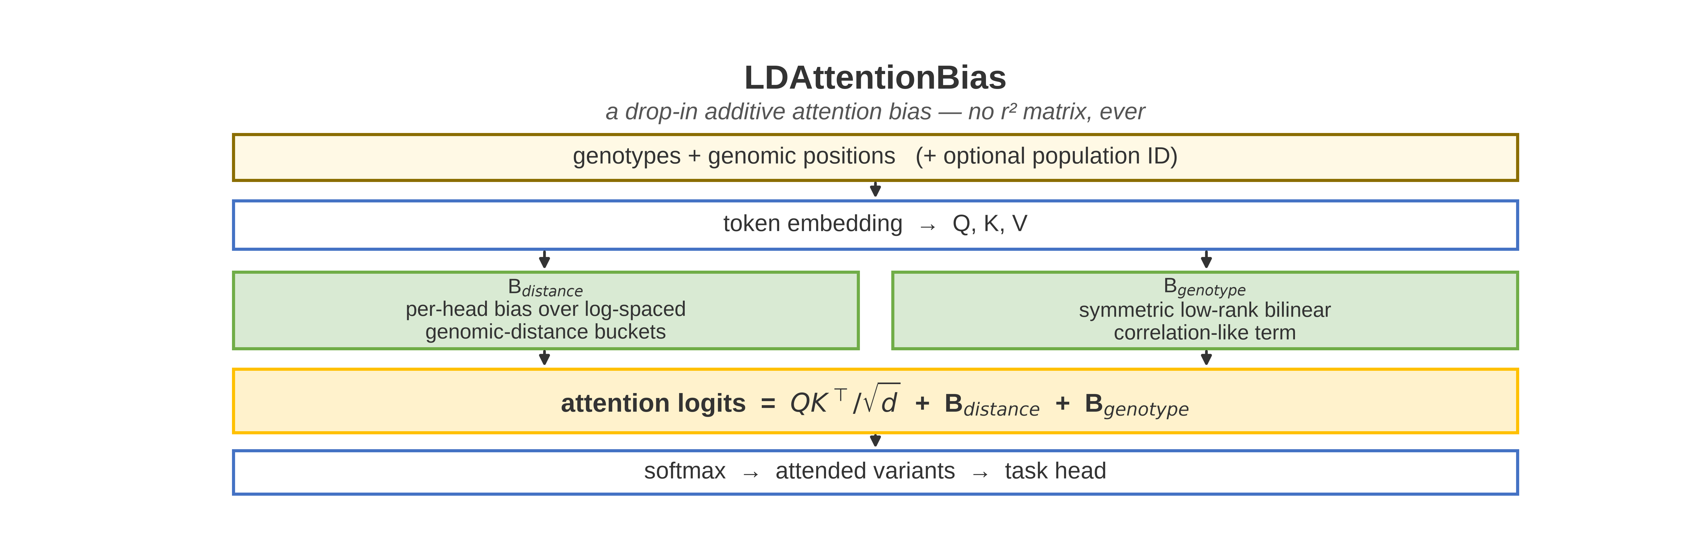
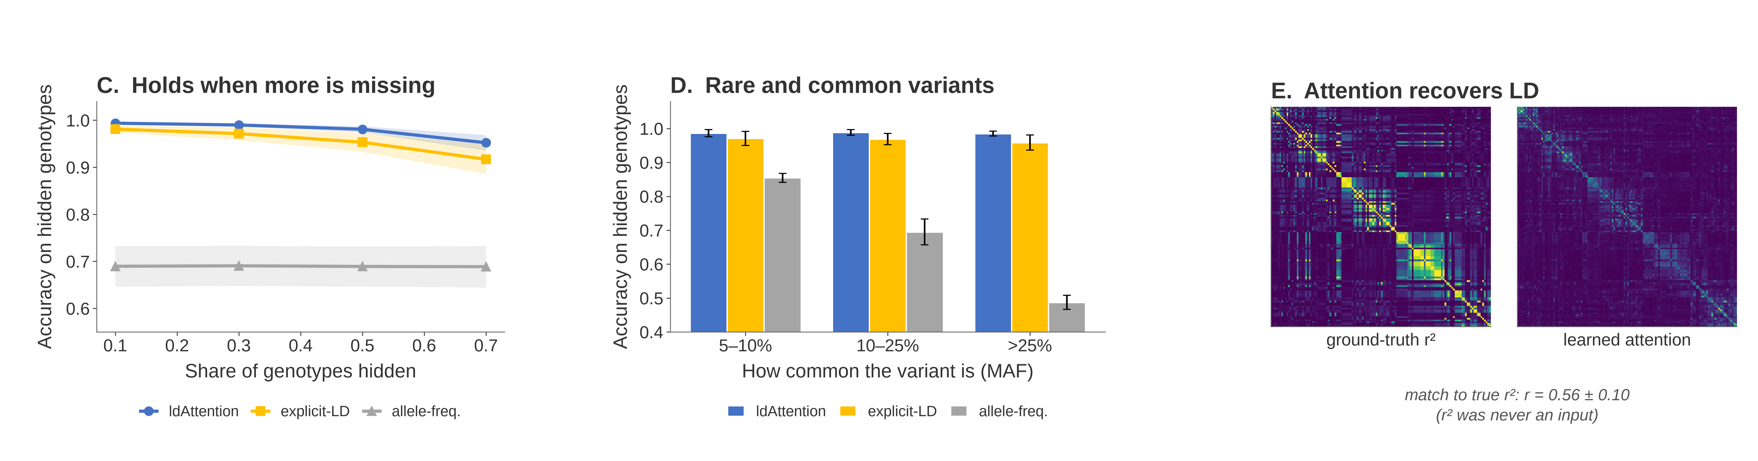











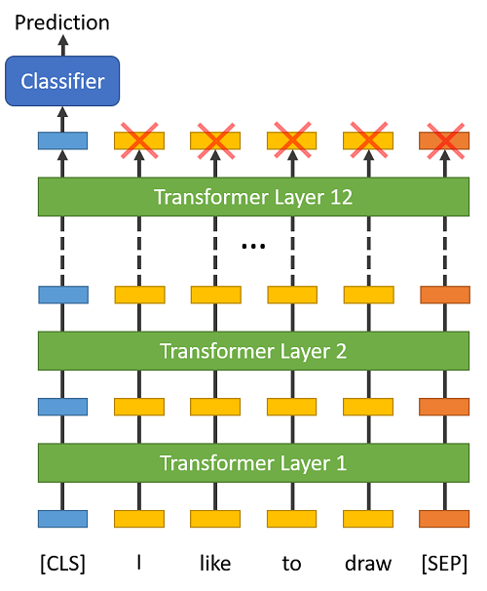
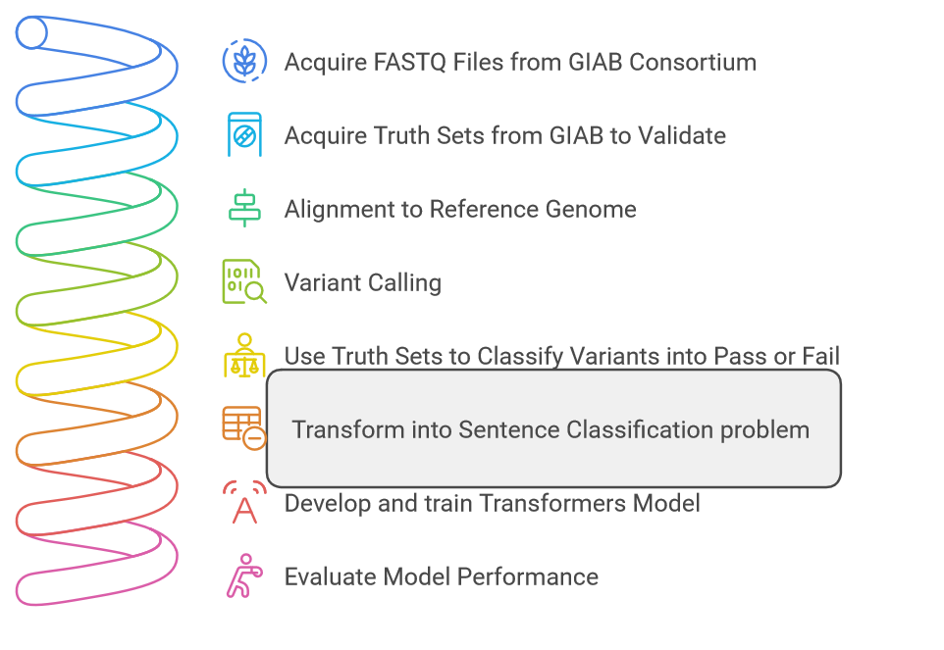
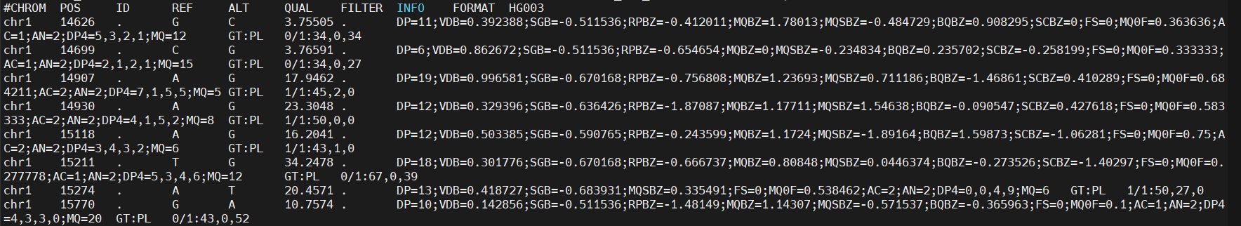

LD-Aware Attention for Genomic Analysis
Fill in missing genotypes without building an r² table
Omar Abdelwahab · Davoud Torkamaneh
3
Methods
1
Background
128 SNPs × 1000 people (msprime, MAF ≥ 5%). Hide 30% of genotypes in 8-SNP blocks (as in GBS). Accuracy = % guessed right on held-out people. A point = 1 pp of that. Same holes, 6 seeds.
Nearby DNA variants are often inherited together. That non-random pairing is called linkage disequilibrium (LD). Geneticists measure it with r²: a score from 0 (independent) to 1 (always travel together). Standard pipelines precompute every pairwise r² and store an L × L table, then rebuild that table for every new cohort, window and frequency cutoff.
Imputation is guessing a genotype the lab did not observe. When neighbouring SNPs drop out together — as they do in genotyping-by-sequencing — a stored list of LD partners vanishes with the site it was meant to rescue. ldAttention is a small add-on that teaches attention that LD structure, so it can still look across the rest of the window, without ever building the r² table.
4
Results
2
Approach
What it does: Before attention picks which variants to look at, we add two learned numbers — an LD bias — to those scores.
Distance term: Nearby sites get a boost. LD fades with genomic distance; this term learns that fade.
Genotype term: Sites whose alleles move together get a boost — a correlation-like pairwise score, learned from the data.
Where it sits: A drop-in for any standard attention layer (PyTorch SDPA or MultiheadAttention). No extra preprocessing stage.
What it removes: The stored L × L r² table. Nothing to build, store, or rebuild when the cohort or the window changes.
Figure 1. Accuracy = % hidden genotypes right on held-out people; a point = 1 pp. a) vs usual and fully-tuned r² pipelines. b) ahead of explicit LD at every cohort size. c) More genotypes hidden. d) By how common the variant is (MAF). e) True r² vs attention. Mean ± s.d., 6 seeds (a, c, d); 3 (b).
5
Conclusion
Beats explicit LD: 98.9% of hidden genotypes right, +4.7 pts vs the usual r² pipeline.
Recovers LD: attention matches the true r² table (r = 0.56), never shown it.
Nothing to precompute: no stored L × L table, no rebuild when the cohort or window changes.
Accuracy = % of hidden genotypes right on new people; a point = 1 pp of that. The layer's edge: beat the r² pipeline without building that table (a) and reconstruct the table in attention (e). Fully-tuned all-partner control: 97.2% (+1.8 pts).
Omar Abdelwahab · Dr. Davoud Torkamaneh
Computational Genomics · Université Laval
Département de phytologie · FSAA
Quebec City, Quebec, Canada
ECCB 2026 · European Conference on Computational Biology
Code & pre-print
github.com/omar-abdelwahab/ldAttention
/omar-abdelwahab/
Scan me
/omarabdelwhab/
Notes:
46 x 36 in
Submit as SVG files
Alper Kucukural, Onur Yukselen, Deniz M. Ozata, Melissa J. Moore, Manuel Garber
DEBrowser: Interactive Differential Expression Analysis and Visualization Tool for Count Data
BMC Genomics 2019 20:6

