Slide 1

Food Ordering App GUCEats
by:Omar Ahmed
Ahmed Tarek
Youssef Rafaat

Slide 2
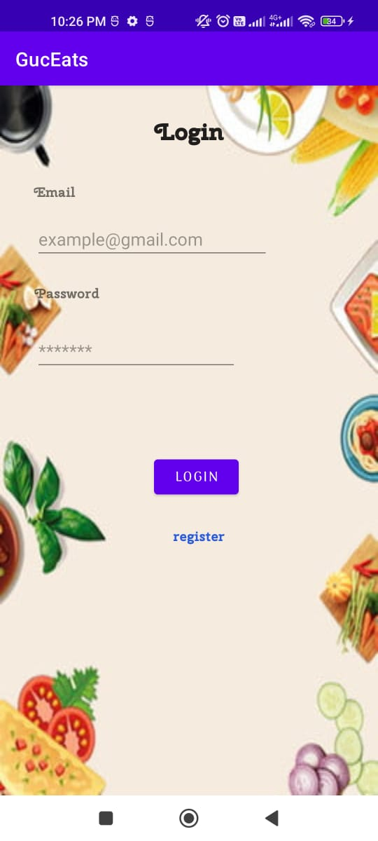
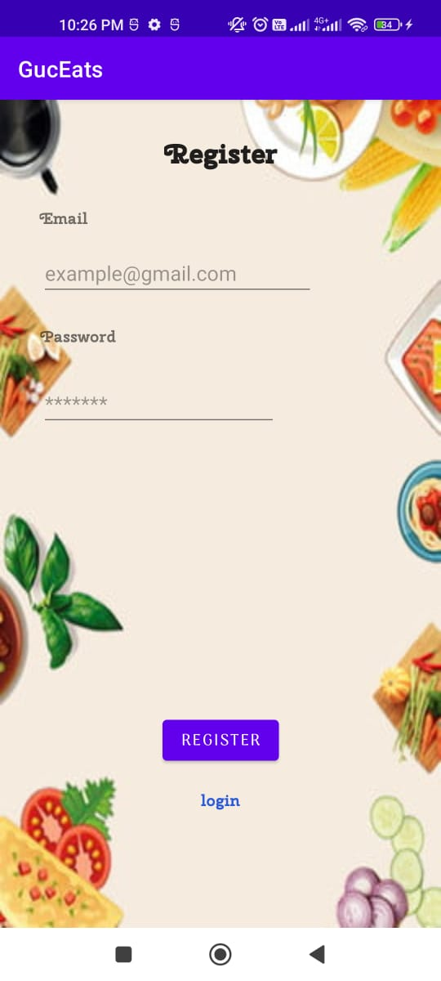
Login/Register

Slide 3
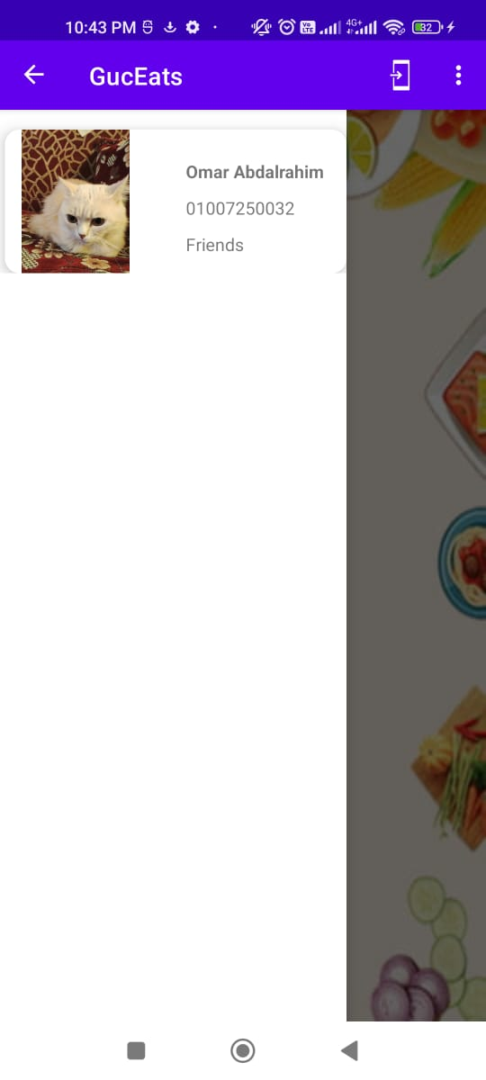
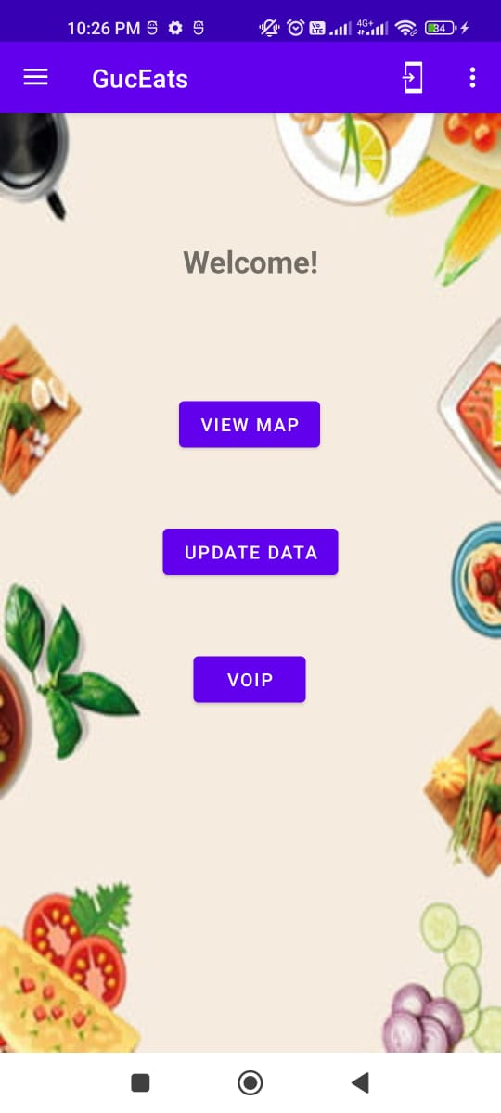
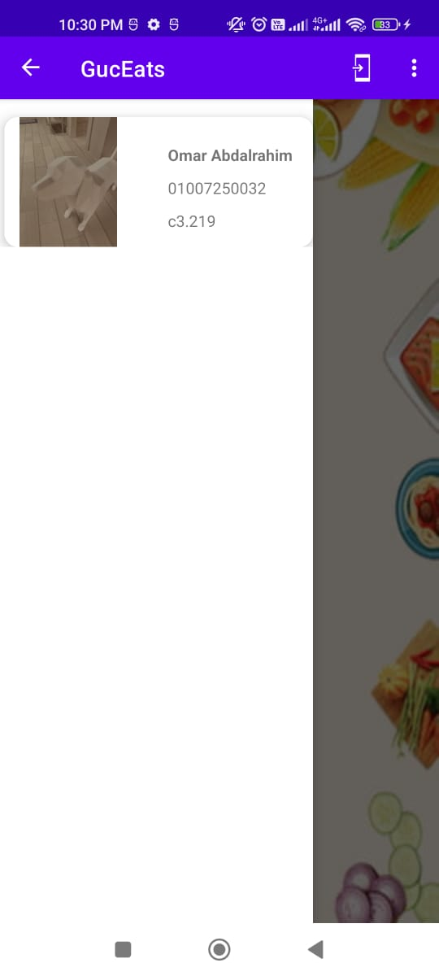
Home

Slide 4
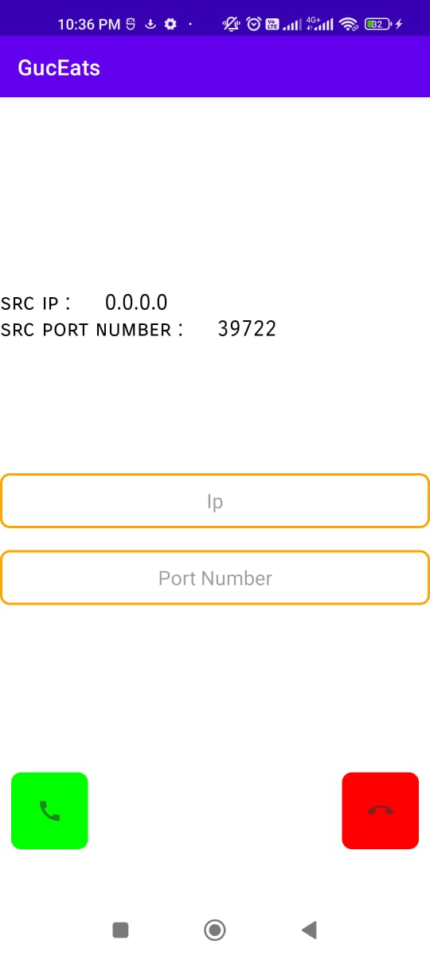
VoIP
1- Both sides should be in the same network.
2- swap your local IP and ports.
3-Both callers should click the green. button to establish the connection.
4- To Terminate simply click on the red button.

Slide 5
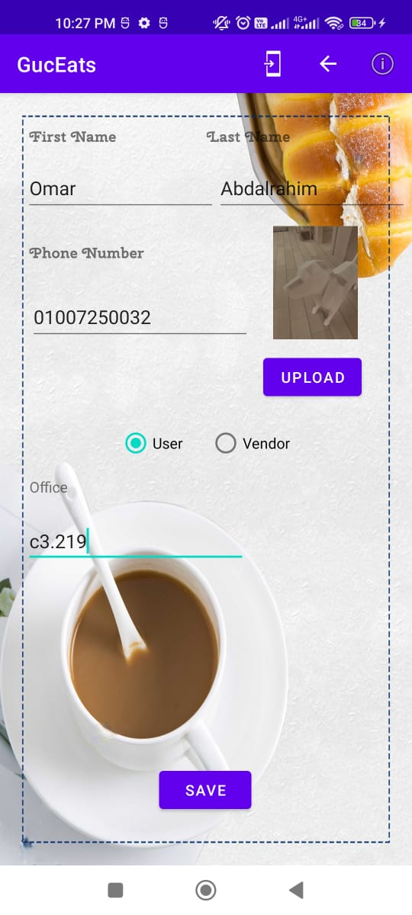
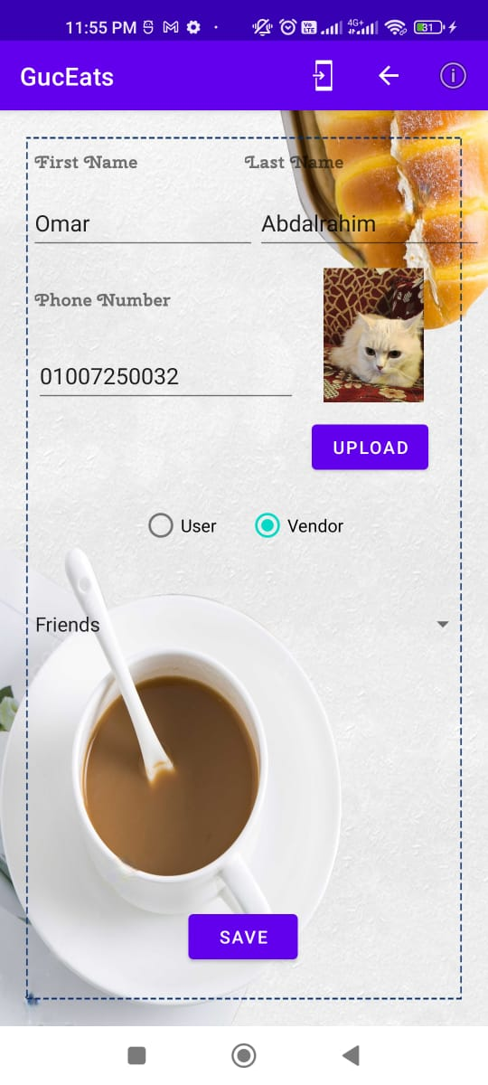
Personal Profile
GUCEats Currently supports 8 Shops available in campus
You can upload picture using Gallery or just take a photo

Slide 6
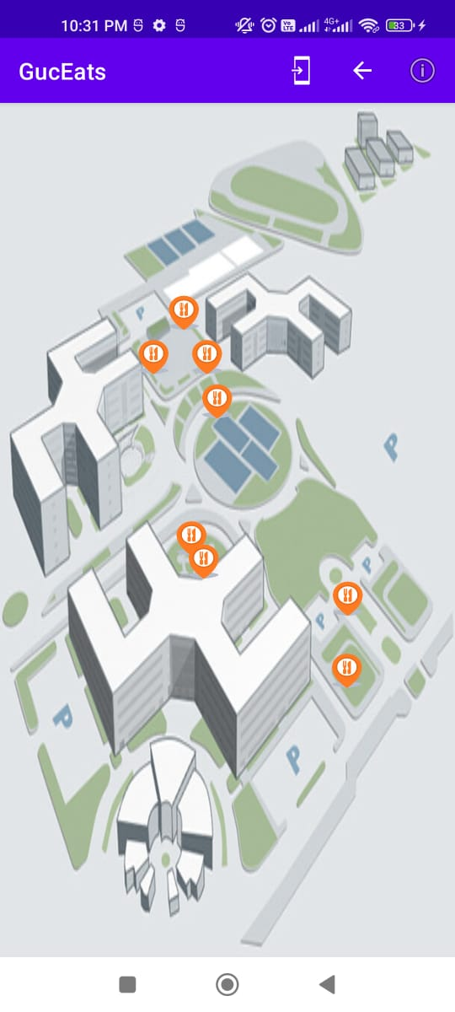
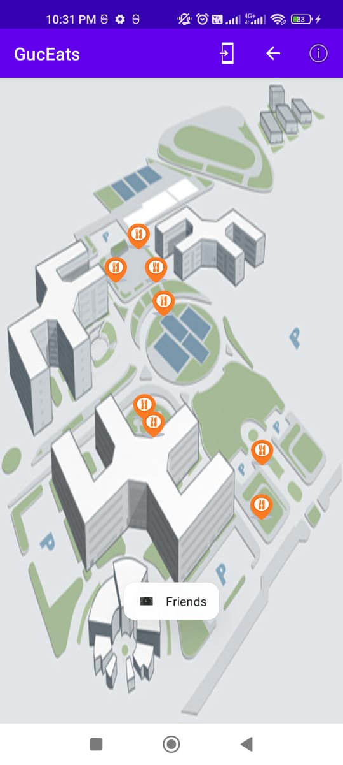
Map
Single click view the shop name While a long click enters the shop
If you are a vendor, you are automatically redirected to your shop

Slide 7
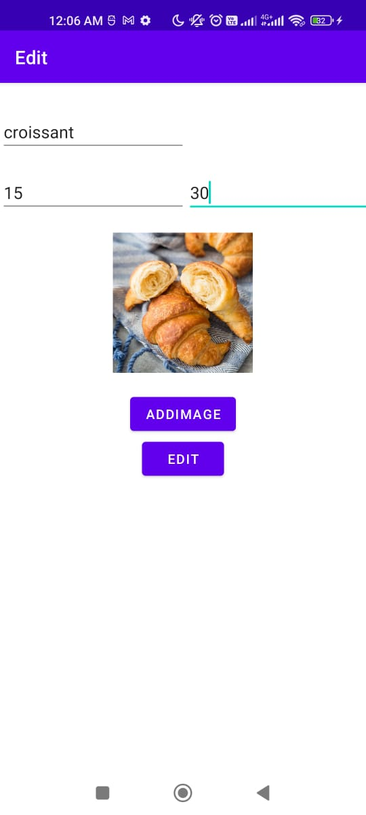
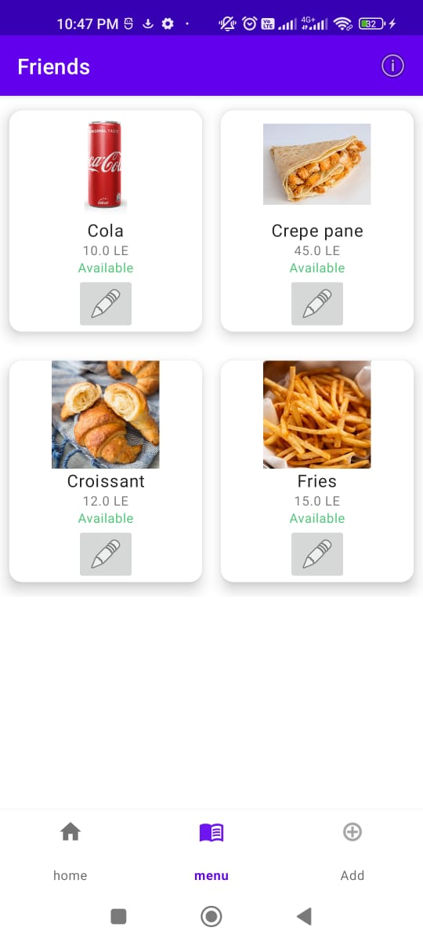
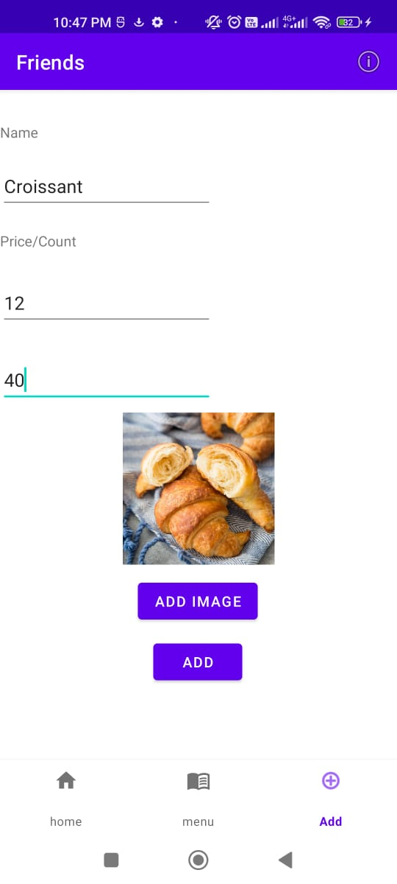
Vendor view

Slide 8
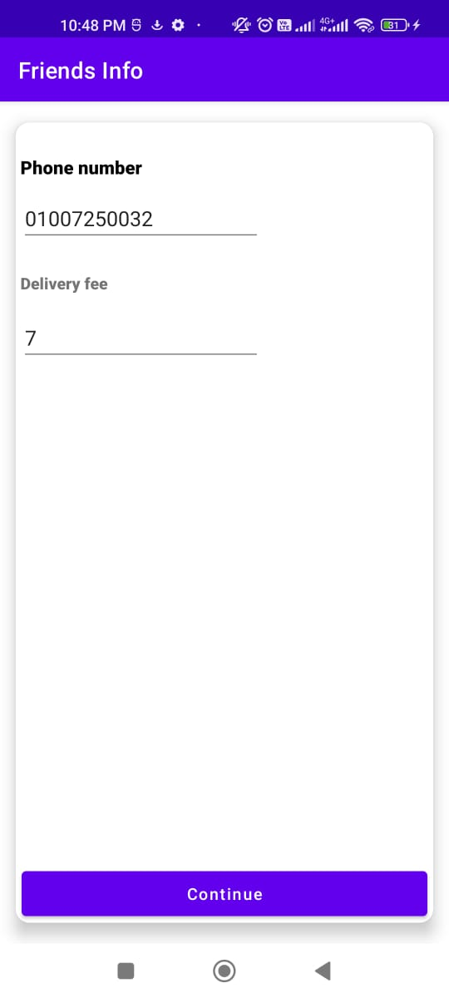
Vendor view

Slide 9
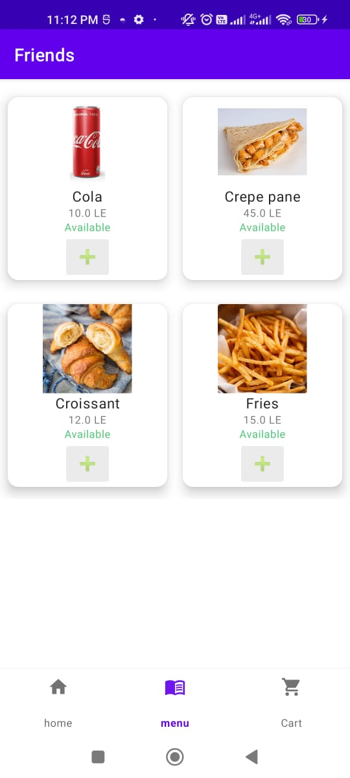
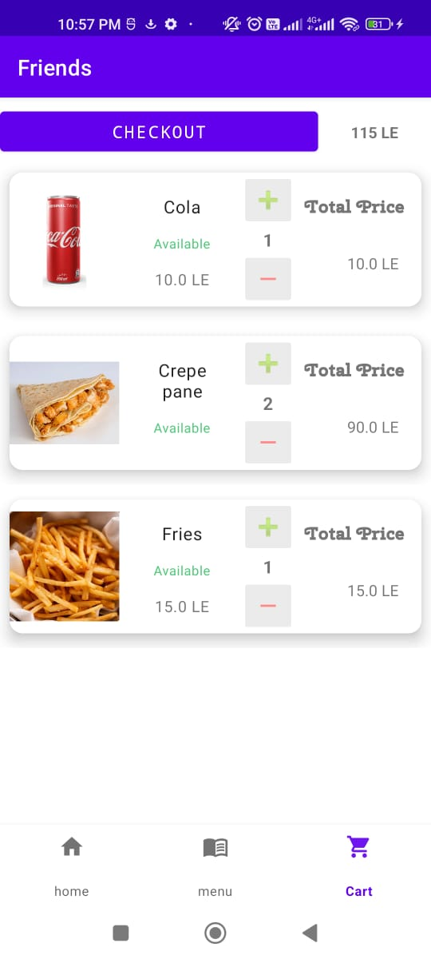
Customer view
Adds Item to Cart

Slide 10
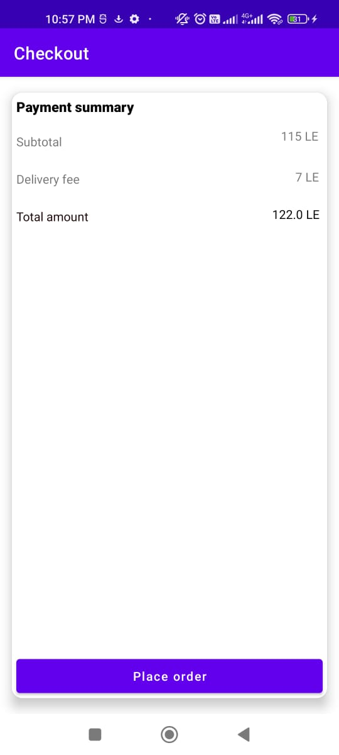
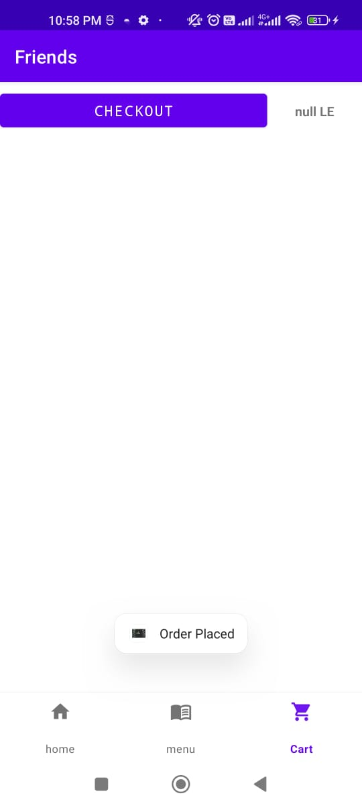
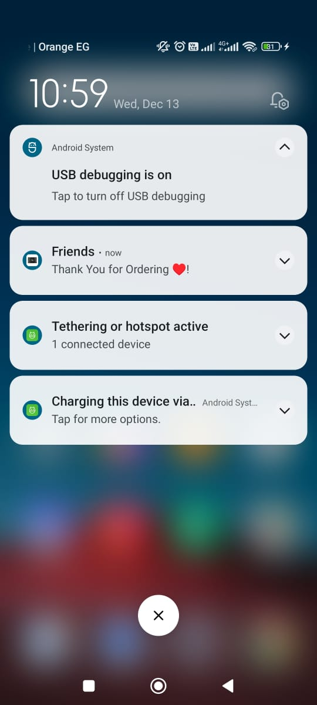
Checkout view

Slide 11
Thanks!
Any Questions?

