Slide 1
LEAN MANUFACTURING · HTU 101366
Jada Company
Steel Door Production — Lean Analysis & Improvement Plan
Student: Omar Abdeljalil · ID: 23110604 · Section 02
Tutor: Eng. Veellage Al-Quraan · Team: Ibrahim Jada
BTEC L/615/1517 · Academic Year 2025/2026

Slide 2
PART I — SUMMARY
TPS Origins & Core Lean Principles
Foundational theory underpinning this project's tool selection
THE TWO TPS PILLARS
5 LEAN PRINCIPLES — APPLIED TO JADA
JUST-IN-TIME
JIDOKA
01 VALUE
Customised doors meeting hospital/bank specs. Any delay = waste.
Produce only what is needed, when needed — eliminates inventory & waiting waste.
Stop on defect. Quality built at the source — never passed downstream.
02 VALUE STREAM
VSM revealed only 15.3% VA time out of 692 total minutes.
03 FLOW
Stop-and-go batches; 85% of time consumed by waiting & transport.
04 PULL
Make-to-order model aligns naturally — pull minimises overproduction.
05 PERFECTION
Operators identify defects, optimise finishing, drive Kaizen.
Key insight: TPS was not pre-planned — it evolved over decades. Lean requires philosophy, not just tools. (Lean_2, Lean_5)

Slide 3
PART II — COMPANY
JADA COMPANY
Steel Door Manufacturer — Amman, Jordan
Est. 1972
80 doors/mo
Family-Owned
World Certified
50+ years in Jordan's
manufacturing sector
Make-to-order:
hospitals · banks · hotels
Small team of skilled
professionals
International quality
certifications
Project Objective
Apply Lean Manufacturing tools (VSM, Process Chart, Takt Time, OEE) to analyse the current production system, identify non-value-added waste, and propose data-driven solutions to transition from a push system to a synchronised pull system — increasing process efficiency from ~15% toward industry benchmarks.
Wastes identified: Overprocessing (Finishing) · Waiting (Paint→Oven) · Transportation (Bending→Assembly)

Slide 4
PART II — PROCESS
Production Process & Flow
38 sequential steps · Fabrication → Painting → Finishing
FABRICATION
PAINTING
FINISHING
Raw Material
Intake
Laser
Cutting
Bending
+ Inspect
Frame
Assembly
Compressing
Surface
Finishing
Paint
Application
Oven
Curing
Accessory
Assembly
Final Output
Activity Distribution — 692 min total lead time
Key Delay Points
VA: 106.2 min (15.3%)
Non-Value-Added: 585.8 min (84.7%)
Waiting before production
304 min
Waiting before assembly
30 min
Waiting before accessory asm.
35 min
Waiting before bending
20 min
Waiting before finishing
30 min
Waiting before paint
15 min
Total transport: 41 m across 9 events

Slide 5
PART II — METRICS
Takt Time & OEE Analysis
Baseline measurements anchoring all improvement targets
TAKT TIME
OEE BREAKDOWN
90%
Availability
144.1 min
Unplanned downtime & changeover
per door
78%
Performance
Speed losses; operators waiting on batches
Available time / shift
480 min
Shifts per day
1
85%
Quality
Doors / month
80
Rework in finishing; surface defects
Working days / month
22
Takt Time
480 ÷ 3.33 = 144.1 min
59.5%
OEE Score
Current cycle time 310 min >> Takt 144 min → bottleneck at Laser Cutting
Availability × Performance × Quality
World-class OEE = 85%. At 59.5%, Jada has significant improvement potential.

Slide 6
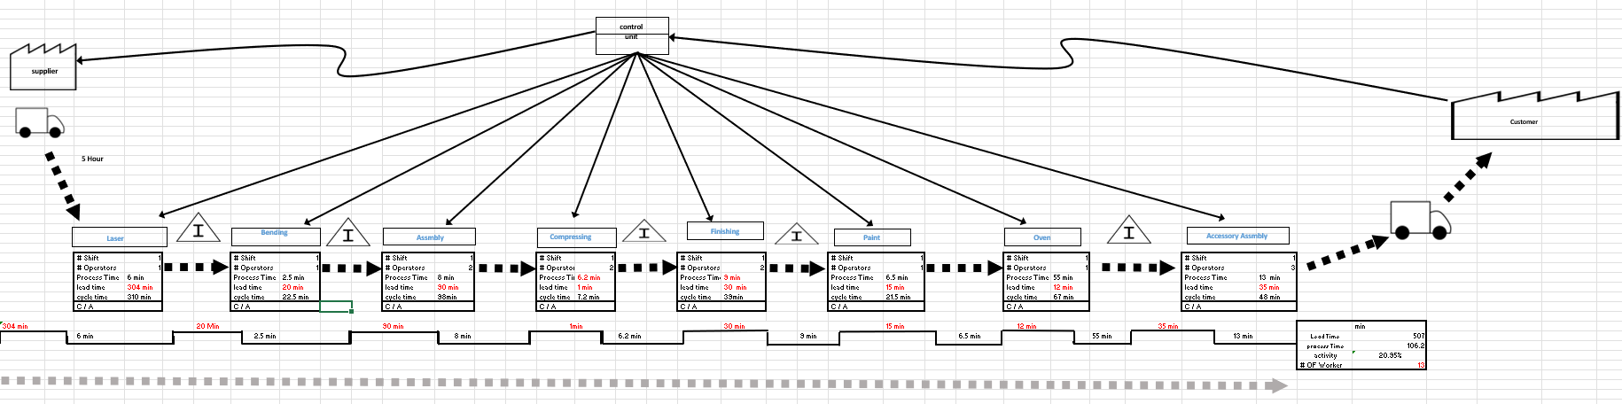
PART II — CURRENT VSM
Current State VSM
Total Lead Time: 692 min · Value-Added: 106.2 min (15.3%) · Takt: 144.1 min
CT:7.2m
WAIT TIMES (Lead Time — before each process):
304 m
20 m
90 m
1 m
30 m
15 m
12 m
35 m
PROCESS TIME (Value-Added):
6 m
2.5 m
8 m
6.2 m
9 m
6.5 m
55 m
13 m
C/A RATIO:
90%
85%
95%
95%
80%
83%
90%
95%
CURRENT STATE · Total LT: 507 min wait + 106.2 min process = 692 min · Activity Ratio: 15.3% · Workers: 13 · Takt: 144.1 min

Slide 7
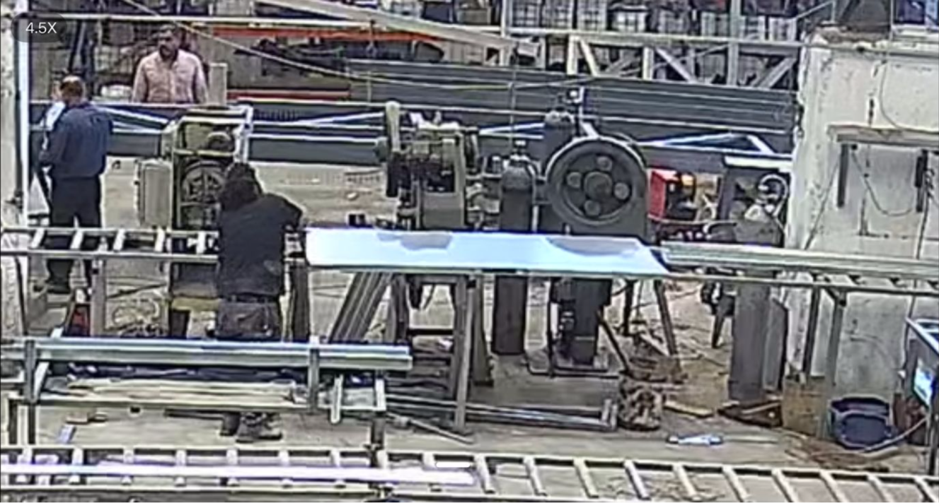
WASTE 1 — OVERPROCESSING
Waste 1: Overprocessing in Surface Finishing
No defined standard — workers grind beyond what paint adhesion requires
Root Cause Identified
No standard operating procedure for surface finishing depth
Workers grind/sand beyond specification — no 'good enough' criterion
Adds NVA time without improving final coat adhesion or quality
Estimated +8 min/door of unnecessary finishing work
PDCA Improvement Cycle
PLAN
Define Ra surface roughness specification required for paint adhesion. Draft SOP with visual gauge.
Overprocessing — Factory Photo
DO
Train operators on spec. Display SOP at workstation. Implement tactile/visual finish standard.
CHECK
Monitor finishing cycle time vs baseline. Track rework rate and paint adhesion failures.
ACT
Standardise the improved procedure. Schedule quarterly audits. Update training materials.
Expected: ~8 min saved/door · 80 doors/month = 10.7 hrs/month reclaimed

Slide 8
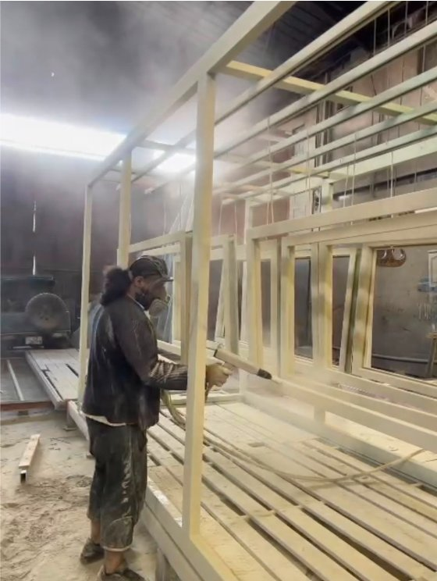
WASTE 2 — WAITING
Waste 2: Waiting — Paint → Oven Queue
Root cause: poor inter-process communication, not synchronisation
Root Cause: No Visual Signal Between Paint & Oven
Oven curing time not communicated to downstream accessory assembly team
Batch released from oven before accessory team is ready → 35-min queue
No status indicator: doors could be CURING, READY, or WAITING with no signal
Root cause = communication gap, not changeover → correct tool = Visual Management (not SMED)
Visual Factory Framework — Solution Design
Andon Board
Real-time oven status: CURING / READY / IDLE — visible to all operators
Timed Ticket Cards
Attached to each door: oven-in time + expected exit time
Paint Spray Stage — Jada Co.
Floor Zone Marking
Colour-coded lanes: GREEN = ready for assembly, RED = still curing
Process Control Chart
Tracks batch timing; triggers alert if curing cycle exceeds takt time
Expected: 35 min wait → 0 min · ~16 min net saved/door · 80 doors = 21.3 hrs/month

Slide 9
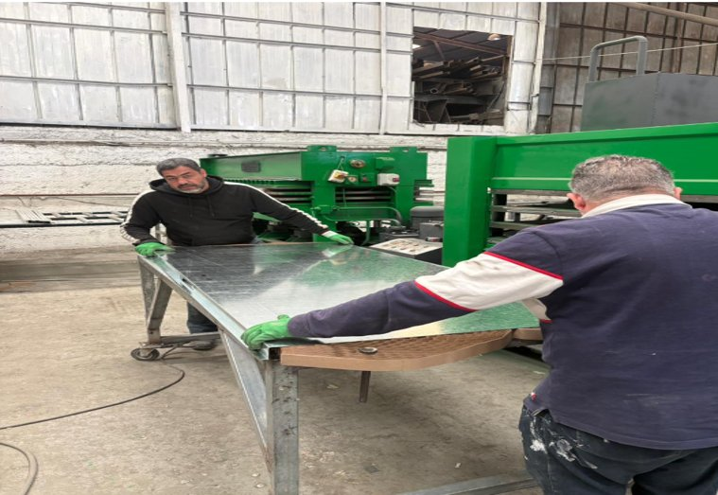
WASTE 3 — TRANSPORTATION
Waste 3: Transportation — Non-Linear Material Flow
41 m total · 9 transport events · Root cause: layout not aligned to process sequence
DMAIC Analysis
DEFINE
41 m total transport. Non-linear paths: Bending→Assembly→Finishing. 9 events of heavy manual steel panel carries.
MEASURE
Avg 4.6 m per move. Estimated 12–18 min of pure movement time per door cycle.
ANALYSE
Layout not aligned to process sequence — Bending and Assembly not co-located, forcing backtracking.
IMPROVE
U-cell layout: co-locate Bending with Assembly. Reduce travel to < 15 m (−63%). Use wheeled trolleys.
Steel Sheet Transport — Jada Co.
CONTROL
Painted floor lanes, shadow boards at each station, monthly travel-distance audit checklist.
Expected: Travel 41 m → < 15 m (−63%) · 12–18 min movement → < 5 min · 80 doors = ~16 hrs/month saved

Slide 10
PART II — BEFORE VS AFTER
Current State vs Future State
Quantified impact of all three waste eliminations combined
Metric
Current State
Future State
Improvement
Total Lead Time
692 min
442 min
−250 min (−36%)
Value-Added Time
106.2 min
106.2 min
No change
Activity Ratio
15.3%
23.3%
+8.0 percentage points
Assembly Wait
90 min
25 min
−65 min (SMED)
Post-Oven Wait
35 min
0 min
−35 min (Visual Mgmt)
Transport Distance
41 m
< 15 m
−63% (Layout U-Cell)
Hours saved/month
—
+~48 hrs
At 80 doors/month
Tools applied: PDCA (Overprocessing) · Visual Management (Waiting) · DMAIC + Layout (Transportation) · Referenced: Lean_2, Lean_5, Lean_17

Slide 11
PART II — BARRIERS
Anticipated Barriers & Responses
Practical obstacles to lean implementation at Jada Company — and how to overcome them
⚠ Worker Resistance to Change — All 3 wastes
⚠ SOP Not Followed After Training — Overprocessing (PDCA)
Response: Involve operators early — let them co-design the SOP and floor zones. Run a 1-week pilot with a volunteer team. Show personal time-saving data to gain buy-in.
Response: Post laminated visual standard at every finishing station. Supervisor spot-checks during first 4 weeks. Monthly audit checklist with sign-off — make compliance visible.
⚠ Layout Disruption During Production — Transportation (U-Cell)
⚠ Family-Business Culture: Informal Habits — All 3 wastes
Response: Schedule U-cell rearrangement over a weekend shutdown. Move one workstation at a time. Maintain a temporary walkway to avoid blocking daily output.
Response: Frame lean as protecting jobs and the family legacy — not replacing people. Present ROI in JD/month to owner. Gain one influential worker as lean champion to spread culture.
⚠ Andon Board Cost & Maintenance — Waiting (Visual Mgmt)
Response: Start with a low-cost whiteboard Andon + timed ticket cards — zero electronics. Upgrade to digital only after pilot proves ROI. Maintenance = one designated operator.
Risk principle: Address cultural barriers first — tools fail without people commitment. (Lean_5)

Slide 12
PART II — RECOMMENDATIONS
Recommendations for Jada Company
A sequenced roadmap from quick wins to sustained lean culture
PHASE 1
PHASE 2
PHASE 3
Weeks 1–4 · Quick Wins
Months 2–3 · Structural Fix
Months 4–6 · Sustain & Expand
1
Deploy Andon board + Timed Ticket Cards at oven exit (zero cost)
1
Redesign floor layout: U-cell — co-locate Bending with Assembly
1
Formalise all SOPs; conduct first quarterly audit with sign-off checklist
2
Post finishing SOP at surface grinding station
2
Apply SMED to Assembly changeover to reduce 90-min queue to 25 min
2
Expand 5S to all workstations; introduce Kanban card system for raw materials
3
Measure baseline: finishing time, post-oven wait, travel distance
3
Install painted floor zones: green (ready), red (curing)
3
Target OEE improvement: 59.5% → 70%+ through focused maintenance rounds
Sequence matters
Link to financials
People first
Measure & review
Implement SMED before reducing batch sizes — wrong order worsens performance (Lean_5)
Translate every saved minute into JD cost — management responds to money, not metrics
Lean fails without cultural change. One lean champion on the floor is worth 10 training days
Monthly KPI board: LT, activity ratio, OEE, travel distance. Make progress visible to all

Slide 13
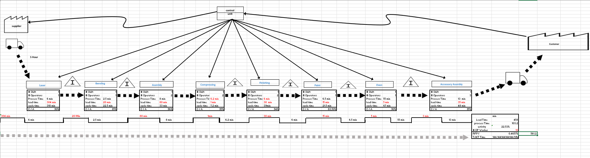
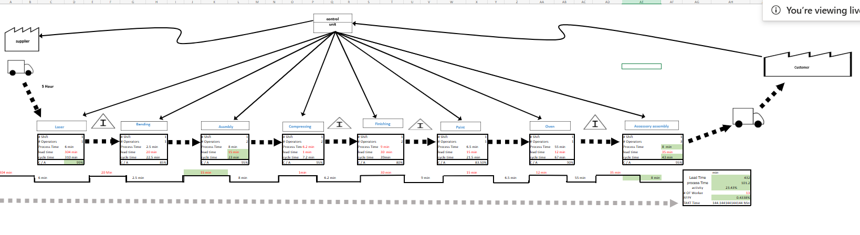
PART II — FUTURE VSM
Future State VSM
Omar
SMED
KAIZEN
Accessory
Asm.
CT:310m
CT:22.5m
CT:48m
Ibrihem
25 min
−65 min

Slide 14
CONCLUSION
Summary & Conclusion
From push to pull — Jada Company's lean transformation roadmap
Overprocessing
(Surface Finishing)
Waiting
(Paint → Oven)
Transportation
(Bending → Assembly)
Tool: PDCA + SOP
Tool: Visual Management
(Andon, Timed Cards, Zones)
Tool: DMAIC + U-Cell
Layout Redesign
~3 min saved
per door
35 min queue
eliminated
90 m → <80 m
−250 min
15.3%→23.3%
~48 hrs
Lead Time Saved
(692→442 min)
Activity Ratio
Improvement
Reclaimed per
Month (80 doors)
HTU 101366 · Omar Abdeljalil 23110604 · Eng. Veellage Al-Quraan · Ibrahim Jada · Lean_2, Lean_5, Lean_17

