Slide 1

Predictive Temperature Monitoring Bracelet
INVENTORY DEPARTMENT
OPERATIONS OVERVIEW
Prepared for Headquarters | Inventory Department Presentation

Slide 2

Product Reliability Architecture
Core Features
Safety Margins
Predictive detection using temperature trend analysis
Early warning system forecasts temperature spikes
No single point of failure
Offline alert system (buzzer, vibration, LED)
Battery health monitoring
Environmental compensation sensors
Placement detection technology
Multi-bracelet redundancy support

Slide 3
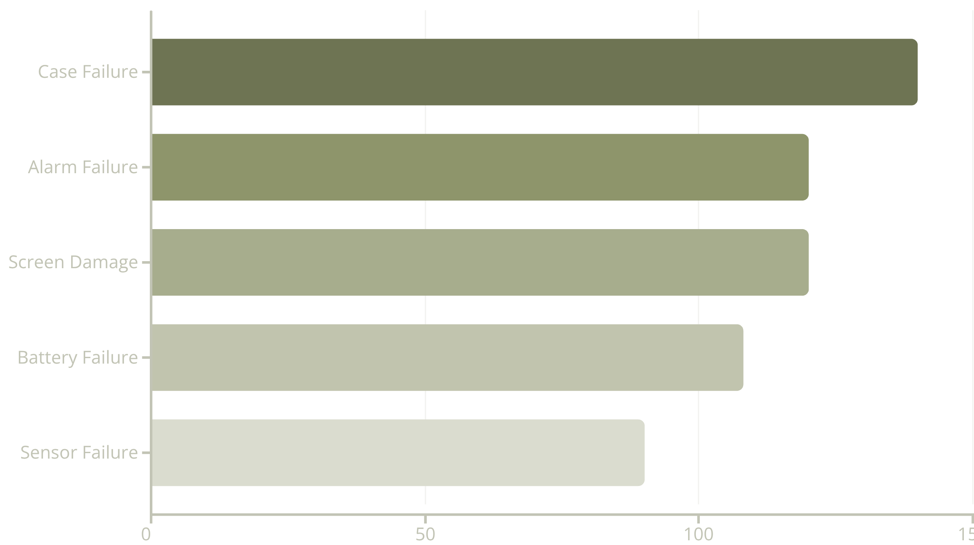
FMEA Results & Actions
Critical Priority
Controlled Risk
Case failure addressed through stronger materials, drop testing, and child-safe design improvements.
Sensor failure lowest RPN due to medical-grade components, waterproofing, and self-diagnostics.

Slide 4





Risk Assessment Framework
Our inventory risk management uses a structured approach combining Risk Breakdown Structure (RBS) and a 4×4 Probability-Impact Matrix to identify, evaluate, and prioritize risks systematically.
Risk Breakdown Structure
Probability-Impact Matrix
Organized categorization of all potential risks affecting inventory operations, from high-level to detailed sources.
4×4 assessment tool evaluating likelihood (1-4) and consequence (1-4) to calculate risk scores and prioritize actions.
Risk Prioritization
Color-coded zones: Green (1-3) monitor, Yellow (4-6) manage, Red (8-9) mitigate, Dark Red (12-16) critical priority.

Slide 5
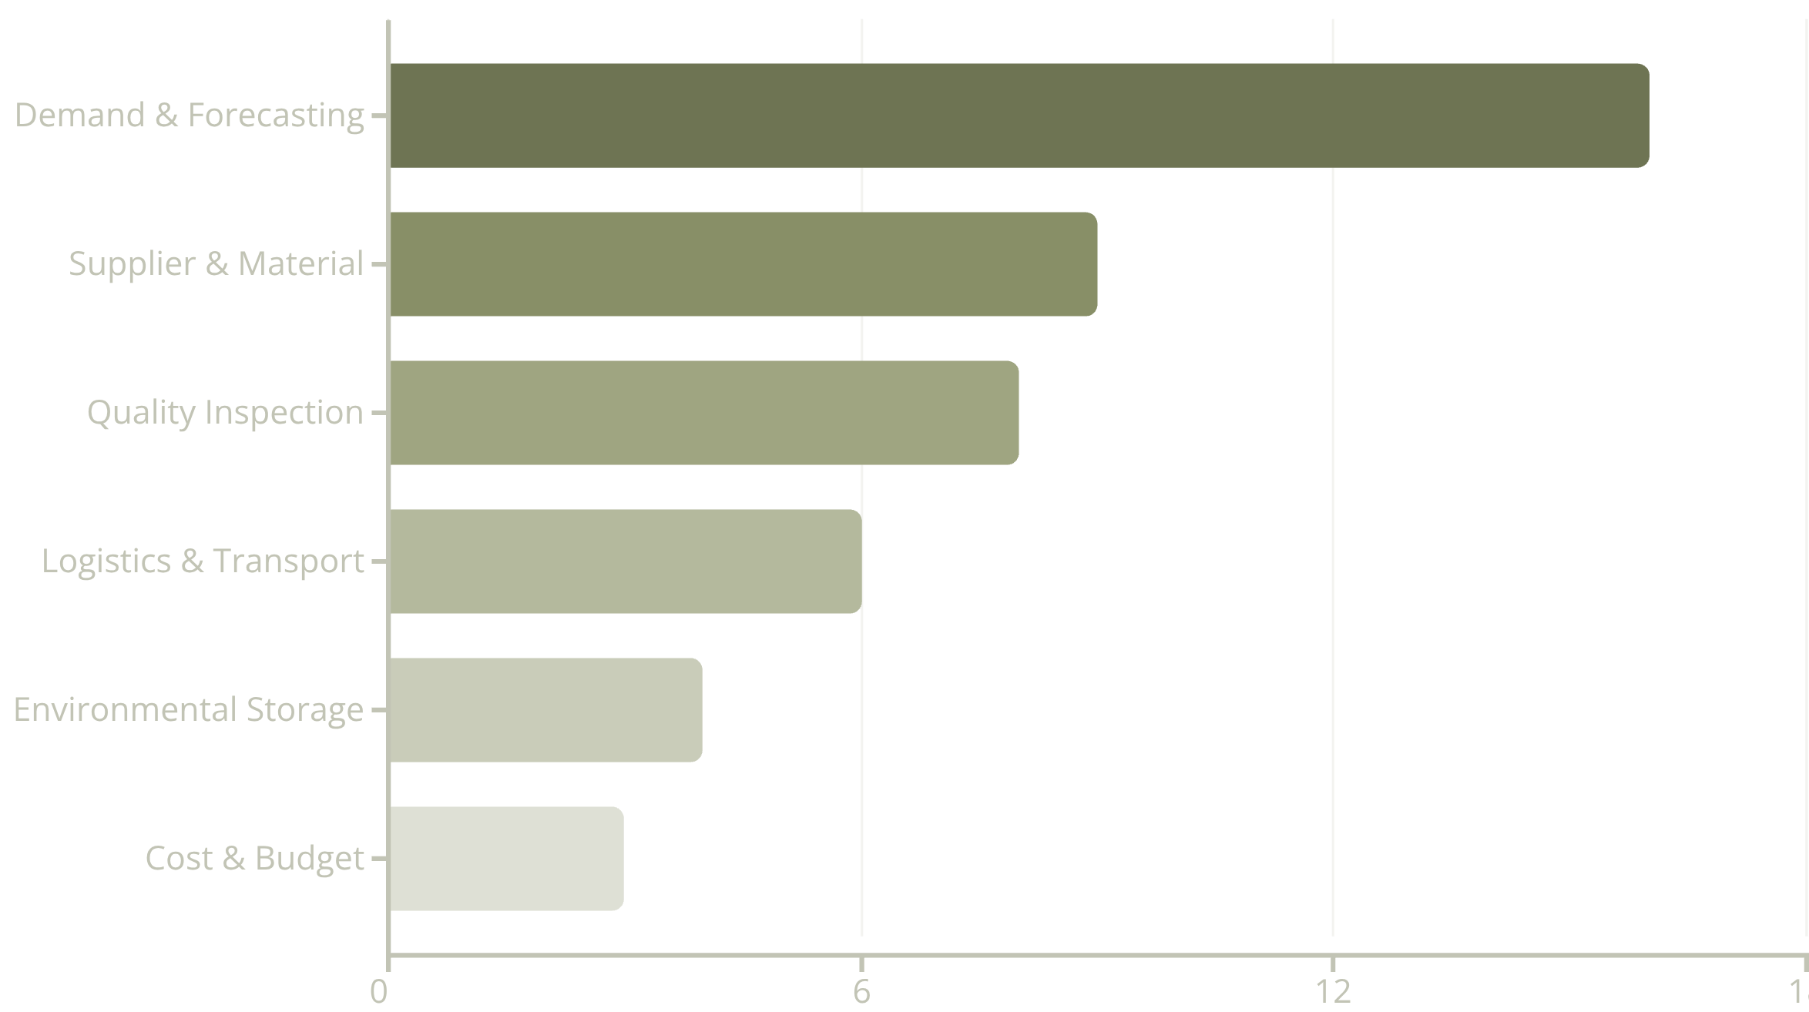
RISK ANALYSIS
Top Inventory Risks
Critical Priority
High Risk Areas
Demand & Forecasting (16): Highest severity requiring immediate attention. Inaccurate forecasting disrupts entire supply chain and production schedules.
Supplier & Material (9), Quality Inspection (8): Significant impact on inventory availability and product reliability requiring active management.

Slide 6
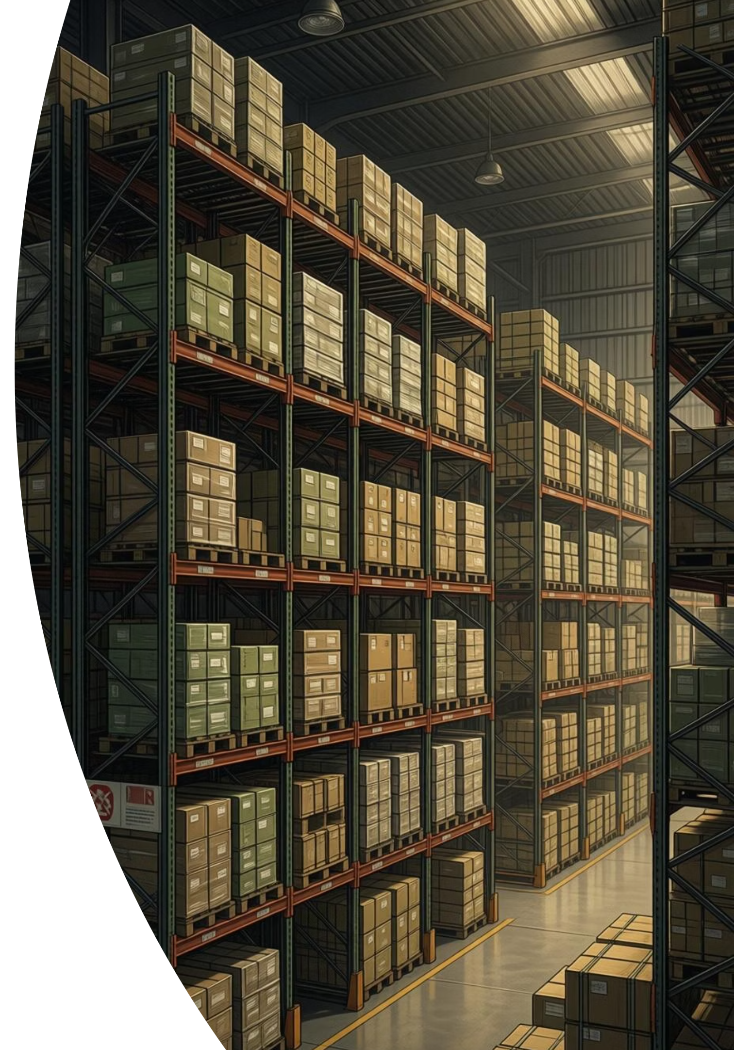


BUSINESS CONTINUITY
Contingency Planning
Receiving Department
Storage Department
Dispatch Department
Backup staffing for peak hours
Manual bin verification protocol
Secondary picking list system
Alternative unloading equipment
Emergency label reprint station
Quality double-check step
Emergency packaging supplies
Emergency documentation protocol
Temporary overflow storage zones
System Failure Response
Cloud-based backup, offline picking lists, manual verification processes activated within 15 minutes.
Shipment Delay Handling
Alternative courier agreements, priority routing protocols, customer communication within 1 hour of delay detection.

Slide 7
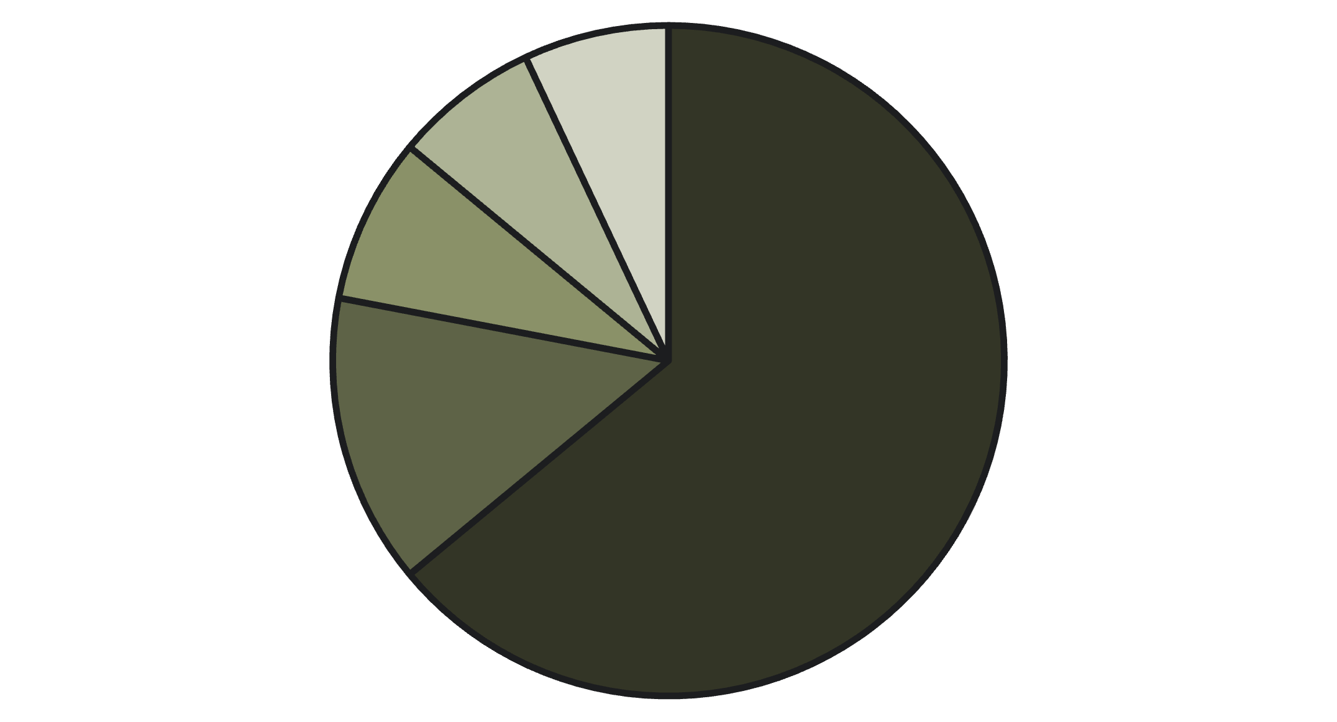
Cost Structure Overview
11.7K
6.65K
20K
220K
Monthly Labor
Monthly Overhead
Total Monthly Cost
Annual Investment
JOD across 4 departments: Receiving, Storage, Dispatch, and Planning teams.
JOD for facilities, operations, IT systems, and logistics support.
JOD combined operational expenses for inventory department.
JOD yearly cost ensuring reliable inventory operations and supply chain continuity.
Labor Costs
Facility & Utilities
Logistics & Transport
Inventory Operations
IT & Systems
Cost Optimization Focus: Labor represents 64% of total costs. Efficiency improvements through automation, process optimization, and staff training offer significant savings potential while maintaining service quality.

Slide 8
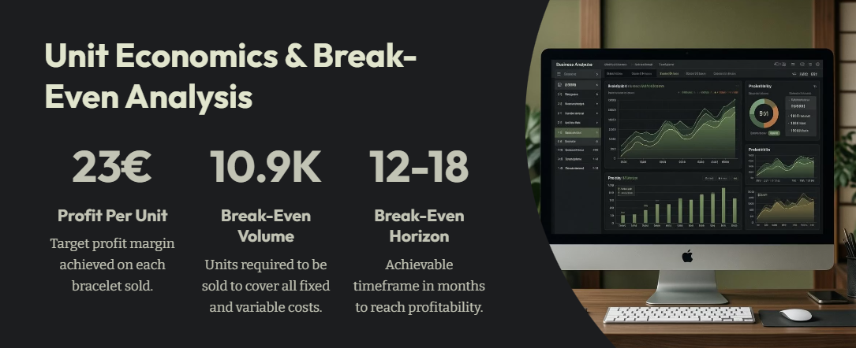

Slide 9
